Slide 1
Progress Update on the Elimination of NC(V) Certificate Backlog (200711-201503)
to
PCHET
31 August 2016

Slide 2
Backlog Reduction Progress (based on Outstanding Report)
27 Aug 2016
Progress Since
Aug 2015
Aug 2015
236 821
Outstanding Certificates^{1&2}
973
Outstanding Certificates²
235 848
Certificates Processed^{2&3}
162 887
Certificates Issued by Umalusi⁴
99.59%
resulted
in
129 516
Candidates Affected¹
835
Candidates Affected
128 681
Candidates Processed³
99.36%
Note:
During April 2016 a program glitch was discovered , the program calculations included certified level 4 candidates and it was not supposed to. This resulted in Outstanding Certificates being overstated by +- 6600 and Candidates Affected being overstated +- 8300. The figures remain unchanged for ease of reporting purposes.
‘Outstanding Certificates – refers to records, therefore
an outstanding certificate may not necessarily result in a certificate being issued by Umalusi e.g. due to the candidate withdrawing from or failing exams
multiple outstanding certificates may result in a single certificate being issued by Umalusi e.g. Seven outstanding subject certificates requests may result in a full National Certificate
‘Processed’ - includes candidates who passed, withdrew from or failed exams
Confirmed by Umalusi on 29 Aug 2016

Slide 3
Analysis of 973 Outstanding Certificates
Last portion of the outstanding certificates are being addressed by DHET and SITA through manual intervention per record due differing types of errors on the records, which is time consuming resulting in the resolution process is taking longer than expected. Errors include:
Incorrect dates against subjects; Subjects on Master file differs from subjects on published document; Raw marks not on master document; Subject totals differs from different documents’; ‘Unconsolidation’ did not remove previous subjects from current record but the date against the previous subjects changed to current but populated current date.
Last portion of the outstanding certificates primarily relates to
Private centres that have amounts in arrears at Umalusi (+- 10%)
Will be resolved when Centres settles their arrears
Data anomalies detected between the original resulting and follow-up certification datasets (+-16%)
Can be attributed to the ‘mopping up’ process which takes place after the publication of results but prior to the certification process per examinations cycle
In some instances examination centres submit incorrect raw data and in others the data is incomplete. For example, several examination centres indicate candidates who were indeed present for the Internal Summative Assessment Task (ISAT), Internal Continuous Assessment (ICASS) and/or examination component as absent on the original resulting dataset submitted to the Department. This has to be corrected when queried after the original resulting process per examination cycle.
Umalusi requires proof and evidence of mark changes (changes from approved results to requests for certification) to accept the records. DHET requested Umalusi to accept the discrepancies between the two datasets which have emerged due to the mopping up process
Resolution pending agreement between DHET and Umalusi
Data errors (+- 74%)
SITA and DHET addressing at a record level. Some datasets have already been sent to Umalusi for processing
Possibility that some records may be private centres that have amount in arrears or data anomalies

Slide 4
Certificates Issued by Umalusi

Slide 5
Details of Certificates Issued by Umalusi
Transaction type | Level | 01Aug16 to 29Aug16 | Total (Aug15 to 29Aug16)
First issue: National Certificate (Vocational) | 2 | 22 | 6 128
First issue: National Certificate (Vocational) | 3 | 9 | 3 716
First issue: Subject Statement | 2 | 354 | 33 434
First issue: Subject Statement | 3 | 380 | 55 155
First issue: Subject Statement | 4 | 214 | 33 270
First issue: NSC/NCV Bachelors Degree | 4 |  | 53
First issue: NSC/NCV Diploma | 4 |  | 391
First issue: NSC/NCV Higher Certificate | 4 | 4 | 1 872
 |  | 983 | 134 019
Replacement: NCV (Change of Status) | 2 | 1 | 7 987
Replacement: NCV (Change of Status) | 3 | 1 | 5 392
Replacement: NSC/NCV Bachelors Degree | 4 |  | 2
Replacement: NSC/NCV Diploma (Change of Status) | 4 |  | 76
Replacement: NSC/NCV Higher Cert (Change of Status) | 4 | 3 | 2 921
Replacement: NCV (Duplicate of Original) | 3 | 1 469 | 1 470
Re-issue: NCV | 2 |  | 20
Re-issue: NCV | 3 | 0 | 3 021
Re-issue: NCV | 4 | 3 | 14
Re-issue: Subject Statement | 2 |  | 6
Re-issue: NSC/NCV Bachelors Degree | 4 | 22 | 78
Re-issue: NSC/NCV Diploma | 4 | 206 | 621
Re-issue: NSC/NCV Higher Certificate | 4 | 1 952 | 6 800
Replacement (complied with pre-requisite | 3 | 260 | 326
Replacement NCV Bach (complied with pre- | 4 | 1 | 1
Replacement NCV DIP (complied with pre-r | 4 | 7 | 7
Replacement NCV HC (complied with pre-re | 4 | 108 | 126
 |  | 4 033 | 28 868

Slide 6
Images of Certificates Printed
Generally, it has taken no more than 5 working days to between printing being authorized and the certificates being delivered to the learners and the colleges.

Slide 7
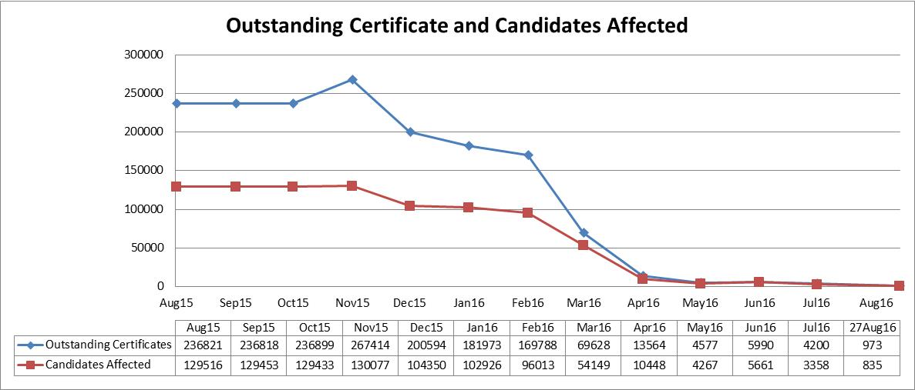
Monthly Backlog Reduction Progress
There was an increase between May 16 and June 16 due to records being identified that were deactivated incorrectly. A ‘reactivation’ script was executed and the outstanding records are being addressed as part of the ongoing process.

Slide 8
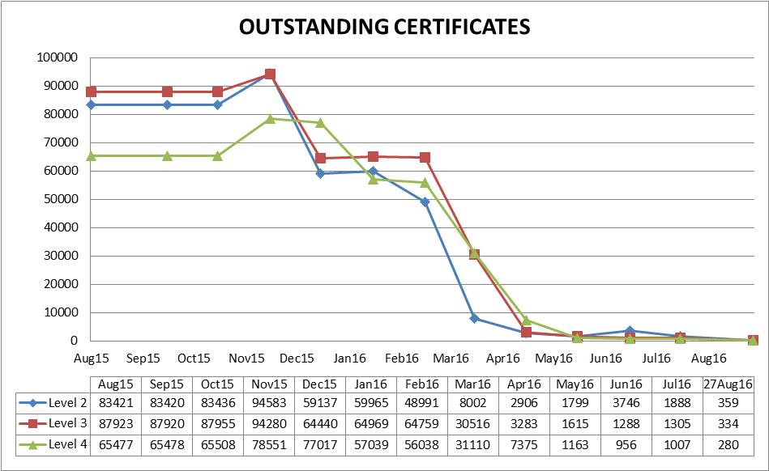
Outstanding Certificates Reduction Per Level Per Month

Slide 9
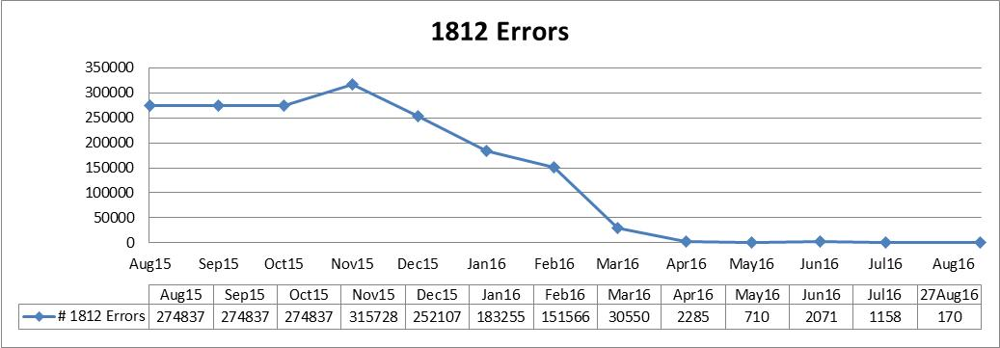
1812 Errors Resolved Monthly
The following graph depicts the reduction in number of errors blocked systematically by the NC (V) application prior to submitting to Umalusi for processing.
There was an increase in comparison May16 and June 16 due to records being identified that were deactivated incorrectly. A ‘reactivation’ script was executed and the outstanding records are being addressed as part of the ongoing process.

Slide 10
Breakdown of Error 1812
Error | 09Sep15 | 27Aug16
1 - Re-marking in process | 406
2 - Re-checking in process | 49
4 - Invalid character(s) in first name(s) | 1 433
5 - Invalid character(s) in surname | 237
6 - Initials outstanding | 178
8 - Result for exam withheld - Irregularity in process | 5182
11 - No certifiable instructional offerings found | 38
15 - Invalid id number and date of birth | 1099
17 - Invalid subject number | 99
18 - Subject not evaluated | 4226 | 18
19 - No subject certificate found for previous instructional offerings passed | 47
20 - No certifiable subjects for current examination | 458
22 - Candidate not evaluated | 21361 | 38
35 - Cannot be a First Issue, must be a Replacement
37 - Candidate's fail indicator not certifiable | 13
41 - Forwarding centre record does not exist | 218
44 - Duplicate Master records | 533 | 2
45 - Invalid subject, may not be taken together | 1606 | 2
47 - Invalid gender | 812
49 - Supplementary is not consolidated with November | 55 864
50 - No document number for published mark on candidate subject record | 20791 | 3
51 - Centre amount in arrears at UMALUSI - State | 29624
52 - Centre amount in arrears at UMALUSI - Private | 2282 | 101
54 - Valid subject total - Paper mark(s) absent | 126670
55 - ICASS mark is 0 | 1611 | 2
57 - No subjects of current exam date used in consolidation |  | 4
58 - Absent subjects may not be consolidated
59 - Result incorrect - Absent raw marks
60 - Result condoned - No subject condoned
Total | 274837 | 170

Slide 11
Progress Against High Level Flight Plan
February
March
April
May
June
Level 2
(21 254)
Level 3
(15 671)
Level 4
(23 944)
Old Backlog
200711-201203
(246)
(159)
(124)
New Backlog
201211-201403
Level 2
(35 497)
Level 3
(44 736)
Level 4
(29 697)
(50)
(44)
(49)
Current Backlog
201411-201503
Level 2
(3 250)
Level 3
(4 534)
Level 4
(3 394)
(63)
(131)
(107)
Legend
Targeted reduction as per Flight Plan presented to PCHET on 03 February 2016
Current Outstanding Certificates as at 27-Aug-2016

Slide 12
Keep 2 Zero – Future View

Slide 13
Concluding Remarks: NCV
The DHET, Umalusi and SITA processes in respect of ‘mop-up’ (e.g. capturing of marks, submission of portfolio of evidence and mark changes) and addressing candidate requests, irregularities, pre-requisites and queries form part of ongoing operations and will span beyond the project
Possibility for additional certificates to come to the fore as the remaining certification data per level is processed and cleared, for example
Should a Level 2 data certification error be resolved it will automatically free up not only the full Level 2 certificate, but also full certificates on Levels 3 and thereafter Level 4 where applicable
When a consolidation run is completed after cleaning up the remaining certificates outstanding per level per cycle, more full certificates will also come to the fore when the data is consolidated across the different levels and cycles
Ongoing data quality checks to be executed
Averting future backlog
Ongoing collaboration between DHET, Umalusi and SITA imperative
Lessons learnt and delivery practices from the backlog project will be leveraged, for example user functions to be enhanced to enable user autonomy in correcting data matters
Resolution of system software functionality deficiencies as part of backlog project resulted in improved controls thereby limiting recurrence of past errors. Prioritise resolution of additional software glitches soon as it arises
Implement knowledge transfer through for example compiling key system documentation and key standard operating procedures
Processing of 201511 Level 2 pending agreement between DHET and Umalusi regarding data anomalies. Once L2 has been accepted by Umalusi, L3 will be processed and then L4. The processing of 201603 will be commence after 201511 has been processed

Slide 14
Concluding Remarks: NCV
SITA thanks DHET and Umalusi for their unwavering commitment and support provided on the project.
Furthermore, the Board and management of SITA is confident that the project has resulted in the development of a critical mass of staff members who have been sensitized to the importance of the work in society and the economy.
As a result of this project, SITA has created a new technical operations team that focuses specifically on the education portfolio. The team is populated with the NCV project team members and several additional staff members.
Specifically, the team is tasked with designing and implementing new applications and providing support and maintenance on of the existing applications for the DBE and DHET and ensuring that all the requirements in respect of all exams for all curricula are met.
The team has already embarked on a process to revise its service delivery processes with a view to better manage and fast track the resolution of incidents and provide enhanced support to the two departments and Umalusi.

Slide 15
Concluding Remarks: NCV: Tshepiso Sehloho
For the past two years, February has been a bad omen in my life. I lost my dad, my confidant, my protector, to cancer. Last February, I lost my elder sister, my role model, someone I looked up to, to cancer too. Ooh how I loathed February. So, when the dreaded February returned this year, and this project came to be, I thought to myself…. Now this is the death of me…. ☹
And boy was I wrong☺. I saw myself transform, blossom, breaking out of my cocoon. Being a middle child, in an all-girls home, I never had to lead. My father was my everything, my elder sis was my leader and role model. However, during this project, the leader in me slowly crept out, emerging, surprising me… ☺ I started articulating, verbalizing, and vocalizing….
I have always been able to Analyse code and Program, however, this time around, for this cause, I became a teacher… and I enjoyed it. I experienced a sense of gratitude when I helped someone experience their own light bulb moment … and feeling more confident about themselves … ☺ I live by the words of a profound woman, Maya Angelou ………. “When you get, give, when you learn, teach”
February turned out to be my Metamorphosis, not the death of me…. ☺☺☺
In my culture, there is a saying that goes “moja morago ke kgosi”, literally translated to: “the king eats last”… It basically means: save the best for last☺.
Thank you for all the opportunities that have been afforded to me to make a difference ☺

Slide 16
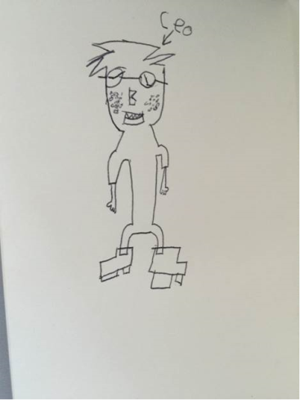
Concluding Remarks: NCV: Mildred Mdhluli
My perspective upon joining the project was more like we shall see, especially the fact that people who have been in the project for quite some time had made us believe that whatever we are facing will be next to impossible if not impossible.
The past two months have been such a great learning curve for me, with its perceived challenges I manage to realize that with dedication, commitment and clear understanding of what you are doing you can achieve anything. I have learnt so much about NCV in a short space of time than what I have learned since I joined SITA.
I have seen great team work relationships being developed and this resulted in me seeing a better view of what we are working towards. I am definitely looking forward in getting involved in such challenging projects in future because I know that it can be done irrespective of past failures. My confidence level has also improved a great deal since I got involved in this project. Having learnt few management skills in the process I can be sure in future my problem solving techniques will be better and handling responsibility that does not only affect me but a whole lot of other people will not be a big issue. In short the experience that I gained is invaluable.
In conclusion I have been so proud about getting involved in the project that I usually talk about it with my kids at home and one of them is my 8 year old son Hope, the day I brought in the journal gift home he asked me who gave it to me and I told him that the CEO did of which he asked me if he can draw something on the back page and after working on his masterpiece for a while the results was this:

Slide 17
Concluding Remarks: NCV: Lorraine Tharaga
I am currently employed by SITA as a Senior Business Analyst and has approximately 10 years’ experience in IT. This experience includes the implementation of projects following the software development lifecycle, requirements management, facilitation and process modelling. Her tertiary qualifications is B-Tech Information Technology. She also has an industry certification of a Diploma in Business Analysis. Specifically in terms of the NC (V) project, I am playing a Business Analyst Role as well as Support Analyst to the Team.
My initial feeling when I joined the projects was that this project was too big for me to handle and that I was new in the organization and I would not be able to add value. I was lost in the beginning and I felt like I could not make it.
This project has taught me that I am capable of doing anything. It taught me that I must not underestimate myself. I must just do the work, apply my mind and knowledge, and that will help me understand and learn more. I also learned not to be afraid to make mistakes because mistakes are part of personal growth and learning. I have learned that if you want to go somewhere the key thing is to start moving, no matter how long the road looks ahead, If you are moving you will get there.
Over the past approximate two months I have documented key processes including the error handling process, process to calculate stats. These processes have provided valuable to the project, for example the release management process enabled this function to be independently executed by the newly appoint release manager for the project and the error handling process also enables the quality assurance process to take place which ensures a smooth execution in fixing issues/errors.

Slide 18
Concluding Remarks: NCV: Mahlodi Monyela
I am Mahlodi Monyela: Snr Manager for Testing and Quality, currently performing the test management role on NCV project. I’ve acquired a National Diploma in Information Technology in 2003, also just completed B-tech in Informatics in Jan 2016. I joined SITA in Jan 2016. I have been doing testing for over 10 years.
Upon joining the project I had no clue of the NCV system, except for the high level overview of the problem, detailed expectations and the timelines. Everyone was a stranger from different business streams, and then everything changed when we moved to the War room, we became one team and we started to understand the goal, the vision and how everyone is going to contribute towards achieving the goal. The active involvement, cooperation and collaboration make the war room a much more enjoyable place to be. The team is motivated and focused, putting extra hours willingly because we all enjoy doing what we are here for.
NCV project team is a well-oiled machine today and credit to Vernon, despite us coming with all different skills, Vernon made us the winning team, Vernon built this team with his strategical thinking and proactive at all times , he inspires, motivate and support us daily. He communicates thoroughly and always provides a constructive feedback.
My personal take away\lesson from this project is how to build a winning team, keep the team engaged and informed because a happy team produces great results. I feel empowered and I have grown in so many ways by just being part of this team. I’m also grateful for the opportunity, being with SITA for the past 3months but I have a beautiful story to tell.
Finally as much as I’m excited about the progress, a part of me is hurt to say when we finish this project then where to? NCV has become a part our DNA, success runs in our blood, we are the proud firefighting team. I would also love to see signature projects managed in a similar manner (agile Methodology) and SITA employees are more than ready. This is a great team and I have established relationships with each one of them and definitely will continue to improvise each other skills and knowledge going forward.

Slide 19
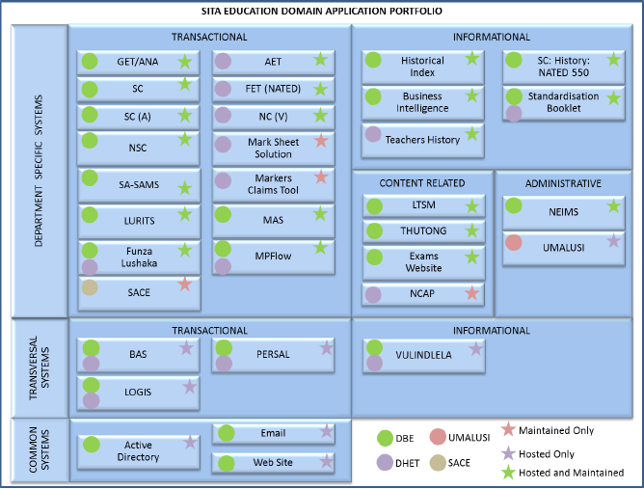
Education Applications

Slide 20
DBE Applications
Application Short Name | Application Name | Application Description
Exams | Exams Website | Used for distributing documents and software
Funza | Funza Lushaka | Teacher Student Bursary Application System.
GET/ANA | General Education and Training System (Annual National Assessment) | Examination system for Grade 1 to 9 learners under the general education and training curriculum, including the annual national assessment.
Historical Index | Historical Index | Tranversal application for indexed history data/certificate/qualification dating back to 1907.
LTSM | Learner Teacher Support Material | Web-based catalogue system for acquiring of learner teacher support material.
LURITS | Learner Unit Record Information and Tracking System | Transversal web-based online and batch system to store learner registration, educator and marks information.
LURITS II | Learner Unit Record Information and Tracking System II | Evolution of LURITS
NEIMS | National Education Infrastructure Management System | Web-based application to store education site information for planning purposes.
NSC | National Senior Certificate | Introduced in 2008.
SC(a) | Senior Certificate (amended) | Used from 2015 onwards for bridging the NSC and SC qualifications.
SC | Senior Certificate | Old curriculum, NATED 550
SA-SAMS | South African Schools Administration and Management System | A stand-alone school administration and management system used at school level.
Thutong | Thutong | Teachers and online support system

Slide 21
DHET Applications
Application Short Name | Application Name | Application Description
NATED | National Accredited Education and Training Diploma | The system enables the certification of for education of programmes consisting of 18 months theoretical at colleges and 18 months practical application in work environments. The levels offered are from N1 to N5 for engineering stuidies and N4 to N6 for business and utility studies.
NC(V) | National Certificate (Vocational) | The system enables certification for education programmes that integrate theory and practice and provides students with a broad range of knowledge and practical skills within specified industry fields. The levels offered are from L2 to L4.
CET | Community Education and Training, previously known as Adult Education and Training | The system enables certification for adult basic education and training which has multiple entries or adults following the school-based curriculum. The qualification is equivalent to NQF level 1.
NCAP | National Career Advice Portal | Portal that provides advice on careers, the requirements for and institutions which offer training on various qualifications.

Slide 22
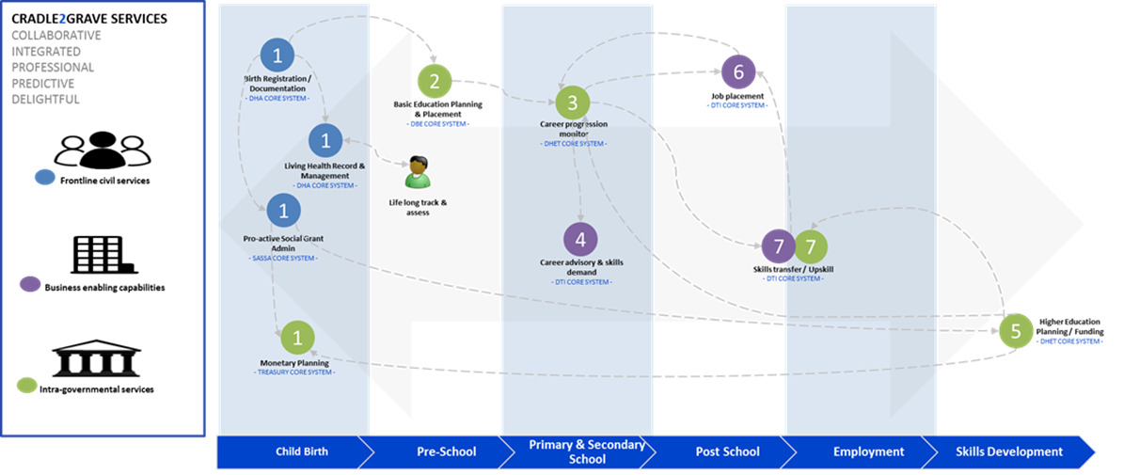
Evolution to e-Government
Our evolving approach to the use of ICTs to improve public service delivery forces us to view systems in the context of various public service value chains…

Slide 23
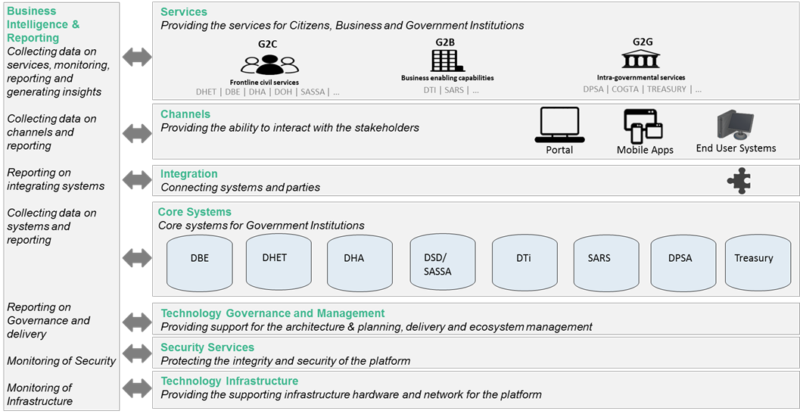
Evolution to e-Government
Enabling us to identify the roles and responsibilities of different members of a context ecosystem and allowing us to build incremental integrated value at different levels of the business and technology stacks.

Slide 24
Thank You

Slide 25
List of Centres Currently in Arrears
CENTRE NO | CENTRE NAME
799995736 | PROFESSIONAL TECHNICAL COLLEGE
799990701 | BETTER BEST EDUCATION PROJECTS:MOKOPANE
799995736 | SPRINGS CAMPUS FOR VOCATIONAL EDUCATION
799995736 | MAJUBA TECHNOLOGY CENTRE
799995736 | SIR VAL DUNCAN CAMPUS
799995736 | NELSPRUIT CAMPUS
799990735 | THASULULO FET COLLEGE
799990735 | ESIKHAWINI CAMPUS
799990735 | GAMALAKHE CAMPUS
799990735 | MAHWELERENG CAMPUS
799995736 | WESTVILLE CAMPUS
799995736 | TECHNIVEN CAMPUS
899998803 | INANDA CAMPUS
799990735 | BRITS CAMPUS
899998803 | TRUE HARVEST COLLEGE
799990735 | MANDENI CAMPUS(SUB-CENTRE FOR 5517)
799990735 | MAVHOI CAMPUS
799990735 | PRETORIA CAMPUS:FULL TIME
799990735 | NORTHDALE CAMPUS
799990735 | STELLENBOSCH CAMPUS
799990735 | JOUBERTON CAMPUS
799990735 | MELBOURNE CAMPUS
799990735 | PINELANDS CAMPUS
799990735 | VREDENBURG CAMPUS
799990735 | KHAYELISHA CAMPUS
799990735 | BLOEMFONTEIN CAMPUS
799990735 | CENTANE CAMPUS
799990735 | AS SALAAM CAMPUS
799990735 | THABA'NCHU CAMPUS
799995736 | ESIKHAWINI CAMPUS
799990701 | OUDTSHOORN_CAMPUS
799990735 | ROODEPOORT WEST CAMPUS
799990735 | EAST LONDON CAMPUS
799990701 | POLOKWANE CAMPUS
799990701 | JOHN KNOX BOKWE CAMPUS
799995736 | KEMPTON CAMPUS

