Slide 1
Recognition of Prior Learning presentation to the Higher Education and Training Portfolio Committee Joe Samuels SAQA 24 August 2016

Slide 2
Contents
Background
1
Lessons learned
2
Policy priorities
3
Achievements
4
Way forward
5

Slide 3
Contents
Background
1
Lessons learned
2
Policy priorities
3
Achievements
4
Way forward
5

Slide 4
SAQA’s legal RPL mandate
13(h)(iii) develop policy and criteria, after consultation with the QCs, for assessment, recognition of prior learning and credit accumulation and transfer;
..\Desktop\VIDEO RPL\Joe Sam - Saqa RPL.mov

Slide 5
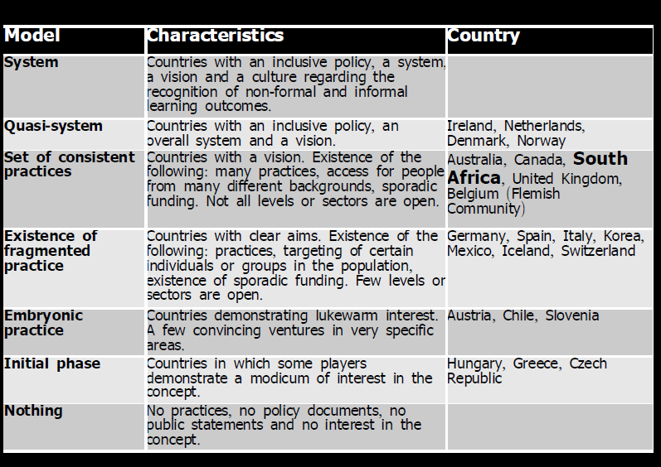

Slide 6
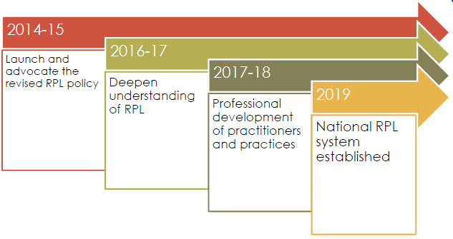
RPL implementation overview

Slide 7
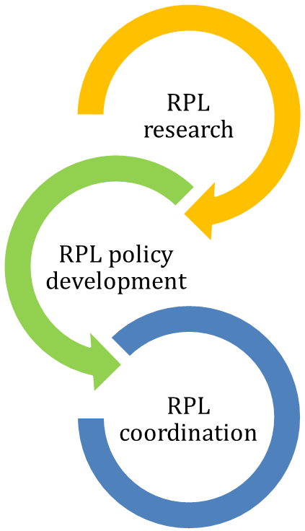
Overview of SAQA’s RPL activities
SAQA Research Partnership with UWC
Existing SAQA RPL Policy (2002, 2003)
RPL Policy on Funding and
Coordination (DHET)
New Revised RPL Policy
SAQA website, NQF website, RPL portal
Strategic RPL projects
Ministerial RPL Task Team
NQF Advisory
Services

Slide 8
Contents
Background
1
Lessons learned
2
Policy priorities
3
Achievements
4
Way forward
5

Slide 9
Drivers
Effective delivery
Quality Assurance
Resourcing
System

Slide 10
Contents
Background
1
Lessons learned
2
Policy priorities
3
Achievements
4
Way forward
5

Slide 11
Policy implementation priorities
Effective delivery
Resourcing
Quality assurance
National Coordination

Slide 12
Contents
Background
1
Lessons learned
2
Policy priorities
3
Achievements
4
Way forward
5

Slide 13
RPL achievements under the NQF Act
MHET RPL Task Team
SAQA
RPL policy
MHET
RPL policy
Strategic national RPL cases
Implementation
HEI SETAs employers
100+ providers
RPL data
RPL networks

Slide 14
Cohesion and Overarching Policies
Professional bodies and professional designations
Qualifications and part-qualifications
Level Descriptors
RPL
CAT
Assessment
System of collaboration
NQF Implementation Framework
Assessment

Slide 15
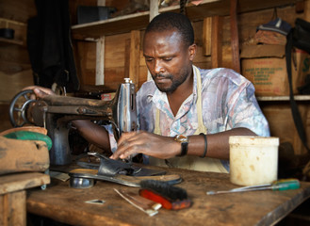
28 696 qualifications
achieved through RPL
2828

Slide 16
Manufacturing, Engineering & Technology 36%
Business, Commerce and Management studies (20%)
Physical planning and construction (17%)

Slide 17
National RPL strategy
Implementation
Coordinating Mechanism
Roles: DHET, SAQA, QCs, Providers, PBs
Funding

Slide 18
Implementation
1996-2010: Islands
2011-2014: National cases
2015 onwards: SAQA: coordination, data, directing individuals/ organisations, requirements of Quality Councils
Quality Councils: RPL policies, implementation plans, implementation, reporting

Slide 19
Co-ordinating mechanism
Legal
Recog
Purpose
Scope
Phases
Subject to NQF Act; Key in WP PSET
RPL2011, 2014, SAQA RPL Policy, Working Doc, MHET RPL TT, RPL cases
Enabling policy environment, funding, coordination
DHET, SAQA, QCs, Govt Depts, Industry, PBs, all providers, those seeking access
Phase 1 (set-up) +
Phase 2 (evaluation, legislation)

Slide 20
Responsibilities of DHET
Legislative
Coordinating Mechanism (Phase 1)
Funding Mechanism
Collaborate, Cooperate, Communicate, Consider, (CCCC) - with SAQA, QCs
Monitor

Slide 21
Responsibilities of
co-ordinating mechanism
Manage funds + information
Professionalisation
Research
Support + advice
Policy development, advocacy, communication
Collaboration with CDS
Referral of learners
Monitoring, evaluation, reporting

Slide 22
Responsibilities of SAQA
Align SAQA RPL policy
Leadership to QCs for implementation
Advise + support Coordinating Mechanism
Conduct sector-wide feasibility study: QA of RPL
RPL data uploads into NLRD
Ensure QC certification policy dev + imp (achievements via RPL never shown publicly)

Slide 23
Responsibilities of QCs
QC Sub-Framework RPL policy
Ensure provider implementation, support
Certify L
Advocate RPL
Quarterly Reports to SAQA

Slide 24
Responsibilities of providers
Institutional RPL policy
Institutional RPL Forum
Institutional RPL implementation
RPL reporting
Collaboration (Coordinating Mechanism, SAQA, QCs)

Slide 25
FUNDING
Funding
No new contributions from fiscus
(optimal use of existing funds)
Primary source = STATE FUNDS
(Additional funds will be sought)
Funding differentiated (1) Coordinating Mechanism (2) RPL implementation
Funds: developed and published annually (DHET)

Slide 26
Contents
Background
1
Lessons learned
2
Policy priorities
3
Achievements
4
Way forward
5

Slide 27
Priorities for the way forward
SAQA’s Aligned RPL Policy approved
RPL Success Cases published
QC RPL Policies/ Rollout Plans finalised
QC RPL Progress Reports to SAQA
QC RPL data, uploads into NLRD
Coordinating Mechanism set up

Slide 28
Recognition of Prior Learning presentation to the Higher Education and Training Portfolio Committee Joe Samuels SAQA 24 August 2016

