Slide 1
PRESENTATION: ACTION PLAN REPORT:
Pollsmoor Correctional Centre in respect of JUSTICE EDWIN CAMERON of the CONSTITUTIONAL COURT OF SOUTH AFRICA POLLSMOOR MANAGEMENT AREA

Slide 2
INTRODUCTION
Presentation to cover challenges faced by DCS at Pollsmoor Management Area and locate these challenges within the context of the Region and National. Those being:
High levels of Crime (Especially violent crime)
Overcrowding
Gang Violence
Shortage of Personnel
Old Infrastructure

Slide 3
CONTEXTUAL BACKGROUND
Visits by Judges
Judicial Inspectorate of Correctional Services
NGO’s
Lawyers
Other Chapter 9 Institutions
With people understanding or not understanding the difficulties and challenges under which DCS operates.

Slide 4
Contextual Background cont…
Apart from the above, the Department has also taken an approach to integrate its response to addressing all the outstanding concerns from stakeholders and oversight bodies, through the normal strategic planning processes that take place during June and July each year.
The current approach of the Department is to solve all challenges/problems in an integrated, institutionalized and holistic approach.

Slide 5
Contextual Background cont…
The basis of this approach is that problems will be solved at the source base level, in order to ensure uniformity and sustainability .

Slide 6
Offender population: SA available bed space as 19/01/2016

Slide 7
Approved capacity vs. unlock on 1st day of the month (01 January 2016)
The most over-populated centers (over 185%)
Allandale (mixed) -231.0% Malmesbury (RDF) 261.2%
Pollsmoor (RDF) -313.78% Pollsmoor Med B (sentenced) 213.22%
Pollsmoor Female (mixed)-195.13% George (mixed) 215.5%
Knysna (mixed) -214.0% Caledon (RDF) 248.8%
Drakenstein Max (sentenced)-197.2% Buffeljagsrivier 205.4%

Slide 8
POLLSMOOR OFFENDER POPULATION ( unlock of 2016-01-20)
Centers | SENTENCED | UNSENTENCED (remand detainees) | TOTAL | At 100% Occupation | Current % Occupation
Medium A | 271 | 440 | 711 | 1111 | 63.99%
Medium B | 1499 | 0 | 1499 | 703 | 213.22%
Medium C | 669 | 0 | 669 | 574 | 116.55%
Remand Facility | 132 | 4352 | 4484 | 1429 (1619) | 313.78% (276.96%)
Female Centre | 257 | 385 | 642 | 329 | 195.13%
TOTAL | 2828 | 5177 | 8005 | 4336 | 174.37%

Slide 9
Impact of Overcrowding
Infrastructure (4336 vs 8005)
Cells, toilets and showers meant for smaller numbers.
Constant breaking of bulbs by offenders – light bulbs are being replaced and fixed daily, on an ongoing basis.
Shutters/screens to be removed to increase natural airflow and light ventilation (target period within the next 6 months).

Slide 10
Impact of Overcrowding cont…
Water and sanitation (4336 vs 8005)
Hot water is available, but not adequate for the number of offenders incarcerated.
Insufficient calorifiers are unable to provide sufficient hot water, in order to meet the actual daily demand, due to the reality of overcrowding.
Blocked drains and toilets and showers are being explored.

Slide 11
Impact of Overcrowding cont…
Bed Space (4336 vs 8005)
Mounted beds in cells
Most offenders are provided with beds
Due to overcrowding and shortage of space, some offenders are provided with mattresses only.
On admission, offenders are issued with clean blankets and cleaning material.
During the 2015/2016 3830 additional mattresses were purchased for the Management Area.

Slide 12
Impact of Overcrowding cont…
Washing of blankets and sheets
Six (06) washing machines were delivered in Sept 2015.
Goodwood and Malmesbury continuously assists with washing of blankets and sheets.
Industrial washing machines were submitted to be included in the Capital Works Budget of 2016/17.

Slide 13
Impact of Overcrowding cont…
Meal Provisions (4336 VS 8005)
Three meals are provided on a daily basis, but practical reality is that two meals are sometimes provided due to shortage of staff.
No dining-halls in Medium A, B & C only Female Centre has a dining-hall.

Slide 14
Impact of Overcrowding cont…
Health Services (4336 vs 8005)
TB
HIV/AIDS
Scabies
Leptospirosis (Rodents)
Diabetes
High Blood Pressure
Injuries

Slide 15
Impact of Overcrowding cont…
One (01) full time Doctor and one (01) sessional Doctor for Remand Detention facility.
Nurses – Fifteen (15)
Pharmacists – Two (02)

Slide 16
Impact of Overcrowding cont…
Exercise
An exercise programme is designed for each unit, but family visits impact on the time and resources to conduct exercises on a daily basis.
Remand Detention Facility has three floors which impacts negatively on the exercise programme.

Slide 17
ASSAULTS : 2015-04-01 UNTIL 2015-12-31
CENTRE | OFFICIAL ON OFFENDER | OFFENDER ON OFFENDER | OFFENDER ON OFFICIAL | TOTAL OF ASSAULTS
RDF | 5 | 143 | 1 | 149
MEDIUM A | 6 | 32 | 1 | 39
MEDIUM B | 2 | 25 | 0 | 27
MEDIUM C | 3 | 21 | 0 | 24
FEMALE | 1 | 24 | 0 | 25
MANAGE-MENT AREA | 17 | 245 | 2 | 264

Slide 18
Impact of Overcrowding cont…
Assaults
In order to prevent assaults, the Head of Centre ensures that all officials are being sensitised continuously during morning briefings and personnel meetings.
Various causes of offender on offender assaults, i.e. Gang violence etc.

Slide 19
GANGSTERISM
Street gangs to Prison gangs
Is a self formed association of peers bond together by mutual interest with identifiable leadership.
They have well developed lines of authority.

Slide 20
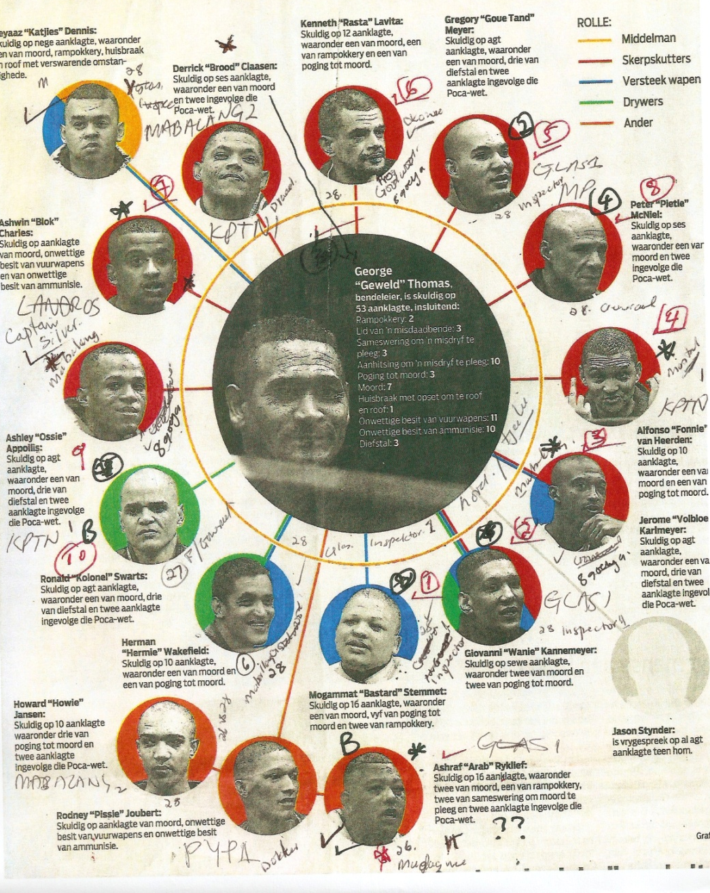
Mobsters –
George Thomas “Geweld” and accused

Slide 21
Gangs within the Community
MANENBERG:
Hard Livings (26 and 28)
Americans (26, 28)
GUGULETHU:
Vatos Locus(26)
Vaurus(26)
KHAYELITSHA:
Italians (26)
Madosela’s Company (28)
HANOVER PARK:
Stupa Boys (26)
Spoilt Brats (26)

Slide 22
Operations
There are 130 street gangs, with a membership of over a 100,000 .
There is a close relationship between the prison number gang and street gangs.
The bulk of our offenders are drawn from these communities

Slide 23
OVERCROWDING
The Department adopted a multi-pronged strategy, in order to address overcrowding at both Regional and National levels, which are as follows:
Down management of Remand detainees.
Sentenced offenders, effectiveness of alternative sentencing, placement and release.

Slide 24
Capital and maintenance programme.
Appropriate sentencing for facilitating rehabilitation.
Correctional supervision (action taken to enhance marketing).
Improving correction and development programmes within Correctional Centres and Community Corrections.

Slide 25
Improvement of 1st and 2nd level of corrections.
Community involvement in social integration.

Slide 26
CONSEQUENCES OF OVERCROWDING
Policy Prescripts
a) Section 8 (5) - Nutrition
Food must be well prepared and served at intervals of not less than
4 and a half hours and not more than 6 and a half hours,
Except that there may be an interval of not more than 14 hours
between the evening meal and breakfast.
b) Section 11 - Exercise
Every inmate must be given the opportunity to exercise sufficiently in order to remain healthy
And is entitled to at least one hour of exercise daily.
If the weather permits, this exercise must take place in the open air.
c) Old regime and dilapidated structures:
Zink structures (Voorberg A, Brandvlei Med C and Pollsmoor Med C Asbestos) Dilapidated Structures (Pollsmoor, Buffeljags, Caledon, Dwarsriver, Drakenstein Med A, etc)
Lack of Maintenance (Insufficient availability of artisans, overworked facilities, and counter productive procurement processes)

Slide 27
CONSEQUENCES OF OVERCROWDING (CONTINUE…)
Policy Prescripts
d) Staff shortages:
The 2003 establishment was never fully aligned with the functions required at operational level.
The impact of the migration based on centre based and non-centre base utilization of staff.
Unit management is 1:40
For maximums it is 1:30
Adding of additional responsibilities without revisiting the available human resources is cutting into security and rehabilitation resources .
The current attrition rate of male officials and the appointment rate of females must be reviewed. Appointment rate of female officials in predominantly male facilities requires a relook.
e) Seven day establishment and Shift Pattern + Personnel shortage
Shift system is making it almost impossible to accommodate the 3 meal system. (4 of 7 days only 50% of staff -2003 establishment)

Slide 28
f) Non compliance with APP, Assaults, unnatural deaths, escapes, gangsterism, Programs, Roll out of CRA, Work opportunities,
g) Infrastructure Centers unable to provide hot water consistently, and infrastructure not coping with the volume of offenders, offenders sleeping on matrasses. Toilets and showers over-burdened.
h) Health Risk – scabies, TB/MDR/XDR/HIV/AIDS, keeping food in over-crowded cells causing other food related illnesses.
- Driving to outside hospitals and hospital guarding.
i) Legal Challenges – Sonke Gender Justice, Offenders taking dept to court
I) Oversight bodies – JICS, Judges, PSC, Human Rights Commission etc
f.

Slide 29
Offenders need to be encouraged to report all alleged assaults.
Shortage of staff
This matter has been discussed in detail by management at the department’s strategic review process and a strategy is underway to address the matter.

Slide 30
HEALTH ISSUES
All relevant aspects have been addressed by the Regional Commissioner, including the reporting and monitoring requirements.
A weekly roster in respect of medical supplies is implemented to ensure offenders have access to the clinic once a week (excluding emergencies, which will be attended to immediately).

Slide 31
Emergency ward stock of medical supplies are being increased.
The turnaround time for issuing prescriptions has decreased to 48 hours with the appointment of 3 more pharmacists.
The opening of the Goodwood Pharmacy has also decreased the workload of the Pollsmoor Pharmacy.

Slide 32
Wayfoward
Need to reduce offender population to 3000 at RDF.
Need to build 1500 bed space correction facility in the Cape Metropole.
Need to increase the number of staff complement
Need to address the shift system

