Slide 1
PORTFOLIO COMMITTEE ON
TRADE AND INDUSTRY
Colloquium on local public procurement
Date: 17th and 18th August 2016

Slide 2
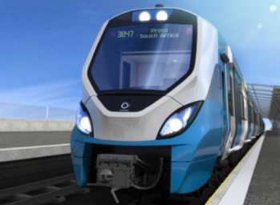
Agenda
  Considerations and Challenges
  Compliance with existing designations
  Mechanisms to assist companies to meet local content requirements
  Mechanisms to ensure local content requirements are met
  Recommendations
  PRASA’s examples of achieving local content

Slide 3
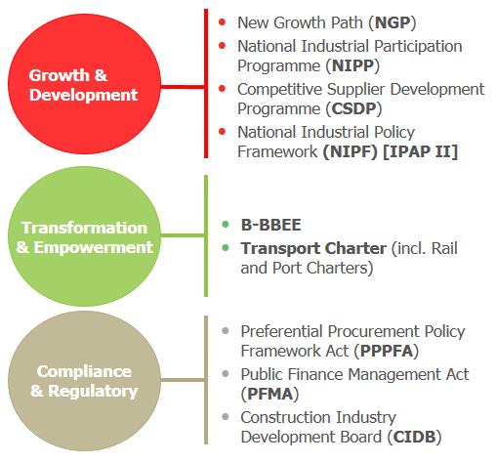
PRASA’s modernisation programme
PRASA is undertaking an intensive modernisation programme…
PRASA has initiated a Programme to transform and modernise passenger railways in South Africa.
PRASA is looking to invest approximately R172bn over the next 10 years.
…and aligned implementation of programmes to Government policies
New Fleet
Rail Infrastructure
Modernisation
Depot Modernisation
Station Upgrades
Technology Improvements

Slide 4
Considerations and Challenges

Slide 5
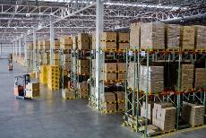



Key considerations to implement localisation
Volumes
Suppliers require a certain volume to enable moving production from their current manufacturing facilities to South Africa. Therefore, volumes to need to be substantial for the high investment to make financial sense for localisation
Value
For a supplier to move operations and manufacturing to South Africa, the project must be financially sustainable. Therefore, the value of the projects must be reasonable enough to cover additional capital costs and operational costs and allow the supplier to cover the gain the same margins as per their normal business
Duration
Suppliers require time to ramp-up localisation. The required ramp-up duration depends immensely on South African capacity. Therefore, projects will need to balance the need for delivery and the time for ramp-up for localisation
Global Competitiveness
The global industry must be understood and localisation efforts must be made on areas where South Africa can be competitive

Slide 6
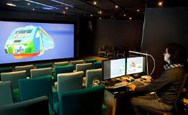





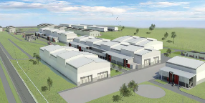

Critical implementation elements required for sustainability
Partnership with Government
Centre of Excellence
  All relevant government departments need to “partner” on the programme thus enabling a platform for sustainable development
  Departments such as the dti, IDC, NEF and Economic Development are key players
  A critical enabler for sustainability of the industry will be the development of a centre of excellence.
  The centre of excellence must be the design authority of products, services and manufacture to
  ensure modern,
  current and
  competitive designs
Rolling Stock Fleet Renewal Programme
Land for Local Factory and Supplier Park
Active Monitoring and Support
  Feasible land (including all environmental authorisations, bulk services, etc.) needs to be in place for ease of construction of facilities
  Development of a Local Factory and a supporting
  Supplier Park
  to ensure a
  competitive hub
  for manufacture
  Active monitoring of the private sector in terms of localisation is critical for sustainability. This will allow preventative measures in industry when issues arise therefore ensuring competitive advantage within the country
  Support from local government,
  municipalities, societies and
  even employees is critical

Slide 7




Strategic approach for localisation
Focus on South African Manufacture
Ensure business case is viable
Long Term Investment Outlook
Provide long-term high volume projects
Economic Development Strategy
Focus on Transformation
Broad-Based Black Economic Empowerment focus
Development of Local Supply Chain
Focus on South African Spend

Slide 8

Key Constraints
Key Constraints for localisation
Lack of insight into current Local supply chain capability and capacity
Lack of existing industry skills
Volumes
Investment Uncertainty
Alignment in planning
OEMs do not recognise partnership approach with Government institutions

Slide 9
Compliance with existing designations

Slide 10

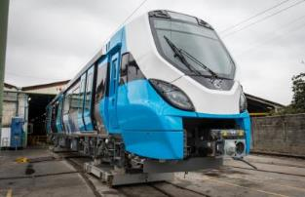
PRASA’s contract with the Gibela Rail Transport Consortium
On the 14th October 2013, PRASA and Gibela signed the following two agreements:
  Manufacture and Supply Agreement (MSA)
  Technical Support and Spares Supply Agreement (TSSSA)
  PRASA and Gibela reached Financial Close on the 26th April 2014
MSA
The MSA has been contracted on the following terms:
  Contract Value: R59 billion (including VAT, excluding inflation)
  Number of Vehicles: 600 New Trains (3600 vehicles)
  Duration: 10 years
TSSSA
The TSSSA is the agreement governing the maintenance of the New Trains.
The scope of the TSSSA will ensure that Gibela will perform at least one overhaul on each New Train.
It is estimated that the TSSSA will have a duration of 18 years.

Slide 11
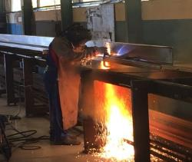
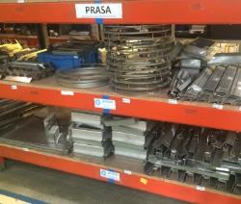
Meeting dti’s designated components list
Gibela’s localisation targets for specified BOM components 65% and above
65% Target

Slide 12
Results in meeting overall targets within designated sector for localisation
PRASA set compliance targets within the Rolling Stock Fleet Renewal Programme
Gibela has committed to these localisation targets for both the supply and maintenance of the new trains:
Manufacture and Supply
Maintenance
Local Content:
  is measured throughout the supply chain, i.e., up to the raw materials used within a component
  measures South African value add on components, i.e., if the raw material is foreign, but has local manufacturing, then the local manufacturing portion will only count as Local Content.
Gibela will thus require companies within its supply chain to have Local Content commitments on their products

Slide 13
Mechanisms to assist companies to meet local content requirements

Slide 14



Mechanisms to assist localisation
South African Government
Export Focus
Incentives
Partnerships
Incubation
Government must support local industry with international partnerships focusing on export agreements
Ensure platforms exist for partnerships between suppliers
Provide Tax incentives for:
  Overachieving localisation
  Exports
Increase utilisation by SMMEs of incubation centres for legal, commercial and negotiations support

Slide 15
Ensuring achievement of Local Content

Slide 16
Categorise commitments for monitoring purposes
1
Local Content
Local Content Percentages
Local Factory
Centre of Excellence
Specified BOM Components
Localisation
2
Skills Development
Number of Individuals Skilled
Total Skills Development Spend
Economic Development
Commitments
3
Job Creation
4
Ownership
5
Management Control
6
Employment Equity
Transformation
7
Preferential Procurement
8
Enterprise Development
9
Socio-Economic Development

Slide 17
Set strict remedial processes within the contract
Remedial Process – Localisation and Skills Development
Description
Penalties
  Non-compliance on the following commitments result in Penalties being awarded:
  Commitments on Local Content percentages in any given year
  Commitments on the Specified Components List
  Commitments on Skills Development (both spend and number of people trained)
Termination Points
  Non-compliance on the following commitments result in Termination Points being awarded:
  Contractor’s commitments to Local Content Percentage in any given year
  Centre of Excellence operational by required year
  Centre of Excellence has minimum Local Employee base by a specific year
  Meeting commitments as set out in the Local Content Plan
  Meeting commitments as set out in the Skills Development Plan
Termination Events
  If the Contractor incurs a specific amount of Termination Points, a Termination Event will occur
  Non-compliance on the following types of commitments result in a Termination Event:
  Achieving and maintaining the 65% Local Content obligation
  Local Factory must produce all of the required Local EMUs as required by the end of the ramp-up period

Slide 18



Ensure independent monitoring
Monitoring through independent government entity
Independent continuous monitoring is critical to ensure that localisation targets are being met
Proactive monitoring further allows for an understanding on how suppliers are developing the local industry and the challenges being faced
The information about business cases and sourcing strategy for components enables more accurate forecasts of localisation of components and will provide a view on the areas for competitive advantage locally
The SABS has been appointed by the dti to monitor local content; thus having a state vehicle to audit and verify localisation provides a strategic partner in localisation decisions
Proactive monitoring also creates an environment of implementation of remedial measures in the event of non-compliance; thus actively promoting suppliers to localise.

Slide 19
Case Example –
PRASA Rolling Stock Fleet Renewal Programme

Slide 20
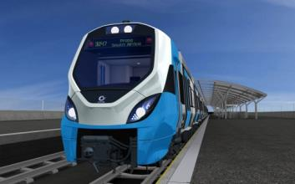
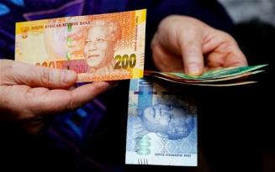
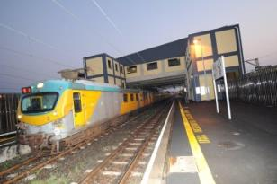
Case Study – PRASA’s Strategy for the Procurement
Strategic Objectives
High Localisation
(including Local Factory)
Approach
Latest Technology
One supplier
Advantage of economies scale based on volume
Minimum capacity for efficiencies
Develop sustainable supply chain
One technology solution
One large contract
Competitive pricing benefit through tender process
Long term contract
Allows local industry to develop over time
Allows PRASA to grow internally and modernise supporting infrastructure
Creates a more attractive sustainable procurement
BOTTOM LINE - Develop a sustainable local supply chain over a period of time, which will eventually become globally competitive
Competitive Pricing
Sustainable Industry

Slide 21
Case Study: Critical Elements focused on in the Rolling Stock Fleet Renewal Programme
Critical elements for localisation
Local Factory
Local Spend
Preferential Procurement
Skills Development
Job Creation
Enterprise Development
A local factory is critical catalyst for sustainable large scale local manufacture
Focus should be on auditing and verifying local spend through compliance with local value add
Promoting skills development will result in suppliers focusing on developing the required skills for local manufacture.
Measuring job creation results in suppliers developing the local capacity required to deliver.
Preferential Procurement is necessary to ensure transformation and localisation objectives are met
Explicitly monitoring a supplier’s enterprise development fund promotes the development of new local enterprises (with access to funding)

Slide 22
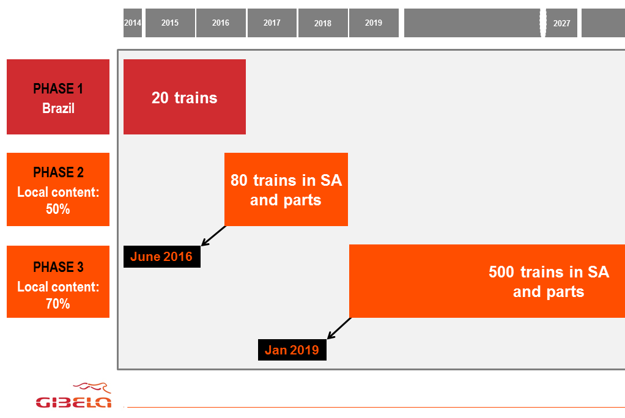
Case Study: Phasing on large contract enables localisation
Gibela required a two phased manufacturing programme, i.e., Brazil and South African manufacturing to achieve two objectives:
  Localisation
  To ramp-up to full delivery in South Africa, Gibela needs to train South African employees in Brazil on the pre-existing manufacturing line.
  This allows for skills transfer to South African employees through “train-the-trainer” programme. from the first year of contract
  Meet PRASA operation demand
  PRASA urgently requires the new fleet, therefore, the Brazil production allows PRASA to receive a set of trains, while the Local Factory is being developed

Slide 23
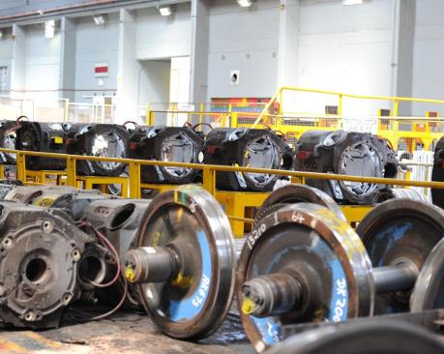
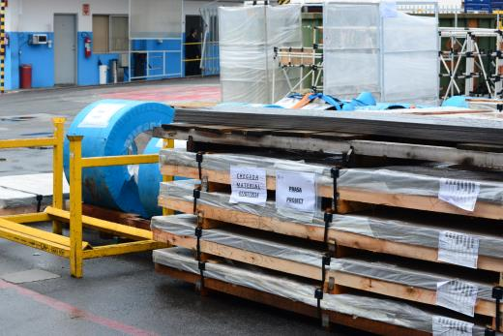
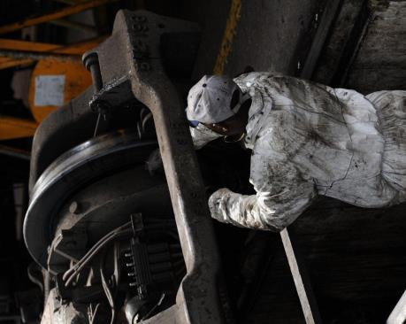
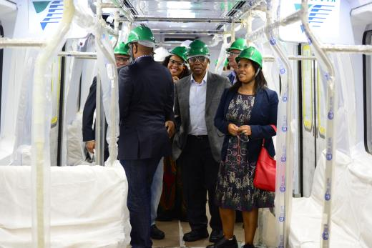
Case Example: Results - Impact of Localisation – in the first phase
Scope of supply | RSA supplier delivering Lapa | Volumes of the items that are locally produced | Price of the Items as a % of the train price
COUPLERS | VOITH South Africa
PASSENGER DOOR | KB South Africa | 36 door leaves per TS | 2.7%
DRIVER SEAT | ISRINGHAUSEN | 2 driver seats + 2 co-driver seats per TS | 0.1%
BRAKING RESISTOR + MOTOR FAN | PENBRO KELNICK | 8 bracking resistors per TS | 0.7%
INPUT FILTER / LINE INDUCTOR | PENBRO KELNICK
CABLES | ABERDARE | Around 8 km of cables per TS | 1.1%
CABLING - CIRCUIT BREAKER | CBI | Around 350 circuit breakers per TS | 0.2%
MASTER CONTROLLER + EMERGENCY ALARM + REAR VIEW MIRROR + VOLTMETER + DOOR INDICATOR | RADEL
SEATS | PROFIBER |  | 1.1%
LATERAL WINDOWS + WINDSHIELD | PG Group | 2 windshields & 68 lateral windows per TS | 0.3%
LIGHTING SALOON | RADEL | Around 100 meters of LED strips per TS x 2 (left and right) | 0.2%
SIDE WALLS (UPPER & LOWER) | TRECKLINER | 133 panels per TS | 0.3%
TS = Train Set

Slide 24
Case Example: Results - Impact of Localisation – in the first phase
Scope of supply | RSA supplier delivering Lapa | Volumes of the items that are locally produced | Price of the Items as a % of the train price
SIDE WALLS (UPPER & LOWER) | TRECKLINER | 133 panels per TS | 0.3%
EQUIPED CEILING AIR DUCTS | GLOBAL COMPOSITES | Around 100 meters of central ceiling per TS | 2.2%
CARBON STEEL + STAINLESS STEEL | MACSTEEL SERVICE CENTRES | Around 80 tons per TS | 5.9%
EXTERNAL LIGHTING | LED LIGHTING | 6 lights per TS | 0.2%
SALOON HEATER + FOOT REST | BOOYCO | 32 saloon heaters + 2 footrests per TS | 0.6%
BATTERY BOX + BATTERY | TTS (inc. FNB & Kare) | 2 boxes per TS | 1.4%
FIRE DETECTION | CONCILIUM
LUGGAGE RACKS + DUCTS | GLOBAL COMPOSITES | 66 luggage rasks per TS | 0.7%
HORN | KAMA | 6 horns per TS | 0.0%
FAIRING & DUCTS | CREST | 80 fairing per TS + 26 airducts per TS | 1.0%
MISCELL. SHEET METAL WORK | LASER JUNCTION | Various small sheet metal parts | 0.1%
AIR TANKS | ILVA ENGINEERING | Around 30 tanks per TS | 0.3%
CABIN DOOR + CAB INTERIORS | SIYAHAMBA | 4 cabin doors per TS + garnishing of 2 cabins per TS | 0.8%
TOOL BOX | SPE | 1 tool box per TS | 0.1%
INSULATION | GIS | 620 sqm per TS | 0.4%
HANDRAILS | DELBERG | 18 tripods, 106 seat handbars, 8 cab access handles and 1 PMR backrest per TS | 0.3%
BASEBOARD DUCT | DENEL | 42 baseboard ducts per TS | 0.5%
TOTAL LOCALISATION IMPACT (percentage of train price) |  |  | 20.9%
TS = Train Set

Slide 25

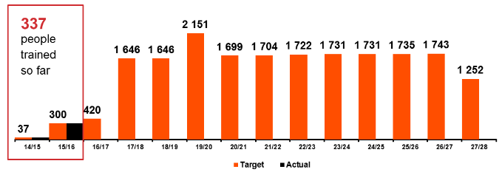
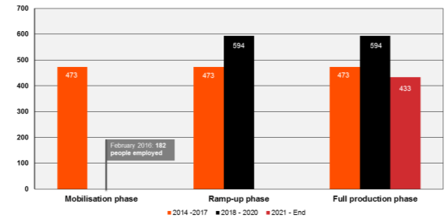
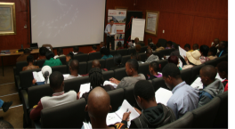


Case Study: Progress on Job Creation and Skills Development
Job Creation
Skills Development
To date Gibela has appointed 182 people, where:
162 are South African Citizens;
145 are Black Citizens;
144 are skilled Black Citizens;
82 are woman; and
113 are youth.
Job commitments have been phased in line with Gibela’s operations
Upskilling of approximately 19 500 individuals over a 10 year period
To date, 337 people have been trained
Gibela has further awarded 180 bursaries, worth approximately R12 million

Slide 26
Recommendations

Slide 27

Recommendations
Recommendations
Localisation strategy should focus on:
Providing long-term certainty in projects
Focus on global competitiveness for an industry
Develop local supply chain
Include transformation objectives
Synergies are required within Government:
Align projects within Government departments and entities (e.g., Transnet, PRASA and Gautrain for purchase of trains, rail equipment and locomotives)
Assistance should focus on:
Increasing utilisation of incubation centres
Export incentives through international government partnerships and tax incentives
Ensure strict monitoring and remedial process within contract
Review definition of Local Content within Policy

Slide 28
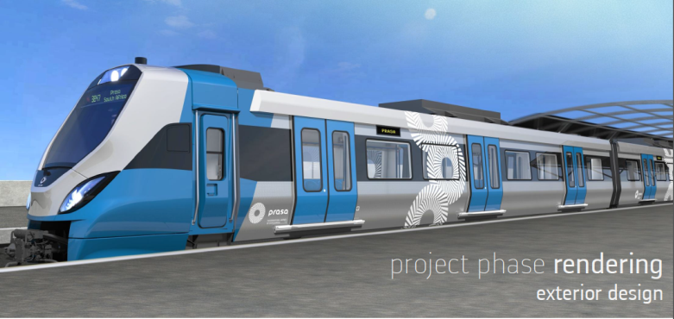

Thank You
The FUTURE of South African Passenger Rail is here!
THANK YOU

