Slide 1
PRESENTATION TO PORTFOLIO COMMITTEE ON HEALTH
NORTH WEST DEPARTMENT OF HEALTH (VOTE 3)
16 AUGUST 2016

Slide 2
OUTLINE OF PRESENTATION
Introduction
Human Resource with emphasis on Community Health Workers
Infrastructure Projects
Financial Management
Supply Chain Management & Procurement
Progress & Challenges: implementation of Ideal Clinic Initiative
Conclusion

Slide 3
Human Resource with emphasis on
COMMUNITY
HEALTH WORKER PROGRAMME

Slide 4
CHW’s CATEGORIES
The North West Department of Health is currently responsible for three categories of the Community Health Workers namely;
  Community Counselors under the HIV, Counseling & Testing (HCT),
  Caregivers under the Home Community Based Care (HCBC) and
  Peer Educators under the High Transmission Areas (HTA).

Slide 5
CAREGIVERS
Categorised into two groups viz:
  Ward Based Outreach Teams which are responsible for PHC Re-engineering functions
  Home Based Caregivers responsible for providing care to patients confined bed at home

Slide 6
COMMUNITY COUNSELORS
This cadre is operating from health facilities by providing counselling to deserving patients
They are also responsible for the uptake of HIV Testing Services (HTS)

Slide 7
PEER EDUCATORS
This cadre operates in High Transmission Areas (HTA)
They are responsible for providing health services at truck-in areas and also to Commercial Sex Workers (CSWs)

Slide 8
CHWs PER DISTRICT
DISTRICT | CATEGORY |  | NUMBER OF CHWs
BOJANALA | Community Counsellors | Counsellors | 360
 |  | Mentors | 37
 | Peer Educators |  | 33
 | Caregivers |  | 1 792
SUB-TOTAL |  |  | 2 222

Slide 9
CHWs PER DISTRICT
DISTRICT | CATEGORY |  | NUMBER OF CHWs
DR RSM | Community Counsellors | Counsellors | 322
 |  | Mentors | 30
 | Peer Educators |  | 10
 | Caregivers |  | 1 419
SUB-TOTAL |  |  | 1 781

Slide 10
CHWs PER DISTRICT
DISTRICT | CATEGORY |  | NUMBER OF CHWs
NMM | Community Counsellors | Counsellors | 360
 |  | Mentors | 35
 | Peer Educators |  | 6
 | Caregivers |  | 2 012
SUB-TOTAL |  |  | 2 413

Slide 11
CHWs PER DISTRICT
DISTRICT | CATEGORY |  | NUMBER OF CHWs
DR KK | Community Counsellors | Counsellors | 326
 |  | Mentors | 30
 | Peer Educators |  | 17
 | Caregivers |  | 1 124
SUB-TOTAL |  |  | 1 585
GRAND TOTAL |  |  | 8 001

Slide 12
MONTHLY STIPEND
CATEGORY | MONTHLY STIPEND
Mentor - Counselor | R2,500
Community Counselor | R2,000
Caregiver | R2,000
Peer Educator | R2,000

Slide 13
CHWs RESPONSIBILITIES
Counsellors
Operate from health facilities by providing counselling to patients
Responsible for the uptake of HIV Testing Services (HTS)
Treatment adherence counselling
General counselling for other issues excluding HIV and AIDS
HIV pre and post test counselling
Couple counselling for HIV and AIDS

Slide 14
CHWs RESPONSIBILITIES
Caregivers
Categorised into two groups:
  Ward Based Outreach Teams which are responsible for PHC Re-engineering functions
  Home Based Caregivers responsible for providing care to patients confined bed at home

Slide 15
CHWs RESPONSIBILITIES
Peer Educators
Operate at the High Transmission Areas (HTA)
Providing health services at truck-in areas and also to Commercial Sex Workers (CSWs)
Hot spots, informal settlements, shebeens and neighbouring communities to high transmission areas.

Slide 16
CHALLENGES
CHW’s being mobilised by labour unions to make demands which include:
  Increase of their stipend
  To be permanently employed by the department
Reporting Delayed payment of UIF
Accredited training
Complexity of reporting of performance through the Dept. of Public Works reporting

Slide 17
CHALLENGES ...
Slow progress in implementation of the exit strategy in line with EPWP programme.
Backlog in training of PHC Re-engineering due to inadequate capacity to train large number of CHWs at a time.

Slide 18
REMEDIAL ACTIONS
National Department of Health is in the process of developing one cadre of CHWs.
CHWs exit plan developed (In Draft) to exit them through different health related trainings.
Department of Social Development as a coordinating department of Social Sector EPWP requested to elevate the EPWP reporting system challenge with the Department of Public Works.

Slide 19
REMEDIAL ACTIONS
The Department resolved the CHWs’ UIF registrations with the Department Labour and claims can be made
The Department made stipend adjustment in 2014 and the increase in subsequent years is in line with Ministerial Determination as informed by Consumer Price Index (CPI).

Slide 20
INFRASTRUCTURE PROJECTS

Slide 21
TABLE OF CONTENTS
  Introduction
  Conditional Assessments
  Maintenance Projects
  New Infrastructure Projects
  Active Infrastructure Projects Experiencing Schedule Slippage
  Conclusion
  Recommendations
  Progress Photos

Slide 22
INTRODUCTION
The 2016/17 Infrastructure Budget is R543m
  Health Facility Revitilization Grant (HFRG) Budget = R480m
  Equitable Share (ES) Budget = R63m
The budget allocated for Villages, Towns and Small Dorpies (VTSD’s) is R463m (85% of R543m).
R28.8m (ES budget) is allocated to Districts, for statutory and day to day maintenance.
R45 935m (HFRG budget) is targeted towards maintenance projects.
The HFRG budgets for Service & Maintenance of Standby Generators and Steam Boilers are “ring-fenced” in a form of three year term contracts.
The major budget component is for large multiyear infrastructure projects.

Slide 23
CONDITIONAL ASSESSEMENTS
2.1 Conditional Assessments at 54 facilities has been completed:
      Hospitals: 17
      Community Health Centres:37
2.2 The assessments prioritised the required work into three categories:
      Priority 1 – Legal Compliance (focus for 2016/2017)
      Priority 2 – Repair
      Priority 3 – Replace / Upgrade
2.3 It will cost an estimate of more than R400m to address all the identified Priority 1 issues.
2.4 The major Priority 1 issues are at Joe Morolong (R71m), Thusong (R47m), Gelukspan (R43m), MPH (R34m), and Lehurutshe (R32m).

Slide 24
MAINTENANCE PROJECTS
3.1 The R45 935m available HFRG budget for 2016/17 is earmarked for maintenance projects at the following five facilities:
    Thusong Hospital
    Gelukspan Hospital
    Joe Morolong Hospital
    Mafikeng Provincial Hospital
    Lehurutshe Hospital
    Schweizer Reneke Hospital
    Moses Kotane Hospital
3.2 Only some of the high priority issues will be addressed since the available budget is not sufficient, where the prevailing issues will be addressed in the next financial year.
3.3 Technical Specifications have been finalised. Contracts were advertised in July 2016.
3.4 The procurement process will ensure that at least 40% of the works goes towards local business development in support of provincial pronouncements on VTSD’s.

Slide 25
NEW INFRASTRUCTURE PROJECTS
The following infrastructure projects are as per the approved B5 Project List, and the 2016/17 Annual Implementation Plan (AIP):
Infrastructure Projects | Status
Maintenance Projects: Thusong, Joe Morolong, Gelukspan, Lehurutshe, Mafikeng Provincial Hospital, | Technical Specification
Madikwe Clinic | Advert :Tender closing – 11-07-16
Brits Staff Accommodation | Advert : Briefing – 11-08-16
Klerksdorp Hospital Boiler (5 ton) | Awarded

Slide 26
NEW INFRASTRUCTURE PROJECTS Cont’d
Infrastructure Projects | Status
Brits Staff Accommodation | Advert : Briefing – 11-08-16
Klerksdorp Hospital Boiler (5 ton) | Awarded
Mafikeng Provincial Hospital Boiler (8 ton) | Advert: 04-08-16
Standby Generator Maintenance: 3 Year Term Contract(Ngaka Modiri Molema and Dr.Kenneth Kaunda Districts) | Awarded
Steam Boiler Maintenance: 3 Year Term Contract | Advert

Slide 27
ACTIVE INFRASTRUCTURE PROJECTS
EXPERIENCING SCHEDULE SLIPPAGE
The following infrastructure project status is as at 29 July 2016:
Projects description | Construction period complete | Physical construction complete | Comment
New Bophelong Staff Accommodation | 50% | 14% | There was a suspension of works for a period of three (3) months following a court order. The legal dispute has been resolved, and project execution has resumed.
Mmabatho Nursing College | 30% | 7% | One of the delays relates to substandard concrete supply.
Weltevrede Clinic | 80% | 73% | Progressing well although 7% behind schedule.

Slide 28
ACTIVE INFRASTRUCTURE PROJECTS
EXPERIENCING SCHEDULE SLIPPAGE … cont’d
Projects description | Construction period complete | Physical construction complete | Comment
Sekhing Community Health Centre | 205% | 86% | Progress is visible onsite, although behind schedule. The contractor committed to increase trades personnel to improve progress. Penalty clauses will be enforced.
Boitekong Community Health Centre | 144% | 53% | Project behind schedule, despite effected cessions. Penalty clauses and/or termination will be enforced.

Slide 29
CONCLUSIONS
An overview of the departmental infrastructure budget has been presented,
The Conditional Assessment at 54 Facilities has been concluded and remedial actions costed,
The available budget for 2016/17 will not enable the department to execute all remedial works emanating from Conditional Assessments,
The department managed to identify five (5) facilities that need prioritisation on maintenance for the current financial year,
Active infrastructure projects experiencing schedule slippage have been listed. The department is pro-actively managing the risks.

Slide 30
RECOMMENDATIONS
The information sighted on this presentation has led to the following recommendations:
that the department implement adequate means such as enforcing contractual penalties and/or termination clauses to accelerate delayed projects and bring them to completion, and
that the Parliamentary Portfolio Committee on Health assist by opening appropriate channels to enable the department to received more funding for maintenance and capex projects.

Slide 31
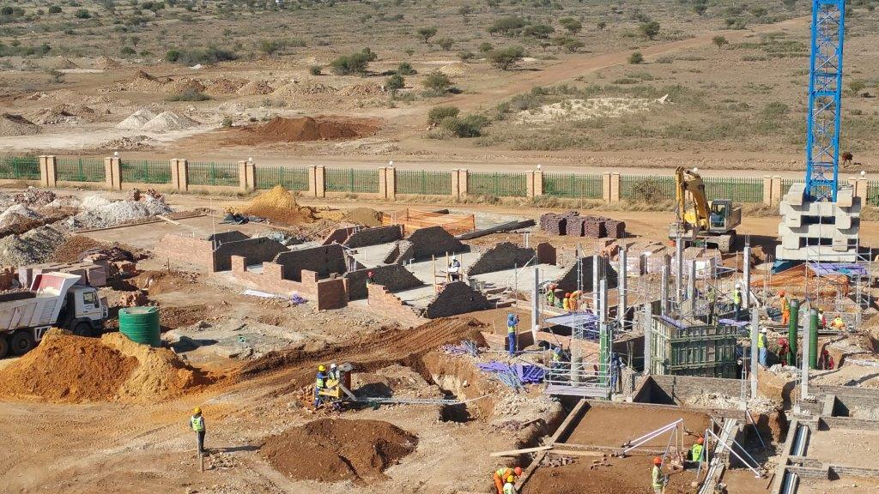
NEW BOPHELONG STAFF ACCOMMODATION

Slide 32
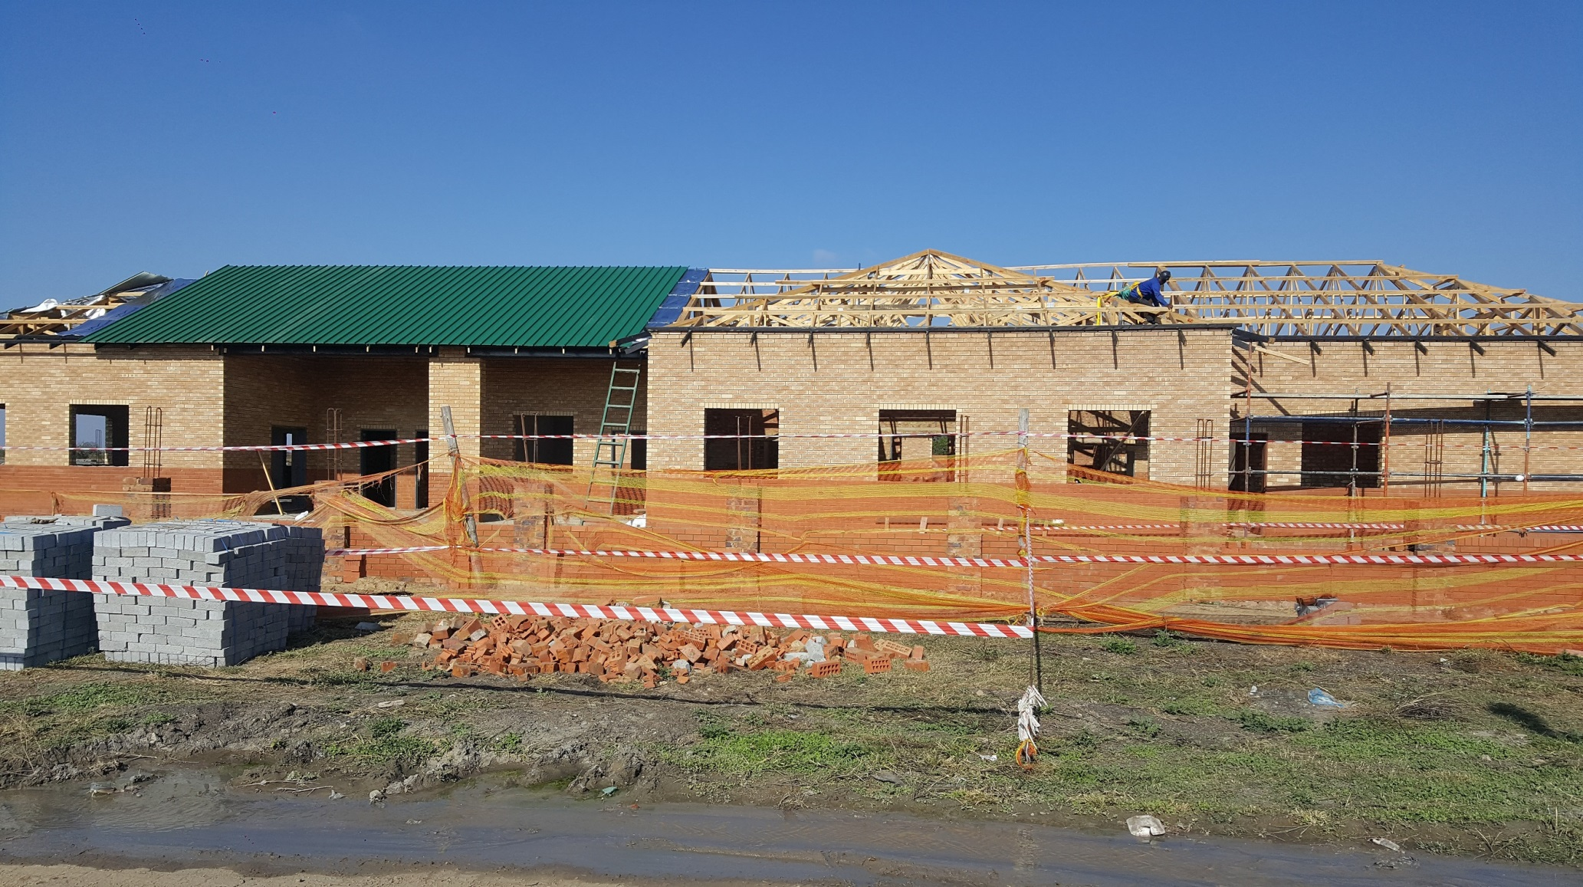
BOITEKONG
COMMUNITY HEALTH CENTRE

Slide 33
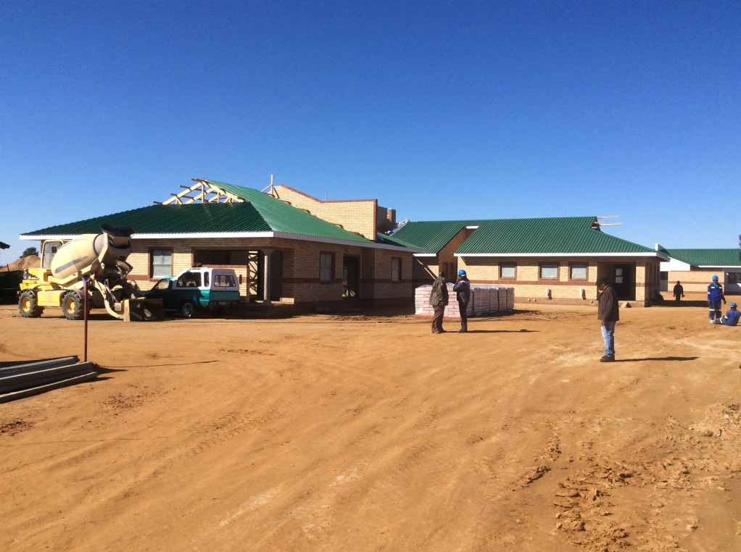
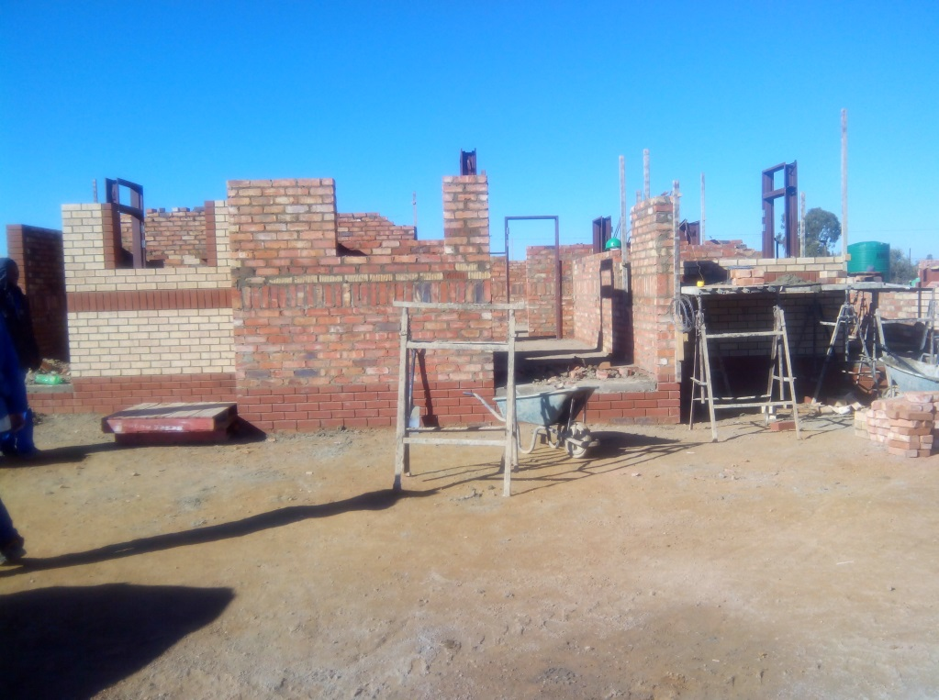
WELTEVREDE CLINIC
Main Clinic – North Western Side
Nurses Home

Slide 34
MMABATHO NURSING COLLEGE UPGRADE
Column Construction

Slide 35
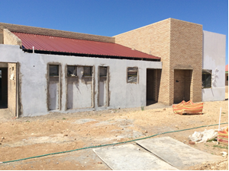
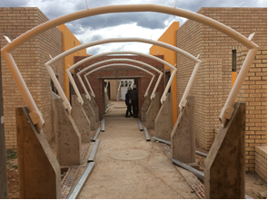
SEKHING
COMMUNITY HEALTH CENTRE
Services Building
Internal walkway being roofed

Slide 36
FINANCIAL MANAGEMENT

Slide 37
FINANCIAL MANAGEMENT
The NW Department received a qualified audit report for the 2015/16 financial year. It was qualified on commuted overtime.
This broke the five (5) years trend of unqualified audit report.
In the prior year, the AG had raised three (3) matters of emphasis namely:
  Unauthorized, irregular and fruitless and wasteful expenditure
  Accruals, and
  Significant uncertainties with regard to the number and value of medico-legal claims

Slide 38
FINANCIAL MANAGEMENT(CONT.)
The following measures were taken to address the matters of emphasis and other findings in the management report:
  Audit action plan was compiled to rectify reported audit findings.
  Responsible managers reported progress on the action plan on monthly basis.
  The latest progress report on the audit action plan indicates that 165 of the 170 actions plans developed have been implemented, that is 97% implementation.

Slide 39
FINANCIAL MANAGEMENT(CONT.)
Specifically on the matters of emphasis:
Unauthorized Expenditure
  There was no unauthorized expenditure in the 2015/16 financial year.
  Unauthorized expenditure of prior years to 2013/14 has been authorized with funding by the Provincial Legislature.
Irregular Expenditure
  Over 80% of the irregular expenditure in the books of the Department was incurred on contracts awarded by the defunct NW Tender Board and the Provincial Department of Public Works for capital projects. The Department has tried unsuccessfully over the years to write-off this balance from its books.

Slide 40
FINANCIAL MANAGEMENT(CONT.)
Fruitless & Wasteful Expenditure
  Fruitless expenditure was incurred primarily on the interest charged on the accruals carried forward from prior years.
  As the Department deals with accruals and tries to reduce them so this item will also be dealt with.

Slide 41
FINANCIAL MANAGEMENT(CONT.)
Accruals
  Management is implementing efficiency and rationalization measures, including restructuring of the Department, to bring operational expenditure in line with the reduced budget and to clear accruals from prior years.
  For the first time in five years, the Department was able to achieve a reduction in accruals from a total liability of R981 million to R657 million. Thus, the Department was not only able to halt the increase but actually reduced the level of accruals.

Slide 42
FINANCIAL MANAGEMENT(CONT.)
  Significant uncertainties with regard to the number and value of medico-legal claims
    This finding, as much as it has a serious financial impact, does not arise from financial mismanagement but rather from profession (medical) negligence
    It is therefore being managed from that angle by
      Improving professional efficiency
      Reducing the pressure on professional staff resulting from staff shortage by employing more health professionals
      Improving emergency medical services by increasing the number of ambulances

Slide 43
SUPPLY CHAIN MANAGEMENT & PROCUREMENT
The Department has implemented internal control systems, policies and procedures to reduce the incidence of non-compliance in supply chain management in a decentralized environment. These include:
  SCM policies and delegations
  Financial delegations
  Standard operating procedures on all aspects of procurement
  SCM Committees at Head Office and District Offices

Slide 44
SUPPLY CHAIN MANAGEMENT & PROCUREMENT (CONT.)
  Pre-audit and post-audit of vouchers and orders using standard checklists before payments are effected
  Internal Audit – provincial set-up with a dedicated team for the Department – to conduct periodic review of compliance and recommend action plans for improvement
  Consequence management to ensure that managers are held responsible for their financial management decisions and actions

Slide 45
Ideal Clinic
Realisation
&
Maintenance Programme

Slide 46
Ideal Clinic Realisation & Maintenance Programme
Part of Operation Phakisa which was launched nationally in 2013.
It focuses on developing a national scale-up framework and an implementation plan to enable all 3,507 PHC facilities in South Africa to achieve Ideal Clinic status by 2018/19

Slide 47
From a Patient Perspective
Provides a comprehensive package of good quality health services every day
Has the basic necessities available, such as essential medicines
Refers people to higher levels of care timeously when this is required
Called “our own clinic” by Community members

Slide 48
From a Patient Perspective (cont)
Opens on time
Set operating hours
Closes only when last patient has been seen
Care with dignity
Community-based health promotion
Clean
Reasonable waiting times

Slide 49
Ideal Clinic Dashboard
Focus on quality and safety
10 components, 32 sub-components, and 183 elements
Three categories of weighting of elements:
Vital elements
Essential elements
Important elements

Slide 50
Vital Element
Extremely important (vital) elements that require immediate and full correction. These are elements that affect direct service delivery and clinical care to patients and they may have immediate and long-term adverse effects on the health of the population (e.g., availability of medicine).

Slide 51
Essential Element
Very necessary (essential) elements that require resolution within a given time period. These are processes and structural elements that indirectly affect the quality of clinical care given to patients (e.g., respect for patient privacy).

Slide 52
Important Element
Significant (important) elements that require resolution within a given time period. These are process and structural elements that affect the quality of the environment in which health care is given to patients (e.g., notice of standard waiting times).

Slide 53
Ideal Clinic Categories of Achievement
WEIGHTS | SILVER | GOLD | PLATINUM | DIAMOND
Vital (15) | 100% | 100% | 100% | 100%
Essential (87) | 70% | 80% | 91% | 100%
Important (81) | 65% | 76% | 87% | 100%
AVERAGE | 70%-79% | 80%- 89% | 90%-99% | 100%

Slide 54
Ideal Clinic Status
in 2015/16

Slide 55
District breakdown of the number of clinics peer-reviewed 2015/16
DISTRICT | NO. OF FACILITIES PEER REVIEWED | NO. OF FACILITIES WITH STATUS REVIEW REPORT
Dr. Ruth Segomotsi Mompati | 17 | 17
Dr. Kenneth Kaunda | 8 | 8
Bojanala | 26 | 26
Ngaka Modiri Molema | 1 | 1
Total | 52 | 52

Slide 56
Common Challenges
Non-availability of some tracer medicines (vital)
Non-availability of certain essential equipment (vital)
Non-availability of water tanks at some clinics (essential)
Non-availability of generators at some clinics (essential)
Lack of external signage at some clinics

Slide 57
Results of Baseline Status Determinations May 2016
District | # of Facilities | # Facilities that conducted SD | % of Clinics that conducted SD | Average % scored | # Facilities with IC status | % of Facilities with IC status
North West Province | 109 | 109 | 100% | 61% | 0 | 0%
Bojanala District | 30 | 30 | 100% | 50% | 0 | 0%
Dr Kenneth Kaunda District | 40 | 40 | 100% | 72% | 0 | 0%
Dr Ruth Segomotsi Mompati District | 16 | 16 | 100% | 65% | 0 | 0%
Ngaka Modiri Molema District | 23 | 23 | 100% | 63% | 0 | 0%

Slide 58
Remedial Actions
Procurement process started for required equipment per district
Stock Visibility System being rolled out to monitor availability of tracer medicines for immediate rectification
Procurement process started
Service provider has been appointed to provide infrastructure

Slide 59
Conclusion
The province has identified all gaps and challenges on the topics presented
Targeted remedial measures and steps have been taken to address these issues

Slide 60
THANK YOU

