Slide 1
VUWANI CURRICULUM AND INFRASTRUCTURE RECOVERY PLAN
PRESENTATION TO THE PORTFOLIO COMMITTEE ON BASIC EDUCATION
ACTING HoD: Limpopo Department of Education
Ms NB Mutheiwana
24 MAY 2016

Slide 2
PRESENTATION OUTLINE
BACKGROUND
AFFECTED SCHOOLS
ESTIMATED COST FOR INFRASTRUCTURE RECOVERY
SUMMARY OF AFFECTED SCHOOLS
CONSULTATIONS – DONORS / PARTNERSHIP
INFRASTRUCTURE RECOVERY
STAKEHOLDER ENGAGEMENTS
INTERVENTIONS
MONITORING BACK TO SCHOOL
PROGRESS IN THE DELIVERY OF MOBILE CLASSROOMS
2

Slide 3
BACKGROUND
The application by the Masia Traditional Council to set aside the Municipal Demarcation Board’s(MDB) decision on the establishment of the new Municipality in the Vhembe District was dismissed by the Limpopo High Court on the 29 April 2016.
The Pro-Makhado Task Team and Traditional Leaders addressed the Community on the 1st May 2016 at the Vuwani Sports Ground, and resolved to disband the Task Team.
A wave of violent unrest exploded in the Mashau, Masakona, Doli, Masia, Bungeni and Vyeboom areas, in the form of:-
Blocking of roads with tree trunks, rocks, stones and pipes;
Damaging and burning of government properties (mainly Schools and Motor Vehicles);
Attacking and ambushing the Police Vehicles patrolling the area;
Attacking motorists; and
Targeted attacks to specific community members and Councillors.

Slide 4
BACKGROUND
Three National Ministers (CoGTA, State Security) and SAPS (Deputy Minister) were mandated by the Cabinet to stabilize the situation.
They met with the MECs for COGHSTA, Education and Public Works including Councillors of Vhembe District Municipality on the 5th May 2016.
The Mayors of Makhado and Thulamela were in attendance in all meetings.
Ministers and the MECs resolved to hold further engagements with Community Structures and mandated the provincial Technical Team led by the Acting DG to develop a stabilization plan.

Slide 5
DECLARATION OF THE LOCAL STATE OF DISASTER
The Executive Mayor of Vhembe has signed the Notice in terms of section 55(1)-(5) read together with section 23 (1) of the Disaster Management Act 57 of 2002 on the 10th May 2016.
Provincial Executive Council endorsed the decision on the
11th May 2016 and directed that emergency funding be released for immediate requirements.
Disaster assessment Team established and a draft report to be submitted by 20th May 2016
A process to secure emergency funding is underway.

Slide 6
VHEMBE POST PROTEST RECOVERY PLAN
BACKGROUND
The following circuits are affected :
Vhuronga 2 (affected by burning), Vhuronga 1, Luvuvhu, Hlanganani South, Hlanganani North, Malamulele West and Malamulele Central (52 827 learners from 102 schools affected – this number is for learners from schools that were vandalised and those that were not vandalised/burned but learners and teachers were intimidated and stopped from going to school).
The protest centred around municipal demarcation issues.
Both primary and secondary schools were affected since protest leaders declared a total shutdown.
Teaching and learning was set back since the 2nd of May 2016, and this also affected the writing of Preparatory Exams in Grade 12 and other forms of assessment from Grade 1 to 11.

Slide 7
Stabilization Plan for Education Department
A preliminary assessment of the infrastructure damages caused to schools in the Vuwani has been done based on information received from the District and will have to be verified by the professional assessment team. The following table (Table 1) provides details of the 27 schools affected (vandalised): information as of 9th May 2016:

Slide 8
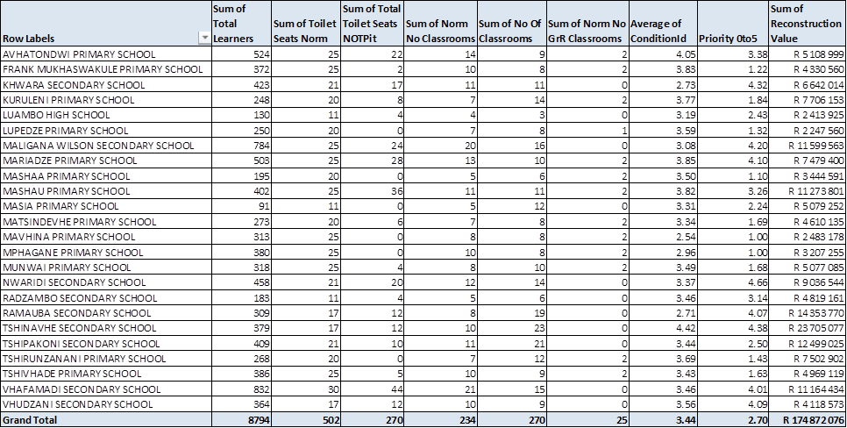
ESTIMATED COST FOR RECOVERY - INFRASTRUCTURE

Slide 9
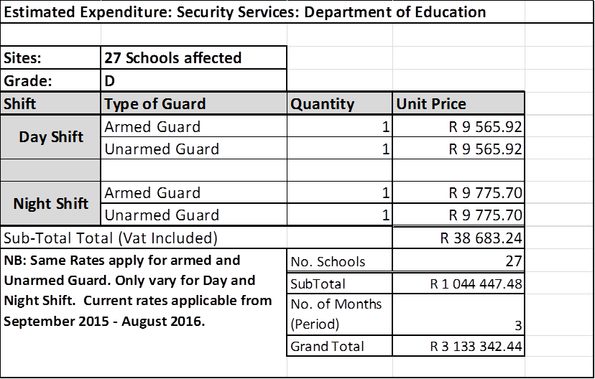
ESTIMATED COST FOR RECOVERY - INFRASTRUCTURE
New mobile classrooms
Number of classrooms required No.76 Purchased cost, mobile classrooms R 245, 000.00
Delivery cost per classroom R 31, 000.00
Total R27.2m (VAT INC)

Slide 10
LTSM and tools of trade:
Pupils 10, 000
Learner desks and chairs R1000.00 pair
Text books replacement R100.00
Subjects per learner. 7 (to be verified)
Printers 2 per school at R15, 000,00 each
Schools affected 27
Computers 2 per school at R10, 000each
Photocopy machines R17, 000 each
Total damages R18.809m

Slide 11
SCHOOL FURNITURE NEEDS

Slide 12
SUMMARY OF SCHOOLS THAT WERE VANDALISED/BURNED
CATEGORY | Number of Schools | Number of Learners
High Schools | 11 | 4 800 (2600 Grade 12)
Primary Schools | 16 | 5 200

Slide 13
CONSULTATIONS - POSSIBLE PARTNERSHIP
No | NAME | AREA OF COLLABORATION | PLEDGE / COMMITMENT
No | Vodacom | Use of e-learning to recover for the lost contact time. | 55 Tablets secured to be distributed to 11 High Schools. Tablets will be loaded with e-learning application. Covering all subject offerings Tablets will also be loaded with e-library application.
 |  |  | Training of Teachers on the use of the e-learning application.
 |  |  | Training of the learners on the use of e-learning application.

Slide 14
CONSULTATIONS - POSSIBLE PARTNERSHIP
No | NAME | AREA OF COLLABORATION | PLEDGE / COMMITMENT
No | Vodacom | Mobile Libraries | Committed to providing mobile libraries that are ICASA compliant – subject to approval by the Vodacom Foundation.

Slide 15
INFRASTRUCTURE RECOVERY PLAN CONT…
Procurement / Relocation of Mobile classrooms.
76 mobile classrooms are readily available from 4 service providers costing R22.4m (to be negotiated)
National Treasury through the Provincial Treasury concurred with the emergency procurement, in deviating from the normal procurement process, given amount.
Delivery started on 17 – 20 May 2016 as confirmed by Service Providers.
350 single desks and 220 double desks secured from the contracted service providers and delivery will start as soon as the mobiles are installed.

Slide 16
INFRASTRUCTURE RECOVERY PLAN
Additional 326 double and 1 260 single identified from non-contracted service providers (deviation to be applied in this regard to procure from them)
Control Works Inspectors together with COGTA Disaster Team will assess the actual extent of damage on 20 May 2016.
Cleaning of the schools, rubble removal and clearing of ground for mobile classes started 17 May 2016 and Parolees were utilised in this regard as well as EPWP workers.
Some Parents and SGBs of affected schools formed part of the cleaning Team.

Slide 17
Stakeholder engagement plan
TARGETED STAKEHOLDERS | VENUE | DATE AND TIME | COMMENTS
District Civil society structures | Vhembe Council Chamber | 05 May 2016 | Stakeholders agreed to ensure stability and Pastors’ Forum committed to the prayer session
Vuwani Traditional Leaders | Dzanani (King’s Palace) | 05 May 2016 | Agreed that both areas’ Traditional Leaders should be engaged
Tsonga / Shangaan Traditional Leaders | Hlanganani | 08 May 2016 | Promotion of social cohesion and equitable allocation of resources was raised

Slide 18
Stakeholder engagement plan CONT…
TARGETED STAKEHOLDERS | VENUE | DATE AND TIME | COMMENTS
All affected Traditional Leaders | The Ranch Hotel | 10 May 2016 | Some Traditional Leaders committed to convene / schedule all stakeholders within their areas

Slide 19
Stakeholder engagement plan CONT…
TARGETED STAKEHOLDERS | VENUE | DATE AND TIME | COMMENTS
Tshikonelo Traditional Area | Tshikonelo Traditional Council | 12 May 2016 10h00 | Indicated they will appeal the court judgement. Committed to the stabilisation as they were guarding their schools 24 hours. Appealed to government to address their service delivery challenges such as roads and housing allocation. MEC of COGHSTA made commitment to review housing allocation(30) for the area in consultation with the municipality and also to provide allocation to Vhurivhuri and Maorani villages which have never received housing allocation since 1995.

Slide 20
Stakeholder engagement plan CONT…
TARGETED STAKEHOLDERS | VENUE | DATE AND TIME | COMMENTS
Davhana Traditional Area | Sport-ground | 12 May 2016 15h00 | Stakeholders committed to the stabilisation of the situation in the area. The also indicated that they support the establishment of the new municipality and that government should address service delivery challenges especially the roads.
Education Sector Dialogue | Vhembe Council Chamber | 13 May 2016 11h00 | Education stakeholders committed to the resumption of teaching and learning

Slide 21
Stakeholder engagement plan cont…
TARGETED STAKEHOLDERS | VENUE | DATE AND TIME | COMMENTS
Mulenzhe Traditional Area | Mulenzhe Traditional Council | 13 May 2016 10h00 | The community structures indicated that: They will be appealing the decision and will interdict government not to continue with the establishment of the new municipality until the appeal is heard. Commitment to ensure that schools re-open in the area on 16/05/2016 Will ensure that stability is maintained as there are no service delivery protests in the area.

Slide 22
Stakeholder engagement plan cont…
TARGETED STAKEHOLDERS | VENUE | DATE AND TIME | COMMENTS
Teacher Unions Business Forum Pastors Forum NASGB | Vhembe District Municipality | 13 May 2016 10h00 | The stakeholder structures indicated: Commitment to ensure that schools re-open in the area on 16/05/2016 Will ensure that stability is maintained and the necessary support is provided.

Slide 23
Stakeholder engagement plan cont…
TARGETED STAKEHOLDERS | VENUE | DATE AND TIME | COMMENTS
Prayer Meeting for all affected Areas | Mashau Christian Warship Centre (CWC) | 14 May 2016 11h00 | The prayer meeting was held albeit poor attendance. Communities allege they were intimidated not to attend.
Principals and SGBs | Vhembe Council Chamber | 17 May 2016 12h00 | The meeting committed to the stabilisation of the situation. Schools were sensitised that mobile classrooms are being delivered and need to be protected by the community.

Slide 24
Stakeholder engagement plan cont…
TARGETED STAKEHOLDERS | VENUE | DATE AND TIME | COMMENTS
Technical Task Team meeting between COGTA/ COGHSTA and King’s and Senior Traditional Leaders’ representations | The Ranch | 17 May 2016 12h00 | The meeting committed to the stabilisation of the situation, provided inputs on the draft terms of reference, agreed to the mediation by an independent body and the name of the Task Team – Vuwani-Tshikonelo and Mulenzhe. Committed to the re-scheduling of outstanding community engagements.

Slide 25
Stakeholder engagement plan cont…
TARGETED STAKEHOLDERS | VENUE | DATE AND TIME | COMMENTS
Nesengani Traditional area | Rivers of living waters | 18 May 2016 10h00 | Commitment for various stakeholders to go back to school.
Netshimbupfe | Netshimbupfe Traditional offices | 19th May 2016 | They are adamant that learners will not go back to school until the MDB’s decision is reversed, however, the delegation could sense that the various stakeholders hold differing views on the matter, suggested a caucus to come-up with a position; Request was made by the stakeholders to first convene a community meeting on 22/05/16 and will be able to respond thereafter.

Slide 26
Stakeholder engagement plan cont…
TARGETED STAKEHOLDERS | VENUE | DATE AND TIME
Mashau Traditional Area | Mashau Traditional Council offices | 20th May 2016 10h00
Masia Traditional Area | Vuwani Fire Station | 20th May 2016 12h00
Masakona Traditional Area | Masakona Traditional Council | 20th May 2016 14h00

Slide 27
Stakeholder engagement plan cont…
TARGETED STAKEHOLDERS | VENUE | DATE AND TIME
Joined Inter Ministerial committee meeting | Vhembe District Municipality | 18th May 2016 At 16h00
Inter Ministerial committee meeting with Senior Traditional leaders | Vhembe District Municipality | 18th May 2016 At 14h00
Technical Task Team meeting between COGTA/ COGHSTA and King’s and Senior Traditional Leaders’ representations . MDB to attend. | Polokwane | 24th May 2016
Technical team reporting to the Inter Ministerial committee | Polokwane | 27th May 2016

Slide 28
INTERVENTIONS
All missed Preparatory Exam papers will be written;
All other forms of assessment for the remaining grades will be dealt with in the same way.
Exams will proceed even during school holidays (end 23 June – resulting in 3rd term) .
CMs, Principals and social partners met (12 May 2016) to map out recovery plan. This will ensure the creation of a sense of ownership of the programme.
Pace setters to be used to identify any backlog in curriculum coverage per school per subject with the view of implementing an accelerated programme to catch up. (Chunked content)
Use of e-learning solution particularly for Grade 12 (Vodacom)

Slide 29
INTERVENTIONS
Grade 12 learners to be engaged even as they write preparatory exams using a specially designed time table informed by backlog in curriculum coverage identified.
SBA - Use of SA-SAMS.
Analysis to be conducted after preparatory exams so as to inform further interventions before the Trial exams.

Slide 30
CATCH-UP PLAN
NO | ACTIVITY | NARRATIVE DESCRIPTION | TARGET | START DATE | END DATE | SUBMISSION DATE | RESPONSIBILTY
2.1. | Implementation of catch-up programme | Teaching and learning run concurrently with administration and marking of prescribed assessment tasks, as per pace-setters, by subject teachers supported by subject advisors. Term 2 content is covered to enable affected learners to start Term 3 work with the rest in the District. | Grade R- 12 | 23 May 2016 | 11 June 2016 |  | SMT, Circuit Managers, Curriculum
2.2 | Mid-year examinations | Mid-year examinations are suspended for these schools to allow time for the catch-up program, and a special time-table has been developed for the different phases. Subject advisors will develop question papers. There will be exceptions in Languages in Grade 10 and 1, and in EGD. | Grade 10-12 | 13 June 2016 | 8 July 2016 |  | SMT, Circuit Managers, Curriculum
 |  |  | Grade 4-9 | 13 June 2016 | 4 July 2016 |  | SMT, Circuit Managers, Curriculum
 |  |  | Grade 1-3 | 10 May 2016 | 15 June 2016 |  | SMT, Circuit Managers, Curriculum

Slide 31
CATCH-UP PLAN
NO | ACTIVITY | NARRATIVE DESCRIPTION | TARGET | START DATE | END DATE | SUBMISSION DATE | RESPONSIBILTY
2.3. | Grade 12 Camping Program | A 5-day enrichment camping session is organized for Grade 12 learners, where targeted content in designated subjects (see 3 below) will be offered by District Lead Teachers supported by Subject Advisors and NECT Curriculum Specialists. Learners will also be exposed to examination guidelines and coached on answering difficult questions. | Grade 12 | 12 July 2016 | 16 July 2016 |  | SMT, Circuit Managers, Curriculum
2.4. | Resulting of learners | School principals that marking (to be completed 3 days after writing), quality assurance of learner scripts and compilation of mark schedules and approval thereof by Circuit Managers is done before learners are resulted. | All learners should be resulted by the 15th of July 2016

Slide 32
CATCH-UP PLAN
NO | ACTIVITY | NARRATIVE DESCRIPTION | TARGET | START DATE | END DATE | SUBMISSION DATE | RESPONSIBILTY
2.5. | Submission of schedules | All approved schedules are submitted to the District Office | Grade 1-12 |  |  | 18 July 2016 | SMT, Circuit Managers, Curriculum
2.6. | Special CASS moderation | Subject Advisors conduct a special catch-up moderation program for Term 1 and 2 FET SBA. | Grade 10-12 | 19 July 2016 Sampling 26 July 2016 Moderation | 20 July 2016 27 July 2016 |  | SMT, Circuit Managers, Curriculum
2.7. | Special support for Vuwani top learners | A session for top performers from the affected schools, who missed Term 2 session, is organized, to support them in line with the District program. | Grade 12 top performing learners | 22 July 2016 | 22 July 2016 |  | SMT, Circuit Managers, Curriculum

Slide 33
REPORT ON MONITORING BACK TO SCHOOL

Slide 34
Progress Report – Operation of Schools
NO | Resolution | Progress
1 | Operations of the schools and assessment of infrastructure | 90% attendance registered at various schools except schools at Mashau and Vuwani areas (16/05/16). School principals and teachers claiming to receive threatening messages. Information sent to school principals and teachers to report cases to SAPS. Disaster team will make assessment on the extent of the damage at various schools on 20/05/2016. Monitoring done at Ha- Nesengani on 19/05/16, the following was observed: Kolokoshani High – 207 learners and 28 Educators; Edson Nesengani High – 71 learners and 26 Educators; Rasivhetshele Primary – 167 learners and 19 Educators; Tshivhazwaulue Primary – 170 learners and 25 Educators; Tshino Primary – 60 learners and 8 Educators Tshipakoni High - 79 learners and 14 Educators Mpheni Primary – 110 learners and 12 Educators No schooling at Tshimbupfe (16 schools)
2 | Provision of furniture | School furniture will be delivered to schools once the Service provider has finalised the assembling of mobile classrooms.
3 | Stationery and books | Department will make an assessment once the learners have returned to school and will then intervene.

Slide 35
MOBILE DISTRIBUTION

Slide 36
MOBILE DISTRIBUTION

Slide 37
MOBILE DISTRIBUTION

Slide 38
MOBILE DISTRIBUTION

Slide 39
Progress Report – Resolutions (16/05/16)
NO | Resolution | Progress
1 | Mobile distribution / allocation per school | Mobile allocation list finalised and distributed accordingly
2 | Securing Parolees and obtain information from Correctional Service | 120 Parolees secured , security arranged, catering as well, tools of trade such as wheel barrows, brooms, mops, buckets, spades, masks and gloves arranged by the Department. As at 19/05/16, 13 schools have been cleaned.
3 | Meeting with Principals, CM & SGB (17/05/2016) | The meeting was held on 17/05/16 as planned and the following issues were raised: SGBs and Principals want to return to schools, however, issues of security are still of serious concern as they continue to receive threatening calls and messages; Their recommendation is that an urgent meeting must be convened by the Traditional Leaders to convey a message that SGBs, Principals, Educators and Learners must go back to school

Slide 40
MEASURES TO ENSURE MINIMUM DISRUPTIONS OF SCHOOLING DURING PROTESTS
There is a need to strengthen communication amongst structures in the community.
To this end the creation of an education forum composed of eminent persons in the community is necessary at all levels.
The education forum should include Traditional Leaders, the SAPS, Pastors, Business, relevant department representatives, Social partners, Municipalities, Civic and Youth formations.
The forum should adopt programmes aimed at strengthening community cohesion at all levels
Strengthening functionality of the following structures and programmes:
school safety committees.
Adopt – a- cop programme (linking schools to police stations)

Slide 41
THANK YOU

