Slide 1
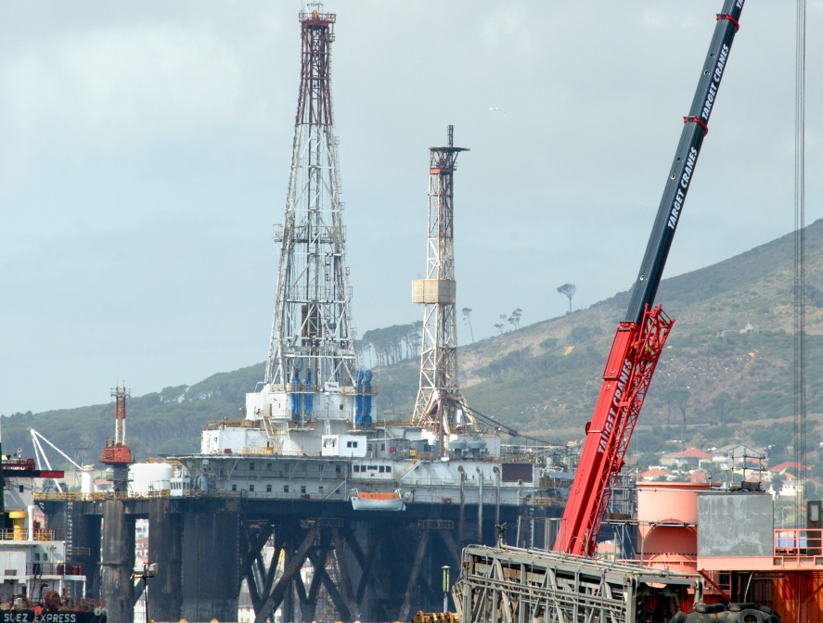
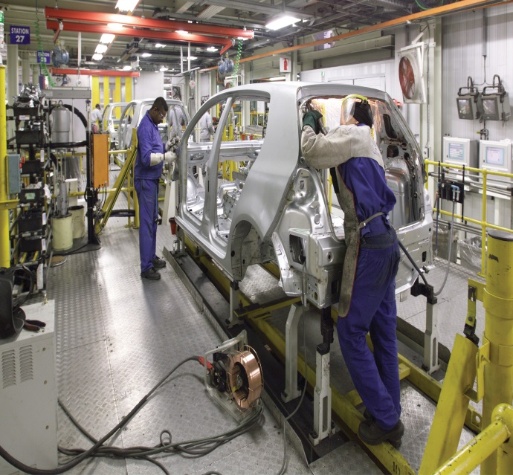
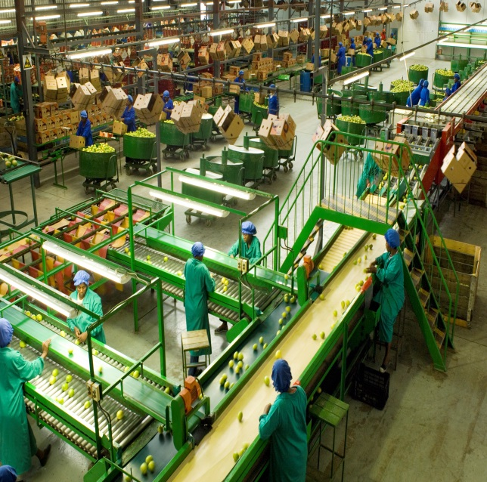
IPAP 2016/17 – 2017/18
Economic Sectors, Employment & Infrastructure Development Cluster
Presentation to the Portfolio Committee on
Trade and Industry, 24 May 2016

Slide 2

CONTENTS
Objectives
Selected sectoral highlights 2015/16
Selected transversal highlights 2015/16
Themes for 2016/17
Up-scaled IPAP: Key observations
Cross-cutting and sector specific programmes
Overcoming challenges
Global context – with supporting data
Domestic context – with supporting data

Slide 3
Policy context for the IPAP
The Industrial Policy Action Plan (IPAP) 2016/17 is informed by the vision set out for South Africa’s development provided by the National Development Plan (NDP). The IPAP is a key pillar of the Presidents Nine Point Plan.
IPAP 2016/17 – 18/19 is aligned with the Medium Term Strategic Framework (MTSF) and the Medium Term Expenditure Framework, (MTEF.
Its policy foundation is provided by the National Industrial Policy Framework (NIPF) adopted in 2007.
Government policy identifies industrial development as one of the key pillars required to catalyse inclusive growth with an emphasis , on value-addition, labour intensive sectors.

Slide 4
Policy context for the IPAP
IPAP programmes are underpinned by an understanding that the domestic economy has deep structural fault lines which require longer term solution. IPAP is also informed by a process which seeks identify key constraints to manufacturing growth in the domestic economy and a problem solving, collaborative approach to the solution of these constraints.
IPAP 2016/17 – 18/19 seeks to build upon the successes achieved and lessons learnt where industrial policy which is well designed; the subject of stakeholder engagement and collaboration and is adequately resourced has been successful – auto’s and CTLF
Successive annual iterations of IPAP have introduced new themes and focus areas to achieve a higher impact industrial policy. e.g. IPAP 2016 introduces an export focus leveraging a devalued currency.
Successive iterations of IPAP take into account the need to adjust and strengthen the range of policy instruments at governments disposal in a very dynamic global and domestic market

Slide 5
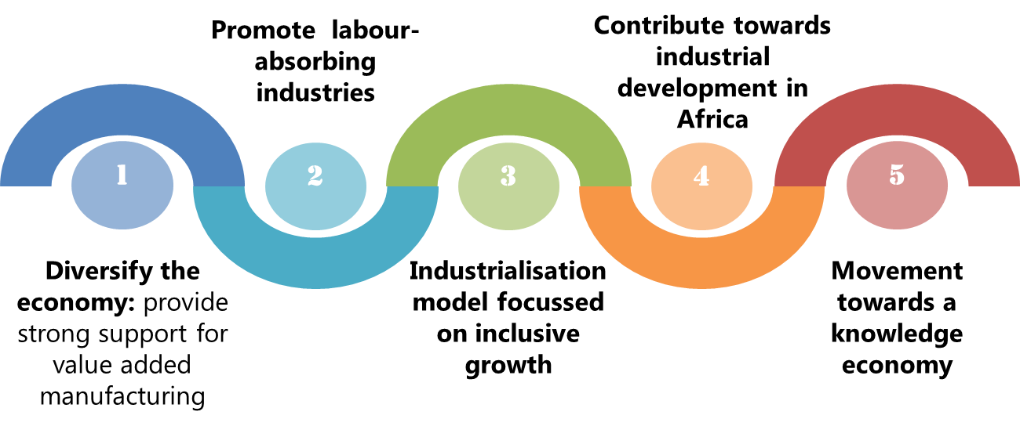
Core Objectives of the IPAP

Slide 6
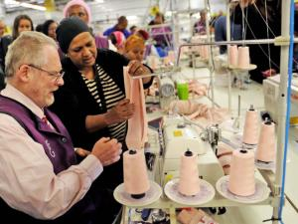
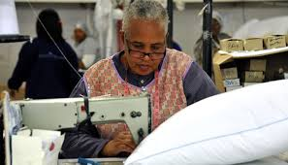
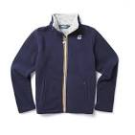

Selected Highlights: CTFL
The dti's support for the sector amounts to R3.5 billion, through the Clothing and Textiles Competitiveness Programme (CTCP) - saving over 67,000 jobs, and an estimated 7,000 new decent jobs
The Competitiveness Improvement Grant (CIP) supports a number of national and sub- national clusters which promote world class manufacturing processes and principles e.g:
  National: Leather & Footwear Cluster at Vaal University of Technology
  Sub-national: Eddles – Foschini Footwear Cluster; Sub-national KZN Footwear & Leather Goods Cluster (Mr Price Cluster); SAFLEC/ Regional Footwear Cluster. The Foschini Group has been investing in the local supply chain through its Quick Response Initiative since 2009 (e.g. the Maitland facility, employing 560 people)
A R150 million eco-friendly blanket manufacturing factory opened in Boksburg, with 1,000 direct jobs created
Cape Union Mart’s K-Way factory has benefited from ongoing incentives and has created more than 200 new jobs

Slide 7


Selected Highlights: CTFL
Transversal tenders managed and awarded by the NT increased from a total value of R237.9 million in FY 2014/5 to R264.4 million in FY 2015/16
The Leather and footwear sub-sector continues to register positive results - exports grew by 60% from 2011 to 2014
In addition to the 22 factories that were opened in the 2014/15 FY, 4 new factories opened since Oct 2015
  Ariana Footwear, Prizm Footwear, Safety Boys, Mystic Eyes,
  A well established local brand called Soviet has taken 51% stake by investing R 18 million in the Jaraf/Kayo Shoe
  The Centre for Social Entrepreneurship (CSE) was launched at Durban University of Technology, with a R15 million grant from the dti

Slide 8


Selected highlights: Business Process Services
The BPS sector continues to maintain its status as a leading global outsourcing destination, whilst steadily moving up the value chain in terms of service offerings
Highlights include the following:
  Investment Promotion Initiatives have resulted in new brands entering South Africa such as Foxtell, Coles, Vodafone, Easyjet, N Power, Quantas and Royal Mail Group
  FY 2015/16: of the 18,000 offshore jobs which were created through BPS incentive, 9,077 were created between 2011 and 2014
  13,000 unemployed youth underwent sector-specific training through the Monyetla Work-Readiness Programme
  A full service call centre established in Umhlanga, KZN will create more than 1,000 jobs over 18 months
  The EXL Cape Town delivery centre, officially commissioned by Minister Rob Davies, currently employs 60 people, but is expected to create 3,000 jobs over the next three years

Slide 9


Selected highlights: Film
Since the dti’s introduction of its first film incentive programme in 2004, the film industry has spent R15.2 billion in South Africa
FY 2015/16: 87 film and TV productions were supported by the dti, total investment of R887 million, supporting 81 000 jobs along the value chain
8 productions were showcased at the 2015 Cannes Film Festival's Marche du Film (film market) incl. South African/Angolan action cop drama, Dias Santana
In conjunction with the National Film and Video Foundation, the Gauteng Film Commission and Africa Magic, the dti supported local feature films Shushh and Ayanda
Other dti funded film projects were Cuckold (supported by the South African Emerging Black Filmmakers Incentive Scheme) and The Crash, film project from Julia Smuts Louw (Sparks Flew Development Studio)
“Of Kings & Prophets” - direct production spend in SA is R490m, of which R391m is expenditure that qualifies for a 20% rebate from government
“Of Kings & Prophets”

Slide 10
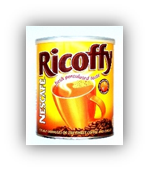
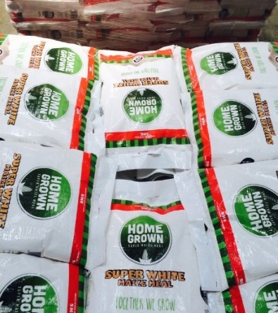
Selected Highlights: Agro-processing
Nestlé has committed to help revive SA’s chicory industry by increasing its local sourcing of the plant for use in its Nescafé Ricoffy (chicory-based) coffee brand, in a move that will create 870 new jobs by 2019
Ice Cream: A R600 million Unilever Ice Cream factory was opened in Midrand, supported by the dti to a value of R350 million
Grain staples: FABCOS was funded by the dti to establish and market the Home Grown brand
Small enterprise development: Through a partnership between DAFF and EDD, MoUs have been signed with Tiger Brands, Nestlé and Massmart for enterprise development from the grass-roots upward

Slide 11
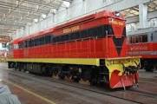
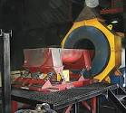
Selected Highlights: Metal Fabrication, Capital And Rail Transport Equipment
Cutting tools manufacturer Renlaw announced a yearly growth increase of 35%, owing to reinvestment of funds granted under MCEP
R100 million gold loan scheme launched
Grindrod Rail showcased their ‘Proudly SA’ AC diesel-electric shunting locomotive
Guestro Foundry awarded contract for the supply of castings components to Knorr-Bremse
Duvha Foundry awarded largest rail bogie castings contract by Transnet
Aberdare Cables launched its latest production line for cables for PRASA and Transnet’s combined R100 billion locomotive build programmes
Grindrod AC locomotive
Helio Microfinish Foundry

Slide 12



Selected Highlights: Green Industries
South Africa’s Renewable Energy Independent Power Producer Procurement Programme (REIPPPP) has proved to be the fastest growing renewable energy programme in the world and is currently the leading infrastructure development programme in South Africa.
Since the 2012/13 FY the dti has facilitated investments to the value of R1,7 billion in the manufacturing of equipment and components for the renewable energy industry
The Minister of the dti, Dr Rob Davies, officially launched the R5-billion Bokpoort concentrated solar plant in the Northern Cape. This project is the largest investment by a Saudi company, ACWA Power.
Investments in renewable energy generation include the following:
  The US Overseas Private Investment Corporation (OPIC), approved funding for a $400-million solar farm in South Africa
  Eternity Power Thermal Harvesting Project received a R30 million ($2.134m) grant from the dti
  Gestamp Renewable Industries (GRI) opened a R300 million wind tower factory in Atlantis, with 200 jobs initially created
  Kouga wind farm became operational at Oyster Bay in the E. Cape

Slide 13
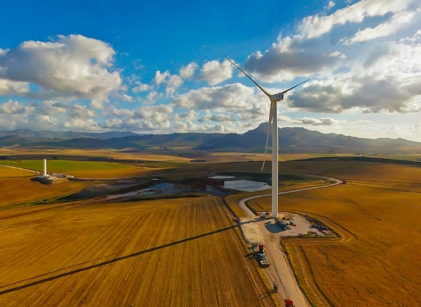

Selected Highlights: Green Industries
  SMA Solar Technology SA launched a multimillion-rand manufacturing facility in Cape Town
  Amplats, together with Vuselela Energy and H1 Holdings, unveiled a R150 million co-generation power plant at its Waterval Smelting Complex in Rustenburg
  Technology group Abengoa announced a $660-million investment in the 100 MW Xina Solar One project
Supply side measures include:
  The National Cleaner Production Centre (NCPC) - working with UNIDO - assisted 153 industrial plants; R1.54 billion saved in energy costs; 5,700 jobs created/preserved
  NCPC has trained over 2,400 professionals since 2010
  A Thermal Test Chamber (TTC) for refrigerated vehicles was established at the SABS in order to improve energy efficiency and reduce greenhouse gas emissions
Wind farm, Western Cape

Slide 14
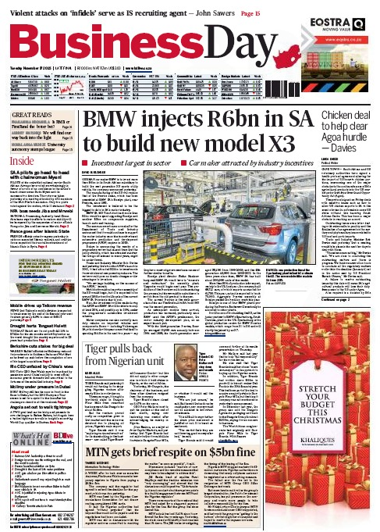
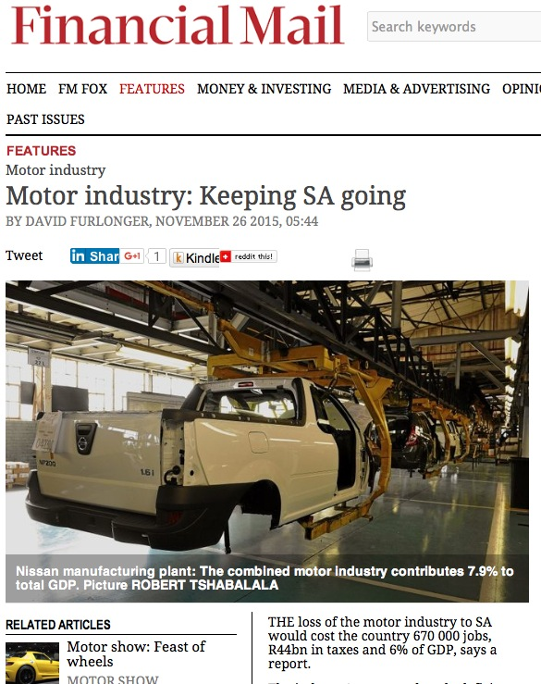
Selected Highlights: Automotives

Slide 15
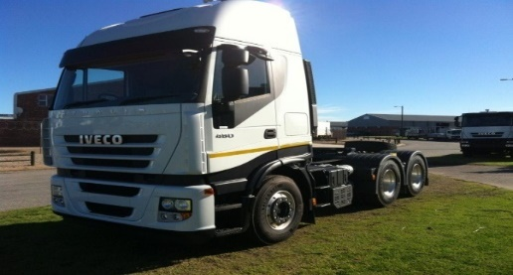

Selected Highlights: Automotives
The revised Automotive Production and Development Programme (APDP) is the critical lever that has supported investment by global OEMs to SA
The APDP has leveraged private sector investment of more than R25.7 bn over the last 5 years
  Daimler announced its decision to make South Africa the regional base for its new global truck and bus strategy. This is expected to bring significant business to Mercedes Benz SA and ultimately result in new investments in its East London plant.
  Beijing Automobile International Corporation - R11 billion 2 500 direct and 7,500 indirect jobs to be created
  BMW - R6 billion for the production of BMW X3

Slide 16
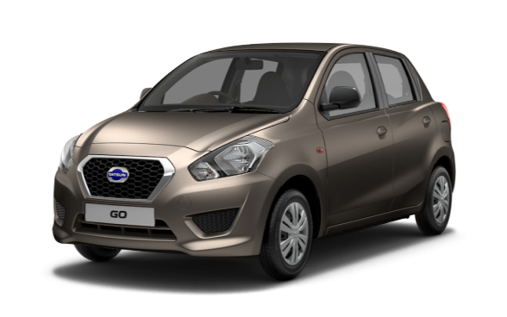
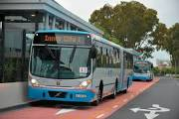
Selected Highlights: Automotives
  Nissan SA Rosslyn – only African manufacturing base for relaunched Datsun Go, creating 225 new jobs
  VOLVO invested R60 million on a regional parts and distribution centre in Benoni, Ekurhuleni
  Goodyear South Africa - R670-million to increase production of high-value-added (HVA) consumer tyres
  VWSA invested R4.5 billion for new models and infrastructure
  Sumitomo Rubber Industries announced a second and final phase of a R2bn investment. Sumitomo Rubber SA received R300m through the dti’s automotive incentive scheme.
    This investment will ensure that the Ladysmith factory retains its current 900 jobs and creates an additional 300 jobs.

Slide 17
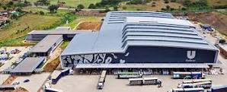
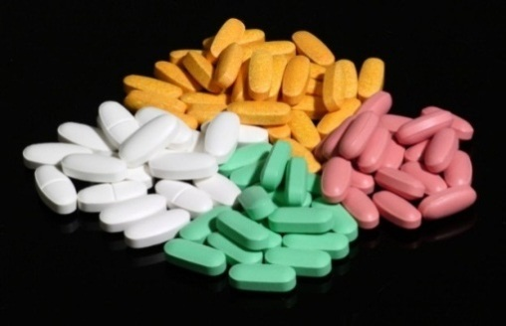
Selected highlights: Chemicals, Cosmetics, Plastics, Pharmaceuticals
  A multi-million Rand Unilever Khanyisa household care factory was launched in Boksburg.
      the dti supported the investment in the Khanyisa plant under the 12i Tax Allowance Incentive scheme, with a qualifying investment value of R1.2 billion, an investment allowance of R350 million and a training allowance of R7 million
  SA companies won 61.1% of the R2.7 billion Oral Solids Dosage (OSD) tender
  A R940 million Anti-TB tender was awarded to local companies
  Cipla will invest R800 million into a new facility for the cost-effective manufacture of biosimilars for supply into both public and private sector markets
  European API manufacturer Sterling has confirmed an investment €25 million (Euros) in the manufacture of low-volume, high-margin, niche APIs for the local and international markets.
Unilever factory, Boksburg
Oral solid dosage

Slide 18
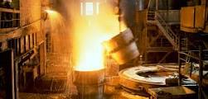
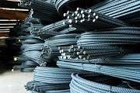
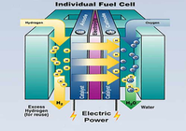
Selected Highlights: Beneficiation
Steel industry
Government is working closely with all stakeholders to save the steel industry and steel value chain
Fuel cell technology
Working in conjunction with key stakeholders in government and industry, the dti has made significant progress in accelerating the development of the fuel cell industry
the dti provided support for a 100kW static fuel cell demonstration.
Further plans for developing a 1.8MW hydrogen fuel cell project are at an advanced stage, through a collaborative project between the dti, IDC and Impala at the Chamber of Mines, launched March 2015

Slide 19
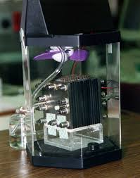
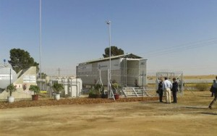
Selected Highlights: Beneficiation
Isondo Precious Minerals (IPM) acquired the rights to manufacture, use, market and sell licensed fuel cell components worldwide, using a portfolio of membrane-electrode assembly and membrane design, formulation and manufacturing technology. the dti has provided R15 million towards the feasibility phase of the project
A demonstration fuel cell forklift with on-board metal hydride storage was developed by the DST’s HySA initiative for Impala Platinum Refineries. The forklift has been operating since October 2015
The Anglo-American Fuel Cell Project is powering the Naledi Trust Community in Kroonstad (comprising an initial 34 households) through a 60kVA peak power fuel cell system
Plans are well under way for the development of an industrial park for fuel cell and battery production, linked to the current OR Tambo Industrial Development Zone
Membrane electrode assembly
Naledi Trust Community Fuel Cell

Slide 20
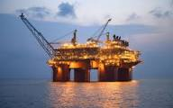

Selected Highlights: Upstream Oil and Gas and Boatbuilding
TNPA identified projects valued at R16.8-billion to facilitate the growth of the local ship-repair, ship-building and oil and gas sectors
the dti supported the opening of a R660 million Burgan Terminals fuel storage project in Cape Town: 350 jobs to be created
UK company Hunting PLC established a new R300 million manufacturing facility in the WC to supply the African Oil and Gas market
R650 million invested in Coega and Saldanha Bay for refining of used oil: 100-150 initial jobs to be created
Chevron South Africa invested R450 million in the construction of a multipoint ground flare in Milnerton, Western Cape
Offshore rig, West Coast
Multipoint ground flare

Slide 21
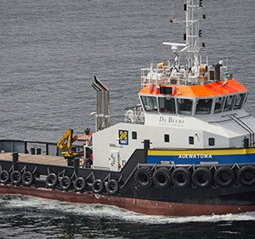
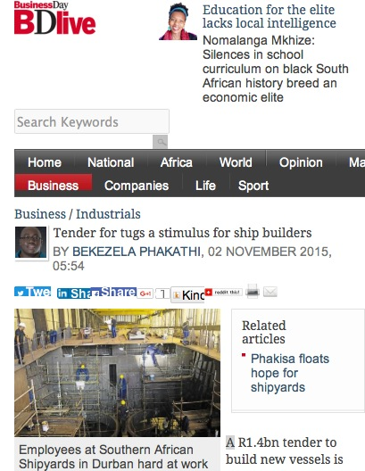
Selected Highlights: Upstream Oil and Gas and Boatbuilding
Southey Holdings and Nautic Africa have invested R289.9 million and R63.4 million respectively, supported under the 12i tax incentive and expected to create 355 direct jobs
Smit Amandla Marine partnered with Damen Shipyards Cape Town to build two new vessels in an overall investment package worth R150 million
Smit Amandla support vessel

Slide 22
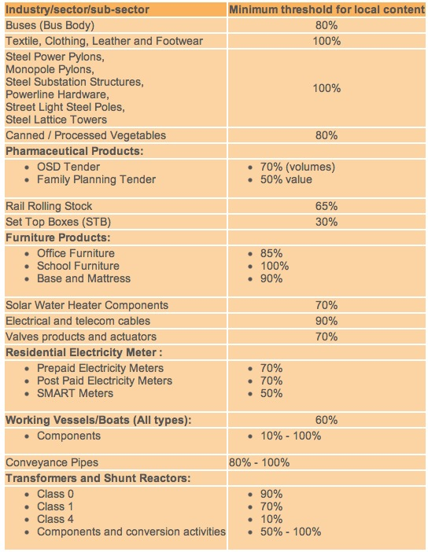
Selected Highlights: Localisation
Local procurement has been identified as a key lever for re-industrialisation.
Essential to secure greater compliance with procurement prescripts across government and SOE’s – audit function
Programmes are in place to build capacity and improve strategic sourcing and supplier development across government departments; spheres of government and State owned companies (SOC).
Private sector support for local procurement has been slow to materialise – but progress is being registered e.g. mining

Slide 23
Selected Highlights: Localisation
  Metals industry:
    Progress with the R50 billion Transnet contract for the building of 1064 locomotives includes:
    Locomotives being built at Transnet Engineering’s plants in Koedoespoort, Pretoria and Durban
    IEC Holden assembled the first SA-made AC Traction motors, demonstrating rapidly improving local capabilities
    In the General Electric supply to Transnet
      1300 candidates trained in lean manufacturing and engineering
      Local content over 55% for fleet procuremnt
      Over 100 parts and components qualified for 27 local suppliers who have been certified
      Green field traction motor established
    PRASA signed a R51 billion deal with Gibela Consortium:
    Construction of a R1 billion factory complex at Dunnottar commenced
    The project - which will see 580 of the 600 trains manufactured in SA - is expected to create about 1,500 direct jobs
    19,000 artisans to be trained and job opportunities created with the launch of the company’s latest production line

Slide 24
Selected Highlights: Localisation
  Green industries
    The local content spend as at 30 June 2015 was R21.7 billion; and the planned local content spend for the first 92 projects amounts to a total of R65 billion
  Automotives - Buses
    Since the implementation of local content regulations more than 700 bus bodies have been manufactured and buses assembled in South Africa. Beneficiaries to date include:
    Busmark 2000: received an order to assemble 700 buses for the City of Cape Town
    Mercedes-Benz SA: successful tender to provide 134 buses for phase 1B of Johannesburg’s Rea Vaya BRT system
    Volvo SA: successful tender to provide 40 new vehicles to the City of Cape Town for its extended MyCiti bus routes, at a cost of R180m
    MAN: supplying 80 new commuter buses to Great North Transport, Limpopo’s largest public transit operator

Slide 25
Selected Highlights: Localisation
  Pharmaceuticals
    SA companies won 61.1% of the R2.7 billion Oral Solids Dosage (OSD) tender
    A R940 million Anti-TB tender was awarded to local companies
  Boatbuilding
  The company SAS is currently building 7 tugboats as part of a R1.4 billion tender awarded by TNPA in 2014
    The contract has to date created approximately 200 additional jobs More than 60 apprentice artisans are in training as well as three marine engineers
    More than R700 million has been earmarked for the Supplier Development Plan entered into by SAS and Transnet local suppliers, employees and graduates
    Vee Craft was awarded a tender worth R23 million to build workboat ferries for the Navy

Slide 26
Selected Highlights: Industrial Financing
Industrial Development Corporation (IDC)
FY 2015/16: The IDC disbursed R6 billion, supporting 4,753 new jobs and securing 4,126 jobs
Development Bank of Southern Africa (DBSA)
The DBSA contributed more than R21 billion to government's infrastructure rollout and municipal support, while DBSA’s total loan book increased to R56.7-billion
National Empowerment Fund (NEF)
The NEF approved 700 transactions worth more than R6.9 billion for black-empowered businesses across the country, supporting over 84,000 jobs
Manufacturing Competitiveness Enhancement Programme (MCEP)
In the period April to December 2015, the MCEP approved funding for 232 entities. R1.7 billion has been committed to support manufacturers, with a total investment value of R8.8 billion, sustaining 52,466 jobs

Slide 27
Selected highlights: Industrial Financing
Automotive Investment Scheme (AIS)
For the period April to December 2015, the AIS approved 39 projects with total incentives of R978 million and an estimated investment value of R3.7 billion
Enterprise Development Programme
The dti launched a R22 million two-year pilot programme to uplift SA’s Industrial Parks
In an initial step, the dti will spend more than R44 million on the revitalisation and refurbishment of two state-owned industrial parks in the Eastern Cape
12i Tax Allowance Incentive Scheme
FY 2015/16: 26 projects with an investment value of R9.5 billion were approved
Aquaculture Development and Enhancement Programme (ADEP)
FY 2015/16: ADEP supported 11 projects, with an incentive value of R 49 million. Investment leveraged was R206 million and 291 new jobs are expected to be created

Slide 28



Selected Highlights: Foreign Investment
FY 2015/16: An investment pipeline of R 31.9 billion achieved
A number of Multinationals have affirmed SA as a regional manufacturing hub, investing in new plant, machinery and technology and upgrading existing plant capacity:
  Unilever - R 4 billion
  Nestlé - R99.8 million
  Samsung - R228 million
  Johnson & Johnson - R300 million

Slide 29

Selected Highlights: Industrial Development Zones (IDZs)
To date IDZs have created 73,000 jobs - 6,896 (9.6%) direct and 65,637 (90.4%) indirect
Coega IDZ has attracted R151 billion since its inception
Ngqura Port unveiled two new berths and associated port operating equipment costing R2 billion
Two SEZs - Dube Trade Port and Maluti-a-Phofung - have been designated since the establishment of the programme
Coega aerial view

Slide 30
Selected Highlights: Ports
The Ports Regulator decided on an average tariff increase of 0%, for the tariff year 2016/17. This will be applicable as follows:
    All cargo dues for 2016/17 shall increase by 0%, except marine services and related tariffs which are to increase by 3.0%.
    Full container exports will, in support of the under-threat to the South African manufacturing sector, decrease by 10%.
    Automotive volume discounts shall be equalised for all users at the maximum 60% level discount
    Maize will receive a 50% discount on cargo dues, capped at 5 million tonnes, for the 2016/17 tariff year as part of the holistic approach to limit the impact of the drought on the people of South Africa

Slide 31

IPAP 2016/17 - Key Themes
Build on the policy platforms, learnings and achievements of existing programmes – e.g. Autos, CTLF, BPS, Renewable Energy:
  Continue to utilise and strengthen the ‘toolbox’ of industrial policy instruments across and within sectors where SA has built competitive advantages and capabilities and where new capabilities can be built working closely with global OEM’s and domestic champions.
  Increase focus on labour-intensive sectors like agro-processing and component suppliers in key value chains
  Boost new growth sectors like Oil and Gas, Locomotives, Capital Equipment, Heavy Commercial Vehicles and Shipbuilding
Strengthen public procurement to support the local manufacturing sector and the growth of world-class industries
  Stronger emphasis on compliance and enforcement
  Closer alignment of all policy levers – Designation; CSDP, NIP to achieve higher levels of localisation and supplier development and raise competitiveness
Continue efforts to secure a higher-impact set of industrial financing and incentive instruments to build and support key industrial sectors and capabilities
  Design sector specific incentives for agro-processing and metals sectors
  Stronger export credit support and sector-specific incentives, including the roll-out of the Black Industrialists Incentive Scheme

Slide 32
Key Themes for IPAP 2016/17
Leverage the competitive advantage that a devalued currency provides for the productive sectors of the economy - particularly manufacturing:
  Stronger engagement and support for existing exporters and a programme to support companies to be ‘export ready’ with a focus on African opportunities.
  The promotion of Special Economic Zones and Cluster Programmes to support investment and exports.
  Close collaborative work with the Department of Science and Technology to secure support for technology acquisition and innovation. E.g. Technology Localisation Unit at the CSIR
Minimise regulatory and red tape barriers – real or perceived – which hinder investment and expansion and tighten up intra-governmental coordination required to underpin the new One-Stop Investment Centres

Slide 33
Key Themes for IPAP 2016/17
Provide ongoing support for less energy-intensive and carbon-mitigating production methods e.g the work of the National Cleaner Production Centre and
Secure stronger localisation criteria and investment in component manufacture for SA renewable energy generation programme.
Strengthen the important economic linkages between the primary agriculture, mining and manufacturing sectors in order to secure much greater downstream beneficiation and maximise upstream linkages
  Arising from the Mining Phakisa, ensure that “Mining Cluster” programmes are carried forward expeditiously
Scale up work to develop and roll out a gas-based industrialisation programme. This includes:
  Developing a robust and diversified market for gas; and
  Rollout critical gas dependant projects such as the Fuel-cell Technology Programme

Slide 34
Overcoming Challenges
A solutions-based approach to key challenges has been adopted by the Economic Sectors, Employment and Infrastructure Cluster. This must be directly applied to:
  Overcoming electricity supply constraints and elevated prices - including creating an enabling environment for own- and co-generation, with a particular focus on renewable energy and fuel cell technology opportunities
  A continuing effort to secure port and rail network reforms to overcome inefficiencies and associated high costs - with a particular emphasis on supporting export competitiveness
  Concerted efforts to address deep-seated and serious skills deficits and mismatches that impact on the capacity of the economy to grow faster and diversify more effectively
  Careful and attentive management of the operational environment in the steel sector across the entire value chain to secure stability and growth

Slide 35
Securing a higher impact IPAP : Key Observations
IPAP is one of the Presidents 9 Point Plans. A focussed national industrial effort characterised by policy coherence and certainty and a close collaborative effort between government, the private sector and labour is required.
IPAP is a product of the Economic and Employment Sectors Cluster of government and assigns a leading and supporting role to key government departments and institutions. IPAP is a very important tool to secure stronger industrial planning, intra-government co-ordination and oversight.
It is critical that compliance across and between national government departments, provincial and municipal spheres of government and SOCs is secured in a collaborative national industrial effort eg; localisation in the public procurement system.
There are few short-cuts and ‘overnight’ impacts: continuous improvement, learning-by-doing, strengthening the capacity of the state and deepening stakeholder engagement are the critical factors

Slide 36
IPAP 2015/2016 TRANSVERSAL FOCUS AREAS
Monitor and ensure compliance with sector designation and localization requirements in state procurement
Monitor expenditure and implements of local content requirements
Increasing aggregate demand through “Buy Local” campaign
Further designation of products for local procurement
Strategic, coordinated, integrated industrial financing system, combining the joint efforts of state and development finance institutions
Integration of DST innovation and commercialization support measures with roll out of Black Industrialist program
Priority processing for dynamic firms – with greater selective/strengthened conditionalities
Public procurement
Industrial Financing
Flexible/strategic tariff setting
Further development of enabling standards and compulsory specifications
Closer and more detailed collaboration with Custom to prevent illegal imports
Continued realignment of technical infrastructure activities in support of key IPAP sectors
IPAP TRANSVERSAL FOCUS AREAS
Expansion of existing Industrial Development Zones: creation of new Special Economic Zones
Develop SEZs as dynamic platforms for foreign direct investment (FDI) and for the deepening of strategic industrial and export capacity, both in the SEZs themselves and in associated regional industrial clusters
Developmental trade policy
SEZs and Regional Economic Clusters
Innovation and technology
Regional Integration
Coordinated development of African regional infrastructure, support for complementary industrialisation, integrated of value chains and expanded trade
Ongoing review of incentives and instruments for Science, Technology and Innovation (STI) to finalise an STI system, aligned to incentives and industrial financing
Formalise and R&D-led industrial development approach through implementation of the Emerging Industries Action Plan (EIAP)
Develop a portfolio of R&D projects aimed at scaling up industrial growth

Slide 37
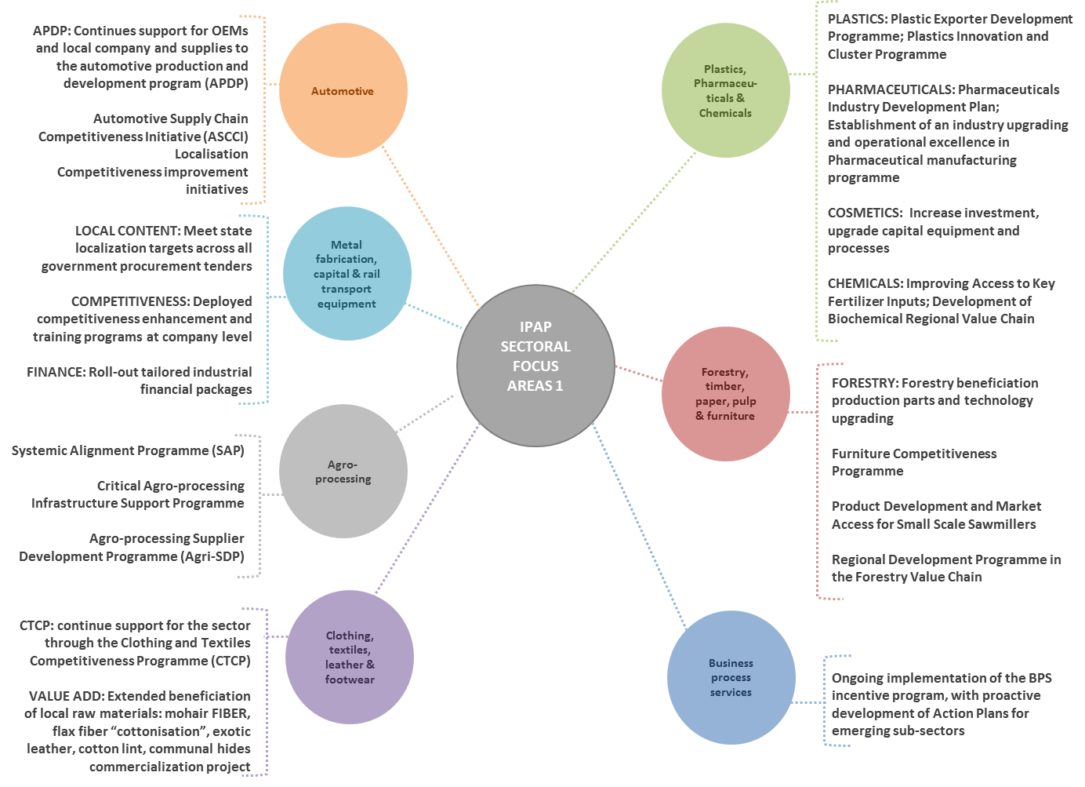
IPAP 2016/2017 SECTORAL FOCUS AREAS 1

Slide 38
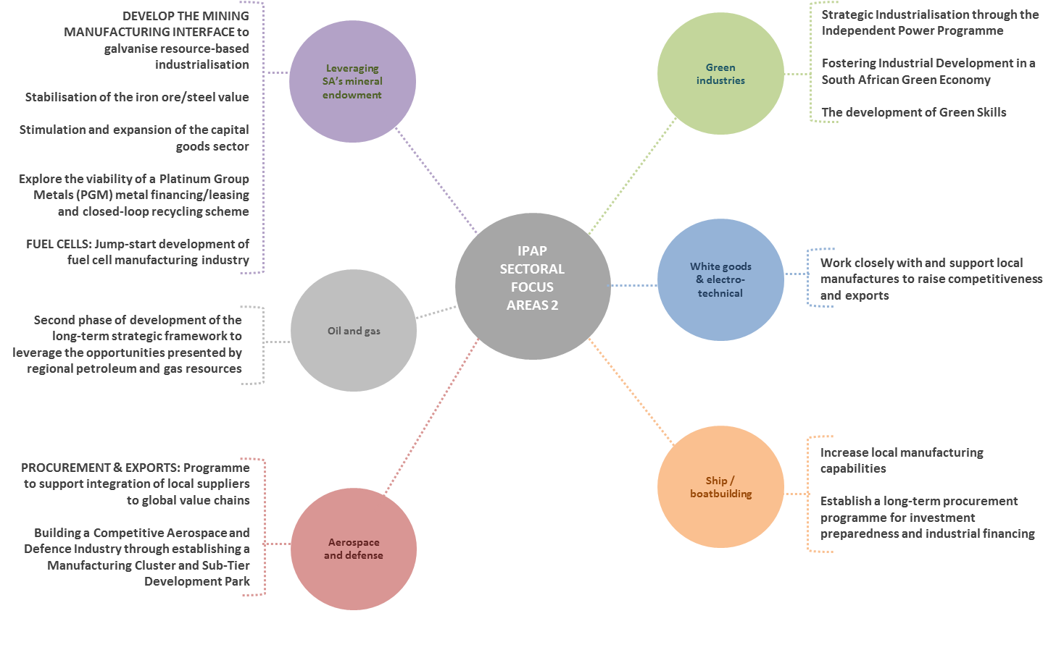
IPAP 2016/2017 SECTORAL FOCUS AREAS 2

Slide 39
Global Context 1
The lingering effects of the great global recession continue to be felt worldwide; reflected in stagnant demand from developed and developing countries alike
Seven years after the global financial crisis and the great global recession that followed, successive aftershocks have impacted the domestic economy including weak aggregate demand, falling commodity prices and increasing financial market volatility in major economies
The contraction and ‘rebalancing’ of the Chinese economy towards a greater focus on domestic demand has had significant and negative consequences for commodity exporting countries
Forecasts indicate that many African countries’ growth will likely fall below expectations, mainly as a result of the slump in primary commodity prices
Against the backdrop of falling commodity prices, increased capital outflows from developing countries and diverging monetary policies, exchange rate volatilities have become more pronounced and many emerging-market currencies have devalued amid significant capital outflows

Slide 40
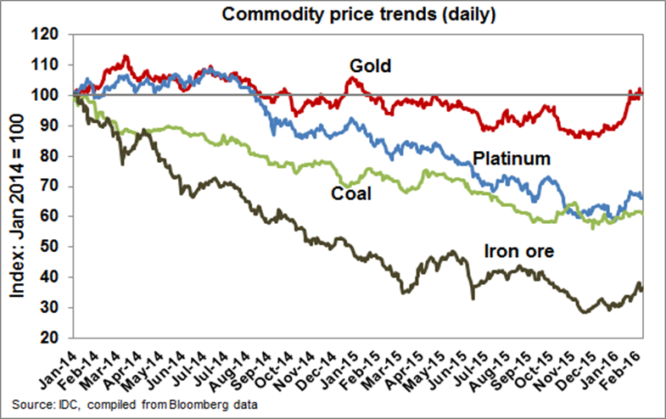
Commodity prices
Source: IMF

Slide 41
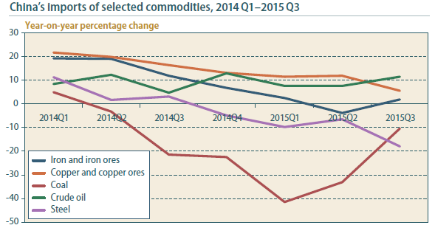
China’s imports of selected commodities
Source: UN

Slide 42
Comparison of export basket to China in
2011 vs 2015

Slide 43
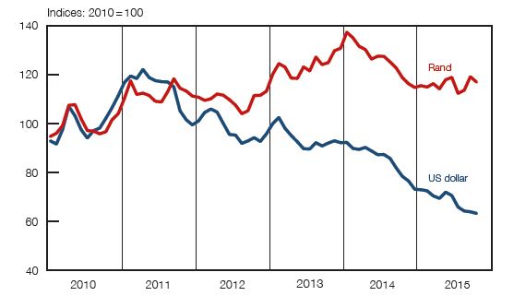
South African produced export commodity prices (excl. gold)
Source: SARB

Slide 44
Domestic context
The domestic economy has continued to be impacted by the lingering effects and successive ‘after-shocks’ of the great global recession
Mining and steel industries have been severely impacted
The sharp downturn in mining - a direct effect of the generalised slump in commodity demand and prices - carries with it significant knock-on effects for the domestic economy in general
A steel crisis occasioned by massive over-capacity in the global steel industry has hit South African producers very hard, threatening the competitiveness and sustainability of many domestic producers
The prolonged and severe drought in many parts of the sub-region is having a severe impact on agricultural production of staple goods and will result in a significant increase in agricultural imports as well as driving a switch to cheaper alternatives.

Slide 45
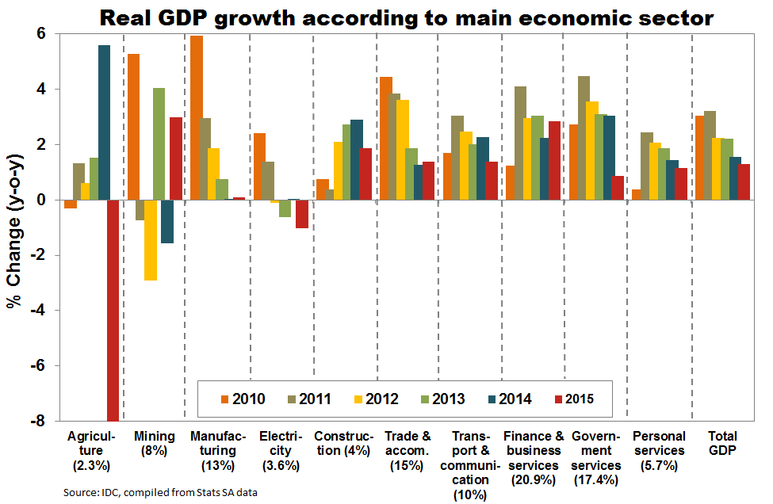
Sector contribution to GDP

Slide 46
Real GDP by industry, percentage change
Source: SARB

Slide 47
Mining GDP, Employment, Export, Investments
Source: SARB

Slide 48
Agriculture GDP, Employment, Export, Investments
Source: SARB

Slide 49
Manufacturing GDP, Employment, Export, Investments
Source: SARB

Slide 50
Appendix A: List of leather and footwear factories opened since 2014/15

Slide 51
Appendix A: List of leather and footwear factories opened since 2014/15

Slide 52
Thank You

