Slide 1
fourth QUARTER PERFORMANCE REPORT
Acting Director-General : Arts and Culture
Date: 17 may 2015

Slide 2
PRESENTATION OUTLINE
Key Highlights
Performance Overview
Programme-Specific Performance for 2015-2016
Performance against Key Programme Indicators
Expenditure Report Ending 31 March 2016

Slide 3
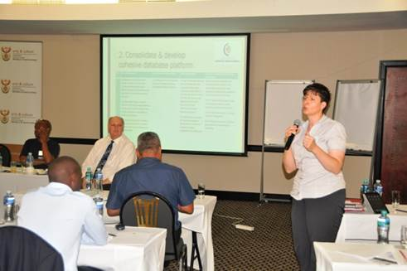
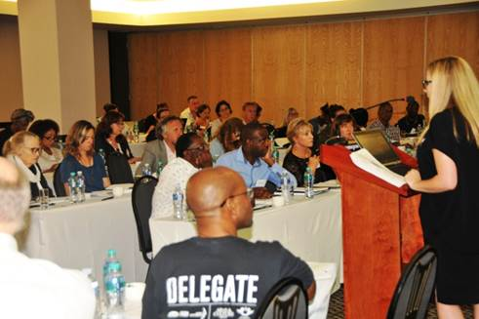
KEY HIGHLIGHTS
Cultural Observatory Set High Bench Marking Standards
Arts and Culture invited industry stakeholders to a document discussion session on a proposed Research Agenda for the Cultural and Creative Industries of South Africa on Friday, 19 February 2016 in Sandton, Johannesburg.
The South African Cultural Observatory is a national research centre hosted by Arts and Culture, Nelson Mandela Metropolitan University, Rhodes University and the University of Fort Hare. The most important function of the Cultural Observatory will be to determine appropriate methods for data collection based on policy relevant research questions in the South African context.

Slide 4
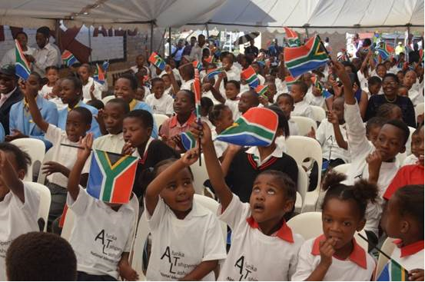
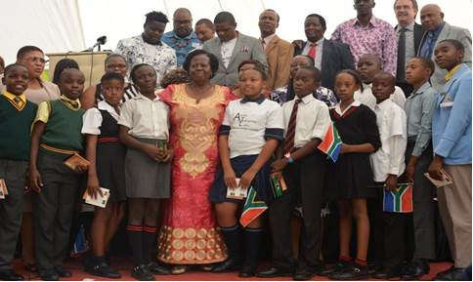
KEY HIGHLIGHTS
The Launch of National Identity Campaign
Deputy Minister Rejoice Mabudafhasi, in partnership with SABC Education, launched the National Identity Campaign under the slogan, “Afurika Tshipembe lashu”, meaning Our South Africa. The launch took place at Mochochonono Primary School in Soweto on 04 February 2016 .
The educational initiative was rolled out in all nine provinces across the country. The SABC partnered with the Department of Arts and Culture to further entrench the SABC’s Vision of inspiring change through enriching, credible, relevant and compelling content that is accessible to all.

Slide 5
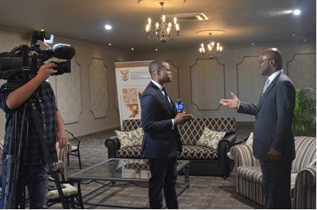
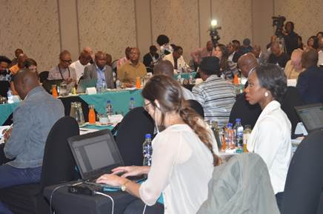
KEY HIGHLIGHTS
A dialogue on building the nation and eradicating racism
Minister Nathi Mthethwa met with Social Cohesion Advocates to discuss ways in which the country can strengthen nation-building and social cohesion, and eradicate racism. The event was well attended, with media showing a great interest. The discussions charted a way forward for the development of sectorial and national plans to build social cohesion, combat racism and eradicate discrimination in South Africa.

Slide 6
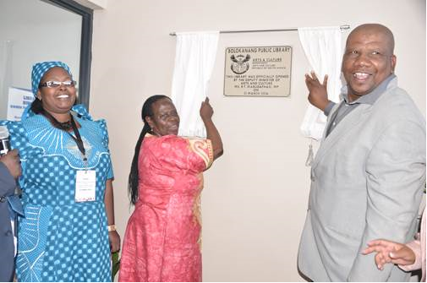
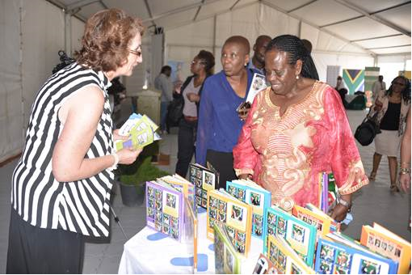
KEY HIGHLIGHTS
The Opening of Bolokanang Library
On Thursday, 31 March 2016, the Deputy Minister of Arts and Culture, Ms Rejoice Mabudafhasi, opened the newly built Bolokanang Community Library and launched the R120 million Mzansi Libraries Online in Petrusburg, Free State. Bolokanang Community Library was built at a cost of approximately R15 million and it was developed as a dual purpose library which will be rendering services to the general community as well as to schools.

Slide 7
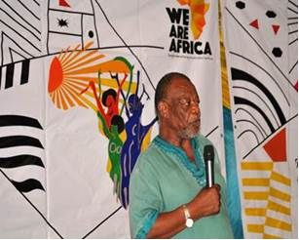
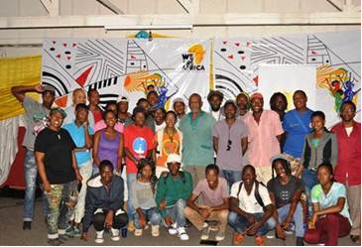
KEY HIGHLIGHTS
Arts and Culture continues to host Living Legends Program (LLP)
The department hosted yet another legendary author Dr Mongane Wally Serote on Saturday, 27February at Funda Centre, Soweto. Young artists from the centre were honoured by the presence of Dr Serote and engaged him in discussions. The dedicated author and poet delved deep into the powerful tools that artists needed to make it as writers. The Master Class was part of the Living Legends Legacy Programme launched in August 2015 by the Department of Arts and Culture to honour the living legends across all arts disciplines for their contribution in the Arts, Culture and Heritage sector.

Slide 9
Comparative analysis of the fourth quarters

Slide 10
Programme-specific performance for 2015-2016

Slide 11
PERFORMANCE AGAINST KEY PROGRAMME INDICATORS

Slide 12
PROGRAMME 1: ADMINISTRATION
PERFORMANCE INDICATOR | 4th QUARTER TARGET | PROGRESS | VARIANCE/COMMENTS or PROGRESS DESCRIPTION
Number of Izimbizo held | 6 | 7 Izimbizo held | One more Imbizo was conducted due to demands from the community to engage with political principals: Gauteng 3, KwaZulu Natal 2, Eastern Cape 1, Free State 1.
Percentage of women employed at SMS level. | 50%. | 46.94% women employed at SMS level. | Percentage changed due to terminations and new appointments at SMS level. The filling of current vacant SMS posts where females are recommended will address the gap in the new financial period (2016/17)
% of people with disabilities (PwD) | 2% | 2.57% Persons with disability are employed.
Percentage of goods and services procurement spend on local content. | % baseline established (goods and services procurement spend on local content) | 100 % of goods and services procured locally

Slide 13
PROGRAMME 1: ADMINISTRATION
PERFORMANCE INDICATOR | 4TH QUARTER TARGET | PROGRESS | VARIANCE/COMMENTS or PROGRESS DESCRIPTION
Percentage of 31 MPAT result areas that score at target level, as reflected in annual MPAT received from DPME for previous assessment period. | DAC MPAT improvement plan implemented | The DAC MPAT improvement plan was developed but not implemented.
Percentage of total value of procurement awarded to BBBEE– compliant service providers. | >70% | 50.01% total value of procurement awarded to BBBEE– compliant service providers |  | Procurement of goods and services from government entities like SITA and Government Printers where BEE ratings were not considered due to unavailable certificates.
Number of MinMEC forums conducted. | 1 | MinMec was held on 31 March 2016

Slide 14
PROGRAMME 2: INSTITUTIONAL GOVERNANCE
PERFORMANCE INDICATOR | 4TH QUARTER TARGET | PROGRESS | VARIANCE/COMMENTS or PROGRESS DESCRIPTION
No. of shareholder compacts signed with ACH public entities. | 26 | Shareholder compacts for 2015/16 financial year were signed with public entities on 2 April 2015
No. of public platforms for social cohesion advocates hosted | 3 | 7 public platforms were created for social cohesion advocates as follows: Free Sate 1; Eastern Cape 1; North- West 2; Northern Cape 1; Gauteng 2
No. of quarterly reports on Outcome 14 submitted to DPME | 1 | The quarter progress report, developed, deliberated by delivery forum and DG Technical Implementation Forum and Cabinet memorandum developed
No. of fully constituted and functional boards of ACH public entities. | 24 + 2 (Windybrow Theatre) – pending integration with Market Theatre; and PANSALB – pending approach re-status as constitutional entity). | Councils of 24 public entities are fully constituted. The Board of PANSALB was dissolved/disbanded in January 2016

Slide 15
PROGRAMME 2: INSTITUTIONAL GOVERNANCE
PERFORMANCE INDICATOR | 4TH QUARTER TARGET | PROGRESS | VARIANCE/COMMENTS or PROGRESS DESCRIPTION
Number of community conversation on social cohesion and nation building conducted per year | 10 Consolidated community conversation report | Thirty three (33 ) Community Conversations were held in this quarter and a draft report has been received.

Slide 16
PROGRAMME 3: ARTS, CULTURE PROMOTION AND DEVELOPMENT
PERFORMANCE INDICATOR | 4TH QUARTER TARGET | PROGRESS | VARIANCE/COMMENTS or PROGRESS DESCRIPTION
Number of multi–year Human Language Technology projects implemented and or completed. | 8 multi–year HLT projects implemented. | 8 multi–year HLT projects implemented of which 4 were completed in 2015/16 (NCHLT Text; NCHLT Speech; NCHLT RMA, Lwazi-III)
Fully operational Art Bank procuring and renting art works. | Fully operational Art Bank procuring and renting art works Launch of Art Bank collection exhibition | The Art Bank is not operational as yet; however the project manager has been appointed and assumed with duties on the 1st April 2016
Number of functional incubators established to support the development of Arts &Culture entrepreneurs. | 1 | 8 incubators were successfully established and are functional to support the development of Arts & Culture entrepreneurs as follows: Western Cape – ArtsCape ; Free-State – PACOFS; Gauteng- Market Theatre, Windybrow & State Theatre; Mpumalanga-Casterbrigde; KwaZulu Natal – Playhouse & Fashion Hub

Slide 17
PROGRAMME 3: ARTS, CULTURE PROMOTION AND DEVELOPMENT
PERFORMANCE INDICATOR | 4TH QUARTER TARGET | PROGRESS
Number of language practitioners bursaries awarded per year | - | 51 students were bursaries to students in the period under review. The overall performance achieved was 463.

Slide 18
PROGRAMME 3: ARTS, CULTURE PROMOTION AND DEVELOPMENT
PERFORMANCE INDICATOR | 2015-2016TARGET | 4TH QUARTER TARGET | PROGRESS | VARIANCE/COMMENTS or PROGRESS DESCRIPTION
Number of arts practitioners placed in schools | 300 | - | 352 Arts practitioners were placed in schools in all the Provinces. Free State Arts and Culture Council (FACC) and the East London Guild Theatre partnered with other entities and hence the department was able to place more artist in schools.

Slide 19
PROGRAMME 3: ARTS, CULTURE PROMOTION AND DEVELOPMENT
PERFORMANCE INDICATOR | 2015-2016 TARGET | 4TH QUARTER TARGET | PROGRESS
Number of community arts programmes activated | 80 | 13 | 50 community arts centres programmes were been supported follows:
Province | Amount spent per province | Number of projects supported
Free State | R144 000.00 | 2
Gauteng | R 1485 000.00 | 20
Mpumalanga | R233 000.00 | 4
KwaZulu-Natal | R 1 512.000.00 | 20
Eastern Cape | R117 000.00 | 1
Western Cape | R272 000 .00 | 3

Slide 20
PROGRAMME 3: ARTS, CULTURE PROMOTION AND DEVELOPMENT
PERFORMANCE INDICATOR | 2015-2016TARGET | 4TH QUARTER TARGET | PROGRESS | VARIANCE/COMMENTS or PROGRESS DESCRIPTION
Number of flagship cultural events supported per year | 25 | 7 flagship cultural events supported | 7 flagship cultural events were supported as follows:
Province | Name of Flagship Event | Amount Spent
Western Cape | Cape Town International Jazz festival | R8,480,000. 00
Free - State | Mine Dance | R1,500,000.00
North- West | Mahika Mahikeng Cultural Festival | R2,000.000.00
KwaZulu- Natal | ILembe Art festival | R2,000.000.00
Gauteng | Discop Africa Project | R5,000.000.00
Western Cape | Cape Town Minstreal 2de Nuwe Jaar | R2,000.000.00
Western Cape | Cape Town Carnival | R3,000.000.00

Slide 21
PROGRAMME 3: ARTS, CULTURE PROMOTION AND DEVELOPMENT
PERFORMANCE INDICATOR | 2015/16 TARGET | 4TH QUARTER TARGET | PROGRESS
Number of part time job opportunities created across MGE works streams | 20990 | - | 8501 work opportunities across all MGE work streams and cultural programmes were created

Slide 22
PROGRAMME 4: HERITAGE PRESERVATION AND PROMOTION
PERFORMANCE INDICATOR | 4th QUARTER TARGET | PROGRESS | VARIANCE/COMMENTS or PROGRESS DESCRIPTION
Number of Government Gazette publications per annum as part of the Geographical Names plan. | 1 | One Government Gazette published ( 226 Geographical Names were standardised )
Annual publication on progress in the programme to document the knowledge of the 10 living human Treasures in provinces. | 1 Annual publication on progress in the programme to document the knowledge of the 10 living human Treasures in provinces | 10 South African Living Human Treasures were identified and documented. However, knowledge on the Treasures has not yet been published. The interviews are still being transcribed

Slide 23
PROGRAMME 4: HERITAGE PRESERVATION AND PROMOTION
PERFORMANCE INDICATOR | 4th QUARTER TARGET | PROGRESS | VARIANCE/COMMENTS or PROGRESS DESCRIPTION
Number of multi–year digitisation projects completed | 2 digitisation projects completed | Dictabelts: The digitisation of all 591 dictabelts have been concluded and an official handover was done on 17 March 2016 at the Palace of Justice in Courtroom C Percy Yutar Papers: Digitisation of the Percy Yutar Papers is completed and external hard drives have been received by NARSSA. Copies were made and delivered to the Nelson Mandela Foundation and the Brenthurst Library
Percentage of accepted disposal authorities issued. | 100% of accepted disposal authorities | 4 Applications were accepted and 4 Disposal authorities were issued.

Slide 24
PROGRAMME 4: HERITAGE PRESERVATION AND PROMOTION
PERFORMANCE INDICATOR | 2015-2016TARGET | 4TH QUARTER TARGET | PROGRESS
Number of bursaries in heritage studies awarded per year | 66 | - | 107 students were awarded heritage bursaries.

Slide 25
PROGRAMME 4: HERITAGE PRESERVATION AND PROMOTION
PERFORMANCE INDICATOR | 2015-2016 TARGET | 4TH QUARTER TARGET | PROGRESS | VARIANCE/COMMENTS or PROGRESS DESCRIPTION
Number of flags and poles installed at schools per year | 2000 | - | 1163 National Flags were installed

Slide 26
PROGRAMME 4: HERITAGE PRESERVATION AND PROMOTION
PERFORMANCE INDICATOR | 2015-2016 TARGET | 4TH QUARTER TARGET | PROGRESS | VARIANCE/COMMENTS or PROGRESS DESCRIPTION
Number of handheld flags distributed per year | 100 000 | 20 000 | 19 710 hand held flags were distributed

Slide 27
PROGRAMME 4: HERITAGE PRESERVATION AND PROMOTION
PERFORMANCE INDICATOR | 2015-2016TARGET | 4TH QUARTER TARGET | PROGRESS | VARIANCE/COMMENTS OR PROGRESS DESCRIPTION
Number of new community libraries built per year | 20 new libraries built (10 dual purpose) | 18 | 5 new libraries built and 31 Modular/dual-purpose libraries
Number of community libraries upgraded per year | 50 | 46 | 28 libraries were upgraded

Slide 28
PROGRAMME 4: HERITAGE PRESERVATION AND PROMOTION
Geographical spread of libraries

Slide 29
PROGRAMME 4: HERITAGE PRESERVATION AND PROMOTION
PERFORMANCE INDICATOR | 2015-2016TARGET | 4TH QUARTER TARGET | PROGRESS
Number of schools receiving Booklets and Posters of national symbols and orders. | 6000 (50% of schools). | - | Materials for 3948 schools in KwaZulu-Natal were delivered to 7 districts in KwaZulu-Natal. See annexure (next slides)

Slide 30
ANNEXURE: NATIONAL SYMBOLS
Province | District | Material delivered per district | Amount spent per district
KwaZulu-Natal | Umzinyathi | National Symbols posters = 1100 Preamble of constitution posters = 1100 National Anthem Posers = 1100 National Identity Passport of Patriotism Booklets = 15000 | R484 R484 R484 R26 850
 | Ilembe | National Symbols posters = 900 Preamble of constitution posters = 900 National Anthem Posers = 900 National Identity Passport of Patriotism Booklets = 12600 | R396 R396 R396 R22 554
 | UMgungundlovu | National Symbols posters = 1200 Preamble of constitution posters = 1200 National Anthem Posers = 1200 National Identity Passport of Patriotism Booklets = 16500 | R528 R528 R528 R29 535
 | Pinetown (KZN) | National Symbols posters = 1200 Preamble of constitution posters = 1200 National Anthem Posers = 1200 National Identity Passport of Patriotism Booklets = 16500 | R528 R528 R528 R29 535
30

Slide 31
ANNEXURE: NATIONAL SYMBOLS
Province | District | Material delivered per district | Amount spent per district
KwaZulu-Natal | Umlazi | National Symbols posters = 1000 Preamble of constitution posters = 1000 National Anthem Posers = 1000 National Identity Passport of Patriotism Booklets = 14500 | R440 R440 R440 R25 955
 | Umkhanyakude | National Symbols posters = 1200 Preamble of constitution posters = 1200 National Anthem Posers = 1200 National Identity Passport of Patriotism Booklets = 16000 | R528 R528 R528 R28 640
 | Uthungulu | National Symbols posters = 1400 Preamble of constitution posters = 1400 National Anthem Posers = 1400 National Identity Passport of Patriotism Booklets = 20600 | R616 R616 R616 R36 874
31

Slide 32
Verification of Performance Information by Internal Audit
Noteworthy is that performance information projected on slides above is management view of how the Department has performed
The performance Information is being subjected to scrutiny through Internal Audit verification exercise to ascertain management view

Slide 33
EXPENDITURE REPORT ENDING 31 MARCH 2016

Slide 34
EXPENDITURE REPORT ENDING 31 MARCH 2016
Summary of Budget vs Expenditure
- per Programme; and
- per Economic classification
Detailed Expenditure per Programme
Explanation of Expenditure variance
- per Economic classification

Slide 35
Summary Total Budget versus Expenditure
Per Programme
Programmes | Final Appropriation 2015/16 | Expenditure 31 March 2016 | Variance (Over)/Under | % Spent
 | R’000 | R’000 | R’000
Administration | 278 287 | 253 932 | 24 355 | 91.2%
Institutional Governance | 224 126 | 146 021 | 78 105 | 65.2%
Arts & Culture Promotion & Development | 999 836 | 973 035 | 26 801 | 97.3%
Heritage Promotion and Preservation | 2 323 798 | 2 303 656 | 20 142 | 99.1%
Grand Total | 3 826 047 | 3 676 644 | 149 403 | 96.1%

Slide 36
Summary Total Budget versus Expenditure
Per Programme

Slide 37
Summary Total Budget versus Expenditure Per Economic Classification
Economic Classification | Final Appropriation 2015/16 | Expenditure 31 March 2016 | Variance (Over)/Under | % Spent
 | R’000 | R’000 | R’000
Compensation of employees | 219 674 | 214 352 | 5 322 | 97.6%
Goods and Services | 404 055 | 369 327 | 34 728 | 91.4%
Interest and rent on land | 203 | 203 | - | 100%
Dept. Agencies & Accounts | 1 463 193 | 1 459 809 | 3 384 | 99.8%
Current | 1 214 136 | 1 237 190 | -23 054 | 101.9%
Capital | 249 057 | 222 619 | 26 438 | 89.4%
Provinces & Municipalities (Conditional Grant) | 1 274 317 | 1 274 317 | - | 100%
Foreign Government Organisations | 4 197 | 3 998 | 199 | 95.3%
Higher Education Institutions | 80 | 80 | - | 100%
Households | 29 007 | 25 583 | 3 424 | 88.2%
Public Corporations | 123 041 | 108 059 | 14 982 | 87.8%
Current | 108 771 | 99 164 | 9 607 | 91.2%
Capital | 14 270 | 8 895 | 5 375 | 62.3%
Non-profit institutions | 201 928 | 186 258 | 15 670 | 92.2%
Current | 157 950 | 149 509 | 8 441 | 94.7%
Capital | 43 978 | 36 749 | 7 229 | 83.6%

Slide 38
Summary Total Budget versus Expenditure Per Economic Classification
Economic Classification | Final Appropriation 2015/16 | Expenditure 31 March 2016 | Variance (Over)/Under | % Spent
 | R’000 | R’000 | R’000
Buildings and other fixed structures | 94 719 | 25 203 | 69 516 | 26.6%
Machinery and equipment | 4 146 | 2 645 | 1 501 | 63.8%
Heritage Assets | 583 | 283 | 300 | 48.5%
Software and other intangible assets | 6 345 | 5 968 | 377 | 94.1%
Payments for financial assets | 559 | 559 | - | 100%
Grand Total | 3 826 047 | 3 676 644 | 149 403 | 96.1%

Slide 39
Summary Total Budget versus Expenditure
Per Economic Classification

Slide 40
EXPLANATION OF EXPENDITURE VARIANCE PER ECONOMIC CLASSIFICATION
40

Slide 41
Explanation of Expenditure Variance Per Economic Classification
Economic classification | Description of the line item | Reason for variance
Compensation of Employees | The line item includes remuneration in cash, social contributions by the employer, basic wages and salaries, overtime, remuneration of nightshift, cost of living allowances, house allowances, bonuses, pension, medical aid etc. | An amount of R214 million (98%) has been incurred as at 31 March 2016. A variance of R5 million was due to the status of filling of vacancies being at different stages of recruitment and selection process.

Slide 42
Explanation of Expenditure Variance Per Economic Classification
Economic classification | Description of the line item | Reason for variance
Goods and Services | The item includes payments for all goods and services to be used by a government unit i.e. goods or services of a current nature, excluding purchases of capital assets. | An amount of R369 million (91%) has been incurred as at 31 March 2016. A variance of R35 million was due to delays in the processing of municipal charges and operating lease invoices from Department of Public Works, delays with the installation of flags in schools, cost cutting measures on travel whereby international trips delegations were minimised.

Slide 43
Explanation of Expenditure Variance Per Economic Classification
Economic Classification | Description of the line item | Reason for variance
Interest and rent on land Departmental Agencies & Accounts (Current Transfers) | These are payments associated with debt, for example interest on borrowing and overdraft facilities as well as payments on overdue accounts This expenditure item relates to subsidies to the Departments’ Public Entities. The Performing Arts Institutions transfers are processed quarterly, Libraries and Heritage Institutions on a monthly basis. | An amount of R203 thousand (100%) has been incurred as at 31 March 2016. An amount of R1,2 billion (100%) has been transferred to various institutions as at 31 March 2016.

Slide 44
Explanation of Expenditure Variance Per Economic Classification
Economic Classification | Description of the line item | Reason for variance
Departmental Agencies & Accounts (Capital) | This expenditure item relates to maintenance, upgrade and refurbishment of the Departments’ Playhouses, Museums and Libraries as well as the construction of Legacy Projects. | An amount of R223 million (89%) has been incurred as at 31 March 2016. A variance of R3 million was due to delays in DPW invoicing the Department for the Heritage Institutions.

Slide 45
Explanation of Expenditure Variance Per Economic Classification
Economic Classification | Description of the line item | Reason for variance
Provinces and Municipalities (Conditional Grant on Community Libraries) | The expenditure relates to the transfers for the Conditional grant on Community Libraries and funds are transferred to various Provinces on a quarterly basis, including MGE projects. | An amount of R1,2 billion (100%) has been transferred as at 31 March 2016. The transfers to Provinces were based on the approved business plans. The spending is outlined as follows:

Slide 46
Explanation of Expenditure Variance Per Economic Classification
Per Province: | Division of Revenue Act, 2015 (Act No. 1 of 2015) | Government Gazette: Other Gazettes | Provincial roll-overs | Total available | Actual transfer by National | Provincial Actual payments | % Transferred of National allocation | % Actual payments of total available
 | R’000 | R’000 | R’000 | R’000 | R’000 | R’000
Eastern Cape | 143 694 | -718 | 14 430 | 157 406 | 142 976 | 152 232 | 100.0% | 96.7%
Free State | 155 776 | -18 | 5 562 | 161 320 | 155 758 | 160 861 | 100.0% | 99.7%
Gauteng | 155 693 | -2 678 | 6 909 | 159 924 | 153 015 | 110 390 | 100.0% | 69.0%
KwaZulu-Natal | 157 696 | -127 | 14 199 | 171 768 | 157 569 | 132 773 | 100.0% | 77.3%
Limpopo | 112 156 | -14 435 | 21 741 | 119 462 | 97 721 | 118 395 | 100.0% | 99.1%
Mpumalanga | 150 325 | - | 12 404 | 162 729 | 150 325 | 126 543 | 100.0% | 77.8%
Northern Cape | 147 121 | -1 576 | 18 549 | 164 094 | 145 545 | 140 118 | 100.0% | 85.4%
North West | 130 096 | -17 160 | 17 833 | 130 769 | 112 936 | 127 403 | 100.0% | 97.4%
Western Cape | 158 469 | - | - | 158 469 | 158 469 | 158 005 | 100.0% | 99.7%
Grand Total | 1 311 026 | -36 712 | 111 627 | 1 385 941 | 1 274 314 | 1 226 720 | 100.0% | 88.5%

Slide 47
Explanation of Expenditure Variance Per Economic Classification
Economic Classification | Description of the line item | Reason for variance
Foreign Government & International Organisations Higher Education Institutions Households | This budget relates to transfers made to Foreign Government and International Organizations This budget relates to transfers made to Higher Education Institutions This expenditure item relates to all the financial assistance projects that the Department funds during the financial year, employer social benefits and MGE projects. | An amount of R4 million (95%) has been incurred as at 31 March 2016, towards the Commonwealth Foundation and African World Heritage Fund. An amount of R80 thousand (100%) has been incurred as at 31 March 2016. An amount of R26 million (88%) has been incurred as at 31 March 2016. A variance of R3 million was due to Arts Social Development and Youth financial assistance projects.

Slide 48
Explanation of Expenditure Variance Per Economic Classification
Economic Classification | Description of the line item | Reason for variance
Public Corporations - Cur/Cap Non Profit Institutions (NPI) - Cur/Cap | This expenditure relates to transfer payments to MGE, Cultural Development, Human Language Technologies and Institutional Governance projects. This expenditure relates to subsidies to BASA, Blind SA, Engelenburg Arts Collection and MGE projects. | A current transfer of R99 million (91%) and a capital transfer of R9 million (62%) respectively, has been transferred as at 31 March 2016. A variance of R9,6 million was due to the under-expenditure of MGE projects and R5 million on Capital Works of Performing Arts projects. A current transfer of R149 million (95%) and a capital transfer of R37 million (84%) respectively has been transferred as at 31 March 2016. A variance of R16 million was mainly due to Arts Social Development and Youth projects.

Slide 49
Explanation of Expenditure Variance Per Economic Classification
Economic Classification | Description of the line item | Reason for variance
Buildings & other fixed structures Machinery and equipment | This budget relates to the purchasing of machinery and equipment including IT equipment as well as acquisition of a building and other fixed structures. Same as above | An amount of R25 million (27%) has been incurred as at 31 March 2016. A variance of R69,5 million was due to delays in DPW invoicing the Department (National Archives Old Library building and Sarah Baartman Centre). An expenditure of R3 million (64%) has been incurred as at 31 March 2016. The variance was due to the tender issued through SITA during 2015/16 financial year. The evaluation process was only finalized in March 2016. The recommendation documents reached DAC in April 2016. The tender was for the digitisation of Rivonia Trial Records, the procurement of Archephones required for storage and accessibility of the records.
49

Slide 50
Explanation of Expenditure Variance Per Economic Classification
Economic Classification | Description of the line item | Reason for variance
Heritage assets Software and other intangible assets Payments for financial assets | Heritage assets refers to assets of significant value for conservation of a historical and heritage purposes This budget relates to the purchasing of machinery and equipment including IT equipment as well as acquisition of a building and other fixed structures This item consists mainly of transactions that create or increase a debtor’s outstanding amount. These transactions are treated as expense items | An expenditure of R283 thousand (49%) has been incurred as at 31 March 2016. An amount of R6 million (94%) has been incurred as at 31 March 2016. A variance of R377 thousand was due to the SITA invoicing the Department less than anticipated for NAARSA project. An amount of R559 thousand (100%) has been incurred as at 31 March 2016.
50

Slide 51
THANK YOU
51

