Slide 1
Portfolio Committee on Environmental Affairs April 2016
PREPARATIONS FOR CITES COP 17

Slide 2
OUTLINE
Background
Logistical arrangements
Inter-departmental substance committee
Communication relating to the CoP
Side events
Exhibition
Delegation and observers
Possible proposals
Ministerial meeting

Slide 3
BACKGROUND
CITES aims to ensure that international trade in CITES listed species is sustainable and not detrimental to the survival of the species in the wild.
CITES listed species are categorized in three Appendices (Appendix I, II and III) according to the extent to which they are threatened. 35 000 species listed
CITES member countries and observers meet approximately every three years to review the implementation of the Convention.
At such meetings, member countries also consider and adopt amendments to the lists of species in Appendices I and II.
South Africa ratified CITES in 1975 and is one of the 182 current signatories to CITES

Slide 4
HOSTING
Host city – City of Johannesburg
Venue: Sandton Convention Centre
Date – 17th CoP to CITES:
24 September 2016 – 5 October 2016
Standing Committee Meetings:
23 September 2016 & 5 October 2016
People and Parks Conference – prior to CoP

Slide 5
LOGISTICAL ARRANGEMENTS: LOC
Local Organising Committee (LOC) – established in 2015:
Responsible to coordinate all:
logistical and
security preparations – SAPS has categorised the event as a Medium Risk and the Event Safety and Security Planning Committee will prepare a specific safety and security plan (SAPS categorisation of event: Medium risk)
Monthly meetings

Slide 6
INTER-DEPARTMENTAL SUBSTANCE COMMITTEE
Responsible for: The development of position paper (content matters – NOTE: Technical nature of the Convention)
Representatives: DEA (B&C, LACE, O&C, EAS, EP), Scientific Authority (SANBI), SANParks, Agriculture, Forestry and Fisheries (DAFF), International Relations and Cooperation (DIRCO), Rural Development and Land Reform (DRDLR), Science and Technology (DST), SAPS, SARS, NPA, Provincial Conservation Departments.
First meetings: 8 December 2015 and 10 March 2016
Additional meetings scheduled for 2016: 10 May 2016, 6 June 2016, 7 July 2016, 23 August 2016

Slide 7
COMMUNICATION
Communication strategy approved
Legacy programme - Sustainable Use & community involvement
Three pronged: Showcase, develop, sponsor
Main focus - legacy: Youth Conservation Programme

Slide 8
LOGO
Built from some of Africa’s endangered species forming the recognisable and powerful shape of the White Rhinoceros. This illustrates the interconnected nature of our South African ecosystem.
Human silhouettes are incorporated to emphasise the crucial role that people play in the ecosystem and the preservation thereof.
Africa, as the heart, speaks to the importance of all species across the continent.
The colour scheme of the logo is inspired by the hues present in African seasons: spring green, summer gold, autumn orange and winter burgundy, combined with the shades of the iconic sunsets that all Africans experience.
The overall White rhinoceros, symbolises not only that South Africa is home to the largest population of rhinos in the world, but also the conservation successes the country has achieved by growing its population from approximately 50 animals in 1895 to more than 18 000 today.

Slide 9
A website has been developed as an information and news portal. It will contain sections for delegates, exhibitors and day visitors
WEBSITE
http://www.citescop17jhb.co.za/

Slide 10
PROPOSED SIDE EVENTS
The role of the National Prosecuting Authority in prosecuting illegal wildlife trade (Focus area: Rhino)
The role of technology as an intervention to counter rhino poaching
The role of the Scientific Authority in science based decision making relating to legal international trade
Collaboration between wildlife sector and government to ensure sustainable utilisation of wildlife
Committee of Inquiry process
Biodiversity Lab – Process and key outcomes
GEF-UNEP Rhino programme – Progress and key deliverables reached

Slide 11
PROPOSED SIDE EVENTS
Environmental Management Inspectorate – showcasing successes and collaboration with other government departments
Cooperation between South Africa and Mozambique - Implementation of MoU
CITES and livelihoods – Outcomes of Workshop
Launch of the Rhino Conservation range States Action Plan
Cycad Conservation Actions – Cycad management strategy
Marine conservation priorities and activities in South Africa
Timber identification
People and Parks programme – Communities living adjacent to Protected Areas: Challenges and opportunities
SADC Side event/s – on some of key issues for SADC

Slide 12
EXHIBITION
Exhibition space available
South African Pavilion (yellow)
Entities and provincial conservation authorities requested to express their interest in participating in the exhibition – Letters to be signed by Minister
Focus: Sustainable use as integral part of conservation and community participation and active involvement in conservation and the wildlife sector

Slide 13
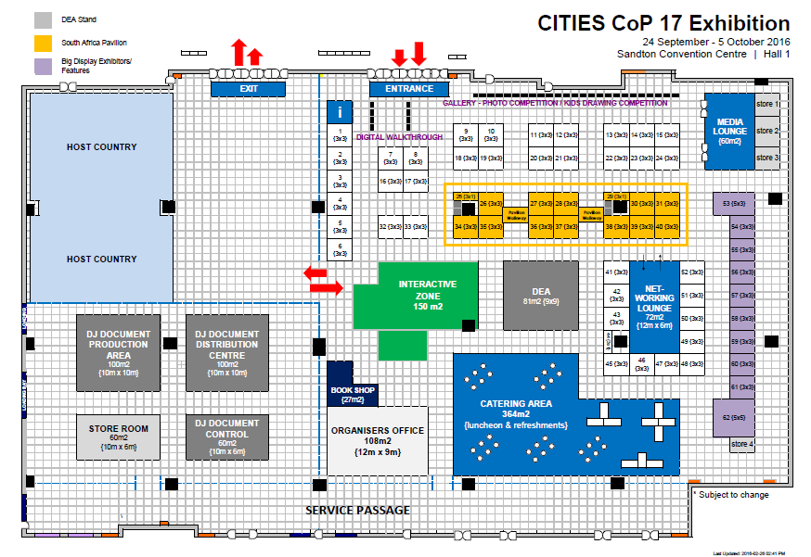

Slide 14
DELEGATION & OBSERVERS
Minister letter inviting Ministers of relevant government departments and Chairpersons of Boards of entities as well as Chairperson of the Portfolio Committee (members of the PC) to:
Attend the Ministerial High Level Segment on 23 September 2016 and to indicate whether interested in attending the CoP (Minister of Environmental Affairs and Minister of International Relations and Cooperation to determine who will be provided with credentials)

Slide 15
DELEGATION & OBSERVERS
Minister letter inviting relevant government departments entities and provincial conservation departments to:
Nominate officials that will form part of delegation (Minister of Environmental Affairs and Minister of International Relations and Cooperation to determine who will be provided with credentials
Officials can attend as observers – capacity building
Identify conservation areas or areas of biodiversity importance to be marketed or included in possible site visits. Also identify opportunities to provide discounts to participants in terms of entrance fees, etc.

Slide 16
POSSIBLE AGENDA ITEMS / PROPOSALS
NOTE: Deadline for submission of documents – 27 April 2016
RULES OF PROCEDURE
SADC will propose an amendment to the Rules of Procedure of the CoP to clarify provisions contained in Rule 26 (Majority) and Rule 30 (Amendment)
Proposed amendments:
Rule 26 (Majority)
Rule 30 (Amendment)

Slide 17
POSSIBLE PROPOSALS
Proposals to amend the Appendices (Proposed by other Parties):
African lion to be transferred from Appendix II to Appendix I (Niger, Rwanda, Togo, Chad)
Pangolin: Transfer from App II to App I (USA & Niger & South Africa)
African grey Parrot: Transfer from App II to App I (Gabon)
African elephant: Transfer from App II (Populations of Botswana, Namibia, South African and Zimbabwe) to App I
Shark proposals to list sharks in Appendix II (Silky shark & Thresher shark) and Mobula ray (Sri Lanka and Fiji)
Peregrine falcon – Transfer from Appendix I to Appendix II (Canada)
Proposed resolution on domestic trade in elephant ivory – Gabon

Slide 18
POSSIBLE PROPOSALS
South Africa: Proposals submitted by interested and affected parties, assessed by Scientific Authority & IDSC & Consulted with range States:
Abalone – Proposed listing on Appendix II (focus on dried specimens only)
Recommendation: Explore Appendix III listing
Cape mountain zebra – Proposed to down-list to Appendix II Recommendation: To be submitted for consideration by CITES COP17
Siphonochilus aethiopicus (wild ginger) – Proposed listing on Appendix II
Recommendation: To be submitted for consideration by CITES COP17
Ground hornbill – Proposed to list on Appendix II
Recommendation: Enhance national regulation (lack of trade data)
Aloe ferox – De-list from CITES Appendices:
Recommendation: Explore annotation to exempt products from CITES requirements at CoP18

Slide 19
POSSIBLE RESOLUTIONS
Trade in hunting trophies of species listed in Appendix II
Seeks to clarify the uniform interpretation of the Convention with regards to hunting trophies,
Emphasising “the contribution of hunting to conservation, socio-economic beneficiation and to provide incentives for people to conserve wildlife
Illegal Wildlife Trade
Highlights the need for
International cooperation,
The sharing of best practices and enforcement resources,
The mobilisation of funds for sustainable interventions in order to combat illegal wildlife trade in CITES listed species
While emphasising the important role played by local communities

Slide 20
POSSIBLE DECISION
C. Cycads (Encephalartos species)
Cycads are globally the most threatened group of plants, with >60% classified by the International Union for the Conservation of Nature (IUCN).
Illegal trade – one of the major threats
The draft Decision, if adopted by the 17th CoP to CITES, will assist in the process to obtain information relating to illegal trade, not only from South Africa, but also from other range States and improve coordination relating to investigations and information sharing

Slide 21
DECISION MAKING MECHANISM
Decision emanating from CITES COP14 (2007):
“Directed to the Standing Committee
The Standing Committee, assisted by the Secretariat, shall propose for approval at the least at the 16th meeting of the Conference of the Parties a decision-making mechanism for a process of trade in ivory under the auspices of the Conference of the Parties”
Decision referenced in the Annotation to Appendix II listing of the African elephant populations of Botswana, Namibia, South Africa and Zimbabwe
16th COP to CITES: No document for discussion – New Decision adopted Decision 16.55
65th SC meeting: Secretariat in collaboration with UNEP – to prepare a background doc (deadline: January 2015; Doc distributed only end of November 2015 – delays: no mechanism proposed by SC for CITES COP17)
66th Standing Committee: SC unable to complete the work; and further requested CoP17 to seek guidance on whether the Working Group’s mandate should be extended

Slide 22
STRUCTURE
CoI
Technical Advisory Committee
Inter-Ministerial Committee
Cabinet
Stakeholder engagement
Research
Existing info

Slide 23
RHINO
Committee of Inquiry:
Assessed the current situation & interventions implemented to date. Identified important trends;
Process of stakeholder consultation, scenario planning, analysis of case studies a decision-tree analysis process; and
Committee identified five key areas that require interventions:
Security (law enforcement)
Community empowerment
Biological management
Responsive legislation
Demand management / reduction
Committee also identified:
4 Options: Demand & Funding
3 Possible trade models

Slide 24
RHINO
RECOMMENDATIONS BY TAC AND IMC
The ITAC & IMC recommended that Option 1 and 2 were not considered feasible options to effectively address demand and funding.
Option 3 recommended:
Risks associated with Option 3, including that it could result in the loss of rhino value until the decision relating to a legal commercial international trade is re-considered and that although costs relating to anti-poaching interventions remain high, there are limited options in terms of alternative sources of funding.
CABINET APPROVED
RECOMMENDATIONS RELATING TO 5 KEY AREAS
OPTION 3 (No immediate intention to trade in rhino horn

Slide 25
MINISTERIAL MEETING
23 September 2016 – Ministers could attend the Ministerial meeting as well as the opening ceremony of the 17th CoP to CITES
Nexus between Sustainable Development Goals & CITES (Legal Wildlife Trade and Sustainable Use), and Illegal Wildlife Trade
Key questions / issues:
A. What are the intersecting issues at the nexus between:
The sustainable development goals, with special reference to Goal 15 and 17,
CITES as a Convention that aims to regulate legal international trade, and
Illegal wildlife trade that threatens species, ecosystems, socio-economic development and national security

Slide 26
MINISTERIAL MEETING
B. Is there a need to reconcile / balance potential conflicts between:
legal international trade that is facilitated through CITES, forms part of sustainable utilization of natural resources, is an important part of economic development for various countries, and form part of the SDGs; and
Illegal wildlife trade, that seems to result in an increasing number of countries implementing stricter domestic measures relating to international trade and proposed bans on international trade,
thereby closing markets for developing countries;
resulting in lack of revenue generated from wildlife and wildlife products that are legally and sustainably utilized,
loss of value associated with wildlife resources,
impacts on livelihoods and
loss of economic opportunities relating to sustainable utilization as an integral part of conservation management.

Slide 27
MINISTERIAL MEETING
C. How can government’s ensure that SDG targets relating to species and ecosystem protection and sustainable use as well as the means for implementation are achieved despite the challenges presented by illegal wildlife trade?
What is the role of CITES? How does CITES advance the achievement of the SDGs and is it the appropriate mechanism to use to effectively address illegal wildlife trade

Slide 28
THANK YOU

