Slide 1
Financial sector reforms on credit and indebtedness Presentation to the Portfolio Committee on Trade and Industry
Presenter: Ismail Momoniat | DDG Tax and Financial Sector Policy
National Treasury | 13 May 2016

Slide 2
National Treasury, South African Reserve Bank and Financial Services Board officials
National Treasury (NT)
Mr Ismail Momoniat
Ms Reshma Sheoraj
South African Reserve Bank (SARB)
Mr Kuben Naidoo (Dep Governor)
Mr Francois Groepe (Dep Governor)
Mr Rene van Wyk (Registrar of Banks)
Financial Services Board (FSB)
Mr Jonathan Dixon
Ms Leanne Jackson

Slide 3
Purpose
The NT, SARB and FSB would like to thank the Committee for the opportunity to present on:
a review of the Consumer Credit Insurance (“CCI”) market in SA;
Household over-indebtedness; and
Financial sector reforms.
Financial sector is unique in that it is like the blood circulation system that allows the real economy to function and enable trade
A failure of a major bank can be a DISASTER for the economy as a whole
Even the failure of an overseas bank like Lehmann caused a recession in SA and a million people lost their jobs!
Big lesson from 2008 Global Financial Crisis (GFC): Regulate and monitor your SIFIs (systemically important financial institutions), regulate INTRUSIVELY, INTENSIVELY and EFFECTIVELY
Most major and medium-size banks are SIFIs, as are major insurance companies

Slide 4
What problems are we trying to solve today?
Portfolio committee is concerned about abuse of credit (reckless lending) that leads to houseshold over-indebtedness
Concerns about abuse of insurance sold with credit
Concerns with failures around African Bank
Concerns about preventing 2008 type GLOBAL FINANCIAL CRISIS (GFC)
Are these problems all separable and distinct?
Can these problems be solved by improving within the current system?
OR IS THE UNDERLYING PROBLEM STRUCTURAL, related to serious flaws in the current system?
If the problem is STRUCTURAL, then patchwork or incremental changes will not solve the problem
So WHAT IS THE UNDERLYING PROBLEM WE TRYING TO SOLVE, and is it STRUCTURAL or not?

Slide 5
Financial sector failures
High fees and layered charges
Retirement fund charges
Over-indebtedness levels high exceeding 70%
Credit insurance mis-selling
Bank failures (SAAMBOU, African Bank, FIDENTIA)
Bulking scandal
PAYDAY LENDERS
Ponzi schemes
List is too long…..

Slide 6
TWIN PEAKS SYSTEM SEES PROBLEM AS STRUCTURAL, REQUIRING RADICAL SOLUTION
The FSR Bill to implement the Twin Peaks system for regulating the financial sector is currently being considered by the Standing Committee on Finance.
Key challenges that Twin Peaks reforms aim to deal with:
How safe is a financial institution? Can it deliver on promises it makes to customers?
How does the financial institution conduct its business? Is it up to standard? How does it charge its customers? Is it treating its customers fairly?
How safe are we from a 2008 type of financial crisis? Does the financial institution pose risks to stability? Is the fin institution a SIFI? (systemically important financial institution?
Financial sector can pose systemic risk to entire economy, as happened with 2008 Global Financial Crisis
Twin Peaks takes account of SOME of the 2014 FSAP recommendations

Slide 7
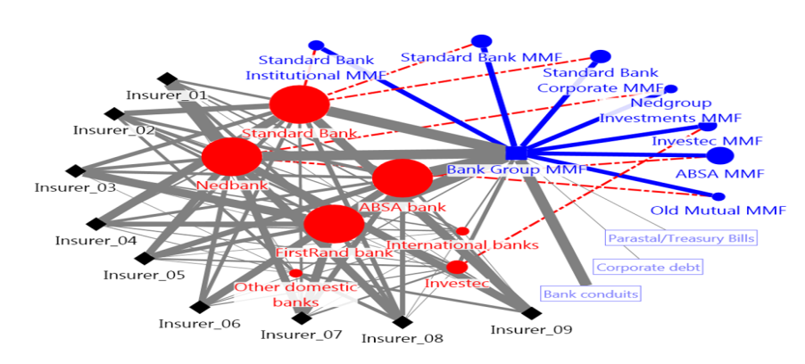
Why was decision taken?
Interconnectedness and complexity mean that curatorship requires flexibility; and even small banks can have systemic implications

Slide 8
Current Challenges with the financial sector (legacy from light touch regulations pre-2008)
Regulatory system is FRAGMENTED – the more regulators you have, the greater the scope for arbitrage and avoidance
We regulate by activity: insurance, credit, deposits, savings, as if these activities are all totally separable
Regulatory system does not protect customers adequately
Customers allowed to become over-indebted, or pay high charges or a plethora of charges or sold inappropriate or unnecessary products or lose their savings
Regulatory system does not do enough to reduce scope for financial institutions failing and losing the funds of customers/depositors/savers
But not all failures must be avoided, but PREVENT SIFI failures as they have system-wide implications

Slide 9
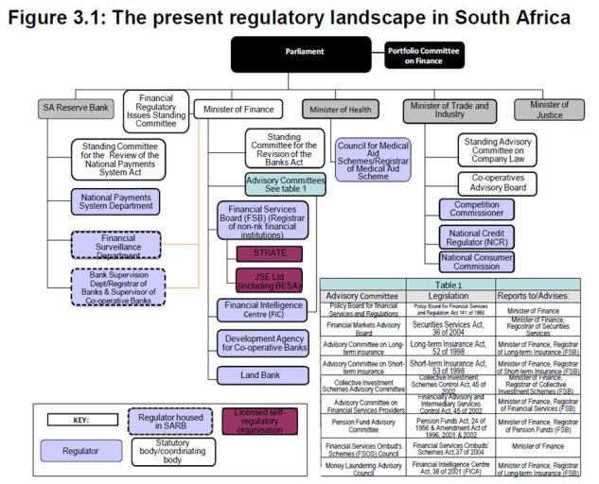
The regulatory architecture - our universe today

Slide 10
International Peer Reviews including FSAP, FATF etc
Financial sector is GLOBAL in nature, but regulated NATIONALLY
G20 and Fin Stability Board commitments make financial sector safer GLOBALLY
International Standards apply (BASEL, IAIS, IOSCO)
FSAP process to review how country regulators implement standards
IMF conduct FSAP on SA in 2014
Number of recommendations made
FATF mutual evaluation on anti-money laundering standards
Failure to implement standards exposes fin institutions to punitive sanctions and fines from overseas regulators
Key priorities for global reform since 2008:
TBTF
OTC Derivatives
Shadow banking

Slide 11
2014 FSAP on SA recommends further improvements
In 2013 and 2014 SA underwent comprehensive reviews of the robustness of its financial sector regulation, including crisis management measures.
Conducted by the IMF, the 2014 FSAP assessment found:
Regulatory system is fragmented and regulators are uncoordinated
SA’s resolution regime must be updated to meet best international practice.
The current curatorship powers lack critical features to deal with a systemic failure and minimise taxpayer risk
Resolution powers should be available at an earlier juncture, facilitate a wider range of resolution tools (including bail-in and bridge banks) and not be at risk of being suspended or reversed
National Treasury – Reserve Bank team is preparing a Bill to address this

Slide 12
Objectives for twin peaks system for regulating financial sector
Two key objectives- regulate PRUDENTIALLY and for MARKET CONDUCT
Each objective needs a different regulator, to ensure that one objective does not squeeze out the other objective
This this mean fragmentation, and potential for arbitrage
Hence need effective co-ordination and co-operation between the two regulators
Better than having a different regulator for different activities
We currently have different legislation and regulators for different activities, so have different regulators for credit, for insurance, for banking, for retirement etc
We split prudential regulation by activity, and ignore mkt conduct (or vice versa)

Slide 13
Twin Peak reforms
The Financial Sector Regulation Bill (“Twin Peaks Bill”) approved by Cabinet and tabled in Parliament .
The Twin Peaks Bill provides a comprehensive framework for regulating the fin sector by:
Establishing a prudential authority within the SARB, with primary responsibility for financial stability
Financial Services Board to be transformed into a market conduct regulator
Enabling SARB to maintain financial stability with the help of the financial stability oversight committee
Enhancing co-ordination and co-operation between regulators and balancing operational independence and accountability,
Crisis management and resolution framework, and
Strengthening enforcement and ombud schemes.

Slide 14
Twin Peaks and improved financial sector regulation
Increased regulatory coverage, minimising potential for regulatory gaps (can designate new products and services in financial sector)
Regulatory laws that are complete, harmonised, integrated, proportionate
Dedicated and equal emphasis on monitoring stability, prudential and conduct risks in financial sector
Enhanced oversight of micro-prudential regulation, special focus on conglomerates
Increased focus on outcomes, especially fair customer treatment
More efficient use of supervisory capacity, strengthen risk-based approach. Empowered with tools to fulfill mandate (e.g. standard setting)
Strong and swift action for contraventions

Slide 15
Dedicated focus on key risks in the financial sector
PRUDENTIAL RISK
Prudential regulator will be a unit within the SARB – called the Prudential Authority
A different deputy governor will be the CEO of the PA, and will have key supervisors report to him or her
CONDUCT RISK
The non-prudential part of the FSB will be absorbed into a new Financial Conduct Authority (FSCA) with a dedicated focus on conduct of business and market integrity
SYSTEMIC STABILITY RISK
SARB responsible for overseeing financial stability, in accordance with a framework agreed with the Min of Finance
An advisory body of regulators chaired by the Governor ( FSOC) will advise the Governor and facilitate co-ordination
Co-ordinating body of all regulators Council of Financial Regulators (CoFC)

Slide 16
Early intervention is required to minimise possible costs later and risk to fiscus
Lessons internationally show crisis management packages for bank failures in countries as diverse as the US, Japan, Korea, Mexico, and Turkey and most recently Portugal- all cost the taxpayer significantly ranging from 13% of GDP in Finland to 32% in Turkey.
The key lesson from other countries dealing with risks to financial stability-
1. It is very PAINFUL with lots of losers:
Any intervention plan involves a transfer of wealth from creditors to debtors, from those that behaved prudently to those that took excessive risks.
2. Speed saves and reduces costs:
A key driver of this variation in ultimate fiscal costs is the speed with which governments act to resolve the crisis.
While the upfront cost of interventions is high, if done right, the government will not be left empty handed.

Slide 17
TWIN PEAKS VISION HARMONISES
One system of licensing
One system of supervision
One system of enforcement and tribunals
One system for ombuds and consumer recourse
One system of info sharing and co-ordination
Two dedicated regulators with NCR
Both FFSCA and NCR are market conduct authorities

Slide 18
A harmonised system of regulation
Twin Peaks is a comprehensive and coherent system going beyond the setting up of the “twins”
PRUDENTIAL REGULATOR/ MARKET CONDUCT REGULATOR
NCR
Deposit Taking
(BANKS)
LT & ST Insurance
(INSURANCE FIRMS)
Securities
(FMIs)
Retirement savings
(PENSION FUNDS)
Financial services/ Advisory
Pooled investments
(CIS)
Credit
(CREDIT PROVIDERS)
Harmonised system of licensing
SIFIs
Co-ordinated supervision
Enforcement
Information sharing
Consumer recourse (including ombuds system)
Appeal mechanism (tribunal)
Coordination, cooperation, collaboration (licensing ,inspections, investigations ,enforcement, etc)

Slide 19
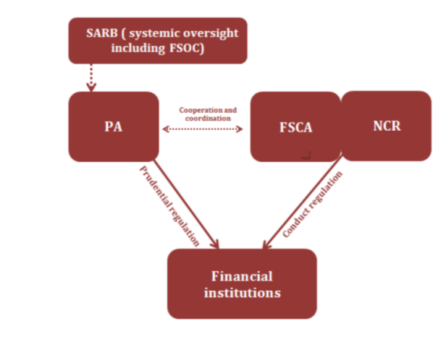
A coordinated approach

Slide 20
Why the need for improved coordination?
NCR regulates credit provider; FSB regulates insurance providers and intermediary services. SARB regulates payment systems (debit orders)
Regulatory arbitrage when same institution provides both services; poor outcomes for customers .
Under Twin Peaks framework, FSCA will have holistic oversight of financial institutions, including credit providers. Will be able to:
Set governance requirements requiring fair outcomes throughout value chain.
Set disclosure standards for CCI products.
Set standards requiring adequate disclosure and suitable advice.
Take swift action against institutions that contravene conduct standards.

Slide 21
The need for a co-ordinated approach
ABC Holding Company
XYZ Furniture retailer
(A licensed credit provider)
PQR Insurance
Credit Agreement
Insurance
Consumer
This relationship is regulated by the NCA, but if credit insurance is purchased from a different company (i.e. not the credit provider itself), even one in the same group, then the NCA is not applicable.

Slide 22
A key problem is the multitude of regulators involved (SARB, NCR, FSB, Companies Act)
African Bank Investments Ltd (“ABIL”)
Listed company (Companies Act /JSE rules)
African Bank Ltd (ABL)
Deposit-taking institution (NT / Bank Supervision)
Credit provider (DTI / NCR)
Stangen
Insurer (NT / Insurance Act)
Credit-life insurance (complicated)
Ellerines
Furniture company
(Companies Act)
NCR is responsible for asset-side of balance sheet (the loans made by the bank)
BSD is responsible for liability side (the depositors in the bank)

Slide 23
Principles for coordination: NCR and FSCA
SARB and PA should regulate all credit providers for stability and safety and soundness respectively, with intensity of oversight determined on a risk-basis.
The NCR and FSCA should regulate credit providers for conduct but in different ways and with a different focus; the FSCA should complement and support the actions of the NCR
NCR is the sole regulator of the credit agreement itself, i.e. the features of the product. The FSCA can regulate credit providers that provide credit agreements, on a risk-basis, especially in relation to the culture of such providers (esp. banks), to complement what is provided for under the NCA.
FSCA sets standards for financial services provided in relation to credit agreements, as may regards disribution and advice, to provide for a system-wide approach to conduct, provided that these support regulatory requirements set by the NCR under the NCA.

Slide 24
Household over-indebtedness is cross-cutting– joint approach to implement Cabinet’s decision
Govt has initiated a wider process to deal with household over-indebtedness:
In December 2013, Cabinet authorised the Ministers of Finance and Trade and Industry to take measures to assist over-indebted households and also prevent them from becoming over-indebted in future.
Inter governmental oversight committee (DoJ, dti, NT, FSB, NCR, NCC, SARB) established.
National Credit Amendment Act No. 19 of 2014 empowers the Minister of Trade and Industry, in consultation with the Minister of Finance, to prescribe a limit in respect of the cost of credit insurance that a credit provider may charge a consumer.
Issues dealt with include garnishee orders (EAOs), debt-collection practices (esp by legal firms), debit order abuses

Slide 25
Specific incremental steps to regulate the cost of credit
Broadly, the overall cost of credit for any consumer is made up of four components:
The cost of funds of the lending institution (e.g. the interest rate that a bank pays its depositers’ on their money which it lends to borrowers),
administration/overhead costs,
the borrower’s risk profile,
and a margin of profit for fulfilling the role of financial intermediation
Interest rate caps, as implemented through the NCA, are intended to limit margin for profit
BUT
Will they work?
The result has been that this cost has been shifted to charges associated with no.’s I-III. E.g. credit insurance (which reduces the risk of a particular borrower for a lending instiution, by shifting the cost of that risk onto the consumer who pays the premium).
While some of these fees are similarly capped (e.g. initiation and administration fees), there is widespread abuse of those that aren’t (e.g. exorbitant delivery fees)
The only way to ensure that charges aren’t shifted, and new as of yet unheard of charges don’t suddenly appear, is to regulate the total cost of credit.

Slide 26
Thank You

