Slide 1
Municipal Infrastructure Grant Expenditure status:
Second & THIRD QUARTER 2015/16 FY (Municipal)
Municipal Infrastructure
Cape Town |
Marius Brand|

Slide 2

Content Outline:
  WC MIG Performance Record
  WC MIG Process and Procedures
  MIG Cumulative expenditure 2015/16 FY graph
  MIG Monthly Claim / Payment status December 2015
  MIG Monthly Claim / Payment status March 2016
  MIG Monthly Claim / Payment status April 2016
  WC MIG Non-financial Performance

Slide 3
  WC MIG Performance Record

Slide 4
PERFORMANCE RECORD (Last 5 FY’s)
Financial Year | Performance
2010/2011 | 99.85%
2011/2012 | 99.30%
2012/2013 | 100.00%
2013/2014 | 96.90%
2014/2015 | 97.44%

Slide 5
  WC MIG Processes and Procedures

Slide 6
PROCESSES AND PROCEDURES
  Project identification and engagement forums
    IDP Indaba
    LGMTECH
    MGRO
    Infrastructure and Growth Plans
  Project Appraisal process
    Internal 8-week process
    Sector and National departmental engagements
  Monthly monitoring and reporting
    Site-visits (Sector departments and WC DLG)
    Project Co-ordination meetings (WC DLG)
    Monthly Co-ordination meetings (LM’s, Sectors and National)
    RACI tool
    Scoreboard

Slide 7
  MIG Cumulative expenditure 2015/16 FY

Slide 8
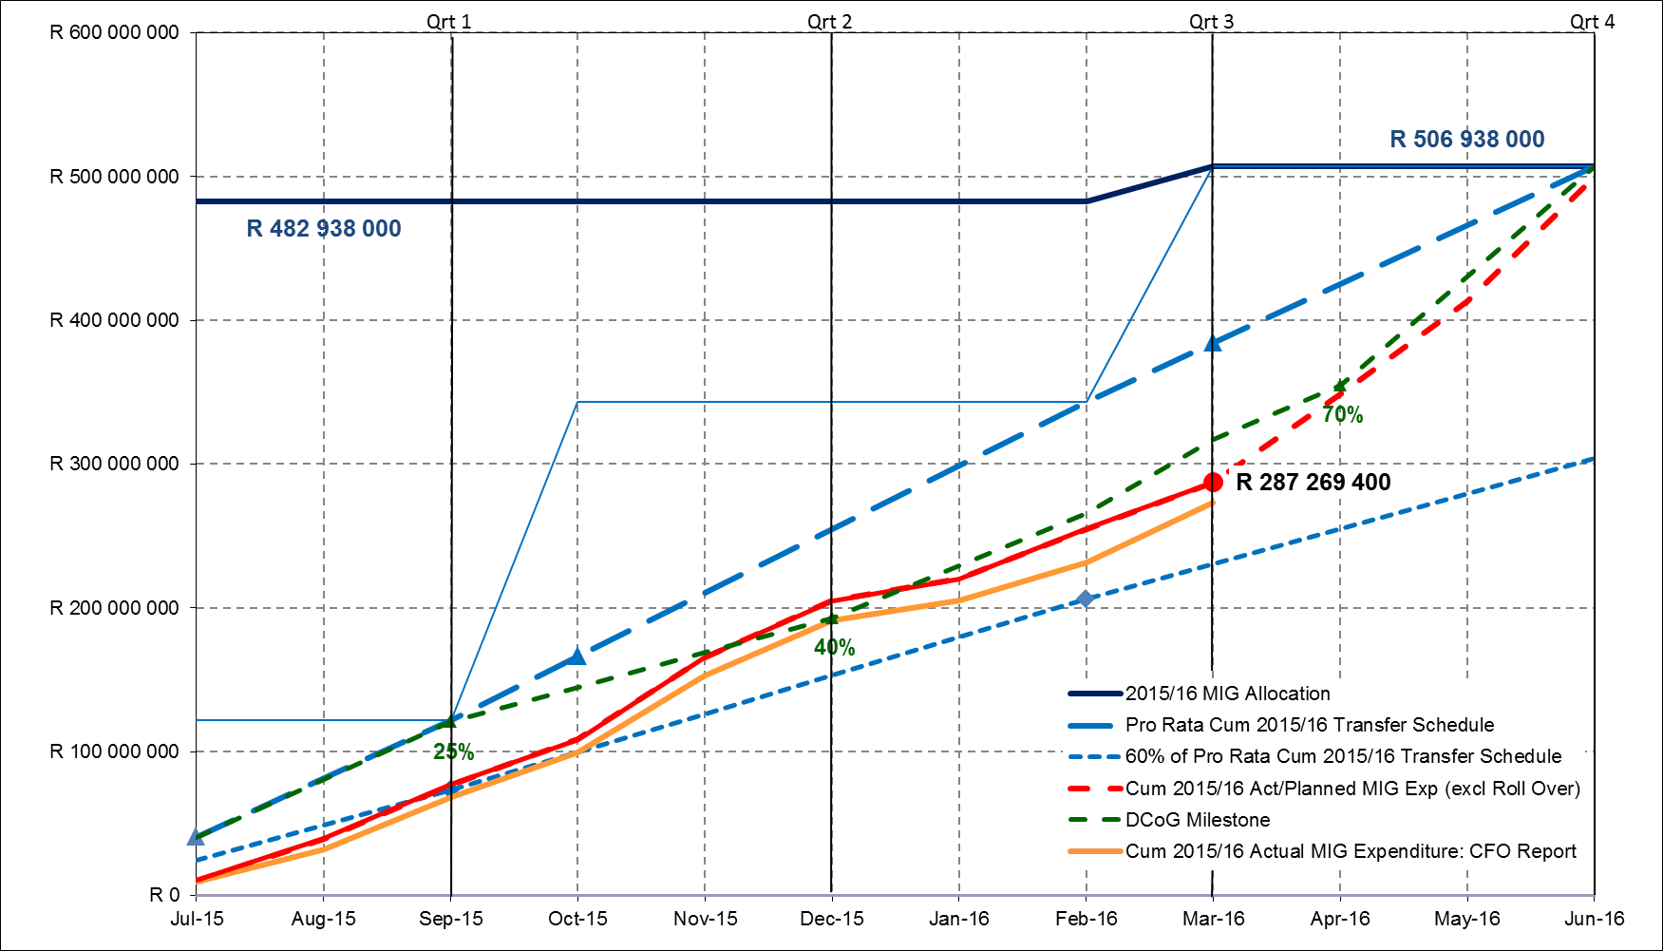

Slide 9
MIG MONTHLY CLAIMS PAYMENT STATUS
Dec’2015 (2nd Quarter)

Slide 10
SITUATIONAL ANALYSIS (2nd Quarter)
  Municipal Infrastructure Grant Expenditure (2015/16 FY)
  Provincial Budget – R482 938 000.
  An overall expenditure of 42.46% of the total Western Cape Provincial allocation - above the benchmark of 40%.
  80% of planned expenditure achieved.

Slide 11
SITUATIONAL ANALYSIS (2nd Quarter)
  6 Municipalities above 50% - Top performing Municipalities. (Saldanha Bay, Swartland, Drakenstein, Knysna, Laingsburg and Beaufort West).
  11 Municipalities between 40%-50% - Municipalities are meeting monthly targets (Matzikama, Cederberg, Witzenberg, Breede Valley, Langeberg, Theewaterskloof, Kannaland, Mossel Bay, George, Oudtshoorn and Bitou).
  4 Municipalities between 30%-40% - Municipalities shall be supported by DLG (Stellenbosch, Overstrand, Swellendam and Hessequa).
  3 Municipalities below 30% - Weekly monitoring of action plans to rectify the situation (Prince Albert, Cape Agulhas, Bergrivier).

Slide 12
SECTION 19 OF DoRA (ACT NO. 1 OF 2015)
  Three Municipalities have evoked the above mentioned Act for not managing to spend 30% of the total allocation:
      Prince Albert
      Cape Agulhas
      Bergrivier
  These Municipalities were called in by DCoG and WC DLG in an attempt to rehabilitate expenditure.
Municipality | Reasons for under-expenditure | Progress to date (April)
Bergrivier | Late project registrations. | All projects registered and in construction phase. Expenditure at 61.80%.
Cape Agulhas | Heavy rains till late October 2015 caused delay of five roads projects. | All projects awarded and in construction phase. Expenditure at 55.60%
Prince Albert | High-tender prices caused delay of projects. | All contractor are on site. Plant and material delivered in March. Expenditure at 30.20%

Slide 13
MIG MONTHLY CLAIMS PAYMENT STATUS
Mar’2016 (3rd Quarter)

Slide 14
SITUATIONAL ANALYSIS (3rd Quarter)
  Municipal Infrastructure Grant Expenditure (2015/16 FY)
  Provincial Budget – R506 938 000.
  An adjustment allocation increase of R24 000 000 has had a 4.97% effect on the overall expenditure of the WC Province.
  An overall expenditure of 56.64% of the total Western Cape Provincial allocation including the adjustment allocation.
  74% of planned expenditure achieved.

Slide 15
SITUATIONAL ANALYSIS (3rd Quarter)
  8 Municipalities above 62.5% - Top performing Municipalities. (Matzikama, Saldanha Bay, Swartland, Drakenstein, Breede Valley, Langeberg, Kannaland and Beaufort West).
  4 Municipalities between 55%-62.5% - (Stellenbosch, Mossel Bay, George and Bitou).
  12 Municipalities below 55% - (Cederberg, Bergrivier, Witzenberg, Theewaterskloof, Overstrand, Cape Agulhas, Swellendam, Hessequa, Oudtshoorn, Knysna, Laingsburg and Prince Albert).

Slide 16
SITUATIONAL ANALYSIS (3rd Quarter)
Municipality | Reasons for under-expenditure | Progress to date (April)
Cederberg | Planned late project implementation. | Progress according to DPIP. Expenditure at 53.80%.
Bergrivier | Late project registrations. | All projects registered and in construction phase. Expenditure at 61.80%.
Witzenberg | Delay in contractor appointment. | Contractor appointed. Progress according to DPIP. Expenditure at 56.90%.
Theewaterskloof | Reservoir tender cancelled. | Reservoir tender awarded and in construction phase. Expenditure at 48.70%
Overstrand | Delay in contractor appointment. | Contractor appointed. Progress according to DPIP. Expenditure at 52.90%
Cape Agulhas | Delay in submitting March claim. | Claim to be submitted with May’s claims. Progress according to DPIP. Expenditure at 55.60%
Swellendam | Delay in submitting March claim. | Claim to be submitted with May’s claims. Progress according to DPIP. Expenditure at 55.60%
Oudtshoorn | Delay in submitting March claim. | Claim to be submitted with May’s claims. Progress according to DPIP. Expenditure at 60.60%
Knysna | Progress according to DPIP. | Progress according to DPIP. Expenditure at 57.50%
Laingsburg | Delay in submitting March claim. | Claim to be submitted with May’s claims. Progress according to DPIP. Expenditure at 53.10%
Prince Albert | High-tender prices caused delay of projects. | All contractor are on site. Plant and material delivered in March. Expenditure at 30.20%
Hessequa | Capacity challenges. | Positions in the shortlisting process. 48.8%

Slide 17
MIG MONTHLY CLAIMS PAYMENT STATUS
April 2016

Slide 18
SITUATIONAL ANALYSIS (April 2016)
  Municipal Infrastructure Grant Expenditure (2015/16 FY)
  Provincial Budget – R506 938 000.
  An overall expenditure of 64.39% of the total Western Cape Provincial allocation including the adjustment allocation.
  77% of planned expenditure achieved.

Slide 19
  WC MIG Non-financial Performance

Slide 20
NON-FINANCIAL PERFORMANCE
Type of Service | Planned poor households benefitted | Progress in current FY - Poor households benefitted | % Progress in current FY
Water | 21 398 | 19 451 | 90.90%
Sanitation | 22 543 | 24 929 | 110.60%
Sport | 15 227 | 21 833 | 143.40%
Electricity | 2 732 | 1 098 | 40.20%
Solid Waste | 33 288 | 38 804 | 116.60%
Cemeteries / Crematoria | 0 | 0
Multi Purpose Community Halls | 660 | 660 | 100.00%
Parks and Open Spaces | - | - | -
Public Transport | 1 882 | 1 213 | 64.50%
Emergency Services | - | - | -

Slide 21
NON-FINANCIAL PERFORMANCE
WEST COAST DISTRICT
SERVICE | 2013/14 | 2014/15 | 2015/16 | 2016/17 | 2017/18
Water | R 109 323 | R 12 111 991 | R 21 179 393 | R 6 589 696 | R 31 715 048
Sanitation | R 45 838 117 | R 34 290 383 | R 17 969 585 | R 27 788 262 | R 79 922 375
Roads and Stormwater | R 20 172 434 | R 19 572 607 | R 34 186 907 | R 32 541 545 | R 73 110 881
Solid Waste | R - | R - | R - | R - | R 2 511 482
Electrical HML & Streetlights | R - | R - | R - | R - | R 4 000 000
Sports | R 6 450 116 | R 12 552 609 | R 12 445 213 | R 12 489 946 | R 22 431 058
TOTAL | R 72 569 990 | R 78 527 590 | R 85 781 098 | R 79 409 449 | R 213 690 844

Slide 22
NON-FINANCIAL PERFORMANCE
CAPE WINELANDS DISTRICT
SERVICE | 2013/14 | 2014/15 | 2015/16 | 2016/17 | 2017/18
Water | R 57 651 298 | R 76 418 786 | R 47 373 662 | R 65 069 379 | R 80 791 779
Sanitation | R 32 561 645 | R 15 779 192 | R 56 405 661 | R 46 262 831 | R 42 039 553
Roads and Stormwater | R 23 812 281 | R 35 965 203 | R 14 322 755 | R 4 518 973 | R 18 654 451
Solid Waste | R - | R 2 924 543 | R 5 486 712 | R 10 452 909 | R 9 324 399
Electrical HML & Streetlights | R 6 333 219 | R 436 747 | R 3 724 570 | R 7 269 591 | R 3 319 356
Sports | R 11 659 351 | R 9 350 324 | R 15 378 340 | R 15 185 400 | R 13 762 240
TOTAL | R 132 017 795 | R 140 874 795 | R 142 691 700 | R 148 759 082 | R 167 891 778

Slide 23
NON-FINANCIAL PERFORMANCE
OVERBERG DISTRICT
SERVICE | 2013/14 | 2014/15 | 2015/16 | 2016/17 | 2017/18
Water | R 13 210 438 | R 5 251 480 | R 14 105 383 | R 19 801 920 | R 10 843 797
Sanitation | R 11 039 798 | R 19 786 723 | R 18 075 854 | R 14 530 090 | R 27 413 900
Roads and Stormwater | R 27 358 990 | R 19 745 994 | R 21 983 599 | R 32 778 025 | R 19 389 813
Solid Waste | R - | R 4 057 361 | R 3 420 000 | R - | R -
Electrical HML & Streetlights | R 340 000 | R 144 420 | R 1 979 581 | R 675 690 | R 68 800
Sports | R 3 727 350 | R 13 354 674 | R 2 414 082 | R 5 279 790 | R 6 930 824
TOTAL | R 55 676 575 | R 62 340 651 | R 61 978 500 | R 73 065 515 | R 64 647 134

Slide 24
NON-FINANCIAL PERFORMANCE
EDEN DISTRICT
SERVICE | 2013/14 | 2014/15 | 2015/16 | 2016/17 | 2017/18
Water | R 32 200 436 | R 32 870 732 | R 32 084 429 | R 63 170 682 | R 80 349 958
Sanitation | R 41 935 601 | R 51 013 389 | R 58 341 009 | R 22 834 600 | R 30 606 326
Roads and Stormwater | R 20 376 549 | R 22 716 486 | R 35 022 630 | R 42 506 214 | R 20 686 999
Solid Waste | R 1 460 102 | R 4 271 145 | R 6 428 768 | R 4 906 009 | R 23 214 229
Electrical HML & Streetlights | R 4 273 911 | R 50 841 | R 3 933 185 | R 2 303 416 | R 5 108 960
Sports | R 20 400 938 | R 18 564 321 | R 16 204 514 | R 18 167 784 | R 27 305 599
TOTAL | R 120 647 538 | R 129 486 914 | R 152 014 536 | R 153 888 706 | R 187 272 071

Slide 25
NON-FINANCIAL PERFORMANCE
CENTRAL KAROO DISTRICT
SERVICE | 2013/14 | 2014/15 | 2015/16 | 2016/17 | 2017/18
Water | R 7 701 322 | R 7 407 757 | R 3 811 020 | R 5 765 740 | R 6 393 572
Sanitation | R 13 491 092 | R 3 259 283 | R 12 545 966 | R 7 344 691 | R 2 920 511
Roads and Stormwater | R 9 862 911 | R 14 332 486 | R 6 638 649 | R 6 523 457 | R 25 498 377
Solid Waste | R 47 162 | R 148 223 | R 337 842 | R 2 088 052 | R 783 092
Electrical HML & Streetlights | R 2 851 399 | R 872 987 | R - | R 2 053 831 | R 3 171 303
Cemeteries | R - | R - | R 934 581 | R 631 668 | R -
Sports | R 3 060 680 | R 3 788 500 | R 2 992 946 | R 2 876 352 | R 6 623 266
TOTAL | R 37 014 566 | R 29 809 236 | R 27 261 003 | R 27 283 791 | R 45 390 122

Slide 26
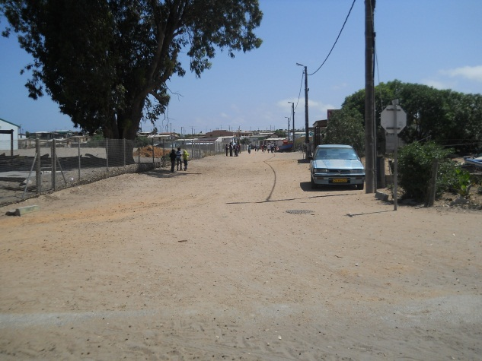
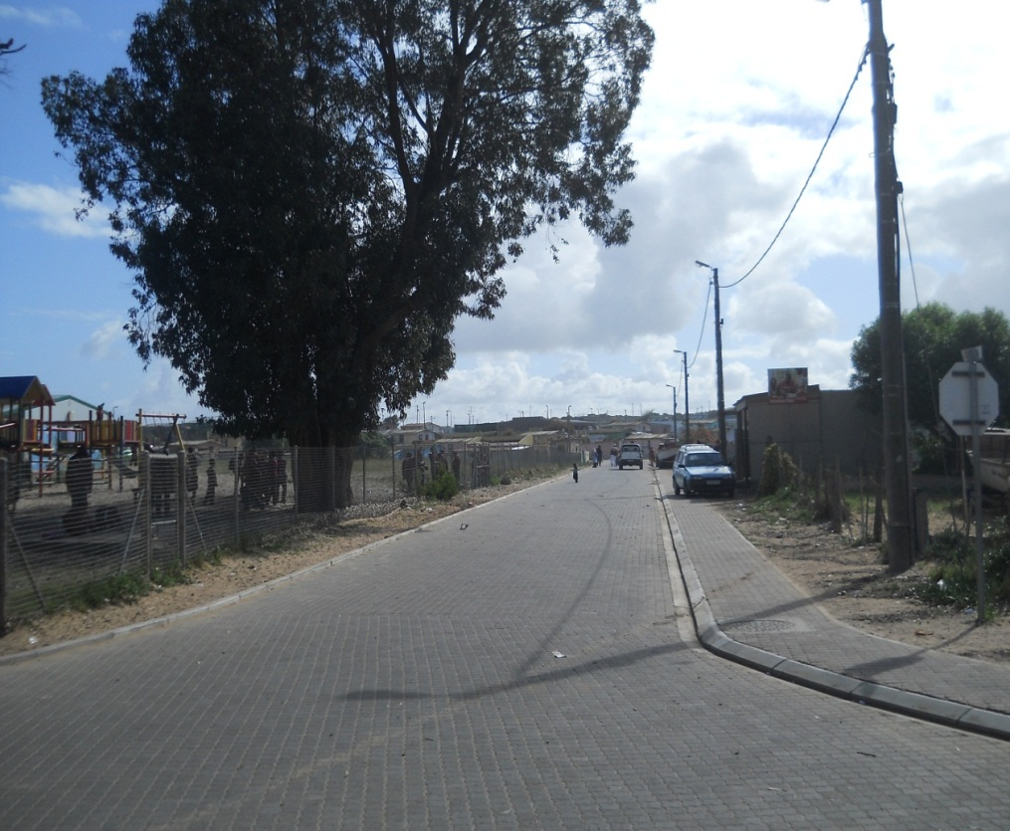
Visual Impact of MIG
Before and After

Slide 27
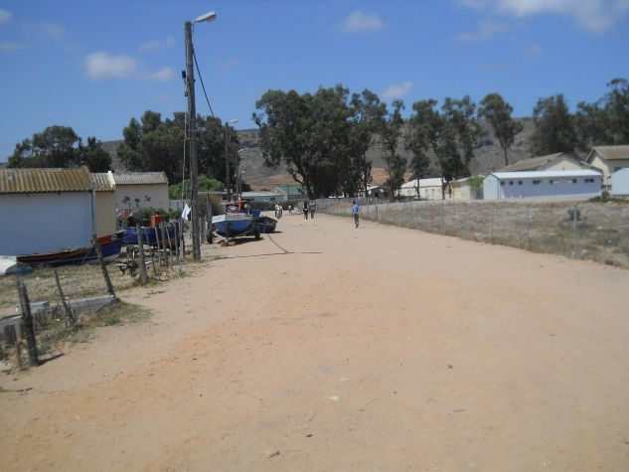
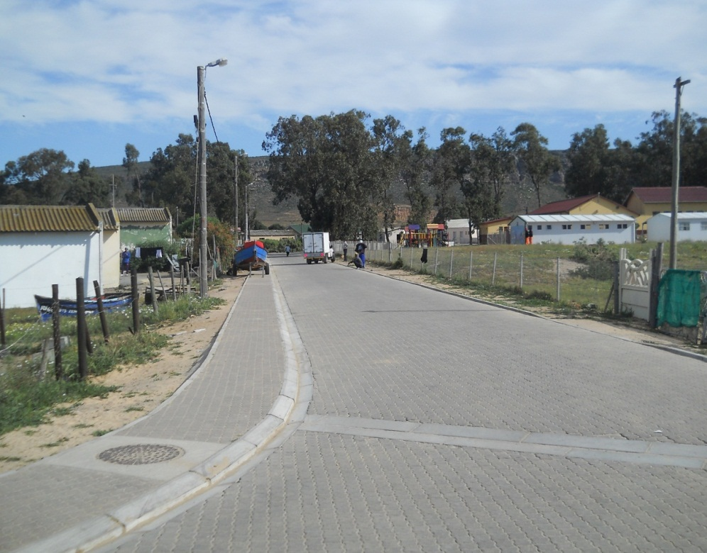
Visual Impact of MIG
Before and After

Slide 28
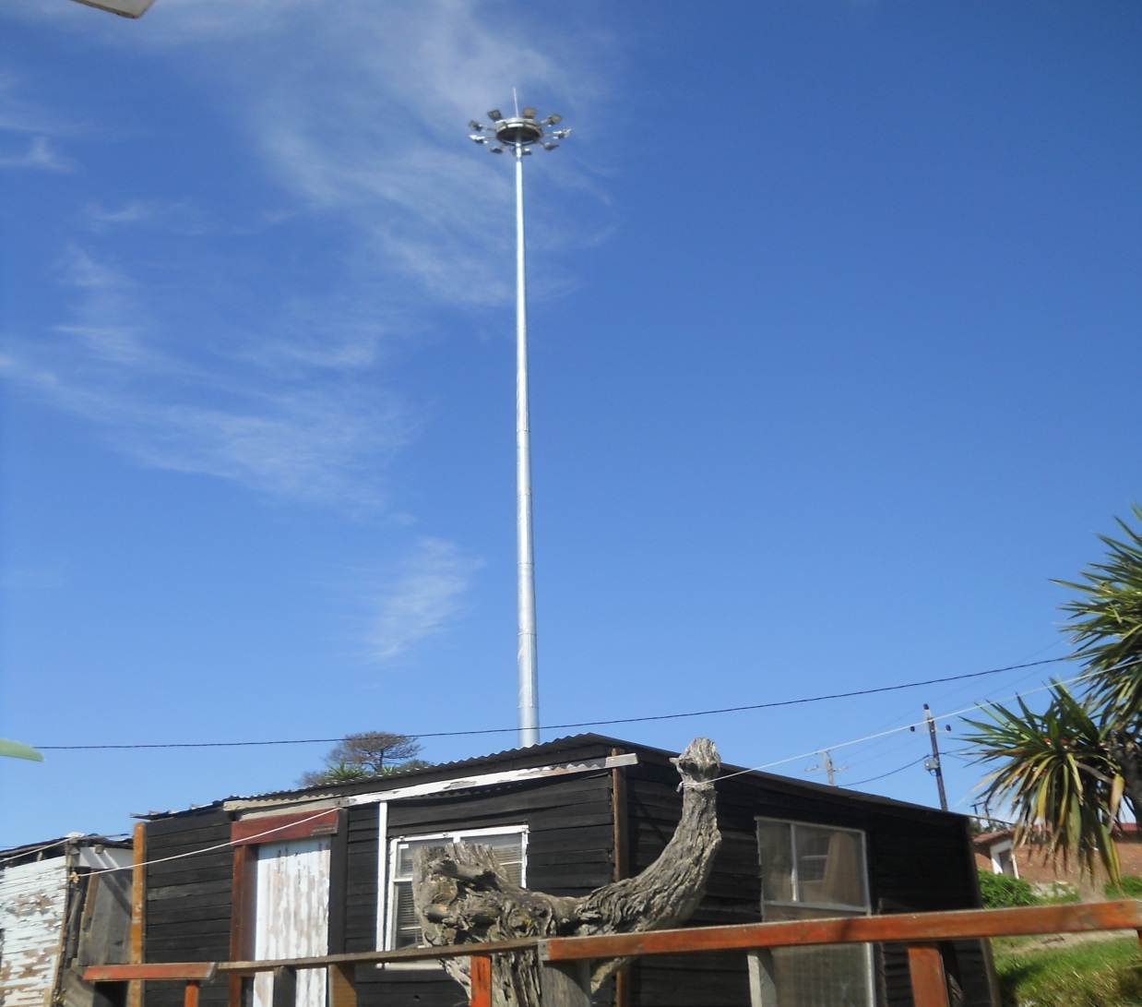
Visual Impact of MIG

Slide 29
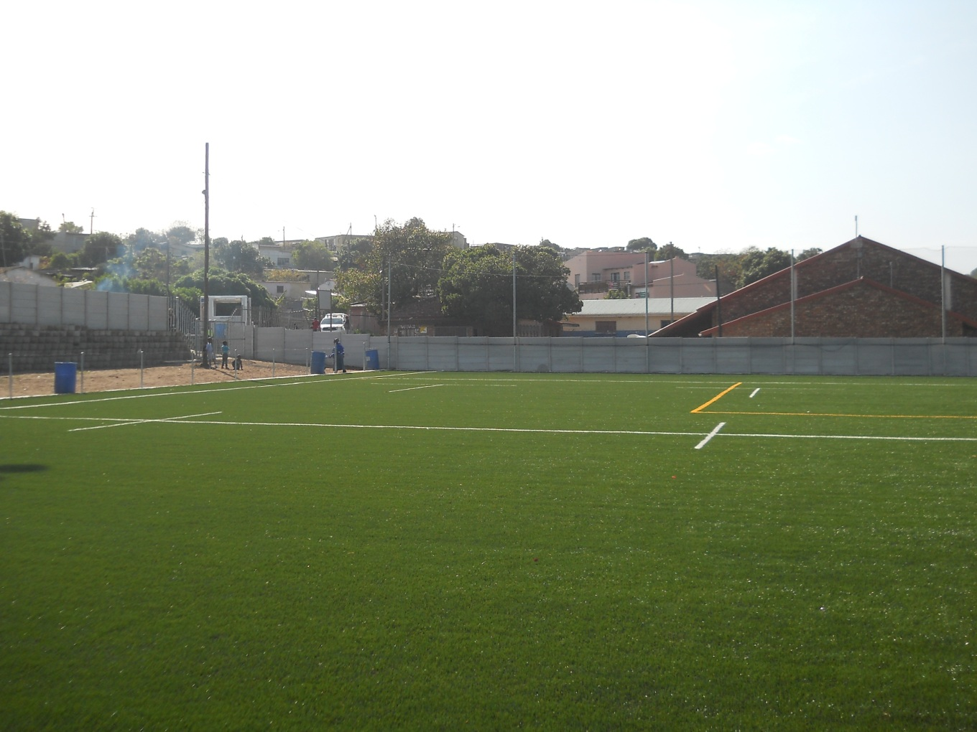
Visual Impact of MIG

Slide 30
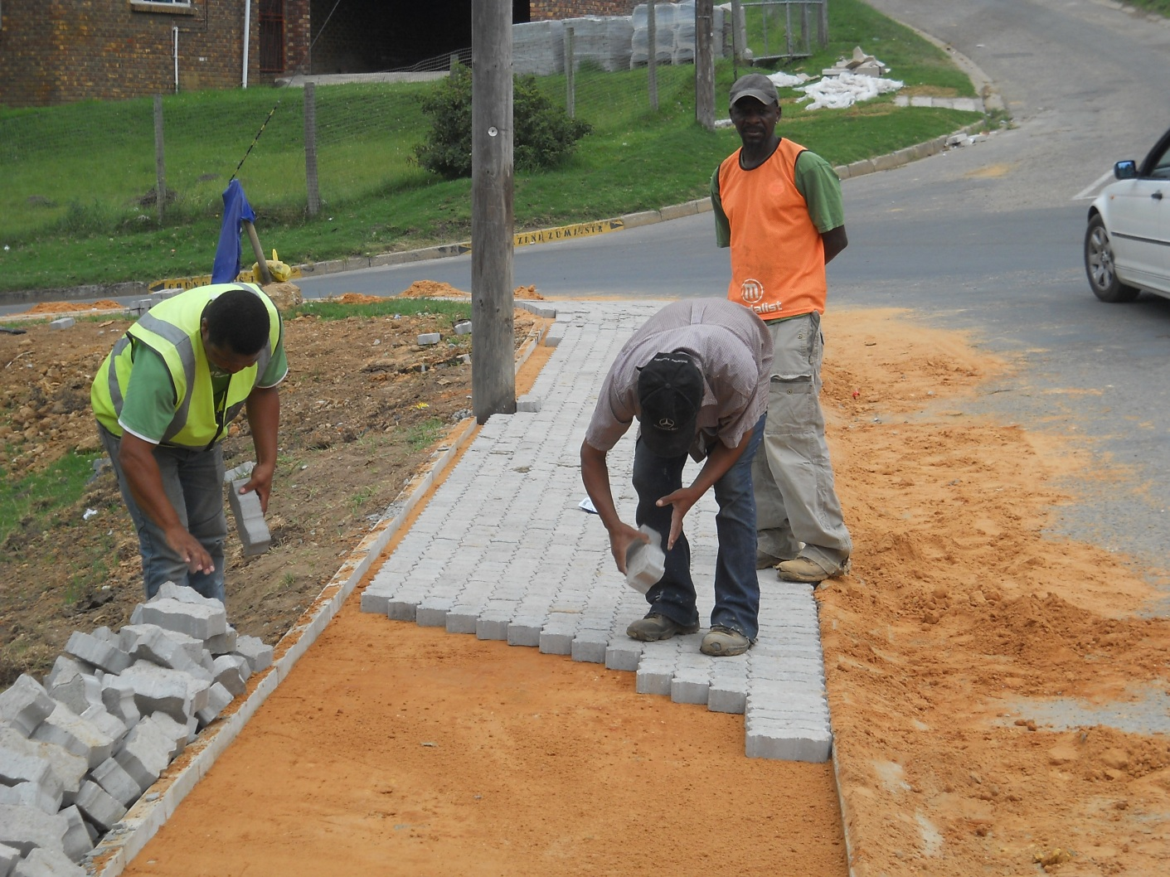
Visual Impact of MIG

