Slide 1
BRIEIFING ON THE NOTICE OF INTERVENTION ISSUED IN TERMS OF SECTION 139 (1) (b) OF THE CONSTITUTION, 1996 TO THABAZIMBI LOCAL MUNICIPALITY, LIMPOPO PROVINCE:
Date: Wednesday, 4 May 2016
Time: 11:00 - 12:00
Venue: Committee Room 2
120 Plain Street,
Parliament, Cape Town

Slide 2
PRESENTATION OUTLINE
Purpose of the report
Overview of the Municipality
Background to the intervention
Legal Mandate
Discussions
Legislative Considerations
Implementation of EXCO resolutions
Recommendations

Slide 3
PURPOSE OF THE REPORT
TO BRIEF MEMBERS OF THE SELECT COMMITTEE ON COOPERATIVE GOVERNANCE AND TRADITIONAL AFFAIRS
ON THE CONSTITUTIONAL, PROCEDURAL AND SUBSTANTIVE MATTERS RELATING TO THE INTERVENTION IN TERMS OF SECTION 139 (1) (b) OF THE CONSTITUTION IN THABAZIMBI LOCAL MUNICIPALITY.

Slide 4
2. OVERVIEW OF THE MUNICIPALITY

Slide 5
The Municipality is situated in the South Western part of the Limpopo Province within the Waterberg District and has Botswana as its International neighbour. It is bordered by Lephalale, Bela Bela, Northwest Province and Gauteng Province.
The total geographical area of Thabazimbi is approximately 10 882 square kilometres and constitute 21.97% of the Waterberg District with a total population of 85 234 and 25 080 households.
Development in Thabazimbi is mainly based on:
Mining
Tourism
Agriculture

Slide 6
Thabazimbi Local municipality is a Grade 3 Municipality and was assigned its powers and functions in line with Section 156 of the Constitution of the Republic of South Africa, Act 108 of 1996 as amended and Section 84(2) of the Municipal Structure Act, 117 of 1998.
The Municipality is a Water Services Authority and Water Services Provider; however, Magalies Water Board and ESKOM provide services directly to mining industries and majority of affluent areas without the relevant authority.

Slide 7
3. BACKGROUND TO THE INTERVENTION

Slide 8
BACKGROUND TO THE INTERVENTION
Thabazimbi Local Municipality started experiencing challenges around May 2015 and a Rapid Assessment Team was established and constituted by officials from COGHSTA, Provincial Treasury and SALGA Limpopo to provide a fair objective report on the state of affairs of the Municipality; focusing on all Key Performance Areas (KPAs) with specific recommendations for remedial action and or support required for the Municipality.
key observations were made by the Rapid Assessment Team:
That governance in the Municipality is compromised,
The financial health of the Municipality has deteriorated since 2011/12 financial year,
Signs of inability by council to exercise its oversight role in the municipal affairs,
Non-adherence to legislations and policies e.g. Supply Chain Management and Human Resources,

Slide 9
BACKGROUND TO THE INTERVENTION
key observations were made by the Rapid Assessment Team:
The Acting Municipal Manager, as the head of administration, has appointed all acting section 56 Managers (CFO and Community Services) without a Municipal Resolution and concurrence from the MEC for COGHSTA,
Lack of interest by the municipality to reverse the illegal promotions which resulted in high salary bill,
Failed to take reasonable steps to prevent the reoccurrence of Section 32 expenditures (perennially procurement through section 32 of Supply Chain Management),
Management has failed to honour financial commitment which resulted in non-payment to creditors,

Slide 10
BACKGROUND TO THE INTERVENTION
key observations were made by the Rapid Assessment Team:
High number of litigations cost as a result of not honouring financial commitments,
The Municipality is technically bankrupt and cannot sustain itself,
The conditional grant (MIG) used for operational expenses,
Irregular expenditure increased from R73 million in 2011/12 to R209 million in 2012/13 due to procurement processes not followed,
The Municipal Public Accounts Committee (MPAC) is not functional due to lack of support from management and that compromised the oversight which includes the investigation of section 32 expenditures, and dealing with the audit and the annual report and,
The Municipality debts was R 320 million and exceeded income.

Slide 11
4. LEGAL MANDATE

Slide 12
LEGAL MANDATE
Section 105 of the Municipal Systems Act, 32 of 2000 obliges the MEC for Local Government to establish mechanisms processes and procedures in terms of section 155(6) of the Constitution to;
monitor municipalities in the province in managing their own affairs, exercising their powers and performing their functions;
monitor the development of local government capacity in the province; and
assess the support needed by municipalities to strengthen their capacity to manage their own affairs, exercise their powers and perform their functions.

Slide 13
LEGAL MANDATE
Section 106 of the Municipal Systems Act, 32 of 2000 prescribes that “(1) If the MEC has reason to believe that a municipality in the province cannot or does not fulfil a statutory obligation binding on that municipality or that maladministration, fraud, corruption or any other serious malpractice has occurred or is occurring in a municipality in the province, the MEC must-
(a) By written notice to the municipality, request the municipal council or municipal manager to provide the MEC with information required in the notice; or
(b) if the MEC considers it necessary, designate a person or persons to investigate the matter”.

Slide 14
LEGAL MANDATE
Section 154 of the Constitution of the Republic of South Africa Act, 108 of 1996 as amended, enjoins national and provincial governments, by legislative or other measures, to support and strengthen the capacity of municipalities to manage their own affairs, to exercise their powers and to perform their functions.
Similarly, Section 155(6) (b) of the Constitution of the Republic of South Africa obliges the provincial sphere to promote the development of local government capacity to enable Municipalities to perform their functions and manage their affairs.

Slide 15
LEGAL MANDATE
Section 136 of the Municipal Finance Management Act (MFMA) stipulates that “if the MEC for local government in a province becomes aware that there is a serious financial problem in a municipality, the MEC must promptly:–
Consult the Mayor of the municipality to determine the facts;
Assess the seriousness of the situation and the municipality’s response to the situation; and
Determine whether the situation justifies or requires an intervention in terms of section 139 of the Constitution of Republic of South Africa”.

Slide 16
5. DISCUSSIONS

Slide 17
DISCUSSIONS
Based on the recommendations of the rapid assessment report, COGHSTA seconded the departmental Chief Financial Officer as a Financial Specialist to the Municipality in August 2015, the purpose of which was to:
Do a detailed analysis of the municipal financial status / situation, and
Develop and implement a financial recovery plan for the municipality with a view to improve on the prevailing financial situation.

Slide 18
DISCUSSIONS
MEC COGHSTA had several engagements as listed and discussed hereunder:
Mining Houses – Engagements with Senior Management of the Mining houses were done through meetings and telephonic conversations regarding payment of rates.
These meetings assisted in mending the relations with the municipality as well as provision by the mining houses of funding to assist the municipality to meet some of their financial obligations.
ESKOM – not less than three meetings were held with ESKOM and the MEC COGHSTA. A new repayment agreement was signed; ESKOM undertook to also assist the municipality with the electricity billing challenges as well as determination of correct tariffs that will assist the municipality to be able to bill consumers correctly.

Slide 19
DISCUSSIONS
MEC COGHSTA had several engagements as listed and discussed hereunder:
National Treasury – through the meeting with National Treasury, CoGTA and MEC COGHSTA, the implementation of sec 216 of the Constitution of SA was put on hold to allow the intervention at the municipality ample time to find amicable solutions.
COGTA – COGTA was engaged to facilitate the transfer of MIG funding to Waterberg District until such time the situation has improved. This has been agreed to by both municipalities and the transfer was done in March 2016. This will ensure that service delivery projects in Thabazimbi are implemented.

Slide 20
DISCUSSIONS
MEC COGHSTA had several engagements as listed and discussed hereunder:
National Treasury – through the meeting with National Treasury, CoGTA and MEC COGHSTA, the implementation of sec 216 of the Constitution of SA was put on hold to allow the intervention at the municipality ample time to find amicable solutions.
COGTA – COGTA was engaged to facilitate the transfer of MIG funding to Waterberg District until such time the situation has improved. This has been agreed to by both municipalities and the transfer was done in March 2016. This will ensure that service delivery projects in Thabazimbi are implemented.

Slide 21
DISCUSSIONS
The MEC: COGHSTA, seconded Mr. Pat Khunou, as a Financial Specialist, to the municipality on 24 August 2015 (for a 3 months period) to conduct an analysis of the municipal financial status and to develop and implement a financial recovery plan for the municipality with a view to improve on the current financial situation that the municipality find itself in.
Then on the 01st November 2015, the MEC seconded Mr. Nyiko Mashamba, as an Acting Municipal Manager, to the municipality for a period not exceeding 6 months to provide strategic management leadership.

Slide 22
6. LEGISLATIVE CONSIDERATIONS
(sec 139 interventions)

Slide 23
Having due regard to the provisions of Section 139 of the Constitution of the Republic of South Africa, COGHSTA considered appropriate steps to intervene in Thabazimbi Local Municipality.
Such steps considered included:
The issuing of a directive to the municipality that would describe the extent of the failure and the steps to be taken in terms of sec 139 (1) (a)
The assumption of responsibility for the relevant obligation in terms of section 139 (1) (b); and
The dissolution of the municipal council in terms of sec 139 (1) (c).
In line with the spirit of co-operative governance as laid out in chapter 3 of the Constitution and in particular section 41(Principles of cooperative government and intergovernmental relations) COGHSTA further took note of the requirement to afford the municipality an opportunity to respond to the issues through issuing of a notice.

Slide 24
Having due regard of the above-mentioned, coupled with extensive interaction between MEC for COGHSTA and both Political Management and Administrative Management of Thabazimbi Local Municipality, assumption of responsibility became the viable option to lift the municipality to minimum standards and to maintain economic unity in the province. This option would also ensure that the situation does not deteriorate further.

Slide 25
The Provincial Executive Council of Limpopo Provincial Government has on Wednesday, 17 February 2016, considered the progress report on Thabazimbi as per COGHSTA intervention from August 2015 to January 2016.
After consideration, EXCO resolved as per Decision No. 90 of 2015/16 as follows:
90.1 The Executive Council approved that the Thabazimbi Local Municipality be placed under Section 139(1) (b) of the Constitution of the Republic of South Africa.
90.2 The Executive Council approved that CoGHSTA should appoint an Administrator who will assume the responsibilities of an Accounting Officer for the Thabazimbi Municipality in in line with Section 139(1)(b) of the Constitution;

Slide 26
After consideration, EXCO resolved as per Decision No. 90 of 2015/16 as follows:
90.3 The Executive Council approved that the Thabazimbi Municipality should invoke Section 152(1) and Section 152(2) of the Municipal Finance Management Act, No. 56 of 2003 by directing the Administrator to apply for stay of legal proceedings for a period not exceeding 90 days while the financial situation in the Municipality is being stabilised; and
90.4 The Executive Council approved that the National Treasury should be requested to undertake a forensic investigation of all municipal activities in order to unearth any further financial irregularities.

Slide 27
7. IMPLEMENTATION OF EXCO RESOLUTIONS

Slide 28
NOTICE OF ASSUMPTION OF RESPONSIBILITY
Thabazimbi Local Municipality
As directed by EXCO, the MEC for COGHSTA, on February 17, 2016, wrote a letter to the Mayor of Thabazimbi Local Municipality informing the municipality of the decision by EXCO. This letter was emailed to the Mayor on February 17, 2016.
On February 18, 2016, a hard copy was hand delivered to the municipality in a meeting between the municipal political management team and the representatives of COGHSTA.
On February 19, 2016, Thabazimbi Local Municipality held its special council meeting and approved the EXCO Decision no.90 of 2015/16 in its entirety. The Mayor of Thabazimbi Local Municipality had, on even date, communicated such decision to the MEC for COGHSTA.

Slide 29
Notifying the Minister of COGTA, NCOP, SALGA and Provincial Legislature
It is required that the Minister responsible for local government (CoGTA), NCOP, Provincial Legislature and SALGA be informed of the intervention.
Notification of the intervention was sent to the Minister of CoGTA and SALGA on February 17, 2016, whilst notification to NCOP and Provincial Legislature was also done on during February 2016
The Minister of CoGTA sent a team of officials to COGHSTA on February 29, 2016 for a further discussion and clarification on the intervention. In terms of the Constitution of the Republic of South Africa, the intervention must stop if the Minister disapproves it or there is no communication from the Minister within 28 days after the intervention has begun.
On March 16, 2016, COGHSTA received approval for the intervention from COGTA dated March 15, 2016.
The NCOP had, on Wednesday, March 2, 2016 requested a copy of the detailed report as submitted to the Provincial EXCO and such was submitted to the NCOP per email.

Slide 30
APPOINTMENT OF ADMINISTRATOR AND SUPPORT TEAM
Upon assumption of responsibility as per sec 139 (1) (b), the MEC for COGHSTA appointed the seconded Acting Municipal Manager, Mr Mashamba NS as an interim administrator with effect from February 18, 2016 until the administrator is appointed.
On March 2, 2016, the MEC for CoGHSTA appointed Advocate Letsepe Thobakgale as the Administrator for Thabazimbi Local Municipality.
The Municipal Infrastructure Support Agent (MISA) seconded Mr Shandukani Mphego, an Engineer, to form part of the Administrator team.
COGHSTA has further seconded its Chief Director responsible for Regulatory and Compliance (Legal Services) to the team.
The CFO of COGHSTA, who has been seconded as a Financial Specialist, will remain at the municipality to bring on board the Administrator and his team on financial matters including finalising the financial recovery plan.

Slide 31
INVOKING OF SECTION 152(1) AND SECTION 152(2) OF THE MUNICIPAL FINANCE MANAGEMENT ACT, NO. 56 OF 2003
COGHSTA enlisted the services of the State Attorney to file papers on behalf of Thabazimbi Local Municipality to invoke section 152(1) and section 152(2) of the Municipal Finance Management Act, No. 56 of 2003.
The matter was heard in the Polokwane High Court on March 1, 2016 and the order was granted. The order has been publicized in the Bushveld (Thabazimbi Local paper) and Sowetan as per the order.

Slide 32
FORENSIC INVESTIGATION
A communique has been sent to the Minister of Finance for the appointment of a competent firm to do forensic investigation as resolved by EXCO.
A response from The Minister is still being awaited.

Slide 33
8. RECOMMENDATION

Slide 34
It is thus recommended that the Select Committee on Cooperative Governance and Traditional Affairs note the report on the intervention issued in terms of section 139 (1) (b) of the constitution, 1996 to Thabazimbi Local Municipality, Limpopo Province.

Slide 35
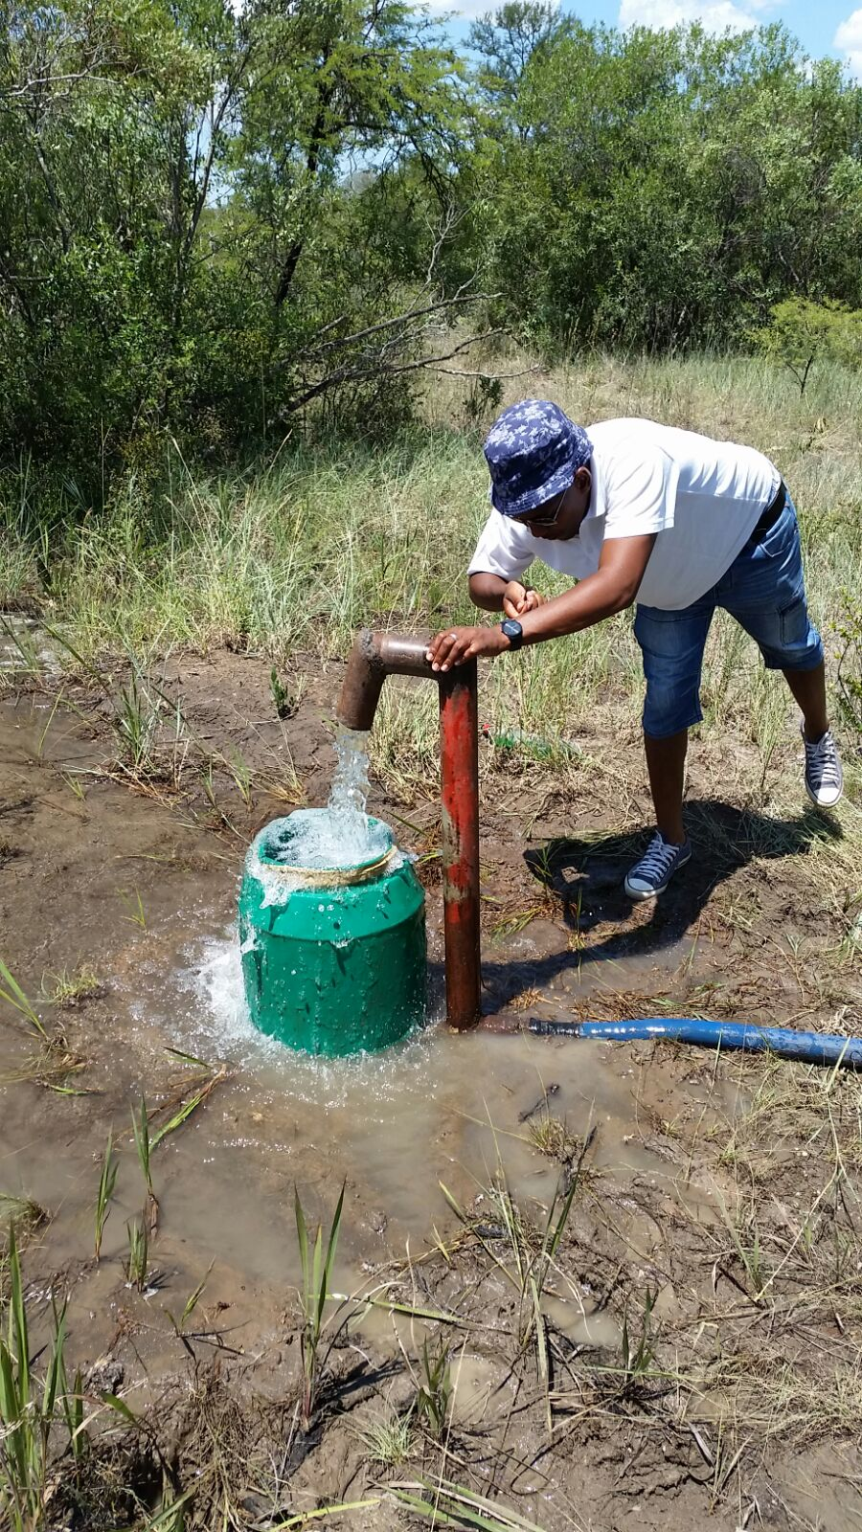
Thank you

