Slide 1
Presentation to the Select Committee on Trade and International Relations the dti’s Annual Performance Plan 2016-2019
4 May 2016
Lionel October
Director General
1

Slide 2
Presentation Outline
Economic Context
Key Interventions for 2016/17
Allocated resources
2

Slide 3
Global Economic Context
The International Monetary Fund (IMF) in its January 2016 World Economic Outlook update, lowered its forecasts for global growth in both 2016 and 2017 by 0.2 percentage points. This reflects growing concerns over growth in China and slowing growth in oil-producing countries.
The IMF now forecasts that global gross domestic product (GDP) growth will reach 3.4% in 2016 and 3.6% in 2017.
Global demand in 2016 is expected to remain subdued, largely due to:
The impact (esp. on Emerging Markets) of ‘normalisation’ of US monetary policy,
Lower energy and other commodity prices, and
Spill-over effects as growth slows in China.
Low oil prices provide a stimulus in oil-importing countries.
However, lower oil revenues in countries such as Nigeria and Mozambique will constrain demand in these countries which have become important destinations for our manufactured exports.

Slide 4
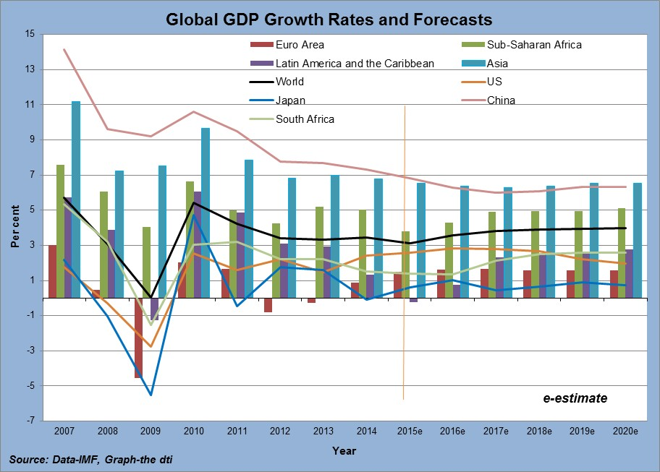
Global Economic Context

Slide 5
Domestic Economic Context: GDP
SA economy grew by 0.7% of GDP in Q3 2015, with Manufacturing (+6.2%) and the Services sector (+8.3%) as the main drivers.
The emergence of severe drought conditions in five provinces pose a significant risk to the economic growth outlook.

Slide 6
Recent Sectoral Output Performance
Some subsectors of manufacturing e.g. Agro-processing, Chemicals & Transport equipment are doing well confirming the necessity of IPAP interventions as key drivers of economic growth.

Slide 7
Recent Sectoral Job Performance
The economy continues to create jobs.
Between Q3 2010 and Q3 2015 2.1 million jobs were created (QLFS). NB: StatsSA sample changes complicate the picture.
Substantial job gains realised in Agriculture, Construction and Financial Services.
Job losses in Mining.
Manufacturing employment has stabilised.

Slide 8
Recent Trade Performance
Exports increased by R9.6 billion or 3.7% per cent to R271.7 billion in Q3 of 2015.
This is attributable to growth in exports from all sectors with agriculture (+20%), mining (+15%) and manufacturing (+2%). In monetary terms manufacturing grew by R4.3 billion, agriculture by R3.3 billion and mining by R1.8 billion.
South Africa’s imports increased by 11.9% to reach R284.5 billion in Q3 of 2015, after trending downwards in Q1 and Q2 of 2015.
The growth in imports accelerated faster than exports resulting in the trade deficit widening by R13.2 billion in Q3 of 2015 from trade surplus of R7.5 billion in Q2.

Slide 9
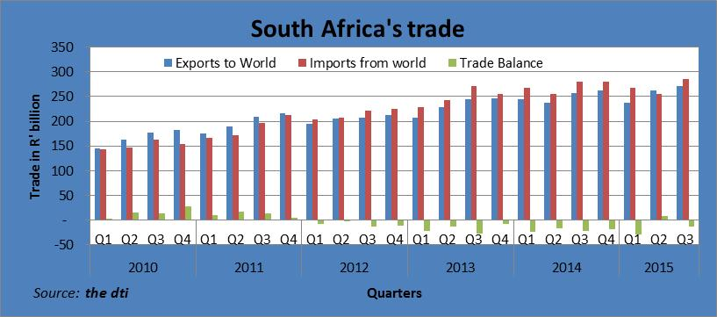
Recent Trade Performance

Slide 10
KEY PLANNED INTERVENTIONS FOR 2016/17 FINANCIAL YEAR

Slide 11
VISION
“A dynamic industrial, globally competitive South African economy, characterised by inclusive growth and development, decent employment and equity, built on the full potential of all citizens”

Slide 12
STRATEGIC GOALS
To facilitate transformation of the economy to promote industrial development, investment, competitiveness and employment creation;
Build mutually beneficial regional and global relations to advance South Africa’s trade, industrial policy and economic development objectives;
Facilitate broad-based economic participation through targeted interventions to achieve more inclusive growth;
Create a fair regulatory environment that enables investment, trade and enterprise development in an equitable and socially responsible manner;
Promote a professional, ethical, dynamic, competitive and customer-focused working environment that ensures effective and efficient service delivery.

Slide 13
STRATEGIC OBJECTIVES
Grow the manufacturing sector to promote industrial development, job creation, investment and exports;
Improved conditions for consumers, artists and opening up of markets for new patents players;
Strengthened capacity to deliver on the dti mandate

Slide 14
PROGRAMMES OF the dti
Programme 1: Administration
Programme 2: International Trade and Economic Development
Programme 3: Special Economic Zones and Economic Transformation
Programme 4: Industrial Development
Programme 5: Consumer and Corporate Regulation
Programme 6: Incentive Development and Administration
Programme 7: Trade Export South Africa
Programme 8: Investment South Africa (New Programme)

Slide 15
Amendment to the Strategic Plan
The following amendments were made to the dti Strategic Plan:
Split of Programme 7: TISA into Trade Export South Africa and a new budget programme called Programme 8: Investment South Africa. These programmes will support the strategic objective- Grow the manufacturing sector to promote industrial development, job creation, investment and exports.
Movement of CD: Africa Bilateral Economic Relations (ABER) from Programme 2: ITED to Programme 7.

Slide 16
KEY INTERVENTIONS – INDUSTRIAL DEVELOPMENT
Upscale industrial policy by tabling the annual rolling Industrial Policy Action Plan (IPAP) to Cabinet and produce quarterly implementation reports
Private Sector Investment leveraged across all incentives (AIS, 12I, CIP, FILM, and ADEP). Value of projected investments to be leveraged from projects approved - R20 billion
Facilitate Industrial Decentralisation
15 Strategic infrastructure projects approved for SEZ/industrial parks
Export revenue leveraged
Value of projected export revenue from projects approved - R800 million

Slide 17
KEY INTERVENTIONS – INDUSTRIAL DEVELOPMENT
Projected number of jobs from enterprises approved:
new jobs supported - 3 600
jobs to be retained - 3 600
Value of support provided to upgrade industrial skills from approved projects - R100 million
Facilitating transition towards low emission and climate resilient economy - Value of Greener investment approved: R800 million
Risk financing for innovative enterprises - value of innovative ventures supported from approved enterprises - R50 million

Slide 18
KEY INTERVENTIONS – TRADE, INVESTMENT and EXPORTS
Africa regional development programme implemented-progress report produced on implementation of agreed programme and projects for priority development areas in SACU and SADC-FTA.
Conclusion of Economic Partnership Agreement (EPA) - trade negotiations with the European Union (EU), Southern African Customs Union (SACU) India Preferential Trade Agreement (PTA), Southern African Development Communities (SADC) - East African Community (EAC) - Common Market for Eastern and Southern Africa (COMESA) Free Trade Agreement (FTA) – Tripartite-Free Trade Agreement (T-FTA): Status report produced on progress towards conclusion of trade negotiations.

Slide 19
KEY INTERVENTIONS – TRADE, INVESTMENT and EXPORTS
Status reports produced on bilateral engagements with the Rest of World
Status reports produced on engagements in Global Fora (e.g. BRICS, G20, AGOA)
Increased manufactured exports under EMIA by increasing the value of exports to R3.5 billion
Investment facilitation in targeted sectors - R50 billion

Slide 20
KEY INTERVENTIONS – BROADENING PARTICIPATION
Implementation of B-BBEE Amendment Act and Code of Good Practice for B-BBEE
Report on the implementation of the B-BBEE Amendment Act and Regulations produced for Minister’s approval
Black Industrialist (BI) development programmes implemented
25 new BIs supported in IPAP sectors and report produced
Revitalisation of industrial parks
Report on the identified Industrial Parks submitted for Minister’s approval.

Slide 21
KEY INTERVENTIONS – BROADENING PARTICIPATION
Revitalisation of industrial parks
Implementation on Phase 1 of the implementation plan has commenced with the following Industrial Parks approved for funding:
Province | Industrial Park
Eastern Cape | Vulindlela Industrial Heights King Sabata Dalinyebo Municipality
 | Queenindustria Chris Hani Development Agency
KwaZulu Natal | Isithebe Ithala Bank
Free State | Botshabelo Free State Development Corporation
Limpopo | Seshego Limpopo Development Maintenance Agency

Slide 22
KEY INTERVENTIONS - REGULATION
Impact assessment of regulation on business and economic citizens
Two SEIAS reports on Companies and Copyright/Performers Protection Amendment Acts developed for Minister’s approval.
Two evaluation reports on Consumer Protection Act (Exemptions and Industry Codes) and Companies Act (Cost of doing business).
One monitoring report on implementation of legislation developed for Minister’s approval.

Slide 23
KEY INTERVENTIONS - REGULATION
Policies, Bills and Regulations to enforce fair business practices
One policy framework on legislative audit report developed for Minister’s approval (policy position on policies to retain or migrate).
Two Bills on Companies Amendment and Copyright/Performers Protection Act.
Four regulations on Liquor, Companies, Gambling and Copyright developed for Minister’s approval and published.

Slide 24
KEY INTERVENTIONS - REGULATION
Establishment of Trading Entities and Copyright Tribunal (repositioning)
Two business cases (National Liquor and Gambling Trading Entities) developed for approval by Minister.
Two institutions/entities repositioned and established (National Liquor and Gambling Trading Entities).

Slide 25
KEY INTERVENTIONS – ADMINISTRATION
Attract, develop and retain professional and skilled officials
Reduction of the vacancy rate from 8.2% to 5%.
Percentage staff turnover rate- 6.8%.
Employment of People With Disability to increase from 2.98% to 3.1%.
Employment of Women in senior management positions to 50% from 48%.
All Creditors’ Payments made in accordance with legislative requirements i.e. 30 days
25
Notes:
98 % invoices processed within 14 days.

Slide 26
KEY INTERVENTIONS – ADMINISTRATION
Public Awareness Platforms
Conduct 22 multimedia awareness campaigns on key sectors of IPAP and the dti strategic projects.
Conduct outreach engagements and exhibitions
32 Outreach engagements
30 Exhibitions
Service Delivery Improvement Plan (SDIP)
2015/16 implementation report for SDIP submitted to DPSA.
26

Slide 27
ALLOCATED BUDGET

Slide 28
Medium Term Expenditure Framework
 | 2016/17 | 2017/18 | 2018/19
 | Medium-Term Estimates (R ’000)
Programmes | Medium-Term Expenditure Framework (MTEF)
Administration | 736 625 | 756 453 | 788 840
International Trade and Economic Development | 126 383 | 123 288 | 127 858
Special Economic Zones and Economic Transformation | 108 282 | 108 971 | 112 488
Industrial Development | 1 735 679 | 1 814 083 | 1 776 411
Consumer and Corporate Regulation | 313 525 | 326 895 | 345 727
Incentive Development and Administration | 6 922 407 | 5 772 956 | 5 095 242
Trade Export South Africa | 336 539 | 339 386 | 333 624
Investment South Africa | 48 077 | 48 448 | 51 195
TOTAL FOR PROGRAMMES | 10 327 517 | 9 290 480 | 8 631 385

Slide 29
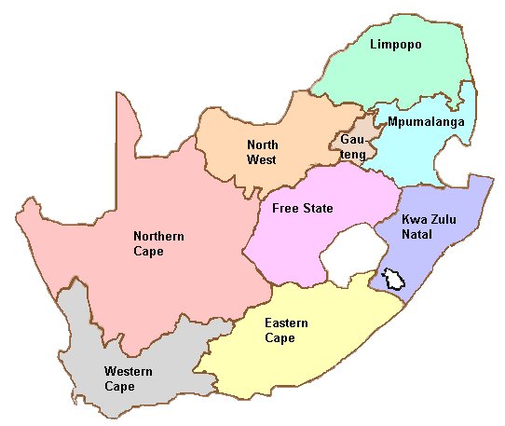
Provincial Performance of Manufacturing Incentives 2015/16
Gauteng:
12I: 9
AIS: 12
MCEP: 107
Limpopo:
12I: -0
AIS: -0
MCEP: 4
North West:
12I: 1
AIS: 2
MCEP: 5
Mpumalanga:
12I: -0
AIS: -0
MCEP: 4
Northern Cape:
12I: -
AIS: -
MCEP: 2
Kwa Zulu Natal:
12I: 6
AIS: 8
MCEP: 27
Free State:
12I: 2
AIS: -0
MCEP: 3
Western Cape:
12I: 11
AIS: -
MCEP: 70
Eastern Cape:
12I: 2
AIS: 15
MCEP: 14

Slide 30
Provincial Performance of Infrastructure & Services Incentives 2015/16
Gauteng:
CIP: 7
FILM: 69
BPS: 4
Limpopo:
CIP: 1
FILM: 0
BPS: 0
North West:
CIP: 0
FILM: 0
BPS: 0
Mpumalanga:
CIP: 1
FILM: 1
BPS: 0
Northern Cape:
CIP: 1
FILM: 0
BPS: 0
Kwa Zulu Natal:
CIP: 1
FILM:5
BPS: 3
Free State:
CIP: 0
FILM: 1
BPS: 0
Western Cape:
CIP: 0
FILM: 37
BPS: 5
Eastern Cape:
CIP: 1
FILM: 1
BPS: 0

Slide 31
STRATEGIC RISKS
Strategic risks that would impede the achievement of the dti’s strategic objectives impacting on the dti include, but are not limited to:
Inability to meet clients/public expectations due to the domestic and global conditions
Possible fraud and corruption risk due to the nature of the Department's operations
Reputational risk and deterioration in governance of the public entities and non-achievement of their performance targets
Reputational risk due to inadequate communications to the public, of the Department's achievements and success stories
Inability to penetrate foreign markets.
Notes:
Largest province – Northern cape
Smallest province – gauteng
Largest population

Slide 32
STRATEGIC RISKS
These risks are being adequately managed through, but not limited to, the following mitigating actions:
early warning system-economic intelligence reporting;
the prioritisation of the African continent as major source of demand (more foreign representatives, more trade missions going to Africa);
energy efficiency programmes (clean audits) and research studies for alternate energy sources as well as participation in the electricity war room;
skills development programmes for the country; and
regular engagements with entity/management of entities and collective bargaining clusters in entities.
Notes:
Largest province – Northern cape
Smallest province – gauteng
Largest population

Slide 33
Ke ya leboga Ke a leboha Ke a leboga Ngiyabonga Ndiyabulela Ngiyathokoza Ngiyabonga Inkomu Ndi khou livhuha Dankie Thank you

