Slide 1
SAPO Corporate Strategic Plan 2016/17 – 2018/19
Parliamentary Portfolio Committee
15 April 2016

Slide 2
AGENDA
        Current Status Overview
        STP Migration
        Status of Mail and Retail Outlets
        Key Challenges
      Strategic Intention
      Revenue Growth and Cost Management Strategy
      Budgets and Financials 2016/17 – 2018/19
      Key Performance Indicators
      Next Steps

Slide 3
A New Vision & Mission
Vision
A leading provider of postal, logistics and financial services to the South African market
Mission
We leverage our established infrastructure and link government, business and customers with each other locally and abroad.
SAPO has revised its vision to one that highlights SAPO’s mandate and sets a goal of becoming a leading service provider within the markets in which it operates.

Slide 4
Current Status
Revenues remain under pressure with declining mail and transaction volumes resulting in monthly cash shortfalls of approximately R125m.
The Strategic Turnaround Plan (STP ) is being implemented and the targets have been re-based in the new Corporate Strategic Plan.
Adequate funding remains the key challenge to settle obligations from the past and position SAPO on the recovery path.
Engagements with banks underway to secure funding to fund SAPO’s growth strategy.
PFMA is making it difficult to compete effectively

Slide 5
STP Migration
STP
28 Initiatives carried over from STP
SAPO
2016-2019
Corporate
Plan
6 Initiatives
completed
3 Initiatives
were not realisable
Note: Please see
Appendices for
detailed initiatives
Initiatives being carried over from the STP into the new corporate plan are revenue generation initiatives and operational efficiency improvement initiatives.
The initiatives that were not realisable are tenders that were not issued but had been in the STP, such as the SASSA tender, which had been estimated at R 250 million and tenders that were not awarded to SAPO, such as tender for distribution of tablets and ARV’s. As well as the launch of the MVNO

Slide 6
Current of SAPO Mail and Retail Outlets – as at 30 March 2016
National Status - Action on outstanding payments on rented outlets
Status | Branches evicted and permanently closed | Locked out | Electricity cut | Summons received | Letter of demand received |  | Total affected outlets
 | Not Trading | Not Trading | Manual Trading | Normal Trading | Normal Trading | Total affected
Number | 25 | 7 | 0 | 25 | 264 | 321
Evicted and permanently closed |  | 25 Post Office branches
Locked out |  | 6 Post Office branches, 1 Depot
Summons received |  | 23 Post Office branches, 1 Mail Depot and 1 Post Boxes Area
Letter of demand received |  | 224 Post Office branches, 21 Mail Depots, 5 Mail Hubs, 10 Post Boxes Area 1 Delivery Management Area office, 3 Mail Centres
Note: Please see
Appendices for
details on the status
Of outlets

Slide 7
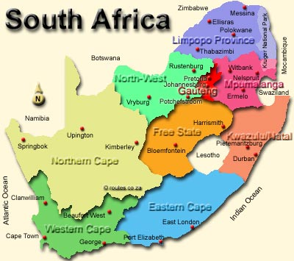
Current Status: The Extensive SAPO Footprint
SAPO Infrastructure and Reach
Daily mail volume | 3m
Household addresses | 11.8m
Average mail items delivered per street address | 2.5
Quality of service | 92%
Delivery Frequency/week | 3 days
% Standard mail | 51%
Post-boxes | 4m
Retail Points of presence | 2,373
Mail centres | 26
Mail depots | 667
Mail delivery and collection points | 4m
325 Points
247 Points
354 Points
193 Points
153 Points
321 Points
136 Points
SAPO has the largest branch network in the country
342 Points
302 Points

Slide 8
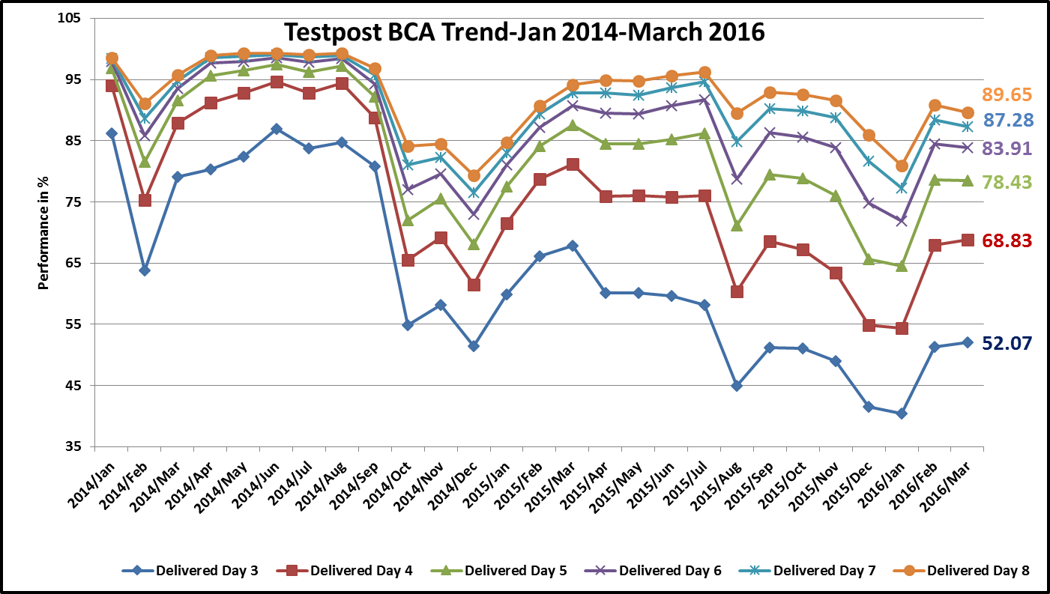
Service Interruption Impact on Revenue Jan 2014-March 2016
The suspension
of services, resulted
in the delivery times
Falling as shown in
the graph, which
reflects a decline
in service quality.
In response to
the decline in
service quality,
customers
withdrew their
business which
resulted declines in
revenue of 13% and
15% respectively.
Linehaul services
suspended in August.
Revenue fell by R 35m,
13% decline, in August
Linehaul services
suspended in October
and December.
Revenue fell by R 36m
15% decline, over both
months

Slide 9
Service Interruption Impact on Revenue Jan 2014-March 2016 (cont.)
R 10m envelope order by SABC
raised overall mail revenue
Linehaul services
suspended in October
and December.
Revenue fell by R 36m
15% decline, over both
months
Linehaul services
suspended in August.
Revenue fell by R 35m,
13% decline, in August
The declines in revenue over the two focus periods show the severe impact on revenue that service suspensions have. Revenues were lifted from December by a R 10m envelope order by the SABC and R 12m increase in revenue from other product lines. When suppliers are paid and service is restored, revenue recovers but not to the levels preceding the suspension of services, September revenue is lower than July revenue, February revenue is lower than September revenue

Slide 10
Current Status: Properties Overview
Property valuation exercise has been completed for the 98 (excluding NPC building) properties target in STP.
Municipal value of the properties was R 83 million. Current market value is R 196 million.
SAPO is in the process of reviewing its overall property strategy including the approach to the disposal of properties.
The review will determine how SAPO deals with offers that have already been received and any future offers.

Slide 11
Key Short-term Challenges
Severe Impact on Cash flow
Service Instability
Operational Losses
Historically unstable labour environment
SAPO (excluding Postbank) is losing approximately R125 million per month.
As a result of slow payment by SAPO, some creditors are refusing to supply SAPO with essential goods and services.
These include obligations arising out of the necessary conversion of temporary to permanent staff, wage negotiations (increases and scale adjustments) and the equal pay for equal value principle.
Solutions to the challenges are in progress

Slide 12
Key Long-term Challenges
International courier companies are making significant headway into the African and South African market
A competitive market
Competitor growth in logistics and parcels market
Migration of consumers to online channels
Operational inefficiencies
Low performance culture
Impact of digital substitution and
alternatives can be clearly seen
in declining physical volumes
Though mail volumes are declining, operating costs have been rising and productivity falling

Slide 13
Opportunities
The South African Mail, Envelope and Courier (MEC) market size is currently R10.5 billion and is growing at 10% to 25% p.a#.
SAPO
Opportunities
Growing MEC Market
Digital and Innovative Postal Products
Government Services
SAPO’s nationwide network positions SAPO to be a key provider of services to government and be a channel for the provision of government services.
Substitution of mail by digital technology presents an opportunity for SAPO to create innovative digital products.
SAPO will be the only
infrastructure player remaining
# http://www.courierscout.co.za/sa-courier-sector-gives-sapo-services-a-run-for-their-money
Posted 8 September 2015

Slide 14
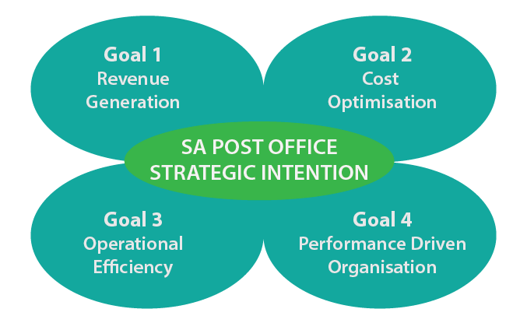
Strategic Intent
The highest priority for SAPO is to return to profitability
This goal will be achieved by the following objectives:
Increasing and Diversifying Revenue Streams
Cost Management
Improving Operating Efficiency
Creating a Modern and High Performance Organisation
These strategic focus areas are also identified in the Strategic Turnaround Plan (STP) as being key for SAPO’s long term sustainability

Slide 15
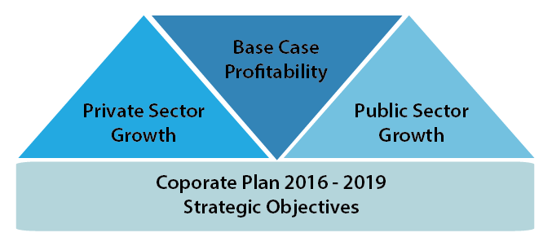
Revenue Growth and Cost Strategy
SAPO’s revenue growth and cost strategy has three elements
Base Case is focused on returning to pre-crisis profitability levels
Growth: Private sector consists of driving growth opportunities in non-government markets
Growth: Public sector focuses on generating growth from servicing government

Slide 16
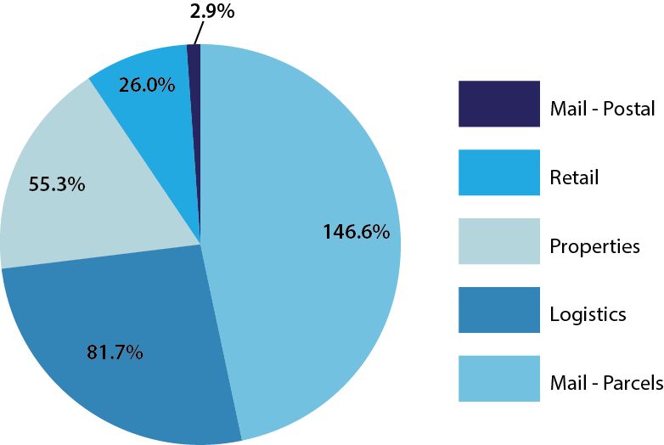
Focus Area 1: Base Case Revenue
Provided that SAPO is adequately capitalized and operationally functional, SAPO’s base case is focused on returning the organization to a “steady-state” of financial performance.
Revenue contribution by Business unit
BU | 2016 Rbn | 2017 Rbn | 2018 Rbn | 2019 Rbn
Mail – Post & Hybrid | 3.4 | 3.7 | 3.9 | 3.9
Mail – Parcels | 0.1 | 0.5 | 1.1 | 1.9
Logistics | 0.2 | 0.3 | 0.6 | 1.2
Digital | - | 0.2 | 0.4 | 0.5
Retail | 0.4 | 0.9 | 1.3 | 1.6
Properties | - | 0.2 | 0.2 | 0.2
Postbank | 0.6 | 0.8 | 1.2 | 1.8
SAPO Revenue 3yrs growth target
Compound Annual Growth Rate (CAGR)

Slide 17
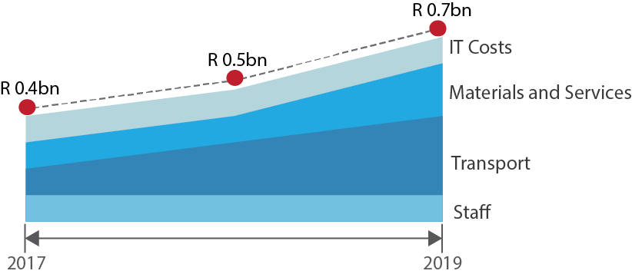
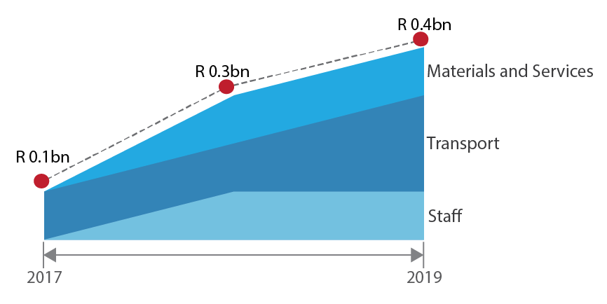
Focus Area 2: Growth Case Revenue Increase
The size of the local markets in which SAPO seeks to operate are significant, and small gains in market share generate substantial revenue. Revenue growth and diversification will come from both the private and the public sectors.
Private Sector
Revenue Growth Target
Public Sector
Revenue Growth Target

Slide 18
Focus Area 3: Cost Management
SAPO has a challenge in that it has a large fixed cost base versus the declining revenues. Reducing the fixed cost base is key to SAPO’s ongoing sustainability.
Staff costs
Is SAPO’s largest cost item and the key focus will be the reduction of staff costs through voluntary separation and early retirement in the 2016/217 and 2017/2018 years.
Properties
Is SAPO’s second largest cost driver and greater focus will be to optimise of all of its rented space
Transport
Is the third largest cost item which will move closer to the industry benchmark for efficient transport operations which is between 13% - 20% of revenue.
The targeted ratio of staff costs will be to reduce the ratio from its current 78% to 40% over three years.

Slide 19
Putting it all together
Group excluding Postbank
Growth case | 2016 | 2017 | 2018 | 2019
Rbillions
Revenue – base case | 4.1 | 5.0 | 6.3 | 7.7
Revenue – growth |  | 0.6 | 0.8 | 1.1
Revenue – government |  | 0.4 | 0.8 | 0.9
Costs before funding and abnormal costs | 5.4 | 5.5 | 5.8 | 6.3
Costs – growth case |  | 0.4 | 0.5 | 0.7
Costs – government case |  | 0.1 | 0.2 | 0.3
Funding costs | 0.1 | 0.2 | 0.3 | 0.2
Net(loss) profit pre-abnormal costs | -1.4 | - 0.3 | 1.1 | 2.3
Abnormal costs |  | 1.0 | 0.5
Net (loss) profit | - 1.4 | - 1.3 | 0.6 | 2.3
Adding the base case and private and public sector growth initiatives the revenue case becomes compelling with the business becoming profitable from 2018 onwards.

Slide 20
SAPO Group Financial Performance
Net Loss of R1.2bn forecast for 2015/16FY, an improvement from the R1.5bn net loss in the prior year.
Net Loss of R1.1bn in the 2016/17FY as business returns to previously levels of performance.
Net Profit of R1.0bn in the 2017/18FY projected from aggressive revenue growth strategies.
Total assets increase to R13bn in the 2018/19FY.
Capital and reserves improves to a positive R1.7bn linked to revenue growth, profitability and a capital injection.

Slide 21
SAPO Group Funding Required
Funding requirements of R3.5bn in the 2016/17FY, to conclude the past obligations and position SAPO for recovery and growth.
Current borrowings of R1.2bn supported by guarantees.
Engagements with banks underway to raise additional funding.
Existing loans and guarantees to be extended to 2018/19FY.

Slide 22
SAPO Group Funding - Repayments
R650m funding allocation by National Treasury in the 2016/17FY.
Equity injections R1.35bn in 2017/18FY and R1.35bn in 2018/19FY will be needed from National Treasury.
All loans to be fully paid by 2018/19FY.

Slide 23
Key Performance Indicators
To monitor the organisation’s progress on towards its strategic objectives, the following KPI’s will be tracked at a corporate level:
Effective management of the Risk Plan and mitigation strategies to ensure successful implementation of Key Performance Indicators. (Detail Risk Management Plan and KPIs are included in the Additional Notes)
Corporate
KPI’s
Mail Delivery Standard
Increase financial inclusion of the mass market
Optimise IT Capacity
Expand Post Box User Base
Achieve Base Case Revenue
Achieve Growth Revenue (Private Sector)
Government Business Share Growth
Maintain Base Case Cost
Optimise SAPO Operations
Performance Management Systems Implementation
Leadership and Career Path Development
Training and Development of Staff in critical skills
Reward and Recognition System Revision
Notes:
Detail on KPI’s included in the Additional Notes: Slides 30 – 34. (Detail Risk Management Plan included in the Additional Notes: Slides 35 – 37)

Slide 24
Next Steps
Conclude the engagements with banks to secure additional funding.
Settle long outstanding creditors to enable operations to function normally.
Continue engagements with labour to settle the past commitments and maintain labour stability.
Restore customer confidence through ongoing engagement and actual delivery on customer’s expectations
Activate the implementation plans for revenue recovery and growth initiatives.

Slide 25
Next Steps Continued
Meetings with key Government departments to pursue strategic partnerships.
Continue engagements with ICASA to conclude reserved postal services complaints lodged.
Improvements in cost and process optimisation for a leaner SAPO.
Finalise the performance contracts of Executives and management to ensure accountability for targets and deliverables.

Slide 26
Thank You

Slide 27

Appendices

Slide 28
Appendix A: STP Migration
Listed are the initiatives that
have been carried over from
the STP into the Corporate
Plan or that were not in
STP and were
introduced in the new
Corporate plan.
Details of Targeted Sales
Initiatives are contained in
Appendix B
Completed initiatives and
Initiatives that were not
feasible are
contained in Appendix C

Slide 29
Appendix B : STP Migration

Slide 30
Appendix C : STP Migration

Slide 31
Appendix D : Branch Forced Closures
 | Region | Branch Name | Address | Closing date
1 | CENTRAL PROVINCES | DIAMOND | SHOP 5A, DIAMOND PAVILLION MALL OLIVER+MAC DOUGAL RD, KIMBERLEY 8305, | 16 April 2015
2 | Western Cape | Idas Valley | Shops 1 & 2, Simonsrust Shopping Centre, Corner Cluver Street & Helshoogte Road, Simonswyk, Stellenbosch, 7600 | 17 April 2015
3 | Central Provinces | Botshabelo East | Caltex Garage. S/number 658, Section H, Main Road | 12 May 2015
4 | WITWATERSRAND | Vorna Valley | VORNA VALLEY SPAR CO 334 ALBERTYN & HARRY GALAUN STRS | 01 April 2015
5 | WESTERN CAPE | HEIDERAND | HEIDERAND MALL, SHOP D4/5, LOUIS FOURIE ROAD | 03 July 2015
6 | NORTH CENTRAL REGION | Entabeni | ENTABENI HOSTEL | 16 July 2015
7 | Witwatersrand | MELVILLE | CAMPUS SQUARE C/O KINGSWAY and UNIVERSTY STREET MELVILLE 2092 | 17 July 2015
8 | KwaZulu-Natal | QUALBERT | 30 ALBERT ST | 27 July 2015
9 | Eastern Cape | VINCENT | Shop No 68A Vincent Park Shopping Complex | 29 July 2015
10 | North Central Region | Denneboom | SHOP D12 MAMELODI CROSSING, CNR WALTLO AND TSAMAYA RD, DENNEBOOM | 04 July 2015
11 | KWAZULU-NATAL | WATERTOWER | Shop9/10 Bluff Shopping Centre 884 Bluff Road Bluff | 29 July 2015
12 | North East Region | Tshikondeni | TSHIKONDENI MINE | 31 July 2015
13 | Central Provinces | Universitas | SHOP 1 & 2 MEDITAS SPAR CENTRE, MUDD SQUARE, UNIVERSITAS, BLOEMFONTEIN | 21 August 2015
14 | KwaZulu-Natal | TALANA | SHOP 5 DUNDEE BOULEVARD, KAREL LANDMAN ROAD | 25 August 2015
15 | Central Provinces | Clarens | SWART STREET, CLARENS | 26 August 2015
16 | North Central Region | Atteridgeville East | CNR KHOZA AND PHUDUFUFU STREET | 15 September 2015
17 | WITWATERSRAND | Wibsey | 369 Shopping Centre shop no 2 cnr Commando and Maraisburg Road | 30 October 2015
18 | WITWATERSRAND | Germiston | GOLDEN WALK CENTRE SHO NO 74 & 75, VICTORIA STREET, GERMISTON | 30 October 2015
19 | Witwatersrand | Phomolong | CAMBRIDGE SHOPPING CENTRE 325 MASTUF ROAD COMMERCIA EXT 9 PHOMOLONG | 30 November 2015
20 | Western Cape | West Coast Village | SHOP 1, WEST COAST VILLAGE MALL SHOPPING CENTRE, CORNER WEEST COAST & SANDOWN RDS | 15 January 2016
21 | North Central Region | Modderspruit | Shop No 28, KE Ya Rona Shopping Centre, Portion of Portion 1 of the Farm Modderspruit No 461 JQ | 29 January 2016
22 | KwaZulu-Natal | Hayfields | HAYFIELDS MALL CNR BLACKBURROW RD AND CLELAND RD PIETERMARITZBURG | 01 March 2016
23 | Western Cape | Bloubergrant | Shop 19, Bayside Mall, Corner Blaauwberg & Otto Du Plessis Drive (also known as R27 West Coast Rd), Tableview, 7441 | 30 April 2016
24 | Western Cape | Bothasig | C/O VRYBURGER & TAFELBERG STREET | 23 March 2016
25 | Western Cape | N1-City | SHOPS 84 & 85, N1 CITY MALL SHOPPING CENTRE, LOUWTJIE ROTHMAN AVE | 22 April 2016

Slide 32
Appendix E : Branches Locked Out and Summonsed
NO | Name of Outlet | Province
 | OUTLETS LOCKED OUT
1 | Bryanston Depot | Gauteng
2 | Strandfontein PO | Western Cape
3 | Bloubergrandt PO | Western Cape
4 | N1 City PO | Western Cape
5 | Bothasig PO | Western Cape
6 | Kranskop PO | KwaZulu-Natal
7 | Barkly East PO | Eastern Cape
NO | Name of Outlet | Province
 | SUMMONSES RECEIVED
1 | Quigney Post Office | Eastern Cape
2 | Huttenheights P O | KwaZulu-Natal
3 | Pinetown Depot | KwaZulu-Natal
4 | Rochdale Park P O | KwaZulu-Natal
5 | Westwood P O | KwaZulu-Natal
6 | Menlyn PO | Gauteng
7 | Uvongo PO | KwaZulu-Natal
8 | Bergvliet PO | WESTERN CAPE
9 | Cape Gate PO | Western Cape
10 | Die Boord PO | Western Cape
11 | Howard Place | Western Cape
12 | Riviersonderend PO | WESTERN CAPE
13 | Stellenbosch PBL | Western Cape
14 | Stellenbosh Depot | WESTERN CAPE
15 | Vlaeberg PO | Western Cape
16 | Diepsloot P O | Gauteng
17 | Randpark Ridge PO | Gauteng
18 | Southdale PO | Gauteng
19 | Southgate PO | Gauteng
20 | Olievenhoutbosch PO | Gauteng
21 | Sihayo PO | KwaZulu-Natal
22 | Maake PO | Limpopo
23 | Bosbokrand PO | Mpumalanga
24 | Plessislaer PO | KwaZulu-Natal
25 | Hoedspruit PO | Mpumalanga

Slide 33
Additional Notes

Slide 34
Legal and Regulatory Framework
The SA Post Office is mandated through the Postal Act 44 of 1958 and the Postal Services Act 124 of 1998 to provide postal services to all South Africans. These Acts provide for the regulation of postal services and the operational functions of the company, including its Universal Service Obligations (USO), as well as the operation of the Postbank.
Postal Services Act 124 of 1998
SA Post Office SOC Ltd Act 22 of 2011
Postbank Act 9 of 2010
Broad ICT policies
There are other pieces of legislation such the PFMA, and the ECT Act, amongst others that the SA Post Office complies with and is governed by
Regulation under auspices
of ICASA and the
Financial Services Board
(FSB).
The National Development Plan
Public Finance Management Act 1 of 1999 (PFMA)

Slide 35
Focus Area 3: Additional Cost Management
Increased automation of repetitive tasks and streamlined workflows will reduce central support costs
Funding Costs
The funding costs have also assumed that the long term loans are completely repaid by the end of the 2018/19
Funding costs have been estimated at an average cost of 9.5% for 2017, with 1% increases in each subsequent year
Support costs to income ratio will reduce to 11.9% by 2019
Support Costs
IT Costs
To accommodate an improved leased-line network, IT costs are expected to increase slightly in the base case.
Future technology investments will only be made in support of increased revenue streams or for legislative compliance.

Slide 36
Focus Area 4: Additional fund raising opportunities
With the aim of generating further revenue generating opportunities, SAPO is also exploring additional areas of opportunity, such as:
Sale of further properties
98 properties planned be sold
Reapply for USO subsidy
Re-negotiating the specifics of the USO obligation with ICASA
Additional properties may be sold
Regulatory Reform
Review and refresh regulations to suit the current operating environment
Tighter control of the reserved market implemented

Slide 37
SAPO Group Income Statement
Net Loss of R1.2bn forecasted for 31 March 2016, an improvement from the R1.5bn net loss in the prior year. Largely contributed by the cost reduction achieved from the STP implementation.
Net Loss of R1.1bn in the 2016/17FY to allow for correction of the business through the re-based turnaround initiatives.
Net Profit of R1.0bn in the 2017/18FY projected from aggressive revenue growth strategies.

Slide 38
SAPO Group Balance Sheet
Total assets increase to R13bn in the 2018/19FY.
Capital and reserves improves to a positive R1.7bn linked to revenue growth, profitability and a capital injection.
Capital expenditure of R1.8bn over the medium term to strengthen infrastructure for competition and growth. Includes Postbank Corporatisation costs of R600m.

Slide 39
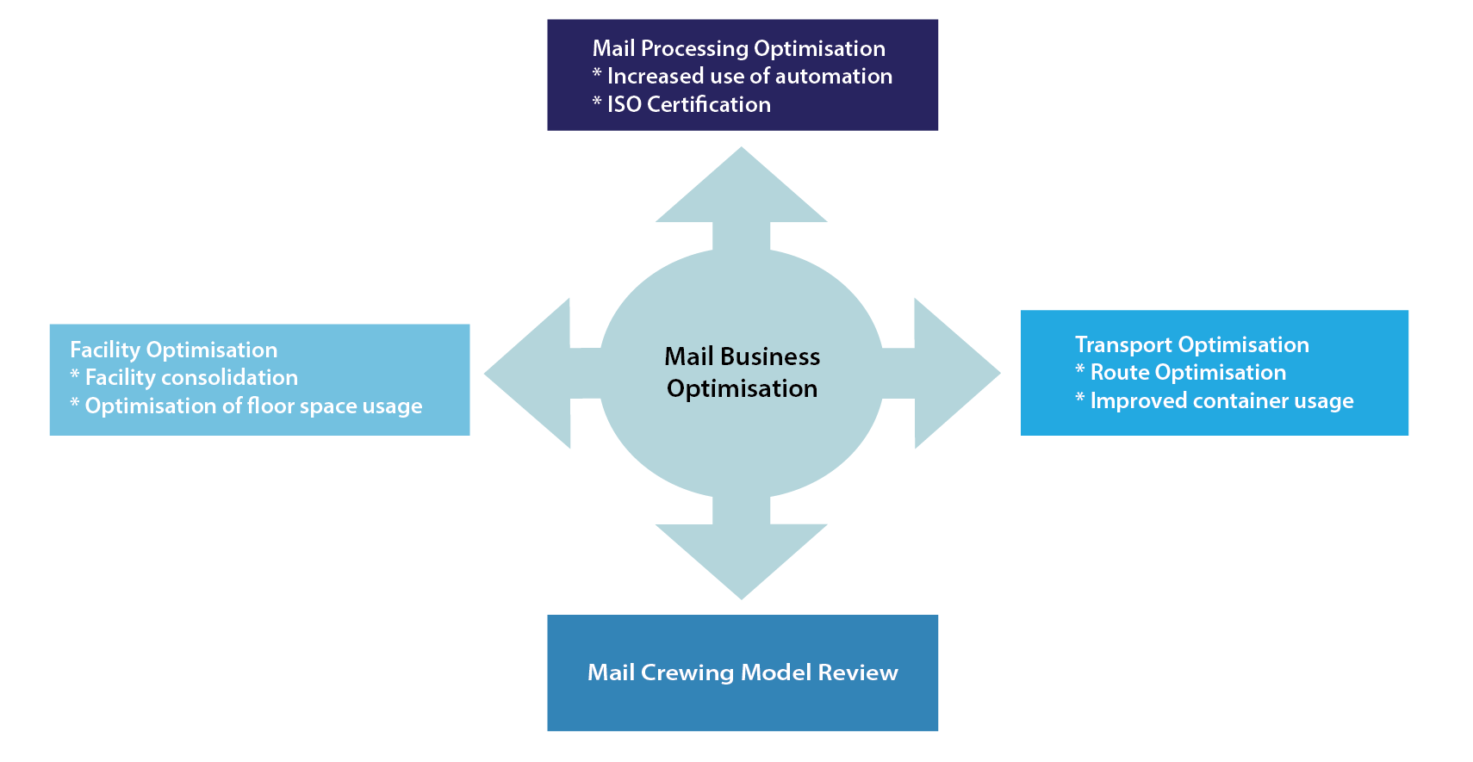
Focus Area 5: Operational Efficiency – Mail
To obtain operating efficiencies, SAPO will exploit rationalization and optimization opportunities within the Mail operations:

Slide 40
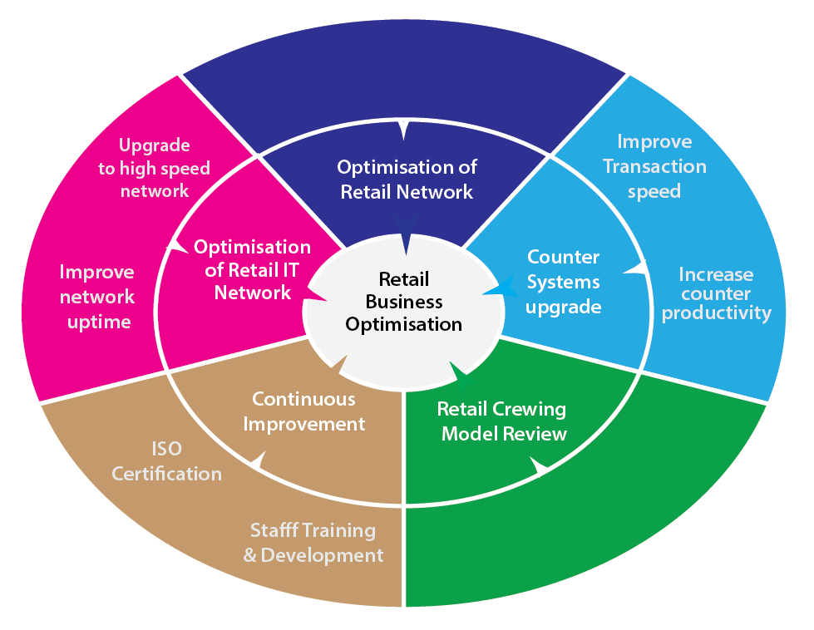
Focus Area 5: Operational Efficiency - Retail
Retail is the consumer-facing side of the organisation.
The Retail business unit is therefore SAPO’s brand ambassador in the retail consumer space, and with South Africans in general.
Improving retail operations
will enhance customer’s
experiences of the Post Office
and restore their confidence in
the company.

Slide 41
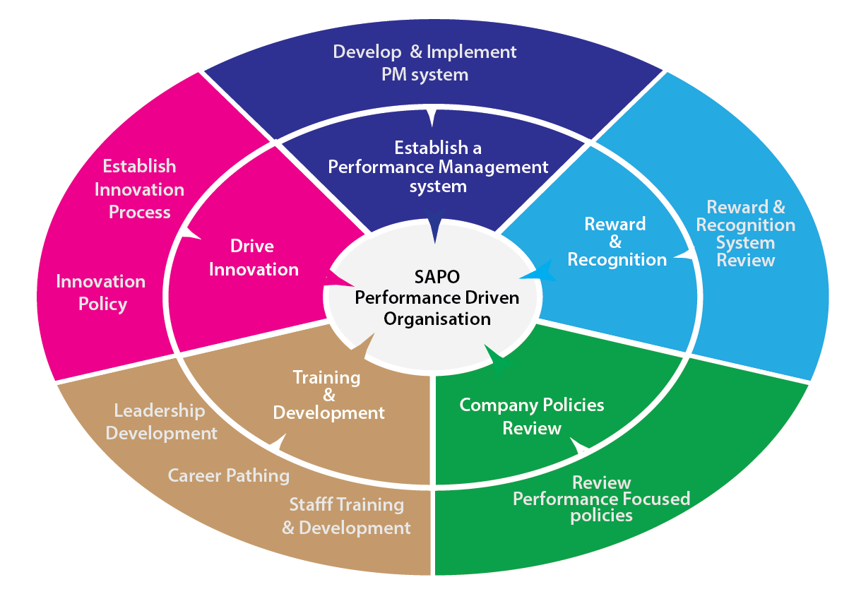
Focus Area 6: Performance Driven Organisation
SAPO does not have a high performance culture. Thus a key objective for SAPO is to focus on improving productivity across the organisation.
SAPO management will implement a variety of best practices with the aim of changing the culture to be performance focused.

Slide 42
KPI’s

Slide 43
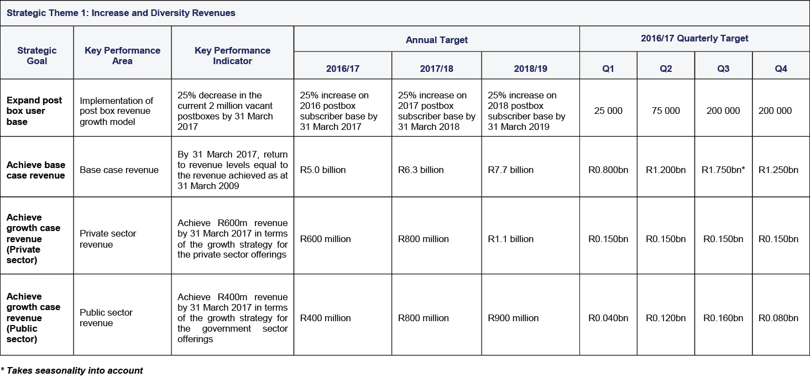
KEY PERFORMANCE INDICATORS

Slide 44
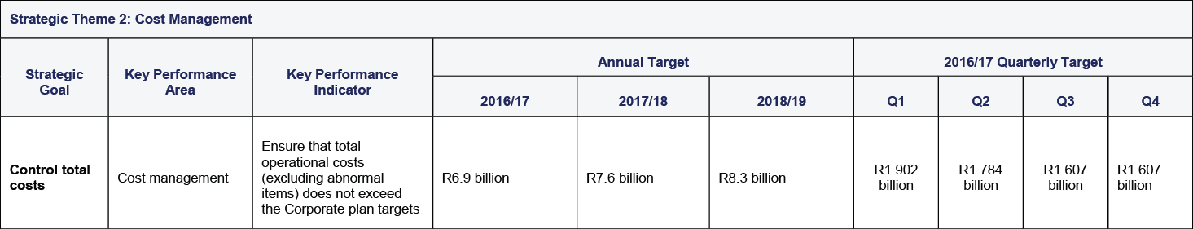
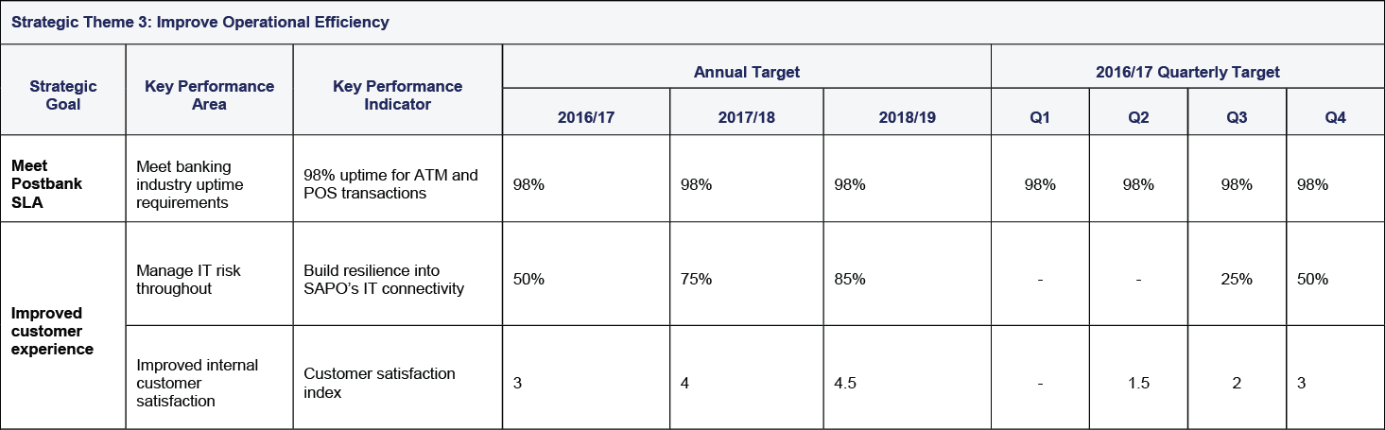
KEY PERFORMANCE INDICATORS

Slide 45
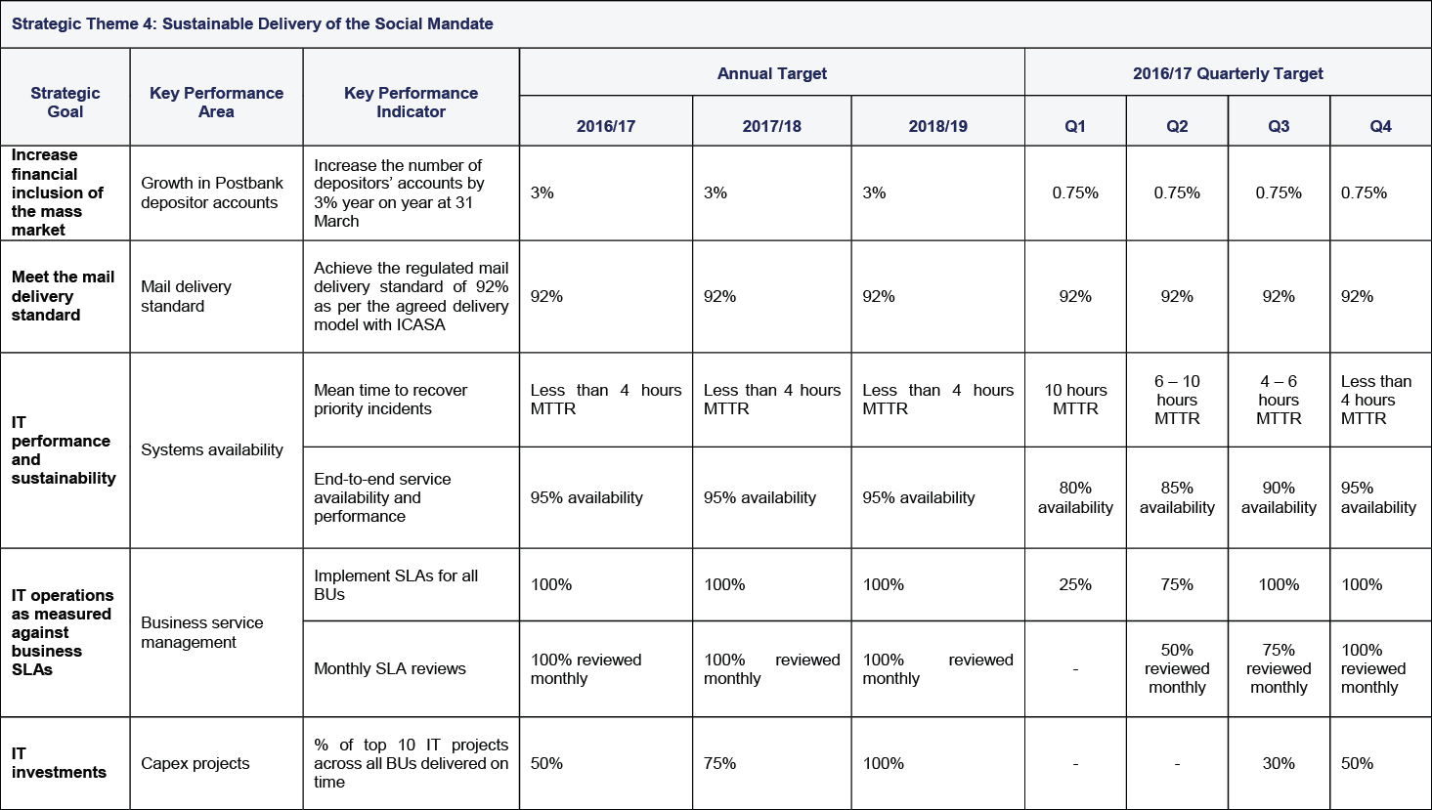
KEY PERFORMANCE INDICATORS

Slide 46
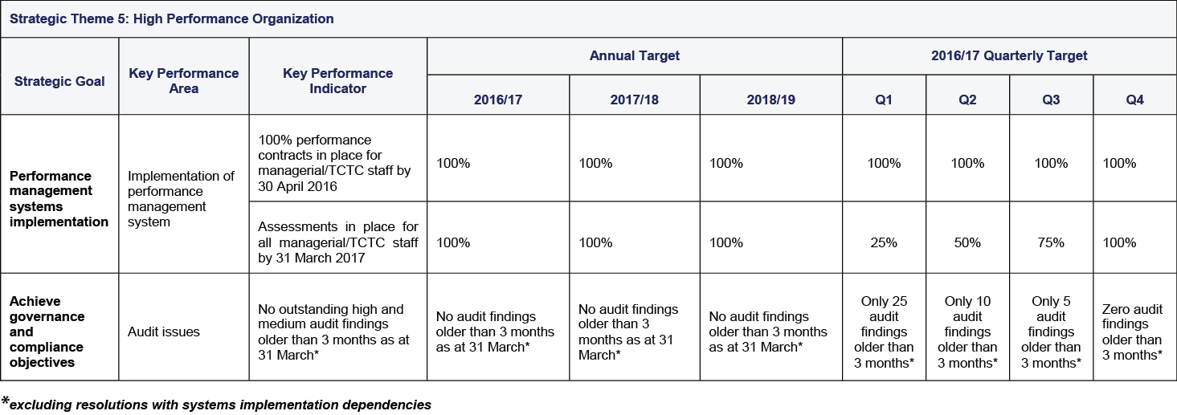
KEY PERFORMANCE INDICATORS

Slide 47
Risk Plan

Slide 48
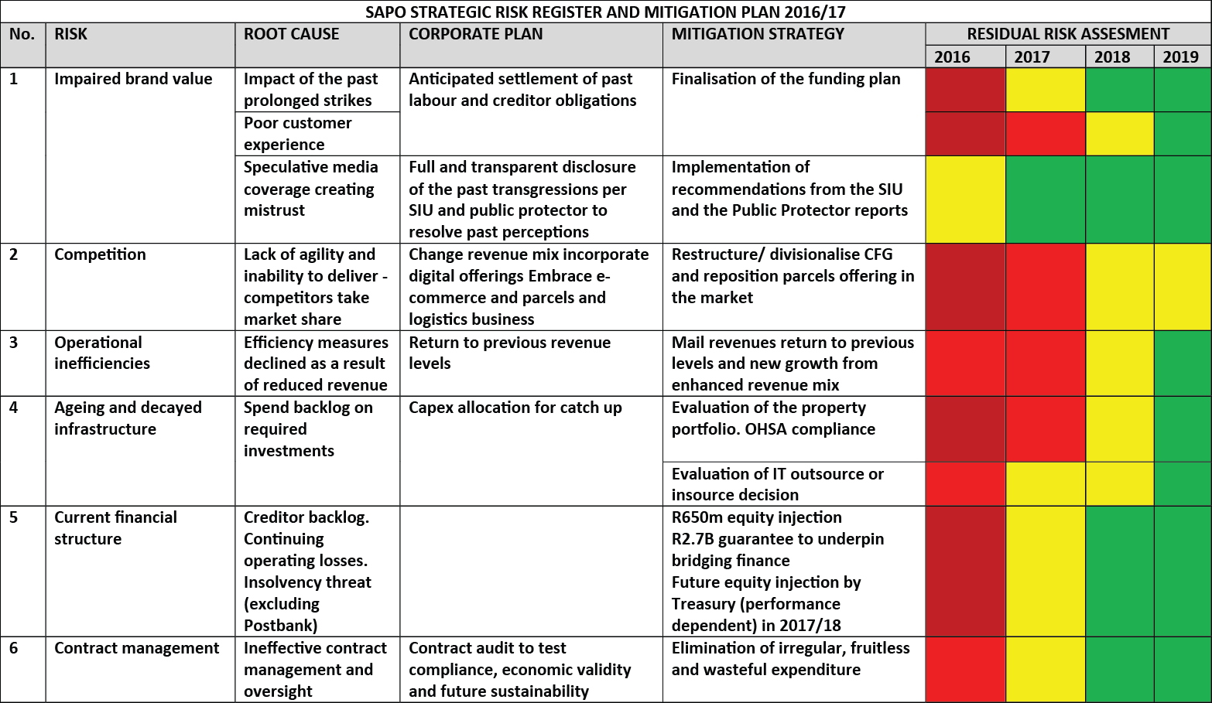
RISK MANAGEMENT PLAN

Slide 49
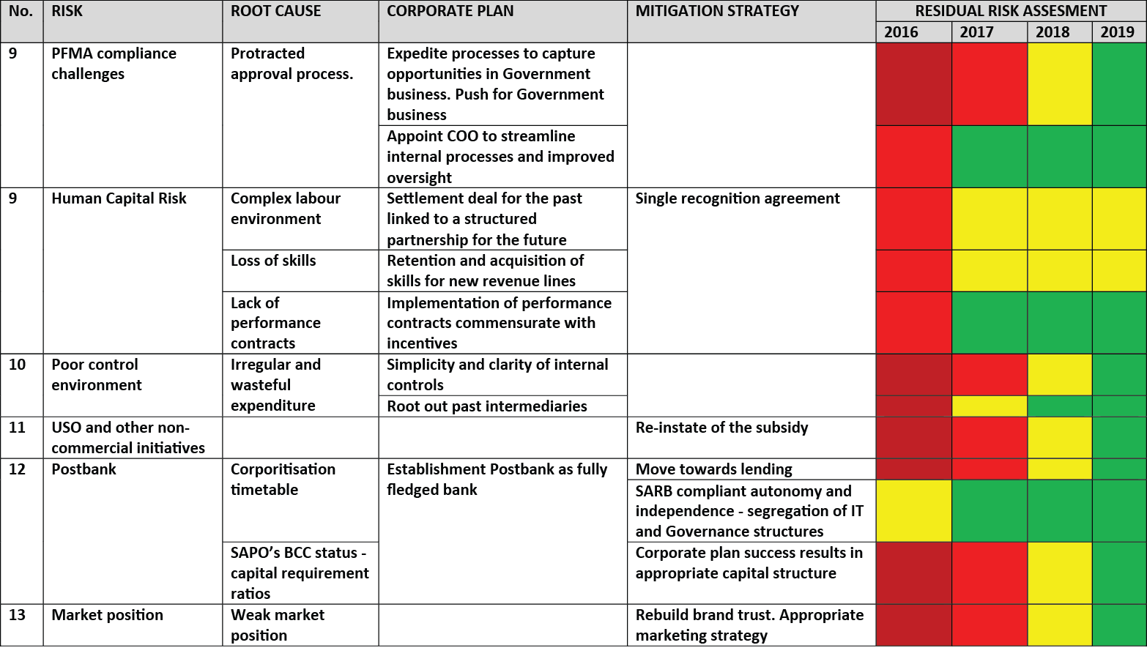
RISK MANAGEMENT PLAN

Slide 50
Thank You

