Slide 1
“Making you weather SMART” Safe: More informed: Alert: Resilient: Timeous
SOUTH AFRICAN WEATHER SERVICE Presentation to the: Parliamentary Portfolio Committee
on
Environmental Affairs
REVISED STRATEGY (2015-20)
AND ANNUAL PERFORMANCE PLAN (2016-17)
14 APRIL 2016
DR. LINDA MAKULENI

Slide 2
Contents
Introduction
SAWS Mandate
Mission, Vision and Values
High Level structure
Alignment with:
Government priorities
NDP and NCCRP
DEA Strategy
The Strategy
Roadmap
Possible Scenarios
Performance Environment
Brand Promise
Strategic Goals and Objectives
Strategic Risks
Financials
Conclusion

Slide 3
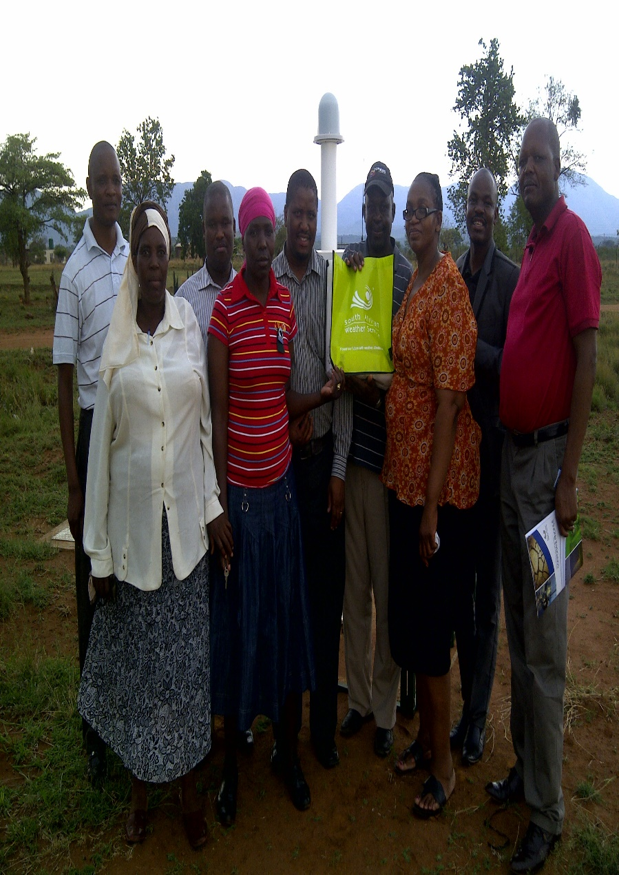
SAWS MANDATE
SAWS is a section 3a entity governed by the South African Weather Service Act, (Act No. 8 of 2001 as amended), the public finance management act (PFMA) and associated treasury regulations.
SAWS in terms of its enabling act, Act no 8 of 2001 (as amended) is mandated to:
Maintain, extend and improve the quality of meteorological and ambient air quality–related information services for the benefit of all South Africans.
Provide public good services and commercial services to all South Africans.
Ensure the ongoing collection of meteorological and ambient air quality data over South Africa and surrounding southern oceans for the use by current and future generations.
Be the long-term custodian of a reliable national climatological and ambient air quality record.
As the national meteorological service of the Republic of South Africa , to fulfil international obligations of the Government under the Convention of the World Meteorological Organization.
As the Aviation Meteorological Authority , to fulfil the international obligations of the Government under the Convention of the International Civil Aviation Organization.
Provide services that are sensitive to the demographic realities of the country.
Fulfil such other weather-related or ambient air quality information international obligations as the Minister may direct ; and.
Be the custodian of the SAAQIS
Notes:
SAWS is classified as an essential service and therefore requires the necessary access to national and global data 24 hours a day.
In order to support both these mandates SAWS deploys high-tech weather equipment throughout the country that provides real-time surface observations and remote sensing data. Of this equipment the radar systems and LDN are the most critical.
The data collected from this equipment is used to detect severe thunderstorms and to support national impacts such as disaster management (safety of life and property), aviation safety and our regional flash flood guidance systems.
This equipment is often located in remote areas and hence subject to poor power quality and frequent supply disruptions. The equipment concerned is sensitive to power fluctuations which results in costly damage to the hardware.

Slide 4
Vision, Mission & Values
Vision
Values
Community conscious
Continuous learning
Collaboration
Safety Conscious
Simplicity
Scientific
A Weather-Smart
Nation
Mission
A weather and climate centre of excellence providing innovative solutions to ensure a weather-smart region, sustainable development and economic growth

Slide 5
High Level Structure
Chief Executive Officer
Personal Assistant
Chief Financial Officer
General Manager: Operations
SM: Finance
SM: Supply Chain Management
General Manager: Commercial
SM: Research & Development
SM: Aviation
SM: Commercial
Marketing Manager
General Manager: Corporate Affairs
General Manager: Human Capital Management
Head: Regional Training Centre
SM: Technical Services
SM: Human Capital Development
SM: Corporate Comunications
SM: Stakeholder Relations
Met Authority Office
Projects Office
Risk Management
International Affairs
SAWS Board
SM: Information Communication Technology
SM: National Foresting Centre
SM: Climate Services
SM: Air Quality
SM: Human Capital Services
Company Secretary
Internal Audit

Slide 6
Alignment with Government Priorities
Government Priorities
Outcome 2: A long and healthy life for all South Africans.
Outcome 3: All people in South Africa are and feel safe.
Outcome 4: Decent employment through inclusive economic growth.
Outcome 5: A skilled and capable workforce to support an inclusive growth path.
Outcome 7: Vibrant, equitable and sustainable rural communities with food security for all.
Outcome 10: Environmental assets and natural resources that are well protected and continually
enhanced.
9-Point Plan
SAWS FOCUS
Revitalising the agriculture and agro-processing value chain;
resolving the energy challenge;
Boosting and diversifying the economy in science and technology
Ensuring a thriving ocean economy
Crosscutting areas of collaboration

Slide 7
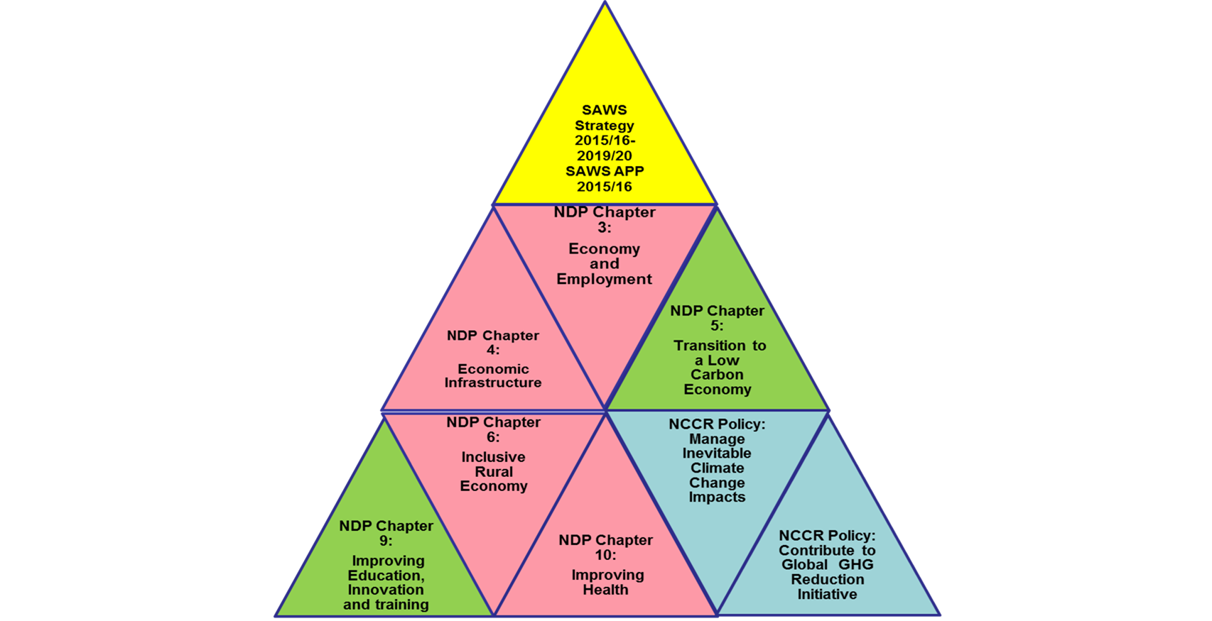
Alignment with NDP Priorities & National Climate Change Response Policy
2016/17
NCCR Policy = National Climate Change Response Policy
NDP Chapters with a direct link to SAWS programme
NDP Chapters with an indirect link to SAWS programme
National Climate Change Response Policy objectives with a direct link to SAWS programme

Slide 8
Alignment with DEA APP
Climate Change and Air Quality Management
DEA Strategic Objective | Related SAWS Objective Statement | SAWS Target Reference SAWS Target 16/17
Coherent and aligned multi-sector regulatory system & decision support across government | Goal 4: S.O. 4.1 | 4.1.3 Scientific Publications SAWS provides reliable science based information to assist in development of plans
Threats to environmental quality and integrity managed Relates to : Climate Change Response Policy enhancement and implementation National climate change regulatory framework Development and implementation of Adaptation strategies | Goal 4: S.O. 4.1 | 4.1.2 Implementation of NFCS
 |  | 4.1.3 Scientific Publications
 |  | Part of the operational activities of SAWS SAWS conducts Climate projections, modelling and monitoring of Green House Gases
 | Goal 1:S.O. 1.2 | 1.2.1:Provide Sector specific decision making products on weather and climate 3 sector specific products provided
Negative impacts on health & wellbeing minimised Relates to Air quality management | Goal 2: S.O. 2.1 | SAWS will provide air quality monitoring information as reported in SAAQIS ( In addition SAWS will also develop near real time air quality health index)
Enhanced sector monitoring and evaluation Relates to management of Greenhouse gas emissions |  | SAWS will be backup in hosting the National Emission Inventory System (SAAQIS Phase II)

Slide 9
The Strategy
SAWS Roadmap
Sustainability Phase
Sustainability – focus of strategy
Resource mobilisation
Strategic Partnering / Collaboration
Positioning of SAWS
Relevant projects
Consolidation Phase
Business model implementation
Establishment Phase
2001 -2007
2007 - 2012
2012 - Future
Timeline

Slide 10
The Strategy
Possible Scenarios
Unfunded Mandate – increased programme responsibilities with a diminishing funding,
and uncertain funding model.
Disenfranchised SAWS – a weakened SAWS that loses key aspects of its current
mandate, especially related to commercial good, but retains increasing Public Good demands.
The Strategic partner to Government(Solutions driven, sustainable organisation) – a comprehensive SAWS that supports socio-economic development and has an expanded mandate:
in revenue generation
best in class technology
an optimal workforce and competence
sustainable business (through increased demand for services and products)
a Weather Smart nation
The Organic SAWS – an “incremental” SAWS, with an unchanged mandate, moderately
improved capacity (Technology/Human Capital) and funding model/resourcing (with increased
demand for services/products).

Slide 11
The Strategy
Performance Environment
Strategic Focus Areas:
Continued relevance of SAWS products and services for a weather-smart nation:
Understanding user requirements;
Research and innovation
Focus on engaging with the various sectors to understand needs
Key research Areas:
The development of Sector-specific products and services that address user-needs;
A research programme aligned to the different time scales;
Commercial deployment of research outcomes and outputs; and
Continued development of SAWS’ research capability for implementation of the Research Strategy.
Enabling the mandate
Provision of reliable Public Good services
Retention of appropriate Skills and Competencies
Deployment of appropriate Infrastructure
Re-capitalisation where necessary

Slide 12
The Strategy
Brand Promise
“Making you Weather Smart”
lert
imeous
afe
ore informed
esilient / ready
S
M
A
R
T

Slide 13
The Strategy
Strategic Goals and Objectives
Strategic goals Short Tittle | Strategic goals Long Tittle | Strategic Objectives | Goal Statement
Strategic Goal 1: Provision of Products and Services | Meteorological Products and Services that meet the needs of a weather-smart nation are provided | 1.1 Develop and provide meteorological and related products and services for targeted communities nationally 1.2 Develop and market meteorological and related products and services for specific economic sectors 1.3 Establish strategic partnerships for products & services | The impact of climate change is resulting in an increasing number of extreme weather events, which impacts on food security, lives and property. This calls for the development and provision of innovative products and services for both commercial and public good purposes that enable a weather- smart nation.
Strategic Goal 2: Capability and capacity developed | Service Delivery Infrastructure and Human Capital Capability and Capacity developed | 2.1 Upgrade, expand and optimise infrastructure 2.2 Position SAWS as employer of choice 2.3 Build a talent pool for atmospheric sciences as a national imperative | A shortage of skills in weather and climate related sciences makes it difficult for SAWS to consistently deliver on its mandate and achieve its vision. This requires building a talent pool both in-house and on a national basis whilst extending and upgrading our current infrastructure.

Slide 14
The Strategy
Strategic Goals and Objectives
Strategic goals Short Tittle | Strategic goals Long Tittle | Strategic Objectives | Goal Statement
Strategic Goal 3: Engaged stakeholders | Strategic relationships leveraged and Stakeholders engaged | 3.1 Position SAWS as a relevant Meteorological Institution 3.2 Manage and leverage strategic relationships | SAWS functions in a complex scientific and service environment where it is essential to maintain and manage stakeholder relationships to the benefit of both parties. Through the activities supporting this goal SAWS is committed to effectively partner, collaborate, manage and leverage its key stakeholder relations to deliver on SAWS' mandate and objectives and to ensure its sustainability.
Strategic Goal 4: Research, knowledge and intelligence creation | Research, knowledge and Intelligence created in support of a weather-smart nation | 4.1 Grow weather and climate knowledge base | SAWS is mandated to innovate and provide products and services that are designed to solve real life weather related challenges. This requires ongoing research to maintain its technological edge in meteorology and related disciplines.
Strategic Goal 5: Growth and sustainability | Revenue growth and organisational sustainability achieved | 5.1 Grow Revenue Streams | SAWS is an essential element of South African public life, contributing to both the country's economic activities and safety of life. In order to grow while also ensuring that it remains sustainable, SAWS must establish sustained and high value sources of revenue to fund its operations.
Note: These strategic goals are long-term and targets for the next 5 years are as indicated in the strategic plan and APP and as set out in the strategic objectives with their related objectives.

Slide 15
Strategic Goal 1:Provision of Products & Service
Strategic Objective 1.1 : Develop and provide meteorological and related products and services for targeted communities nationally
Key Performance Indicator | Estimated Performance 2015/16 | Target 2016/17 | Quarterly Targets 2016/17
% completion of the ‘As is’ community weather- smart Needs Analysis Report across all targeted communities for the development of products and services to improve weather resilience | N/A New | 100% completion of ‘As is’ and community weather smart Needs Analysis Report across all targeted communities for the development of products and services to improve the weather resilience | Q1: Develop Terms of Reference and implementation plan for the community weather-smart needs survey
 |  |  | Q2: Conduct community weather-smart needs survey
 |  |  | Q3:Conduct community weather-smart needs survey
 |  |  | Q4:Compile ‘As is’ and Community weather-smart Needs Analysis Report
Strategic Objective 1.1 Develop and provide meteorological and related products and services for targeted communities nationally
Key Performance Indicator | Estimated Performance 2015/16 | Target 2016/17 | Quarterly Targets 2016/17
Number of community segmented products and/or services provided (cumulative target) | 4 products and services developed | 1 new (not previously provided) product or service for a community segment Maintain the provision of 4 existing community segmented products and/or services | Q1:Maintain the delivery of 4 existing products
 |  |  | Q2:Maintain the provision of 4 existing products Develop marketing plan for additional new products: SWWS, seasonal climate forecast, public weather forecasts, historic weather reports
 |  |  | Q3:Launch 1 new (not previously provided or developed) product or service for a community segment Maintain the provision of existing products
 |  |  | Q4: Provision of 1 new community segmented product Maintain the provision of 4 existing products

Slide 16
Strategic Goal 1:Provision of Products & Service
Strategic Objective 1.1 Develop and provide meteorological and related products and services for targeted communities nationally
Key Performance Indicator | Estimated Performance 2015/16 | Target 2016/17 | Quarterly Targets 2016/17
Number of community segmented products and/or services provided (cumulative target) | 4 products and services developed | 1 new (not previously provided) product or service for a community segment Maintain the provision of 4 existing community segmented products and/or services | Q1: Maintain the delivery of 4 existing products
 |  |  | Q2:Maintain the provision of 4 existing products Develop marketing plan for additional new products: SWWS, seasonal climate forecast, public weather forecasts, historic weather reports
 |  |  | Q3: Launch 1 new (not previously provided or developed) product or service for a community segment Maintain the provision of existing products
 |  |  | Q4:Provision of 1 new community segmented product Maintain the provision of 4 existing products
Strategic Objective 1.2 : Develop and market meteorological and related products and services for specific economic sectors
Key Performance Indicator | Estimated Performance 2015/16 | Target 2016/17 | Quarterly Targets 2016/17
Number of sector specific products provided (cumulative) |  | 3 sector specific products provided into the market | Q1 :No target set
 |  |  | Q2:Agricultural sector specific product
 |  |  | Q3:Energy sector specific product
 |  |  | Q4:Water sector specific product

Slide 17
Strategic Goal 1:Provision of Products & Service
Strategic Objective 1. 2 :Develop and market meteorological and related products and services for specific economic sectors
Key Performance Indicator | Estimated Performance 2015/16 | Target 2016/17 | Quarterly Targets 2016/17
% completion of 5- year marketing plans for sector specific products on weather and climate in targeted sectors | N/A New | 100% completion of 5- year marketing plan for sector specific products on weather and climate for the agricultural sector | Q1: 25% completion of sector specific 5- year marketing plan for the agricultural sector as per the implementation plan
 |  |  | Q2: 40% completion of sector specific 5- year marketing plan for the agricultural sector
 |  |  | Q3:60% completion of sector specific 5- year marketing plan for the agricultural sector
 |  |  | Q4: 80% completion of sector specific 5- year marketing plan for the agricultural sector
Strategic Objective 1. 2 :Develop and market meteorological and related products and services for specific economic sectors
Key Performance Indicator | Estimated Performance 2015/16 | Target 2016/17 | Quarterly Targets 2016/17
% implementation of annual milestones for Sector-Specific 5- year marketing plans | N/A New | % implementation of annual milestones for Sector-Specific 5- year marketing plans: 80% agricultural sector | Q1: 25% completion of implementation of sector specific 5- year marketing plan for the agricultural sector as per the implementation plan
 |  |  | Q2: 40% completion of implementation of sector specific 5- year marketing plan for the agricultural sector
 |  |  | Q3:60% completion of implementation of sector specific 5- year marketing plan for the agricultural sector
 |  |  | Q4: 80% completion of implementation of sector specific 5- year marketing plan for the agricultural sector

Slide 18
Strategic Goal 1:Provision of Products & Service
Strategic Objective 1.3 : Establish partnerships for Products and services
Key Performance Indicator | Estimated Performance 2015/16 | Target 2016/17 | Quarterly Targets 2016/17
Number of joint ventures and strategic alliances established (cumulative target) | 8 partnerships (Reviewed KPI) | 1 joint venture & 1 strategic alliance established | Q1: Identify areas within SAWS for joint venture and alliance
 |  |  | Q2: Identify partners for joint venture and strategic alliance
 |  |  | Q3: Engage with partners
 |  |  | Q4: Establish 1 joint venture & 1 strategic alliance

Slide 19
Strategic Goal 2: Capability and Capacity Developed
Strategic Objective 2.1 :Upgrade, expand and optimise infrastructure
Key Performance Indicator | Estimated Performance 2015/16 | Target 2016/17 | Quarterly Targets 2016/17
% availability of radar data | Radar data availability = 80% | Radar data availability = 80% | Q1-Q4 : Radar data availability = 80%
Strategic Objective 2.1 :Upgrade, expand and optimise infrastructure
Key Performance Indicator | Estimated Performance 2015/16 | Target 2016/17 | Quarterly Targets 2016/17
% Lightning Detection Network (LDN) data⁵ availability | LDN data availability = 80% | LDN data availability = 95% | Q1-Q4:LDN data availability = 95%
Strategic Objective 2.1 : Upgrade, expand and optimise infrastructure
Key Performance Indicator | Estimated Performance 2015/16 | Target 2016/17 | Quarterly Targets 2016/17
% SAAQIS availability | SAAQIS availability⁶ = 90% | SAAQIS availability = 90% | Q1-Q4 SAAQIS availability = 90%
Strategic Objective 2.2 :Position SAWS as an employer of choice
Key Performance Indicator | Estimated Performance 2015/16 | Target 2016/17 | Quarterly Targets 2016/17
% implementation of annual milestones for the SAWS dual career pathing programme | N/A New | Implement 80% of annual plan/ targets of the dual career pathing programme | Q1: Stakeholder engagement on career maps (dual career pathing)
 |  |  | Q2-:30% implementation of the dual career pathing programme
 |  |  | Q3: 60% implementation of the dual career pathing programme
 |  |  | Q4: 80% implementation of the dual career pathing programme

Slide 20
Strategic Goal 2: Capability and Capacity Developed
Strategic Objective 2.2 : Position SAWS as an employer of choice
Key Performance Indicator | Estimated Performance 2015/16 | Target 2016/17 | Quarterly Targets 2016/17
% (increase) in employee capability for core and critical skills (cumulative) | N/A New | Establish baseline in employee capability | Q1-Q3: Conduct analysis of current employee capability
 |  |  | Q4: Establish a baseline
Strategic Objective 2.2: Position SAWS as an employer of choice
Key Performance Indicator | Estimated Performance 2015/16 | Target 2016/17 | Quarterly Targets 2016/17
% increase in leadership competency index | No target set | 5% increase in leadership competency index | Q1-Q3 Conduct analysis of current employee leadership capability to establish a baseline
 |  |  | Q4: 5% increase in leadership competency index
Strategic Objective 2.2: Position SAWS as an employer of choice
Key Performance Indicator | Estimated Performance 2015/16 | Target 2016/17 | Quarterly Targets 2016/17
% employee retention rate for core/critical skills | 92% | 92% employee retention rate for core/critical skills | Q1-Q4 92% employee retention rate for core/critical skills
Strategic Objective 2.2 : Position SAWS as an employer of choice
Key Performance Indicator | Estimated Performance 2015/16 | Target 2016/17 | Quarterly Targets 2016/17
% achievement of Employment Equity (EE) targets as per the organisational EE plan | N/A New | 74% Africans 3% People With Disabilities 40% women in core 42% women in management | Q1-Q4 100% of EE targets achieved

Slide 21
Strategic Goal 2: Capability and Capacity Developed
Strategic Objective 2.3: Build a talent pool for atmospheric and related science as a national imperative
Key Performance Indicator | Estimated Performance 2015/16 | Target 2016/17 | Quarterly Targets 2016/17
% completion of the phase of implementation of the National Educational Plan | Implement phase 1 of the NEP | 100% completion of phase 1 of the NEP | Q1-Q3 Stakeholder engagement as per the stakeholder engagement plan for the NEP
 |  |  | Q4: Achieve 100% completion of phase 1 of NEP
Strategic Objective 2.3: Build a talent pool for atmospheric and related science as a national imperative
Key Performance Indicator | Estimated Performance 2015 | Target 2016/17 | Quarterly Targets 2016/17
% Implementation of annual targets of the Regional Training Centre (RTC) strategy | Implementation of RTC strategy as per strategy milestones | 80% of the RTC APP targets achieved | Q1:40% of the RTC APP targets achieved
 |  |  | Q2: 60% of the RTC APP targets achieved
 |  |  | Q3:70% of the RTC APP targets achieved
 |  |  | Q4:80% of the RTC APP targets achieved
Strategic Objective 2.3: Build a talent pool for atmospheric and related science as a national imperative
Key Performance Indicator | Estimated Performance 2015/16 | Target 2016/17 | Quarterly Targets 2016/17
Number of bursaries awarded | 62 bursaries awarded | 62 bursaries awarded | Q1: Report on uptake of bursaries and re-allocate bursaries
 |  |  | Q2: Develop bursaries marketing plan
 |  |  | Q3:Advertise bursaries
 |  |  | Q4: 62 bursaries awarded

Slide 22
Strategic Goal 2: Capability and Capacity Developed
Strategic Objective 2.3: Build a talent pool for atmospheric and related science as a national imperative
Key Performance Indicator | Estimated Performance 2015/16 | Target 2016/17 | Quarterly Targets 2016/17
% of bursars absorbed by SAWS | Absorption of 45% of bursars | 60% of bursars absorbed | Q1 – Q3: No Target Note: The absorption is only achieved at the end of the financial year when results are received
 |  |  | Q4:Absorption of 60% of bursars
Strategic Objective 2.3: Build a talent pool for atmospheric and related science as a national imperative
Key Performance Indicator | Estimated Performance | Target 2016/17 | Quarterly Targets 2016/17
% completion of Doctoral programme plan % implementation of Doctoral Programme milestones | N/A New | 100% completion of Doctoral programme plan 10% of the doctoral programme annual milestones achieved | Q1: 25% completion of Doctoral programme plan
 |  |  | Q2: 50% completion of Doctoral programme plan
 |  |  | Q3: 75% completion of Doctoral programme plan
 |  |  | Q4: 100% completion of Doctoral programme plan 10% of the Doctoral programme milestones

Slide 23
Strategic Goal 3:Engaged Stakeholders
Strategic Objective 3.1 Position SAWS as a relevant meteorological institution
Key Performance Indicator | Estimated Performance 2015/16 | Target 2016/17 | Quarterly Targets 2016/17
% completion of annual targets as set out in the corporate communications strategy | Develop and Implement programmes and campaigns that promote the organisation as per the communications strategy and implementation plan | Implementation of 80% of annual communications programmes for 2016/17 as per the communications strategy | Q1:Implementation of 20% of communications programmes as per the communications strategy for 16/17
 |  |  | Q2: Implementation of 40% of communications programmes as per the communications strategy for 16/17
 |  |  | Q3: Implementation of 60% of communications programmes as per the communications strategy for 16/17
 |  |  | Q4:Implementation of 80% of communications programmes as per the communications strategy for 16/17
Strategic Objective 3.1: Position SAWS as a relevant meteorological institution
Key Performance Indicator | Estimated Performance 2015/16 | Target 2016/17 | Quarterly Targets 2016/17
% (increase) in traffic volumes on media platforms (website/ facebook, twitter, YouTube) | N/A New | Establish a baseline in traffic volumes on media platforms (website/ facebook, twitter, YouTube) | Q1: Establish media platforms to engage stakeholders (website/facebook, twitter, YouTube)
 |  |  | Q2:Monitor media platforms to engage stakeholders (website/facebook, twitter, YouTube)
 |  |  | Q3: Monitor media platforms to engage stakeholders (website/facebook, twitter, YouTube)
 |  |  | Q4: Establish a baseline

Slide 24
Strategic Goal 3:Engaged Stakeholders
Strategic Objective 3.1 : Position SAWS as a relevant meteorological institution
Key Performance Indicator | Estimated Performance 2015/16 | Target 2016/17 | Quarterly Targets
Rand value Advertising Value Equivalent (AVE) (cumulative) | N/A New | Advertising Value Equivalent (AVE) - R22m | Q1: Advertising Value Equivalent (AVE) –R4m
 |  |  | Q2: Advertising Value Equivalent (AVE) –R8m
 |  |  | Q3: Advertising Value Equivalent (AVE) –R16m
 |  |  | Q4:Advertising Value Equivalent (AVE) –R22M
Strategic Objective 3.2: Manage and leverage strategic relations
Key Performance Indicator | Estimated Performance 2015/16 | Target 2016/17 | Quarterly Targets 2016/17
Number of engagement programmes for targeted stakeholder groups as per SES(2016/17) % implementation of stakeholder programmes for targeted stakeholder groups as per (SES) (2018-20) | N/A New | Engagement programmes for 8 targeted stakeholder groups(SES) | Q1-Q4 Engagement programmes for2 targeted key stakeholder groups

Slide 25
Strategic Goal 3:Engaged Stakeholders
Strategic Objective 3.2 :Manage and leverage strategic relations
Key Performance Indicator | Estimated Performance 2015/16 | Target 2016/17 | Quarterly Targets 2016/17
Overall stakeholder satisfaction rating (expressed as a percentage) |  | Overall stakeholder satisfaction rating - 86% | Q1 – Q2: No action required
 |  |  | Q3:Conduct a stakeholder satisfaction survey
 |  |  | Q4:Overall stakeholder satisfaction rating - 86%

Slide 26
Strategic Goal 4:Research, Knowledge and intelligence creation
Strategic Objective 4.1: Grow weather and climate knowledge base
Key Performance Indicator | Estimated Performance 2015/16 | Target 2016/17 | Quarterly Targets 2016/17
% of funds secured for conducting SEB study | N/A New | 25% of funds secured for conducting SEB study | Q1: Develop Socio-Economic Benefit study funding proposals
 |  |  | Q2: SEB study funding proposal approved
 |  |  | Q3: 15% of funds secured for conducting SEB study
 |  |  | Q4: 25% of funds secured for conducting SEB study
Strategic Objective 4.1: Grow weather and climate knowledge base
Key Performance Indicator | Estimated Performance 2015/16 | Target 2016/17 | Quarterly Targets 2016/17
National Framework for Climate Services (NFCS) implementation per key sector | NFCS developed and approved | Implementation of NFCS facilitated for 3 key climate sensitive sectors | Q1: Review of NFCS
 |  |  | Q2: Implementation of NFCS for agriculture
 |  |  | Q3: Implementation of NFCS energy
 |  |  | Q4: Implementation of NFCS for water & health
Strategic Objective 4.1: Grow weather and climate knowledge base
Key Performance Indicator | Estimated Performance 2015/16 | Target 2016/17 | Quarterly Targets 2016/17
Number of partnership agreements for applications and / or products development for various socio-economic sectors in in support of the NCCRP | N/A New | 1 partnership that translates into applications or products for decision making in modelling | Q1: Identify potential partner
 |  |  | Q2: Negotiate with partners on identified application/ product
 |  |  | Q3: Preparation of partnership agreement
 |  |  | Q4: Signing of partnership agreement

Slide 27
Strategic Goal 4: Research and Knowledge/intelligence creation
Strategic Objective 4.1: Grow weather and climate knowledge base
Key Performance Indicator | Estimated Performance 2015/16 | Target 2016/17 | Quarterly Targets 2016/17
Number of peer- reviewed articles published in accredited national or international scientific journals where SAWS scientists are the leading author or co-author. (cumulative target) | Modified 14 articles in scientific publications | 14 publications | Q1: 3 publications
 |  |  | Q2: 7 publications
 |  |  | Q3: 12 publications
 |  |  | Q4: 14 publications

Slide 28
Strategic Goal 5: Growth and Sustainability
Strategic Objective 5.1 : Grow Revenue Streams
Key Performance Indicator | Estimated Performance 2015/16 | Target 2016/17 | Quarterly Targets 2016/17
Parliamentary grant funding excluding SAAQIS | No target set in the 2015/16 strategy Revised MTEF allocation R145,51m excluding SAAQIS | R189,28m | Q1: R47,32m
 |  |  | Q2: R47,32m
 |  |  | Q3: R47,32m
 |  |  | Q4: R47,32m
Strategic Objective 5.1 : Grow Revenue Streams
Key Performance Indicator | Estimated Performance 2015/16 | Target 2016/17 | Quarterly Targets 2016/17
Growth in year-on-year aviation revenue | R98,45m | R108,37m | Q1: R20,67m
 |  |  | Q2: R22,43m
 |  |  | Q3: R30,76m
 |  |  | Q4: R34,51m
Strategic Objective 5.1: Grow Revenue Streams
Key Performance Indicator | Estimated Performance 2015/16 | Target 2016/17 | Quarterly Targets 2016/17
Growth in commercial revenue as per set target (annual total revenue) | R16,00m | R18,00m | Q1: R3,60m
 |  |  | Q2: R3,89m
 |  |  | Q3:R4,74m
 |  |  | Q4:R5,77m

Slide 29
Strategic Risks
Strategic Goal 1: Provision of Products and Services
Strategic Objectives | Strategic Risks | Risk Description | Mitigation Measures
1.1: Develop and provide meteorological and related products and services for targeted communities nationally 1.2: Develop and market meteorological and related products and services for specific economic sectors 1.3: Establish strategic partnerships for products and services | Commercialising of SAWS products and services | Slow pace in commercialising SAWS products and services; and inability to market effectively. | Develop marketing plans for products and services. Establish strategic partners for marketing & distribution of weather service products. Implementation of the perception survey recommendations (to address customers’ requirements/needs) Agree on approach with DEA and National Treasury on the commercial business model for Schedule 3A entities.
 | Competitors | Increased competition in the African market for limited customer base. Increased competition for both commercial and public good services. Lack of regulatory focus for sectors outside of the aviation industry. | Develop, approve and execute an Africa plan. Review and implementation of strategy to enhance SAWS’ competitive edge in the weather and climate space Influencing international agenda
 | Financial sustainability | Inability to secure adequate funding from Government and other sources | Engagements with DEA and National Treasury to showcase SAWS’ economic value Review of the costing model for SAWS products and services Develop marketing plans for products and services.

Slide 30
Strategic Risks
Strategic Goal 2 Capability and Capacity Developed
Strategic objectives | Strategic Risks | Risk Description | Mitigation Measures
2.1 Upgrade, expand and optimise infrastructure 2.2 Position SAWS as an employer of choice 2.3 Build a talent pool for atmospheric and related sciences as a national imperative | Infrastructure performance | Inadequate maintenance of ICT, Observation and Auxiliary Infrastructure; and Inadequate of ICT infrastructure and expertise. | Development and implementation of an Integrated Asset Management System. Resource mobilisation for infrastructure maintenance (Capex funding) Resource mobilisation for and implementation of the ICT Master System Plan. Transfer of skills and succession planning.
 | Service delivery by key service providers | Poor service delivery by key service providers for electricity, telecommunication and observation network maintenance. | Continuous improvement and automation of Contracts administration Negotiate essential services status with key service providers (to minimise business interruptions). Continuous testing of the effectiveness of the Business Continuity Management Plan
 | Critical skills attraction and retention | Limited critical skills attraction and retention. | Implementation and continuous improvement of Attraction and Retention Programmes. Implementation of Mentorship and Coaching Programme. Resource mobilisation for the implementation of the Science, Engineering and Technology Institution (SETI) Review recommendations. Implement the National Education Plan
 | Safety and security of resources | Inadequate safety of people and security of infrastructure. | Investigate and implement a remote infrastructure monitoring mechanism. Branding of equipment and the new acquired fleet at all regions Training of Technical Service technologists on first aid to minimise the effect of any injury on duty.

Slide 31
Strategic Risks
Strategic Goal 3: Engaged Stakeholders
Strategic Objectives | Strategic Risks | Risk Description | Mitigation Measures
3.1 Position SAWS as a relevant meteorological Institution 3.2 Manage and leverage strategic partnerships | Stakeholder engagement | Reliance on stakeholders to deliver; and stakeholders not delivering on the requirements aligned to SAWS mandate. Inadequate engagement with different stakeholders to ensure the delivery of expected outcomes. SAWS not positioned as key role player in climate change and adaptation. | Implement the Stakeholder Engagement Matrix; and SAWS Communications strategy Engage and conclude compacts with identified key stakeholders Develop and implement key shareholder matrix Agree on the Shareholder Compact. Position SAWS as a key role player in the climate change and adaptation arena

Slide 32
Strategic Risks
Strategic Goal 4: Research and Knowledge/intelligence creation
Strategic Objectives | Strategic Risks | Risk Description | Mitigation Measures
4.1 Grow weather and climate knowledge base | Value creation through information and knowledge management | Inability to extract and optimise information to create value. Limited institutional memory and succession planning to ensure knowledge is shared and retained within the organisation. | Review process used to disseminate information and data. Development and implementation of the Knowledge Management policy. Identification of key Knowledge experts. Employee Awareness on Knowledge Management. Review and implementation of the succession plan.
 | Innovation | Limited Organisational culture to innovate. Inadequate production of relevant new products and services Inadequate research and development of new offerings. | Promote innovation within the Organisation (through the award programme recognition). Include innovation as part of performance objectives. Develop matrices for monitoring and evaluating innovation. Implementation of the application and product development framework.

Slide 33
Strategic Risks
Strategic Goal 5: Growth and Sustainability
Strategic Objectives | Strategic Risks | Risk Description | Mitigation Measures
5.1 Grow revenue streams | Financial sustainability | Limited revenue streams (Inability to secure adequate funding from Government; and other sources) | Engagement with National Treasury-showcasing SAWS economic value. Development of project‑based funding proposals. Develop Funding Framework. Develop marketing plans for products and services. Review costing model. Source funding for the implementation of the National Education Plan implementation.
 | Commercialising of SAWS products and services | Slow pace in commercialising SAWS products and services; and inability to market effectively. | Develop marketing plans for products and services. Implementation of the perception survey results. Agree on approach with DEA and NT on the commercial business model for Schedule 3A Entities. Establish strategic partners for marketing & distribution of weather service products.

Slide 34
The Strategy
Financials – Linking Goals to Expenditure
# | Strategic Goal | 2015/16 Expenditure R'000 | 2016/17 Expenditure R'000 | 2017/18 Expenditure R'000 | 2018/19 Expenditure R'000 | 2019/20 Expenditure R'000
1 | Provision of Products and Services | 177 880 | 213 150 | 214 067 | 224 995 | 241 663
2 | Capability and Capacity Development | 43 045 | 51 580 | 52 318 | 58 472 | 58 480
3 | Engagement of Stakeholders | 13 891 | 16 645 | 17 561 | 18 192 | 18 872
4 | Research and Knowledge Creation Intelligence | 5 458 | 6 540 | 7 507 | 7 540 | 7 414
5 | Growth and Sustainability | 44 598 | 53 441 | 54 169 | 60 616 | 60 590
 | Total Expenditure | 284 872 | 341 356 | 345 622 | 369 815 | 387 019

Slide 35
The Strategy
Financials – Income statement
Description | Current Financial Year | ENE Allocations over the MTEF Period 2016/17 to 2018/19 |  |  | Projected
 | 2015/16 | 2016/17 | 2017/18 | 2018/19 | 2019/20
 | R'000 | R'000 | R'000 | R'000 | R'000
Revenue
Government Grant - Operational | 145 507 | 189 278 | 188 490 | 188 935 | 198 382
Government Grant - Capex | - | - | 35 000 | 37 030 | 40 000
Government Grant - SAAQIS | 14 916 | 15 707 | 16 992 | 17 117 | 18 182
Commercial Income | 16 000 | 18 000 | 21 600 | 25 900 | 31 000
Aviation Income | 98 449 | 108 371 | 108 540 | 127 363 | 128 430
Other income and Donor Funds | 10 000 | 10 000 | 10 000 | 10 500 | 11 025
Total Revenue | 284 872 | 341 356 | 380 622 | 406 845 | 427 019
Expenditure
Employee Costs | (190 686) | (222 763) | (238 356) | 255 040) | (272 893)
Administrative and Operating Costs | (94 186) | (118 593) | (107 266) | (114 775) | (114 126)
Total Expenditure | (284 872) | (341 356) | (345 622) | (369 815) | (387 019)
Operating Surplus Before Depreciation and Amortisation | 0 | - | 35 000 | 37 030 | 40 000
Depreciation and Amortisation | (28 116) | (28 892) | (30 244) | (31 759) | (35 443)
Surplus / (Deficit) for the year | (28 116) | (28 892) | 4 756 | 5 271 | (4 557)

Slide 36
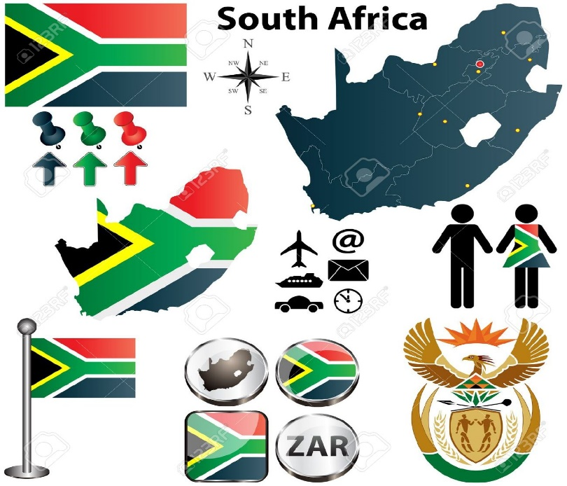
Conclusion
Stakeholder Engagement
Strategic partnership
Conducting Relevant Research
Creating Solutions to national challenges
Enabling Operations
Executing Relevant projects
Infrastructure expansion
Knowledge Generation
Understanding user requirements
New and Relevant Product and service Development
Capacity and Capability Development
Human Capital
Infrastructure
Funded mandate Expansion
Collaboration

Slide 37
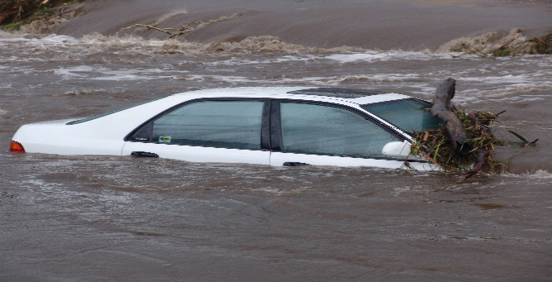
Discussion
Thank You!
Baie Dankie!
Enkosi!
Ke a leboga!
Ndo livhuwa nga maanda!

