Slide 1
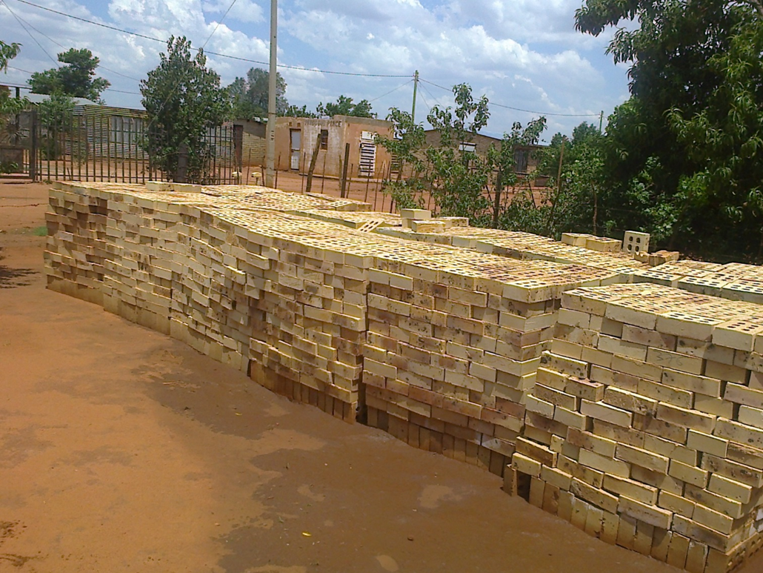

ANNUAL PERFORMANCE PLAN 2016/17and STRATEGIC PLAN 2016-2019
Presentation to: Portfolio Committee on Human Settlements
Jabulani Fakazi, CEO
and
Bruce Gordon, CFO

Slide 2
Outline
RHLF mandate
Service delivery model
How we create value for people in our mandate
Policy context
Market and Regulatory environments
  Market conditions
  Review of Limitations on Fees and Interest Rates Regulations
  RHLF Pricing Policy
  Draft Credit Life Insurance Regulations
2016/17 Annual Performance Plan
  Progress Performance in 2015/16
  Strategic Oriented Outcomes
  Statement of Financial Position
  Statement of Financial Performance
Governance: The Board Structure
Concluding remarks

Slide 3
Mandate and Core Business
Facilitate access to incremental housing finance for low income households in rural areas
Rural
Communal land, rural towns and small towns
Monthly Income
Maximum R15 000 up from R9 800
Focus remains under R3 500
People

Slide 4
Voucher programme
Description
A programme to enable qualifying beneficiaries to access housing subsidy funds to build their own houses in rural areas (communal land)
Status
Approved by MINMEC, but implementation on hold
Piloting cost of a voucher house to assist Minister in approving the quantum for the Programme

Slide 5
Business model
Intermediaries
Carry credit risk
Loan requirements
Unsecured, so can never lose homes
Cost of borrowing
In accordance with the National Credit Act
Market & lend to clients
Commercial or non-profit (CBOs)
Wholesale Lending
Ideally disbursed through building merchants
Must be used for housing in rural areas
Details later on NCA Pricing and RHLF Pricing Policy
Facilities approved for intermediaries
People decide what they need
Must be repaid
No grants, unless the Voucher system is implemented
RHLF discounts to those who charge less

Slide 6
Creating value for people in RHLF’s mandate
Mission: To empower people in rural areas to maximise their housing choices and improve their living conditions through access to housing credit.

Slide 7
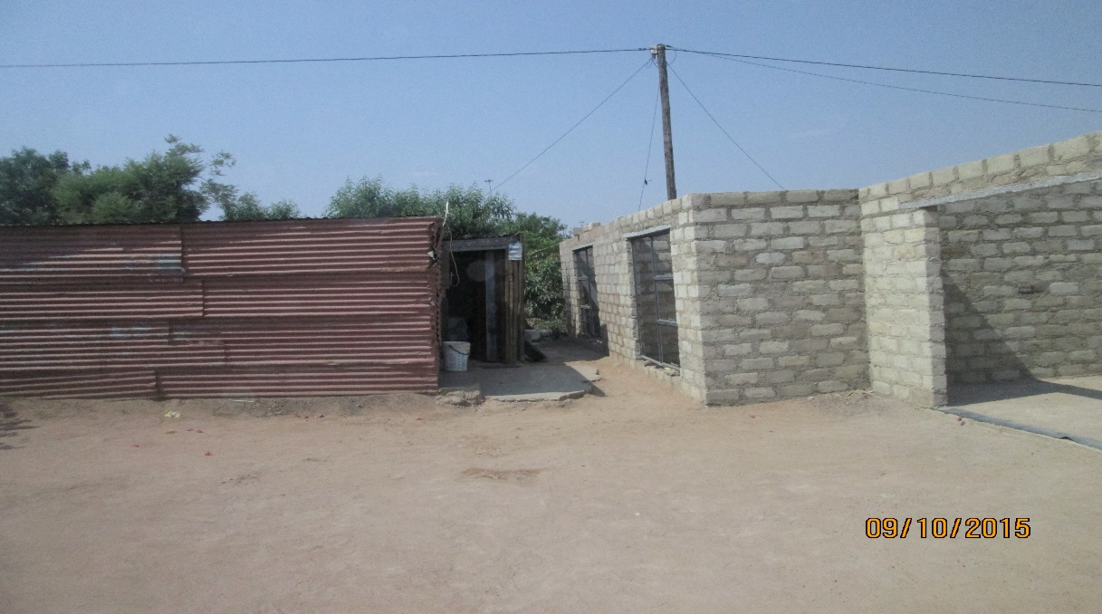
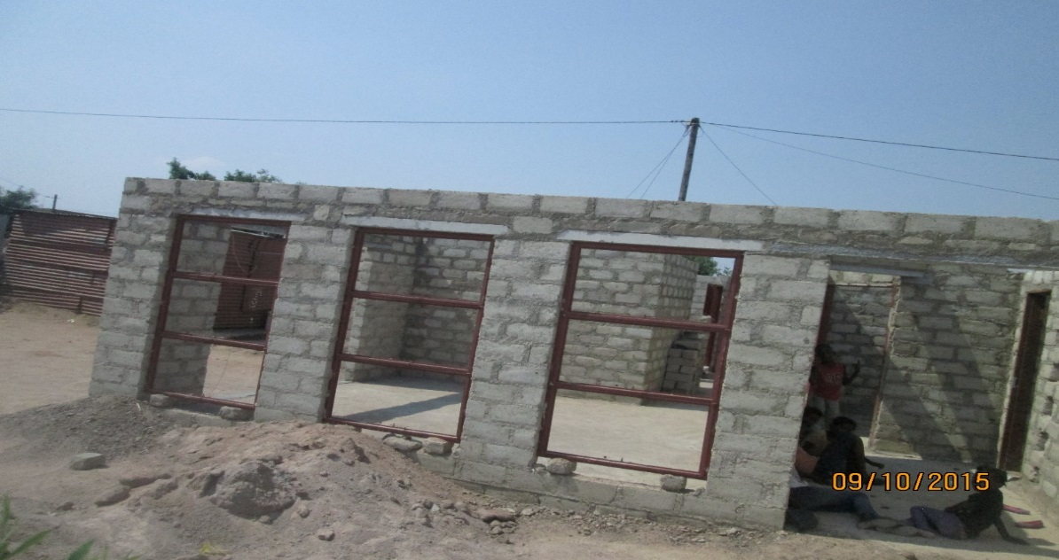
From a shack to a permanent structure (Hammanskraal)

Slide 8
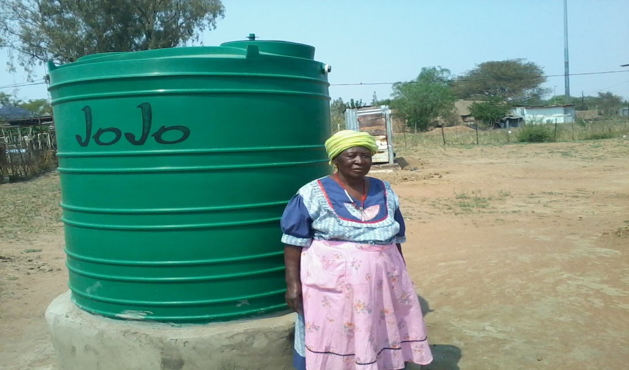
Operation hydrate: Stinkwater, Hammanskraal

Slide 9
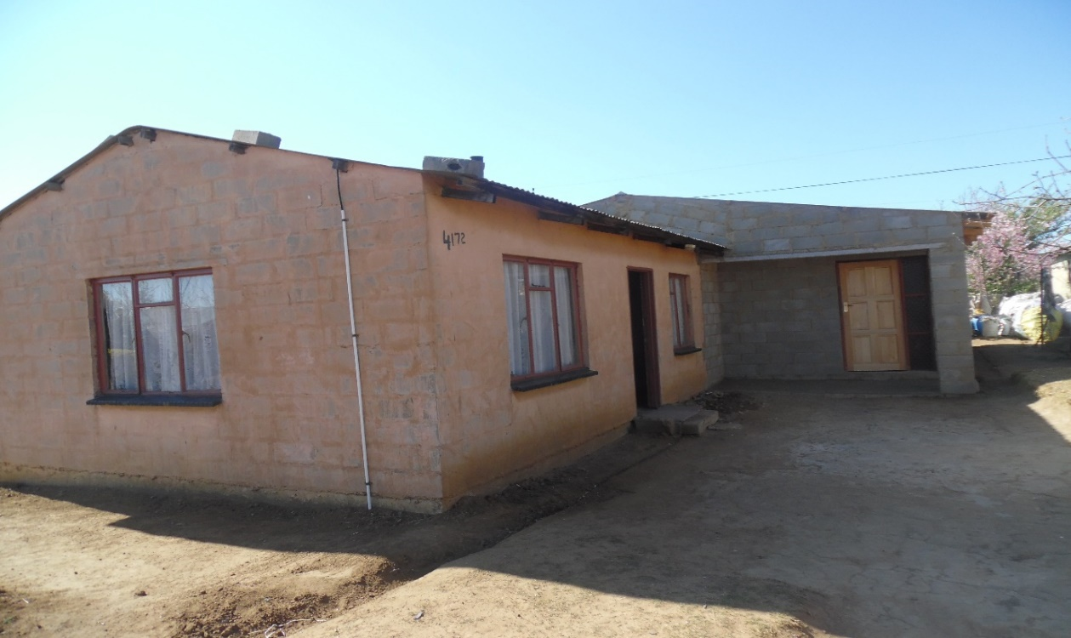
RDP House Extension, Harrismith, Free State

Slide 10
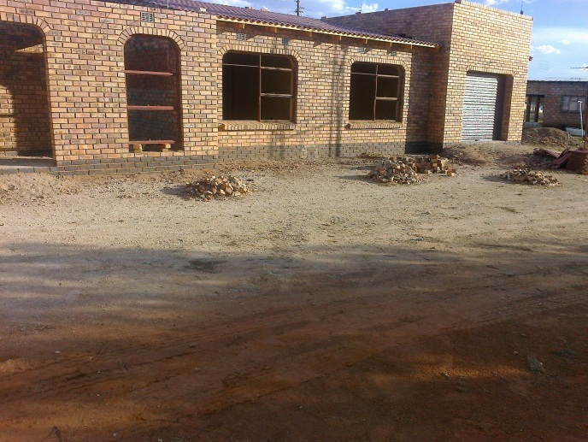
Using a loan and savings to build a new house, Magogoe Village, Free State

Slide 11
Policy Context
Outcome 8: Human Settlements
Adequate housing
Comprehensive Rural Development Programme
Ensuring funding reach priority rural areas
Housing
Informal settlements upgrading
SMME & Co-operatives Development
Finance SMMEs & Coops to on-lend
Inclusive rural economy
Transforming rural human settlements
Support entrepreneurs & job creation
Improved quality of living environments
National Development Plan

Slide 12
Market & Regulatory Environments
Market conditions
Economic growth
Unemployment
Interest rates
Regulatory Environment
Interest rate caps
Insurance fee
Court Judgements
Inflation
Fees (initiation, service)
Levels on indebtedness
Rand exchange rate

Slide 13
Maximum Interest rate for unsecured credit
Maximum Prescribed Interest Rates [NCA Reg. 42 (1)]
RR = Repo Rate (6.75%)
 | New max interest rate | Current max interest rate
 | New Reg: w.e.f.: May 2016 | Before new Regulations
(1) Unsecured credit | RR + 21% per year (27.75%) | [(RR x 2.2) + 20%] p.a. (34.85%)
(2) Developmental Credit | RR + 27% per year (33.75%) | [(RR x 2.2) + 20%] p.a. (34.85%)
For the development of small business
For low income housing (unsecured)

Slide 14
Maximum Initiation Fees
Amendment of NCA Reg. 42 (2)
 | Proposed initiation maximum fee | Current init. maximum fee
 | Effective May 2016
Unsecured credit | R165 per agreement plus 10% of the amount in excess of R1 000 But never to exceed R1 050 | R150 per agreement plus 10% of the amount in excess of R1000 But never to exceed R1 000
Developmental credit:
1. For development of small business | R275 per agreement plus 10% of the amount in excess of R1 000 But never to exceed R2 600 | R250 per agreement plus 10% of the amount in excess of R1 000 But never to exceed R2 500
2. For low income housing | R550 per agreement plus 10% of the amount in excess of R1 000 But never to exceed R2 600 | R500 per agreement plus 10% of the amount in excess of R1000 But never to exceed R2 500

Slide 15
RHLF PRICING POLICY
Objective: To reduce cost of credit for borrowers in our target market
Rate charged by RHLF to commercial lenders | Example based on Prime = 10.25% | Rate charged by lenders to borrowers | Example, RR = 6,75%
Prime + 4% | 14,25% | RR x 2.2 +>18 % | >32,85%
Prime + 3% | 13,25% | RR x 2.2 +>16-18 % | >30.85%
Prime + 2% | 12,25% | RR x 2.2 +>14-16 % | >28.85%
Prime + 1% | 11,25% | RR x 2.2 +>12-14 % | >26.85%
Prime % | 10,25% | RR x 2.2 +>10-12 % | >24.85%
Prime - 1% | 9,25% | RR x 2.2 +10 or less % | ≤24.85%
Loans to CBOs at Prime MINUS 2.5% (currently 6.75%)--for benefit of members only

Slide 16
Draft Credit Life Insurance Regulations
[ref. to section 106(1)(a) of the National Credit Act]
The following rates are maximums but insurance must be risk based
Sub-sector | Maximum prescribed cost of credit life insurance
Unsecured credit transaction | R4. 50 per R1 000 of the outstanding amount (excluding the cost of credit)
Developmental credit transaction | R2. 00 per R1 000 of the outstanding amount (excluding the cost of credit)
Covered events:
Death; Temporary disability; Permanent Disability; Unemployment and inability to earn income
(Each of these has exceptions and limitations listed in draft Regulations)
See draft Credit Life Insurance Regulations

Slide 17
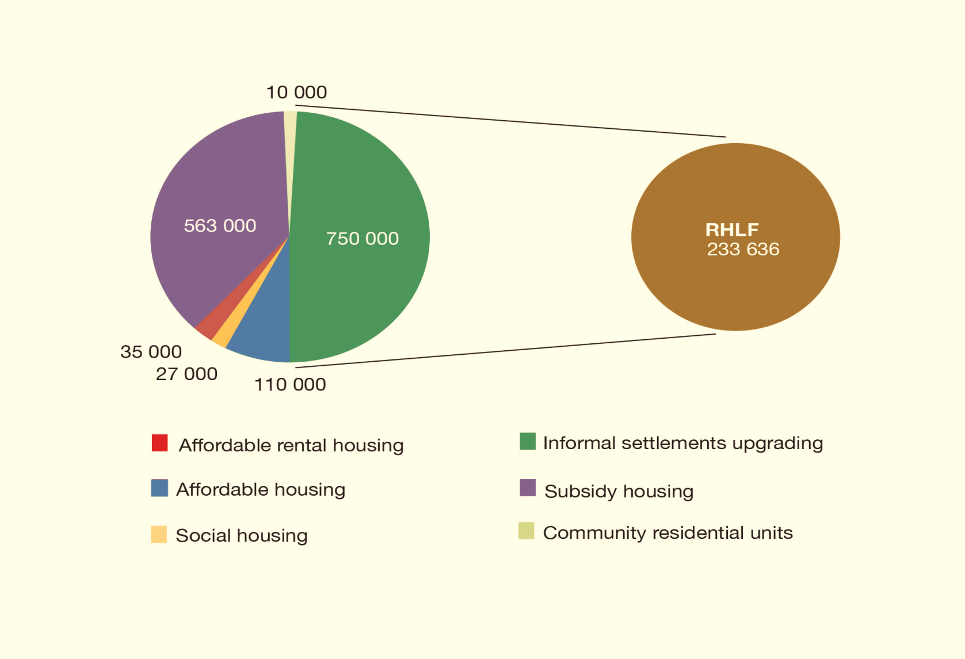
MINISTER’S COMMITMENT AND RHLF CONTRIBUTION
MTSF Period

Slide 18
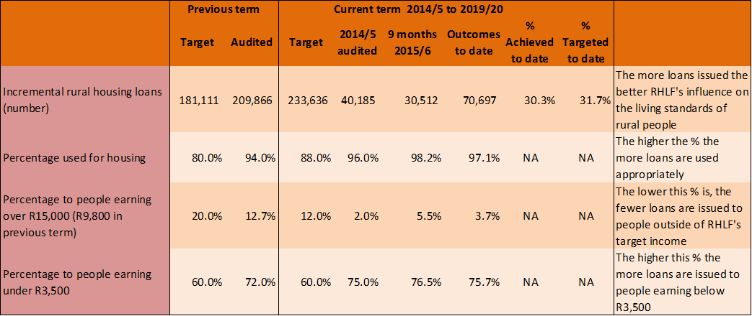
Performance YTD (2015/16-q3)
  Stakeholder Perspective – incremental housing

Slide 19
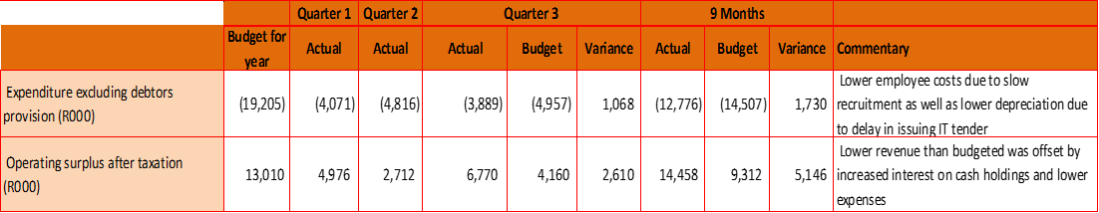
Performance YTD (2015/16-q3)
  Financial Perspective

Slide 20
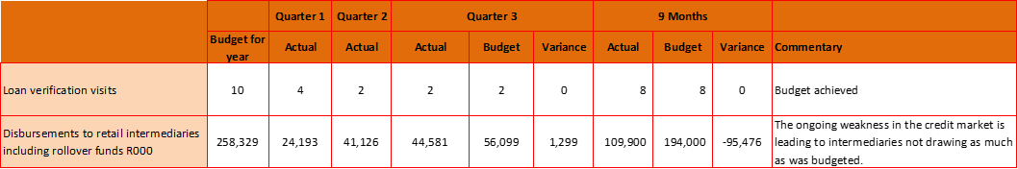
Performance YTD (2015/16-q3)
  Business process perspective

Slide 21
MTEF: Strategic Outcome Orientated Goals
  Stakeholder Perspective – incremental housing

Slide 22
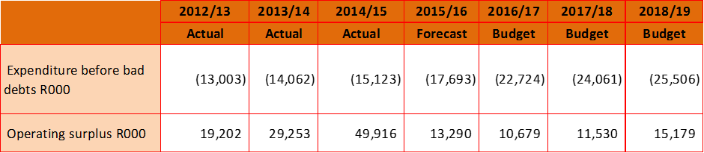
Strategic Outcome Orientated Goals
  Financial Perspective

Slide 23
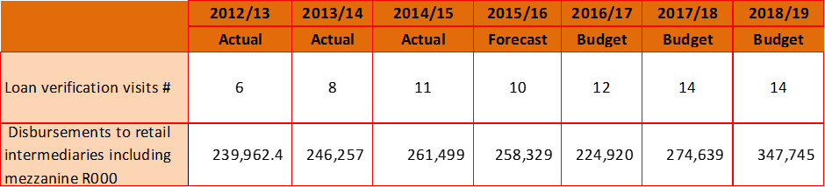
Strategic Outcome Orientated Goals
  Business process

Slide 24
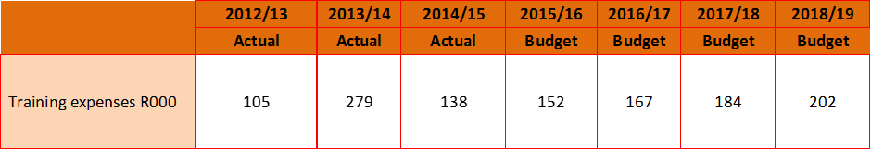
Strategic Outcome Orientated Goals
  Learning and growth

Slide 25
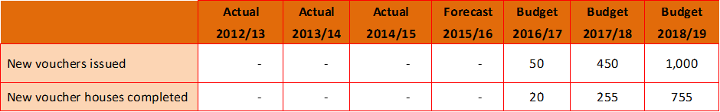
Strategic Outcome Orientated Goals
  Stakeholder – Voucher programme
These are subject to:
Approval of the programme pilot
Buy in from the provinces who supply the funds

Slide 26
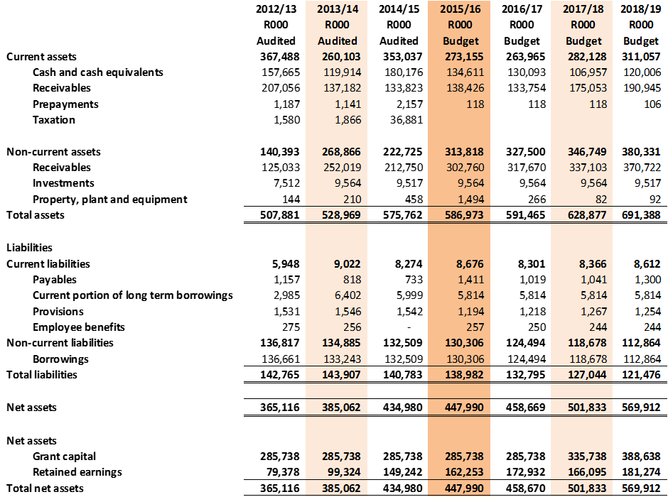
Statement of Financial Position

Slide 27
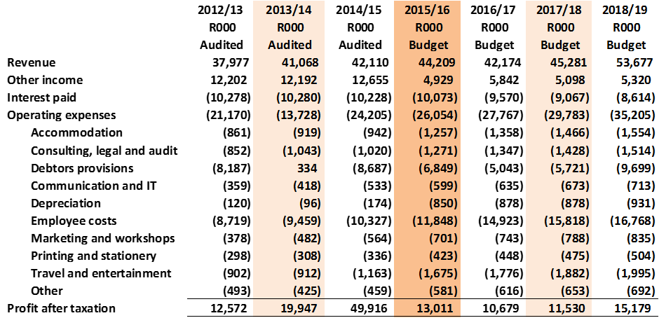
Statement of Financial Performance

Slide 28
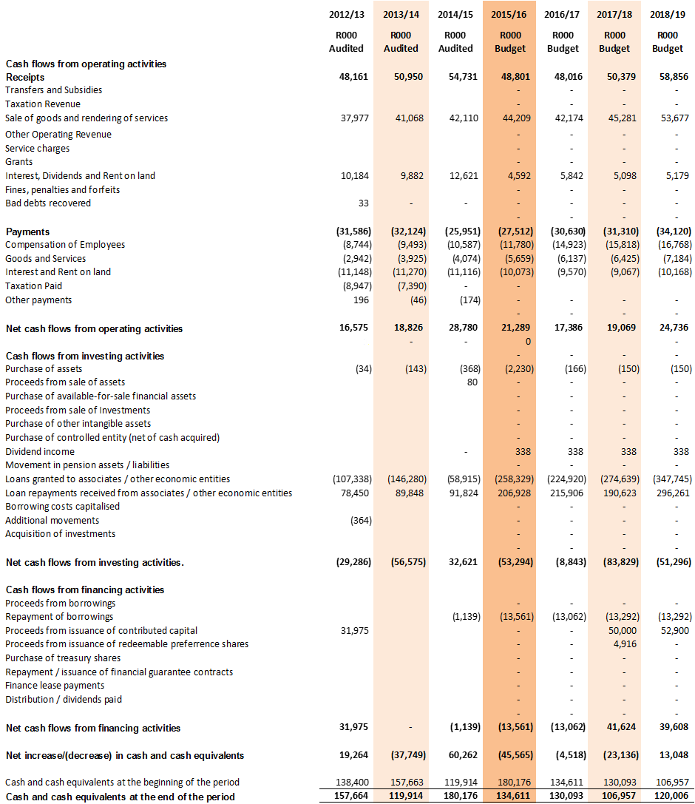
Cash flow statement

Slide 29
Governance: The Board Structure
BOARD OF
DIRECTORS
HR ETHICS and
REMUNERATION COMMITTEE
CREDIT AND DEVELOPMENT
COMMITTEE
AUDIT AND RISK
COMMITTEE
MOI provides for a maximum of 8 directors (7 NEDs & 1 ED)
Only four Non-Executive Directors
Three vacancies currently

Slide 30
Concluding Remarks
RHLF achieves its mandate within the constraint of its funding resources as well as the challenges faced by the economy
Tough market conditions and high level of indebtedness pose a challenging outlook
Target market is huge and more needs to be done to significantly increase market coverage
RHLF business model resonates with active citizenry advocated in the NDP—people drive their building process and improvement of their living conditions

