Slide 1
Estate Agency Affairs Board
2014/15 -2018/19
STRATEGIC PLAN and APP
Bryan Chaplog – CEO
Silence Mmotong – CFO
Nikita Sigaba - CRO

Slide 2
Strategic Overview
VISION
To be a trusted world-class regulator of the profession of estate agency.
MISSION
Ensure the integrity of the activities between the estate agent and consumer is of a high standard by regulating, protecting, guiding and enhancing the conduct of the real estate agents’ profession in South Africa

Slide 3
Strategic Overview
Strategic Outcome Oriented Goal number 1 | Compliant Estate Agency Sector.
Goal Statement | Perform inspections on 50% of Estate Agencies over the 2014 to 2019 financial period in order to increase compliance levels of estate agents
Strategic Outcome Oriented Goal number 2 | Property consumers are aware and understand all forms of property transactions
Goal Statement | The EAAB will ensure that at least 2 million consumers are made aware of property transactions through media publications and television by the end of 2018/19.
Strategic Outcome Oriented Goal number 3 | Sustainable Fidelity Fund
Goal statement | The EAAB will ensure that the Fidelity Fund is efficiently and effectively operated to achieve aggregate growth rate of 5% per annum against the 2013 baseline by the end of 2018/19.
Strategic Outcome Oriented Goal number 4 | Professional and capacitated Estate Agency Sector
Goal Statement | The EAAB will ensure that 100% of the registered estate agents are fully qualified in terms of legislative requirements by the end of 2018/19.

Slide 4
Financial Intelligence Centre
The EAAB is the Supervisory Body of the estate agency profession pursuant to the Financial Intelligence Centre Act and is obliged to take all steps required to prevent; alternatively, identify and report on, anti-money laundering and terrorist financing activities in the Estate Agency Sector.

Slide 5
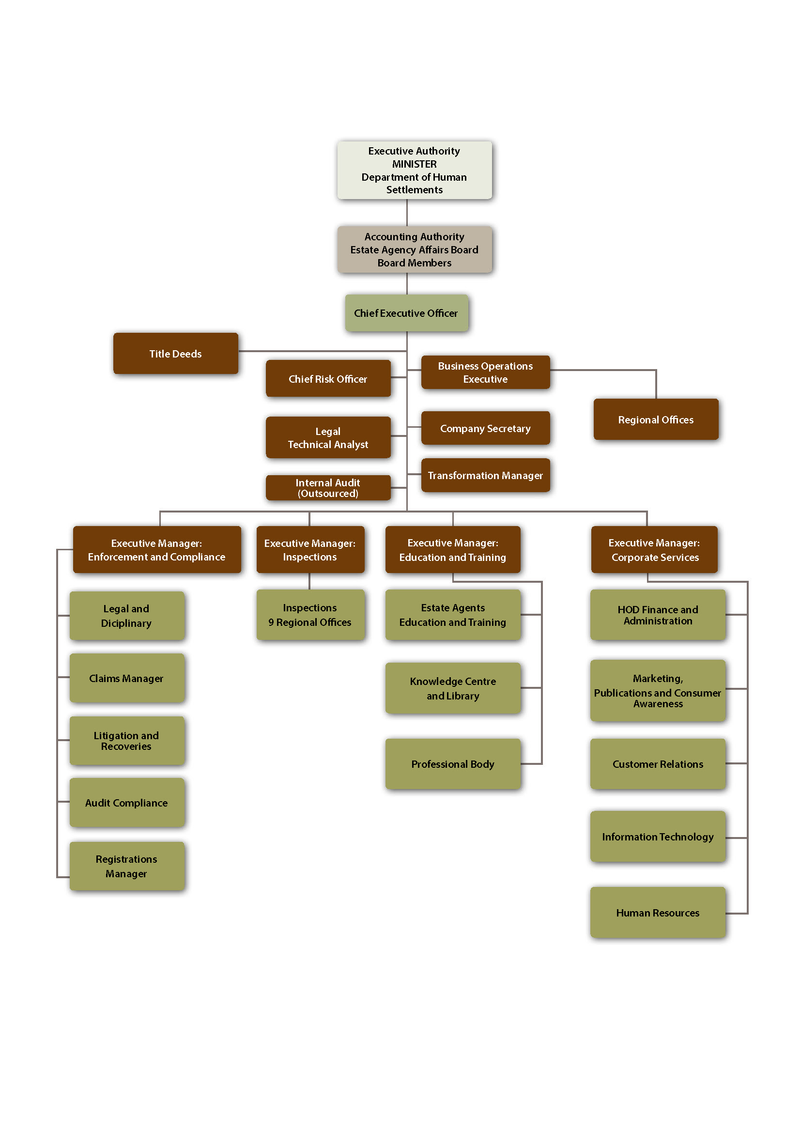

Slide 6
Government –wide priorities
Based on the MTSF sub-outcome 4, the EAAB is responsible for the following:
Consumer education.
Placement of unemployed youth with Principal Estate Agents.
Development transactional support programmes in the affordable housing market developed.
Issuing of title deeds to form part of hosing development process. This includes pre-1994 and post-1994 backlog.

Slide 7
KEY PERFORMANCE ANNUAL TARGETS
Programme | Sub Programme | Performance Indicator | Baseline | 2014/15 | 2015/16 | 2016/17 | 2017/18 | 2018/19
Compliance | Enforcement | % Percentage of complaints resolved within 6 months | 70% Percentage of complaints resolved within 6 months | 70% | 75% | 80% | 85% | 90%
 | Registrations | % increase on issued certificates (FFC) to new registered and compliant estate agents within 21 days | 80% of FFC issued to compliant new registered estate agents issued within 21 days | 80%. | 85% | 90% | 95% | 95%
 |  | % increase on renewal certificates (FFC) of compliant estate agents within 5 days | 92% of FFC issued to compliant current registered estate agents issued within 5 days | 92% | 94% | 95% | 95% | 95%
 | Inspections | Number of self-assessment evaluation Received | 1107 Number of self-assessment evaluation Received | 1107 | 400 | 500 | 600 | 700

Slide 8
KEY PERFORMANCE ANNUAL TARGETS
Programme | Sub Programme | Performance Indicator | Baseline | 2014/15 | 2015/16 | 2016/17 | 2017/18 | 2018/19
Education & Training | Professional designation Examination (PDE) | % Percentage of NQF level 4 & 5 candidates wrote the PDE and received results | 95% Percentage of NQF level 4 & 5 candidates wrote the PDE and received results | 95% | 95% | 95% | 95% | 95%
 | Marketing | Number of consumer awareness events | 16 Number of consumer awareness events | 16 | 16 | 18 | 20 | 22
 |  | Number of estate agent roadshow seminars performed | 16 Number of estate agent roadshow seminars performed | 16 | 16 | 18 | 20 | 22
 |  | Number of AGENT magazines published and issued | 4 Number of AGENT magazines published and issued | 4 | 4 | 4 | 4 | 4

Slide 9
KEY PERFORMANCE ANNUAL TARGETS
Programme | Sub Programme | Performance Indicator | Baseline | 2014/15 | 2015/16 | 2016/17 | 2017/18 | 2018/19
 | Professional Body | Percentage of CPD programmes supplied to Full status candidates in compliance with Education requirements over 3-year rolling period | N/A | N/A | 100% implementation of CPD project plan | N/A | N/A | 100% of CPD programmes supplied to Full status candidates in compliance with Education requirements over 3-year rolling period
Fidelity Fund | Claims department | Percentage of claims finalised for payments within 6 months | 30%of claims finalised for payments within 6 months | 30% | 35% | 40% | 45% | 50%

Slide 10
KEY PERFORMANCE ANNUAL TARGETS
Programme | Sub Programme | Performance Indicator | Baseline | 2014/15 | 2015/16 | 2016/17 | 2017/18 | 2018/19
Fidelity Fund | Interest received from agency trust accounts | Percentage increase in interest from estate agency trust accounts collected within 30 days of due dates | 30% | 30% | 35% | 40% | 45% | 50%
Corporate Services | Administration | Percentage in resolution of audit findings raised within the agreed turnaround time | 80% | 80% | 90% | 90% | 95% | 100%
 |  | Percentage of vacancy rate at EXCO and MANCO level | 15% | 15% | 14% | 13% | 12% | 11%
 |  | Percentage of implementation of ICT strategy | 92% | 92% | 94% | 92% | 94% | 96%
 |  | Percentage of queries received from stakeholders and resolved within 48hours | 80% | 80% | 85% | 95% | 100%

Slide 11
KEY PERFORMANCE ANNUAL TARGETS
Programme | Sub Programme | Performance Indicator | Baseline | 2014/15 | 2015/16 | 2016/17 | 2017/18 | 2018/19
Medium Term Strategic framework | Consumer awareness and Education | Number of consumers reached trough radio- National | 900 000 | 900 000 | 900 000 | 400 000 | 400 000 | 400 000
 |  | Number of consumers reached through radio -Community | 445 000 | 445 000 | 400 000 | 400 000 | 400 000 | 400 000
 |  | Print media – Awareness | 100 000 housing consumers reached | 100 000 | 600 000 | 600 000 | 600 000 | 600 000
 | Women, Disabled and Youth Empowerment | Number of Interns placed with Principal Estate Agencies | 900 Number of Interns placed with Principal Estate Agencies | 900 | 2000 | 3100 | 4000 | N/A

Slide 12
KEY PERFORMANCE ANNUAL TARGETS
Programme | Sub Programme | Performance Indicator | Baseline | 2014/15 | 2015/16 | 2016/17 | 2017/18 | 2018/19
Medium Term Strategic Framework | Transactional support Title Deeds | Transactional support – data/information on industry trends and analysis. | N/A | N/A | 100% implementation of transactional support | Quarterly data/ information on industry trends and analysis available | Quarterly data/ information on industry trends and analysis available | Quarterly data/ information on industry trends and analysis available
 |  | Project management and secretarial support to eradicate Title deeds back-log by 2019 | N/A | N/A | Scoping exercise developed to formulate the implementation plan | Project management and secretarial support in the Implementation Plan. | Project management and secretarial support in the Completion of project plan | Project management and secretarial support in the Completion of project plan

Slide 13
STRATEGIC RISK REGISTER
Risk No | Strategic objective | Risk Description | EAAB Action Plan | Residual Risk Rating | Risk Owner
GR1 | To improve compliance with the Estate Agency Affairs Act and Financial Intelligence Act | There is an increase in illegal trading estate agents which cannot be traced and therefore leads to non-compliance | The new Property Practitioners Bill specifically addresses the issue of restricting payment of commission to illegal estate agent. The implementation of the Property Practitioners Act will reduce the use of illegal trading agent) | 16 | EM: Compliance
GR2 | To professionalise the Estate Agency industry through creating awareness of the education requirements | Unsuitably qualified individuals operating as estate agents. Lack of interest in compliance with the education and training requirements | Online CPD system implementation. Awareness of qualifications deadline. Consequence implementation for unqualified Estate Agents | 12 | EM: Education & Training

Slide 14
STRATEGIC RISK REGISTER
Risk No | Strategic objective | Risk Description | EAAB Action Plan | Residual Risk Rating | Risk Owner
GR3 | To ensure that the Fidelity Fund is financially sustainable | Increases in white-collar crime could lead to higher claims from Fidelity Fund. Failure to bank into the trust account can result in claims lodged against the Fidelity Fund, affecting the Fund’s performance Unlimited claims either in size or number may deplete the Fidelity Fund An increase in emerging home owners and renters and consequent escalation in the number of complaints and claims impacts the Board’s resources and the Fund | Appointment of investment specialist to review investment strategy Re-insurance of Fidelity fund claims. | 16 | EM: Corporate services
GR4 | To promote and implement government-wide priorities, i.e contribution to the MTSF | Expanding mandate outside of legislation and without securing funding, leads to unauthorized expenditure | Inclusion of MTSF activities in the EAAB Budget process as priority. Implementation of Revenue strategy implementation to fund government-wide priorities. | 12 | EM: Corporate services

Slide 15
STRATEGIC RISK REGISTER
Risk No | Strategic objective | Risk Description | EAAB Action Plan | Residual Risk Rating | Risk Owner
GR5 | To ensure that EAAB operations are efficient and effective | Financial constraints to fund essential organisational projects and programmes (Failure to retain revenue streams | Revenue generation strategy implementation to fund organizational projects and programmes | 12 | Board Secretary
GR6 | To ensure that EAAB operations are efficient and effective | Non –compliance with legislation applicable to EAAB. | Develop a compliance framework on all legislative requirement Develop legal compliance function. | 12 | Executive Committee

Slide 16
BUDGET FOR MTEF
Our sources of funding
Levies paid by estate agents;
Examination fees;
Income generated from selling study guides;
Management fee charged for managing and controlling Fidelity Fund;
Fee charged for CPD training;
Interest on investments of surplus funds

Slide 17
BUDGET FOR MTEF
THE ESTATE AGENCY AFFAIRS BOARD
PROJECTED INCOME AND EXPENDITURE BUDGET
FOR THE YEAR ENDING 31 MARCH 2017
 | 2014/2015 | 2014/2015 | 2015/2016 |  | 2016/2017 | 2017/2018 | 2018/2019
 | Budget | Actual | Forecast |  | Budget | Forecast | Forecast
Turnover | 118 362 667 | 94 668 393 | 123 039 608 |  | 131 048 339 | 140 221 723 | 150 037 243
FFC Renewals | 32 713 625 | 15 165 334 | 16 193 042 |  | 27 092 453 | 28 988 924 | 31 018 149
New Registrations | 3 285 089 | 2 380 549 | 3 268 725 |  | 3 667 697 | 3 924 436 | 4 199 146
Examinations and CPD | 19 208 800 | 11 629 566 | 43 595 590 |  | 33 489 300 | 35 833 551 | 38 341 900
Interest Income | 1 980 630 | 2 486 842 | 1 968 343 |  | 2 209 851 | 2 364 540 | 2 530 058
Other Income | 61 174 524 | 63 006 102 | 58 013 908 |  | 64 589 038 | 69 110 271 | 73 947 990
Operating costs | 113 321 769 | 97 270 803 | 124 431 885 |  | 128 121 150 | 137 097 130 | 146 702 179
Admin expense | 35 304 587 | 37 065 850 | 50 234 963 |  | 42 083 131 | 45 028 950 | 48 180 977
Other operating expense | 1 710 562 | 948 299 | 784 517 |  | 1 558 065 | 1 674 630 | 1 800 104
Staff costs | 73 157 676 | 57 384 330 | 70 805 236 |  | 81 788 770 | 87 513 984 | 93 639 963
Board Members Remuneration | 3 148 944 | 1 872 324 | 2 607 169 |  | 2 691 183 | 2 879 566 | 3 081 136
Total Operaring Costs | 113 321 769 | 97 270 803 | 124 431 885 |  | 123 321 769 | 137 097 130 | 146 702 179
Surplus/(Deficit) before CAPEX | 5 040 899 | -2 602 410 | -1 392 277 |  | 2 927 189 | 3 124 592 | 3 335 064
Capital Expendirure | 4 835 000 | 2 693 553 | 3 612 667 |  | 2 650 000 | 1 450 000 | 1 300 000
Surplus/(Deficit) after CAPEX | 205 899 | -5 295 963 | -5 004 944 |  | 277 189 | 1 674 592 | 2 035 064

Slide 19
BUDGET FOR MTEF
Income and expenditure trends
Income
FFC renewals fee to increase by 40% except for interns to support transformation
FFC new registration fee to increase by 40% except for interns to support transformation
Income from exams and CPD to decrease due to the change in timing of CPD registrations;
Interest income to increase due to increase in interest rates;
Other income, which includes management fee, to remain relatively constant;
Expenses
Admin cost to decrease slightly due to decreased costs of CPD due to e-learning;
Staff costs to increase by 15% due to inflation, establishment of regional centers and filling of vacant positions;

Slide 20
BUDGET FOR MTEF
Other initiatives
Expenses
Contribute R360 000 towards stipends for EAAB Internship programme (20 Interns) in partnership with South African Graduates Development Association (SAGDA) ;
Spend R1 million towards training and development (upskilling) of employees;
Reduce travelling costs, including international travel, by 23%;
Increase spending on SMMEs from 49% to 50% of budget on SMMEs;
Contribute R1 million towards transformation initiatives
Increase spending on Consumer Awareness by 94% from R1.9 million to R3.7 million, including affordable housing market and RDP homeowners

Slide 21
BUDGET FOR MTEF
ESTATE AGENCY AFFAIRS BOARD
ANNUAL BUDGET FOR THE YEAR 2016/2017
CONSOLIDATED FORECAST
PROJECTED STATEMENT OF FINANCIAL POSITION
AS AT 31 MARCH 2017
 |  |  | 2017 |  | 2016
 | Notes |  | R |  | R
ASSETS
Non-current assets |  |  | 73 761 800 |  | 76 010 995
Property, plant and equipment (SPO) | 3 |  | 72 190 423 |  | 73 995 547
Intangible Assets | 4 |  | 1 571 377 |  | 2 015 448
Current assets |  |  | 46 443 628 |  | 45 006 194
Trade and other receivables | 5 |  | 2 601 742 |  | 2 431 534
Inventory | 6 |  | 147 750 |  | 138 085
Cash and cash equivalents (SPO) | 7 |  | 9 334 136 |  | 10 136 575
Loan Fund | 8 |  | 4 360 000 |  | 4 300 000
Investments | 9 |  | 30 000 000 |  | 28 000 000
TOTAL ASSETS |  |  | 120 205 428 |  | 121 017 189
EQUITY AND LIABILITIES
Reserves |  |  | 103 922 878 |  | 100 995 689
Accumulated surplus |  |  | 103 922 878 |  | 100 995 689
Current liabilities |  |  | 13 820 000 |  | 18 201 000
Trade and other payables (SPO) | 10 |  | 10 000 000 |  | 15 000 000
Provisions | 11 |  | 3 400 000 |  | 2 800 000
Post Employment Medical Aid Benefits | 13 |  | 420 000 |  | 401 000
Non-Current liabilities |  |  | 2 002 550 |  | 1 820 500
Post- Employment Pension Fund | 12 |  | - |  | -
Post- Employment Medical Aid | 13 |  | 2 002 550 |  | 1 820 500
TOTAL EQUITY AND LIABILITIES |  |  | 119 745 428 |  | 121 017 189

Slide 22
BUDGET FOR MTEF
Income and expenditure trends
Current ration of over 3.36:1 in the medium term
Solvency ration of over less than 13%

Slide 23
BUDGET FOR MTEF
EXPENDITURE ESTIMATES (PROGRAMES FROM BUDGET STRUCTURE)
Programme ('000) | Audited Outcome |  | Projected | MTEF
 | 2013/14 | 2014/15 | 2015/16 | 2016/17 | 2017/18 | 2018/19
Compliance | 26 382 | 32 330 | 29 832 | 36 169 | 38 701 | 41 410
Education and Training | 6 091 | 9 770 | 29 899 | 22 261 | 23 819 | 25 487
Administration | 42 138 | 55 171 | 64 700 | 69 690 | 74 568 | 79 788
Estate Agency Fidelity Fund | 71 711 | 69 904 | 67 376 | 71 768 | 76 792 | 82 167
 | 146 322 | 167 175 | 191 807 | 199 888 | 213 880 | 228 852

Slide 24
THANK YOU

