Slide 1



Presentation of the Strategic Plan 2015-2020 and APP 2016-2017
April 2016

Slide 2

Structure of the Presentation
Introduction
DPME Mandate
Strategic Focus
Budget Programmes
Programme Focus
Key Focus Areas for 2016/17 for key programmes
Human resources issues
Finance

Slide 3
Departmental Programme

Slide 4
Introduction
The Department of Planning Monitoring and Evaluation(DPME) has a critical role to play in giving direction on the implementation and monitoring of the National Development Plan vision 2030 (NDP) through focused planning, monitoring and evaluation
The Medium Term Strategic Framework (MTSF) is government’s first five year implementation plan of the NDP, covering the financial years 2014/15 to 2018/2019
DPME has a responsibility to monitor and report against the targets in the MTSF for the 14 outcomes (aligned to the NDP)
It also has the responsibility to ensure that key government programmes are evaluated to determine their impact in reducing poverty, inequality and joblessness
In addition, the department has to monitor service delivery to the citizens of our country, identify bottle necks and implement interventions where necessary. To do this, a number of programmes have been developed to assist the department to fulfil its mandate
DPME cannot monitor everything government does. It has to be strategic and focus on priority plans and programmes being implemented across government that will make the greatest contribution to the NDP goals of reducing poverty, unemployment and inequality

Slide 5
Introduction(2)
The Strategic Plan 2015-2020 is focused on these key functions. The strategic plan has not been revised in the current financial year. However, DPME is currently reviewing its strategy to enhance its impact in monitoring and strengthening the implementation of the NDP.
This review might result in the review of the Strategic Plan for the period 2017-2020
The APP 2016-17 has been revised to make it more sharper and to take into account some of the changes emerging from the current strategy review process
The current organisational structure has 340 posts but is expected to increase to about 500 over the MTEF once the strategy review process is concluded.
The increase in the number of posts is meant to enhance the capacity of the department to deliver on its mandate
Total departmental budget is projected to increase from R739.8 million in 2015/16 to R994.3 million in 2018/19
For the financial year 2016/17 the total allocated budget is R827, 6 million

Slide 6
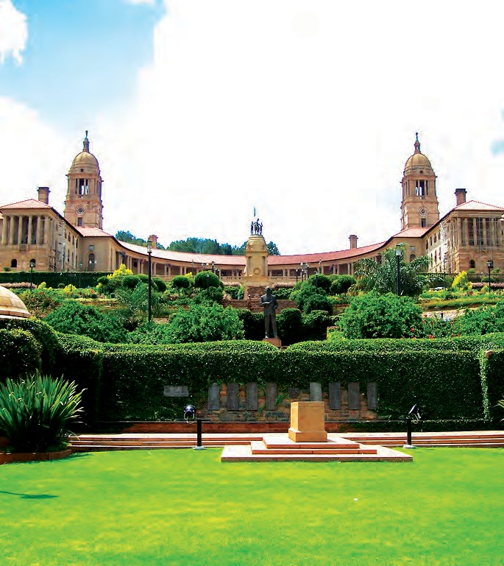


DEPARTMENT: PLANNING, MONITORING AND EVALUATION
STRATEGIC PLAN
2015-2020

Slide 7
Departmental Mandate
The mandate of the Department of Planning, Monitoring and Evaluation as stated in both the strategic plan 2015-2020 and the APP 2016/17 is derived from Section 85(2)(b-c) of the Constitution of the Republic of South Africa which states that:
    the President exercises executive authority, together with the other members of the Cabinet by:
        developing and implementing national policy
        coordinating the functions of state departments and administrations
This has been given concrete expression by the “Policy Framework on Performance Monitoring and Evaluation - Our Approach” document and “Revised Green Paper: National Planning Commission”, which were both tabled in Parliament

Slide 8
Departmental Mandate (2)
The mandate of DPME as captured in both documents is to:
Facilitate the development of long-term and medium-term plans for the priorities as captured in the 14 outcomes targeted by government, and monitor the implementation
Assess departmental Strategic Plans and Annual Performance Plans to ensure alignment with long term and short term plans (NDP and MTSF)
Monitor the performance of individual National and Provincial Government departments and municipalities
Monitor frontline service delivery
Carry out evaluations of key government programmes
Promote good monitoring and evaluation (M&E) practices in government

Slide 9

Strategic Plan Focus Areas
The strategic focus of DPME for 2015-2020 is to:
Strengthen the linkages between the planning in government and monitoring and evaluation functions
Ensure stronger focus on outcomes of government programmes and impacts on citizens
Enhance the implementation of the NDP vision 2030
Support M&E practices as a means to improve performance of government

Slide 10
Strategic Plan Focus Areas (2)
The strategic focus of DPME for 2015-2020 is to:
  Address aspects of planning in government which have been previously neglected, such as medium-term planning and programme implementation
  Promote co-ordination and improved use of resources for effectiveness and efficiency
  Improve responsiveness of government to the needs of the public

Slide 11
Budget Programmes
To fulfil its mandate, the department is organised in 5 programmes as follows:
Programme | Programme Goals
Programme 1: Administration | An efficient and effective department that complies with legislation, policy and good corporate governance principles
Programme 2 : Outcomes Monitoring and Evaluation | To advance the strategic and developmental agenda of government through monitoring, reporting and recommending corrective measures on the implementation of the NDP and the MTSF targets and evaluating key government programmes
Programme 3: Institutional Performance Monitoring and Evaluation (P&ME) | To strengthen institutional performance through regular monitoring, evaluation and support
Programme 4: National Planning | To facilitate integrated short, medium to long-term planning and policy coherence in support of the implementation of the National Development Plan and government programme
Programme 5: Youth development | To promote youth development and empowerment

Slide 12
Programme 1 Focus Areas
Administration | Provide strategic support, management and administration to the Ministry and Director General Exercise oversight responsibility regarding financial, performance reporting, compliance and related internal controls Implement effective HR management practices to ensure that adequate and appropriately skilled human resources are in place Promote good corporate governance and practices Provide ICT to enable the department to deliver on its mandates

Slide 13
Programme 2 Focus
Outcomes monitoring and evaluation | Coordinate, monitor and report on implementation of the 14 outcomes and priorities targeted by government, and evaluating impact Assist the President to conclude and monitor performance agreements with Ministers Advice political principals on strategic matters including Cabinet memoranda Support departments, other spheres of government, clusters and Cabinet committees to identify and address blockages in achieving government outcomes Conduct evaluation and research on key government policies and programmes

Slide 14
Programme 3 Focus
Institutional Performance Monitoring and Evaluation (P&ME) | Assess management practises in national and provincial departments and municipalities using the Management Performance Assessment Tools on an annual basis Monitor the quality of services experienced by citizens when receiving government services in government facilities using appropriate tools of measurement in selected facilities Involve citizens in monitoring of government services at selected facilities (including the Presidential Hotline) Lead PM&E capacity development and knowledge management initiatives, and facilitate better use of PM&E knowledge across government

Slide 15
Programme 4 Focus
National Planning | Promote coherent policy-making, planning and implementation of government programmes including analysis of budget alignment with the NDP Facilitate the development of medium and long-term plans in all spheres of government Provide oversight, direction and regulation in respect of strategic and annual performance planning in Government Support the development of high level planning frameworks to guide the detailed planning in departments, government agencies as well as provincial and local government Engage different sectors of society on aspects of planning that go beyond government to solicit input and secure buy-in.

Slide 16
Programme 5 Focus
Youth development | Develop and co-ordinate implementation of youth policies and programmes Transfer of budget to the National Development Youth Agency 3. Conduct oversight of the NYDA

Slide 17


ANNUAL
PERFORMANCE PLAN
2 0 1 6 / 1 7
DEPARTMENT: PLANNING, MONITORING AND EVALUATION

Slide 18

Key Focus Areas for 2016/17 for key programmes
Key focus areas for Programme 2 (Outcomes Monitoring ) include the following:
Revision of the Medium Term Strategic Framework (MTSF) chapters and/or related Delivery Agreements to take into account emerging trends and challenges
Production of outcomes monitoring reports against MTSF targets including
  payment of suppliers within 30 days of receipt of a valid invoice;
  the status of mining towns and labour sending areas and;
  assessment of municipalities using Local Government Management Improvement Model (LGMIM)
Working with Stats SA, establish a data nerve centre to monitor key government programmes in and integrated manner
Production and publication of the Development Indicators to show progress against developmental goals
Using Operation Phakisa Methodology to improve and speed-up service delivery

Slide 19
Key Focus Areas for 2016/17 for key programmes (2)
Support Cabinet Office and other Departments to implement the Socio-Economic Impact Assessment System (SEIAS)
Provision of advisory services and support to Cabinet and the Executive through briefing notes and reports
Production and implementation of a National Evaluation Plan focusing on key government programmes and submit to Cabinet for approval annually
Supporting provinces to produce their own annual Evaluation Plans for their key provincial programmes.
Conducting evaluations in key government programmes and producing evaluation reports and improvement plans for those evaluations in line with the Evaluation Plan
Conducting research assignments on critical programmes of government to improve their implementation

Slide 20
Key Focus Areas for 2016/17 for key programmes (3)
Programme 3 Institutional Performance Monitoring
Conducting annual assessment of National and Provincial departments compliance with management practices using the MPAT Model
Assisting DGs and HODs with the performance agreement to ensure that their performance is alignment and linked with government priorities
Monitoring the quality of services provided to citizens in frontline facilities by conducting both scheduled and unscheduled visits including the extent to which youth are being mainstreamed into the work of these institutions
Using the Presidential Hotline to address citizen’s concerns
Rolling out Citizen Based Monitoring (CBM) initiatives to strengthen citizen’s involvement in monitoring the work of government
Rolling out capacity building and knowledge management initiatives, to facilitate better use of PM&E knowledge in government

Slide 21
Key Focus Areas for 2016/17 for key programmes (3)
Programme 4 Planning
Support research initiatives of the National planning Commission
Conducting Income Dynamic Studies (NIDS) wave 4
Participation in the budget review and planning prioritisation for key government departments to ensure alignment of budgets with key national priorities as set out in the NDP and MTSF.
Development of a concept document for approaches to institutionalisation of long term planning in government
Supporting the work of the NPC by providing secretarial and technical support
Strengthening and institutionalising medium term planning frameworks by reviewing the framework for medium term planning
Assessing departmental strategic plans and APP to ensure alignment with the NDP/MTSF priorities

Slide 22
Key Focus Areas for 2016/17 for key programmes (3)
Programme 5 Youth Development
Develop a monitoring tool for the monitoring of Youth Policy
Oversight over the work of the NYDA
Transfer of budget to the NYDA

Slide 23
DPME Organisational structure
Minister in the Presidency for Planning, Monitoring & Evaluation
Deputy Minister
Director-General
Office of the DG
Directorate: Internal Audit & Risk Management
Administration : CFO
CIO
HR
Branch:
Outcomes Monitoring & Evaluation
Branch:
Institutional Performance Monitoring
Branch:
Planning (NPC Secretariat)
Notes:
Programme 5 resides in the DG’s office

Slide 24
Overview of the Organisational structure (Continued)
The MPSA concurred with an interim structure where the number of approved posts for 2015-16 as at 1 April 2015 was 290 (up from 266 in 2014/15).
As a result of the merging of the NPC and the Department of Performance Monitoring and Evaluation, the number of approved posts increased to a total of 340
The Department is presently reviewing its strategy in order to expand its ability and capability to fulfil its mandate and enhance performance
Programme | Approved Posts (1 April 2015) | Approved posts at end of the 3rd quarter (31 December 2015) | Filled Posts as at 31 December 2015
Administration (including Youth Desk) | 103 | 143 | 109
Outcomes Monitoring & Evaluation | 83 | 86 | 78
Institutional Performance Monitoring & Evaluation | 73 | 75 | 58
Planning & Secretariat National Planning Commission | 31 | 36 | 31
TOTAL | 290 | 340 | 276

Slide 25
BUDGET ALLOCATION - MTEF
Additional funding for the DPME for compensation amounting to R126.7 million over the MTEF 2016/17 to 2018/19 has since been approved by National Treasury.
Total departmental spending is projected to increase from R739.8 million in 2015/16 to R994.3 million in 2018/19
The compensation budget will increase by R54.3 million in 2016/17, R32.6 million in 2017/18 and R39.8 million in 2018/19.
The goods and services budget will increase by R16.1 million in 2016/17, R31.6 million in 2017/18 and R47.2 million in 2018/19
Transfers to the NYDA will amount to R406.7million, R437.2 million and R462.5 million over the MTEF
Capital expenditure will increase by R11.9 million in 2016/17 to source new office space for the expanding structure

Slide 26
BUDGET ALLOCATION - MTEF

Slide 27
Conclusion
DPME has through its outcomes planning, monitoring and evaluation work, developed a number of tools to fulfil its mandate
Going forward, the department intends to improve its effectiveness and impact by expanding its ability to fulfil its mandate to enhance performance and delivery in government
In this regard the department will focus on priorities that will have the greatest contribution to the achievement of NDP goals

Slide 28
Ke ya leboga Ke a leboha
Ke a leboga Ngiyabonga Ndiyabulela Ngiyathokoza Ngiyabonga Inkomu Ndi khou livhuha Thank you Dankie

