Slide 1
Work Programme
2016/17
Planet
People
Prosperity
Statistics A Conduit of Trust
Pali Lehohla

Slide 2
Outline of the Presentation
Transforming delivery of statistics: Empowering society through KNOWLEDGE
Mandate of Official Statistics as a Knowledge System
Prerequisite for a conduit of Trust: Legislative Review and Reform
Looking ahead at the 18 projects
Risks to the system
2

Slide 3
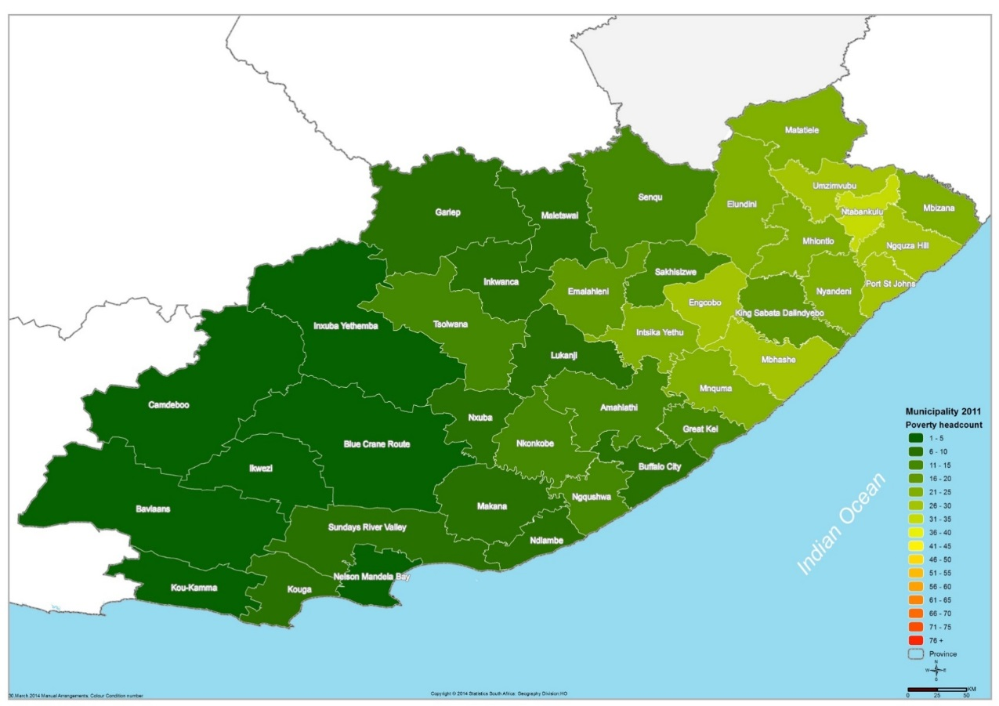
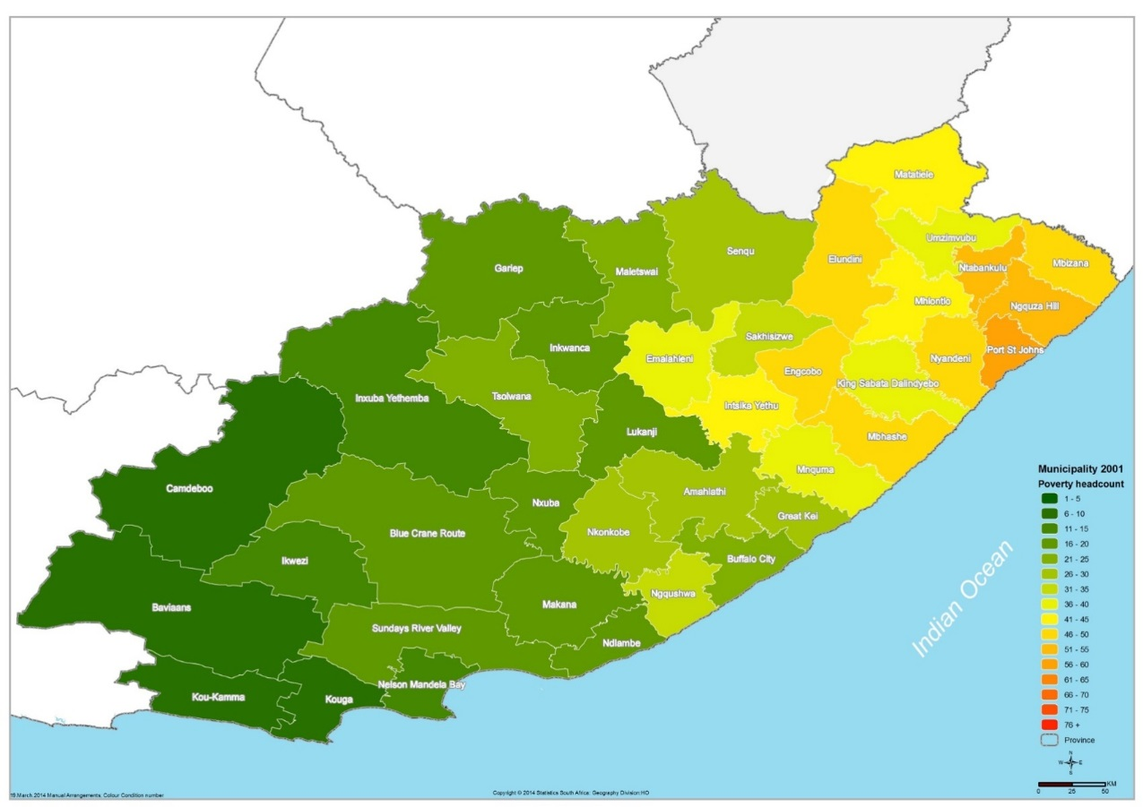
Mapping the poverty headcount by Municipality Eastern Cape – 2001-2011 (SAMPI)
Poverty headcount by municipality – 2001-2011 (SAMPI)
3

Slide 4
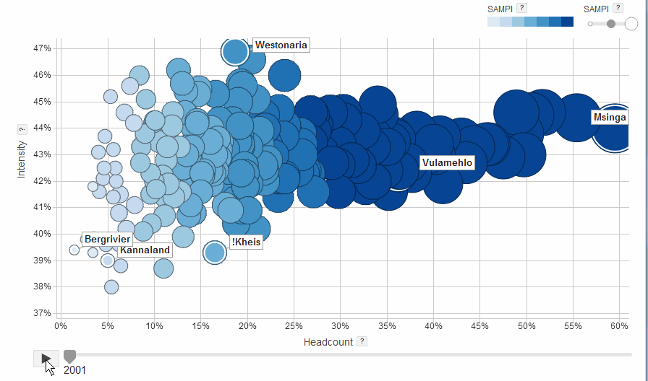
Poverty headcount by municipality – 2001-2011 (SAMPI)
4

Slide 5
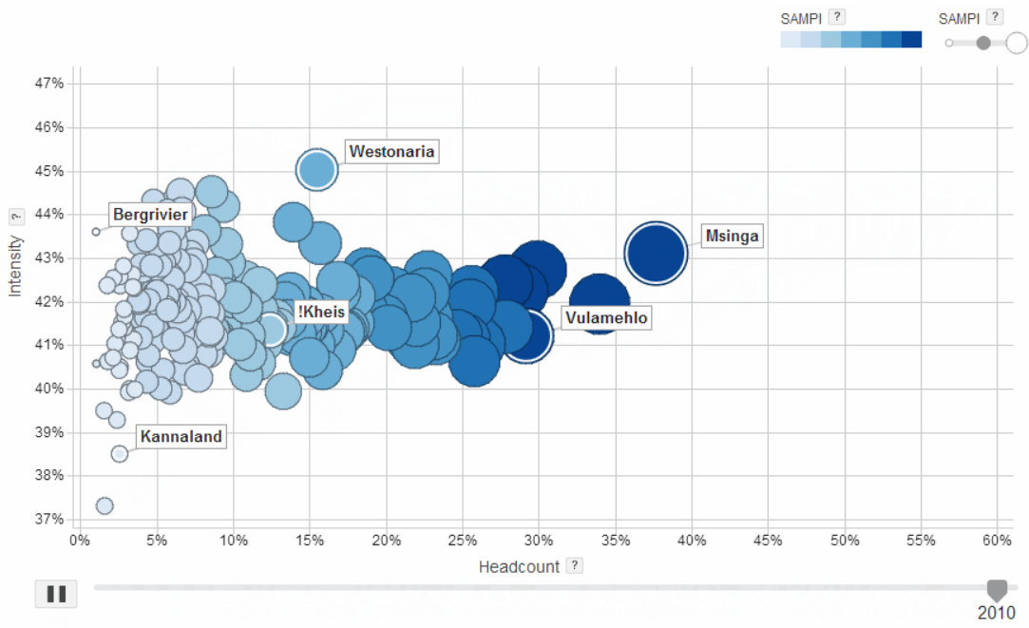
Poverty headcount by municipality – 2001-2011 (SAMPI)
5

Slide 6
On average, a woman will give birth to
Education Legotla
Fertility has declined from an average of 2,79 children per woman in 2002 to 2,57 children per woman in 2014
2,57
children
Provided that current fertility behavior prevails
Source: MYPE, 2014
6

Slide 7
Education Legotla
24,4
Fertility (births) have shown a decline since 2002
2,79
22,4
Total Fertility Rate (TFR)
Crude Birth Rate
2,57
7

Slide 8
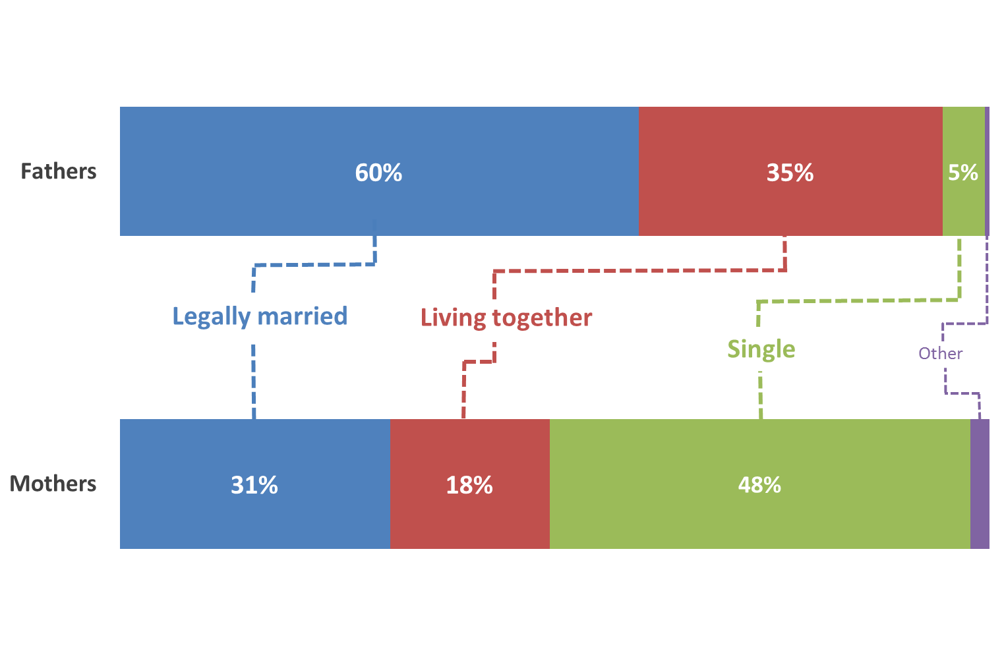
Marital status of mothers and fathers
Almost half of all mothers in South Africa are single
8

Slide 9
Education Legotla
Population group | Males |  |  |  |  | Females
 | Q1 | Q2 | Q3 | Q4 | Q5 | Q1 | Q2 | Q3 | Q4 | Q5
Black African | 39,2 | 42,3 | 46,8 | 49,2 | 52,3 | 35,3 | 38,2 | 43,4 | 50,7 | 62,9
Coloureds | 35,7 | 48,0 | 48,9 | 44,4 | 61,9 | 51,4 | 52,9 | 51,3 | 56,0 | 73,9
Indian/Asian | 0,0 | 90,0 | 51,2 | 64,1 | 69,4 | 0,0 | 75,0 | 73,0 | 74,9 | 81,6
White | 0,0 | 88,2 | 58,2 | 67,1 | 78,8 | 0,0 | 100,0 | 57,7 | 82,5 | 88,4
Black and Coloured population fair poorly irrespective of the school quintile they attend suggesting that racial correlates are at play
Source: DBE 2014
9

Slide 10
Education Legotla
Population group | Males |  |  |  |  | Females
 | Q1 | Q2 | Q3 | Q4 | Q5 | Q1 | Q2 | Q3 | Q4 | Q5
Black African | 41,0 | 43,7 | 48,3 | 50,0 | 54,5 | 36,9 | 40,1 | 44,8 | 51,3 | 64,1
Coloureds | 43,5 | 54,2 | 41,9 | 42,1 | 63,3 | 39,1 | 57,4 | 43,1 | 50,4 | 73,9
Indian/Asian | 0,0 | 90,9 | 63,6 | 70,5 | 74,7 | 0,0 | 75,0 | 82,4 | 77,2 | 84,5
White | 0,0 | 88,9 | 41,3 | 67,9 | 79,4 | 0,0 | 49,0 | 85,2 | 90,7 | 89,7
Amongst females as well Black and Coloured population fair poorly irrespective of the school quintile they attend suggesting that racial correlates are at play
Source: DBE 2014
Gender gap between black African males and female who studied physical science and achieved a bachelor’s pass narrowest amongst those in low quintiles
10

Slide 11
White
The alarming evidence points to regressive proportions in Bachelor’s completion rates amongst Blacks
Indian/Asian
Black African
Coloured

Slide 12
Number and proportion of the middle class by population group (2006 to 2011)
Population group | 2006 |  |  | 2008 |  | 2011
 | N |  | % | N | % | N | %
Black African | 531 872 |  | 5.6 | 643 912 | 6.7 | 1 006 660 | 10.0
Coloured | 185 420 |  | 19.2 | 225 514 | 21.8 | 293 511 | 26.4
Indian/Asian | 110 236 |  | 35.5 | 151 917 | 47.8 | 196 791 | 58.9
White | 1 102 031 |  | 69.0 | 1 129 167 | 72.0 | 1 225 912 | 75.4
Total | 1 932 648 |  | 15.5 | 2 150 510 | 17.1 | 2 722 874 | 20.8
Number, proportion and distribution of black African middle class households by sex of head of household
Sex | 2006 |  |  |  | 2009 |  |  | 2011
 | N | % |  | Distribution | N | % | Distribution | N | % | Distribution
Male | 369 967 | 6.7 |  | 69.6 | 446 817 | 8.2 | 69.4 | 680 103 | 11.9 | 67.6
Female | 161 905 | 4.0 |  | 30.4 | 197 095 | 4.7 | 30.6 | 326 557 | 7.6 | 32.4
Black African | 531 872 | 5.6 |  | 100.0 | 643 912 | 6.7 | 100.0 | 1 006 660 | 10.0 | 100.0
12

Slide 13
Education Legotla
Percentage of workers in each age group who are skilled (managers, professionals, technicians)
There were much weaker gains in the black African group for all ages
1994
2014
The percentage of workers in skilled occupations increased in all age and all race groups, except for black Africans aged 25-34, which decreased
13

Slide 14
Ownership of housing by Age Group Across Time
14

Slide 15
Value of property owned by race
15

Slide 16
Education Legotla
Economic activity
Poverty drivers in South Africa are multidimensional
Living standard
Unemployment rate
Unemployment is now the major driver of poverty in the country
Education
Health
16

Slide 17
KZN Citizens Priority
Areas by population group
!
For All Population Groups Job Creation is the Main Priority
Black African
#1
#2
#3
#1 Job Creation
Provision Housing
Provision Housing
Coloured
#1
#2
#3
#1 Job Creation
Education & skills Development
Poverty eradication
Indian/
Asian
#1
#2
#3
#1 Job Creation
Crime prevention
Fighting corruption
White
#1
#2
#3
#1 Job Creation
Poverty eradication
Fighting corruption
17

Slide 18
18

Slide 19
Mandate for Official Statistics as a Knowledge System
Global
Continental
National
Fundamental Principles of Official Statistics
(United Nations adopted 10 principles)
Statistics Act (Act 6 of 1999)
Statistical production
Statistical coordination
African Charter on Statistics
(African Union adopted 6 principles)
19

Slide 20
Policy and Statistics
Global
Continental
National
Policy Agenda: SDGs
(Sustainable development Goals)
Policy Agenda: Vision 2063
(African Integration
Agenda:
Long term perspective of Africa’s development)
Policy Agenda: NDP
(National Development
Plan:
Long-term perspective of SA’s development)
20

Slide 21
Policy, Statistics and decision-making
For USE in
Planning
(baseline information for NDP)
Monitoring & Evaluation
(measuring development and impact)
Policy development
(increasing rationale for making
decisions for better policies)
Decision-making
(decision making in government,
subnational, business & the public)
Increased knowledge, understanding and use by the
leadership, citizens and state

Slide 22
The Knowledge Society and
Official Statistics
Knowledge Society:
Is a well informed Society in fact, that should become increasingly
better informed
In a complete knowledge society, all the knowledge of the world will be:
available to everyone
available everywhere
available simultaneously
available freely
Pre-conditions
Non-technological infrastructure should first be upgraded
Literacy
Promotion of use
Promotion of access
Basic freedoms
22

Slide 23
Forms of Knowledge
Knowledge as information
Semantic form and irrespective of empirical validity or pragmatic
relevance
Knowledge as understanding
Scientific knowledge as opposed to trivia in entertainment even amateur
epistemology & public relations maneuvers
Knowledge as insight, competence and authority
selected, activated and applied: implying applying specific rules of
preference and creating added value (Bhor & Einstein)
23

Slide 24
Cognitive Map of the knowledge society
as an aid to orientation
Academic
Private
Commercial
Serious
Nonacademic
Public
Noncommercial
Light hearted
Technological
Historical world of experience
Cultural & natural
Electronic world of networks
24

Slide 25
Cognitive Map of the knowledge society
For Official Statistics
Serious
Nonacademic
Public
Noncommercial
Technological
Electronic world of networks
25

Slide 26
Social Division of knowledge
from an official statistics perspective
Utilization
Research &
Science
Processing
Documentation
Distribution
Social Division of knowledge
from an academia perspective
Research &
Science
Processing
Documentation
Distribution
Utilization
26

Slide 27
Order Policy of Knowledge & the Need
For Separation
Knowledge
Ideas
Theory
Knowledge
institutions
Independence
Disinterested
handling
(ideological)
Freely
accessible
Exoneration
from actions
Property
Interests
Practice
Government
27

Slide 28
Positive Contributions of
Official Statistics
Basic information on society
Informational service as arise
from legal rulings
Raising information levels for
the information society
Provides orientation aids
Supplement other info services
Knowledge base for counter
information
Statistical advice for
government
Knowledge Deficits of
Official Statistics
Unavoidable knowledge gaps
e.g. the future
Intentional ignorance e.g. where
there should be stats but none exist
Limited partial knowledge
Legalised knowledge errors e.g,
definitions & standards poverty
Inherent limits of statistical
information: By its nature it can’t
deliver insights
28

Slide 29
Handlers of information &
Risk Profile
Blind (mailman not allowed to read)
Discreet (butler knows but no comment)
Anonymous (statistician notes mass data)
Mechanical (politicians)
Participatory (scientist excited by theory)
Interventionist (knowledge = power)
Competency Profile & Risk
Management
No insight understanding intervention
Insight understanding no intervention
Understanding no insight intervention
Insight intervention no understanding
Insight understanding no intervention
insight understanding & intervention
29

Slide 30
What Makes Statistics Useful
Nonacademic
Purposive
Serious
Resolve Life
Problems
Noncommercial
Legal monopoly
Public
Accessible
Electronic world of networks
Technological
Adaptable
portable
Can be
Managed in a virtual world
30

Slide 31
Statistics Act
Outlines the relationship amongst institutions
President appoints the Statistician-General
Political responsibility
Minister
SG and Stats SA
Council
Appointment
Advice-Accountability
Approval of Work Programme
Accountability
Safeguards official statistics
Administers Statistics Act
Consultation
Advice-Accountability
Inter-dependance
31

Slide 32
Statistical Production System
Line Ministries
Official Statistics
Input
Process
Output
Outcome
Impact
Policy analysis
Registers/Administrative records
Surveys
Research
Sector statistics
Stats SA
32
Notes:
(a) Inputs: all the resources that contribute to the production and delivery of outputs. Inputs are “what we use to do the work”. They include finances, personnel, equipment and buildings.
(b) Activities: the processes or actions that use a range of inputs to produce the desired outputs and ultimately outcomes. In essence, activities describe “what we do”.
(c) Outputs: the final products, or goods and services produced for delivery. Outputs may be defined as “what we produce or deliver”.
(d) Outcomes: the medium-term results for specific beneficiaries that are the consequence of achieving specific outputs. Outcomes should relate clearly to an institution’s strategic goals and objectives set out in its plans. Outcomes are “what we wish to achieve”.
(e) Impacts: the results of achieving specific outcomes, such as reducing poverty and creating jobs.

Slide 33
The objective of a functioning SANSS is to address the
Information gap
Quality gap
Capacity gap
Came to the realisation that the 3 gaps cannot be adequately addressed unless there existed an enabling legal environment
33
Notes:
(a) Inputs: all the resources that contribute to the production and delivery of outputs. Inputs are “what we use to do the work”. They include finances, personnel, equipment and buildings.
(b) Activities: the processes or actions that use a range of inputs to produce the desired outputs and ultimately outcomes. In essence, activities describe “what we do”.
(c) Outputs: the final products, or goods and services produced for delivery. Outputs may be defined as “what we produce or deliver”.
(d) Outcomes: the medium-term results for specific beneficiaries that are the consequence of achieving specific outputs. Outcomes should relate clearly to an institution’s strategic goals and objectives set out in its plans. Outcomes are “what we wish to achieve”.
(e) Impacts: the results of achieving specific outcomes, such as reducing poverty and creating jobs.

Slide 34
Pre-requisite for a Conduit of trust:
Legislative Review and Reform
Purpose of Amendments: To strengthen statistical production and coordination of the national statistics system
Implementing statistical geography as a deliberate strategy for transforming the national development information landscape;
Strengthening coordination mechanisms and compliance in order to optimise informatics efficiency and effectiveness;
Embrace data revolution in order to ease the methods of doing business by dramatically changing the capabilities of information collection, access, analysis, use, retrieval, storage and archiving, thereby increasing and deepening our knowledge basis;
Creating a state-wide statistics service through professionalising, training and deployment; and
Establishing institutional arrangements and protocols that will lead and deliver a professional and sustainable National Statistics System.
34
Notes:
(a) Inputs: all the resources that contribute to the production and delivery of outputs. Inputs are “what we use to do the work”. They include finances, personnel, equipment and buildings.
(b) Activities: the processes or actions that use a range of inputs to produce the desired outputs and ultimately outcomes. In essence, activities describe “what we do”.
(c) Outputs: the final products, or goods and services produced for delivery. Outputs may be defined as “what we produce or deliver”.
(d) Outcomes: the medium-term results for specific beneficiaries that are the consequence of achieving specific outputs. Outcomes should relate clearly to an institution’s strategic goals and objectives set out in its plans. Outcomes are “what we wish to achieve”.
(e) Impacts: the results of achieving specific outcomes, such as reducing poverty and creating jobs.

Slide 35
Statistical Geography
Geospatial information is about the location and names of features beneath, on or above the surface of the earth
The Spatial Data Infrastructure Act, 2003 (Act No. 54 of 2003) provides for the establishment of the South African Spatial Data Infrastructure (SASDI) to regulate the collection, management, maintenance, integration, distribution and utilisation of spatial information in the country. However Geospatial information – is currently not meeting planning and policy requirements to implement the NDP 2030
Intent
To transform the system of information from a temporal based approach with spatial displays to an integrated spatio-temporal conception for goal and target setting with associated indicator ontologies that deliver semantic clarity to sustainable development. Poses key questions on Statistics Act & SDI Act?
Strategic change:
Demand a high level of informatics platform as an enabler
35

Slide 36
Strengthening coordination mechanism and compliance
Stats Act mandates the Statistician-General to coordinate production of statistics produced by other organs of state
Formulating quality criteria and establishing standards, classifications and procedures;
Providing statistical advice; and
Designating statistics as official
Issues to be addressed to strengthen coordination
National Strategy for Development of Statistics (NSDS) for strategic management of the SANSS;
Statistical information systems in other organs of state (Statistics Units: reporting, independence etc);
SANSS governance structures (NCC, Statistical Clearing House, Sectoral working groups)
Administrative data (conversion to statistics, access to data, confidentiality)
SASQAF for designating statistics as official
Strategic change:
Responsibility of Heads of Organs of State towards statistical production
36

Slide 37
Embrace data revolution
Stats Act not specific on data revolution
Emerging international discussion led by the UN to respond to SDG Agenda
Issues to be addressed to embrace data revolution
Public private civil society partnerships
Bringing together traditional and new data sources (including big data)
Data sharing and open data sources; Promoting innovation to fill data gaps
Modelling; Capacity building
Quality of data; Privacy and confidentiality
Strategic change:
Responsiveness of the statistics system to emerging data demands e.g. Sustainable development goals
37

Slide 38
Creating a State-wide Statistics Service
Stats Act not specific on State-Wide Statistics Service
Issues to be addressed to create a State-wide Statistics Service
Professional body of statisticians
Code of ethics
Statistical literacy and capability
Statistics Institute for capacity building
Statistical leadership
Strategic change:
A capable statistics system based on ethical conduct
38

Slide 39
Institutional arrangements
Stats Act provides for:
SG reporting to the Minister
Statistics Council advisory role to both the Minister and SG
Issues to be addressed in terms of Institutional arrangements
Fundamental principles of Official Statistics/African Charter
Independence of reporting (Reporting to Parliament)
Coordination of statistical reporting; Referee and Player
Asymmetry vs Symmetry; Various scenarios
Establishing a statistics authority?
SG for Statistics System and DG for Stats SA?
Strategic change:
Delivery model coordinating statistical production to respond to state needs based on Fundamental principles of Official Statistics and African Charter on Statistics
39

Slide 40
MDG vs SDG FOCUS AREAS
SDGs
From 8 to
17 Goals
MDGs
Adapted from http://www.theguardian.com/global-development/ng-interactive/2015/jan/19/sustainable-development-goals-changing-world-17-steps-interactive
40

Slide 41
Africa and the road to SDG
41

Slide 42
AGENDA 2063
A prosperous Africa based on
inclusive growth and sustainable development
42

Slide 43
Agenda 2063
50 Year Vision
Agenda 2063 is a strategic framework for the socio-economic transformation of the continent over the next 50 years. It builds on, and seeks to accelerate the implementation of past and existing continental initiatives for growth and sustainable development
Adopted in January 2015
Adopted in January 2015, in Addis Ababa, Ethiopia by the 24th African Union (AU) Assembly of Heads of State and Government
10 Year Implementation Cycle
Five ten year implementation plan – the first plan 2014-2023
43

Slide 44
AGENDA 2063 ASPIRATIONS
2
5
An integrated continent, politically united and based on the ideals of Pan-Africanism and the vision of Africa’s Renaissance
An Africa with a strong cultural identity, common heritage, shared values and ethics
3
6
An Africa of good governance, democracy, respect for human rights, justice and the rule of law
An Africa whose development is people-driven, relying on the potential of African people, especially its women and youth, and caring for children
4
7
A peaceful and secure Africa
Africa as a strong, united and influential global player and partner
44

Slide 45
Steps on Agenda 2063
FORMULATE
Formulate indicators for tracking the implementation of the first ten years of agenda 2063.
ALIGN
Align SDG indicators to Agenda 2063
COST
Cost the first ten years of agenda 2063.

Slide 46
Process and Progress for Development of Continental and National Indicators
September 2015
September 2015
October 2015
November 2015
Workshop of IAEG-SDG member countries and ASSD, AUC and ECA developed indicators for national and continental targets for Agenda 2063 ten-year implementation plan
AUC, ECA and ASSD met and matched national targets from Agenda 2063 plan to SDG targets
Matched indicators from Agenda 2063 and Africa proposal on global indicators and harmonize as much as possible
Developed a set of continental and national indicators from Africa proposed global set, continental indicators of Agenda 2063 agenda
Meeting of NSOs and planners from countries which: a) validated the list of indicators for Agenda 2063 and b) endorsed the continental framework of indicators build through the process of alignment of SDGs and Agenda 2063 implementation plan
Africa Statistical Commission and Committee of DGs approved the continental and national set of indicators
46

Slide 47
South Africa and the SDG process
47

Slide 48
Stats SA’s role in SDG reporting
SANSS: Statistical Reporting (SDGs)
SDG secretariat
Data gathering
Data assessments using SASQAF
NCC/SWG/TWG secretariat
Report writing/Report writing facilitation
Report dissemination
48

Slide 49
Key Partners
To deliver on the SDGs, Agenda 2063 and other national/continental reporting obligations
NSOs need to partner, coordinate and collaborate with the following sectors
Sector departments
1
NSS
Civil Society
2
The Private Sector
3
International organisations
4
49

Slide 50
Core Business
P
P
P
Planet
People
Prosperity
Information about the environment
Information about people and society
Information about the economy
50

Slide 51
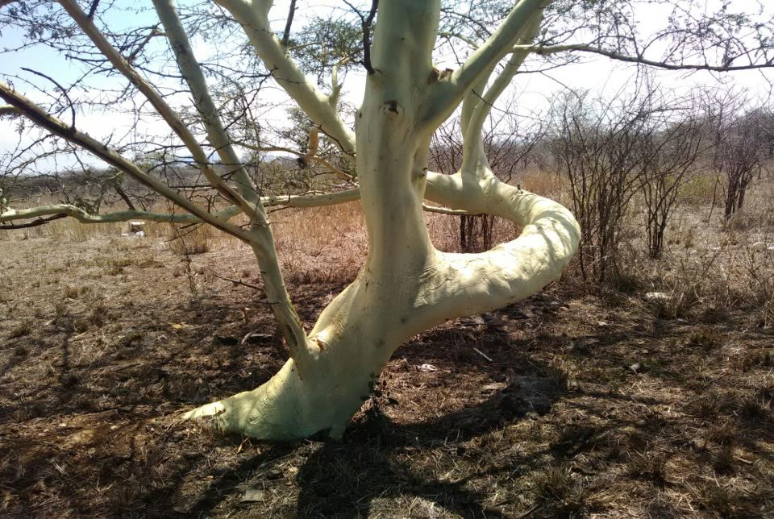
Measuring
PLANET
Energy
Natrural resources
Biodiversity
Minerals
Fisheries
Air
Water
Environment
Eco Systems
…
Polution
Green Growth
Land use
SDG
Future
Forrestry
Natural Capital Accounting
SEEA
Sustainable
Statistical Report: 1
51
Notes:
The United Nations principles state official statistics are produced:
As public information which is relevant, impartial and accessible.
With professional standards and ethics.
Using accountable and transparent methods and procedures.
Ensuring misuse and erroneous interpretation is prevented.
In a cost-effective manner.
With all individual data as confidential
Within required statistical system legislation.
With coordination nationally among producers.
Using international standards, concepts, classifications, methods.
Where international cooperation is fostered.

Slide 52
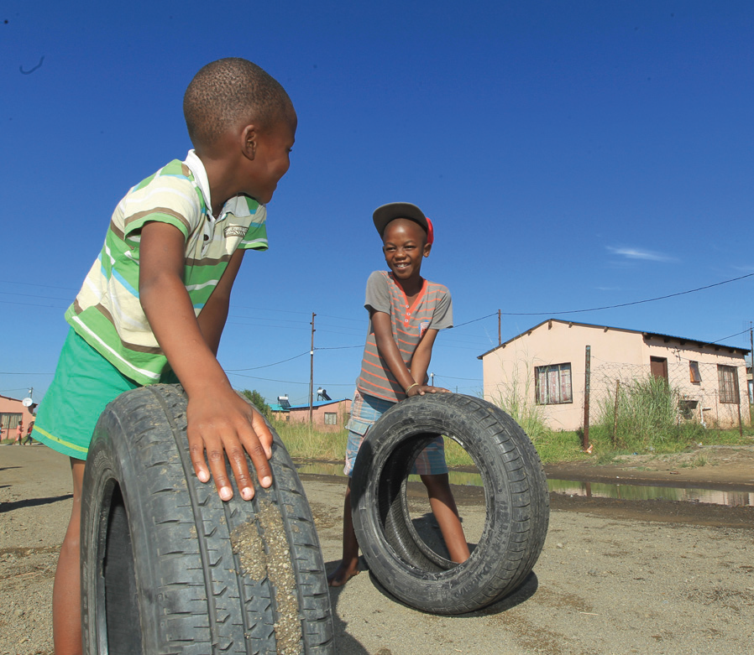
Measuring
PEOPLE
Labour
Single headed households
Youth unemployment
Housing
Education
Gender
Poverty
Population
Vulnerable groups
Causes of death
CRIME
Access to Water
Access to Electricity
Deaths
Marriages
Access to Transport
Health
Births
Divorces
Statistical Reports: 37
52
Notes:
The United Nations principles state official statistics are produced:
As public information which is relevant, impartial and accessible.
With professional standards and ethics.
Using accountable and transparent methods and procedures.
Ensuring misuse and erroneous interpretation is prevented.
In a cost-effective manner.
With all individual data as confidential
Within required statistical system legislation.
With coordination nationally among producers.
Using international standards, concepts, classifications, methods.
Where international cooperation is fostered.

Slide 53
Measuring
Prosperity
Employment
Producer price Index
Consumer Price Index
Primary Sector
Forestry
Agriculture
Services
Prices
Manufacturing
Government
Transport sector
Mining
Communication
Wholesale Trade
GDP
Finances
Finances
Buildings
Trade
Provincial spending
Electricity
Statistical Reports: 246
53
Notes:
The United Nations principles state official statistics are produced:
As public information which is relevant, impartial and accessible.
With professional standards and ethics.
Using accountable and transparent methods and procedures.
Ensuring misuse and erroneous interpretation is prevented.
In a cost-effective manner.
With all individual data as confidential
Within required statistical system legislation.
With coordination nationally among producers.
Using international standards, concepts, classifications, methods.
Where international cooperation is fostered.

Slide 54
Funding: 2016/17
Programme R million | 2016/17 | 2017/18 | 2018/19
1. Administration | 709.2 | 709.5 | 731.1
2. Economic Statistics | 224.7 | 229.2 | 237.3
3. Population and Social Statistics | 127.0 | 128.3 | 132.3
4. Methodology, Standards and Research | 69.6 | 67.0 | 67.5
5. Statistical Support and Informatics | 255.4 | 258.4 | 267.2
6. Statistical Collection and Outreach | 569.9 | 584.3 | 607.2
7. Survey Operations | 533.3 | 191.5 | 157.7
Total | 2 489.1 | 2 168.3 | 2 200.4

Slide 55
Baseline Assessment: Growth trends
Census 2011
Community
Survey
New Building

Slide 56
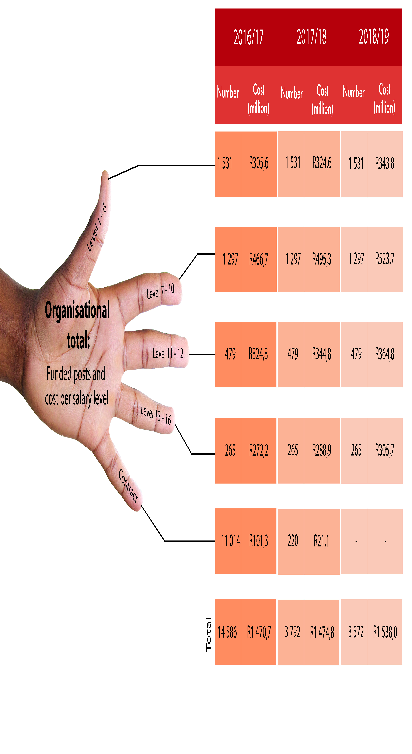
Personnel

Slide 57
Risks to the statistics system
Income and Expenditure Survey – as the basis for rebasing the CPI basket and providing information on poverty and inequality
Continuous Population Survey – as the basis for providing information at local level more frequently to inform planning

Slide 58
Key priority projects: 2016/17
GDP Expenditure approach : All three approaches housed in one institution
Scheduled to publish in June 2016
Move to a new building in 2016 : Information is freedom
Scheduled to move in on 1 June 2016
Improve the Policy, Statistics and Decision-making value chain Integrative & spatial analysis for better use in planning, M&E, policy and decision-making
Scheduled to deliver SAM and GAF to inform better planning
Community Survey Better, faster, cheaper – driving innovation for better efficiency
Scheduled to publish in June 2016
Lead statistical development on the Continent: An Africa that Counts Develop measurement indicators for Vision 2063 aligned to SDG; Review SHaSA
Drive statistical and legislative reform: Changing the statistical landscape in SA
Amendments to the Act scheduled for 2016
54

Slide 59
Looking ahead: 2016 and beyond
Annual International Comparison Programme (ICP)
Addressing informational requirements to guide Africa attaining a demographic dividend
Eliminate scandal of invisibility in Africa through CRVS programme;
Dynamic map of regional consumption markets and industrial markets to inform Africa’s
industrialization program
Addressing infrastructure statistics in Africa
Compendium of Statistics that informs Agenda 2063
Strengthen African statistics institutions through tuition programme
Implement a System of economic and environmental statistics in Africa
System of statistics that tracks and traces merchandise properties, its origin, destination and use to
inform industrialisation strategy and deliver a by-product for address illicit financial flows
1
2
3
4
5
6
7
8
9
55

Slide 60
Use as fundamental for strategic shift: indicators of use
Statistics for>> | Transparency | Accountability | Results | Transformation
Statistical leadership: Embed use through legislative and institutional authority | Use statistics for mutual trust in statecraft | Use statistics for mutual accountability and governance | Use statistics for results-based management | Use statistics to lead change for different and better results
Strategic planning: Embed use in administrative practices and procedures | Use statistical metrics for fact based norms and standards | Use statistical indicators for mutual accountability | Use statistical targets for results based management | Use statistical metrics to drive change
Statistical products: Embed use through application of products in service delivery | Ensure that products are accessible and understood | Ensure that products anticipate and respond to policy questions and concerns | Ensure that you provide evidence about the use of products | Use statistical product s measure outcomes and impact measures to spur change
Statistical process: Embed use through consultation, training and user support | Provide metadata with the results | Anticipate user and support needs Report in cycles predictable | Put systems and infrastructure for access and use of results | Inspire better and different outcome expectations to drive change
Organisation & management: Embed use in the organisation | Ensure that methods are known and understood | Publish statistics that are produced and ensure access | Anticipate user requests and address them | Use lessons learnt to catalyse change for better

Slide 61
Step change: Use at the centre
Outcome:
use of evidence
S
T
A
R
T
Statistics
Transparency
Accountability
Results
Transformation
are numerical facts for statecraft
a pre-audit to ensure predictability
taking responsibility and accepting consequences
allow parties to read the same facts
is action in unison to drive change for the better
57

Slide 62
Our strategy driving statistical reform
Our vision:
The South Africa I know, the home I understand
To lead and partner in statistical systems and products for evidence based decisions
Our Mission:
What we want to achieve - strategic outcomes
Informing a nation
Trusted statistics
Partners in statistics
Capable organisation
Statistical leadership
We will change our business processes
Statistical production
Statistical coordination
IT systems
People
Organisation environment
We will invest in

Slide 63
Questions
58

