Slide 1
URBAN SETTLEMENTS
DEVELOPMENT GRANT (USDG)
presentATION to the
Portfolio Committee on Human Settlements
12 April 2016

Slide 2
METRO PROFILE
Size | 1 950 km²
Population | 1 152 115 (Source: StatsSA; Census 2011)
Formal Households | 276 850 (Source: StatsSA; Census 2011)
Indigent Households | 44% households receive at least one social grant
Number of Informal Settlements | 79
Unemployment | 36.6% (Source: StatsSA; Census 2011)
Access to water | 100 % of formal households in the urban edge
Access to electricity | 96,80% of formally surveyed erven
Access to waste collection | 99,77% of households in the urban edge
Access to sanitation | 92,39% of households
Buckets in informal areas | 20 900

Slide 3
METRO URBAN TRENDS
The overall population density is 80 – 100 persons per hectare (20 units per hectare). This is low.
The predicted population for 2020 is 1 243 930.
The growth will therefore be less than 100 000 people (25 000 units for all population groups over the next 7 years).
This agrees with studies showing low in-migration figures and the NMBM demographic study conducted in 2008.
Low growth scenario.
The implication of this is that change will be slow.

Slide 4
1. MTSF RESPONSE

Slide 5
MTSF- NMBM
MTSF TARGET 2019 | National 5 yr MTSF Target for Metro | Annual MTSF Target | 2015/16 | 2016/17 | 2017/18 | 2018/19 | 2019/20 | 5 yr MTSF (Less or more)
750 000 households in informal settlements upgraded to Phase 2 of the Informal Settlements Upgrading Programme
Individual households: Water Sanitation Electricity | 14810 | 2962 | 4000 | 3000 | 4000 | 4000 | 4000 | +4190
 | 14810 | 2962 | 4000 | 3000 | 4000 | 4000 | 4000 | +4190
 |  |  | 2532 | 3238 | 3648 | 3779 | 3007
Shared services (number of households benefiting) Water Sanitation |  |  | 4000 | 4000 | 4000 | 4000 | 4000
 |  |  | 500 | 500 | 500 | 500 | 500

Slide 6
MTSF Priority per programme | Stand costs | Annual Target | Annual Costs | 5-Year Target | Total Cost
UISP phase 2 (with interim services) | R48000 | 3000 - 4000 | R175m | 19000 | R950m
Available Funding | 2016/17 | 2017/18 | 2018/19
MTEF Allocation
USDG: | R 868,282,000 | R 918,970,000 | R 965,421,000
HSDG Portion | R 517,128,000 | R 528,171,000 | R 565,367,000
Total | R 1,385,410,000 | R 1,447,141,000 | R 1,530,788,000
Required funding | R 2,500,000,000 | R 2,900,000,000 | R 3,500,000,000

Slide 7
2. 2016/17 - 2018/19 TARGETS

Slide 8
LAND
IMMEDIATE INTENTIONS
Establish principles for land acquisition
Prepare a prioritised programme for land for Human Settlements.
Match budget sources to the programme including designation of municipal land and other state land.
Programme land development .

Slide 9
DRAFT LAND ACQUISITION PIPELINE 2015-2019
Project Name: Property Description | Area and No of Families | Status | Estimated Acquisition Cost | Est. Time Frames 2015-2019 | Funding | Land Assembly Status
Lorraine Informal Settlements | ±17ha ±500ru’s | Private Land: Informal Settlement | To be determined (TBD): Market value | 2015 - 2019 | TBD | Council Resolution obtained. Valuations awaited
Vastrap: Erf 2069 Bloemendal | 26,58ha ±1742 ru’s | Private Land: Informal Settlement | To be determined: Market value | 2015 - 2019 | TBD | Technical Assessment Complete, Council Resolution outstanding
Gro Gro: Erf 432 Hunters Retreat | 85,96 ha ±1600 ru’s | Private Land: Informal Settlement | To be determined: Market value Owner Offer: R 40, 000, 000 | 2015 - 2019 | TBD | Feasibility and Council resolution outstanding
Walmer Arlington Race Course Erf 4195 Walmer | 75,12ha ±4500 ru’s | Private Land Suitable for Residential Development | Owner Offer: R 70, 900, 000 / R60 000 000 | 2015 - 2019 | TBD | Feasibility and Council resolution outstanding
Portion 8 of the farm Kuyga No. 8 | 25,804ha 500-1000 ru’s | Private land Suitable for residential development | TBD | 2015 - 2019 | TBD | Feasibility and Council Resolution Outstanding: Fitches corner
Erf 1212 Colchester | ± 61,04ha ± 1200-1500 ru’s | Private Land | Owner Offer: R 17 677 000 | 2015 - 2019 | TBD | Feasibility and Council Resolution outstanding
Total Est. Land Acquisition Costs |  |  | TBD

Slide 10
OTHER POSSIBLE LAND ACQUISITION
Ward 40
Seaview
Fitches Corner
Colchester
Uitenhage

Slide 11
2016/17 - 2018/19
USDG TARGETS: LAND DEVELOPMENTS

Slide 12
USDG LAND DEVELOPMENT 2016-2019
ITEM | 2015/2016 | 2016/2017 | 2017/2018 | 2018/2019
Number of hectares of land planned for Greenfields development in relation to relation to informal settlements upgrading | 95 | 120 | 120 | 120
Number of hectares of land planned for Brownfields development in relation linked to informal settlements upgrading programme | 48 | 70 | 70 | 70
Number of hectares of land proclaimed (township establishment completed) for in situ and incremental development of informal settlements | 143 | 190 | 190 | 190
Number of dwelling units developed and planned per hectare for upgrading informal settlements | 20 | 20 | 20 | 20
Number of existing hectares of well located-land earmarked and planned for in situ and incremental upgrading ( see location prioritisation) | 190 | 190 | 190 | 190

Slide 13
2016/17 - 2018/19
INFORMAL SETTLEMENT UPGRADING

Slide 14
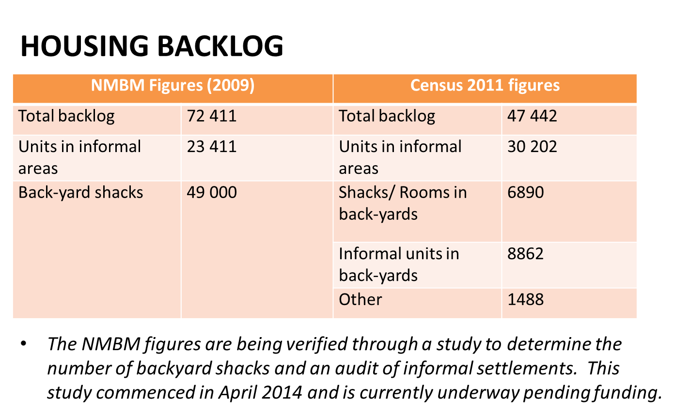

Slide 15
UPGRADING OF INFORMAL SETTLEMENTS
The Metro has a Council approved human settlements development plan which includes the informal settlement’s upgrade plan approved in Dec 2008.
Plan included:
105 informal settlements
52 In-situ upgrades
36 Full relocation
17 Greenfields
The plan priorities and programmes areas for redevelopment according to vulnerability, status and projected available funding.

Slide 16
UPGRADING OF INFORMAL SETTLEMENTS
Progress in terms of serviced sites :
23 980 Sites serviced to date
34 Informal Settlements Upgraded
10 greenfields developed for relocations

Slide 17
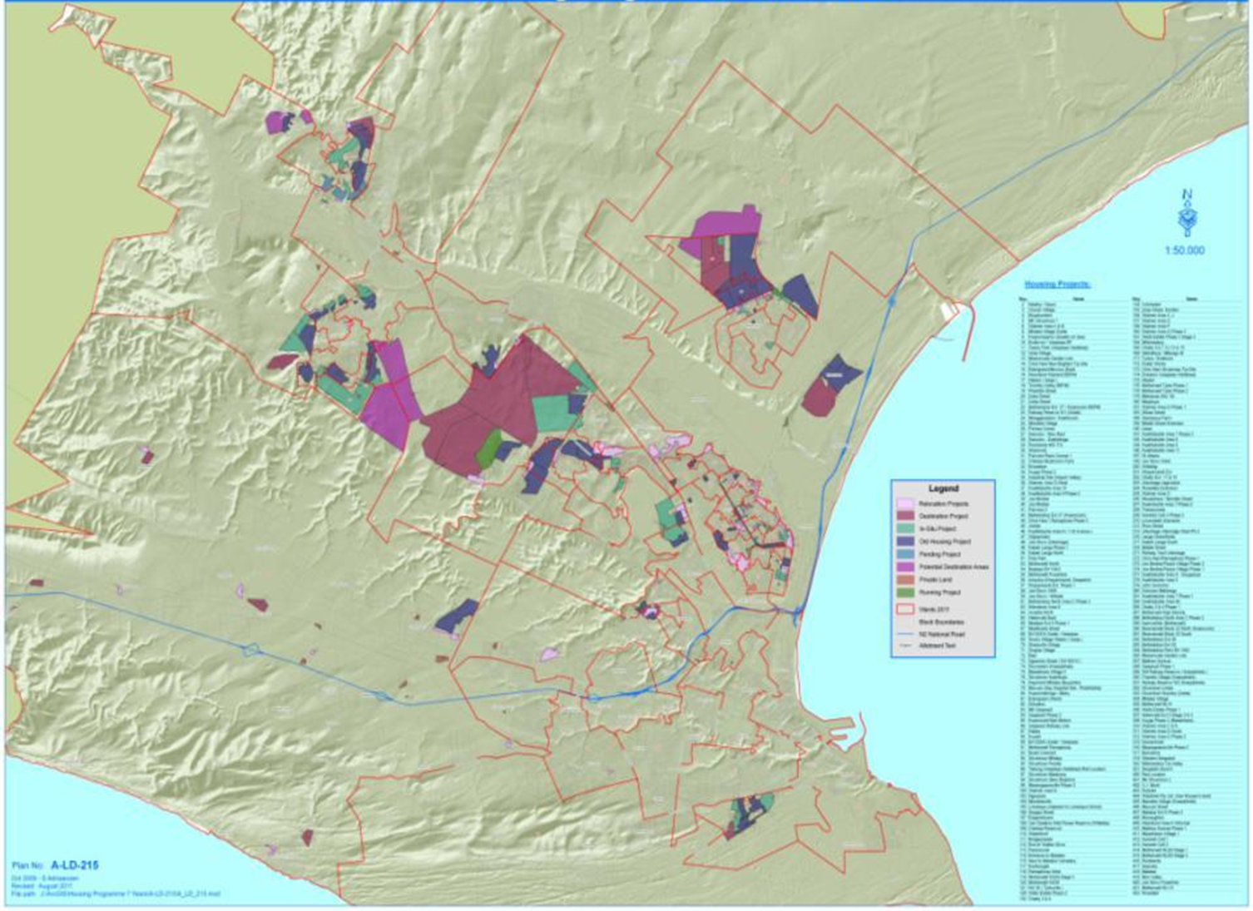

Slide 18
UPGRADING OF INFORMAL SETTLEMENTS
Approved Human Settlements Plan
Plan is translated into Readiness Matrix
This Matrix guides:-
Technical Readiness
Vulnerability
Budget
USDG - Capital budget

Slide 19
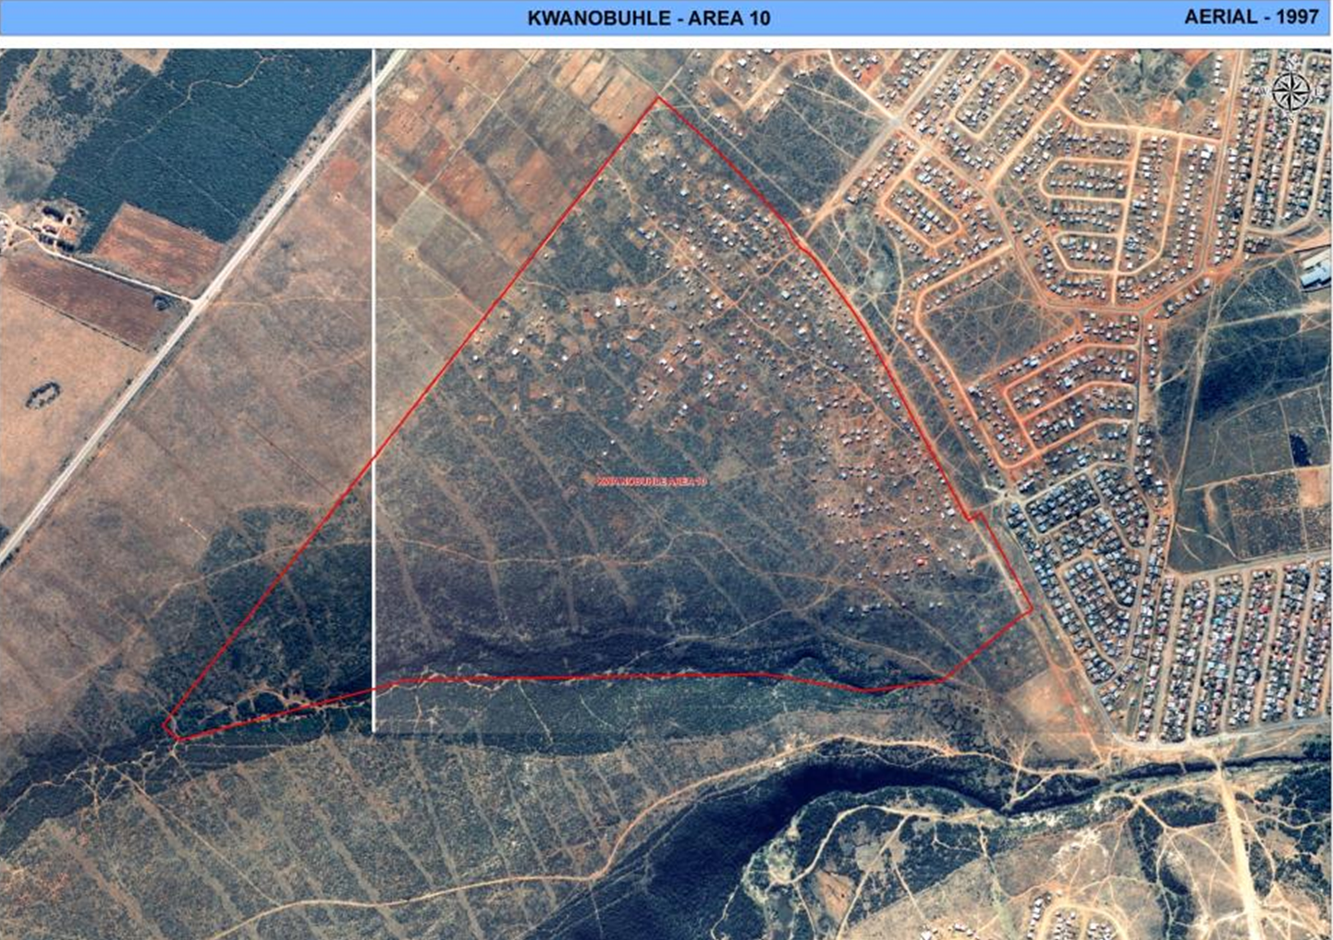

Slide 20
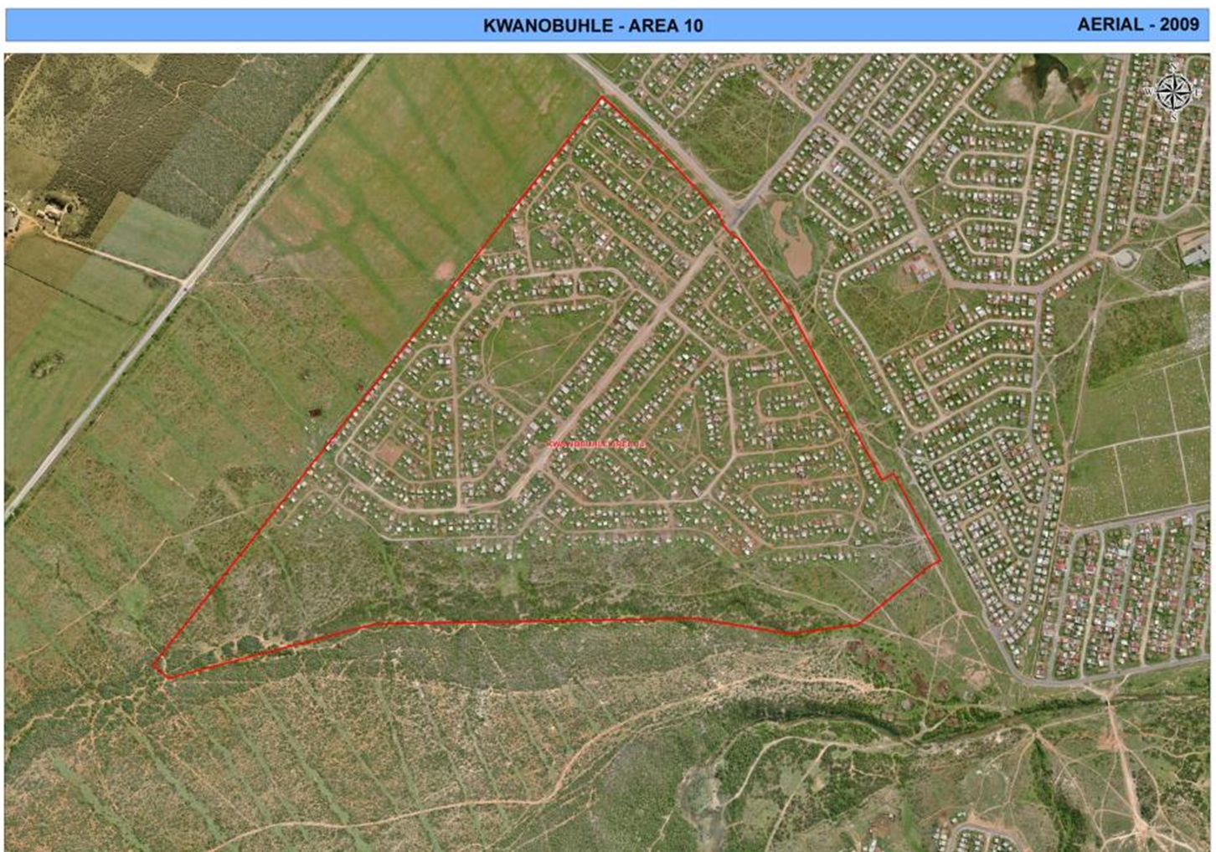

Slide 21
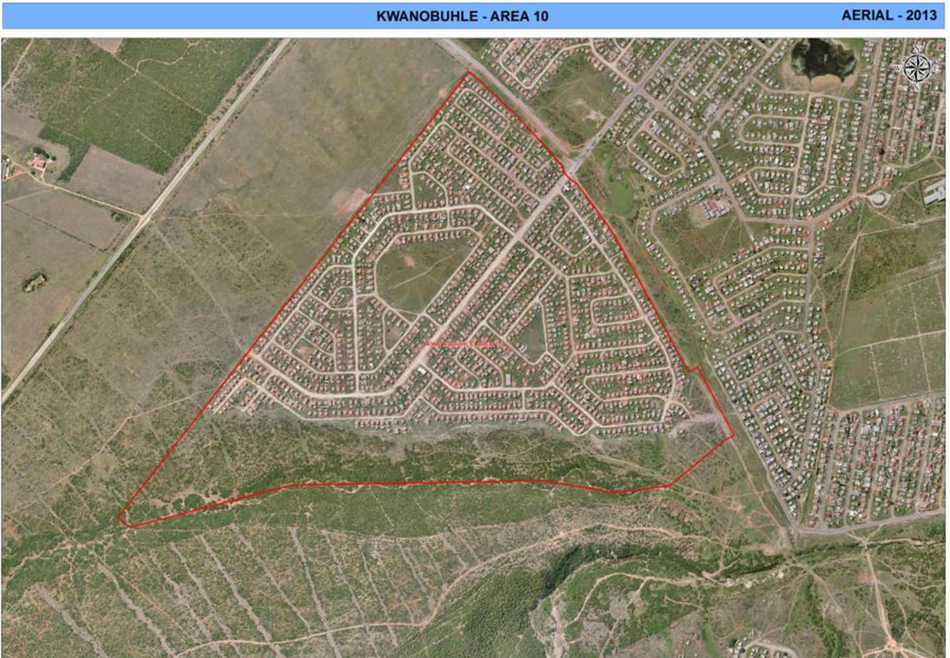

Slide 22
2016/17 - 2018/19 USDG TARGETS: INFORMAL SETTLEMENTS
ITEM | 2015/2016 | 2016/2017 | 2017/2018 | 2018/2019
Number of informal settlements targeted for upgrading | 4 | 4 | 4 | 4
Number of informal settlements targeted for upgrading with upgrading plans | 4 | 4 | 4 | 4
Number of households living in informal settlements targeted for upgrading | 3000 | 4000 | 4000 | 4000
Number of informal settlements in situ upgraded (services provided): | 2 | 2 | 3 | 2
Number of informal settlements targeted for formalisation (services and tenure provided) through relocation and in situ upgrading | 2 | 2 | 3 | 2

Slide 23
2016/17 - 2018/19
USDG TARGETS: AMENITIES
Description | Targets
Number of title deeds to be transferred to eligible beneficiaries | 600pa
Number and type of alternative/ interim tenure arrangements to be provided (e.g. permission to occupy, recognition certificates etc.) | 1200pa
Number of housing support centres to be created to support consolidation of top structures | Nil
Number and type of social and economic amenities planned and to be provided in in - situ upgraded settlements | Not Quantified
Number and type of social and economic amenities planned and provided in relocation greenfield projects | Not Quantified

Slide 24
2016/17 - 2018/19
USDG TARGETS: BASIC SERVICES
 | 2016/17 | 2017/18 | 2018/19
Number of water service points to be installed for informal settlement dwellers within a 200m radius | Target met
Number of sanitation service points (Communal Ablutions): | 75 | 150 | 75
Number of basic services( water, sanitation and refuse removal) planned to be provided on an individual household 1-1 basis | 4000 | 4000 | 4000

Slide 25
2016/17 - 2018/19 USDG TARGETS: CATALYTIC PROJECTS
Catalytic Urban Development Projects in Integration Zones 2016/17 – 2018/19,

Slide 26
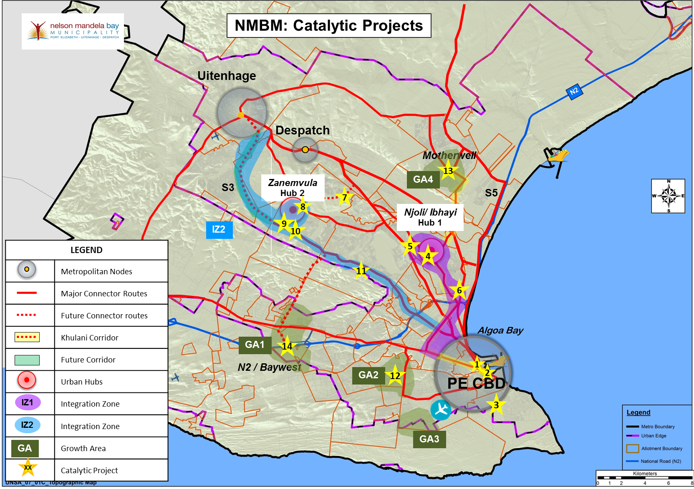

Slide 27
2016/17 - 2018/19
USDG TARGETS
2016/17 -2018/19 DRAFT USDG CAPITAL BUDGET ALLOCATIONS
 | Draft Budget | Draft Budget | Draft Budget
Directorate | 2016/2017 | 2017/2018 | 2018/2019
Human Settlements | 244,074,000 | 279,297,000 | 260,490,000
Infrastructure and Engineering | 624,208,000 | 639,673,000 | 704,931,000
Roads, Storm water and Transportation | 62,700,000 | 51,300,000 | 68,400,000
Sanitation Service | 379,050,000 | 388,588,000 | 402,546,000
Water Service | 182,458,000 | 199,785,000 | 233,985,000
TOTAL | 868,282,000 | 918,970,000 | 965,421,000
Note:
Project schedule is extensive.
Projects are in support of Housing Plan and the development of integration zones.

Slide 28
2016/17 - HSDG TARGETS
Project Names | Units
Missionvale G. Lots 2400 Units | 207
Joe Slovo Uitenhage (614) | 258
Motherwell NU 29 Phase 2 | 77
Joe Slovo Uitenhage 398 | 124
Khayamnandi 184 | 179
Mandellaville (121) | 121
Ebhongweni 55 | 55
KwaNobuhle Area 2, 7 and 8 ( 52 Units) | 52
Walmer Gqeberha Phs 1 (500) | 90
Joe Slovo West | 700
Chatty 1060 | 628
Soweto on Sea infills 500 | 400
Chatty (491) Military Veterens | 120
Vastrap Destitute (Chatty 1060) | 228
TOTAL | 3239

Slide 29
2017/18 – 2018/19 - HSDG TARGETS
Project Name | Sites
Kwazakhele – Ekhumphumleni | 100
Motherwell Nu 30 | 750
Khayamnandi Ext | 500
KwaNobuhle Area 11 | 750
Jagvlakte | 500
Motherwell NU 31 | 650
MK Silvertown | 100
MK Silvertown Qaqawuli | 100
Walmer Airport Valley | 100
Malabar Ext 6 | 250
Hunters Retreat | 200
TOTAL | 4000

Slide 30
3. FINANCIAL PERFORMANCE 2015/16: CAPITAL BUDGET BREAKDOWN

Slide 31
CAPITAL BUDGET BREAKDOWN
Funding Source | 2015/2016 Budget
Own Funding | 357 276 000
Integrated National Electrification Programme (INEP) | 35 500 000
Urban Settlements Development Grant (Capital Budget Portion) | 795 162 649
Fuel Levy | 344 317 107
Equitable Share | 1 482 000
Public Transport Infrastructure Grant (PTIG) | 222 256 000
Neighbourhood Development Partnership Grant | 20 000 000
Total Per Funding | 1 775 993 757

Slide 33
4. FINANCIAL PERFORMANCE:
USDG 2015/16

Slide 34
USDG EXPENDITURE PER SERVICE
As at 31 March 2016
Service | Budget | Q3 2015/16 Actual | 2015/16 Actual Q3 %
Water Services – Bulks & Supply | 202 467 739 | 139 154 679 | 69%
Sanitation – Bulks | 281 352 000 | 164 202 574 | 58%
Electricity & Energy - Electrification | 18 240 000 | 18 240 000 | 100%
Roads, Stormwater & Transportation | 91 200 000 | 60 850 978 | 67%
Public Health – Public Open Spaces Development | 2 280 000 | 2 280 000 | 100%
Human Settlements – Reticulation Services | 199 622 915 | 134 424 140 | 67%
Bucket Eradication | 51 317 346 | 18 759 556 | 37%
TOTAL | 846 480 000 | 537 911 927 | 64%

Slide 35
SYNOPSIS: FINANCIAL PERFORMANCE
As at 31 March 2015
USDG | Expenditure | % Spend of Allocation
Quarter 2 | R 390,276,196 | 46%
Quarter 3 | R 537 911 927 | 64%
Transfered | Expenditure | % Spend of Transfered Funds
Q2: R542 121 000 | R390 276 196 | 72%
Q3: R846 480 000 | R537 911 927 | 64%
Last USDG transfer received date 25/02/2016 of R304 359 000
Year-On-Year Q2 Comparison
2013/14 | 2014/15 | 2015/16
33% | 34% | 46%
Year-On-Year Q3 Comparison
2013/14 | 2014/15 | 2015/16
46% | 56% | 64%

Slide 36
5. NON-FINANCIAL PERFORMANCE:
USDG 2015/16

Slide 37
Informal Settlements: Planned Targets 2015/16
Name of Informal Settlement | Service Provided | Annual Target 2015/16 | Actual Progress 1 July 2015 to 31 March 2016
Pola Park | Full water and sanitation services | 109 | 81
Motherwell Nu 30 |  | 850 | 720
Khayamnandi Ext |  | 642
KwaNobuhle Area 11 |  | 650 | 798
KwaNobuhle Erf 8228 |  | 99 | 111
Rosedale – Phase 2 (249) |  | 100 | 167
Missionvale Garden Lots – (2458) |  | 150 | 54
MK Silvertown |  | 100
MK Silvertown Qaqawuli |  | 100
Masakhane Village |  | 100 | 95
Malabar Ext 6 |  | 50
Ekuphumleni |  | 50
Total |  | 3000 Sites | 2026

Slide 38
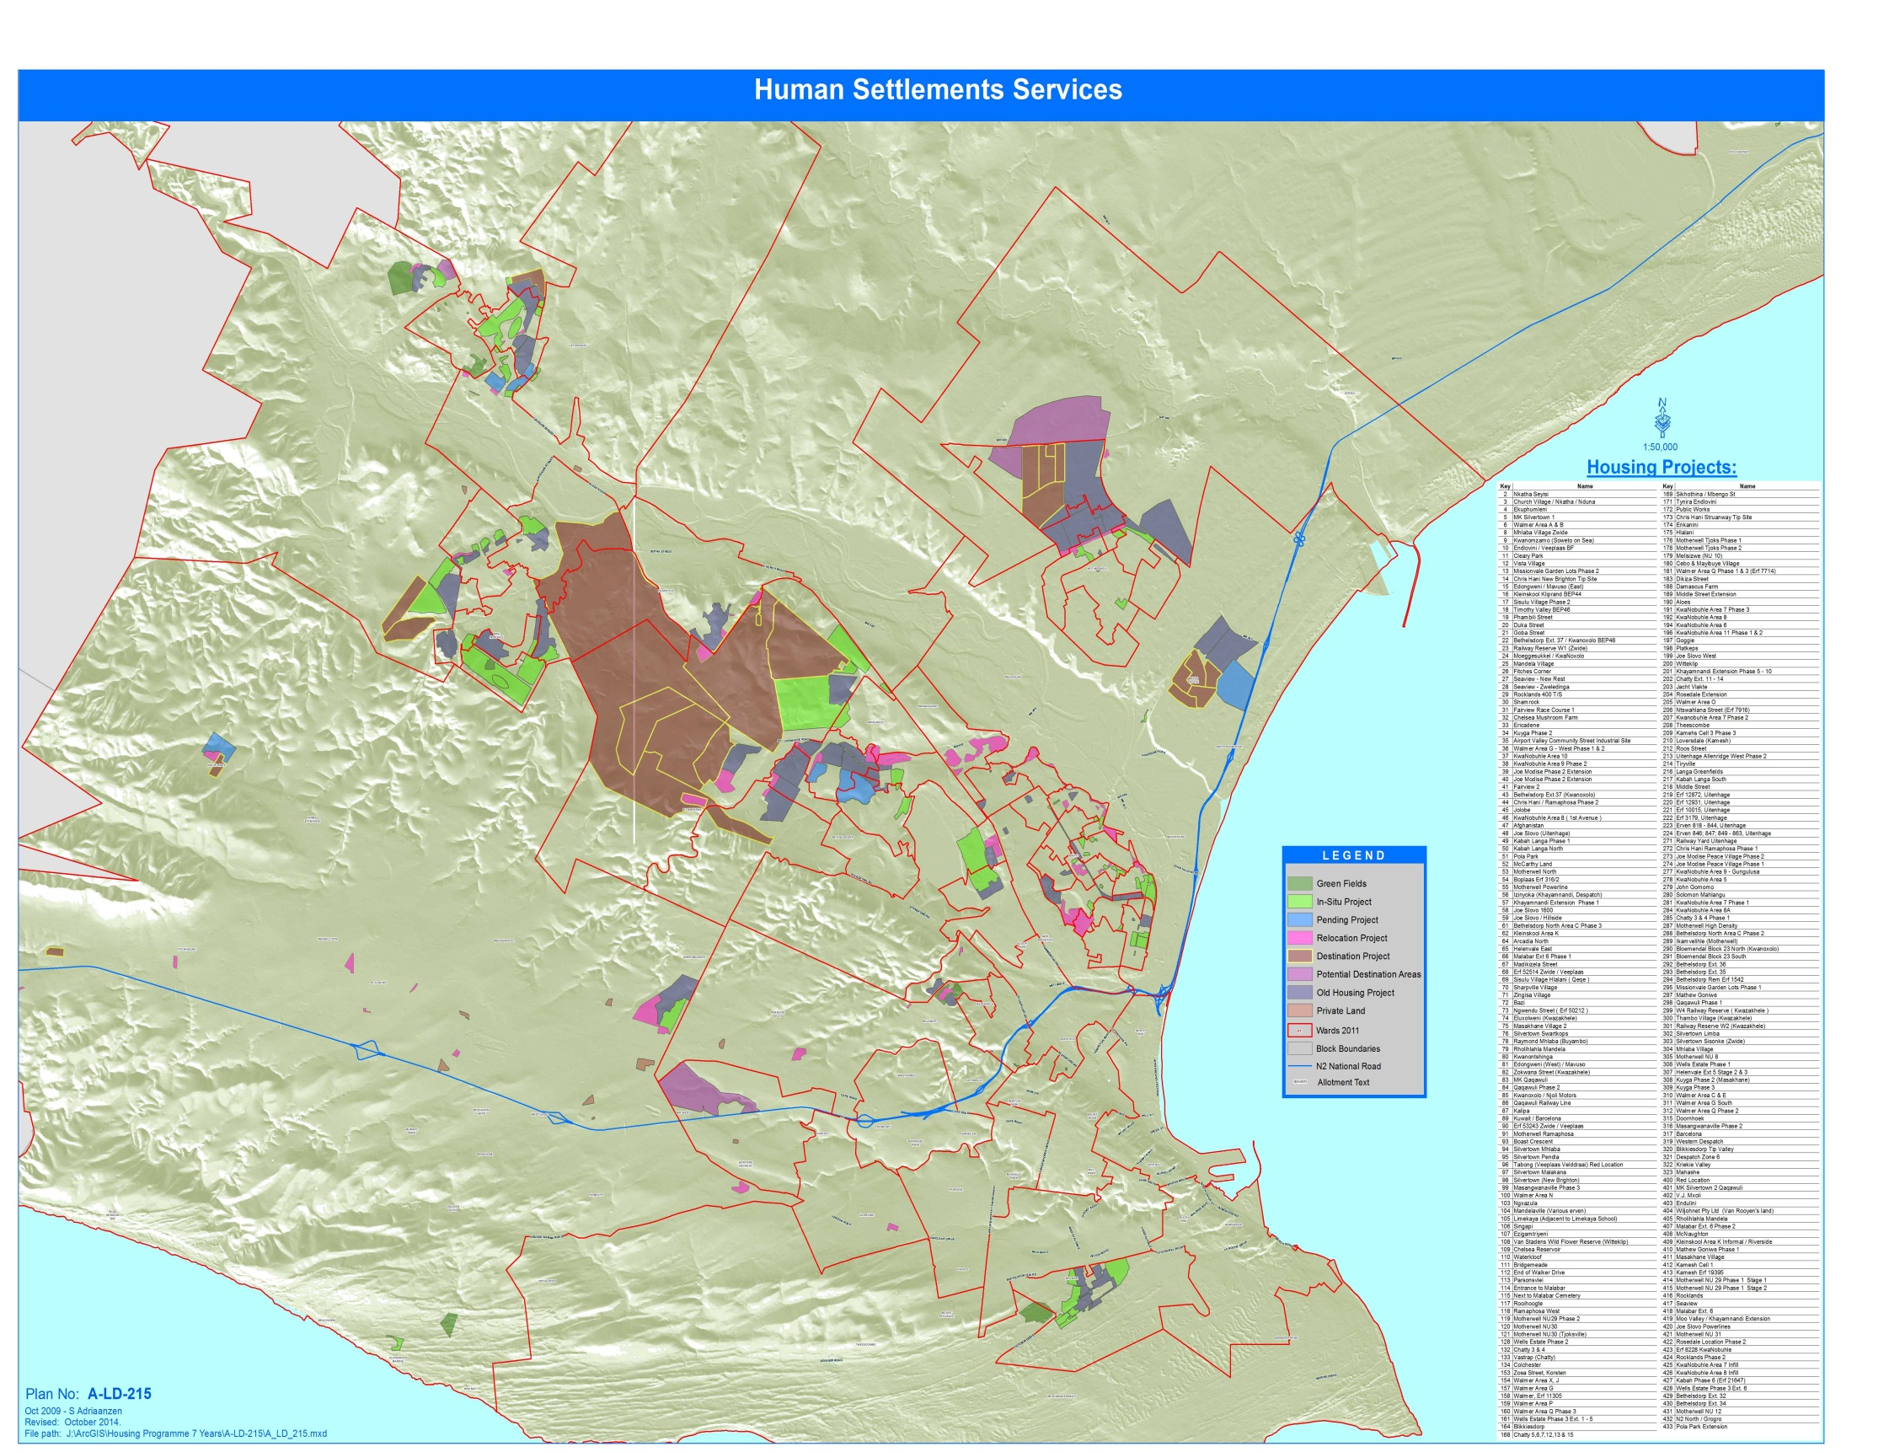
Human Settlements - Planned projects 2015/2016
Rosedale
Pola Park
Motherwell Nu30
Kwanobuhle Area 11
Khayamnandi Ext
Kwanobuhle Erf 8228
Ekhumphumleni
Missionvale Garden Lot
Walmer Development

Slide 39
3RD QUARTER ACHIEVEMENTS
HUMAN SETTLEMENTS
KEY PERFORMANCE INDICATOR(S) | QUARTER 3 TARGET | QUARTER 3 ACTUAL | ANNUAL TARGET
Number of state subsidised housing units provided | 650 | 1035 | 1 293
Number of erven provided with permanent water and sanitation services | 2000 | 2026 | 3 000
Number of settlements upgraded from informal to formal | 3 | 3 | 4
Number of households relocated from stressed informal settlements and other servitudes to Greenfield development areas | 900 | 499 | 1200

Slide 40
HUMAN SETTLEMENTS
Project ID | Project Title | Org Code | Budget (incl VAT) | Actual (incl VAT) | Progress
20070267 | Land Acquisition | 1228 | 684,000.00 | 684,000.00 | Land Process finalized
20110088 | Joe Slovo - Uitenhage Phase 1- Human Settlements (Services) | 415 | 741,000.00 | - | This project is complete, funds available for water meter instillation and retention
20110089 | Wells Estate Phase 3 - Ext 4 & 5-Human Settlements(Services) | 415 | 91,200.00 | 18,781.04 | This project is complete, funds available for water meter instillation and retention
20110091 | Khayamnandi Extension - Human Settlements (Services) | 415 | 19,568,100.00 | 11,331,685.32 | This is a large project that will span multiple financial years (10 Phases and 7828 sites)Phase 1,2 ,3 and Phase 4 are complete. To Note: Phase 5 will start after Phase 6. - Phase 6 contractor is progressing well and is expected to be complete by November 2016. Full budget to be spent.
20110092 | Missionvale Garden Lots - Human Settlements (Services) | 415 | 21,346,500.00 | 16,579,194.47 | This is a problematic project linked to ponding and deep tranches(5 Phases with 2498 sites). Phase 1 and 2 and 3 are complete, Phase 4 is complete with outstanding snags being finalized. Phase 5 is 90% complete. - The pump station is being repaired, pumping equipment was only available by Dec 2015 with retro-fitting commencing in Jan 2016. Project is delayed due to contractor problems - potential liquidation. Liquidation process has since been halted, business rescue in place and contractor moving back on site
20110096 | Rosedale - Human Settlements (Services) | 415 | 18,048,252.00 | 14,971,542.57 | This project is being completed in 2 phases. Phase 1 of this project is 100% complete. Relocation in progress from phase 2 to phase 1. The contractor commenced phase 2 in Feb 2015. 68% complete . Project is delayed due to contractor problems - potential liquidation - Liquidation process has since been halted, business rescue in place and contractor moving back on site
20120030 | Kwanobuhle Area 11 - Human Settlemnts (Services) | 415 | 26,904,000.00 | 20,926,884.14 | This is a large project planned in multiple phases over financial years. Phase 1 of this project is complete. Phase 2 Contractor commenced in November 2014 and 98% complete and progressing well. Project experienced delays due to stoppages by EM's. Planed completion end April 2016. Full budget to be spent.
20120031 | Kwazakhele: Ekhumphumleni - Human Settlements (Services) | 415 | 9,745,210.20 | 5,122,822.64 | Tender Process is complete and the letter of award is ready to be issued. Relocation process is slow. Political engagement with the community to resolve the relocation problem and allow contractor to commence construction underway. Date of commencement still uncertain. The project is being monitored in terms of progress to ensure expenditure, Should expenditure not improve funds will be moved to other fast moving projects.

Slide 41
HUMAN SETTLEMENTS
Project ID | Project Title | Org Code | Budget (incl VAT) | Actual (incl VAT) | Progress
20120033 | Jacht Flakte - Human Settlemnts (Services) | 415 | 2,478,360.00 | 2,386,422.93 | This is a large project that will span multipul financial years. Project in planning phase EIA approved, attending to its conditions. Amendment submitted to amend incorrect residential sites. Approval still awaited.
20120042 | Sisulu Village - Human Settlements (Services) | 415 | 28,500.00 | 10,219.89 | This project is complete, funds available for water meter instillation.
20120043 | Seaview Housing Project - Human Settlements (Services) | 415 | 228,000.00 | - | This project is experiencing environmental problems. The EAP has submitted a report to DEDEA. This has to be resolved before services can be installed. Waste Water Conveyance appointed a Consultant to investigate alternative sanitation forms for this project as no WWTW is commissioned within the area. LOA also issued for the appointment of Consultant for the planning processes of this project.
20120047 | Walmer Development - Human Settlements (Services) | 415 | 20,359,362.60 | 16,731,833.76 | Re - Planning of Airport Valley G, West and Q1 and remainder of Q3. LOA issued to Contractor to start with construction of services in Airport Valley Section A. Re-positioning of households to be done on site on available open spaces. Process is slow due to limited space. The project is being monitored in terms of progress to ensure expenditure, Should expenditure not improve funds will be moved to other fast moving projects.
20120048 | Hunters Retreat - Grogro - Human Settlements (Services) | 415 | 3,306,000.00 | 2,922,326.96 | Still in Planning stage.
20120052 | Walmer Q Phase 3 - Human Settlements (Services) | 415 | 54,720.00 | 2,509.89 | This project is complete, funds available for water meter instillation
20120053 | MK Silvertown 2 Qaqawuli - Human Settlements (Services) | 415 | 21,888,000.00 | 6,987,339.54 | The project is programmed in 2 phases. Phase 1 has been awarded @ 40% completion and progressing slowly due to resistance to relocations, phase 2 has been awarded. Relocations required prior to starting the project. Land needs to be found to finalize these relocations. Project is delayed due to contractor problems - potential liquidation - Liquidation process has recently been halted, business rescue in place and contractor moving back on site. Should expenditure not improve funds will be moved to other fast moving projects.
20120055 | Motherwell NU30 - Human Settlements (Services) | 415 | 29,708,400.00 | 24,721,464.57 | This is a large project planned in multiple phases over financial years. Phase 1 is complete . Phase 2 Contractor commenced and 65% complete. Project is delayed due to contractor problems - potential liquidation - Liquidation process has since been halted, business rescue in place and contractor moving back on site .
20120059 | Malabar Ext 6 Phase 2 - Human Settlements (Services) | 415 | 951,022.20 | - | Project in tender phase, WULA(Approved in March 2016) and EIA authorisation approved. Tender process underway.
20120060 | Masakhane Village - Human Settlements (Services) | 415 | 7,980,000.00 | 1,444,363.71 | Contractor has been appointed, and site handover done. Work progressing well and is expected to be complete by June 2016. Full budget to be spent.

Slide 42
HUMAN SETTLEMENTS
Project ID | Project Title | Org Code | Budget (incl VAT) | Actual (incl VAT) | Progress
20120062 | Kuyga Phase 3 - Human Settlements (Services) | 415 | 182,400.00 | - | Project still planning phase. Land acquisition required. Availability of provincial land for development being explored.
20120095 | Motherwell NU 29 - Phase 2 Stage 2 - 890 Sites | 415 | 5,700.00 | - | This project is complete, funds available for water meter instillation and retention
20130038 | Kwanobuhle ERF 8228 - Human Settlement (Services) | 415 | 5,567,839.80 | 5,413,776.14 | This is a small project, Project has reached practical completion, minor snags to be finalized.
20130040 | Inkatha Seyisi - Human Settlements (Services) | 415 | 456,000.00 | - | The tender was advertised for the appointment of a consultant. It has been through BAC and LOA issued from SCM to Consultant. Tender documents to be signed by Acting Executive Director.
20130041 | Raymond Mhlaba/ Buyambo - Human Settlemnts (Services) | 415 | 3,266,578.80 | 144,737.98 | The project is under the procurement stage. Tender closed in Dec 2015. Tender recently approved by BAC, finalization of the appointment of the contractor to be done in April 2016. Full budget to be spent.
20130054 | Bethelsdorp Ext 32, 34 & 36 - Human Settlemnts (Services) | 415 | 228,000.00 | - | The tender was advertised for the appointment of a consultant. It has been through BAC and LOA issued from SCM to Consultant. Tender documents to be signed by Acting Executive Director.
20130056 | Dikisa Street - Human Settlements (Services) | 415 | 969,000.00 | 19,306.13 | Project is ready for construction, to commence in April 2016
20130057 | Kleinskool Kliprand - Human Settlemnts (Services) | 415 | 456,000.00 | 432,949.71 | The tender was advertised for the appointment of a consultant. It has been through BAC and LOA issued from SCM to Consultant. Tender documents to be signed by Acting Executive Director.
20130059 | Mandelaville | 415 | 91,200.00 | - | Project in Planning Phase - Geotechnical investigations concluded. All services in order.
20130060 | Pola Park - Human Settlements (Services) | 415 | 4,289,569.20 | 3,573,080.93 | This is a small project. Contractor commenced construction in Feb 2015,85% complete expected completion by April 2016.
 |  |  | 199,622,914.80 | 134,425,242.33 | 67 %

Slide 43
2015/16 DETAILED PROJECT PROGESS
ROADS & STORMWATER
ROADS AND STORMWATER
KEY PERFORMANCE INDICATOR(S) | QUARTER 3 TARGET | QUARTER 3 ACTUAL | ANNUAL TARGET
Km of gravel roads surfaced | 3 km | 2.13 km | 10.50 km
Number of gravel culs-de-sac tarred | 7 | 3 | 20
Km of stormwater drainage installed | 0.3 km | 0.3 km | 1 km
Project ID | Project Title | Budget (incl VAT) | Actual (incl VAT)
20050286 | Tarring of Gravel Roads | 91,200,000 | 60,850,978
 |  | 91,200,000 | 60,850,978
Note: The provision of tarred roads and the associated stormwater infrastructure is in support of the previously served sites.

Slide 44
2015/16 DETAILED PROJECT PROGESS WATER
WATER
KEY PERFORMANCE INDICATOR(S) | QUARTER 3 TARGET | QUARTER 3 ACTUAL | ANNUAL TARGET
% formal households within the urban edge provided with access to a basic potable water supply | 100% | 100% | 100%
% informal households within the urban edge provided with access to a basic potable water supply within a 200m radius* | 100% | 100% | 100%
Number of state subsidised housing units provided with access to water | 850 | 351 | 1 293 (in line with housing provision)
* Communal standpipes were installed within a 200 radius of 24 204 informal households in the 77 informal settlements within the urban edge, as per the requirements of the Water Services Act. No additional standpipes were installed during the 2015/16 third quarter.

Slide 45
WATER
Project ID | Project Title | Org Code | Original Budget | Amended Budget | Actual | % Spent (Budget)
19930320 | Pipe Rehabilitation and Improvements to System - General | 504 | 14,000,000.00 | 14,000,000.00 | 11,124,379.18 | 79.46
19960156 | Elandsjagt - Upgrade to Restore Capacity | 486 | 28,000,000.00 | 28,000,000.00 | 25,032,748.63 | 89.4
19990184 | Reservoir Fencing | 504 | 400,000.00 | 400,000.00 | 321,112.44 | 80.28
20000037 | Loerie Treatment Works: Rehabilitation | 485 | 880,000.00 | 2,130,000.00 | 621,785.32 | 29.19
20000051 | Installation of Zone Water meters | 504 | 2,000,000.00 | 2,000,000.00 | 302,355.60 | 15.12
20000052 | Purchase of Water Meters - Metro | 507 | 8,000,000.00 | 8,000,000.00 | 9,648,819.46 | 120.61
20010307 | Upgrading Groendal Water Treatment Works | 951 | 18,860,000.00 | 18,860,000.00 | 14,769,454.98 | 78.31
20042881 | Office Accommodation: Water | 507 | 1,250,000.00 | 1,250,000.00 | 28,395.55 | 2.27
20042885 | Metro Water: Master Plan Replacement of Pipes | 504 | 1,095,760.00 | 1,095,760.00 | 803,603.98 | 73.34
20050097 | Nooitgedagt/Coega Low Level System | 487 | 85,103,280.00 | 85,103,280.00 | 47,075,302.56 | 55.32
20050106 | Water Pump Station: Upgrades | 501 | 1,265,000.00 | 1,265,000.00 | 280,153.09 | 22.15
20060080 | Upgrading of Churchill Water Treatment Works | 483 | 6,000,000.00 | 6,000,000.00 | 2,903,794.13 | 48.4
20060083 | Rudimentary Service: Water | 504 | 500,000.00 | 500,000.00 | 470,348.70 | 94.07
20070140 | Groendal Dam: Rock Stabilisation and Improved Outlet | 1584 | 555,000.00 | 555,000.00 | 447,710.64 | 80.67
20070157 | Telemetry System: Upgrade | 621 | 1,000,000.00 | 1,000,000.00 | 846,526.89 | 84.65
20070160 | Purchase New Vehicles | 621 | 4,054,240.00 | 4,054,240.00 | 4,064,491.24 | 100.25
20070161 | Groundwater Investigation | 946 | 3,000,000.00 | 3,300,000.00 | 2,370,853.87 | 71.84
20070162 | Desalination Augmentation | 1583 | 3,000,000.00 | 3,000,000.00 | 1,365,493.80 | 45.52
20080087 | Rehabilitation of Pipe Bridges | 477 | 415,000.00 | 415,000.00 | 559,851.57 | 134.9
20080088 | Bulk Water Metering and Control | 477 | 1,000,000.00 | 1,000,000.00 | 156,729.00 | 15.67
20080093 | Water Service Maintenance Backlog: Pump Stations | 474 | 3,500,000.00 | 2,250,000.00 | 1,353,365.12 | 60.15

Slide 46
5.6 2015/16 DETAILED PROJECT PROGESS
SANITATION
SANITATION
KEY PERFORMANCE INDICATOR(S) | QUARTER 3 TARGET | QUARTER 3 ACTUAL | ANNUAL TARGET
% households provided with access to basic sanitation (excluding bucket system) | 70% | 92,4% | 94%
Number of state subsidised housing units provided with access to sanitation | 850 | 351 | 1 293 (in line with housing provision)

Slide 47
SANITATION
Project ID | Project Title | Org Code | Original Budget | Amended Budget | Commitment | Actual | % Spent (Budget)
19930112 | Sewer Replacement and Relining | 447 | 2,400,000.00 | 2,400,000.00 | 0 | 1,018,224.45 | 42.43
19940098 | Improvements to Sewerage System | 447 | 28,300,000.00 | 28,300,000.00 | 8,719,415.30 | 11,435,450.22 | 40.41
19960525 | Chatty Valley Collector Sewer Stage 1 (nodes 20 -24) | 447 | 15,800,000.00 | 15,256,000.00 | 460,880.14 | 6,332,463.86 | 41.51
19980344 | Replacement of Sewerage Collection Vehicles | 451 | 5,514,990.00 | 5,514,990.00 | 0 | 3,252,416.00 | 58.97
20030034 | Markman - Replace 600mm Sewer | 447 | 500,000.00 | 500,000.00 | 1 | 256,609.75 | 51.32
20030167 | Rockland PHB Housing Project: Wastewater Treatment Works | 1494 | 100,000.00 | 100,000.00 | 0 | 50,933.78 | 50.93
20030182 | Upgrade Despatch Reclamation Works | 741 | 1,200,000.00 | 1,200,000.00 | 7 | 986,207.02 | 82.18
20030672 | Sewers: Maintenance Backlog Pipes Replacement | 447 | 3,600,000.00 | 3,600,000.00 | 0 | 3,058,268.26 | 84.95
20042912 | Sewerage Master Plan System Updating | 449 | 250,000.00 | 250,000.00 | 0 | 209,034.00 | 83.61
20042918 | Office Accommodation : Sanitation | 446 | 85,016.00 | 85,016.00 | 17 | 47,031.50 | 55.32
20050247 | Rudimentary Services: Sanitation | 456 | 2,000,000.00 | 2,000,000.00 | 130,000.88 | 843,067.59 | 42.15
20050248 | Bucket Eradication Programme | 448 | 10,600,000.00 | 10,600,000.00 | 1,360,315.97 | 805,727.62 | 7.6
20050250 | Driftsands WWTW Phase 3 extension | 459 | 4,106,000.00 | 4,650,000.00 | 434,867.00 | 3,162,388.24 | 68.01
20060075 | Cape Receife WWTW : Upgrade | 458 | 2,500,000.00 | 2,500,000.00 | 2 | 942,975.17 | 37.72
20060103 | Jagtvlakte Bulk Sewerage | 1626 | 500,000.00 | 500,000.00 | 0 | 247,052.63 | 49.41
20060106 | Motherwell North Bulk Sewerage | 449 | 5,580,000.00 | 5,580,000.00 | 602,098.28 | 1,613,093.77 | 28.91
20060107 | Motherwell/Coega WWTW and outfall sewer | 449 | 6,600,000.00 | 6,600,000.00 | 2 | 4,572,671.92 | 69.28
20060178 | Sewerage Pump Station : Maintenance Backlog | 447 | 14,200,000.00 | 14,200,000.00 | 2,257,411.07 | 7,604,921.94 | 53.56
20070143 | Rehabilitation of Kwazakhele Collector Sewer | 447 | 500,000.00 | 500,000.00 | 0 | 88,898.35 | 17.78
20070144 | Kwanobuhle WWTW : Upgrading | 977 | 2,000,000.00 | 2,000,000.00 | 127,028.50 | 566,458.55 | 28.32
20070147 | Kelvin Jones WWTW: Upgrade | 975 | 12,000,000.00 | 12,000,000.00 | 3,063,495.74 | 2,677,165.85 | 22.31
20070153 | Brickfields: Upgrade | 460 | 2,000,000.00 | 2,000,000.00 | 43,291.44 | 35,873.15 | 1.79
20070156 | Fishwater Flats WWTW Upgrade | 457 | 103,914,000.00 | 103,914,000.00 | 89,482.56 | 81,881,343.22 | 78.8
20110056 | Swartkops Low Level Collector Sewer Upgrade | 447 | 600,000.00 | 600,000.00 | 0 | 26,252.89 | 4.38
20110066 | Bulk Sewers Joe Slovo, Mandelaville, Allenridge West UIT | 447 | 750,000.00 | 750,000.00 | 0 | 343,419.22 | 45.79
20110068 | Kwanobuhle Area 11 - Link sewer | 447 | 18,900,000.00 | 18,900,000.00 | 3,207,358.77 | 13,980,179.60 | 73.97

Slide 48
5.7 2015/16 DETAILED PROJECT PROGESS
ELECTRICITY
ELECTRICITY AND ENERGY
KEY PERFORMANCE INDICATOR(S) | QUARTER 3 TARGET | QUARTER 3 ACTUAL | ANNUAL TARGET
Number of state subsidised housing units provided with access to electricity | 350 | 142* | 1 293 (in line with housing provision)
Number of informal households connected to electricity | 850 | 41* | 1 945
% of all households on officially surveyed sites provided with access to electricity | 95% | 85.2% | 95%
* The underperformance is due to delays in Supply Chain Management processes in awarding the electrification project tenders.
Project ID | Project Title | Budget (incl VAT) | Actual (incl VAT)
19930283 | Public Lighting | 18,240,000 | 18,240,000
 |  | 18,240,000 | 18,240,000

Slide 49
5.8 2015/16 DETAILED PROJECT PROGESS
WASTE MGT
PUBLIC HEALTH
KEY PERFORMANCE INDICATOR(S) | QUARTER 3 TARGET | QUARTER 3 ACTUAL | ANNUAL TARGET
Number of Public Open Spaces developed though either provision of fencing, pathways, benches or through tree planting | 2 | 2 | 6
Number of Public Open Spaces (POS) maintained through grass-cutting | 1550 | 699 | 1 550
Project ID | Project Title | Budget (incl VAT) | Actual (incl VAT)
20010362 | Upgrade and Development of Public Open Spaces | 2,280,000 | 2,280,000
 |  | 2,280,000 | 2,280,000

Slide 50
2015/16 DETAILED PROJECT PROGESS
TITLE DEEDS
Project Name | Annual Target 2015/16 | Number of Title Deeds issued (1 July to 30 September 2015) | Number of Title Deeds issued (1 October to 31 March 2016) | Budget (USDG) | Expenditure (USDG)
Kwanobuhle Area 10 | 100 | 6 | 0 | From Operating Budget
Kwanobuhle Area 7 (500) | 75 | 7 | 0
Kwanobuhle Area 7 & 8 (300) | 75 | 0 | 0
Kabah Langa South | 220 | 73 | 0
Wells Estate 600 & 668 | 100 | 18 | 0
Wells Estate Ph 3 (603) | 50 | 0 | 0
TOTAL | 620 | 104 | 0

Slide 51
PERFORMANCE SUMMARY: USDG 15/16
MTSF TARGET 2019 | ACTUAL DELIVERY PROGRESS
 | 2014/15 Q4 | 2015/16 |  |  |  | Total to date
 |  | Q1 | Q2 | Q3 | Q4
750 000 households in informal settlements upgraded to Phase 2 of the Informal Settlements Upgrading Programme
Individual households (metered): Water Sanitation Electricity | 1041 | 137 | 47 | 167 |  | 1392
 | 1041 | 137 | 47 | 167 |  | 1392
 | 2215 | 48 | 135 | 100 est. |  | 2498
Shared services (number of households benefiting) Water Sanitation | 5340 | 0 | 0 | 0 |  | 5340
 | 592 | 0 | 0 | 0 |  | 592
Title Deeds: 563 000 for new developments Pre-1994 housing stock Post-1994 housing stock | 620 | 104 | 0 | 0 |  | 998
 | 163 | 17 | 0 | 0 |  | 180
10 000 of hectares of well-located land | 91.03 Metro & 83.36 Province | 0 | 0 |  |  | 91.03 Metro & 83.36 Province

Slide 52
CHALLENGES WITH REGARD TO TITLE DEEDS
The time from registration to the time that title deeds are available from the deeds office in Cape Town is currently 4 - 6 months. This has partially been addressed by NDHS.
Beneficiaries do not respond to notices to collect title deeds even when title deeds are available in areas close to the projects.
The Provincial Department of Human Settlements have stopped the issuing of title deeds to beneficiaries pending a launch without time frames.
Inadequate programme for title deeds hand-over.

Slide 53
Project | Challenges | Remedial Measures
Various projects | SMME’s stoppages | Development of SMME Policy. Engagements with SMMEs
Various projects | SCM challenges: Low levels of staffing Administrative instability Inadequate project planning | New Acting City Manager appointed. Staff competency and complement to be addressed.

Slide 54
LINK BETWEEN USDG & HSDG
USDG – Housing Internal Services | 2014/15 Actuals | HSDG – Top Structure | 2015/16
Pola Park | 8 |  | -
Motherwell Nu 30 – Phase 1 | 430 |  | -
Motherwell Nu 30 – Phase 2 | 700 |  | -
KwaNobuhle Area 11 Phase 1 (350) | 350 |  | -
KwaNobuhle Area 11 Phase 2 (777) | 700 |  | -
Missionvale Garden Lots – (2458) | 568 | Missionvale Garden Lots (2498) | 259
Kwanobuhle Area 7 | 244 | Kwanobuhle Area 7 (244) | -
KwaNobuhle Area 8 | 463 | Kwanobuhle Area 8 (464) | -
KwaNobuhle Erf 8228 | 12 |  | -
Rosedale – Phase 2 (249) | 160 | Rosedale - 505 | 355
Khaymnandi Ext | 360 | Khayamnandi 184 | 525
Doorenhoek | 40
 |  | Joe Slovo 398 | 398
 |  | Motherwell NU29 | 368
 |  | Uit Tyrville (187) | 78
TOTAL | 4035 | TOTAL | 1938

Slide 55
USDG – Housing Internal Services | 2014/15 Actuals | HSDG – Top Structure | 2015/16
 |  | Chatty 491 | 68
 |  | Chatty 1060 | 257
 |  | Joe Slovo West | 590
 |  | Soweto On Sea | 100
 |  | Walmer Area Q | 189
 |  | Sisulu Hlalani | 18
TOTAL |  | TOTAL | 1222

Slide 56
USDG – Housing Internal Services | 2015/16 Target | HSDG – Top Structure | 2016/17
Pola Park | 109
Motherwell Nu 30 | 850
Khayamnandi Ext | 642 | Khayamnandi 184 | 179
KwaNobuhle Area 11 | 650
KwaNobuhle Erf 8228 | 99
Rosedale – Phase 2 (249) | 100
Missionvale Garden Lots – (2458) | 150 | Missionvale G. Lots 2400 Units | 207
MK Silvertown | 100
MK Silvertown Qaqawuli | 100
Walmer Airport Valley | 100
Malabar Ext 6 | 50
Ekuphumleni | 50
TOTAL | 3000 | TOTAL | 386

Slide 57
USDG – Housing Internal Services | 2015/16 Target | HSDG – Top Structure | 2016/17
 |  | Chatty (491) Military Veterens | 120
 |  | Joe Slovo Uitenhage (614) | 258
 |  | Soweto on Sea infills 500 | 400
 |  | Mandellaville (121) | 121
 |  | Ebhongweni 55 | 55
 |  | KwaNobuhle Area 2, 7 and 8 ( 52 Units) | 52
 |  | Walmer Gqeberha Phs 1 (500) | 90
 |  | Joe Slovo West | 700
 |  | Chatty 1060 | 628
TOTAL |  | TOTAL | 2810

Slide 58
THANK YOU

