Slide 1

2016/17-2018/19 ANNUAL PERFORMANCE PLAN
PORTFOLIO COMMITTEE ON COMMUNICATIONS
Date:

Slide 2
Presentation Outline
Topic
1. Strategic Overview
1.1 The Constitutional Mandate
1.2 The GCIS Mandate
1.3 Vision, Mission, Values
2. Situational Analysis
3. Revisions to the 2015/20 Strategic Plan
4. Strategic Goal and Objectives 2016/19
5. GCIS Structure
6. 2016/20 Targets per Programme
7. 2016 MTEF Budget Summary

Slide 3
1. Strategic Overview
1.1 Constitutional Mandate &
Legislative Mandate
Section 195 (g) of the Constitution (1996) - Public should be provided with timely, accurate and accessible information.
Deepen democracy and sustain nation-building and patriotism by ensuring that the citizenry is informed about government programmes and that they are able to influence and participate in such programmes.
In 1998, the South African Communication Service was dissolved and the GCIS established by Cabinet, largely on the basis of recommendations contained in the report of the Task Group on Government Communications (Comtask: 1996: 58).
The Public Finance Management Act, 1999 (Act 1 of 1999), as amended.
Section 41: Cooperative governance values.
Section 195: Basic values and principles governing public administration.
Sections 231: International agreements.
The Medium Term Strategic Framework 2014-2019.
Framework for Developing Strategic & Annual Performance Plans.

Slide 4
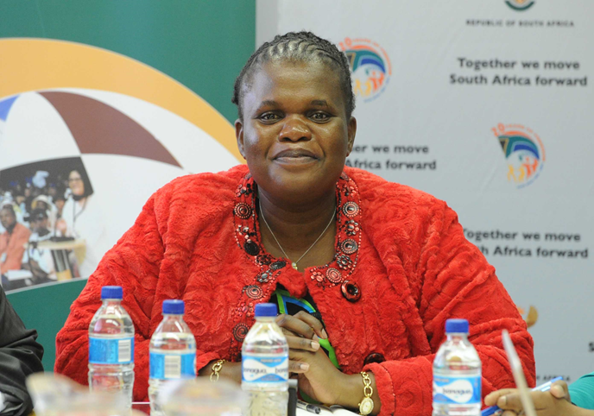
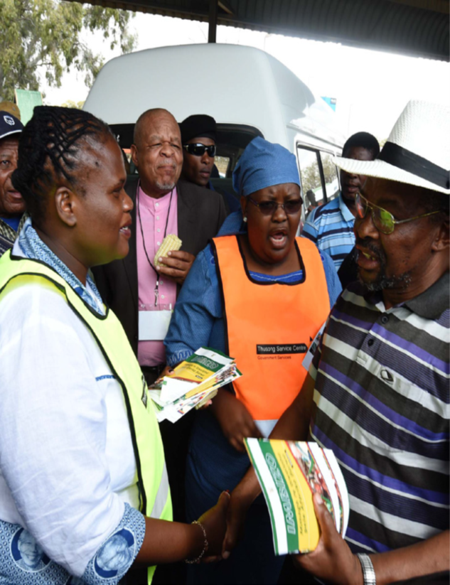
Strategic Overview
1.2 GCIS Mandate: Our primary role
Coordinate, guide and advise on government communication, including media liaison, development communication and marketing.
Works to achieve integrated, coordinated and coherent communications between government and South African citizens, which enables the public to be involved in the country’s transformation.
Drive coherent messaging across the three spheres on the key priorities of government

Slide 5
Strategic Overview
1.3 Vision, Mission, Values
Vision
To be the pulse of communication excellence in government
Mission
Values
Professionalism, diversity, openness & transparency, innovation, and honesty & integrity.
To deliver effective strategic government communication. Set and influence adherence to standards and coherence of messages and proactively communicate with the public about government policies, plans, programmes and achievements

Slide 6
2. Situational analysis
Challenges | Mitigation Plans
1. Limited fiscal resources in constrained budget environment | Reprioritisation and improved efficiency from other departmental resources for priority interventions
2. Increased demand for government communication in a dynamic democracy | 2.1 Re-evaluate govt communication approach, platform and language mix
 | 2.2 Increase Vuk’uzenzele newspaper’s reach
3. Contested communication environment | 3. Present government programmes timeously and transparently to citizens
4. Public perception of government performance | 4. Communicate honestly what government has achieved

Slide 7
3. Revisions to the 2015/20 Strategic Plan
  Informed by the recent reconfiguration of the State, changing fiscal conditions, communication environment and government regulations, GCIS made the following changes to its 2015/2020 Strategic Plan – tabled in 2015.
2015/20 Strategic Goal | 2016/20 Strategic Goal
Provide a responsive, cost-effective, compliant and business focused organisation | A responsive, cost-effective, compliant and business focused organisation
Professionalise the communication system, build a reliable knowledge base and enhance communication products | Professionalise the communication system by building a reliable knowledge base and through communication products
Provide efficient and effective communication services | Converted to a strategic objective for the CSA sub-programme
Enhance the image of government and that of the State | Enhance the image of government

Slide 8
3. Revisions to the 2015/20 Strategic Plan
Programme 1: Administration
2015/20 Strategic Objectives | 2016/20 Strategic Objectives
Implement efficient and effective strategic management processes and procedures in line with the relevant legislation. | Provide adequate and effective corporate services functions in pursuit of good governance
Competent personnel attracted and retained to ensure GCIS delivers on its mission.
Efficient and effective IM&T infrastructure and systems provided.
Provide proactive, flexible, compliant and cost-effective finance, supply chain and facilities management.
Professional internal audit services for the improvement of governance and risk control provided.

Slide 9
3. Revisions to the 2015/20 Strategic Plan
Programme 2: Content Processing and Dissemination
2015/20 Strategic Objectives | 2016/20 Strategic Objectives
Enhance government’s communication products and services to grow the share of voice of government messages in the public arena. | Produce government’s communication products and provide services to grow the share of voice of government messages in the public arena.
Provide effective and efficient marketing and distribution services for government. | Provide efficient and effective communication services
Provide cost-effective media bulk-buying services for government.
Provide cost-effective and efficient media products and services for government.
Manage the corporate identity for government. | Manage the corporate identity for national government.
  A few indicators and targets were refined, in line with the DPME and Auditor-General’s recommendations on the SMART principle.

Slide 10
4. Strategic Goals and Objectives
STRATEGIC GOALS | STRATEGIC OBJECTIVES
A responsive, cost-effective, compliant and business-focused organisation. | 1.1 Provide adequate and effective Corporate Services functions in pursuit of good governance.
Professionalise the communication system by building a reliable knowledge base and through communication products. | 2.1 Produce government’s communication products and services to grow the share of voice of government messages in the public arena.
 | 2.2 Provide strategic leadership and support in government communication through public opinion research and analysis of media coverage to understand the communication environment and inform government messages.
 | 2.3 Provide efficient and effective communication services.
Enhance the image of government. | 3.1 Manage the corporate identity for national government.
 | 3.2 Implement a proactive and reactive media engagement system by building, maintaining and improving relations with the media and drive the government communication agenda.
Maintain and strengthen a well-functioning communication system that proactively informs and engages the public. | 4.1 Improve interdepartmental coordination by joint planning and sharing of messages across the three spheres of government to ensure coherence and alignment of government messages.
 | 4.2 An informed and empowered citizenry on government’s policies, plans, programmes and achievements to increase public participation in government.

Slide 11
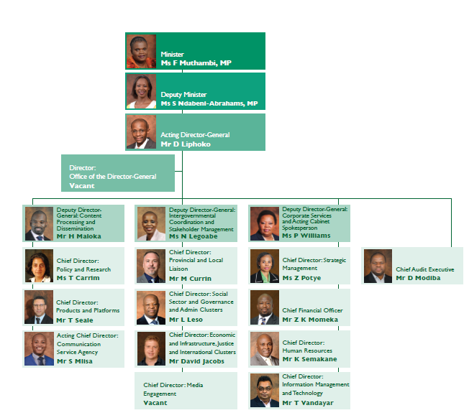
5. GCIS Structure

Slide 12
6. 2016/19 Targets Per Programme
Programme 1
Administration
Purpose
Provide strategic leadership, management and support services to the department

Slide 13
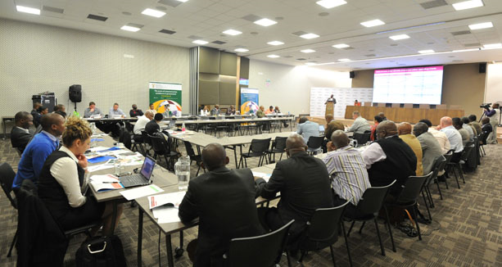
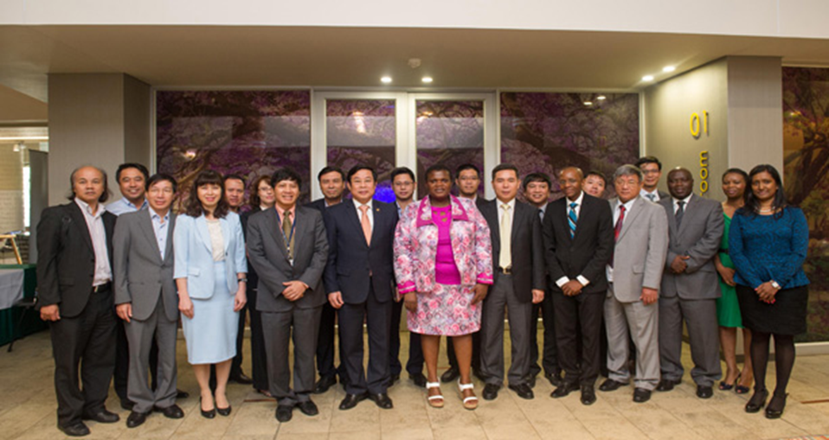



Slide 14
6. 2016/19 Targets Per Programme
Programme 1: Administration
Strategic Objective 1.: Provide adequate and effective Corporate Services functions in pursuit of good governance
Performance Indicators | Targets (2016/19)
Strategic management processes and procedures implemented | 2017-2020 APP and tabled in Parliament according to prescribed legislation
 | Four approved quarterly performance reports submitted to National Treasury, DPME and Executive Authority according to prescribed legislation
 | Departmental Annual Report tabled in Parliament within National Treasury guidelines and legislative time frames
IM&T governance implemented | Four reports on the availability of IT Infrastructure presented to the IM&T SC
 | Four reports on IM systems development presented to the IM&T SC

Slide 15
6. 2016/19 Targets Per Programme
Programme 1: Administration
Strategic Objective 1.: Provide adequate and effective Corporate Services functions in pursuit of good governance
Performance Indicators | Targets (2016/19)
Annual financial statements prepared and issued within legislated prescripts | Annual financial statements prepared and issued within legislated prescripts
Performance, compliance, financial audit conducted | Updated risk-based internal audit plan and 2016/17 operational plan approved
 | Four progress reports on performance, compliance, financial audit conducted
MTEF Human Resource Plan implemented | Annual adjusted HRP and HRP implementation report submitted to the DPSA

Slide 16
6. 2016/19 Targets Per Programme
Programme 2
Content Processing and Dissemination
Purpose
Provide strategic leadership in government communication to ensure coherence, coordination, consistency, quality, impact and responsiveness of government communication

Slide 17
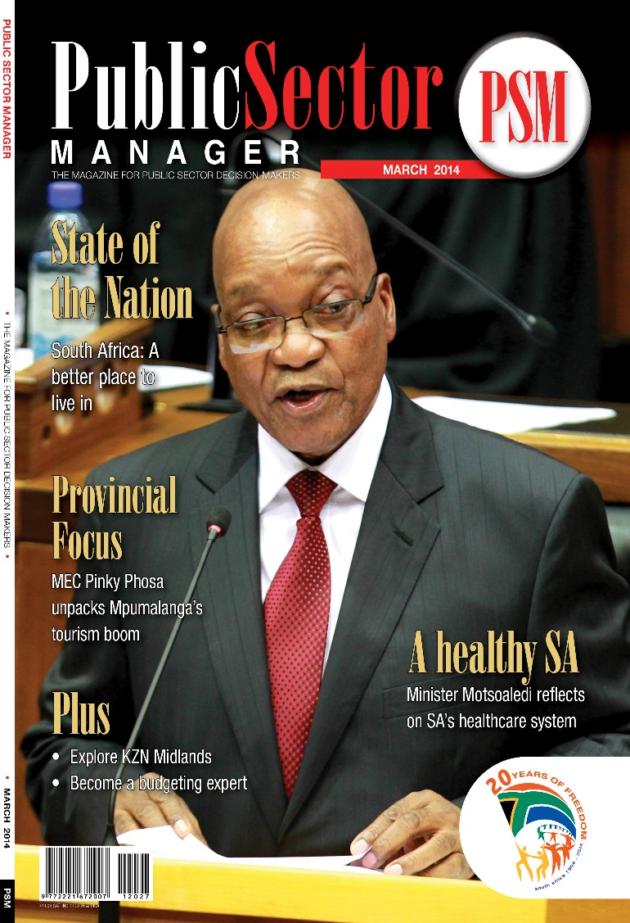


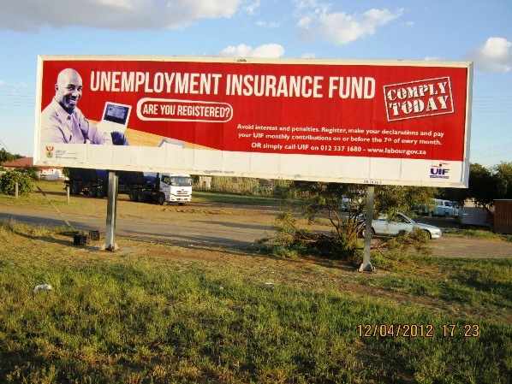





Slide 18
6. 2016/19 Targets Per Programme
Programme 2: Content Processing and Dissemination
Strategic Objective 2.1:Produce government’s communication products and services to grow the share of voice of government messages in the public arena.
Performance Indicators | Targets (2016/19)
Number of editions of Vuk’uzenzele newspaper published | 21 editions published annually
Number of editions of GovComms published | Four editions published annually
Number of editions of PSM magazine published | 11 editions published annually
An annual edition of SAYB and Pocket Guide to South Africa published | One edition published annually
Daily news updates on key government programmes and activities | Daily news updates on key government programmes and activities

Slide 19







6. 2016/19 Targets Per Programme
Programme 2: Content Processing and Dissemination
Strategic Objective 2.1:Produce government’s communication products and services to grow the share of voice of government messages in the public arena.
Performance Indicators | Targets (2016/19)
Number of language services requests completed | 1 500 language services requests completed
News updates on key government programmes and activities(excluding public holidays, weekends and holiday periods | Daily news updates on key government programmes and activities
Number of reports on social media accounts performance as per weekly content plans | 12 reports per year on social media accounts performance

Slide 20
6. 2016/19 Targets Per Programme
Programme 2: Content Processing and Dissemination
Strategic Objective 2.2:Provide strategic leadership and support in government communication through public opinion research and analysis of media coverage to understand the communication environment and inform government messages.
Performance Indicators | Targets (2016/19)
Number of cluster reports on priorities produced | 10 cluster reports produced per year
Number of Pulse of the Nation reports produced | Two Pulse of the Nation reports produced per year
Number of report on government communication monitoring and evaluation produced | Two reports on government communication monitoring and evaluation produced

Slide 21


6. 2016/19 Targets Per Programme
Programme 2: Content Processing and Dissemination
Strategic Objective 2.2: Provide strategic leadership and support in government communication through public opinion research and analysis of media coverage to understand the communication environment and inform government messages.
Performance Indicators | Targets (2015/2020)
Number of media content analysis reports produced | Two media content analysis reports produced
Percentage of key messages produced. | Produce 100% of key messages requested.
Percentage of opinion pieces produced | Produced 100% of opinion pieces requested

Slide 22
6. 2016/19 Targets Per Programme
Programme 2: Content Processing and Dissemination
Strategic Objective 2.3: Provide efficient and effective communication services.
Performance Indicators | Targets (2015/2020)
Number of approved media buying campaigns implemented | 250 approved media buying campaigns
Number of photographic products and services provided | 500 photographic products and services provided
Number of video products and services provided | 520 video products and services provided
Number of radio products and services provided | 520 video products and services provided
Number of radio products and services provided | 200 radio products and services provided

Slide 23
6. 2016/19 Targets Per Programme
Programme 2: Content Processing and Dissemination
Strategic Objective 2.3: Provide efficient and effective communication services.
Performance Indicators | Targets (2016/20/19)
Number of Corporate Identity services provided | 340 Corporate Identity services provided
Number of graphic designs completed | 500 graphic designs completed
Percentage of approved marketing services activities implemented | 100% of approved marketing services requests implemented
Number of GCIS print products distributed | 22 print products produced by the GCIS distributed (21 editions of Vuk’uzenzele and one edition of the Pocket Guide to South Africa)

Slide 24
6. 2016/19 Targets Per Programme
Programme 3
Intergovernmental Coordination and Stakeholder Management
Purpose
Implement development communication through mediated and unmediated communication channels and foster sound stakeholder relations and partnerships

Slide 25
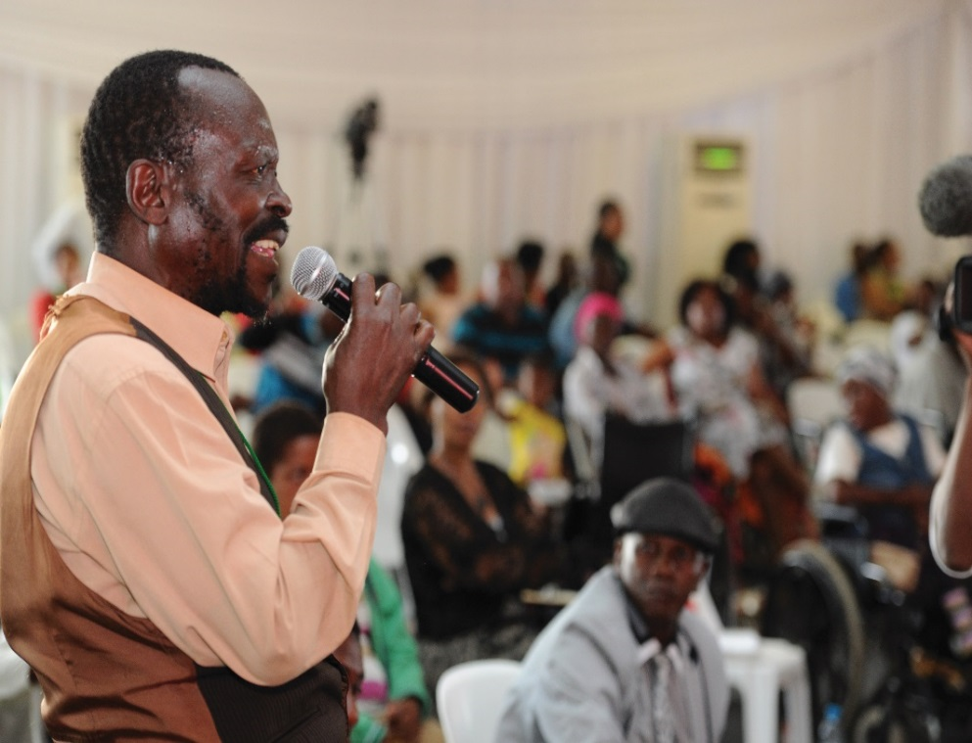

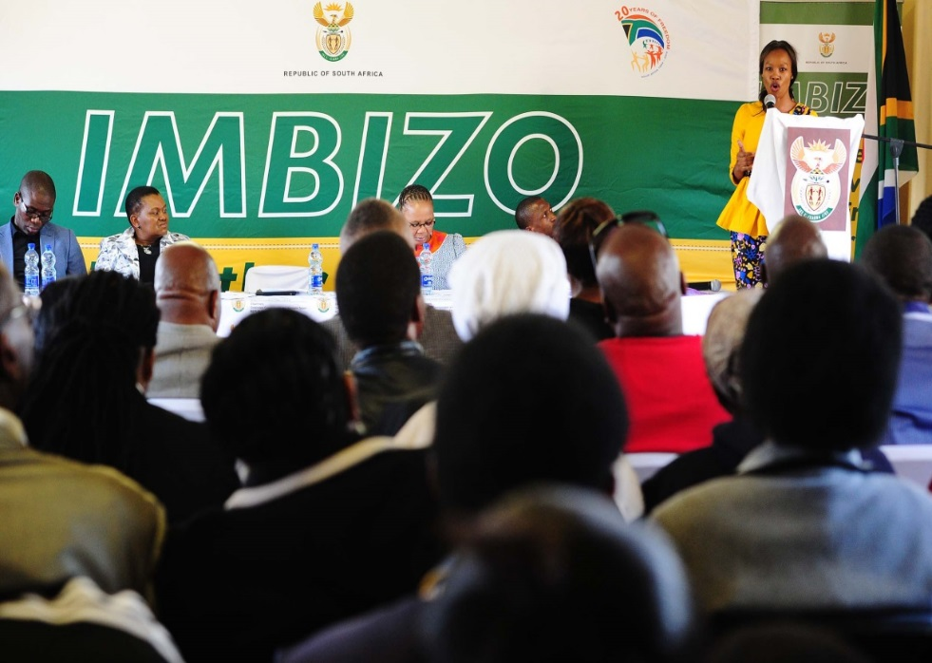


Slide 26
6. 2016/19 Targets Per Programme
Programme 3: Intergovernmental Coordination and Stakeholder Management
Strategic Objective 3.2: Implement a proactive and reactive media engagement system by building, maintaining and improving relations with the media and drive the government communication agenda
Performance Indicators | Targets (2016/2019)
Number of engagements between government officials and senior journalists on the government Programme of Action (PoA) and policy issues | 16 engagements between government officials and senior journalists on the government PoA and policy issues
Number on post-Cabinet media briefings and/or statements issued after ordinary Cabinet meeting | 18 post-Cabinet media briefings and/or statements issued after ordinary Cabinet meetings
Number of biweekly Rapid Response reports for the minister produced (excluding December and January) | 24 biweekly Rapid Response reports produced for the Minister (excluding December and January)

Slide 27
6. 2016/19 Targets Per Programme
Programme 3: Intergovernmental Coordination and Stakeholder Management
Strategic Objective 4.1: Improve interdepartmental coordination by joint planning and sharing of messages across the three spheres of government to ensure coherence and alignment of government messages.
Performance Indicators | Targets (2016/2019)
Number of Government Communication Programmes (GCPs) developed for the clusters | Five GCPs 2016/17 developed
Percentage of communication strategies developed for cluster campaigns/projects/programmes (based on demand) | 100% of communication strategies developed for cluster campaigns/projects/programmes (based on demand)
Number of Internal Communicators’ Forum (ICF) coordinated | Two Internal Communicators’ Forums coordinated

Slide 28
6. 2016/19 Targets Per Programme
Programme 3: Intergovernmental Coordination and Stakeholder Management
Strategic Objective 4.1: Improve interdepartmental coordination by joint planning and sharing of messages across the three spheres of government to ensure coherence and alignment of government messages.
Performance Indicators | Targets (2016/2019)
Number of reports on government communication training produced. | Four reports on government communication training produced
Number of Government Communicators’ Forums (GCF) coordinated. | Two Government Communicators’ Forums coordinated.
Percentage of communication projects implemented (based on demand) | 100% of communication projects implemented

Slide 29
6. 2016/19 Targets Per Programme
Programme 3: Intergovernmental Coordination and Stakeholder Management
Strategic Objective 4.2: An informed and empowered citizenry on government’s policies, plans, programmes and achievements to increase public participation in government.
Performance Indicators | Targets (2016/2019)
Number of development communication activations aligned to the GCP | 1 200 development communication activations aligned to the GCP
Number of marketing events for Thusong programme held | 486 marketing events for Thusong programme held
Number of community and stakeholder liaison visits undertaken | 1 800 community and stakeholder liaison visits undertaken
Number of reports on Izimbizo events held | Four quarterly reports on Izimbizo events held

Slide 30
7. 2016 MTEF Budget Summary
 | 2016/17 |  |  |  | 2017/18 | 2018/19
 | Total appropriated | Current payments | Transfers and Subsidies | Payments for capital assets | Total | Total
MTEF allocation | R’000 | R’000 | R’000 | R’000 | R’000 | R’000
P1 Administration | 143 064 | 142 490 | 44 | 530 | 151 699 | 161 488
P2 Content Processing & Dissemination | 133 608 | 133 112 | - | 496 | 141 861 | 150 855
P3 Intergovernmental Coordination & Stakeholder Management | 105 484 | 105 392 | 12 | 80 | 112 257 | 120 070
Total expenditure estimates | 382 156 | 380 994 | 56 | 1 106 | 405 817 | 432 413

Slide 31
7. 2016 MTEF Budget Summary
GCIS CONSOLIDATED | 2016/17
 | Compensation of Employees | Goods and Services | Transfers and Subsidies | Payments for capital assets | Total
MTEF allocation | R’000 | R’000 | R’000 | R’000 | R’000
P1 Administration | 64 087 | 78 403 | 44 | 530 | 143 064
P2 Content Processing and Dissemination | 74 346 | 58 766 | - | 496 | 133 608
P3 Intergovernmental Coordination and Stakeholder Management | 84 368 | 21 024 | 12 | 80 | 105 484
Total expenditure estimates | 222 801 | 158 193 | 56 | 1 106 | 382 156

Slide 32
7. 2016 MTEF Budget Summary
PROG 1: ADMINISTRATION | 2016/17
 | Compensation of Employees | Goods and Services | Transfers and Subsidies | Payments for capital assets | Total
MTEF allocation | R’000 | R’000 | R’000 | R’000 | R’000
Departmental Management | 6 336 | 855 | - | 42 | 7 233
Corporate Services | 28 459 | 19 933 | - | 198 | 48 590
Financial Administration | 24 047 | 6 642 | 44 | 265 | 30 998
Internal Audit | 5 245 | 2 402 | - | 25 | 7 672
Office Accommodation | - | 48 571 | - | - | 48 571
Total expenditure estimates | 64 087 | 78 403 | 44 | 530 | 143 064

Slide 33
7. 2016 MTEF Budget Summary
PROG 1: ADMINISTRATION | 2016/17 | 2017/18 | 2018/19
 | R’000 | R’000 | R’000
Departmental Management | 7 233 | 7 704 | 8 249
Corporate Services | 48 590 | 51 597 | 55 028
Financial Administration | 30 998 | 32 980 | 35 266
Internal Audit | 7 672 | 8 155 | 8 709
Office Accommodation | 48 571 | 51 263 | 54 236
Total expenditure estimates | 143 064 | 151 699 | 161 488

Slide 34
7. 2016 MTEF Budget Summary
PROG 2: CONTENT PROCESSING AND DISSEMINATION | 2016/17
 | Compensation of Employees | Goods and Services | Transfers and Subsidies | Payments for capital assets | Total
MTEF allocation | R’000 | R’000 | R’000 | R’000 | R’000
Programme Management | 3 043 | 348 | - | 30 | 3 421
Policy and Research | 24 328 | 8 667 | - | 50 | 33 045
Products and Platforms | 20 605 | 29 758 | - | 159 | 50 522
Communication Service Agency | 26 370 | 19 993 | - | 257 | 46 620
Total expenditure estimates | 74 346 | 58 766 | - | 496 | 133 608

Slide 35
7. 2016 MTEF Budget Summary
PROG 2: CONTENT PROCESSING AND DISSEMINATION | 2016/17 | 2017/18 | 2018/19
 | R’000 | R’000 | R’000
Programme Management | 3 421 | 3 644 | 3 901
Policy and Research | 33 045 | 35 162 | 37 346
Products and Platforms | 50 522 | 53 559 | 56 834
Communication Service Agency | 46 620 | 49 496 | 52 774
Total expenditure estimates | 133 608 | 141 861 | 150 855

Slide 36
7. 2016 MTEF Budget Summary
PROG 3: INTERGOVERNMENTAL COORDINATION AND STAKEHOLDER MANAGEMENT | 2016/17
 | Compensation of Employees | Goods and Services | Transfers and Subsidies | Payments for capital assets | Total
MTEF allocation | R’000 | R’000 | R’000 | R’000 | R’000
Programme Management | 2 706 | 348 | - | - | 3 054
Provincial and Local Liaison | 57 547 | 15 928 | 10 | 80 | 73 565
Media Engagement | 10 398 | 2 927 | 2 | - | 13 327
Cluster Supervision (HD, SP, GA) | 7 349 | 932 | - | - | 8 281
Cluster Supervision (EI, JI) | 6 368 | 889 | - | - | 7 257
Total expenditure estimates | 84 368 | 21 024 | 12 | 80 | 105 484

Slide 37
7. 2016 MTEF Budget Summary
PROG 3: INTERGOVERNMENTAL COORDINATION AND STAKEHOLDER MANAGEMENT | 2016/17 | 2017/18 | 2018/19
 | R’000 | R’000 | R’000
Programme Management | 3 054 | 3 252 | 3 483
Provincial and Local Liaison | 73 565 | 78 275 | 83 703
Media Engagement | 13 327 | 14 181 | 15 163
Cluster Supervision (HD, SP, GA) | 8 281 | 8 820 | 9 446
Cluster Supervision (EI, JI) | 7 257 | 7 729 | 8 275
Total expenditure estimates | 105 484 | 112 257 | 120 070

Slide 38
Thank you
- End -

