Slide 1
EASTERN CAPE Presentation Achievements for 2015/6 Business plan for 2016/7
April 2016

Slide 2
KEY ACHEIVEMENTS
R500m additional funding
The M3 Agreement is gaining momentum in Nelson Mandela Metro with the following achievements being;
Reduction of the Revolving fund
Establishment of a credible Contractor database
Stability in the administration
Hands on support from national department
De-commitment of none active projects
100% expenditure with a bias on value create
Over achievement on housing
Strong pipeline of Social Housing
Title deeds ready for issuing in the Metro

Slide 3
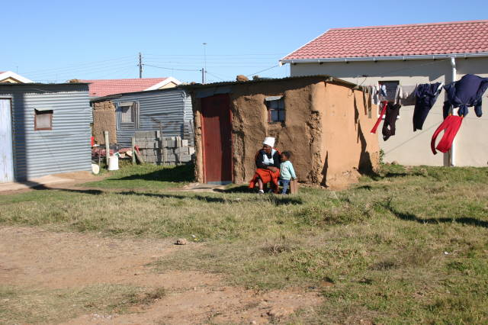

Slide 4
Overall achievement 2015/16
Programme 3
Description | Target | Delivery
Top structures | 13 100 | 13 198
Services | 10 231 | 10 361
Rectification | 2 311 | 2 987
Informal settlements upgrade | 18 | 20
Emergency housing programme | 337 | 334
Military veterans | 73 | 51
EPHP | 263 | 231

Slide 5
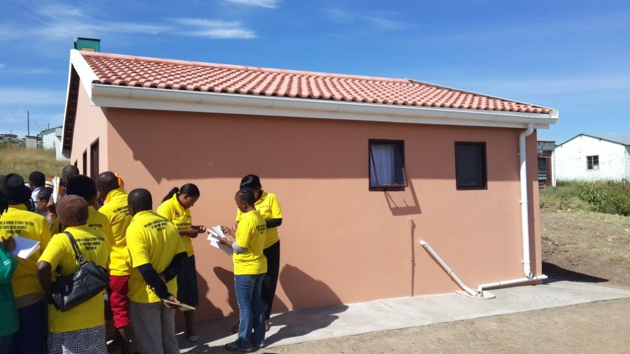

Slide 6
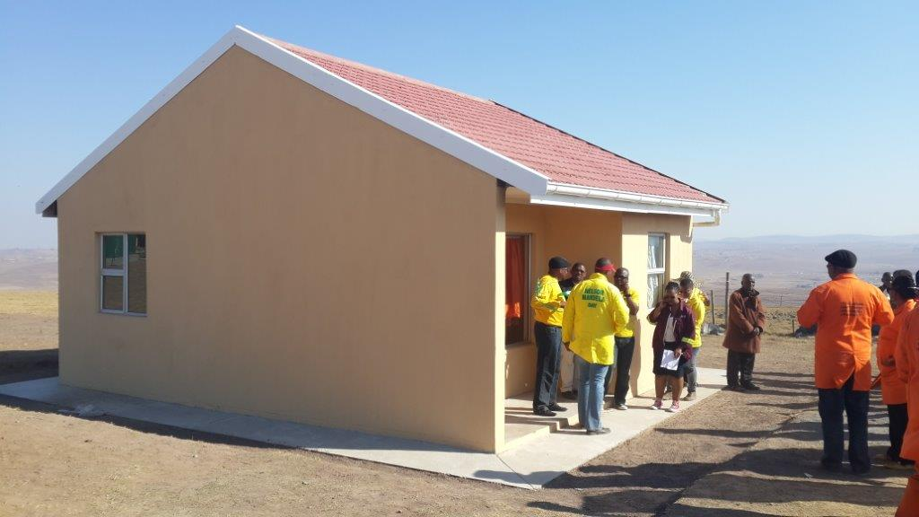
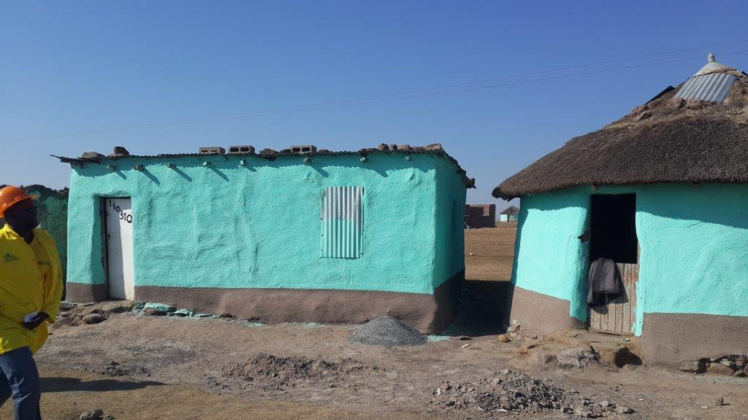
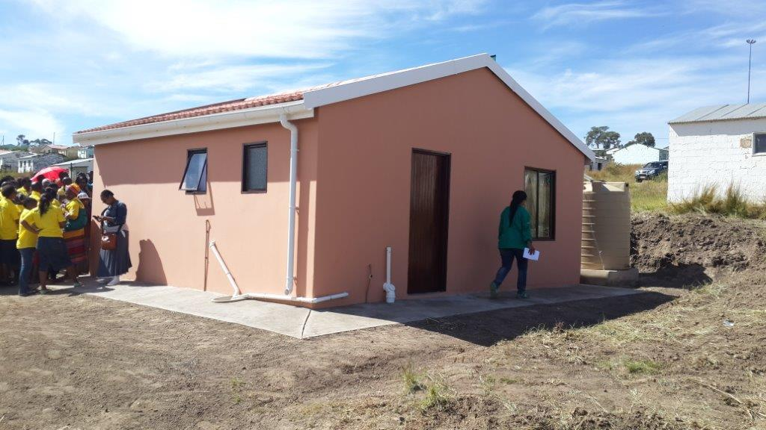
Overall achievement 2015/16
Programme 4
Description | Target | Delivery
Land acquisition has been discontinued due to a strategic decision to focus on output of houses and services
FLISP | 200 | 207
Social housing | 393 | 64
Title deeds | 6 000 | 403

Slide 7
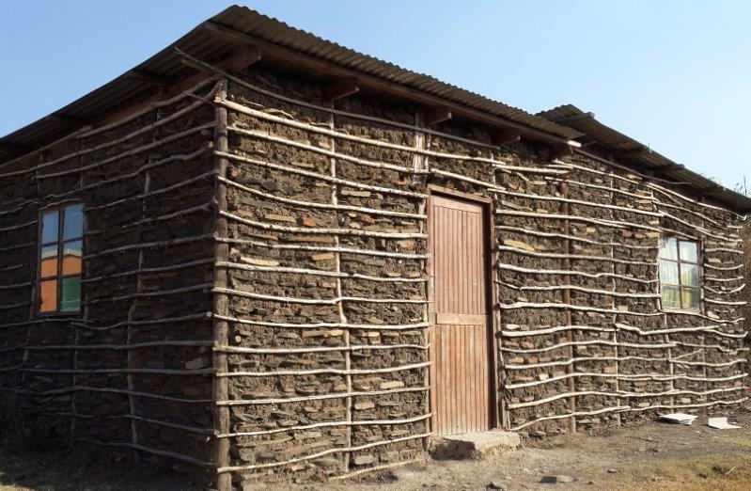
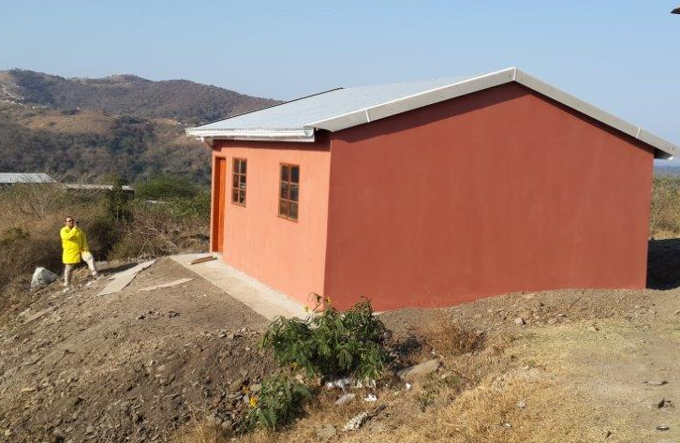

Slide 8
HSDG ALLOCATIONS

Slide 9
EXECUTIVE SUMMARY
2
The overall budget for the Province is R 1, 991, 457, 000 billion
Regional Budget for Units, Rectification and Sites = R 1,825,366,893 billion including the Declared Disaster Grant = R100, 000, 000 million
Centralised = R 166,090,107 million
The EC Dept. of Human Settlements will be constructing 13 180 units as follows:
RDP (40m²) House = 12 426 Units FLISP, Individual Subsidies, Social & Rental Housing = 754 Units
Total = 13 180 Units
The department will also be servicing 10 606 sites
Rectifying 1899 defective units with a budget of R 170,311,503 million.

Slide 10
GRAPHICAL PRESENTATION ON BUDGET SPLIT
4

Slide 11
Regional Budget & Decentralised Programmes
5
Region | No of Projects | UNITS | SITES | Regional Budget | Social & Rental | Socio Econo | Unblock | Accreditation | Total
Alfred Nzo | 118 | 2 000 | 1 986 | R 203 370 369 | R 35 299 | R 3 485 787 | R 705 982 | R 0 | R 207 597 437
O R Tambo | 71 | 2 000 | 2 096 | R 211 151 621 | R 266 004 | R 4 350 000 | R 0 | R 0 | R 215 767 625
Amathole | 64 | 1 013 | 1 209 | R 178 084 154 | R 0 | R 0 | R 105 897 | R 0 | R 178 190 051
Buffalo City | 39 | 1 800 | 786 | R 217 865 502 | R 2 514 810 | R 1 058 973 | R 0 | R 6 300 000 | R 227 739 285
Chris Hani | 102 | 1 000 | 750 | R 134 460 449 | R 0 | R 1 606 724 | R 1 394 315 | R 0 | R 137 461 488
Sarah Bartman | 76 | 900 | 1 127 | R 164 649 423 | R 0 | R 3 777 004 | R 11 988 375 | R 0 | R 180 414 802
Joe Gqabi | 49 | 713 | 997 | R 8 099 078 | R 0 | R 1 764 955 | R 123 547 000 | R 0 | R 133 411 033
NMBM | 85 | 3 000 | 1 655 | R 585 276 206 | R 11 662 143 | R 5 450 000 | R 0 | R 0 | R 602 388 349
Totals | 604 | 12 426 | 10 606 | R 1 702 956 802 | R 14 478 256 | R 21 493 443 | R 137 741 569 | R 6 300 000 | R 1 882 970 070
Centralized | 7 | 754 | - | R 104 736 176 | R 1 800 754 | R 1 950 000 | R 0 | R 0 | R 108 486 930
TOTAL | 611 | 13 180 | 10 606 | R 1 808 706 340 | R 16 279 010 | R 23 443 443 | R 14 318 116 | R 6 300 000 | R 1 991 457 000

Slide 12
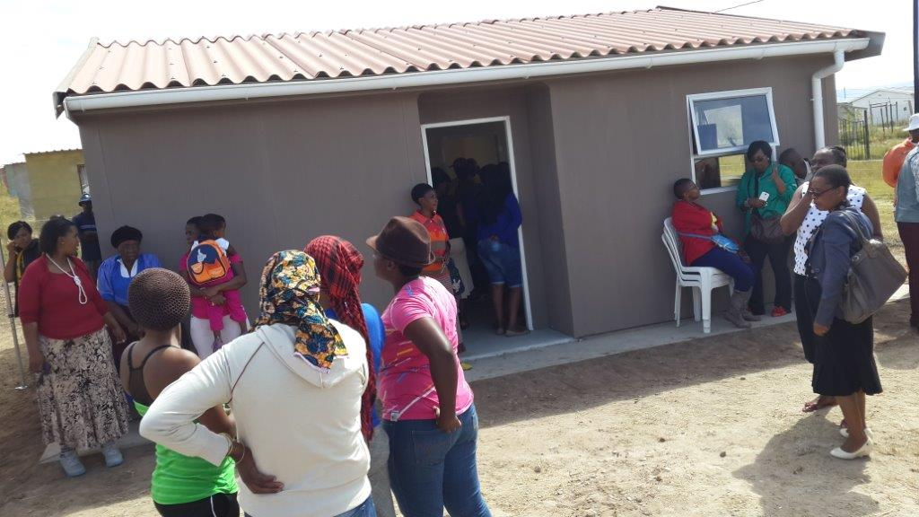

Slide 13
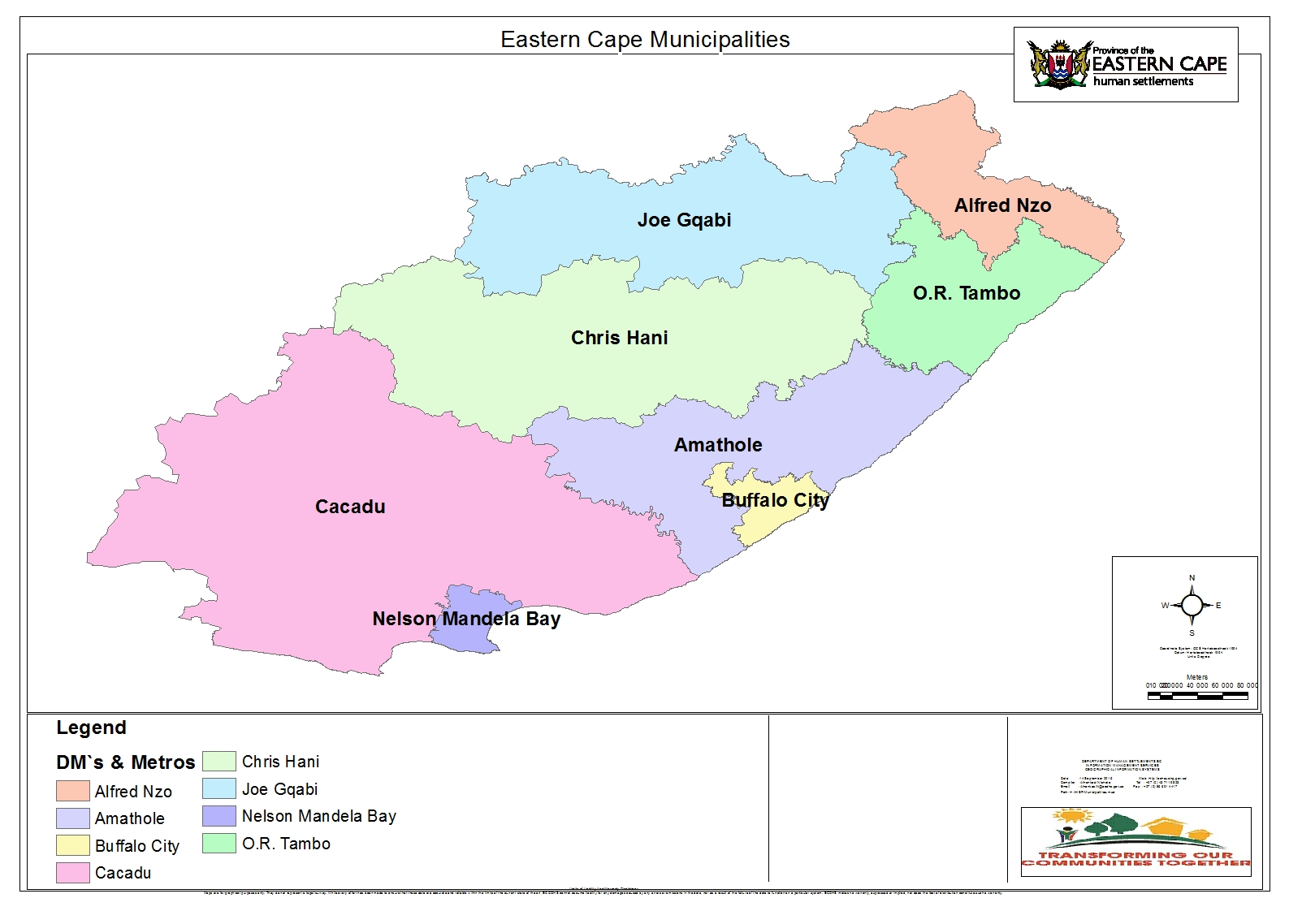
REGIONAL & DECENTRALISED ALLOCATIONS ON FINANCIAL & NON-FINANCIALS
Units = 713
Sites = 997
Budget=R133,41m
Units = 2000
Sites = 1986
Budget=R207,59m
Units = 1000
Sites = 750
Budget=R137,46m
Units = 900
Sites = 1127
Budget=R180,42m
Units = 2000
Sites = 2096
Budget=R215,77m
Units = 1800
Sites = 786
Budget=R227,74m
Sarah Bartman
Units = 1013
Sites = 1209
Budget=R178,19m
TOTAL DEPARTMENTAL ALLOCATIONS
Units = 12,426
Sites = 10,606
Budget = R1,882,970,070 Million
Units = 3000
Sites = 1655
Budget=R602,39m
CENTRALISED PROG’s
Units = 754
Sites = 0
Budget=R108,40m

Slide 14
SUMMARY OF ALL INSTRUMENTS – 16/17
Sub-Programme |  | Units/QTY | Budget
1. Financial Intervention
1.1a Individual housing subsidies (R0 - R3 500) credit linked |  | 0 | R 0
1.1b Individual housing subsidies (R0 - R3 500) Non - Credit Linked |  | 101 | R 3 145 192
1.2 Housing finance linked Individual subsidies (FLISP)-(R3 501 - R7 000) |  | 203 | R 3 248 678
1.3 Enhanced Extended Discount Benefit Scheme (EEDBS) |  | 1 939 | R 8 282 182
1.4 State Asset Maintenance Programme |  | 6 511 | R 2 710 442
1.5a Rectified RDP stck 1994-2002 |  | 1 681 | R 143 397 005
1.5b Rectification of Housing Stock(pre 1994) |  | 218 | R 31 179 229
1.6 Social and Economic Facilities |  | 1 | R 23 443 443
1.7 Accredited Municipalities (level 1 & 2): |  | 0 | R 26 402 344
1.8 Operational Capital Budget |  | 0 | R 51 773 872
1.9 Blocked projects |  | 0 | R 0
1.10 NHBRC enrolment (related to grant) |  | 26 000 | R 9 084 356
1.11a Land parcels procured(IHAHSD) |  | 0 | R 0
1.12 Housing chapters of IDP's |  | 0 | R 1 744 016
Sub-total: Financial Intervention |  | 304 | R 304 410 759

Slide 15
SUMMARY OF ALL INSTRUMENTS – 16/17
8
Sub-Programme | Sites | Units/QTY | Budget
2. Incremental Housing Programmes
2.1 Project Linked Subsidies(current commitments approved up to 31/03/07) | 0 | 0 | R 0
2.2a Integrated Residential Development Programme :Phase 1:Planning and Services | 3 270 | 0 | R 196 729 697
2.2b Integrated Residential Development Programme :Phase 1:Planning and Services INFORMAL SETTLEMENTS | 446 | 0 | R 37 211 850
2.2c Integrated Residential Development Programme :Phase 2:Top Structure Construction | 0 | 941 | R 109 544 918
2.2d Integrated Residential Development Programme :Phase 2:Top Structure Construction INFORMAL SETTLEMENTS | 0 | 2 724 | R 383 380 402
2.2e Integrated Residential development Programme :Phase 4:Top Structure Construction (INFORMAL SETTLEMENTS) | 0 | 0 | R 0
2.3a People's Housing process | 167 | 255 | R 24 393 411
2.3b People's Housing Process INFORMAL SETTLEMENTS | 0 | 0 | R 0
2.4 Informal Settlement Upgrading | 387 | 2 307 | R 264 033 369
2.5a Consolidation Subsidies (Excluding Blocked Projects) | 0 | 30 | R 4 000 000
2.5b Consolidation Subsidies (Blocked Projects) | 0 | 0 | R 0
2.6 Emergency Housing Assistance | 411 | 511 | R 56 614 488
Sub-total: Incremental Housing Programmes | 4 681 | 6 768 | R 1 075 908 134

Slide 16
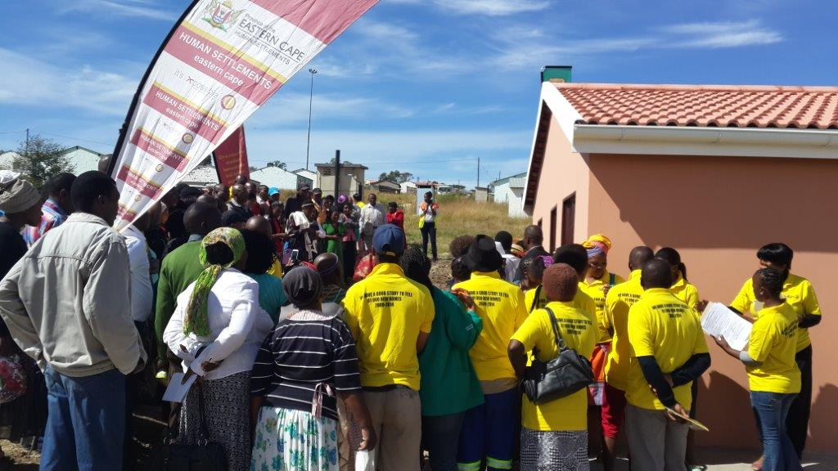

Slide 17
SUMMARY OF ALL INSTRUMENTS – 16/17
9
Sub-Programme |  | Units/QTY | Budget
3. Social & Rental Housing
3.1 Institutional Subsidies |  | 450 | R 14 212 252
3.2a Social Housing:operational support |  | 0 | R 1 800 754
3.2b Social Housing:Capital Grants for rental housing (Funded by NDoH) |  | 0 | R 0
3.3a Community residential units (CRU) Converted/Upgraded (NORTHCREST FLATS PARTNERSHIP WITH PUBLIC WORKS ) |  | 0 | R 266 004
3.3b Community residential units (CRU) Constructed |  | 0 | R 0
Sub-total: Social & Rental Housing |  | 450 | R 16 279 010

Slide 18
SUMMARY OF ALL INSTRUMENTS – 16/17
10
Sub-Programme | Sites | Units/QTY | Budget
4. Housing
4.1 Farm Worker Housing Assistance | 0 | 0 | R 0
4.2 Rural Housing: Communal land rights | 5 635 | 5 190 | R 535 289 267
4.3 Urban Housing | 5 635 | 5 190 | R 535 289 267
TOTAL | 10 316 | 12 712 | R 1 931 887 170
5. PROVINCIAL SPECIFIC PROGRAMMES | 290 | 468 | R 59 569 830
GRAND TOTAL | 10 606 | 13 180 | 1 991 457 000
50/50

Slide 19
OUTCOMES 8 and POLICY SPEECH PROGRAMMES
11
Item No | SUB-PROGRAMME or INSTRUMENT | SITES | UNITS
1 | New Units | 0 | 12 426
2 | Sites Serviced | 10 606 | 0
3 | Basic Water & Sanitation | 3 716 | 0
4 | Informal Settlements Upgrading | 0 | 833
5 | Social & Rental | 0 | 450
6 | Community Residential Unit – CRU | 0 | 0
7 | Destitute | 459 | 614
8 | Military Veterans | 0 | 140

Slide 20
CASHFLOW PROJECTIONS
12
R286m – Apr
R276m – May
R215m - Jun
R155m – Jul
R155m – Aug
R161m - Sep
Q1
R777m
Q2
R470m
Annual
R 1,991 b
Q3
491m
Q4
R253m
R140m – Oct
R159m – Nov
R192m - Dec
R 72m – Jan
R105m – Feb
R 76m – Mar

Slide 21
MTSF TARGETS & BUDGET ALLOCATIONS
13

Slide 22
THE MTSF (2014 - 2019) PLANS FOR THE E.C. HUMAN SETTLEMENTS PLANS
Units = 4,210
Sites= 3,699
Budget=R0,589b
Units = 11,715
Sites=13,104
Budget=R1,291b
Units = 5,315
Sites= 4,698
Budget=R1,011b
Units = 10,878
Sites= 13,918
Budget=R1,476b
Units = 4,210
Sites= 3,699
Budget=R0,771b
Units = 9,880
Sites= 9,586
Budget=R0,927b
Sarah Bartman
Units = 8,561
Sites= 3,882
Budget=R1,331b
Units = 14,626
Sites= 11,602
Budget=R2,425b
TOTAL MTSF TARGETS
Units = (73,473+3,772)=77,245
Sites = 71,981
Budget = R11,284,326b
CENTRALISED PROG’s
Units = 3,772
Sites = 0
Budget=R1,463b

Slide 23
MTSF ALLOCATION - units
Region | 14/15 | 15/16 | 16/17 | 17/18 | 18/19 | Total
Alfred Nzo | 2,502 | 2,230 | 2,000 | 2,039 | 2,944 | 11,715
O R Tambo | 1,781 | 1,913 | 2,000 | 2,265 | 2,919 | 10,878
Amathole | 2,852 | 1,670 | 1,013 | 1,757 | 2,588 | 9,880
Buffalo City | 2,059 | 1,333 | 1,800 | 1,316 | 2,053 | 8,561
Chris Hani | 652 | 1,000 | 1,000 | 1,132 | 1,531 | 5,315
Sarah Bartman | 872 | 1,311 | 900 | 2,259 | 2,946 | 8,288
Joe Gqabi | 419 | 865 | 713 | 899 | 1,314 | 4,210
NMBM | 2,332 | 2,778 | 3,000 | 3,450 | 3,066 | 14,626
Regional Totals | 13,469 | 13,100 | 12,426 | 15,117 | 19,361 | 73,473
Centralized | 696 | 668 | 754 | 784 | 870 | 3,772
Total | 14,165 | 13,768 | 13,180 | 15,901 | 20,231 | 77,245

Slide 24
MTSF ALLOCATION - sites
Region | 14/15 | 15/16 | 16/17 | 17/18 | 18/19 | Total
Alfred Nzo | 1,318 | 2,230 | 1,986 | 3,776 | 3,794 | 13,104
O R Tambo | 1,813 | 2,285 | 2,096 | 4,026 | 3,698 | 13,918
Amathole | 1,582 | 1,581 | 1,209 | 2,588 | 2,626 | 9,586
Buffalo City | 1,282 | 408 | 786 | 693 | 713 | 3,882
Chris Hani | 280 | 400 | 750 | 1,569 | 1,699 | 4,698
Sarah Bartman | 1930 | 863 | 1,127 | 3,776 | 3,796 | 11,492
Joe Gqabi | 333 | 535 | 997 | 907 | 927 | 3,699
NMBM | 1,501 | 1,928 | 1,655 | 3,249 | 3,269 | 11,602
Regional Totals | 10,039 | 10,230 | 10,606 | 20,584 | 20,522 | 71,981
Centralized | 0 | 0 | 0 | 0 | 0 | 0
Total | 10,039 | 10,230 | 10,606 | 20,584 | 20,522 | 71,981

Slide 25
MTSF ALLOCATION - Financials
Region | 14/15 | 15/16 | 16/17 | 17/18 | 18/19 | Total
Alfred Nzo | R 385,943 | R 211,450 | R 207, 597 | R 242,230 | R 213,493 | R 1,290,731
O R Tambo | R 319,996 | R 208,217 | R 215, 767 | R 312,650 | R 394,586 | R 1,476,320
Amathole | R 290,511 | R 157,262 | R 178, 190 | R 183,113 | R 114,048 | R 927,259
Buffalo City | R 273,722 | R 193,185 | R 227, 739 | R 289,334 | R 344,905 | R 1,331,248
Chris Hani | R 183,967 | R 137,933 | R 137,461 | R 294,090 | R 243,810 | R 1,011,117
Sarah Bartman | R 105,030 | R 162,735 | R 180,418 | R 181,089 | R 137,400 | R 770,638
Joe Gqabi | R 69,005 | R 123,512 | R 133, 411 | R 137,695 | R 120,448 | R 588,875
NMBM | R 326,288 | R 397,835 | R 602 388 | R 570,771 | R 612,772 | R 2,424,794
Regional Totals | R1,954,462 | R1,592,129 | R1,881,957 | R2,210,972 | R2,181,462 | R9,820,982
Centralized | R 438,255 | R 370,242 | R 109,500 | R 249,688 | R 295,659 | R1,463,344
Total | R2,392,717 | R1,962,371 | R1,991,457 | R2,460,660 | R 2,477,121 | R11,284,326
There is only R 6,929 Billion remaining out of R 11,284 Billion which was made available for Eastern Cape for the current MTSF.

Slide 26
PROJECT READINESS
There are 106 running projects at various stages with around 65% at roof and completion
80 projects at SCM stage from TOR to BAC
Planning has been slowed down due to the active pipeline
There is a bias to the Metro’s with Alfred Nzo and O R Tambo budgets being reduced.
Nelson Mandela from R450m to R602m
Buffalo city is increased to R227m
There are three Military veterans projects with the flagship being the 491 project in Nelson Mandela

Slide 27
Key issues
Budget reduction
Reduced equitable share informed by apex priorities
Beneficiary administration ownership
Bulk services
Municipal readiness

Slide 28
OPPORTUNITIES
Catalytic projects
Deed of sales should be issued with NHBRC enrollment
M3 agreement
Social housing pipeline
Closing of projects
Value for money
DVRI in BCMM

Slide 29
THANK YOU
“We have come a long way – Celebrating 20 Years of Freedom!”

