Slide 1
STRATEGIC PLAN, APP and AGSA REMEDIAL PLAN
2016 / 17

Slide 2
At the April 2014 Strategic Planning Workshop, Council and Senior Management met to reposition the institution, adopt a new vision and took a decision to decentralise the functions of the institution and focussing on the empowerment of DMSA employees.
The new vision of DMSA, sustainable museums accessible to all, resonates with the above in ensuring that the museums embrace cultural diversity and promote the nation’s democracy.

Slide 3
BACKGROUND
NDEBELE MURAL

Slide 4
Attuned to this vision, the plan presents innovative ways of unlocking the potential of the heritage assets entrusted to the institution, whilst developing new audiences and market niches to ensure that the museums and heritage sites are accessible to all communities

Slide 5
DMSA has three major programmes :-
Administration (Corporate Services), Business Development (Core Functions) - Museum Operations) and Public Engagement informed by the following Strategic Goals:
Efficient and effective organisation
Properly preserved, well curated and researched collections accessible to the general public.
Diversified funding base
Greater accessibility to the museums
Developed and retained skills and expanded specialised knowledge.

Slide 6
These strategic goals are being executed by the four business units which are the Head Office, Cultural, Military and Natural History Museums as well as the five satellite museums:- Sammy Marks; Willem Prinsloo Agricultural; Tswaing Meteorite Crater; Pioneer and Kruger House

Slide 7
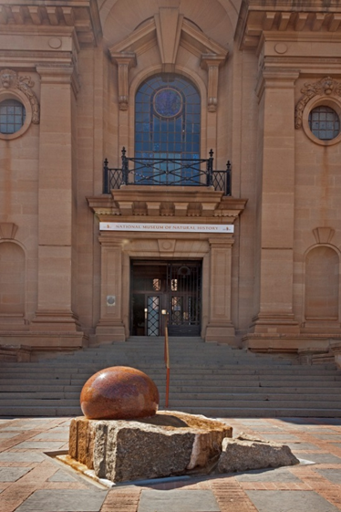
INSTITUTIONAL CHANGES
DITOSNG NATIONAL MUSEUM OF NATURAL HISTORY

Slide 8
PROGRAMME 1 : ADMINISTRATION
Sub- Programme : Finance
Objective : Financially sustainable organisation
Support core function departments by providing an enabling environment to ensure that DMSA fulfils its core mandate.
New Performance Indicators
- 50% of products and services charged at market related prices
- Own revenue generated increased by 20%
- Decentralised model budget aligned to activity based costing
- Increase the number of outsourced curio shops (2)
- Business case developed and negotiations entered into with PWD with regard to transfer of land and buildings owned by DMSA
- Increased utilisation of vacant space for operating and revenue purposes. (10%)
Notes:
INSTITUTIONAL CHANGES
PROGRAMME 1 : ADMINISTRATION
Support core function departments by providing an enabling environment to ensure that DMSA fulfils it’s core mandate.
New Performance Indicators
- 50% of products and services charged at market related prices
- Own revenue generated increased by 20%
- Decentralised model budget aligned to activity based costing
- Increase the number of outsourced curio shops (2)
- Business case developed and negotiations entered to with PWD wrt transfer of land and buildings owned by DMSA
- Increase utilisation of vacant space for operating and revenue purposes. (10%)

Slide 9
Sub – Programme : Marketing and Communication
Objective – contribute to Mzanzi economy
Increased visitor numbers by 10 % (virtual and physical)
Return on Marketing expenditure to number of visitors
Memoranda of Understanding (3)
Increased number of platforms to market Ditsong products and services
Information desk to promote museums
Stakeholders and interest groups forums established
Training courses or research opportunities for tertiary students

Slide 10
Sub-programme : Human Resources
Objective - Employer of Choice
Reduction of labour disputes by 10%
Induction of employees in the first month of employment
Competency assessment tools developed for all relevant posts
Reduction of absenteeism due to sick leave reduced by 15%
All approved positions have job descriptions
Performance Agreements signed by employees before the start of the new financial year
Exit interviews and reports
Retention of professional and skilled staff
Implementation of Succession Plans
Leadership development programmes developed and implemented
New organisational structure developed and approved
Reduction of post retirement liabilities by 50%

Slide 11
SUB PROGRAMME : GOVERNANCE
Objective : Good governance
Increased number of policies developed, reviewed and approved
Risk assessment undertaken and mitigation plan developed and implemented
100% of internal audit queries addressed
100% Auditor General findings addressed with the exception of GRAP 103

Slide 12
SUB – PROGRAMME : SECURITY
Objective Security systems for collections and data
Integrated DMSA security system implemented
Notes:
SUB – PROGRAMME : SECURITY
Integrated DMSA security system implemented.

Slide 13
PROGRAMME 2 : BUSINESS DEVELOPMENT (CORE BUSINESS)
Purpose : research, manage, retain, restore and render access to collections
Collections Management:
Quarterly Legal Requirements Reports
Manual with standardised museum terminology consistent with ICOM definitions developed and implemented
Revised GRAP 103 project plan developed
GRAP 103 – centralised inventory of collections developed and evaluated.
SUB – PROGRAMME : SECURITY
Integrated DMSA security system implemented
Notes:
PROGRAMME 2 : BUSINESS DEVELOPMENT (CORE BUSINESS)
Purpose : research, manage, retain, restore and render access to collections
Collections Management:
Quarterly Legal Requirements Reports
Manual with standardised museum terminology consistent with ICOM definitions developed and implemented
Revised GRAP 103 project plan developed.
Grap 103 – centralised inventory of collections developed and evaluated.
SUB – PROGRAMME : SECURITY
Integrated DMSA security system implemented.

Slide 14
SUB – PROGRAMME Collections Management:
Objective – curated and accessible collections
Quarterly Legal Requirements Reports
Manual with standardised museum terminology consistent with ICOM definitions developed and implemented
Revised GRAP 103 project plan developed
GRAP 103 – centralised inventory of collections developed and evaluated
SUB – PROGRAMME : SECURITY
Integrated DMSA security system implemented

Slide 15
SUB-PROGRAMME : RESTORATION AND CONSERVATION
Objective - conserved and restored Heritage Assets
Quarterly Report and implementation of Store room maintenance plan
Quarterly Report on heritage buildings maintained and restored
Quarterly Report on objects conserved and restored

Slide 16
SUB-PROGRAMME : RESEARCH (HERITAGE THOUGHT LEADERSHIP CREATION)
1 blog maintained
Electronic newsletters (5)
Submission of articles to popular publications
Soft back guides
Papers produced for research on electronic professional and academic media associations
Regimental, personal or institutional histories and family trees done.
Peer reviewed articles
You-tube educational programmes produced
National and International seminar and conference presentations
Knowledge Management Strategy developed and approved and implemented

Slide 17
PROGRAMME 3 : PUBLIC ENGAGEMENT
To develop and maintain public programmes and exhibitions for accessibility for the public
Notes:
PROGRAMME 3 : PUBLIC ENGAGEMENT
To develop and maintain public programmes and exhibitions for accessibility for the public.
SUB – PROGRAMME – PUBLIC PROGRAMMES
Accessible and relevant programmes
Co-ordinated programmes
Number of events, lectures and festivals
Establish partnerships with fraternal institutions
Report on Educational programmes developed
Strategic outreach programmes locally and nationally
Mobile museum established and educational exhibitions developed

Slide 18
SUB – PROGRAMME – PUBLIC PROGRAMMES
Accessible and relevant programmes
Co-ordinated programmes
Number of events, lectures and festivals held
Establish partnerships with fraternal institutions
Report on educational programmes developed
Strategic outreach programmes locally and nationally
Mobile museum established and educational exhibitions developed

Slide 19
PROGRAMME 3 : PUBLIC ENGAGEMENT
To develop and maintain public programmes and exhibitions for accessibility for the public.
SUB – PROGRAMME – PUBLIC PROGRAMMES
Accessible and relevant programmes
Co-ordinated programmes
Number of events, lectures and festivals held
Establish partnerships with fraternal institutions
Report on educational programmes developed
Strategic outreach programmes locally and nationally
Mobile museum established and educational exhibitions developed

Slide 20
FINANCIALS
NATIONAL MUSEUM OF CULTURAL HISTORY

Slide 21
Income and Expenditure trends
 | 2010/11 | 2011/12 | 2012/13 | 2013/14 | 2014/15 | 2015/16 | 2016/17
Revenue | 60 577 | 61 805 | 68 551 | 81 572 | 75 954 | 84 026 | 90 807
Expenditure | 79 306 | 66 919 | 83 602 | 78 837 | 83 662 | 84 026 | 89 825
Surplus/deficit | -18 729 | -5 114 | -15 051 | 2 735 | -7 708 | 0 | 982
Agency of Department of Arts & Culture
21
Notes:
The surplus/deficit in previous financial years was as a result of the movements in the post employment benefit liability. This movement cannot be projected into the future years without the assistance of the actuarial valuations which are done annually, at year-end.

Slide 22
Income
Sources of income | 2010/11 | 2011/12 | 2012/13 | 2013/14 | 2014/15 | 2015/16 | 2016/17
Grant transferred | 51 242 | 54 411 | 58 417 | 62 450 | 66 350 | 69 402 | 73 080
Trading revenue | 4 342 | 3 419 | 3 284 | 5 778 | 5 899 | 10 775 | 11 991
Investment income | 2 277 | 1 965 | 1 751 | 1 816 | 2 240 | 1 705 | 1 986
Other | 2 716 | 2 010 | 5 099 | 11 528 | 1 465 | 2 144 | 3 750
TOTAL | 60 577 | 61 805 | 68 551 | 81 572 | 75 954 | 84 026 | 90 807
Agency of Department of Arts & Culture
22
Notes:
Trading revenue increased between 2012-13 and 13/14 due to increased in rental income. Other revenue increased between 2011/12 and 12/13 due to increase in NRF grant sourced. The increase in other revenue between 2012/13 and 13/14 was due to an actuarial gain of R10.4m on post employment benefit liability valuation. Trading revenue from 2015/16 expected to increase due to implementing turnaround plan and sweating the assets.

Slide 23
Expenditure items
 | 2010/11 | 2011/12 | 2012/13 | 2013/14 | 2014/15 | 2015/16 | 2016/17
Compensation of employees | 47 925 | 43 853 | 53 079 | 51 452 | 53 207 | 61 844 | 64 486
Goods and services | 30 160 | 21 733 | 29 840 | 26 449 | 29 403 | 22 182 | 25 339
Depreciation | 1 222 | 1 333 | 683 | 936 | 1 052 | 0 | 0
Total | 79 307 | 66 919 | 83 602 | 78 837 | 83 662 | 84 026 | 89 825
Agency of Department of Arts & Culture
23
Notes:
Compensation of employees increased between 2011/12 and 12/13 due to increase in post employment benefit liability of R10m. DMSA management has sourced quotations from investment companies to take over the post employment obligation and the presentations to Council and management is scheduled for May 2016. Goods and services fluctuated between 2010/11 to 2012/13 due to the expenditure trends on projects expenditure which was very high in 2010/11 low in 11/12 and resumed in 12/13. The forecast from 2015/16 does not include the project expenses as this is operational budget.

Slide 24
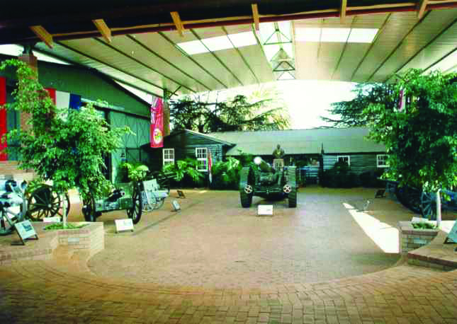
AUDIT OUTCOME FOR 2014/2015 PERIOD & REMEDIAL ACTION
DITSONG:NATIONAL MUSEUM OF MILITARY HISTORY

Slide 25
Qualified audit opinion on four issues:
Property, Plant and Equipment
Heritage assets
Receivables from exchange transactions and
Irregular expenditure
Material findings on the annual performance report concerning the usefulness of reported performance information and on the uncertainty on the going concern of the entity

Slide 26
2014/15 Audit Report and Management Letter

Slide 27
ANNEXURE A: MATTERS AFFECTING THE AUDITOR’S REPORT
TRADE AND OTHER RECEIVABLES
Finding | Action Plan | Due Date | Progress Report
Limitation and misstatement of trade receivables in the annual financial statements | Long outstanding debts followed up Debtors files reconciled Debt collection agency will be appointed | 15 April 2016 | Debtors files updated Statements sent to debtors to confirm or disputes debts in DMSA books Contract Debtors clerk appointed In process of appointing debt collector by 15 April 2016

Slide 28
TRADE AND OTHER RECEIVABLES
Finding | Action Plan | Due Date | Progress Report
Interest not charged on all overdue accounts | Interest will be charged monthly | 30 July 2015 | Task complete
Provision for doubtful debts is not correctly accounted for | Provision for doubtful debts has been recalculated | 30 July 2015 | Task complete

Slide 29
PROPERTY, PLANT AND EQUIPMENT
MOVEABLE ASSETS
Finding | Action Plan | Due Date | Progress Report
Inadequate annual assessment of residual values and useful lives | Assets will be recounted and useful lives determined | 15 May 2016 due to adjustments required for Financial Statements | Asset counts performed quarterly Physical asset verification underway till 15 April 2016 Update asset register and investigate discrepancies by 30 April 2016 Update values in the financial statements is currently being updated by 15 May 2016
The moveable assets are not recorded in the asset register | Assets will be recounted and register updated
Moveable assets could not be physically verified for existence | Assets will be recounted and register updated

Slide 30
HERITAGE ASSETS
Finding | Action Plan | Due Date | Progress Report
Heritage assets are incorrectly valued as at year end | GRAP implementation plan was approved by Council and implementation is continuing Recognition of assets will be undertaken to ensure correct disclosure and fair valuation. | 31 March 2016 | GRAP 103 implementation plan in progress Library books valuation commenced SOP for heritage assets developed GRAP103 policy approved

Slide 31
REVENUE MANAGEMENT - COMPLIANCE
Finding | Action Plan | Due Date | Progress report
Property rented at less than market value | All tariffs for new contracts are based on fair market values. Management is currently reviewing all existing contracts Standard DMSA tariffs sourced from Grading Council developed | 31 March 2016 | Consultants appointed to determine market related rates of rental facilities Reports received for 50% of rented facilities
The accounting authority did not take effective and appropriate steps to collect all money due to Ditsong | Follow ups on outstanding debt will be done and debt collection processes will be followed | 15 April 2016 | Contract Debtors clerk appointed In process of appointing debt collector by 15 April 2016

Slide 32
AUDIT OF PREDETERMINED OBJECTIVES
Finding | Action Plan | Due Date | Progress Report
Targets do not adhere to the SMART criteria | These indicators have been removed in the 15/16 APP and will ensure that 16/17 APP indicators meet the SMART criteria in consultation with the Internal Auditors | 30 November 2015 | Current APP has been reviewed in consultation with Internal Auditors 2016/17 APP was reviewed by AGSA
Indicators not meeting a good performance indicator criteria | These indicators have been removed in the 15/16 APP and will ensure that 16/17 APP indicators meet the SMART criteria in consultation with the Internal Auditors | 30 November 2015 | Current APP has been reviewed in consultation with Internal Auditors 2016/17 APP also reviewed by AGSA and inputs effected on the final APP

Slide 33
AUDIT OF PREDETERMINED OBJECTIVES – CONT…
Finding | Action Plan | Due Date | Progress Report
Lack of controls over collecting and recording of performance information | Quarterly Reports will be accompanied by portfolio of evidence and reviewed by the Internal Auditors before it being submitted to council and DAC; The institution is investigating an integrated recording system that will be used at all DMSA museums | 31 October 2015 | Internal Auditors perform verification of the Portfolio of Evidence before submission to Council.
Strategic plan not approved by the executive authority | As from 2015/16 financial year both the Strategic and Annual Performance Plans are submitted | 28 February 2015 | DAC governance unit confirmed that SP required every 5 years

Slide 34
LIMITATION OF SCOPE
COMPLIANCE WITH LAWS AND REGULATIONS
Finding | Action Plan | Due Date | Progress Report
Supporting documents/information on HR not submitted for audit purposes | SLA with Metro file will be reviewed to strengthen the turnaround response rate. | 31 December 2015 | SLA with metro file reviewed. AGSA 2015/16 audit strategy includes plan to deal with HR files
Finding | Action Plan | Due Date | Progress Report
Irregular expenditure disclosed is understated | Compliance with SCM will be enforced | 31 July 2015 | Irregular expenditure is investigated and reported as soon as it is detected. Action taken against transgressors
The accounting officer did not take effective and appropriate steps to prevent irregular and fruitless and wasteful expenditure | Compliance with SCM will be enforced | 31 July 2015
Alleged financial misconduct not investigated on time | Compliance with SCM will be enforced | 31 July 2015

Slide 35
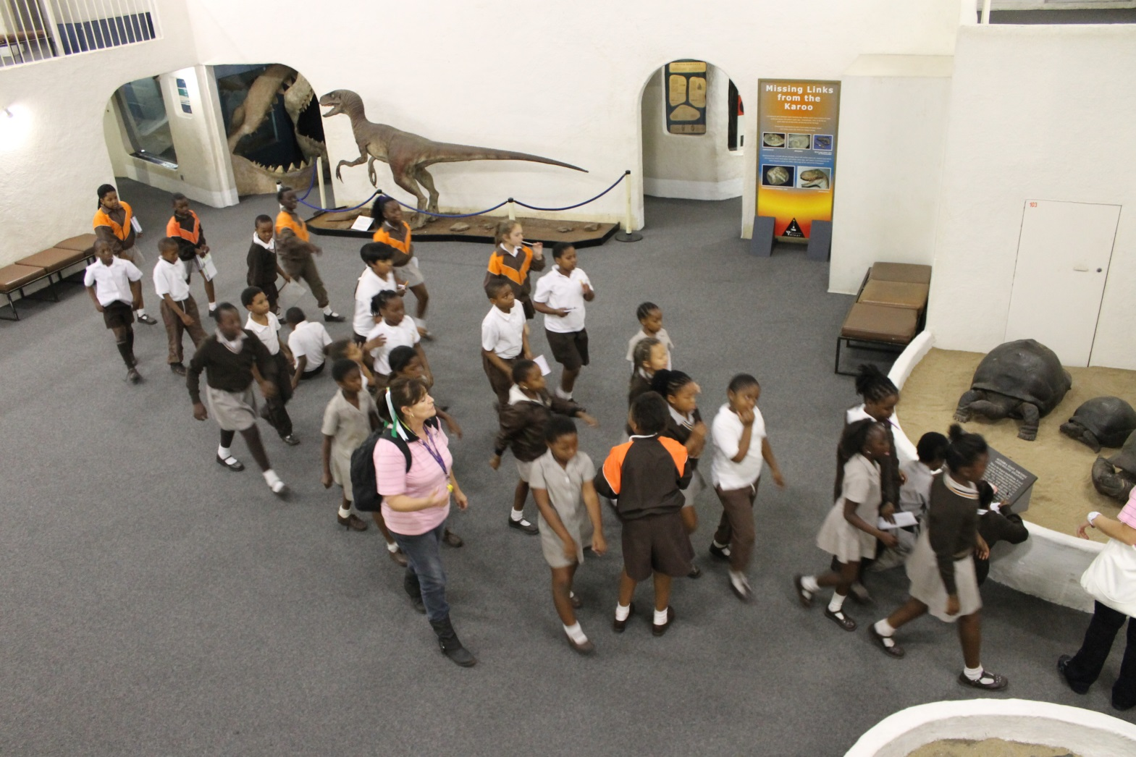
ANNEXURE B: OTHER IMPORTANT MATTERS

Slide 36
COMPLIANCE WITH LAWS AND REGULATIONS
Finding | Action Plan | Due Date | Progress Report
Payments not made within 30 days of receipt of the invoice | Compliance with SCM will be enforced | 31 August 2015 | Task completed
Procurement processes not followed | Compliance with SCM will be enforced | 31 August 2015 | Task completed Requests for deviation from procurement processes handled by procurement committee

Slide 37
EXPENDITURE MANAGEMENT
Finding | Action Plan | Due Date | Progress Report
Invoice was recorded in an incorrect accounting period | Invoice will be recorded at the right period | 30 July 2015 | Task completed. Adjustment effected
No prior approval for the local trips | Transport policy will be updated. S&T policy will be developed | 31 January 2016 | S&T policy requiring prior travel approval has been approved
Employee embarked on a trip prior authorisation | Transport policy will be updated. S&T policy will be developed | 31 January 2016 | S&T policy approved
Supplier that charged VAT is not a registered VAT vendor | Supplier is a VAT vendor | 30 July 2015 | Task completed. Evidence of VAT registration provided

Slide 38
AUDIT OF PREDETERMINED OBJECTIVES
Finding | Action Plan | Due Date | Progress Report
No formally documented Standard Operating Procedures for performance information | SOP will be documented, approved, and communicated to all staff for implementation | 31 March 2016 | SOPs have been developed
Lack of controls over the disclosure of indicators in the performance information report | Regular reviews of performance information will be done by EXCO and Internal Auditors to ensure accurate reporting | 31 July 2015 | Action implemented and ongoing
Differences between reported and audited performance information | Regular reviews of performance information will be done by EXCO and Internal Auditors to ensure accurate reporting | 31 July 2015 | Action implemented and ongoing

Slide 39
AUDIT OF PREDETERMINED OBJECTIVES – CONT…
Finding | Action Plan | Due Date | Progress Report
Prior year information reported in current year’s performance information | Regular reviews of performance information will be done by EXCO and Internal Auditors to ensure accurate reporting. | 31 July 2015 | Action implemented and ongoing
Lack of review of performance information reports | Monthly discussion point by EXCO Quarterly reviews of performance information will be done by Internal Auditors to ensure accurate reporting | 31 August 2015 | Action implemented and ongoing

Slide 40
GOVERNANCE
Finding | Action Plan | Due Date | Progress Report
Appointment letters of audit committee members are not signed by the members as acknowledgement of their position | All members have since signed their appointment letters except one who has since resigned | 31 July 2015 | Task completed
Assessment of the effectiveness of the Audit Committee was not performed | Management will ensure that council perform an assessment on the effectiveness of the audit committee on annually | 20 April 2016 | Template for assessment has been developed with the help of Internal Audit, being reviewed by ARC and assessment will be conducted before the end of April 2016.
Committees operating without charters or charters not approved by the relevant authority | All charters will be finalized by 30 September 2015. | 30 September 2015 | All Committee Charters or Terms of Reference are in place.

Slide 41
GOVERNANCE – CONT…
Finding | Action Plan | Due Date | Progress Report
Risk assessment not adequately performed | Risk register has been approved by Council and will be reviewed as risks re emerging Operational risk registers will be developed | 31 March 2016 | Risk identification workshop conducted in the 4th quarter
Internal policies not developed or reviewed | Policies will be reviewed in the next two quarters | 31 March 2016 | Policies are being developed and/or reviewed on annual basis Developed and reviewed the ff policies: S & T, GRAP103 Public programmes, Conservation, Restoration, SCM, Fixed Assets and Cell-phone & Telephone Allowance and were approved by Council

Slide 42
Ditsong National Museum of Cultural History

Slide 43
INFORMATION TECHNOLOGY
Finding | Action Plan | Due Date | Progress Report
No approved information technology governance framework | SITA engaged to draft the framework | 30 April 2016 | Draft ICT governance framework developed and discussed by both the Audit & Risk Committee and Council at March 2016 meetings but referred back with amendments
No information technology strategic plan | SITA engaged to draft the ICT Master plan | 30 April 2016 | Draft ICT Master plan developed and discussed by both the Audit & Risk Committee and Council at March 2016 meetings but referred back with amendments
No formally documented and approved process that is used to manage the process of granting users access (access control) to all financial systems | The ICT function is give priority in the 2015/16 financial year as outlined in the APP | 31 March 2016 | Access control request forms and Standard operating procedure are in place

Slide 44
INFORMATION TECHNOLOGY – CONT…
Finding | Action Plan | Due Date | Progress Report
No independent reviews of activities of the person responsible for granting users access to financial systems | Independent reviews will be performed | 30 October 2015 | Corporate Services Director responsible for independent reviews of access granted
No approved IT continuity plan, approved disaster recovery plan and approved backup and retention strategy | SITA has been appointed to develop the plans and strategy | 31 May 2016 Revised date 2016/2017 Due to SITA incapacity to deal with phase 2 (ICT Security Services) | SITA appointed to develop Business Continuity Plan Metro file has been appointed to manage backup and retention
No formally documented and approved processes in place to manage upgrades/updates made to all financial systems | These will be developed | 30 April 2016 | Major upgrades will be governed by the ICT Framework Other upgrades governed by SLA’s with service providers

Slide 45
PROPERTY, PLANT AND EQUIPMENT
MOVEABLE ASSETS
INTANGIBLE ASSETS
Finding | Action Plan | Due Date | Progress Report
Misstatement of the assets on the assets register | The register will be updated | 15 May 2016 due to adjustments required for Financial Statements | Asset register is currently being updated.
Finding | Action Plan | Due Date | Progress Report
Intangible assets additions not amortised | These will be amortised | 31 July 2015 | Task completed

Slide 46
BIOLOGICAL ASSETS
Finding | Action Plan | Due Date | Progress Report
Biological assets could not be physically verified | These were available at the museum however not tagged | 31 March 2016 | Biological assets have been tagged except for poultry, wild game and horses. SOP developed for identification of animals that are not tagged. Fixed asset policy approved
Biological assets are not uniquely identifiable | An SOP on identification and completeness of GAME will be developed | 31 March 2016
Biological assets incorrectly accounted for as additions | Note included in the AFS to clarify additions | 31 July 2015 | Task completed

Slide 47
DISCLOSURES
Finding | Action Plan | Due Date | Progress Report
Contingent liabilities and assets notes are misstated in the annual financial statements | These notes have been adjusted with confirmations | 31 July 2015 | Task completed
Directors’ emoluments note incorrectly disclosed | This note has been adjusted | 31 July 2015 | Task completed
Commitments are misstated in the annual financial statements | This note has been adjusted | 31 July 2015 | Task completed
Irregular expenditure comparative figures are misstated in the annual financial statements | This note has been adjusted | 31 July 2015 | Task completed
Difference between the TB and AFS for other receivables | The TB and AFS have been adjusted to agree | 31 July 2015 | Task completed
Prior period error incorrectly calculated | This note has been adjusted | 31 July 2015 | Task completed

Slide 48
DISCLOSURES – CONT…
Finding | Action Plan | Due Date | Progress Report
Related party note is not properly disclosed in the annual financial statements | This note has been adjusted | 31 July 2015 | Task completed
Incomplete related party disclosure note | This note has been adjusted | 31 July 2015 | Task completed
Non existing entity disclosed as a related party | This note has been adjusted | 31 July 2015 | Task completed
The accounting policy in relation to admission fees is not in line with the GRAP requirements | This note has been adjusted | 31 July 2015 | Task completed

Slide 49
HUMAN RESOURCES MANAGEMENT
Finding | Action Plan | Due Date | Progress Report
Vacation leave not pre-approved | An electronic system is in place for application and management of leave | 01 June 2015 | Task completed
Sick leave incorrectly captured as vacation leave | An electronic system is in place for application and management of leave | 01 June 2015 | Task completed
No proof provided for family responsibility leave | An electronic system is in place for application and management of leave | 01 June 2015 | Task completed
Leave not recorded on time | An electronic system is in place for application and management of leave | 01 June 2015 | Task completed
Cell phone allowances paid without an approved policy | Council approved allowances. The policy will be reviewed | 29 July 2015 | Cell-phone and Telephone allowance Policy approved

Slide 50
HUMAN RESOURCES MANAGEMENT – CONT…
Finding | Action Plan | Due Date | Progress Report
Overtime payments made prior approval | Control measures will be improved | 31 July 2015 | Task completed
Overtime hours calculated incorrectly | Overtime hours calculated correctly | 31 July 2015 | Task completed
No supporting documentation for the acting and casual employees | Acting letters were provided. Casual employee list will be updated | 31 July 2015 | Task completed
No approved Human Resources Plan | The draft HR Plan will be finalized | 31 December 2015 | HRD Strategy and 5 year Plan approved

Slide 51
HUMAN RESOURCES MANAGEMENT – CONT…
Finding | Action Plan | Due Date | Progress Report
Lack of controls over the signing of performance agreements | Controls will be improved | 30 July 2015 | Currently 151 of 175 employees have signed performance agreements. Historical trust issues affecting and engagement with organised labour taking place to ensure 100% sign off by end of April 2016/17
Differences on the performance bonus paid to employees | There were no differences | 31 July 2015 | Performance bonus clarified with auditors
Payroll reconciliations not performed on a monthly basis | Reconciliation will be performed | 31 September 2015 | Backlog payroll reconciliations have commenced From April ‘16, HR admin and Accountant will perform monthly reconciliation
Differences between amounts charged by third parties and amounts paid by DITSONG | Reconciliation will be performed | 31 September 2015

Slide 52
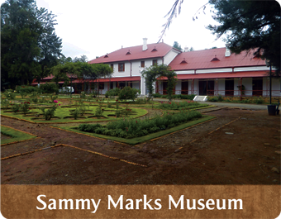

Slide 53
SUSPENSE ACCOUNTS
Finding | Action Plan | Due Date | Progress Report
Amounts in the clearing accounts not allocated on a monthly basis | Suspense accounts will be cleared monthly with the exception of unidentified deposits | Revised date of 15 May 2016 due to adjustments required for Financial Statements | Suspense accounts cleared monthly with the exception of unidentified deposits which cannot be cleared monthly due to time delays in identifying deposits. Monthly follow-ups on unidentified deposits are performed

Slide 54
LIABILITIES
ACCRUALS
DEFERRED REVENUE
Finding | Action Plan | Due Date | Progress Report
Accruals not included on the prior period error note | This has been adjusted in the AFS | 31 July 2015 | Task completed
Accruals are overstated as at year end | This has been adjusted in the AFS | 31 July 2015 | Task completed
Finding | Action Plan | Due Date | Progress Report
Deferred conditional grants with a debit balance. | This has been adjusted in the AFS | 31 July 2015 | Task completed

Slide 55
REVENUE MANAGEMENT
Finding | Action Plan | Due Date | Progress Report
Revenue from grants received incorrectly recognised as deferred income | This has been adjusted in the AFS | 31 July 2015 | Task completed
Completeness and accounting period of rental income could not be verified | The contract of this tenant has been terminated | 31 July 2015 | Task completed
Difference on rental amount disclosed on the financial statements | The deposit amount has been adjusted | 31 July 2015 | Task completed
No approved procedure manual for setting selling prices | A procedures manual will be developed to standardize setting of mark-up | 31 March 2016 | Procedure manual developed

Slide 56
TRADE AND OTHER RECEIVABLES
Finding | Action Plan | Due Date | Progress Report
Debtors reconciliations are not prepared | Debtors reconciliation performed | 1 5 April 2016 | Appointed debtors clerk to perform debtors reconciliation
Process of debtors’ collection not followed | A collection agency appointed Debtors and payments followed up |  | Specifications for a collection agency drafted and appointment by April 2016
Duplicate payments made to suppliers | Controls will be improved | 31 July 2015 | Task completed

Slide 57
ANNEXURE C: ADMINISTRATIVE MATTERS
Finding | Action Plan | Due Date | Progress Report
Fixed assets reconciliation not performed on a monthly basis | Reconciliations will be performed | Revised date 15 May 2016 due to adjustments required for Financial Statements | Asset register is currently being updated
Leave pay-out incorrectly calculated | Thorough internal control measures will be enforced. | 31 July 2015 | Task completed
Petty cash reconciliation not performed timeously | Reconciliations will be performed. | 31 March 2016 | Petty cash reconciliations currently being performed
SCM policy not in line with the Treasury Regulations and National Treasury instruction notes | The policy will be updated as and when the regulations and instruction notes are amended and/or introduced | 31 March 2016 | The revised SCM Policy approved

Slide 58
CHALLENGES AND MITIGATING FACTORS

Slide 59
CHALLENGES | INTERVENTIONS
GRAP 103 compliance | Prioritised as a key project by Council A project team has been appointed Collections are being categorised in terms of significance Fixed term and interns contracted to undertake inventory management of collections Sourcing a uniform database software for heritage assets Equipment purchased to digitise collections GRAP 103 Heritage policy approved Valuations of Library collections commenced
Staff Retention and the Budget Constraints | Development of DMSA Employer of Choice Strategy Bursaries offered to employees Training and Development Strategy and 5 year plan approved Recognition of Prior Learning program policy approved Remuneration, Integrated Performance Management Reward and recognition policies being developed
Permanent exhibitions | Conceptualisation and redesigning of two exhibitions, Three exhibitions are being constructed
Knowledge Management | Draft Knowledge management strategy and plan developed improve thought leadership role, research, relevancy to society, intellectual property and mitigate risks of succession planning,

Slide 60
CHALLENGES | INTERVENTIONS
Audit findings | ‘War room’ created by Council to ensure Risks and Issues raised in the AGSA Interim Audit Management letter are addressed timely to improve 2015/16 Audit comes, Progress report on audit remedial plan submitted to Council and DAC on quarterly basis Internal Audit will be assigned to give ARC and Council assurance on the remedial plan progress The use of ICT to modernise systems, services and controls being prioritised in working with SITA DAC to be engaged to help improve risk management environment
Litigation prone contract management | SCM policy revised to address contracting risks Forensic Audit commissioned Out of Court settlement has resolved a number of litigation matters, freeing facilities for revenue generations
Financial Sustainability | Improved planning to increase own revenue Adopted a two year plan on new and refreshing exhibitions Building partnerships with key stakeholders Implement market rates for use of facilities Implementing the approved integrated marketing and communication strategy
Agency of Department of Arts & Culture
60

Slide 61
CONCLUSION
Council and management commit themselves to improve on the strategies to address challenges which tend to lead to audit findings.

Slide 62
THANK YOU!!!
DITOSNG :NATIONAL MUSEUM OF NATURAL HISTORY

