Slide 1
SANBI ANNUAL PERFORMANCE PLAN 2016/17
Dr Tanya Abrahamse, CEO

Slide 2
SANBI DELEGATION
Mrs Nana Magomola, Board Chairperson: SANBI
Dr Tanya Abrahamse, Chief Executive Officer
Ms Carmel Mbizvo, Head of Branch: Biodiversity Science & Policy Advice
Dr Joseph Sebola, Chief Director: Biosystematics & Collections
Mr Alan Smith, Director: Finance

Slide 3
PRESENTATION OUTLINE
SANBI background and key information
Legislative, policy & mandate
SANBI’s role in brief
Mission, Vision & Goal
High-level Structure
Key Strategic Risks
Budget Estimates
SANBI’s Programmes (CSP 2015 -2020 and APP 2016/17)
Strategic Objectives, Performance Indicators and Targets

Slide 4
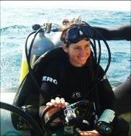
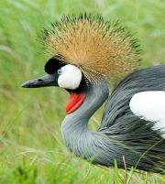
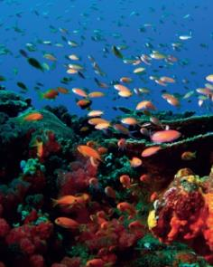
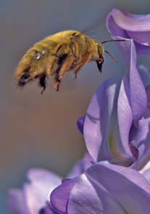
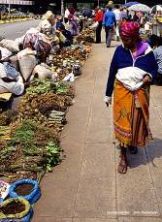
SANBI Vision Biodiversity richness for all South Africans

Slide 5
POLICY and LEGAL FRAMEWORK (source of mandate)
National Environmental Management: Biodiversity Act NEMBA (Act No 10 of 2004) | Gazetted
SANBI role in NEMBA Regulations: Threatened or Protected Species; CITES including the National Scientific Authority; Alien and Invasive Species | Gazetted
Obligations in the National Biodiversity Framework (NBF) -the five year plan from Cabinet approved 20 year vision the National Biodiversity Strategic Action Plan (NBSAP) 2015 to 2025 | Gazetted
Obligations in Minister’s Delivery Agreement – Outcome 10 and MTSF’s targets | Published / Parliamentary approved
The Climate Change Response White Paper – SANBI role in delivering Long Term Adaptation Scenarios for the bio-natural resources / designated National Implementing Entity (NIE) for the Global Adaptation Fund | Published/ Ministerial approved

Slide 6
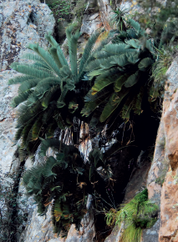
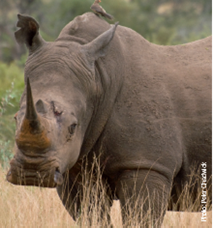
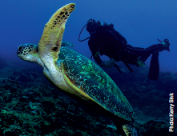
REPORTING ON DELIVERY OF MANDATE
Key mandate deliverables are reflected in 5 years Corporate Strategic Plan (CSP) & Annual Performance Plan (APP) and achievements are documented in Annual Report.
Governance Protocol agreement with DEA.
Progress report on APP is done quarterly and analysed and approved by DEA.

Slide 7
human wellbeing
improved service delivery
job creation
harnessing biodiversity value
investment in ecological infrastructure
ecosystem-based adaptation to climate change
streamlined environmental decision-making
WHAT WE INFLUENCE
SCIENCE INTO POLICY / ACTION:
information | planning | policy advice | models | tools
BUILDING BIODIVERSITY KNOWLEDGE:
assessments | status | trends | monitoring | modelling
GARDENS
windows on biodiversity
HUMAN CAPITAL DEVELOPMENT
WHAT WE DO
FOUNDATIONS OF BIODIVERSITY:
collections| taxonomy | inventory | maps | classification of ecosystems and species

Slide 8
SANBI’s contribution to DEA’s Outcomes
National Development Plan (NDP) desired 2030 outcome
Transition to a society & economy which is internationally competitive, equitable, job creating & sustainable
Medium Term Strategic Framework (MTSF) Sub-outcomes
ENVIRONMENTAL ECONOMIC CONTRIBUTION OPTIMISED Facilitate sustainable Socio- economic Growth & Development by catalysing, optimising & scaling up the contribution of the environmental sector to economic prosperity
ECOLOGICAL INTEGRITY
SAFEGUARDED & ENHANCED
Provide leadership in promoting & ensuring environmental sustainability through the management, utilisation, conservation, protection & valuing of our natural resources
SOCIALLY TRANSFORMED & TRANSITIONED COMMUNITIES
Drive socio-economic transformation & transition by optimising the fair & equitable sharing of benefits & enabling Social Development
GLOBAL AGENDA INFLUENCED & GLOBAL/LOCAL OBLIGATIONS MET
Enhanced international cooperation supportive of SA environmental /Social Development priorities
DEA Outcomes
GARDENS AS WINDOWS ON BIODIVERSITY
FOUNDATIONS OF BIODIVERSITY SCIENCE
BUILDING BIODIVERSITY KNOWLEDGE
SCIENCE INTO POLICY/ ACTION
HUMAN CAPITAL DEVELOPMENT
SANBI’s Contribution

Slide 9
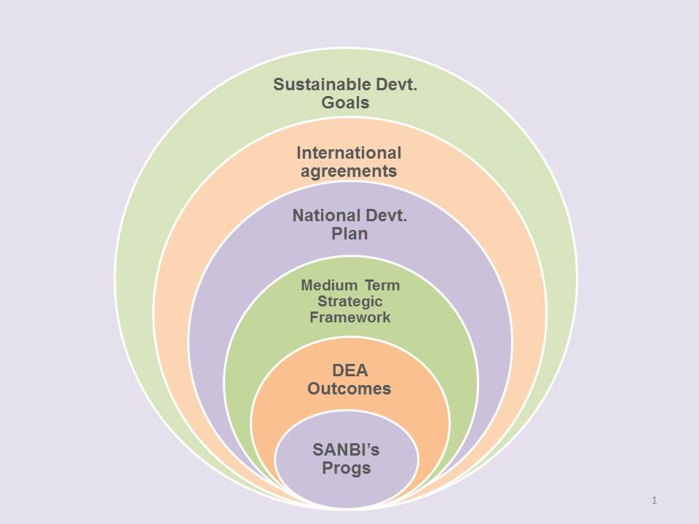
SANBI contribution to Sustainable Development Goals (SDGs) through national and international obligations
The figure below reflects how SANBI’s programmes contribute to national priorities and South Africa’s international obligations. These include the Convention on Biological Diversity (CBD); The United Nations Convention on Disertification (UNCD); the Convention on International Trade in Endangered Species (CITES); the Intergovernmental Platform on Biodiversity and Ecosystem Services (IPBES); the United Nations Framework Convention on Climate Change (UNFCCC); and the Sustainable Development Goals.

Slide 11
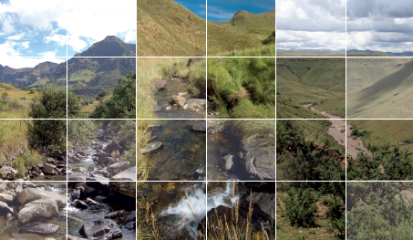
SANBI’s Strategic Goal
SANBI is positioned to lead the biodiversity sector of South Africa and is recognised as the first port of call for knowledge, information and policy advice on biodiversity.

Slide 12
SANBI’s Programmes
1: Render effective and efficient corporate services
2: Manage and unlock benefits of the network of National Botanical
Gardens as windows into South Africa’s biodiversity
3: Build the foundational biodiversity science
4: Assess, monitor and report on the state of biodiversity and increase knowledge for decision making including adaptation to climate change
5: Provide biodiversity policy advice and access to biodiversity information; and support for climate change adaptation
6: Provide human capital development, education and awareness in response to SANBI’s mandate

Slide 13
PROGRAMME 1 : Render effective & efficient Corporate Services

Slide 14
PROGRAMME 1 : Render effective & efficient Corporate Services
1.1: SANBI is positioned as an employer of choice in the biodiversity sector
Performance indicator | Baseline | 2016/17 target
Percentage of payroll allocated and spent on staff development | 2% of payroll allocated and spent on staff development. | 2% of payroll allocated and spent on staff development.
Transformed Institute that reflects the demography of South African population | Employment Equity Plan | 57% male staff on permanent and contract employment. 43% female staff on permanent and contract employment 3% People with disabilities on permanent and contract employment.

Slide 15
PROGRAMME 1 : Render effective & efficient Corporate Services (continue...)
1.2: Implement an effective, efficient and transparent supply chain and financial management system as regulated by PFMA
Performance indicator | Baseline | Annual target 2016/17
GRAP and PFMA compliant annual financial statements. | AFS produced for submission to Parliament. | Unqualified AFS produced to comply with PFMA and GRAP requirements.
1.3: Improved financial sustainability of the Institute
Percentage increase of income generated on rental, admission sales and other income. | New indicator. | 2% increase on own income.
1.4: Effective corporate services rendered to achieve the mandate of SANBI
Percentage availability of SANBI ICT network and ICT business services. | SANBI ICT network and business services are available. | 90% of ICT network and business services are available.
All identified risks managed through an annual risk assessment and implementation of the risk management plan. | Annual Risk Assessment completed | Updated, mitigated and monitored risks.
Compliance with all relevant Acts and SANBI/DEA protocol through implementation of the Compliance Framework. | SANBI is compliant with all relevant Acts including SANBI/DEA Protocol and regulations | Quarterly Performance report is monitored against the approved APP including PFMA, Cash and ENE reports on a quarterly basis by DEA according to specified time frames set out by the Department.

Slide 16
PROGRAMME 1 : Render effective & efficient Corporate Services (continue)
1.4: Building a compelling brand for all stakeholders
Performance indicator | Baseline | Annual target 2016/17
Number of marketing initiatives identified and utilised for SANBI promotion, profiling and external communication to stakeholders. | New corporate identity applied to approximately100% of SANBI collateral, SANBI attends exhibitions, shows and activations/ campaigns, secures concerts and events to continue profiling the Institute and its offerings | 4 Shows 4 Exhibitions 12 Concerts 12 Events and 4 Campaigns/Activations
Number of appropriate platforms utilised for internal communication. | Quarterly CEO’s letter, staff newsletter and competitions to ensure that staff is kept informed at all times. | 4 internal communication platforms

Slide 17
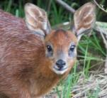
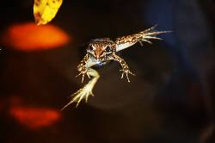
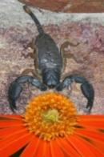
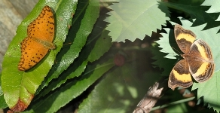
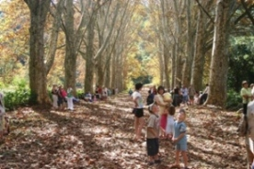
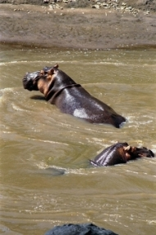
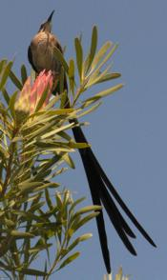
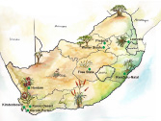
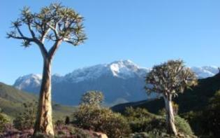
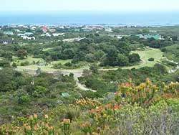
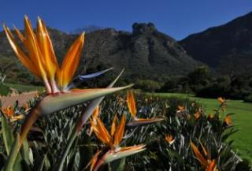
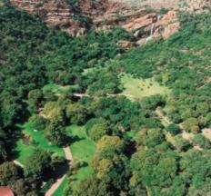
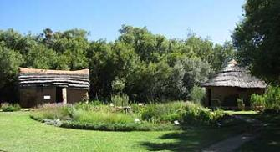
Windows to biodiversity

Slide 18
PROGRAMME 2: MANAGE AND UNLOCK BENEFITS OF THE NETWORK OF NATIONAL BOTANICAL GARDENS AS WINDOWS INTO SOUTH AFRICA’S BIODIVERSITY
2.1: A network of National Botanical Gardens are managed and maintained in order to realize benefits to SANBI, civil society and other relevant stakeholders
Performance indicator | Baseline | Annual target 2016/17
Increased representation and display of indigenous plants in the living collections of SANBI’s National Botanical Gardens or the Millenium Seed Bank Partnership. | Through involvement in implementation of the Convention on Biological Diversity (CBD), SANBI is contributing towards two international plant conservation initiatives (International Agenda for Botanic Gardens in Conservation (through Botanic Gardens Conservation International or BGCI) and the Global Strategy for Plant Conservation (GSPC), 2010 to 2020). Signed MoA with the Royal Botanic Gardens, Kew’s (UK) international Millennium Seed Bank Partnership (2011 to 2015) which contributes towards the implementation of specific targets (particularly Target 8) of the GSPC New Garden Records Database developed | 20 new indigenous plant species added to the living collections of the combined network of National Botanical Gardens and/or the Millenium Seed Bank Partnership.

Slide 19
PROGRAMME 2: MANAGE AND UNLOCK BENEFITS OF THE NETWORK OF NATIONAL BOTANICAL GARDENS AS WINDOWS INTO SOUTH AFRICA’S BIODIVERSITY (continue…)
2.1: A network of National Botanical Gardens are managed and maintained (continue…)
Performance indicator | Baseline | Annual target 2016/17
Number of new National Botanical Gardens established and operational | Gardens Expansion Strategy approved by the SANBI Board in November 2010 and submitted to DEA. Dedicated annual Gardens Expansion budget allocation made available to SANBI from DEA for the period 2013/14 to 2015/16 (R49.337 million) Dedicated infrastructure budget allocated to SANBI for the period 2013/14 to 2015/16 (R150million) Site identified for new national botanical garden in the Eastern Cape. Kwelera National Botanical Garden proclaimed by the DEA Minister on 25 July 2014 (Phase 1 of 2 phases).) MoA signed between SANBI, ECPTA and DEDEAT for the co-management of the Kwelera Nature Reserve as the natural portion of the proposed Kwelera National Botanical Garden. EPWP allocations earmarked by DEA for new gardens planned for the Eastern Cape (R30 million) and Limpopo (R20 million) Provinces. | Implementation of the MoA between SANBI and LEDET for the management of the new national botanical garden in the Limpopo Province.
 |  | Implementation of the Kwelera Nature Reserve Management Plan between SANBI and ECPTA for the management of the Kwelera National Botanical Garden in the Eastern Cape.

Slide 20
PROGRAMME 2: MANAGE AND UNLOCK BENEFITS OF THE NETWORK OF NATIONAL BOTANICAL GARDENS AS WINDOWS INTO SOUTH AFRICA’S BIODIVERSITY(continue…)
2.1: A network of National Botanical Gardens are managed and maintained (continued..)
Performance indicator | Baseline | Annual target 2016/17
Number of maintenance, development and capital infrastructure projects completed across SANBI’s National Botanical Gardens. | Ten National Botanical Gardens with associated SANBI estates, infrastructure and living collections (biological assets), located in seven provinces. | 45 maintenance/ development projects and two (2) SANBI capital infrastructure projects completed.
2.2: Nature-based tourism and recreational activities are strengthened in all National Botanical Gardens in order to contribute to and support SANBI’s sustainability
Performance indicator | Baseline | Annual target 2016/17
Percentage visitor numbers increased through expanded tourism-related activities and events in National Botanical Gardens | - External review conducted of commercial operations across SANBI’s national botanical gardens. - Business skills training given to Curators of SANBI’s National Botanical Gardens. 1,813,019 visitors received by all National Botanical Gardens. | Minimum of two percent (2%) annual increase in visitor numbers

Slide 21
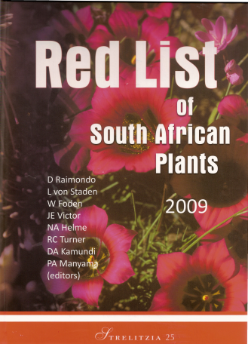
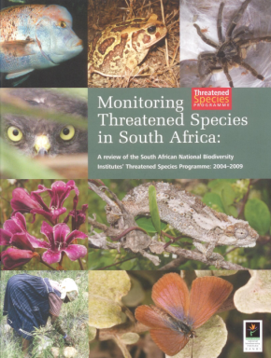
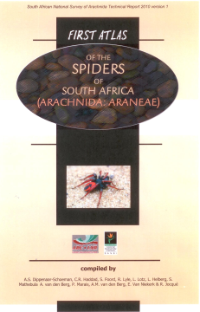
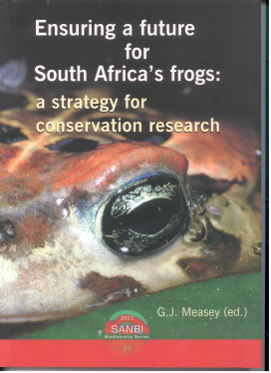
Science-based evidence

Slide 22
PROGRAMME 3: BUILD FOUNDATIONAL BIODIVERSITY SCIENCE
3.1: Foundational biodiversity information is developed through describing and classifying species and ecosystems in South Africa
Performance indicator | Baseline | Annual target 2016/17
Number of plant and animal species for which descriptive and classification information has been compiled | SANBI is co-ordinating the compilation of an e-flora and an e-fauna which will provide information about South Africa’s species | Information on 4,200 South African plant and 1,000 animal species compiled.
Number of ecosystem classification systems and maps developed for the National Biodiversity Assessment | A classification system for terrestrial ecosystems is in place based on the vegetation map and a classification for wetlands has been published | Actions and plans to finalise ecosystem classification systems and maps, as approved by the National Committee, completed (for terrestrial, fresh water, estuarine and marine realms)
Number of quality controlled records for plant specimens in SANBI’s herbaria, and for animal specimens in museums or based on observations, added to databases. | A foundational biodiversity information programme has been implemented together with DST/NRF to generate information. Comprehensive datasets for butterflies, spiders and reptiles compiled through the Threatened Species Programmes Red Listing projects. Approximately 1,270,000 quality controlled records for South African plant specimens in SANBI’s herbaria have been databased. | 12,000 records added to plant database; 35, records added to animal database.

Slide 23
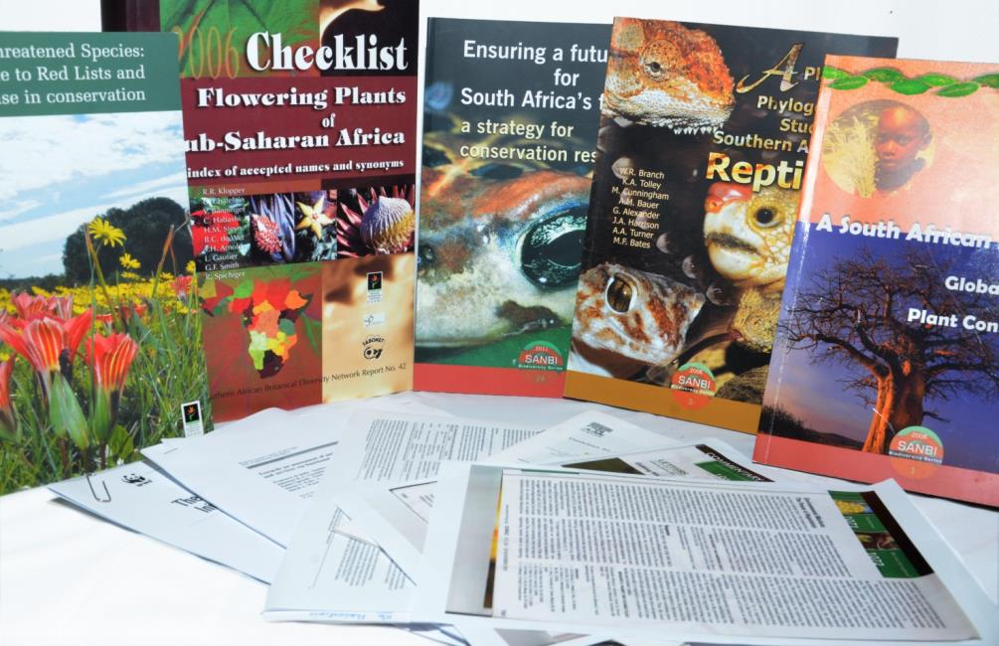
Access to biodiversity information
Since 2004, SANBI has produced 2700 articles, including 1115 peer reviewed papers, 81 books, and >1000 popular articles

Slide 24
PROGRAMME 4: ASSESS, MONITOR AND REPORT ON THE STATE OF BIODIVERSITY AND INCREASE KNOWLEDGE FOR DECISION MAKING (INCLUDING CLIMATE CHANGE)
4.1: New biodiversity knowledge created for decision making.
Performance indicator | Baseline | Annual target 2016/17
Number of research papers published in ISI journals | 80 papers published in 2015/16. | 75 publications. Biosystematics: 20 publications Biodiversity Research Assessment and Monitoring 55 publications

Slide 25
PROGRAMME 4: ASSESS, MONITOR AND REPORT ON THE STATE OF BIODIVERSITY AND INCREASE KNOWLEDGE FOR DECISION MAKING (INCLUDING ADAPTATION TO CLIMATE CHANGE) continued…
4.2: Scientific evidence on the status of biodiversity (based on monitoring and assessment including that of biodiversity loss) and the risks and benefits, is provided
Performance indicator | Baseline | Annual target 2016/17
Number of national scientific synthesis & assessment reports produced | - The National Biodiversity Assessment was published in 2011 - A framework for GMO monitoring was produced in 2009 | - NBA 2018 operational plan meeting targets agreed to by the Core Reference Group and Steering Committee - National Invasive Species Report (NISR) 2017 initiated and data acquisition plan implemented GMO monitoring plan submitted - One Red List Assessment (spiders) completed and Core Reference Group approved, report workplan approved -Test data analysis for National Invasives report -Monitoring plan for GMOs
Number of annual updates of non detriment findings for the Scientific Authority to support NEMBA regulations | 12 NDF assessments were completed for the Scientific Authority, representing ca. 60% of prioritised taxa. | One update for Non-Detriment Findings for the Scientific authority
Number of large (>R2 million) cooperative research and assessment programmes that have delivered knowledge and data | Three large research and assessment programmes running or stated, based on external funding and utilizing the managed network to generate knowledge and data (SEAKEYS, invasive species programme, BioGAP) | Three large research and assessment programmes initiated (SEAKEYS, invasive species programme, BioGAP)

Slide 26
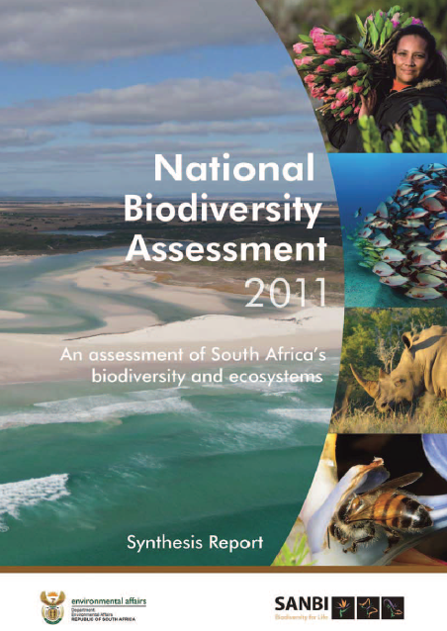
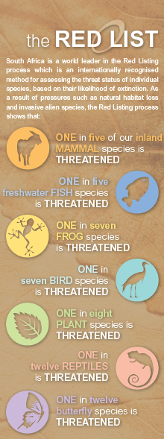
Provide policy tools & advice

Slide 27
PROGRAMME 5: PROVIDE BIODIVERSITY POLICY ADVICE AND ACCESS TO BIODIVERSITY INFORMATION AND SUPPORT FOR CLIMATE CHANGE ADAPTATION
5.1: Tools to support management and conservation of biodiversity developed and applied
Performance indicator | Baseline | Annual target 2016/17
Number of tools and knowledge resources developed to support mainstreaming of biodiversity assets and ecological infrastructure in production sectors and natural resource Management. | Tools developed include, e.g: Framework for Investments in Ecosystem Services; guidelines for Grasslands Biodiversity; Toolkit; Mining and Biodiversity Guidelines, etc. | Two tools produced, including an Ecosystem Restoration Decision Support Tool and an Online User Tool for accessing biodiversity information.
 | Seventeen knowledge resources for demonstrating the value of biodiversity developed and disseminated; Making the Case Implementation Strategy and Making the Case: Case Study Development Toolkit developed. | Three knowledge resources developed and disseminated.
Number of coordination or learning mechanisms convened to share lessons and build capacity among provincial, municipal or other relevant decision makers. | The following learning or coordination events convened: Biodiversity Planning Forum, Grasslands Partners Forum, Land Reform and Biodiversity Stewardship Learning Exchange, MPAH Forum, CAPE Partners Forum, Africa Rising and Freshwater Ecosystem Network. | Four learning or coordination events convened.
 | Three training sessions held per year for provincial, municipal or other relevant decision-makers on uptake of tools. | Four training sessions convened

Slide 28
PROGRAMME 5: PROVIDE BIODIVERSITY POLICY ADVICE AND ACCESS TO BIODIVERSITY INFORMATION AND SUPPORT FOR CLIMATE CHANGE ADAPTATION (continue..)
5.2: Access to biodiversity data, information and knowledge provided
Performance indicator | Baseline | Annual target 2016/17
Number of biodiversity records published. | 12, 908,214 records published. | An increase of 50 000 records published.
5.3: Scientific advice to support national and international policy processes provided
Percentage of policy requests from DEA, provinces, municipalities and other organs of state responded to within timeframe stipulated in the request. | Support provided to DEA on: Listing of threatened terrestrial ecosystems ; listing of threatened river ecosystems developed as part of the NBA 2011; etc. | 100% of written requests from DEA and other organs of state responded to within timeframe stipulated.

Slide 29
PROGRAMME 5: PROVIDE BIODIVERSITY POLICY ADVICE AND ACCESS TO BIODIVERSITY INFORMATION AND SUPPORT FOR CLIMATE CHANGE ADAPTATION (continue..)
5.4: Policy support on climate change adaptation provided to inform national and international decision making
Performance indicator | Baseline | Annual target 2016/17
An effective National Implementing Entity to the Global Adaptation Fund shares lessons and experiences on a number of national and international platforms to inform climate change adaptation policy. | Two Adaptation Fund projects approved by the Adaptation Fund; NIE lessons and experiences shared at seven NIE Steering Committee meetings, seven international and seven national meetings. | Lessons and experience from NIE projects captured to inform two (2) national and two (2) international platforms on climate change adaptation Policy.
Number of biodiversity sector tools into which Climate Change Adaptation has been mainstreamed. | Draft Strategic Framework for Ecosystem Based Adaptation developed collaboratively. | A Biodiversity tool into which Climate Change Adaptation will be incorporated is identified.

Slide 30
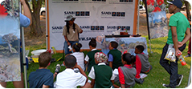
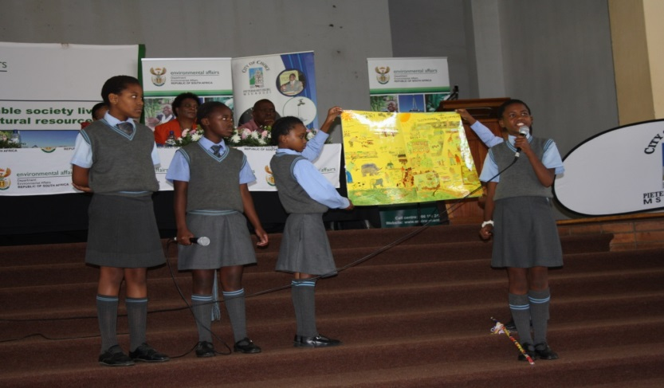
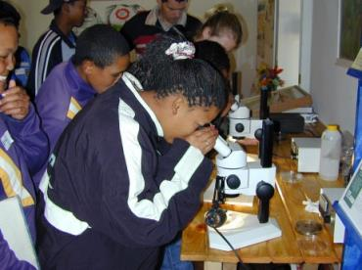
PROGRAMME 6: PROVIDE HUMAN CAPITAL DEVELOPMENT, EDUCATION AND AWARENESS IN RESPONSE TO SANBI’S MANDATE

Slide 31
PROGRAMME 6: PROVIDE HUMAN CAPITAL DEVELOPMENT, EDUCATION AND AWARENESS IN RESPONSE TO SANBI’S MANDATE
6.1: A transformed and suitably skilled workforce for the biodiversity sector is developed.
Performance indicator | Baseline | Annual target 2016/17
Number of black biodiversity professionals developed through human capital development initiatives including structured internships, post graduate studentships and fellowship programme for the achievement of a transformed and skilled workforce in the biodiversity sector. | 930 black professionals developed through human capital development initiatives including structured internships, post graduate studentship and fellowship programme for the achievement of a transformed and skilled biodiversity workforce. | 92 professionals developed through structured internships, post graduate studentships.
Number of beneficiaries participate in the Biodiversity Careers Programme aimed at attracting young people into the biodiversity sector. | 3337 beneficiaries participating in Biodiversity Careers Programme aimed at attracting young people into the biodiversity sector. | 1000 beneficiaries participate in Biodiversity Careers Programme.

Slide 32
PROGRAMME 6: PROVIDE HUMAN CAPITAL DEVELOPMENT, EDUCATION AND AWARENESS IN RESPONSE TO SANBI’S MANDATE (continued…)
6.2: All national botanical gardens are promoted and used as platforms for biodiversity awareness, education and recreation.
Performance indicator | Baseline | Annual target 2016/17
Number of users and beneficiaries of botanical gardens and school-based programmes for education, awareness, training and recreation have been increased. | 40 000 beneficiaries reached through school group activities predominantly garden based. | 50 000 beneficiaries of garden and school-based have been reached.
6.3: Civil society is engaged to contribute to science, monitoring and biodiversity conservation.
Number of platforms facilitated for civil society engagement that contribute to biodiversity monitoring and biodiversity conservation. | 3 platforms developed and supported for plants (CREW), birds (SABAP) and general biodiversity (iSpot) | Three platforms strengthened and facilitated.

Slide 33
Budget Estimates Overview
 | R’000
Income | 475 348
Operational MTEF | 256 151
Infrastructure MTEF | 63 180
Projects Income | 78 871
Internally Generated Income* | 77 146
Expenses | (475 348)
Surplus/(Deficit) | NIL
* Internally generated income: Primarily gate admission fees and rentals.

Slide 34
Budget Estimates Spending Allocations
 | R’000
Employees | 247 162
Opex | 87 860
Infrastructure | 63 180
Projects | 77 146
Total Spending | 475 348

Slide 35
Budget Estimates Employee Costs
 | R’000
Gardens | 111 227
Research, Policy & Knowledge Management | 81 699
HR | 9 517
Marketing | 5 209
CEO & AA Costs | 3 780
Corporate Services | 11 877
Finance | 15 664
Group | 8 185
Total Employee Costs | 247 161

Slide 36
Budget Estimates Employee Costs - Group
 | R’000
Performance Bonus (capped at 1.5% of Employee Costs) | 3 633
Awards (Merit & Long Service) | 300
Career Ladder | 750
Notch Increases | 451
Temp Staff | 1 500
Total Group Costs | 8 185

Slide 37
Budget Estimates Operating Expenditure
 | R’000
Gardens | 23 695
Research, Policy & Knowledge Management | 20 849
HR | 11 070
Marketing | 4 393
CEO & AA Costs | 1 054
Corporate Services | 17 572
Finance | 2 372
Group* | 6 853
Total Opex | 87 860
* Group costs: Insurance and Audit Expenses

Slide 38
Budget Estimates Overall Spending
 | R’000
Gardens | 172 246
Research, Policy & Knowledge Management | 192 551
HR | 20 587
Marketing | 9 602
CEO & AA Costs | 4 834
Corporate Services | 29 449
Finance | 18 037
Group* | 25 038
Total Opex | 475 348
* Group costs: Staff awards, career ladder, insurance, audit expenses and performance bonus (capped at 1.5% of employee costs)

Slide 39
Strategic Risks
 | Risk Description | Causal Factor | Mitigating Controls
1. | Insufficient MTEF funding from national government | 1. Budget cuts 2. Change in government priorities and so funding 3. Late and insufficient monitoring of the budget 4. Allocated budgets not spen 5. Internal budgeting allocation and distributions between Divisions/ Programs | 1. Alternative income 2. International sponsorships 3. Donations 4. National sponsorships 5. Bequests 6. Admission fees 7. Events 8. Project implementation 9. CSP and business plans approved by government and APP submitted in a timely manner. 10. Mandate aligned with the Act 11. Motivate to achieve mandate (budgeting)
2. | Inadequate and failure of critical ICT infrastructure and services | 1. Insufficient funding 2. Non alignment to business requirements 3. Insufficient bandwidth 4. Insufficient infrastructure capacity (Disc space, servers) 5. Dependence on external service providers 6. Cyber crime vulnerability | 1. Leveraging on SANReN investment 2. Upgraded internal networks 3. Back-ups monitored 4. IT Steering Committee strategic advice 5. Third party support for specialised services 6. Disaster Recovery Plan and Business Continuity Plan 7. Aligned with COBIT and ITIL, Prince 8. Virtual private networks

Slide 40
Strategic Risks continues..
 | Risk Description | Causal Factor | Mitigating Controls
3. | Shortage of skilled capacity in key areas | MTEF Funding limitation Limitations for meeting Equity targets Limitation of internal mentorships 4. Legacy issues | 1.Managed network 2. Accelerated equity plan 3. Career ladders 4. Internal HDC training 5. Workforce plan 6. Mentorships Internal and external 7. Further studies program 8. Post doctorate program 9. Partner organisations utilised 10. Delivery and Skills transfer through the Partner organisations e.g GreenMatter
4. | Negative impact on horticultural collections in the gardens due to Water shortage | 1. The dryness associated with climate change 2. Dysfunctional boreholes and water pumps 3. Dependence on municipal water 4. Municipal restrictions on water usage 5. Abuse of water resources 6. Leaking water systems | 1. Ensure limited water usage 2. Install boreholes 3. Efficient use of sprinkler irrigation systems 4. Encourage water-wise gardening 5. Catch rainwater in tanks and dams 6. Maintenance of plumbing and water equipment

Slide 41
Strategic Risks continues..
 | Risk Description | Causal Factor | Mitigating Controls
5. | Fire hazard on thatch roofed buildings and horticultural/ herbarium collections in NBG’s | The dryness associated with climate change Faulty electrical installations Human negligence Non adherence to guidelines of the use of gas and electrical heaters Incorrect storage and use of chemicals Weak water pressure from the water hose reels connected to the water tanks. Lack of fire and smoke detecting devises | Fire hydrants installed Lightning conductors installed Occupational Health And Safety training and awareness communication HIRA conducted Management of field fire breaks Cooperation with municipal fire fighting authorities Participation in ‘Working on Fire” programmes with NGO’s Fire suppression system installed Staff training of handling fire hazards Fire drills

Slide 42
Strategic Risks continues..
 | Risk Description | Causal Factor | Mitigating Controls
6. | Disruption of SANBI Services due to electricity shortages | Power outages | Installation of power generators Installation of energy saving light bulbs Installation of heat pumps Use of solar panels Gardens participating in the national Department of Tourism’s renewable energy retro fitment pilot project (and into the future) 7. Staff encourages via signage to switch lights off. 8. Installed motion sensors to deactivate lights in certain buildings Monitoring of electricity encourages staff to use electricity wisely

Slide 43
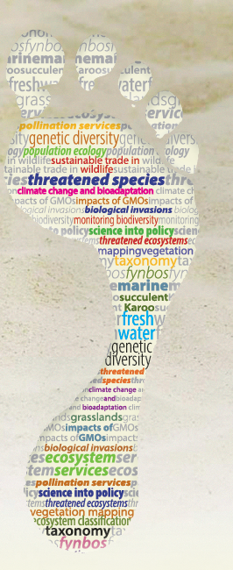
Thank You

