Slide 1
THE PERFORMING ANIMALS PROTECTION (PAPA) AMENDMENT BILL (B9-2015)
PRESENTATION TO THE
SELECT COMMITTEE ON LAND AND MINERAL RESOURCES
DEPARTMENT OF AGRICULTURE, FORESTRY AND FISHERIES
12 APRIL 2016

Slide 2
OUTLINE
Acronyms
Introduction
Development of the Bill
Technical Amendments
Consultation Process
Financial Implications
Recommendations

Slide 3
ACRONYMS

Slide 4
Introduction
The Performing Animals Protection Act (PAPA), 1935, (Act No. 24 of 1935) is among the legislations previously administered by the then Department of Justice. It was transferred to the Department of Agriculture, Forestry and Fisheries (DAFF) since it dealt with animals;
The constitutionality of sections 2 and 3 of the PAPA, was challenged by the National Society for the Prevention of Cruelty to Animals (NSPCA) during 2012;
Sections 2 and 3 provide for delegative powers which set Magistrates as having the authority for issuing licences for performing animals (animals used in circuses, movies, dogs for safe guarding etc.) to respective industries;
On the 11th of July 2013, the Constitutional Court of South Africa declared sections 2 and 3 of the PAPA to be unconstitutional; and ordered the Parliament to remedy the defect within 18 months.
The Court’s finding was that the issuing of licences is an administrative function that should be performed by the Executive and not by the Judiciary.

Slide 5
Introduction
The Department noted the Constitutional Court Judgement and initially considered the implications and explored three options:
Option 1: Considering the technical amendments to the existing PAPA focusing only on sections 2 and 3; or
Option 2: Considering a total repeal of the aforementioned Act, and a replacement with new Animal Welfare Act; or
Option 3: Considering a total repeal APA and PAPA and consolidating them into one Animal Welfare Act.
A total repeal of all animal welfare related Acts will require substantive period of time, therefore the preferred option was Option 1 which only considered technical amendments to the existing Performing Animal Protection Act, 1935 (Act 24 of 1935) focusing on sections 2 and 3 – the advantage of this option lies in its remedying the Constitutional Judgement quicker than the other options.
The implementation of Option 1 was adopted as it would assist the Parliament to comply with the Constitutional Court judgement.
The Bill was developed in consultation with State Law Advisors.

Slide 6
The aim of the Bill
In a nutshell the Bill proposes that:
The functions of issuing licences previously performed by the Magistrates are to be delegated to the Provincial State Veterinary Office or any office of the Department of Agriculture, Forestry and Fisheries with Animal Scientists in the same Magisterial area.
Objectives of the Bill:
To amend PAPA so as to insert certain definitions; to provide for the designation of a National Licensing Officer; to provide for a procedure for the application for a licence, to provide for the functions of a National Licensing Officer; to provide for the issuance of licences; to provide for an appeals process; and to provide for matters connected herewith.

Slide 7
TECHNICAL AMENDMENTS
Clauses 1 and 2: Repeal of sections 2 and 3, respectively.
These clauses deal with Magistrates issuing licences for the exhibition and training of performing animals and for the use of dogs for safeguarding.
These clauses were declared unconstitutional by the Constitutional Court on the basis that a member of the Judiciary should not be performing administrative actions that are supposed to be performed by the Executive.

Slide 8
TECHNICAL AMENDMENTS
Clause 3: Insertion of sections 3A to 3P
This clause sets out a procedure for the granting and issuing of licences and matters connected therewith, thereby ensuring compliance with the Constitu­tional Court judgment.
This clause further provides for the designation of a National Licensing Officer, the qualiﬁcations and functions of the National Licensing Officer, the appointment of experts to assist the National Licensing Officer, delegation of powers and functions by the National Licensing Officer.

Slide 9
TECHNICAL AMENDMENTS
Clause 3: Insertion of sections 3A to 3P
The clause also provides for a procedure for the consideration and granting of applications for licensing, the duration of the licence, the process for the application of a licence, the hearing of applications, the process for the issuing of licences, the process for the withdrawal of licences and the validity of a licence.
Furthermore, the clause provides for an appeals process, whereby the Minister may either consider an appeal or constitute a board (i.e. the Appeal Board) to make recommendations about a decision or action by the National Licensing Officer. The Minister may confirm, set aside or vary the decision of the National Licensing Officer.

Slide 10
TECHNICAL AMENDMENTS
Clause 4: Amendment of section 4
The clause is a consequential amendment whereby references to the word “dog” or “dogs” in the current PAPA are substituted for the word “animal” or “animals”, where relevant.
This amendment is aligned to the amended definition of “use for safeguarding” in the Bill, to extend the definition of “use for safeguarding” (once the Bill is enacted) to “animals”, as opposed to only dogs, as originally defined in the PAPA.

Slide 11
TECHNICAL AMENDMENTS
Clause 5: Amendment of section 5
This clause seeks to amend section 5 of the PAPA to increase the fine and period of imprisonment for a person who wilfully obstructs, delays or otherwise interferes with a police officer’s duties, granted in the PAPA.
This clause substitutes the outdated penalties in the original PAPA with more contemporary penalties,
The clause proposes that upon conviction, a fine not exceeding R20 000 or an imprisonment for a period not exceeding five years.

Slide 12
TECHNICAL AMENDMENTS
Clause 6: Amendment of section 7
The clause provides for the amendments section 7 of the PAPA by deleting any reference to “dogs” (i.e. as a consequential amendment of the amendment of the definition of “use for safeguarding”)
It also inserts additional empowering provisions that would authorise the Minister to make regulations in relation to the manner in which a person may appeal,
The fee to be paid by a person who appeals and
The remuneration to be paid to a member of the Board.

Slide 13
TECHNICAL AMENDMENTS
Clause 7: Amendment of section 8
This clause seeks to amend section 8 of the PAPA that relates to penalties to substitute the outdated penalties in the original PAPA with more contemporary penalties;
Upon conviction, a fine not exceeding R20 000 or imprisonment for a period not exceeding five years.

Slide 14
TECHNICAL AMENDMENTS
Clause 8: Amendment of section 11
This clause seeks to incorporate additional definitions into the Act that are consequential to the revised procedure adopted for the granting and issuing of licences.
The following definitions have been inserted:
‘‘Animal Scientist’’, “Board”, “head of department”, ‘‘National Licensing Officer’’, “officer” and ‘‘Veterinarian’’. Furthermore, the definition of “use of safeguarding” has been amended to extend the definition of “use for safeguarding” (once the Bill is enacted) to “animals”, as opposed to only dogs, as originally defined in the PAPA.

Slide 15
TECHNICAL AMENDMENTS
Clause 9: Insertion of section 11B
This clause provides for transitional arrangements and states that a licence issued in terms of the repealed sections 2 or a certificate issued in terms of the repealed section 3 of the PAPA, is deemed to have been issued in terms of the proposed new section 3J, as inserted by clause 3 of the Bill.
It further provides for anything done before the commencement of the Bill (once it becomes enacted), is to be processed and finalised as if sections 2 and 3 of the PAPA had not been repealed.

Slide 16
TECHNICAL AMENDMENTS
Clause 10: Amendment of certain expressions
Clause 10 is a consequential amendment whereby the expressions “a dog for safeguarding”, “any dog for safeguarding” and “dogs for safeguarding”, wherever it occurs in the PAPA, have been substituted with the relevant expressions “an animal for safeguarding”, “any animal for safeguarding” and “animals for safeguarding”.
This amendment is aligned to the amended definition of “use for safeguarding” in the Bill, to extend the definition of “use for safeguarding” (once the Bill is enacted) to “animals”, as opposed to only dogs, as originally defined in the PAPA

Slide 17
TECHNICAL AMENDMENTS
Clause 11: Short title
This clause provides that the short title of this Act, upon its enactment, is the Performing Animals Protection Amendment Act, 2016, which comes into operation on a date ﬁxed by proclamation in the Gazette.

Slide 18
CONSULTATION PROCESS
Draft bill was Gazetted in April 2014, and written comments were received from:
The South African Institute for Advanced Constitutional, Public, Human Rights and International Law: A Centre of the University of Johannesburg (“SAIFAC”);
Western Cape Government, Directorate: Legislation;
The Humane Education Trust;
The Dog Club;
Love South African Circus;
The Licensed Animal Trainers’ Association;
The Animal Anti-Cruelty League;
The South African Federation of Sledding Sports;
Commercial Producers Association of South Africa;
SA National Bird of Prey Centre;
SA Dog Academy and
The National Society for the Prevention of Cruelty to Animals.

Slide 19
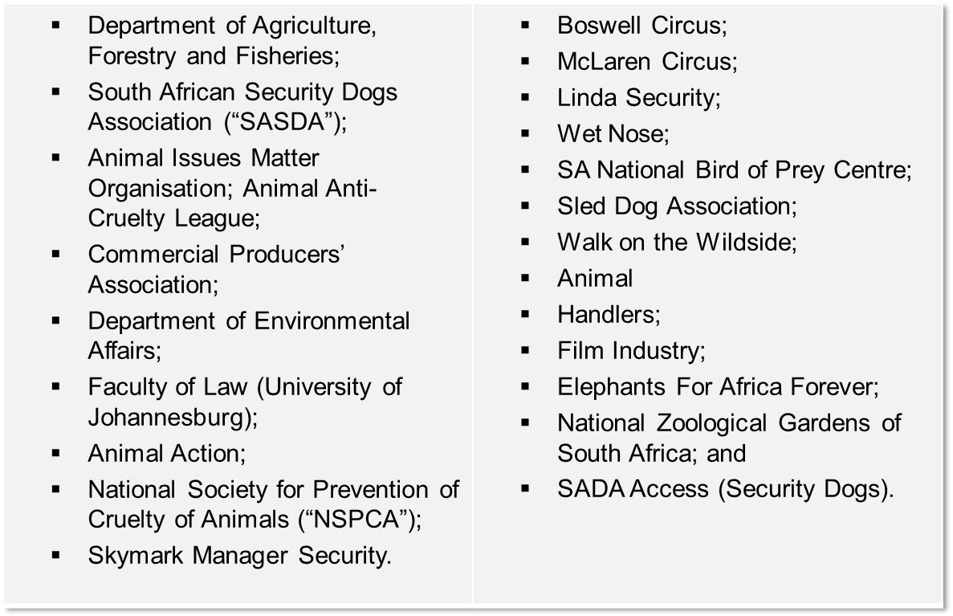
STAKEHOLDER CONSULTATIVE WORKSHOP: 16 May 2014

Slide 20
PARLIAMENTARY PROCESS
The Parliament started processing the Amendment Bill in March 2015.
The Portfolio Committee (PC) on Agriculture, Forestry and Fisheries called for written comments in April 2015.
PC also held public hearings in May 2015.
The Departments responded positively to concerns raised by the stakeholders.

Slide 21
STAKEHOLDERS CONCERNS
Stakeholders expressed concerns over some exemption: -the following Animals are exempted from PAPA licence:
Animals for military training
Animals for police training
Animals for sporting purposes
Animals for agricultural shows
Show horses
Show dogs
Show caged birds
Military or police tournaments/exhibitions
Gymkhanas
Safeguarding dogs by the South African Defence or the South African Police or the Prisons Service
Public Zoological Gardens

Slide 22
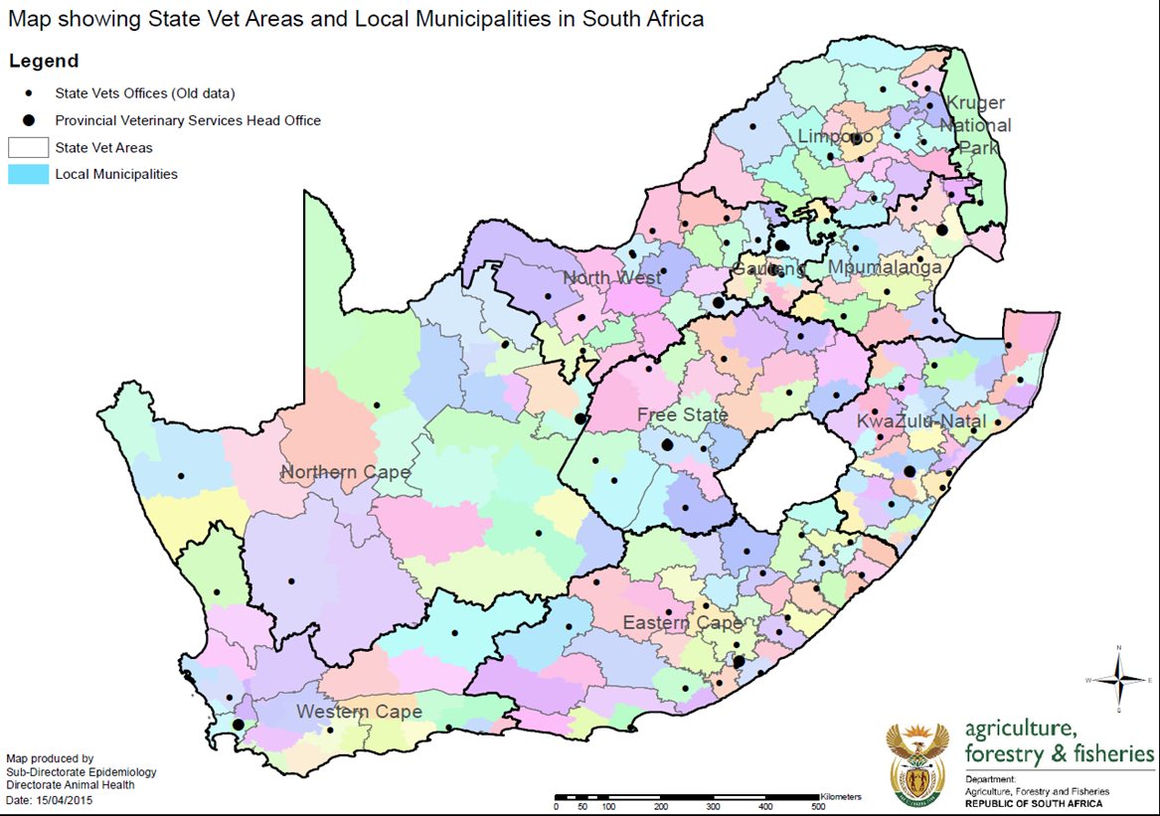
STAKEHOLDER CONCERNS
There was a concern on the capacity of DAFF to carry the functions, and the location of State Veterinarians and Animal Scientists

Slide 23
OUTCOMES OF STAKEHOLDER CONSULTATIONS
Other concerns raised included:
Mandate to issue licenses DAFF or NSPCA?
PAPA & APA outdated?
Exemptions for a PAPA licence?
Capacity within DAFF to implement licencing?
Selection and expertise of the appeals board?
Turn around time for PAPA licences?
As a way forward, a holistic Animal Welfare Strategic Framework in response to the short-term and long-term animal welfare matters has been drafted and is currently being consulted.
In this regard, a comprehensive “modern” Animal Welfare Bill is envisaged and this Bill will repeal and substitute all old Animal Welfare laws.

Slide 24
FINANCIAL IMPLICATION
In the short term, DAFF and the Provincial Departments of Agriculture will reprioritised the existing resources in order to accommodate the new functions. Departments will be encouraged to utilise existing State Veterinarians and Animal Scientists in different municipal districts;
However, the outer years will have to cater for the new component on Animal Welfare and an estimated budget of R54 million has been envisaged to carry the operations and the structure of the:
National Licensing Officer;
Technical Staff (State Veterinarians, Animal Scientist); and
Administrative Staff.
Notes:
t

Slide 25
RECOMMENDATION
It is recommended that the Select Committee on Land and Mineral Resources:
Take note of the Bill, and after due consideration, approves the Performing Animals Protection Amendment Bill
and
Recommends the Bill to President to be signed into law.
Notes:
t

Slide 26
Thank you

