Slide 1
ANNEXURE
ORGANISATIONAL STRUCTURE: DEPARTMENT OF WOMEN

Slide 3
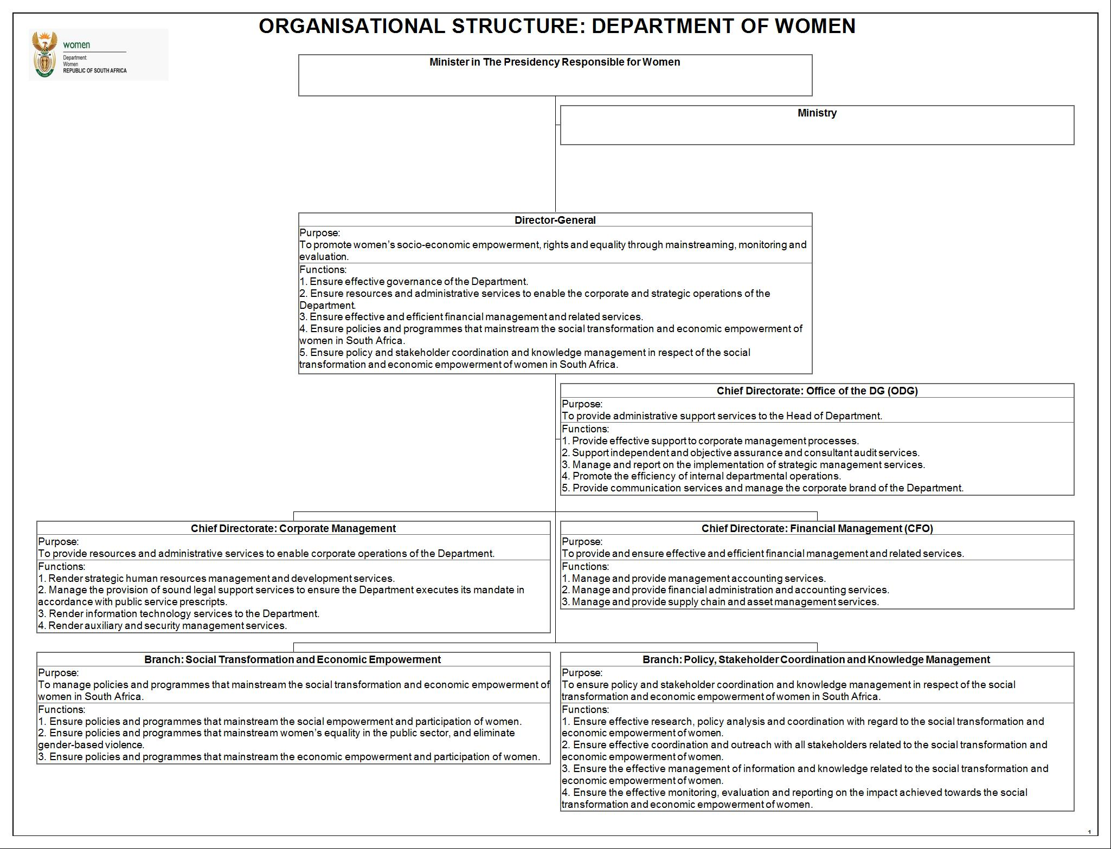

Slide 10
