Slide 1

Briefing by DPME on the Strategic Plan and 2016/17 APP of Department of Agriculture, Forestry and Fisheries
A presentation to the
Portfolio Committee on DAFF
Dr Tsakani Ngomane
Outcome Facilitator: Rural Development
08 April 2016

Slide 2
Purpose
To brief the Committee on DPME’s assessment of DAFF’s Strategic Plan and the Annual Performance Plan 2016/17 as tabled on the 10th March 2016.
Specific areas of focus are as follows:-
Alignment of SP and APP with objectives of the NDP and priority outcomes in MTSF 2014-19
Technical Compliance with National Treasury Regulation in the compilation of the SP and APP

Slide 3

2009-2014
MTSF: 2014-2019
2019-2024
2024-2029
Notes:
The Development Indicators publication is one of our key sources for tracking progress towards achievement of the National Development Plan (NDP) Vision 2030, on annual basis. Whereas the production of this publication predates the adoption by our country of the NDP 2030, the majority of indicators identified at the outset and tracked since then, remain pertinent to the present. This 2014 publication is useful in many respects. It is the first to be produced since government published the 20-year review in 2014, and thus further enriches the evidence-base that informs the design and delivery of our socio-economic development programmes.
The socio-economic development programmes implemented in partnership with all key stakeholders, and therefore have to be monitored and evaluated jointly with all our partners. Your presence here today fellow South Africans, to join hands with us as we take stock of milestones recorded to date, is of utmost importance.

Slide 4
National Development Plan (NDP)
The NDP serves as the umbrella for the cross-cutting strategies i.e., New Growth Path, Industrial Policy Action Plan and other government plans
Through the development of the Medium-term Strategic Framework (MTSF), critical actions and key outputs aimed at putting the country on a positive trajectory towards achievement of the NDP were identified for delivery by departments over the period 2014-19
The MTSF has key performance targets and indicators from the NDP to be achieved by Government over the 5yr period
Therefore, DAFF’s strategic plan should be grounded in the MTSF 2014-2019

Slide 5
Chapter 6 of NDP highlights Agriculture Potential
Agriculture’s Potential = 1 Mil New Jobs by 2030 through:
Expanding irrigated agriculture—1,5 Mil ha expanded by at least another 500 000 ha to 2 Mil ha;
Cultivating under-utilised land in communal areas and land reform projects for commercial production;
Supporting agricultural industries and regions with the highest growth and employment potential;
Supporting upstream and downstream job creation;
Finding creative opportunities for collaboration between commercial and communal farmers and complementary industries;
Developing strategies that give new entrants access to value chains

Slide 6
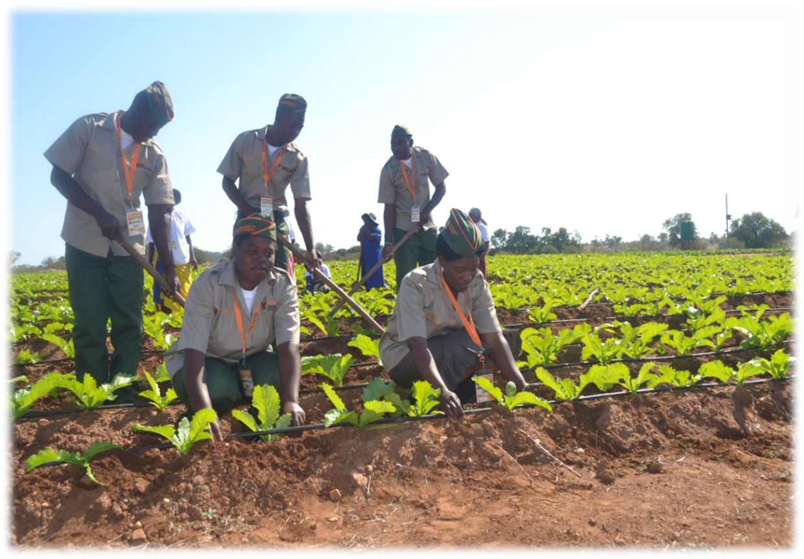
Outcome 7: Comprehensive Rural Development and food security (MTSF 2014-19)

Slide 7
Outcome 7 seeks to implement Chapter 6 of the NDP through 6 sub-outcomes
      1: Improved land administration and spatial planning for integrated development in rural areas
      2: Sustainable land reform contributing to agrarian transformation
      3: Improved food security ( DAFF Led)
      4: Smallholder producers’ development and support (technical, financial infrastructure) for agrarian transformation ( DAFF Led)
      5: Increased access to quality infrastructure and functional services, esp. in education, health care and public transport in rural areas
      6: Growth of sustainable rural enterprises and industries- resulting in rural job creation

Slide 8
Linking NDP to DAFF’s Strategic Planning (1)
The DAFF’s strategic planning process was informed by the MTSF 2014-2019 for Outcomes 4, 7, 10 and 12
  Outcome 4: Decent employment through inclusive economic growth
  Outcome 7: Comprehensive rural development and food security
  Outcome 10: Protect and Enhance out environmental assets and natural resources
  Outcome 12: An efficient, e3ffective and development oriented public service

Slide 9
Strategic Goals and Objectives
The Strategic Plan for DAFF has 4 strategic goals, 11 strategic objectives, spanning 6 programmes as follows:
  Programme 1: Administration
  Programme 2: Agricultural production, Health and Food Safety
  Programme 3: Food Security and Agrarian reform
  Programme 4: Trade Promotion and Market Access
  Programme 5: Forestry & Natural Resource Management
  Programme 6: Fisheries

Slide 10
Programme 1: Administration (1)
Need to be linked to Outcome 12, sub-outcomes 1-7. Currently the programme is not fully aligned with the sub-outcomes
  A stable political-administrative interface
  A public service that is a career of choice
  Efficient and effective management and operations systems
  Procurement systems that deliver value for money
  Increased responsiveness of public servants and accountability to citizens
  Improved inter-departmental coordination and institutionalisation of long-term planning
  Improved mechanisms to promote ethical behaviour in the public service

Slide 11
Programme 1: Administration (2)
Activities and indicators for implementation of policies (Outcome 12) should have been included in the sub- programmes per Strategic Objective:
SO 1.1: Ensure compliance with statutory requirement and good governance practices
SO 1.2: Strengthen the support, guidance and interaction with stakeholders
SO 1.3: Strengthen institutional mechanisms for integrated policy planning, monitoring and evaluation in the sector

Slide 12
Programme 2: Agricultural Production Health and Food Safety
Linked to Outcome 7; Sub-outcome 1 and 4
  Creating an enabling environment for increased and sustainable agricultural production
  Smallholder producer’s development and support for agrarian transformation
Strategic objectives:
  SO 2.1: Ensure increased production and productivity in prioritized areas as well as value chains
  SO 2.2: Effective management of biosecurity and related sector risks
  SO 4.1: Ensure the conservation, protection, rehabilitation and recovery of depleted and degraded natural resources.

Slide 13
Programme 3: Food Security and Agrarian Reform
Linked to Outcome 7; Sub-outcome 3 and 4
  Improved Food Security
  Smallholder producers’ development and support for agrarian transformation
Strategic Objectives:
  SO 3.1: Lead and coordinate Government food security initiatives
  SO 3.2: Enhance capacity for efficient delivery in the sector
  SO 3.3: Strengthen comprehensive support systems and programmes

Slide 14
Programme 4: Trade promotion and market access
Linked to Outcomes 7, sub-outcome 4; and 4, sub-outcome 2
Smallholder producer’s development and support for agrarian transformation
The productive sectors account for a growing share of production and employment through the following actions;
    Agricultural Policy Action Plan (APAP) developed, implemented and reviewed regularly to impact on growth, employment, rural incomes, investment, output, exports and African regional development
    Implementation of the Comprehensive Africa Agriculture Development Programme (CAADP)
    Agriculture, Forestry and Fisheries Market and Trade Development Strategy
Strategic Objectives:
SO 2.3: Ensure support for market access and processing of Agriculture, Forestry and Fisheries products

Slide 15
Programme 5: Forestry and Natural Resource Management (1)
Linked to Outcome 10, sub-outcome 1 & 2; and Outcome 7, sub-outcome 4
Sub-outcome 1: Ecosystems are sustained and natural resources are used efficiently
  Combat land degradation
Sub-outcome 2: An effective climate change mitigation and adaptation response
  Development and Implementation of sector adaptation strategies/plans
Sub-Outcome 4: Smallholder producer’s development and support for agrarian transformation
  Expand land under irrigation
  Revitalization of Irrigation schemes

Slide 16
Programme 5: Forestry and Natural Resource Management (2)
Strategic objectives:
SO 4.1: Ensure the conservation, protection, rehabilitation and recovery of depleted and degraded natural resources
SO 4.2: Ensure adaptation to climate change through implementation of effective prescribed frameworks

Slide 17
Programme 6: Fisheries (1)
Linked to Outcome 10, sub-outcome 1 and Outcome 7, sub-outcomes 3 and 4
Sub-outcome 1: Ecosystems are sustained and natural resources are used efficiently
  Scientific update of resource status and recommendations for the following season’s sustainable catch for abalone, West Coast Rock Lobster and deep-water hake
Sub-outcome 3: Improved food security
  Implement the comprehensive food security and nutrition strategy
Sub-outcome 4: Smallholder producers’ development and support for agrarian transformation
  Providing support to smallholder producers in order to ensure production efficiencies

Slide 18
Programme 6: Fisheries (2)
Strategic objectives
SO 2.1: Ensure increased production and productivity in prioritized areas as well as value chains
SO 3.1: Lead and coordinate Government food security initiatives
SO 4.1: Ensure the conservation, protection, rehabilitation and recovery of depleted and degraded natural resources

Slide 19
Alignment Discrepancies (1)
Sub-outcome 1 (Outcome 7)
  The Preservation and Development of Agricultural Land Act is not mentioned in the APP, yet the Act needs to be expedited to enable protection of high value agricultural land from other uses, such as for golf estates and mining
Sub-outcome 3 (Outcome 7) has 2 indicators,
  Number of HHS benefitting from food and nutrition initiatives,
  Number of HHS supported with Food Production initiatives implemented under the comprehensive food security and nutrition strategy
  However, only number of HHS benefiting is mentioned in the APP. DAFF need to clarify whether these 2 measures are one and the same.

Slide 20
Alignment Discrepancies (2)
Sub-outcome 3 (Outcome 7): 2 indicators in MTSF, not in APP
  number of new hectares used by smallholder producers, and
  number of projects to support the revitalization of irrigation schemes implemented
  These are crucial and not to be excluded for the following reasons;
  the NDP identified irrigation as having great potential for growth, stating an additional 500 000ha under irrigation is achievable by 2030
  the Bureau for Food and Agricultural Policy in consultation with the National Agricultural Marketing Council had revised in 2015 the figure downwards to 145 184 ha from 500 000 ha for 2030
  the Department of Water and Sanitation reported in the National Water Resources Strategy (2013) that water is available for expansion of irrigation by 80 000ha, and
  the Water Research Commission (2013) established that the country could expand its irrigated land by 280 000ha simply by improving water loss controls and irrigation efficiencies

Slide 21
Alignment Discrepancies (3)
Outcome 4, Sub outcome 2:
The productive sectors account for a growing share of production and employment and have 2 actions for which DAFF is responsible, BUT not captured in the APP.
These are:
  Implementation of the Comprehensive Africa Agriculture Development Programme (CAADP)
  Implementation of Agriculture, Forestry and Fisheries Market and Trade Development Strategy
  Misplaced:
  Agricultural Policy Action Plan developed, implemented and reviewed regularly in terms of impact on growth, employment, rural incomes, investment, output, exports and African regional development

Slide 22
Alignment Discrepancies (4)
Outcome 12
  Several indicators under this outcome that DAFF need to implement in line with policy prescripts, are not in the APP
  Important issues excluded include, but not limited to:
    30 Day payment to suppliers with legitimate invoices reported monthly
    Dealing with staff turnover and filling vacant funded posts
    Dealing with assessments of HODs and retention of HODs
    Adherence to Human Resource standards of MPAT
    Resolving queries at the Presidential Hotline

Slide 23
Technical Compliance with National Treasury Regulations and Guidelines in the compilation of the SP and APP

Slide 24
Regulatory Framework and Timelines
The PFMA, Treasury Regulations and the Framework for Strategic Plans (SP) and Annual Performance Plans (APPs) provide the minimum planning requirements which departments must adhere to when producing Strategic and Annual Performance Plans
DAFF submitted the first and second draft APPs in August and November 2015 respectively, and tabled the SP in March 2016
DPME provided feedback to DAFF in October 2015 (first draft) and January 2016 (second draft)

Slide 25
Assessment and Feedback
Feedback included assessments conducted by DPME in collaboration with National Treasury (NT) and the Department of Women (DoW)
Assessment overview entailed
    Alignment to the MTSF (DPME)
    Alignment to the Budget (NT)
    Technical Compliance to Planning Principles (DPME)
    Gender Analysis (DoW)
DPME further engaged with DAFF in February 2016 on the feedback on the second draft APP before the final draft was produced

Slide 26
Technical Compliance Assessment
  The department adhered to the APP submission dates as stipulated in the Framework for SPs and APPs
  Though the quality of the APP has improved from previous financial years; however, there are areas that require further improvements

Slide 27
Areas for further Improvement (1)
    Ensures that there is no duplication between measuring the strategic objectives and measuring the programme performance indicators and targets which contribute towards the strategic objectives.
    Example:
    Programme 1 the strategic objective indicator “Strengthen institutional mechanisms for integrated policy, planning, monitoring and evaluation in the sector by 2019/20” with targets of “Project verification report submitted to EXCO for approval”, while the programme performance indicator “Project management methodology for the department institutionalised” has the same target of “Project verification report submitted to EXCO for approval”.

Slide 28
Areas for Improvement (2)
    Ensures that the strategic objective five year targets are SMART and have related annual targets for each of the financial years over the MTEF period.
    Example:
    Programme 2 there are no strategic objective five year targets, or related annual targets for the strategic objective indicator “Number of improvement schemes for prioritised value chain commodities monitored to increase production and productivity”.
    Programme 4, the strategic objective five year target “Participation to influence trade negotiations” provides an example of a five year target which is not SMART.

Slide 29
Areas for Improvement (3)
    Ensures that annual and quarterly targets are SMART and are aligned to programme performance indicators.
    Example:
    Programme 2 for the programme performance indicator “Number of primary animal health care clinics delivered to provinces” the annual target is “32 primary animal health care clinics (light delivery vehicles) delivered to provinces”; however, the quarterly targets do not provide the breakdown of related numbers planned, but refer to procurement processes and reports.
    Programme 3, the annual target “Implement national plans to conserve diversity of animal and plant genetic resources” is not aligned to the programme performance indicator “National Policy on Extension and Advisory Services approved and implemented”.

Slide 30
Areas for Improvement (4)
    Ensures that all strategic objectives and programme performance indicators are clearly explained in the Technical Indicator Descriptions table.
    Example:
    The strategic objective indicator in Programme 1 “Strengthen good governance and control systems by 2019/20”, the department should provide an explanation of what good governance and control systems (including the strengthening of these systems) entails.

Slide 31
I thank you
  Go to http://www.dpme.gov.za for PME documents
  including narrative guide to outcomes approach, outcomes documents and delivery agreement guide

