Slide 1
Strategic Plan (2015/19) and
Annual Performance Plan (2016/17)
Presentation to Portfolio Committee on Telecommunications and Postal Services
7 April 2016

Slide 2
Contents
Introduction
Strategic overview
Strategic priorities
Strategic initiatives
Strategic programmes and goals
Strategic objectives, indictors and targets
Financials

Slide 3
Introduction
The development of the Strategic Plan and Annual Performance Plan (APP) was a process which involved a detailed analysis of the internal and external environment. This was coupled with multiple planning workshops with all relevant stakeholders.
The Strategic Plan and APP are aligned to the NDP, MTSF, SoNA and budget vote.
The plans were approved by the SITA BOARD and further submitted to the Executive Authority (DTPS) for considerations and approval. Feedback from DTPS has been effected where applicable.
The Strategic Plan & APP comprises of 6 Strategic Goals supported by 13 Strategic Objectives and 25 Annual Targets for 2016/17 financial year.
The APP further unpacks the 25 annual targets into quarterly targets. The targets are implemented across 6 strategic programmes.

Slide 4
Strategic Overview
SITA continues to deliver on e-Government in alignment with the MTSF outcomes. The Agency will work in partnership with its customers to design and build integrated e-Government services.
The Agency will implement a number key initiatives in response to the legislative requirements, security gaps identified within the public ICT systems, Internal and External ICT Security Reviews, support for the DTPS Cyber Security mandate and also contribute to the South African e-Skills programme by focusing on building cyber skills.
SITA has designed a comprehensive approach to implementing its procurement mandate in order to realise the intended economies of scale by government, improve efficiency, turnaround times and customer satisfaction while curbing fraud and corruption in its practices.
SITA will also strengthen its collaboration with the office of the National Treasury Chief Procurement Officer and proactively work on enhancing the current tender portal to create an enabling environment for automating of its procurement processes across Government.

Slide 5
Strategic Overview
The Agency has strategically planned to modernise its infrastructure with advanced technology capability by upgrading its current central data centre and will modernise all SITA owned Data Centres and also create Disaster Recovery centre capabilities to ensure business continuity .
Modernising the technology landscape within the data centres will results in a capability allowing SITA to effectively implement, provide and support systems currently used by government. This modernisation will further enable government to consolidate their current data centre ICT investments through centralisation and implementation of broadband capability.
The Agency will develop and implement a customer relationship management strategy and a new customer centric engagement model. The key thrust of the strategy is the placement of customer challenges, fears and unsatisfied desires as a primary area of focus. This emphasis being informed by the understanding that comprehension of customer needs define new market opportunities, drive innovation and ultimately growth.
SITA will continue to build on its business development strategies for growth, harnessing more value and achieving a larger share of the current approved ICT spend. The organisation has reviewed its financial statements to present a rather sombre but realistic financial plan that is free of material errors, practical in terms of its ability to execute on and that presents a fair picture of the state of the organization.
SITA continues to place emphasis on culture and climate, accountability, coordination and control, capabilities and motivation in the drive to create a high-performance organisation.

Slide 6
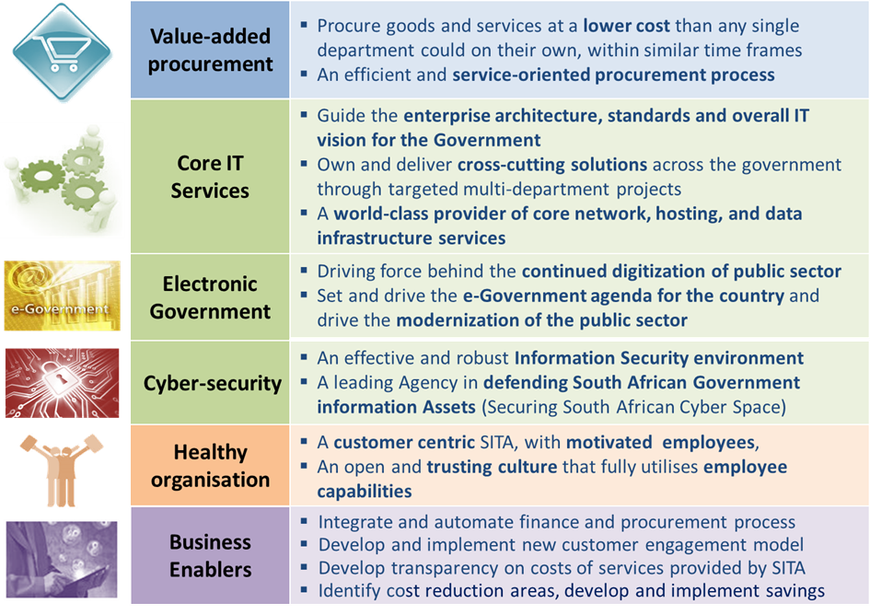
Strategic Priorities
The figure below provides a summary description of the strategic priorities
The strategic priorities have not changed, implementation still continues as per
the MTSF targets

Slide 7
Strategic Initiatives
The figure below depicts the 23 strategic initiatives across 4 key categories
1
  Implement contract tracking & management system
  Implement new approach to technical specifications
  Launch new procurement process
  Establish contract model
  Launch On-line Buying
  Introduce new organisation model
  Revise SITA’s procurement policies
8
  Consolidate & modernise data centres
  Upgrade bandwidth & network
  Design and implement security system
  New IT Service Delivery Model, System Integration & e-GOV
  Build internal capabilities
  Design and implement retained organisation (contract external assistance)
2
9
10
3
4
E-Gov &
IT Service Portfolio
11
5
Procurement
6
12
7
A
B
13
SITA
18
  Create transparency on cost
  Integrate and automate finance and procurement process
  Develop and implement new customer engagement model
  Recruit top talent to SITA
  PMO Strategy Institutionalization
  Financial Sustainability
D
C
14
  Create a customer centric
  organisation (include stakeholder)
  Reward and recognise exceptional performance
  Implement HPO across organisation
  Empower SITAzens to fully leverage their capabilities
19
Business
Enablers
Organisa-
tional Health
15
20
21
16
22
17
23
The strategic initiatives have been revised to include an initiative on financial sustainability

Slide 8
Strategic Programmes and Goals
The table below provides the 6 strategic programmes and related goals
Strategic programme | Goals
Programme 1: Service Delivery | Goal 1: To provide high-quality IT services to enable Government to deliver efficient and convenient services through the use of ICT
Programme 2: Infrastructure | Goal 2: To optimise the provision of SITA’s IT infrastructure services in order increase availability, flexibility, scalability, predictability and security
Programme 3: Procurement | Goal 3: To address all issues relating to delayed procurement turnaround times, removing customer pain points, and transforming the procurement function
Programme 4: Financial Sustainability | Goal 4: To ensure an effective and efficient financial management and ensure financial growth and sustainability
Programme 5: Organisation | Goal 5: To build and maintain organisational capability to enable SITA to achieve its strategic imperatives and becomes an employer of choice within the ICT industry
Programme 6: Governance and Administration | Goal 6: To provide leadership, strategic management, governance, risk and resource management in line with government-accepted norms and standards

Slide 9
Strategic Objectives, Indicators and Annual Targets(2016/17)
Strategic Programmes | Strategic Objectives | Performance Indicators | Annual Targets
Programme 1: Service Delivery | Enhance efficiency of Government business processes | # of e-Government services implemented | 20 e- services implemented
 | Improve Security of Government Data assets | Level of maturity of ICT security | Implementation of the following security controls: Endpoint protection Threat Management
 |  | % compliance of SITA National Key Points (NKP) with National Key Points Act with South African Police Services (SAPS) evaluation | >90% compliance of SITA NKP with SAPS evaluation
 |  | % compliance to personnel security clearance requirements | >90% compliance to personnel security clearance requirements

Slide 10
Strategic Objectives, Indicators and Annual Targets (2016/17)
Strategic Programmes | Strategic Objectives | Performance Indicators | Annual Targets
Programme 1: Service Delivery | Transform SITA into customer centric organisation | Customer satisfaction level | 60% customer satisfaction level
 |  | % performance against measured contracted SLA metrics | 95% performance against measured contracted SLA metrics
 | Achieve growth in government market share | % increase in government market share | 10% increase in government market share (increase on 2014/2015
 |  | % retention of services provided to customer | 90% retention of services provided to customer

Slide 11
Strategic Objectives, Indicators and Annual Targets (2016/17)
Strategic Programmes | Strategic Objectives | Performance Indicators | Annual Targets
Programme 2: Infrastructure | Consolidate and modernize data centers | #of data centres modernized | 3 SITA owned data centres stabilized to 99.749% availability electrically and mechanically
 |  | # of storage and server infrastructure refreshed | Infrastructure and modernisation plan developed and approved by Board
 | Improvement of ICT Infrastructure: Disaster Recovery (DR) | # of disaster recovery sites established | 2 disaster recovery sites established

Slide 12
Strategic Objectives, Indicators and Annual Targets(2016/17)
Strategic Programmes | Strategic Objectives | Performance Indicators | Annual Targets
Programme 3: Procurement | Improve procurement operational efficiency (to enable service delivery) | % of tender awards completed within the targeted turnaround time | 65% of tender awards completed within the targeted turnaround time
 |  | Development and roll-out of the Government e-Procurement portal | Implementation and roll-out of Government Transversal e-Procurement portal at SITA and National Treasury in the OCPO
 | Drive ICT cost effectiveness through economies of scale | % Actual savings on acquisition of ICT goods and services with major OEM’s / OSM | 10% actual savings on acquisition of ICT goods and services with major OEMs / OSM
 | Drive ICT Economic Transformation agenda | % of ICT acquisition spend through SMME entities | 10% of ICT acquisition spend through SMME entities
 |  | Number of SMME entities completed SITA Enterprise Development (ED) programs | 10 SMME entities completed SITA ED programs

Slide 13
Strategic Objectives, Indicators and Annual Targets (2016/17)
Strategic Programmes | Strategic Objectives | Performance Indicators | Annual Targets
Programme 4: Financial Sustainability | Achieve Sound Financial Management | % EBIT | 2% EBIT
 |  | Liquidity Ratio | 1.2:1
 |  | % Gross Margin | 20% Gross Margin
 |  | % expenditure against approved Capex budget | 90% expenditure against approved Capex budget
Strategic Programme | Strategic Objectives | Performance Indicators | Annual Targets
Programme 5: Organisation | Build a Healthy & High Performing Organisation | % Improvement on HPO baseline and HPO institutionalisation | Drive & implement 80% of the 13 HPO Dimensions as per the HPO improvement plan
 |  | % of critical positions with minimum cover ratio of 1:2 | 20% of critical positions with minimum cover ratio of 1:2

Slide 14
Strategic Objectives, Indicators and Annual Targets(2016/17)
Strategic Programmes | Strategic Objectives | Performance Indicators | Annual Targets
Programme 6: Governance and Administration | Establish effective governance practice | # of Material Auditor General findings on finances, predetermined objectives and compliance to laws and regulations | 0 Material Auditor General findings on finances and predetermined objectives
 |  | Maturity level of risk management implementation | Maturity level 4 of risk management implementation
 | Proactive approach to procurement compliance including fraud & corruption | # of findings in the External Audit with respect to fraud and corruption in procurement process related activities. | 0 findings

Slide 15
  Statement of Financial Performance

Slide 16
  Budget per Programme

Slide 17
Statement of Financial Position

Slide 18
  Statement of Cash Flows

Slide 19
Capital Expenditure

Slide 20
Thank You

