Slide 1
PORTFOLIO COMMITTEE MEETING
PRESENTATION ON THE APP AND BUDGET ALLOCATION FOR THE YEAR 2016/2017
7th APRIL 2016

Slide 2
PRESENTATION LAYOUT
Purpose
Mission and Vision
Overview
Context Factors
Strategic plan 2015-2020
Baseline budget allocation for the financial year 2016/2017
Budget allocation on income and expenditure, compensation of employees and goods & services for the financial year 2016/2017
Challenges, Impact and Way forward
Recommendations
Closure

Slide 3
PURPOSE
The purpose of the presentation is for the Portfolio Committee Members to note the APP and the budget allocation, the challenges, impact and way forward for the year 2016/17.

Slide 4
MISSION AND VISION
Independent statutory body – 2 main areas from HE Act of 1997:
Monitoring trends, research …. Advice
Assuring and promoting quality in HE (HEQC)
From NQF Act of 2008
Quality Council – manage its sub-framework of NQF … qualifications

Slide 5
OVERVIEW
Review of the state of HE (completed) - advice
Reflections book (completed)
Student funding (Kagisano, new project)
Quality Enhancement Project – institutional visits underway
HEQSF alignment project (completed), accreditation growing
Qualification standards in development
National Review LLB
Quality promotion work continuing
Planning for audits underway

Slide 6
CONTEXT FACTORS
Tight fiscal climate – budget cuts
Responsive to higher education climate
New governance and executive management members – planning processes
Services of peer academics – both pro bono and commissioned for reviewing and research

Slide 7
STRATEGIC PLAN – 2015-2020 OVERVIEW OF IMPERATIVES
1. Enhancing policy analysis and information
Managing the HEQSF and standards in HE – quality
Developing the quality assurance system further
Building of intellectual capability and an enabling
organisational climate

Slide 8
1. POLICY ANALYSIS IMPERATIVE
To provide advice to the MHET on request and proactively.
Ministerial requests – fee increases
Key challenges arising from the Review of Higher education

Slide 9
2. To monitor the state of higher education
Ongoing projects
VitalStats and performance indicators
Governance in HE, including student governance
New projects
Academic profession (on hold)
Student funding and throughput
ICTs in HE (on hold)
Joint EU project with DHET on assessing teachers in HE

Slide 10
2. MANAGE THE HEQSF AND STANDARDS IN HE
3. To develop and manage the HEQSF, including the alignment of existing higher education programmes with the requirements of the HEQSF.
Phase 3 of alignment – replacement programmes
Articulation
Framework for professional bodies/CHE terrain

Slide 11
4. TO DEVELOP AND IMPLEMENT POLICY, CRITERIA AND STANDARDS FOR THE DEVELOPMENT, REGISTRATION AND PUBLICATION OF QUALIFICATIONS
Four new qualification standards to develop.
Using developed standards in national review - LLB

Slide 12
5. TO MAINTAIN A DATABASE OF LEARNER ACHIEVEMENTS IN HIGHER EDUCATION AND TO SUBMIT THE DATA TO THE NATIONAL LEARNER RECORDS DATABASE (NLRD), WHICH IS MAINTAINED BY SAQA
Ongoing submission of student enrolment and achievement data via HEQCIS to NLRD.
New data fields being populated by private providers. Now like HEMIS; records developed.

Slide 13
3. QUALITY ASSURANCE DEVELOPMENT
6. To audit the quality assurance mechanisms of higher education institutions.
Ongoing: assessment and approval of institutional improvement plans in relation to audits.
Completion of Phase 1 of Quality Enhancement Project:
- Institutional visits (26 publics)
Phase 2 in development, implementation postponed
- Planning for next cycle of audits

Slide 14
7. TO ACCREDIT NEW PROGRAMMES SUBMITTED BY PUBLIC AND PRIVATE HIGHER EDUCATION INSTITUTIONS AND TO RE-ACCREDIT EXISTING PROGRAMMES OFFERED BY PRIVATE HIGHER EDUCATION INSTITUTIONS
Ongoing accreditation and re-accreditation processes, including site visits. Usually in the region of 400 new programmes, but increasing – HEQSF implementation.
Carry out site visits – 87 planned at 47 institutions.

Slide 15
8. TO UNDERTAKE NATIONAL REVIEWS OF PROGRAMMES IN SPECIFIC SUBJECT FIELDS AND QUALIFICATION LEVELS OFFERED BY PUBLIC AND PRIVATE HIGHER EDUCATION INSTITUTIONS
Bachelor of Social Work progress reports, monitoring and feedback
Phases 1 and 2 of LLB review completed
Report on state of LLB

Slide 16
9. TO PROMOTE QUALITY AND TO DEVELOP CAPACITY AND UNDERSTANDING OF THE ROLE OF QUALITY ASSURANCE IN IMPROVING QUALITY IN HIGHER EDUCATION AT BOTH THE SYSTEMIC AND INSTITUTIONAL LEVELS
Ongoing QA forums and newsletters.
Ongoing CHE-HELTASA Teaching Excellence Awards.
Ongoing training of evaluators for accreditation and peer panels for national reviews.
Development of framework/good practice guide
Joint EU project with DHET – framework for professional councils

Slide 17
4. ENABLING ORGANISATIONAL CLIMATE
10. To ensure the development of human resources management environment that enables staff to develop their full potential.
11. To ensure that financial, administration and supply chain management is compliant with the requirements of the PFMA, relevant Treasury regulations and laws.
12. Ensure effective governance and compliance of ICT with statutory requirements
Ongoing – review of policies and procedures, including moving to electronic systems; staff training and development.

Slide 18
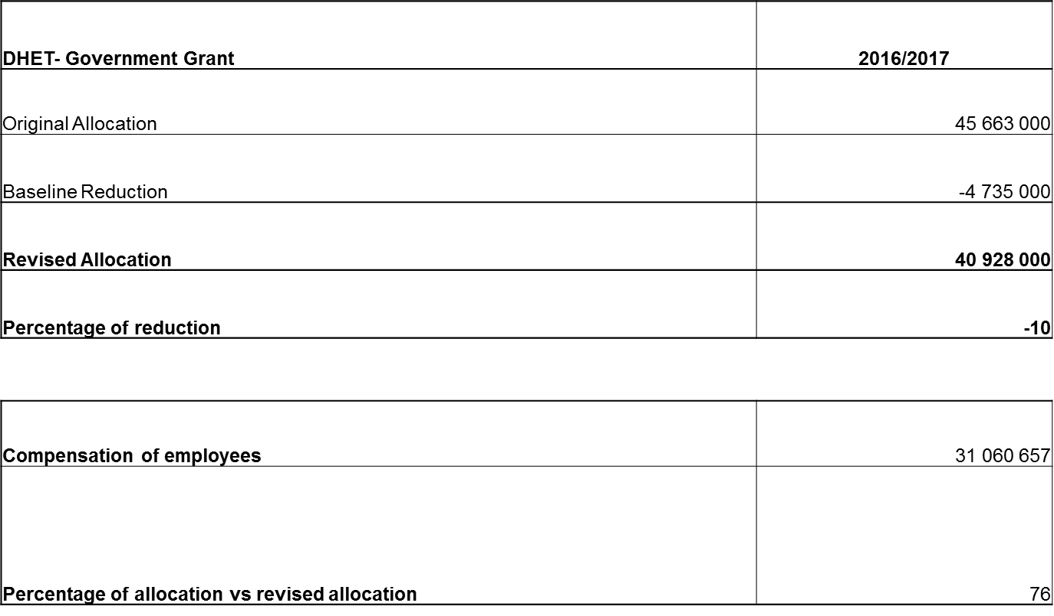
BASELINE GOVERNMENT GRANT BUDGET ALLOCATION FOR THE FINANCIAL YEAR 2016/2017

Slide 19
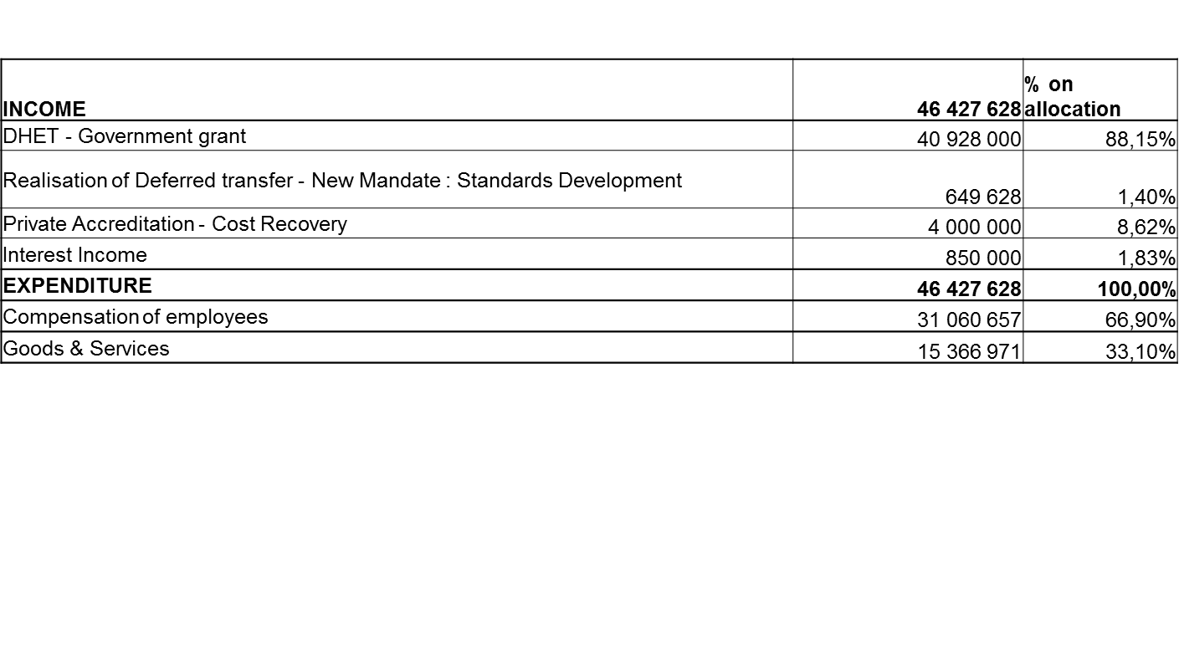
BUDGET ALLOCATION ON INCOME AND EXPENDITURE FOR THE FINANCIAL YEAR 2016/2017

Slide 20
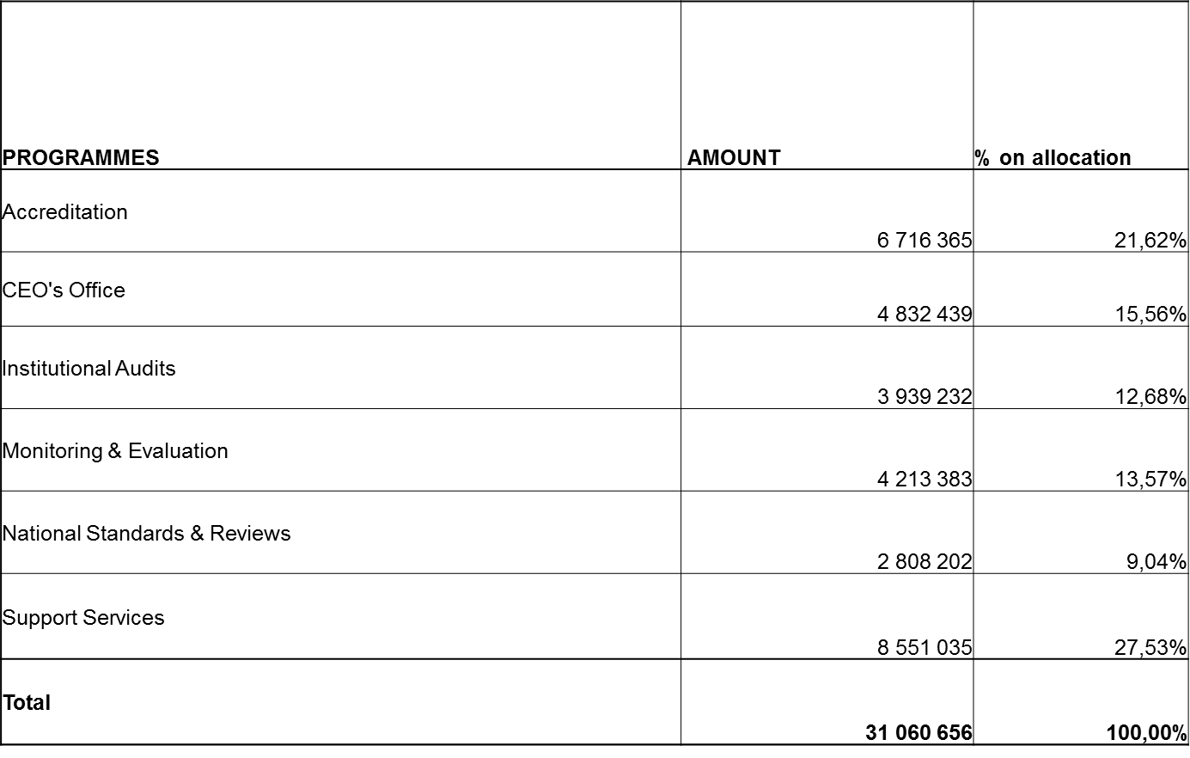
BUDGET ALLOCATION ON COMPENSATION OF EMPLOYEES FOR THE FINANCIAL YEAR 2016/2017

Slide 21
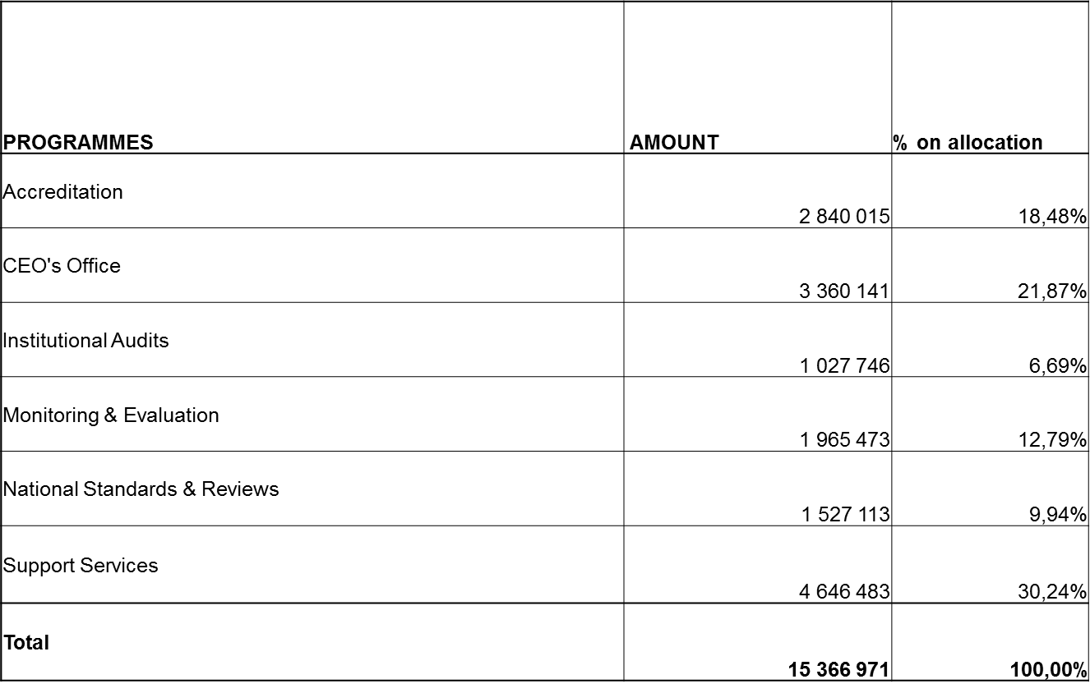
BUDGET ALLOCATION ON GOODS & SERVICES FOR THE FINANCIAL YEAR 2016/2017

Slide 22
CHALLENGES, IMPACT AND WAY FORWARD
CHALLENGES
Baseline reduction by 10% resulted in budget shortfall of R14 900 453
IMPACT
Some of the APP targets may not be realised.
WAY FORWARD
Management will engage DHET on the shortfall of R14 900 453 for more funding.
Further reprioritisation of projects in the third quarter.
All vacant funded posts put on hold until programmes’ business processes are finalised.
Implement cost-containment measures such as teleconferencing facilities to reduce operational costs on meetings.

Slide 23
RECOMMENDATION
Portfolio Committee Members to note the APP and budget allocation, the challenges, impact and way forward for the financial year 2016/17.

Slide 24
THANK YOU

