Slide 1
Agrément South Africa
www.agrement.co.za
Slide 1
PRESENTATION TO THE PARLIAMENTARY PORTFOLIO COMMITTEE
FOR
THE DEPARTMENT OF PUBLIC WORKS
Strategic Plans, Annual Performance Plans and Budgets for the 2016/17 Financial Year
6 April 2016

Slide 2
Presentation Outline
www.agrement.co.za
Slide 2
Annual Performance Plan
Vision, Mission & Values
Regulations
Situation analysis
Performance & Organisational environment
Organisational structure
Contribution towards achieving National Outcomes
Stakeholders
Strategic Intent or Goals & Strategic Objectives
Quality Management Target
Technical Assessments Targets
Governance & Financial Performance Targets.

Slide 3
Annual Performance Plan
The Annual Performance Plan (APP) of Agrément South Africa which is an entity of the Department of Public Works sets out the strategic outcomes for the period 2016/2017.
The strategic outcomes are goal oriented and are aligned to the APP of the Department, which in turn has aligned its APP to the National Treasury requirements and to the overall Medium Term Strategic Framework of the Government.
Outcomes-based priorities are therefore reflected, as well as the short, medium and long-term planning initiatives of the national Government.
The policy priorities of Agrément South Africa are also reflected in its day to day operational plans.

Slide 4
Annual Performance Plan
The idea is to keep same status quo regarding the physical location and laboratories so as to minimise the possible unintended adverse consequences of the formation of the new entity.
Agrément South Africa’s 2016/2017 annual performance plan is based on the broad frameworks set by the Government’s National Development Plan, the Medium-Term Strategic Framework and the Minister of Public Work’s policy statement.
Agrément South Africa carefully analyzed what had changed in the last year and incorporated what needs to be done differently.

Slide 5
Annual Performance Plan
The Board of Agrément South Africa is mandated to, among others, assess the fitness-for-purpose of non-standardised construction related products or systems for use in the construction industry, and for which a national standards do not exist.
Certification of products and systems found to be fit-for-purpose will contribute to their acceptance and use and assist in the creation of a dynamic and innovative construction industry.
Agrément South Africa is committed to sustainable construction and provides assurance of fit-for-purpose of innovative and non-standard products and systems not covered or fully covered by a South African Bureau of Standards (SABS) or generally accepted codes of practice.

Slide 6
Annual Performance Plan
Agrément certificates demonstrate compliance with national building regulations, as specified in the certificate and enjoy deemed-to satisfy status in the National Building Regulations.
The key strategic objectives of Agrément South Africa outlined in the Annual Performance Plan are to:
support and promote the process of integrated socio-economic development in South Africa;
facilitate the introduction, application and utilisation of satisfactory innovation and technology development and at the same time minimising associated risks;
enhance Agrément South Africa’s position as the internationally acknowledged, objective South African centre for the assessment and certification of non-standardised construction products.

Slide 7
The process followed and salient issues
www.agrement.co.za
Slide 7
The operation of Agrement will proceed as a going concern in its current form and operating environment.
The vision, mission and mandate of Agrement South Africa were re-affirmed and remained the same as in the previous year.
The plan is compiled with the latest available information from departmental and other sources.
The new entity will only come into effect on 01 April 2017 and will therefore form part of the 2017/2018 Annual performance plan.

Slide 8
Vision & Mission
www.agrement.co.za
Slide 8
VISION: Agrément South Africa`s vision is to be a world-class Technical Assessment Agency.
MISSION: Agrément South Africa’s mission is to promote the use of innovative construction products and systems in the country through its certification scheme in order to contribute to the Government’s overall objectives of economic development, good governance and raising living standards and prosperity in South Africa.

Slide 9
Values
Friday, 08 April 2016
www.agrement.co.za
Slide 9
The values are:
People – striving to attain full potential in support of science.
Reputation – enhancing relevance, integrity, quality and delivery.
Ingenuity – realising the full intellect of our people in creating solutions.
Diversity – embracing an environment that respects the individual and multi-cultural heritage.
Energy – working together to achieve impact through passion, drive and agility.

Slide 10
Regulations
Friday, 08 April 2016
www.agrement.co.za
Slide 10
Agrément South Africa’s corporate governance practices commit the organisation to sound management principles framed by integrity and efficiency.
Section 29.1 of the Treasury Regulations, 2005, promulgated in terms of the Public Finance Management Act (PFMA), 1999, requires the Agrément South Africa Board to prepare and submit a Annual Performance Plan for the forthcoming Medium Term Expenditure Framework (MTEF) for approval by the Executive Authority.
The approved Annual Performance Plan must be submitted to the Treasurer annually not later than 30 September of each year.

Slide 11
Situation analysis
Friday, 08 April 2016
www.agrement.co.za
Slide 11
As major drivers of the economy, the built environment and infrastructure play a fundamental role in supporting other sectors and industries to meet national strategic objectives.
The South African Government has set a target to reduce poverty.
In order to achieve this, the Government’s growth path strategy calls for the reduction of unemployment, and has set growth targets for the economy of around 6%.
However, the economic downturn of our major trading partners has seen South Africa going into a recession in recent times and markets are still very volatile.

Slide 12
Performance environment
www.agrement.co.za
Slide 12
Strategic review of Agrément South Africa will continue to guide organisational endeavours during the period 2016/17 as it gives effect to its strategic mandate.
The review confirmed the existing strategic goals, highlighting the need to:
focus on excellence in technical assessments;
focus on transformation to ensure continued representation of women and black people in all its operations;

Slide 13
Performance environment
www.agrement.co.za
Slide 13
The review confirmed the existing strategic goals, highlighting the need to:
increase the impact of our work
develop significant numbers of highly skilled people;
strengthen internal operations, monitoring and evaluation, as well as control mechanisms to continuously improve performance in executing our mandate and strategic intentions;
safeguard financial sustainability and our good corporate governance record.

Slide 14
Organisational environment
www.agrement.co.za
Slide 14
A major drive within the organisation in the 2016/17 financial year will be the improvement of the organisation’s focus and the impact of its work.
In this regard Agrément South Africa continues to adhere to strict internal operations and procedures aimed at improving its activities.
This strategy will guide the organisation’s operational decisions.
Agrément South Africa will review its activities during the forthcoming year to improve efficiency. This will result in some degree of re-organisation.

Slide 15
Organisational structure
www.agrement.co.za
Slide 15
The proposed organisational structure is derived from the Board’s mandate and is a delivery mechanism to give effect to the current ministerial delegation of authority.
Agrement South Africa will fill in the shared services posts identified by the Transitional Task Team (TTT) which may include finance, administration, human resources, legal, audit and facilities staff members amongst other posts.
In filling the posts the budgetary allocations will have to be made prior to the posts being filled, as the current financial amounts allocated in the budget does not cover or cater for the additional staff members required to run the organisation.

Slide 16
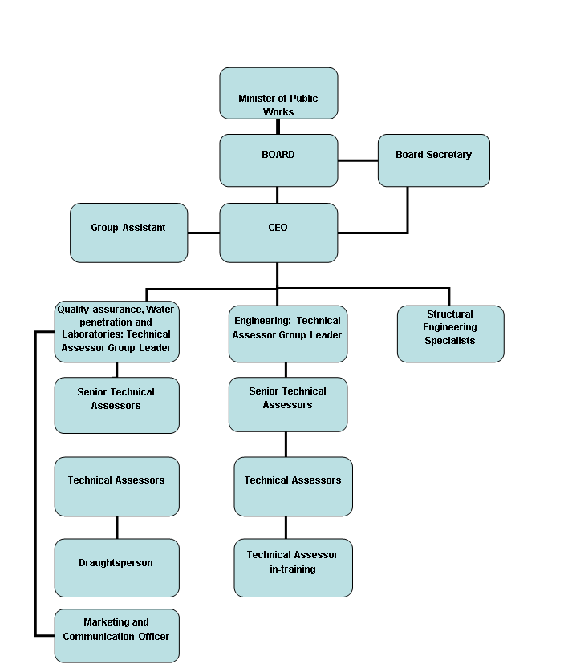
Organisational structure

Slide 17
Organisational structure
Friday, 08 April 2016
www.agrement.co.za
Slide 17
Board
Technical Committee
Technical Agency
Agrément South Africa
Industry Technical Experts

Slide 18
The Building Industry's 4 Levels of legislation + 1
LEVELS OF LEGISLATION
SOLUTIONS TO SATISFY THE REGULATIONS
1
Act 103 0f 1977
Building Industry is to be REGULATED
PERFORMANCE BASED REGULATIONS
Mandatory
2
Level 1
GOAL
Act 103 of 1977
NRCS: REGULATION KEEPER
Level 2
FUNCTIONAL REQUIREMENTS
Regulation 2008
3
Level 3
PERFORMANCE REQUIREMENTS
SANS 10400 2010
South African National Standards: SANS 10400
Process Level
EVALUATION
Voluntary
4
“Deemed to Satisfy”
the regulations
Rational
Assessment
Rational
Design
Agrément certificate
Other SANS documents: SANS 204, SANS 10252
Competent Person
3
Local Authority: Enforcer of REGULATIONS
5
1
2

Slide 19
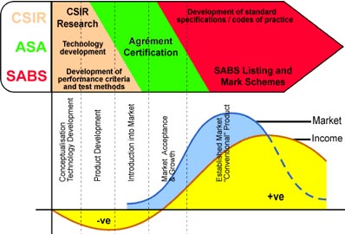
Typical Product Development Cycle
No Duplication of roles. Only Collaborative Synergies
Friday, 08 April 2016

Slide 20
Contribution to achieving National outcomes
Outcome | Agrément South Africa’s contribution
A long and healthy life for all South Africans | Technical certification of technologies that improve indoor thermal performance to provide a healthy living environment and contribute towards a long life and a healthier nation.
A responsive, accountable and efficient local government system | Participate in the activities of government, specifically: undertaking presentations to local authority building inspectors nationally as well as during the annual building inspector’s convention membership of the advisory council of the National Regulator for compulsory specifications proactive support to building inspectors at local authorities to exercise building control within their areas of jurisdiction.

Slide 21
Contribution to achieving National outcomes
Outcome | Agrément South Africa’s contribution
Decent employment through inclusive economic growth | Undertaking technical certification of several new, labour-intensive construction methods, such as developing criteria for using thin concrete technology in road construction similar to the technology developed and implemented in communities. Assist in facilitating the development of technologies that improve the competitiveness of the construction industry.
Environmental assets and natural resources that are well protected and continually enhanced | Include environmental assessment as part of contributing towards environmental sustainability, such as thermal performance and energy efficiency software

Slide 22
Contribution to achieving National outcomes
Outcome | Agrément South Africa’s contribution
Sustainable human settlements and an improved quality of household life | Participate in the activities of the Department of Human Settlements, including research and development, such as awarding an Agrément South Africa certificate of fitness-for-purpose for a new design for a low-income house. Compared to the standard RDP house, the house has better indoor air quality, utilises ‘zero wastage’ and modular construction approaches and has an innovative thin concrete foundation that saves one tonne of concrete per house significantly reduces construction time.

Slide 23
Contribution to achieving National outcomes
Outcome | Agrément South Africa’s contribution
Vibrant, equitable and sustainable rural communities and food security for all | Technically assessing technologies that can improve the performance of dwellings and therefore the living environment in rural areas, such as improved traditional building methods and the use of lightweight building construction technologies and materials that are easier and cheaper to transport than conventional materials and are therefore suitable for remote rural areas.

Slide 24
STAKEHOLDERS
STAKEHOLDER | NATURE OF INTEREST | SOURCE OF POWER
Building professionals | Benefits associated with innovative construction technologies | Innovative technology, products and systems are usually not specified
Certificate holders | Facilitation of approvals and marketing | Agrément certification is deemed to satisfy the requirements of the building regulations
Department of Human Settlements (DoHS) | The provision of subsidy housing | The Department is mandated to decide where human settlements will be located and which construction technology/ methodology to employ

Slide 25
STAKEHOLDERS
STAKEHOLDER | NATURE OF INTEREST | SOURCE OF POWER
Department of Public Works (DPW) | Tasked with encouraging the use of innovative products and systems to the benefit of South Africa | Funding the day-to-day costs of maintaining Agrément South Africa
Home owners | Benefits associated with innovative construction technologies | Financial
Local authorities | Plan approval is required by law. Promote uniformity in the understanding and implementation of National Building Regulations (NBRs) made in terms of the National Building Regulations & Building Standards Act, 103 of 1977. | The withholding of building plan approval; when present, professional architects and engineers are required to perform specific functions.

Slide 26
STAKEHOLDERS
STAKEHOLDER | NATURE OF INTEREST | SOURCE OF POWER
National Home Builders Registration Council (NHBRC) | Management of risk associated with their structural and water penetration warranty scheme | Refusal to register contractor and building, thereby denying insurance cover
National Regulator for Compulsory Specifications (NRCS) | Government is responsible for protecting the health and safety of citizens, the environment and for ensuring fair trade | Government is obliged to ensure that national and international trade is fair and based on reliable measurements
Roads Agencies | Benefits associated with innovative construction technologies | Innovative construction technologies and products and systems are usually not specified

Slide 27
STAKEHOLDERS
STAKEHOLDER | NATURE OF INTEREST | SOURCE OF POWER
South African Bureau of Standards (SABS) | Promotes South African national standards to facilitate international trade and enhance South Africa's economic performance and transformation | Develops, promotes and maintains standardisation and quality for commodities and the renders related conformity assessment services

Slide 28
Strategic Intent or Goals
The Board has identified five overarching long-term goals for the next five years. These are to:
provide active support to the Minister’s strategic programmes and initiatives, aimed generally at turning around the National Department of Public Works and specifically at increasing South African innovation and emerging creativity development;
consolidate Agrément South Africa into a viable and cutting edge organisation with sound corporate governance, risk management profile and world-class processes and systems with a strong technological intellectual base;
Friday, 08 April 2016

Slide 29
Strategic Intent or Goals
drive the growth and progress of Agrément South Africa as a leading state-owned, internationally acknowledged centre for the assessment and certification of non-standardised construction products;
build a centre that enhances SA’s position, leadership and strong global presence through innovation, research and development;
promote a human capital strategy that enables Agrément South Africa to address its current and future human resource challenges, including the shortage of critical skills in the construction industry.
Friday, 08 April 2016

Slide 30
STRATEGIC OBJECTIVES
STRATEGIC OBJECTIVE | STRATEGIC PLAN TARGET | TARGET 2016/2017
Ensure effective corporate governance processes and sound resource management and increase technical assessment outputs. | % amount of revenue collected. | 100% revenue collection.
 | Manage all debtors to ensure payments are received prior to undertaking any work at risk. | Comply 100%
 | Payments done within 30 days. | Comply 100%
 | Expenditure to income ratio equal or better than budget. | Comply 100%
 | Investments in terms of approved Investment policy and strategy. | Investment benchmark as approved by Agrément South Africa.

Slide 31
STRATEGIC OBJECTIVES
STRATEGIC OBJECTIVE | STRATEGIC PLAN TARGET | TARGET 2016/2017
Certification of products and systems as being fit for purpose. [% of certificates processed = number of applications /offers/ certificates processed (approved or rejected) within specified period divided by total number of applications received in a year]. | % of Evaluation offers processed and accepted / rejected within seven days from date of receipt. Excludes in-completed submissions. | 90%
 | % of Agrément offers issued within 15 working days of receiving such applications. | 90%
 | % of Agrément certificates issued within Board approved contract period. | 90%

Slide 32
STRATEGIC OBJECTIVES
STRATEGIC OBJECTIVE | STRATEGIC PLAN TARGET | TARGET 2016/2017
Human Capital Development. | % improvement in employee satisfaction. | Conduct employee satisfaction survey.
Ensure sustainability and stability of the Agrément South Africa technical agency. | Assemble Board Technical Committee including industry experts as per Board approved schedule. | Comply 100%
 | Review and make reference to latest national standards and technical requirements. | Comply 100%

Slide 33
STRATEGIC OBJECTIVES
STRATEGIC OBJECTIVE | STRATEGIC PLAN TARGET | TARGET 2016/2017
Improve technical assessments through participation in the World Federation of Technical Assessments Organization (WFTAO) and international research organizations to contribute towards Study tours and active participation in projects undertaken by other developmental states. | Devise innovative construction technologies suitable for fast-tracking rural development in South Africa by introducing appropriate systems which have been used successfully in other parts of the world. Target of at least one system annually. | Participate in the 19th Annual General Meeting of the WFTAO.
Effective business management solutions for enhanced implementation of Agrément’s mandate. | Effective use of People-soft Enterprise Resource Planning Solution for financial, human resources and project management. | Comply 100%
Ensure improved service delivery to meet client expectations and leverage stakeholder relations. | % improvement in customer satisfaction. | Conduct customer satisfaction survey
 | % of certificate holders subjected to quality audit. | 100%

Slide 34
QUALITY MANAGEMENT TARGETS
OBJECTIVE STATEMENT | ANNUAL TARGET OUTPUTS (2016/2017)
Facilitate and monitor the implementation of the Quality inspections on all Agrément South Africa’s Certificate Holders. | Completion and monitoring of Quality Inspection Implementation Plan.
Monitoring of previous Quality Records and manuals. | Monitoring of previous Quality Records and manuals.
Conduct and monitor Annual quality inspections and annual fees. | Compilation of all annual Quality Inspection. Monitoring the payment of the annual fee by the certificate holder
Approval of the certificate holder’s licensees or qualified installers. | Monitoring the registration of licensees and qualified installers

Slide 35
QUALITY MANAGEMENT TARGETS
OBJECTIVE STATEMENT | ANNUAL TARGET OUTPUTS (2016/2017)
Facilitate the approval of the certificate holder’s quality manual based on the quality management system and implementation. | Ensure all certificate holder implement quality plan based on quality management system and implementation.
Facilitate and monitor the resources required. | Ensure that there is resource for the quality management.
Facilitate and monitor the use of Agrément certificates by certificate Holders and licensees. | EXTERNAL FOCUS: Completed project registration documents.
Following up on certificates. | Follow up on issues concerning the use of Agrément certificates.
Facilitate and monitor the three yearly validity reviews. | Compilation of all validity review schedules.

Slide 36
TECHNICAL ASSESSMENTS TARGETS
OBJECTIVE STATEMENT | ANNUAL TARGET OUTPUTS (2016/2017)
Facilitate and monitor the implementation of the technical assessments on all Agrément South Africa’s Certificate applicants. | Completion and monitoring of technical assessment Implementation Plan.
Monitoring of previous Technical assessment Records and certificates. | Monitoring of previous Technical assessment Records and certificates.
Conduct and monitor Technical assessment. | Compilation of all Technical assessment reports.
Facilitate the approval of the certificate holder’s quality manual based on the quality management system and implementation. | Ensure all certificate holder implement quality plan based on quality management system and implementation.
Publish certificates. | Publish synopsis of the certificates on Agrément South Africa Web site, government gazette and the Agrément South Africa Annual Report.
Following up on certificates. | Follow up on issues concerning the use of Agrément certificates.

Slide 37
Governance
The Minister of Public Works approved the Agrément South Africa’s 2016/17 Annual performance plan.
The Annual Performance Plan 2016/17 was delivered to the Parliamentary stores by 9 March 2016 for tabling.
By undertaking technical assessments of innovative systems for and on behalf of the Government, Agrément South Africa has made a great contribution in the safe introduction of innovative technologies in the country with commensurate benefits.
Innovative systems have potential to teach people the ways and gives them the means to take control over their own future accommodation by allowing them to build their own houses.

Slide 38
Governance Matters: Values
Agrément South Africa has excellent support systems, business enterprise processes & very strong linkages with global best practice organizations, processes and individuals.
Agrément South Africa is very well governed with strong internal control processes and systems.
The Board addresses issues of corporate governance to ensure compliance with treasury & national requirements.
This ensures proper fiduciary management within the Agrément South Africa.
Agrément is making a contribution to build a better South Africa!

Slide 39
ANNUAL FINANCIAL PERFORMANCE TARGETS
Agrément South Africa [R'000] | Financial period
 | 2016/17
External Income | 12 383
Other Income | 2 436
Total Income | 14 819
Human Resources | 7 712
Running Costs | 3 648
Other Costs | 3 133
Total Costs | 14 493
Surplus (loss) | 326
Interest Income | 160
Employee remunerations | 136
NET MARGIN AFTER INTEREST | 350

Slide 40
Financial Comments
Agrément South Africa has operated for 46 years under ministerial delegation of authority from the Minister of Public Works.
The annual grant funding is channeled from the Department of Public Works (DPW).
The funds are ring fenced & only used for Agrément South Africa.
The transactions are subject to the policies, procedures and governance processes as per treasury regulations.
Finances are audited as required by treasury regulations.
The CSIR has received an unqualified audit report for the last few years and has been hailed as an example of good financial management.

Slide 41
Thank you… for Achieving excellent results TEAM: Together Everyone Achieves More
Friday, 08 April 2016
www.agrement.co.za
Slide 41
GOAL
EFFORT
SUPPORT

