Slide 1
State Diamond Trader
Annual Performance Plan & Budget 2016/17

Slide 2
Annual Performance Plan 2016/17
The State Diamond Trader (SDT) is presenting its plan against the backdrop of a severely affected market performance.
Since the middle of 2014, the global diamond industry performed negatively and the local industry and SDT were not immune against this negative performance.
If the slight improvement in the global market recorded since January 2016 carries on, the SDT is confident that its budgeted purchases and sales as well as the loss for the year 2016/17 will change positively through its trading during the course of the year.

Slide 3
State Diamond Trader Strategy
The Strategic Objectives of the SDT are as follows:
To contribute to the growth of the local diamond beneficiation industry;
To increase sales of rough diamonds to HDSA beneficiators;
To contribute towards youth skills development.

Slide 4
State Diamond Trader Strategy
Our Strategic Objectives are aimed at the following outcomes:
A sustainable growing and transformed diamond beneficiation industry
Diamond industry enterprise development
Large scale SA (HDSA) owned sustainable diamond cutting and polishing companies established
Be an efficient, innovative and development orientated organization (continuous learning environment)

Slide 5
Key Activities 2016/17
1. Implement SDT Marketing Strategy
The SDT will continue implementing its Marketing Strategy under the prioritised areas:
Conduct Provincial Promotional Activities
Promote enhanced access to local and international markets
Pilot establishment of “Diamonds SA” brand

Slide 6
Key Activities 2016/17
2. Organise and host the SA Diamond Indaba 2016
The inaugural SA Diamond Indaba 2015 achieved its objective of getting all stakeholders of the Diamond Indaba conversing about the status quo and the future of the SA Diamond Industry
The SDT is building on this success and importantly providing a platform for diamond industry discussions on industry growth, sustainability and transformation
The SDT intends to publish an “ABC” guide to diamonds

Slide 7
Key Activities 2016/17
Government and Industry stakeholders are being consulted on the second Indaba
Issues of industry growth and transformation in a competitive environment will be high on the agenda
Youth participation has been identified as core to the growth of the industry and their participation will be key

Slide 8
Key Activities 2016/17
3. Facilitate access to international and local markets
The SDT, in collaboration with the Dti, will continue to facilitate participation of its clients, especially HDSA clients, at exhibitions related to diamonds, for example:
The Hong Kong Gem and Jewellery Show
Jewellex South Africa
Africa Jewellery Show

Slide 9
Key Activities 2016/17
4. Measure the impact of SDT marketing initiatives on its client businesses
Participating client business growth target for 2016/17, target set at 5%
Consultations and surveys to be conducted on participating clients
Results to determine further engagements

Slide 10
Key Activities 2016/17
5. Develop Youth Enterprises in diamond beneficiation
The SDT commenced with its three year Enterprise Development Programme for the youth in 2015. This is set to continue in 2016/17
Industry partners have expressed an interest and excitement in further partnering with the SDT.
The SDT is looking at a success rate of 75% which will be participants establishing their own beneficiation enterprises starting in 2018/19.

Slide 11
Key Activities 2016/17
6. Conduct Provincial Promotional Activities with partners – State and private sector
The SDT began visiting provinces in 2014/15 and continued with this task in 2015/16
Thereby marketing both diamond beneficiation and the SDT
The SDT plans to conduct five Provincial Promotional Activities throughout the country

Slide 12
Key Activities 2016/17
7. Pilot the establishment of “Diamonds SA” brand
Messages from international of diamonds being synonymous with South Africa
Intention to build on this sentiment and extend potential for new entrant businesses
Enhance local knowledge on diamonds and jewellery
Increase local diamond jewellery consumption

Slide 13
Key Activities 2016/17
8. Continue with the implementation of approved sales strategy by:
Increasing the amount of overall sales to HDSA beneficiators to a minimum of R50 million;
Increasing the number of actively trading HDSA clients;
Increasing total purchases of inspected SA diamond production
Increasing overall sales

Slide 14
Key Activities 2016/17
9. Employ and train youth with disabilities on rough diamond valuations
The SDT will continue with work done in 2015/16 preparing for the employment of youth with disabilities
Training is scheduled to start in quarter two for a period of 3 years.
The training is for employment by the SDT once completed.

Slide 15
Key Activities 2016/17
10. Launch short term learnership programme on general diamond skills
Two young people at a time will benefit from this programme, with therefore six youth benefiting for the year
It is expected that a new possibility for them will be established thereby

Slide 16
APP 2016/17 - Strategic objectives linked to DMR and National outcomes
National Outcome | DMR Programme | SDT Strategic Objectives
Decent employment through inclusive economic growth An efficient, competitive and responsive economic infrastructure network Environmental assets and natural resources that are well protected and continually enhanced | 1. Equitable and sustainable benefit from mineral resources | Contribute to the growth of the local diamond beneficiation industry Increase sales of rough Diamonds to HDSA Beneficiators
Create a better South Africa and contribute to a better Africa and a better world | Equitable & sustainable benefit from Mineral Resources | Contribute to the growth of the local diamond beneficiation industry
An Efficient, effective and development-orientated Public Service | Efficient, effective and development-orientated department | Contribute towards youth skills development

Slide 17
SDT 2016/17 Budget
Sales | 425 256 000
Cost of Goods Sold | (408 900 000)
Gross Profit | 16 356 000

Slide 18
SDT 2016/17 Budget
Overheads | (21 165 478)
Of which:
Salaries | 13 036 071
Leases | 666 787
Computer and other IT | 548 837
Travel | 1 927 118
Fees | 1 977 887
Other | 3 008 778

Slide 19
SDT 2016/17 Budget
EBIT | (4 809 478)
Interest Income | 1 275 180
Interest Expense | (1 393 409)
Profit before Taxation | (4 927 707)
Taxation | -
Net Loss | (4 927 707)

Slide 20
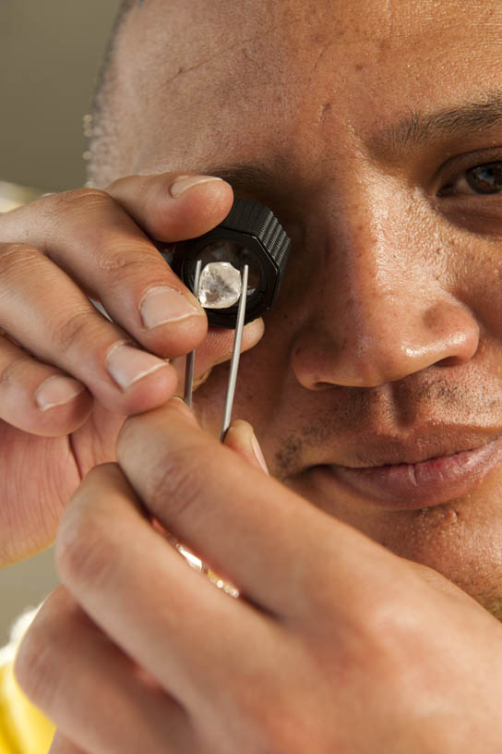
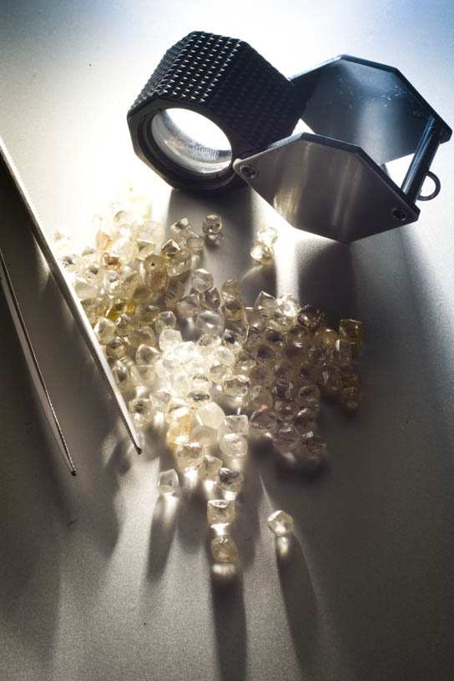
The State Diamond Trader

