Slide 1
PRESENTATION OF THE 2016/17 ANNUAL PLAN TO THE PPC
6 APRIL 2016

Slide 2
CGS ORGANOGRAM
CGS Acting CEO
Mr S Sikhosana
COO
Dr M Makgae
CSS
Mr F Ramagwede
CFO
Mr L Matsepe
CGS Board

Slide 3
OUTLINE OF PRESENTATION
THE MANDATE OF THE CGS
FOCUS AREAS
OPERATIONS
HUMAN RESOURCES
FINANCE

Slide 4
THE MANDATE OF THE CGS as amended by Geoscience Amendment Act, (No. 16 of 2010)
The systematic onshore and offshore geoscientific mapping of South Africa
Basic geoscience research into the nature and origin of rocks
The collection and curation of all geoscience data and act as a National Geoscience Repository
Rendering of geoscience knowledge services and advice to the State
Manage a number of national geoscience facilities on behalf of the country
Render commercial geoscience services and products to national and international clients

Slide 5
CGS FOCUS AREAS
ENVIRONMENT
SOCIAL
ECONOMY
Mineral & Energy Resources
Environmental & Water
GEOSCIENCE MAPPING
Engineering & Geo-hazards

Slide 6
OPERATIONS

Slide 7
Key National Priority Projects
Stimulation Of Investment on Mineral Resources Of South Africa.
Shale Gas
Mine Rehabilitation – Derelict & Ownerless Mines
Mine Water Management
Microzonation of Johannesburg

Slide 9
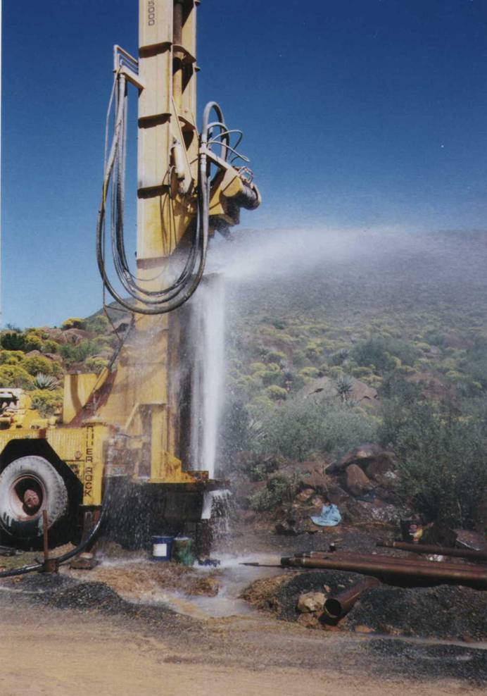
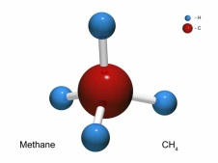
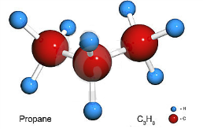
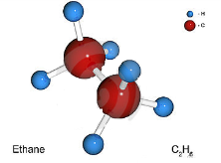
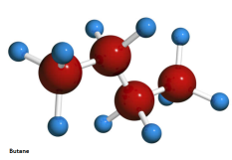
Importance of conducting research studies
on Shale gas exploration
What is Shale gas:
Shale gas is a natural gas that is occurring and can be extracted from Shale. The natural gas can be utilised for power and energy production. South Africa has an estimate of 390 trillion cubic feet (tcf) of technically recoverable natural gas that can be extracted from Shale and this is embedded in the Karoo Basin. The natural gas estimates of the country are technically unproven.
Shale gas exploration in South Africa could be facing various major unknown geological questions:
The amount of economically recoverable gas trapped in the Karoo formations;
The geo-environmental problems linked to the nature and the structure of the rock,
The ground water migration, and
The micro-seismicity related to Shale gas.
Shale gas primarily consists:
70 % - 90% in Shale gas
0% - 20% in Shale gas
Why Shale gas is crucial for South Africa:
Its can provide clean energy.
The country can be less reliable to coal usage.
Increase the economy of South Africa.
0% - 20% in Shale gas
0% - 20% in Shale gas
How will the CGS Shale gas project support the South African Government:
The CGS Shale gas project will serve as a baseline study for future shale gas research work and play a vital role in review of Petroleum Exploration and Exploitation Regulations.
NEMA regulations will be utilised as a framework in identifying shortfalls of the environmental impacts of the shale gas explorations.

Slide 10
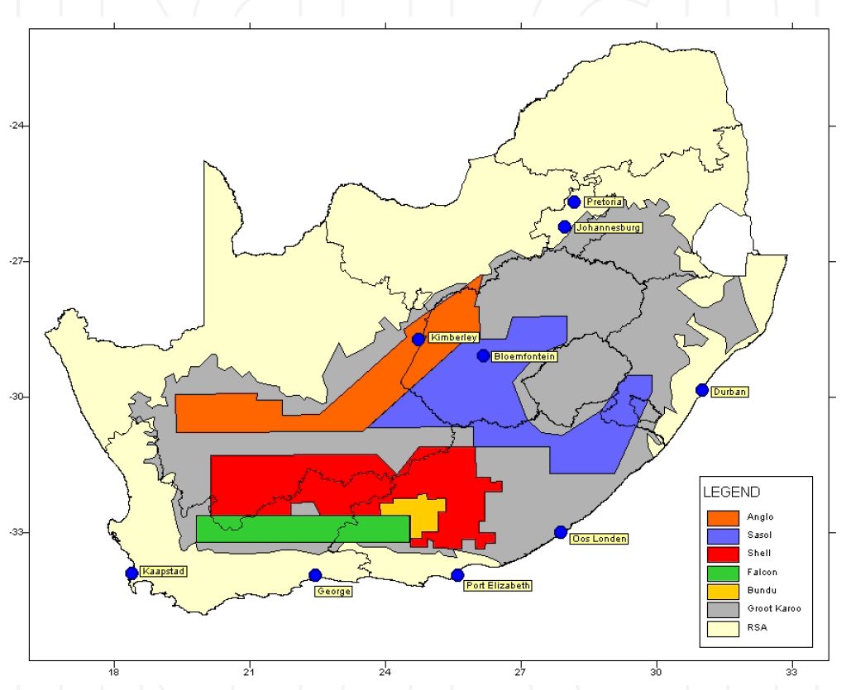
Shale gas project: Site-Selection
Project site

Slide 11
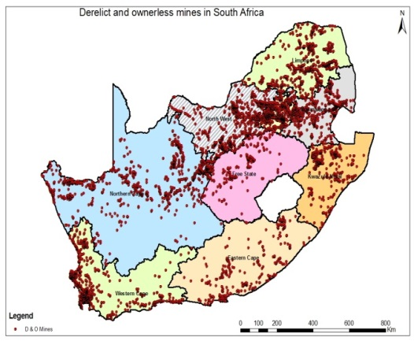
Derelict and Ownerless Mines

Slide 12
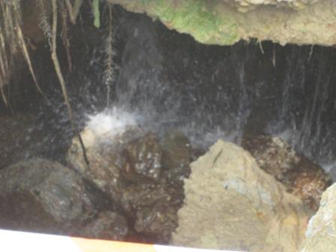
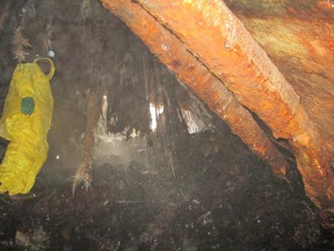
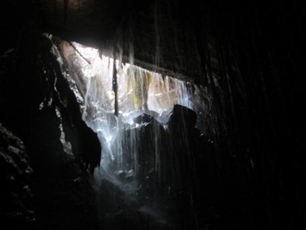
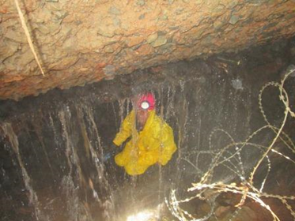
Mine Water Management Project
Photographs taken inside the New Kleinfontein opening, clearly showing the ingress of water (Courtesy of Gold One)

Slide 13
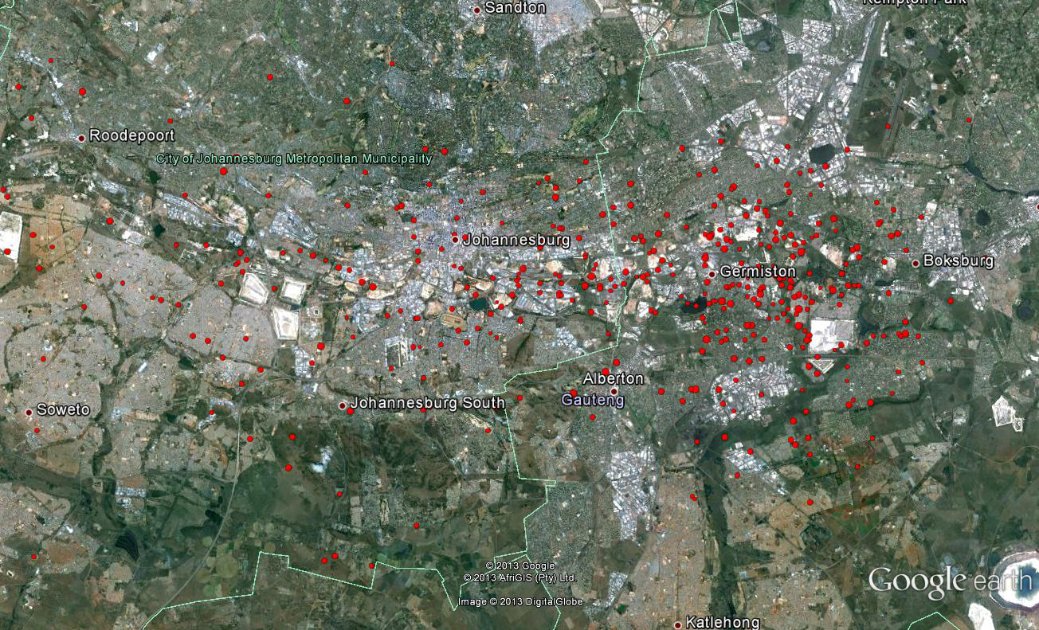
Recorded Seismic Events in Witwatersrand Basin
(from January 2008 to date)

Slide 14
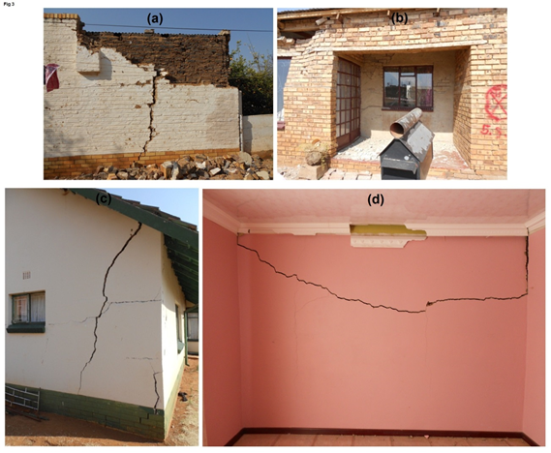
Macroseismic survey of the magnitude 5.5, 2014 Orkney earthquake

Slide 15
Commercial Projects
Geological mapping of Namibia
Hydrogeological mapping of Malawi
Geological mapping of Malawi
Supervisory role in mapping of Cameroon
City of Johannesburg –Ground water study
ENVIREE (EU) – Feasibility of extraction of REE from mine wastes
SANEDI- Carbon Capture Storage

Slide 16
HUMAN RESOURCES

Slide 17
Staff Profile as at 31 March 2016
LEVEL | MALE |  |  |  | FEMALE |  |  |  | TOTAL
 | African | Coloured | Indian | White | African | Coloured | Indian | White
Top Management | 3 | - | - | - | 1 | - | - | - | 4
Senior Management | 8 | - | 1 | 4 | 1 | - | - | 2 | 16
Professional qualified | 50 | 3 | 3 | 33 | 44 | 3 | 4 | 19 | 159
Skilled | 63 | 3 | - | 8 | 16 | - | 1 | 10 | 101
Semiskilled | 9 | 2 | - | 2 | 35 | 4 | - | 10 | 62
Unskilled | 6 | - | - | - | 3 | - | - | - | 9
TOTAL | 139 | 8 | 4 | 48 | 100 | 7 | 5 | 41 | 351

Slide 18
World-class People Perspective
Key Objectives | Measures | Target 2015/16 | Target 2016/17 | Target 2017/18
To attract and retain a skilled workforce | Nett staff turnover | <10% | <10% | <10%
 | No. of staff funded for MSc and PhD degrees | 43 | 40 | 40
 | Proportion of scientists to total staff | 40% | 40% | 40%
 | % of scientific staff with PhD and MSc degrees | 46% | 48% | 50%
To enhance present levels of excellence | No. of papers and articles published | 50 | 25 | 30
 | No. of projects with external collaborators | 19 | 20 | 22
 | No. of strategic science partnerships | 19 | 20 | 22

Slide 19
World-class People Perspective (cont.)
Key Objectives | Measures | Target 2015/16 | Target 2016/17 | Target 2017/18
To build positive organisational culture | Staff satisfaction level | 65% | 70% | 75%
To reflect and embrace RSA diversity | EE Stats (Consolidated) W:B ratio | 30:70 | 26:74 | 24:76
 | EE Stats (Gender) (M:F) | 53:47 | 51:49 | 50:50

Slide 20
FINANCE

Slide 21
Budget 2015/16 – 2018/19
Income
Income (Rands) | 2015/16 Budget x 1000 | 2016/17 Budget x 1000 | 2017/18 Budget x 1000 | 2018/19 Budget x 1000
Government grant | 340 714 | *378 598 | *365 988 | *302 862
Deferred income | 108 597 | - | - | -
Sales and contracts | 40 000 | 44 000 | 48 400 | 53 240
Sundry income | 3 191 | 3 350 | 3 518 | 3 694
TOTAL INCOME - A | 492 501 | 425 948 | 417 906 | 359 796

Slide 22
Expenditure
Expenditure (Rands) | 2015/16 Budget x 1000 | 2016/17 Budget x 1000 | 2017/18 Budget x 1000 | 2018/19 Budget x 1000
Personnel costs | 196 148 | 211 840 | 226 777 | 244 919
Bursaries | 2 530 | 2 783 | 3 061 | 3 367
Commercial project costs | 18 000 | 19 800 | 21 780 | 23 958
Overheads and operating costs | 189 842 | 142 171 | 124 895 | 72 052
SUBTOTAL - B | 406 520 | 376 594 | 376 513 | 344 296
Surplus before Capital Expenditure A - B | 85 981 | 49 354 | 41 393 | 42 584

Slide 23
Expenditure Continued
Application of Surplus | 2015/16 Budget x 1000 | 2016/17 Budget x 1000 | 2017/18 Budget x 1000 | 2018/19 Budget x 1000
Capital Expenditure
Vehicles & Aircrafts | 15 000 | 3 500 | 3 500 | 3 500
Equipment | 10 000 | 12 000 | 12 000 | 12 000
Building and Laboratory Infrastructure | 60 981 | 33 858 | 25 893 | 27 084
Subtotal | 85 981 | 49 354 | 41 393 | 42 584
TOTAL EXPENDITURE | 492 501 | 416 477 | 400 896 | 421 965

Slide 24
ANALYSIS OF GOVERNMENT GRANT ALLOCATION FOR 2015/16 TO 2018/19
ITEM | 2015/16 R | 2016/17 R | 2017/18 R | 2018/19 R
Baseline allocation | 165.3m | 184.6m | 177.2m | 206.9m
Mine Rehabilitation program | 37.9m | 43.0m | 38.2m | 42.2m
Mine Water Ingress Project | 22.7m | 23.9m | 23.0m | 26.1m
Shale Gas | 16.8m | 21.6m | 26.4m | 27.6m
Economic Competitiveness Support Package (ECSP)
Stimulation of investment in the Mineral Sector | 68.0m | 71.6m | 68.7m
Laboratory & infrastructure (AC) | 32.2m | 33.9m | 32.5m
Total Government Grant (* 16/17-18/19 DMR allocation letter 29 January 2016) | 342.9m | *378.6m | *365.9m | *302.8m
Other – Budget Support Program – Microzonation “Donor Funding” | 14.8m | 11.5m

Slide 25
BASELINE ALLOCATION VS. PERSONNEL AND OPERATIONAL COSTS
 | R’000 | R’000 | R’000 | R’000
 | Budget | Budget | Budget | Budget
 | 2015/2016 | 2016/2017 | 2017/2018 | 2018/2019
Baseline allocation | 165 301 | 184 592 | 177 200 | 206 938
Personnel costs | (196 148) | (211 840) | (226 777) | (244 919)
Shortfall | (30 847) | (27 248) | (49 577) | (37 981)
Operational costs | (29 643) | (33 104) | (31 777) | (37 103)
Total shortfall | (60 490) | (60 352) | (81 358) | (75 084)

Slide 26
35th IGC - Cape Town, South Africa
27 August – 4 September 2016
26

Slide 27
THANK YOU

