Slide 1
PRESENTATION TO THE PORTFOLIO COMMITTEE
Wednesday 6 April 2016
BSA STRATEGIC PLAN AND APP 2016/17

Slide 2
LEGAL FRAMEWORK
Boxing Rules and Regulations
BSA Policies and Procedures
South African Boxing Act
Safety at Sports and Recreational Act
Labour Relations Act
Public Finance Management Act
Promotion of Access to Information Act
Preferential Procurement Policy Framework Act
Skills Develop. Act
Basic Conditions of employment Act

Slide 3
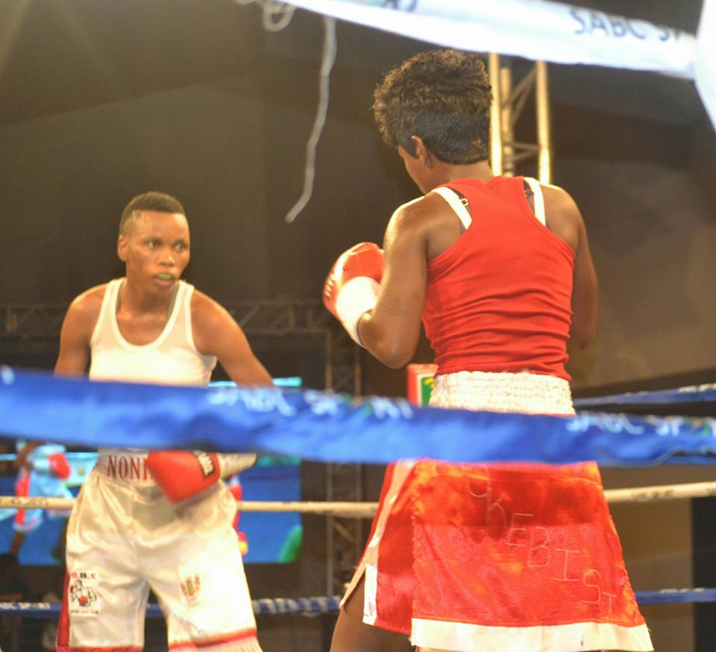
BSA
STRATEGIC INFLUENCES
National Development Plan
Government Outcome 14
White Paper on Sport and Recreation
National Sport and Recreation Plan
Medium Term Strategic Framework
BSA Strategic Plan
Annual Performance Plan

Slide 4
STRATEGIC PLANNING 2015 - 2020
Vision:
To be a leading sporting code in South Africa and world class boxing authority
Mission:
To develop, promote and effectively regulate the administration of boxing in SA, by:
Ensuring and safeguarding the health, safety and general well-being of professional boxers;
• Promoting, marketing and sanctioning quality boxing events and tournaments;
Increasing the sport’s popularity with athletes, supporters and sponsors;

Slide 5
STRATEGIC PLANNING 2015 - 2020
Mission: (cont…….)
Credibly rating boxers and training licensees;
Positioning BSA as a point of reference for international sanctioning bodies in South Africa and ensuring that BSA fulfils its role as a custodian of the best interest and concerns of all South African Boxers at home and on the international front;
Improving the stature of national and provincial titles; and
Coordinating the activities of all boxing stakeholders in the country for the purposes of unifying the sporting code and managing expectations with integrity.

Slide 6
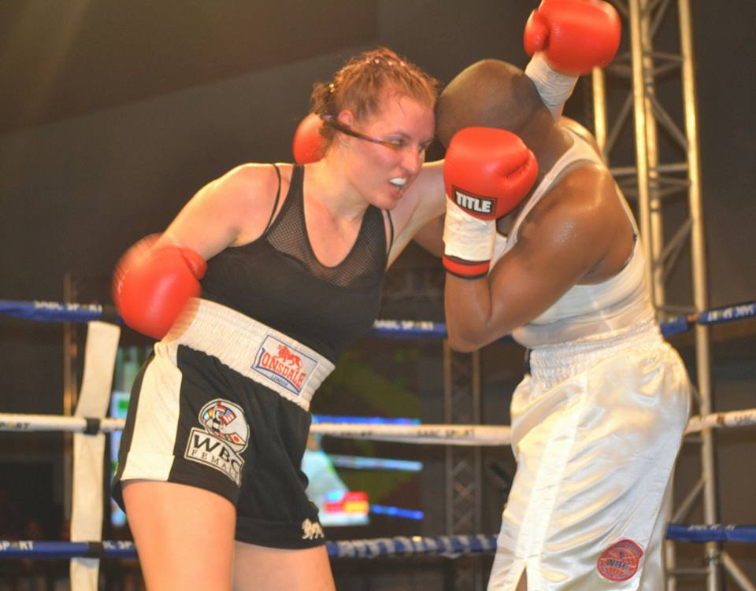
To ensure an effective, efficient and sustainable organization.
STRATEGIC GOALS 2015 - 2020
GOAL 1: Effective and sustainable organisation

Slide 7
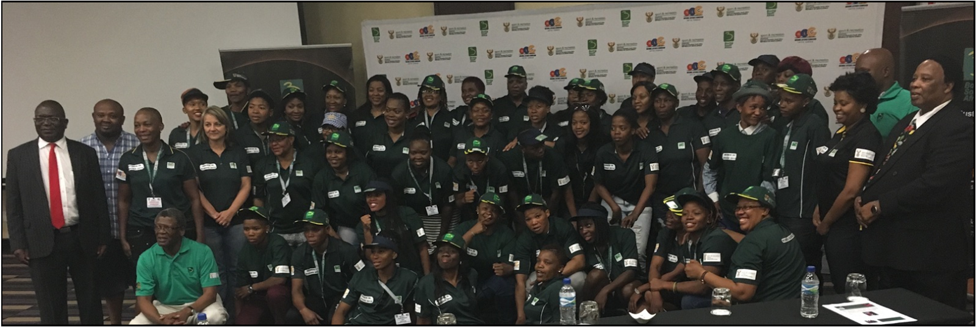
STRATEGIC GOALS 2015 - 2020
GOAL 2 : Transformed and regulated environment

Slide 8
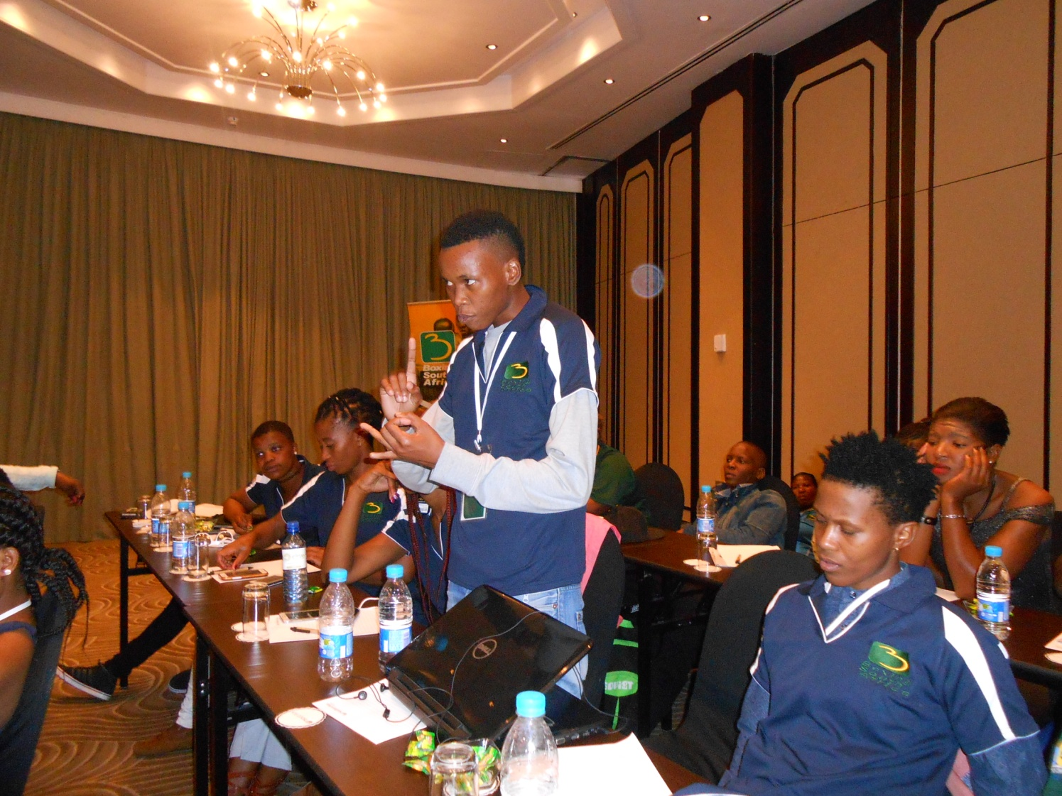
STRATEGIC GOALS 2015 - 2020
GOAL 2: Transformed and regulated environment
To ensure the development and transformation of boxing and create synergy between professional and amateur boxing.

Slide 9
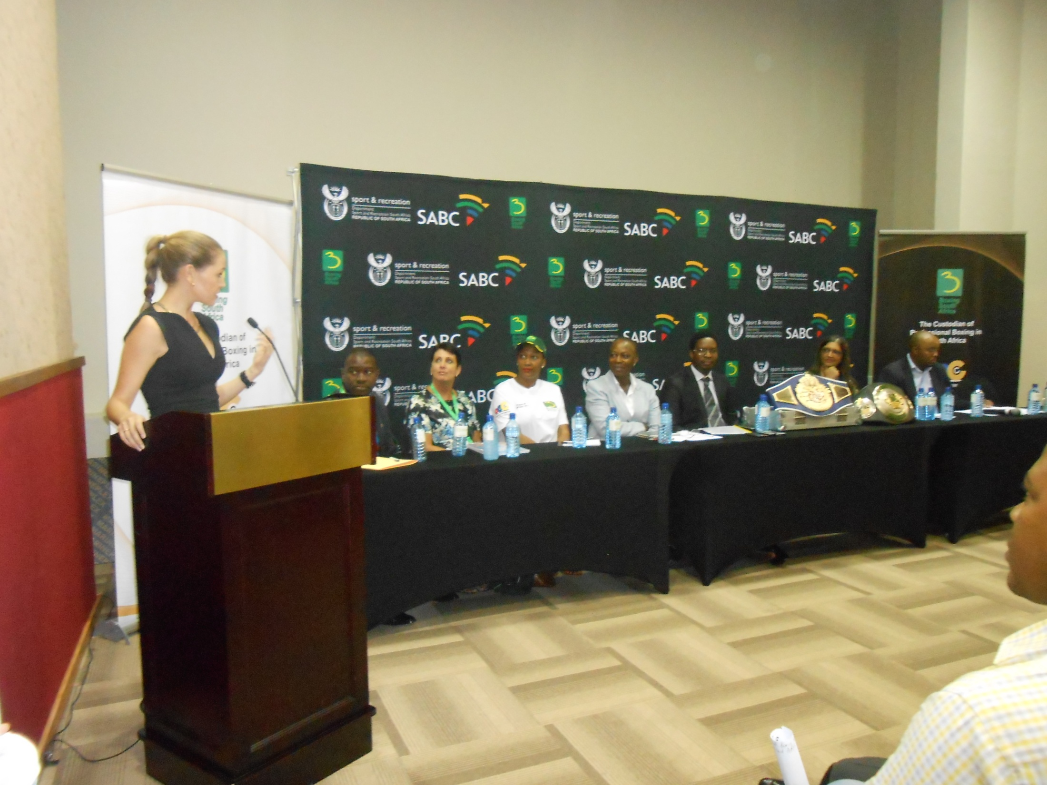
STRATEGIC GOALS 2015 - 2020
STRATEGIC GOALS 2015 - 2020
GOAL 3: Marketing, communication and stakeholders managed
To ensure that there is marketing of boxing and to promote interaction
between associations of boxers, managers, promoters, trainers
and officials and BSA.

Slide 10
BUDGET PROGRAMME STRUCTURE
Prog 3: Boxing Promotion
Prog 2: Boxing Development
Prog 1: Governance and Administration

Slide 11
BUDGET PROGRAMME PURPOSES
Governance and administration
To provide strategic leadership, good corporate governance and the overall administration and financial sustainability of boxing.
Boxing Development
Boxing Promotion
To promote and market boxing to improve its public profile, increase its brand value as well as coordinate premium BSA events across the country.
To ensure compliance with the key aspects of the boxing Act, and rules regulations and enforce their application where non-compliance is observed
The programme will drive compliance with the licensing of practitioners, sanctioning of BSA events, rating of boxers as well as the coordination of training needs of all licensees to enable them to meet the requirements of the regulations.

Slide 12
STRATEGIC OBJECTIVES
Governance and Administration
Strengthen governance and oversight
Boxing Development
Systems and protocols
Boxing Promotion
Marketing and communication strategy
Improve administrative capacity,
Stakeholder engagement framework.
Boxing sponsorship
Events coordination
Revenue generation
Funding model
Licensees training and development
Education and awareness
Compliance and enforcement
Partnership agreements MOU’s with international sanction bodies
Sanctioning and ratings
Legislation (Amendment of Boxing Act)
Woman in Boxing
National Coverage
Health and Safety
Associations assisted

Slide 13
RISK MANAGEMENT
Risk Description | Mitigation Action (s)
Insufficient funding and lack of revenue sustenance. | 1, Solicit Sponsorship 2. Develop a revenue generation and collection strategy. 3. Revive and maintain relations with broadcasters.
Key strategic positions left unfilled and identification of new. | 1, Review the organogram. 2. Fill all vacant posts. 3. Attract and retain skilled personnel.
Constraining limitation within the South African Boxing Act and BSA not fully complying with legislations | 1, Lobby for review and amendment of the Act. 2. Create awareness across stakeholders
Licensees not complying/dissatisfied with SA Boxing regulations | 1. Enforce compliance with all legislations. 2. Consultation and stakeholder awareness. 3. Review process and procedures
Negative coverage of boxing | 1, Develop a communication and media liaison strategy. 2. Inform and educate stakeholders. 3. Participation/interaction/collaboration/ Integration.

Slide 14
BOXING SA ORGANISATIONAL STRUCTURE
CHIEF EXECUTIVE OFFICER
PA to CEO
DIRECTOR OF OPERATIONS
HR MANAGER
CHIEF FINANCIAL OFFICER
TECHNICAL ASSISTANT
IT OFFICER
FINANCIAL MANAGER
DRIVER
GENERAL ASSISTANT
FINANCE OFFICIAL
RECEPTIONIST

Slide 15
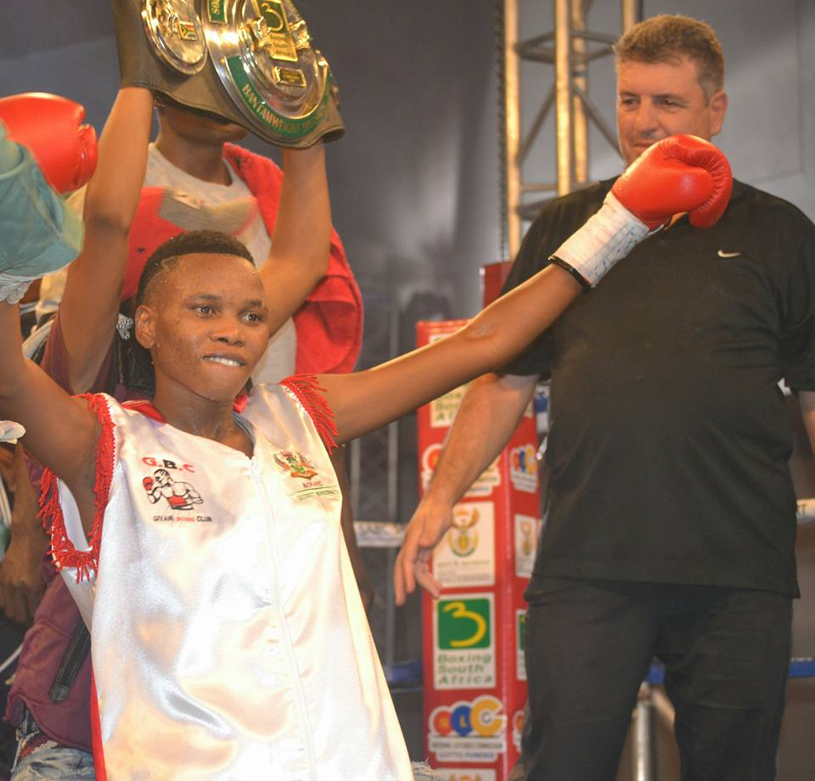
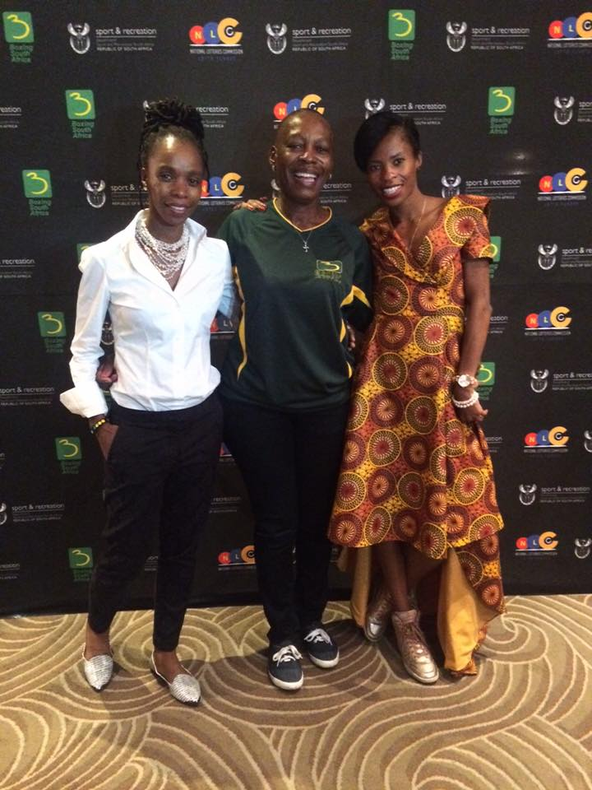
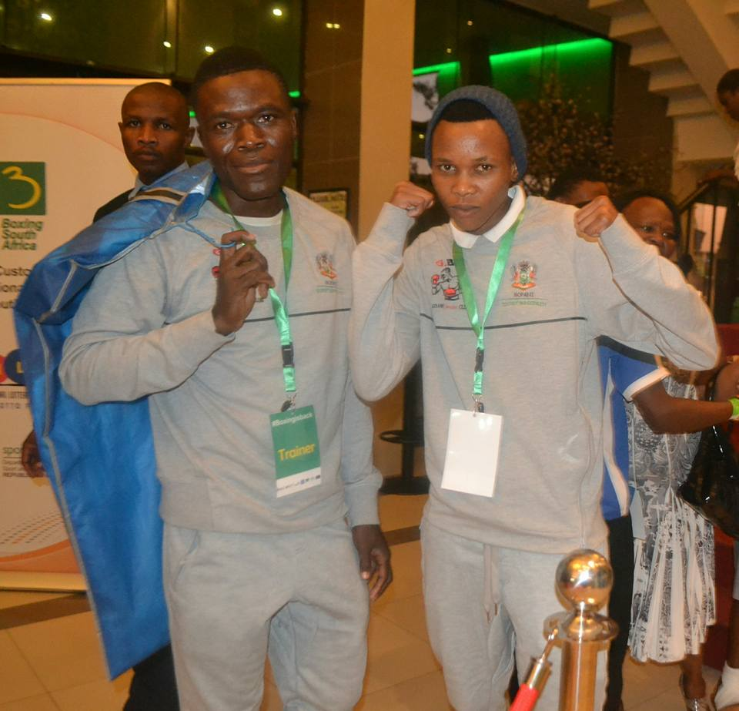
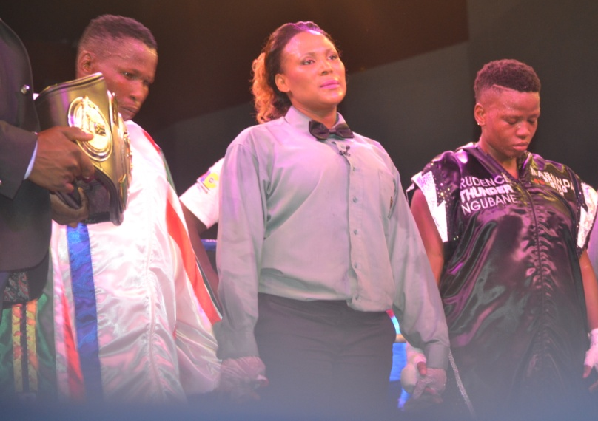
ANNUAL PERFORMANCE PLAN 2016-2017

Slide 16
SUB – PROGRAMMES
Governance and Administration
The Office of the CEO and Corporate Services
The Stakeholder Mobilisation and lobbying
The Board

Slide 17
2016/17 DELIVERABLES
GOVERNANCE AND ADMINISTRATION
The Board
Meetings of the Board held and its sub committees.
Implementation of Board resolutions.
Office of the CEO
CEO’s reports on management of the entity.
Stakeholder mobilization
Boxing Mobilization events
Implementation of Board resolutions.
Strategic stakeholder networking

Slide 18
SUB – PROGRAMMES
Boxing Development
Licensing, sanctioning and ratings
Regulations and compliance and enforcement
Licensees training and development

Slide 19
2016/17 DELIVERABLES
BOXING DEVELOPMENT
Licensing, Sanctioning and ratings
Increase in a number of registered licensees by BSA
Licensees training and development
Boxers and ring officials trained and developed on life skills.
Regulations compliance and enforcement
Licensees and boxing facilities visited across the country to check level of compliance.
Sanctioned events or tournaments as per the set standards.
Conduct ratings on monthly basis.
Ensure licensees compliance with regulations

Slide 20
SUB – PROGRAMMES
Boxing promotion
Marketing and branding
Events coordination
Communication
Revenue generation

Slide 21
2016/17 DELIVERABLES
BOXING PROMOTION
Marketing and branding
Lobbying television rights with at least one broadcaster.
Communication
Developed communication strategy to popularize BSA programmes.
Events coordination
Identify and promote nationally boxing premium events.
Develop marketing and branding strategy.
Secure sponsorship for boxing sport.

Slide 22
THANK YOU!!!

