Slide 1
The Role of State Owned Companies in Supporting Localisation and Local Procurement in South Africa
PORTFOLIO COMMITTEE ON PUBLIC ENTERPRISES
16 March 2016

Slide 2
Purpose of the Presentation
An overview on some of the economic changes facing South Africa
Role of the SOCs in Economic Development
PPPFA and Local Content
Regulation 9.3 of the PPPFA
List of Designated Sectors (approved, outstanding and not approved)
Highlights on Designated Sectors
Priority areas for consideration

Slide 3
The National Challenges
Socio-economic challenges facing South Africa
Unemployment
Inequality
Skills shortage
Growing population
Infrastructure shortage
Limited industrial capacity
Reliance on resource export
The National Agenda
Job creation
Skills development
Normalising society and economy
Local procurement and economic growth
Infrastructure development
Government Response
National Development Plan
New Growth Path
IPAP
Local Procurement Accord
CSDP
B-BBEE
SME development
Overall policy reform
PPPFA, designation

Slide 4
Problem statement
Economic Challenges Facing SOCs
  The problem in South Africa is that the SOCs have not been investing adequately infrastructure development.
  Consequently the binding constraints to industrialisation include:
    decades of under-investment in economic infrastructure;
    rising administered costs such as high port and freight charges with port charges amongst the highest in the world; and
    electricity supply challenges and rapidly rising cost amongst others.
  The resolution of all these depends on how the SOCs carry out their mandate.

Slide 5

1. Problem statement
Fixed Investments by the Public Sector

Slide 6
RSA: Manufacturing challenges & the need for localisation
The manufacturing sector’s contribution to SA GDP declined sharply from 20.9% in 1994 to 11.6% by 2014, whilst the mining sector’s share increased from 7.3% to 9.2%.

Slide 7
Manufacturing Import Leakage in South Africa
Source: SARB, IDC, the dti

Slide 8
1. Problem statement
The Role of SOCs in Economic Development
The 9PP identifies the role of SOC’s as fundamental to the SA economic recovery:
  Direct impact on growth e.g. Energy and Broadband constraints are potentially costing the economy 1% each,
  Transport incl. port infrastructure is constraining value-added exports,
  Not localising will worsen the current account deficit and become a brake on economic growth,
  Resolving the infrastructure constraints and localising infrastructure inputs could add as much as 2.4% – 3.2% to our GDP.
Global experience suggests that SOCs are in a unique position to drive industrialisation through investments in infrastructure and direct investment and support for building domestic industrial capabilities.

Slide 9
Problem statement Cont’
  Another critical lever for industrial development is localisation, when SOCs invest in infrastructure they must ensure they use locally manufactured products.
  This is in line with the Government’s local content programme as well 75% local procurement target.
  This industrialisation programme therefore is not a narrow departmental objective but a national one that needs to be committed to by all state agencies
  SoEs must be the drivers of our industrialisation programme and there are several policy levers that empower them to do that.

Slide 10
Procurement Levers
National Industrial Participation Programme (NIPP)
  Applicable to all government procurement, except State Owned Companies (SOCs) that have opted for CSDP
  Imported Content => US$10 million
  Direct NIPP & Indirect NIPP
Defence Industrial Participation
  Managed by Armscor and applicable to all defence procurement
  Imported Content => US$2 million
CSDP
  Managed by DPE in conjunction with State Owned Companies (SOCs)
  Used in instances where there are long term Supplier Development Plans in place
  Designation & Local Production
  Used in instances where government has carried out an in depth analysis of the sector and there is local production capacity and public procurement opportunities.

Slide 11
Different and Linked Aspects of Localisation
Key policy objectives | Focus areas
Industrialisation | Leveraging procurement spend to foster industrial and competitive capabilities in the South African economy
Localisation Country Province/Municipal Site/Operation | Utilisation of procurement spend to develop South African based suppliers (integrating B-BBEE and Black Owned suppliers)
Skills development | Increasing the skill base (number and skill level) of South African workers, especially in areas where there is a national scarcity of skills
Employment and job creation | Creation of new jobs directly and indirectly by suppliers in the value chain
Enterprise and supplier development programmes | Providing a platform for SA-based suppliers to develop into national and international suppliers, through Capability, Capacity & Competitiveness development

Slide 12
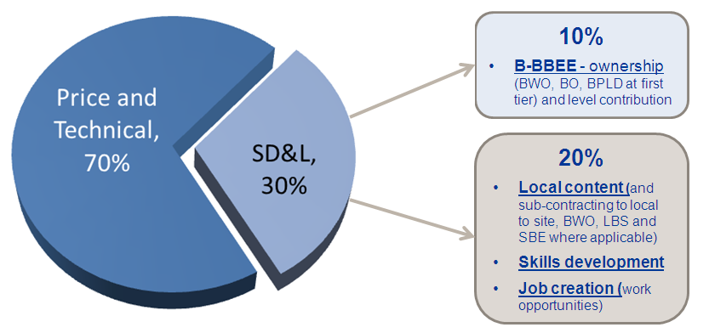
SD&L evaluation criteria
Eskom’s Supplier Development & Localisation Criteria
The evaluation criteria seeks to increase SD&L evaluation score allocation in the overall scoring and to ensure all dimensions of local development are considered:
| 12

Slide 13
Eskom’s Supplier Development & Localisation Criteria
Criteria | Weight (%) | Total Target (%) | Proposed Target (%) | Total Overall Weighted Score
Local Content to South Africa | 30% | 70% | 0 | 0
Local to site | 15% | 10% | 0 | 0
Procurement from LBS | 15% | 10% | 0 | 0
Procurement from BWO (Local to site) | 10% | 5% | 0 | 0
Procurement from SBE(Local to site) | 10% | 5% | 0 | 0
Skills development | 20% |  |  | 0
Total | 100% |  |  | 0
 | Localisation Score. |  |  | 0
Note: A Supplier’s tender response must achieve a total Localisation score greater than 60% to get to the next stage of tender evaluation process. Some suppliers might be locally-based but importers.

Slide 14
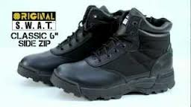

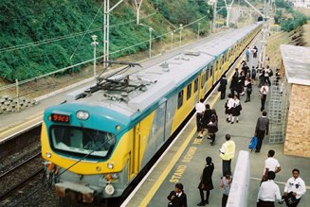
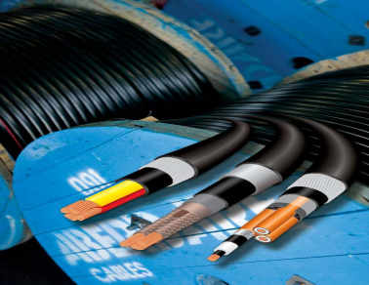
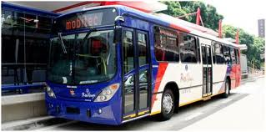

Understanding of Local Content Value Chain & Linkages
 | Supply Chain Programme Management: Once off opportunity Manufacturing has longer term opportunity due to added O&M phase
 | Design | Material | Manufacturing/ Construction | Testing | Commissioning | O&M | Decommissioning/ Disposal
Scope | Understanding Current Industry Capabilities |  |  |  |  |  |  | GAP Analysis
 | Research ad Development
 | Finance / Funding
 | Skills Development
 | BBBEE / Transformation
 | Intellectual Property / Technology Transfer
 | Appropriate Legislation
 | Procurement Process
 | Contract Management (Penalties and Incentives)
 | Supplier Relationship Management

Slide 15
PPPFA and Local Content
  Preferential Procurement Policy Framework Act (PPPFA) was enacted in 2000, and its Regulations promulgated in 2001
  The Regulations were amended in 2011 and new regulations came into effect on 7 December 2011.
  Section 9: Local Production and Content
  Paragraph 9 (1) of the Regulations empowers the dti to designate specific industries where tenders should prescribe that only locally manufactured products with a prescribed minimum threshold for local production and content will be considered
  To give effect to government decisions on public procurement; sectors/products were and are being designated for local production

Slide 16
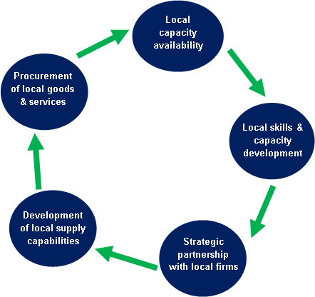
Key Elements of a Local Content Programme
“Local Content” means that portion of the tender price which is not included in the imported content, provided that local manufacturing does take place within the borders of South Africa (SABS Approved Technical Specification SATS 1286:2011)
Source: Adapted from Lunde (2013)

Slide 17
Designated Products

Slide 18
Leveraging South Africa’s Rail Industry Strengths
As the Continent’s major rail country, the South African rail industry is uniquely positioned to support the growth in freight and passenger rail on the continent…
South Africa is the continent’s leading rail country in terms of both freight and passenger rail infrastructure, as well as rolling stock assets.
The South African rail sector has developed capabilities, skills and expertise as manufacturer, assembler and supplier of rail infrastructure, rolling stock and components, including the refurbishment and rejuvenation of aged rail and rolling stock infrastructure and components.
South Africa’s own substantial investments in its freight and passenger rail and rolling stock infrastructure over the next decade will further strengthen and deepen its participation in important aspects of the rail industry value chain.

Slide 19
Progress on Designated Sectors
Rail fleet procurement
  Under rolling stock, PRASA and Transnet Freight Rail (TFR) are implementing CAPEX programme: Alstom-Gibela will build the PRASA coaches/EMUs (3600 coaches at the cost of R51 billion) and the 1064 locomotive programme is delivered by GE & CNR for diesel locos and CSR & Bombardier for electric locos. The following deliveries have happened to-date:
    First 2 of 20 train-sets for PRASA built by Alstom-Gibela in Brazil. The local factory is being established in Nigel to assemble the remaining units
    First 6 of Class 44 diesel locomotives built by GE in the USA. The assembly of the remainder has commenced at TE Koedoespoort
    First 40 of Class 22E dual voltage electric locomotives built by CSR in China. The assembly of the remainder has commenced at TE Koedoespoort
    CNR will do the assembly at TE facility in Durban and also working with MTU SA for local assembly on diesel engine
    Bombardier will do the assembly at TE facility in Durban

Slide 20
Progress on Designated Sectors
Rail fleet procurement
  At the back of these OEMs work packages:
    IEC Holden assembled the first SA made AC traction motors under the Bombardier loco contract
    BT built a Propulsion and Controls Production facility in Elandsfontein
    Over 50 companies are benefiting from both the PRASA and TFR contracts directly or through the Tier 1 suppliers. However, they are challenges (e.g. cash flow issues and weak balance sheets) which has the potential to erode their installed capacity and be replaced with imports
  Interventions have been made at the various foundries to improve competitiveness under the National Foundry Technology Network
    Mitech, Guestro and Dhuva Foundries, amongst others, revamped their manufacturing facilities with a state-of-the-art equipment to gear themselves to meet the local content requirements for rolling stock and valves designations but have financing challenges

Slide 21
Rail fleet procurement

Slide 22
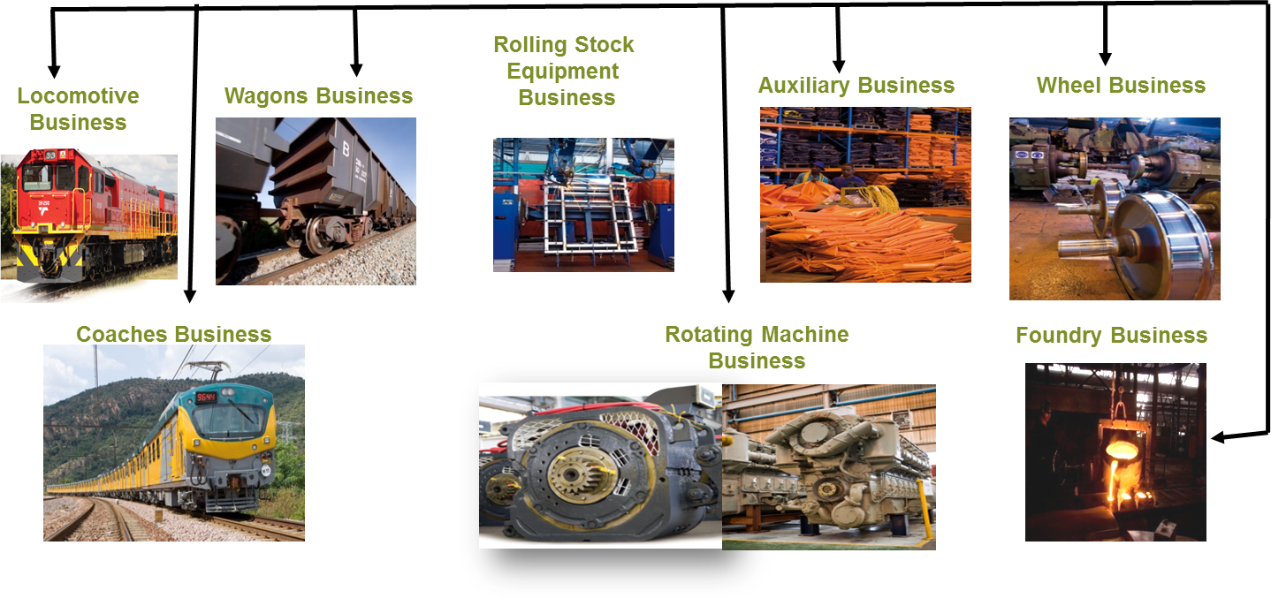
Rail Rolling Stock Opportunities

Slide 23
Transnet National Ports Authority (TNPA)
Transnet National Ports Authority (TNPA) and Transnet SOC Limited have adopted a Public- Private -Partnership (PPP) model to finance new Operation Phakisa infrastructure.
  TNPA has committed R7 billion for public sector investment in domestic ports to support industrial opportunities in the ports
Establishment of Saldanha Bay as an oil and gas hub:
  Total scope of initiative amounts to R9.2 billion investment (public and private).
    1. Offshore Supply Base – work has commenced.
    2. Berth 205 (rig repair facility)
    3. Mossgas Jetty (extension)
the dti designated working vessels for local procurement (60% local content). National Treasury issued Instruction Note.
A R1.4bn tender by TNPA for the procurement of tug boats was awarded to a South African company in support of local procurement

Slide 24
Role of Denel in Regional Aircraft Development
The Small African Regional Aircraft Program involves developing a 24 seat passenger / freight pressurised African air taxi.
This can act as a base-load of demand for the sustaining and building of an entire cluster.

Slide 25

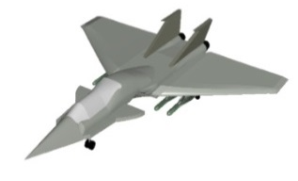


Defence’s role in Industrial Development
Metals, plastics, fabrics,…
Railway rolling stock, transport & logistics
Software, design,…
Engines, propulsion systems
Electronics
Automotive
Road freight
Mechanical & Electrical Engineering

Slide 26
Local Procurement of Non-Designated Products
Regulation 9 (3) prescribes that “…where there is no designated sector, an organ of state may include, as a specific tendering condition, that only locally produced services, works or goods or locally manufactured goods with a stipulated minimum threshold for local production and content, will be considered, on condition that such prescript and threshold(s) are in accordance with the specific directives issued for this purpose by the National Treasury in consultation with the dti”.
Consideration:
  Constitutional and legal compliance
  Economic and fiscal considerations
  Long term public procurement plan and expenditure
  Alignment with policy objectives, in particular the creation and retention of decent jobs
  Promotion of SMME’s, geographic spread, technological capabilities
  Local manufacturing capacity and security of supply

Slide 27
Priority areas for consideration
  The alignment of procurement levers to optimise industrial development
  Develop and agree on instruments to support the government’s 75% Local Procurement Target
  Finalise and implement guidelines on Regulation 9.3 of the PPPFA
  On-going efforts to secure stronger alignment with the Department of Public Enterprises (DPE) and Transnet with respect to localisation and supplier development in the rail procurement across all OEM’s in the rail fleet procurement
  On-going efforts to secure stronger alignment with the National Industrial Participation programme (NIPP) to secure investment in key industrial sectors

Slide 28
Priority areas for consideration
  Participate in the PPPFA Reforms (amendment of the Act, Regulations and Competition policy issues)
  Powers to deal with non-compliance on local content / designation
  An engagement is currently taking place with the Auditor General’s Office to develop a framework to audit compliance and expenditure on designation / local content
  Alignment of BB-BEE Scorecards (enterprise and supplier development) and Competitive Supplier Development Programme
  Capacity building in local content management, planning, sourcing and supplier development

Slide 29
Thank You

