Slide 1
Submission on 2016 Division of Revenue EQUAL EDUCTION AND EQUAL EDUCATION LAW CENTRE STANDING COMMITTEE ON APPROPRIATIONS Friday 11 March 2016 Parliament, Cape Town
Andile Cele, Tshepo Motsepe and Solminic Joseph

Slide 2
Contents
Introduction
School Infrastructure
Funding
Education Infrastructure Grant
Accelerated Schools Infrastructure Deliver Initiative
Norms and Standards
Scholar Transport
Contextual Background
Challenges in the provisions of scholar transport assistance
Funding for Scholar Transport
Concluding Remarks and Recommendations

Slide 3
Introduction
EE is a movement of learners, parents, teachers and community members working for quality and equality in the South African education system through research, analysis and activism. We are based in the Western Cape, with satellite offices in Gauteng and the Eastern Cape, and a strong presence in Kwa-Zulu Natal and Limpopo
The Equal Education Law Centre Trust is a registered non-profit trust, established for the sole object of providing legal services for the benefit of poor and needy persons through the establishment, management and supervision of the Equal Education Law Centre(EELC).
The main object of the EELC is promoting equitable, adequately resourced and high quality education in South Africa through the provision of specialised legal services and advice on matters concerning education, having particular regard to the needs of socially and economically disadvantaged persons.

Slide 4
…Introduction
The EELC is closely aligned with the objectives of Equal Education.
Legal representative of Equal Education in all major campaigns, including their campaign for the implementation of the minimum norms and standards for school infrastructure and the Scholar Transport Campaign.
Provide research support for campaigns

Slide 5
…Introduction (Cont.)
The purpose of the presentation is to comment on the 2016 Division of Revenue Bill (DoRB)
Provide overview of expenditure trends and delivery through the EIG and ASIDI
Highlight the Norms and Standards deadlines and necessary funding
Examine the necessity of adequate scholar transport funding
Present recommendations for Parliament to consider

Slide 6
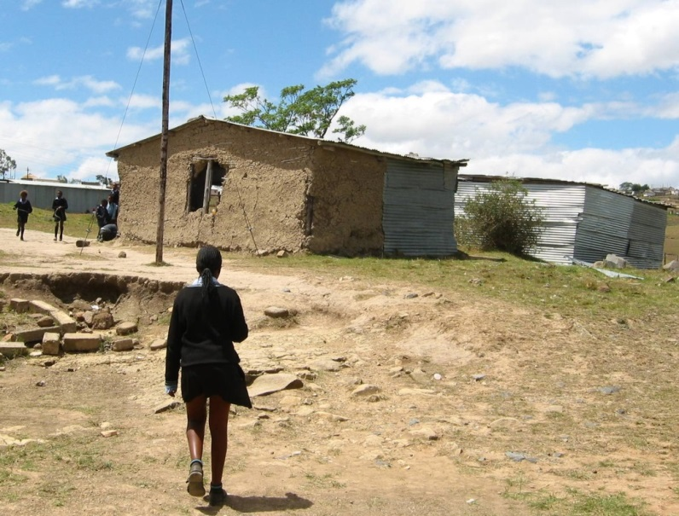
Infrastructure
There has been significant progress made in the delivery of school infrastructure BUT many South African schools are still considered unsafe or ‘inappropriate’.
The eradication of mud schools in South Africa is terribly long overdue.
In 2004, former President Thabo Mbeki announced that…
“…by the end of this year (2004/05) we shall ensure that there is no pupil learning under a tree, mud school or any dangerous conditions that expose pupils and teachers to the elements”

Slide 7
Funding
Two dedicated sources of funding for school infrastructure: the Education Infrastructure Grant (EIG), and the School Infrastructure Backlogs Grant (SIBG) also known as the Accelerated School Infrastructure Delivery Initiative (ASIDI).
Provinces can also choose to contribute funds towards school infrastructure from their Equitable Share (ES) transfers.

Slide 8
Education Infrastructure Grant (EIG)
EIG is intended to be supplementary to provincial infrastructure funds.
It also has the purpose of enhancing the speed with which infrastructure is delivered; inclusive of maintenance, rehabilitation and upgrading of new and existing infrastructure.
Implemented by Provincial Departments of Education.

Slide 9
EIG (Cont.)
Table 1: Total allocations to the education infrastructure grant
R’000 | 2014/15 | 2015/16 | 2016/17 | 2017/18 | 2018/19
2013 | 7,160,699 | 10,059,320
2014 | 6,928,908 | 9,469,408 | 10,037,961
2015 |  | 9,517,555 | 9,773,692 | 10,330,562
2016 |  |  | 9,613,692 | 12,780,435 | 13,511,560
Sources: National Treasury 2013, 2014 , 2015 Division of Revenue Act and 2016 Division of Revenue Bill

Slide 10
EIG (Cont.)
The overall 2016 EIG budget increases by a mere 1% this year. This is R160 million less from what was initially projected in last year’s national Budget.
Increases in the outer years are as a result of diverting ASIDI funding toward EIG in 2017/18, and not necessarily due to additional funding being put forward by Treasury.
While the allocation for 2015/16 is slightly more than the previous forecast in the 2014 national Budget, it is almost R500 million less than the very first estimate for the 2015/16 year which was presented in the 2013 national Budget.
The projected allocation for 2016/17 in the 2015 Budget is also less than the amount forecasted in the 2014 Budget.

Slide 11
EIG (Cont.)
In 2012/13, before the publication of the N&S, a total EIG allocation of R6.3 billion was projected for the 2014/15 year. In the next year, this allocation was revised upwards to R7.2 billion. However, in the 2014 Budget, this allocation was revised again and reduced slightly to R6.9 billion.
While there is no solid long term trend, both actual budget allocations in the two years after the publication of the N&S (2014/15 and 2015/16) are either less than the revised forecast or less than the first forecast for that year, suggesting less money being allocated to the provision of school infrastructure despite the additional delivery pressures created by the N&S.
EE wants to know how Treasury (and Education Departments by extension) expect to meet N&S targets if no additional funding is allocated to ensure that all schools are conducive to quality teaching and learning.

Slide 12
EIG Incentive Based Allocations
The 2013 national Budget speech announced that the application process for infrastructure grants was being revised to improve the quality of infrastructure spending. Provinces would have to submit “building plans” two years before implementation, and would only receive allocations if those plans met certain “benchmarks”.
According to the 2016 DoRB, a province needed a score of 60% or more to qualify for an incentive (in addition to its base allocation). Performance appears to be scored on how well provinces are able to plan.

Slide 13
EIG Incentive allocation (Cont.)
Table 2: Provincial EIG incentive allocations
 |  | 2016/17 (R’000)
R'000 000 | Planning Assessment Score | Basic Component | Incentive Component | Disaster Recovery Funds | Final Allocation
Eastern Cape | 62% | 1,443 | - | 61 | 1,505
Free State | 54% | 695 | - |  | 695
Gauteng | 64% | 1,252 | 133 |  | 936
KZN | 64% | 1,825 | 133 |  | 1,958
Limpopo | 46% | 830 | - |  | 830
Mpumalanga | 27% | 788 | - |  | 788
Northern Cape | 69% | 353 | 133 | - | 486
North West | 60% | 787 | 133 | 51 | 971
Western Cape | 78% | 858 | 133 | - | 992
TOTAL |  | 8,834 | 666 | 112 | 9,613
Source: National Treasury. 2016 Division of Revenue Bill (Table W1.20) Education Infrastructure Grant Allocations, p.85

Slide 14
EIG Incentive allocation (Cont.)
Limpopo and Mpumalanga had the poorest scores and did not receive any incentive allocation. The EC was also among those who did not receive an incentive allocation. Limpopo has consistently scored poorly and missed out on incentive allocations
It is alarming to note that the provinces that need the additional funding the most (the EC and Limpopo) fail to receive the necessary funds.

Slide 15
Concerns Raised
Equal Education is concerned that the current mechanism for scoring “performance” fails to take into account actual implementation – thereby failing to incentivise school infrastructure delivery. However, it is also the case that an exclusive focus on delivery disadvantages poorer provinces. Hence, we call for a more nuanced approach to assessing performance.
This year the Eastern Cape, Free State, Mpumalanga and Limpopo scored poorly on their User Asset Management Plans (U-AMPs) and did not qualify for the incentive.
This allocation methodology, although aimed at incentivising provinces to improve infrastructure planning, could further create inequities in school infrastructure by benefiting only the better performing, well-resourced provinces such as Western Cape and Gauteng while poorer provinces – provinces with significant needs – fail to qualify.

Slide 16
Concerns Raised
The Eastern Cape has the highest need in terms of school infrastructure and is highly dependent on the EIG which accounts for a large share (between 77% and 98% depending on the year under consideration) of its provincial education infrastructure budget.
Another potential disadvantage is the definition of performance. Provinces are currently evaluated for incentive allocations based on their performance on planning and not in terms of actual delivery of school infrastructure.
The impact of good plans on actual implementation is not guaranteed and in some provinces this is still to be seen. It is one thing to produce a plan but quite another to implement it. The conditions in which EIG is being implemented differ from one province to another.

Slide 17
Concerns Raised
Incentives targeted at improving planning alone will not be sufficient to address these service delivery challenges but rather the focus should be on creating incentives that will strengthen institutional weaknesses through capacity building and by rewarding improvements in actual delivery of school infrastructure.
Planning by the Provincial Departments of Education is currently being evaluated, but they are not the implementers of the grant – they are the administrators. Performance based incentives need to be comprehensive and inclusive of actual implementers of the grant, and there is also a need to stringently monitor the Provincial Departments of Public Works as well as other implementing agents and private service providers.

Slide 18
Concerns Raised
The incentive requirements for EIG outlined in DoRB do not require that Provincial Educations Departments produce a monitoring and evaluation plan, and neither does it require citizen participation.
The performance based approach should guard against unfairly disadvantaging poorer provinces. The design of the grant needs to take into account the different capacity levels, stakeholders, and conditions in which provinces operate when implementing the EIG, but still maintain a strong emphasis on actual school infrastructure delivery and implementation.

Slide 19
Accelerated Schools Infrastructure Delivery Initiative (ASIDI)
The SIBG – commonly known as the Accelerated Schools Infrastructure Delivery Initiative (ASIDI) – was first introduced in 2011 as a short-term measure to fast-track the eradication of inappropriate school infrastructure, and to provide water, sanitation and electricity to specific schools (most of which are located in the Eastern Cape).
Grant is managed by national DBE.
It was meant to conclude in 2014/15, but due to a number of challenges was extended to 2017/18

Slide 20
ASIDI (Cont.)
Prior to the introduction of the N&S, R13 billion was set aside to implement ASIDI.
Despite the target period for ASIDI being extended, if total actual and adjusted expenditure on ASIDI is added to the projected allocations for the 2016 MTEF period, only R8.904 billion would have been spent on ASIDI by 2017/18.
ASIDI allocations have been reduced by over R4.1 billion

Slide 21
ASIDI (Cont.)
Table 3: Total allocations to ASIDI: 2012 MTEF
R'000 | 2012/13 | 2013/14 | 2014/15 | Total
2012 DoRA | 2,315,000 | 5,189,000 | 5,500,340 | 13,004,340
Source: 2012 DoRA, p.96
Table 4: Actual ASIDI expenditure and budget allocations
R’000 | 2012/13 | 2013/14 | 2014/15 | 2015/16 | 2016/17 | 2017/18 | 2018/19 | Total
2016 ENE | 859 628 | 1 370 124 | 2 407 887 | 2 024 310 | 2 242 143 | - | - | 8 904 092
Source: 2016/17 Basic Education Budget, pg. 28

Slide 22
ASIDI (Cont.)
The above figures indicate a vast decrease in ASIDI; allocations have been reduced by over R4.1 billion, from R13 billion to R8.9 billion in the current form of the fund.
Turning to actual expenditure by the DBE it emerges that while the overall Budget may have an allowance of R8.9 billion for ASIDI, the reality is that even less than that amount has been spent by the DBE.

Slide 23
ASIDI (Cont.)
Table 5 : Actual Expenditure against Allocations
R’ 000 | 2011/12 | 2012/13 | 2013/14 | 2014/15 | 2015/16 | Total
DoRA Allocation | 700 000 | 2 065 000 | 2 489 000 | 2 540 484 | 2 046 186
Actual Expenditure | 76 084 | 859 628 | 1 392 307.2 | 2 542 860 | 1 066 148 | 5 937 027.2
Source: DBE Presentation to Select Committee on Appropriations, 02 June 2015
DBE has only spent R5.94 billion of the R 8.9 billion on table, this is R7.1 billion less
Than the initial R13 billion set aside for ASIDI in 2011/12

Slide 24
ASIDI (Cont.)
With ASIDI merging with the EIG next year, EE has a few concerns. The advantage of the merger is that EIG performance and expenditure has been better than that of ASIDI.
The main disadvantages are that ASIDI was initially introduced because provinces highlighted a lack of sufficient funds to address schools made out of inappropriate material, and funding for other school infrastructure projects.
Provinces, particularly those with significant backlogs, no longer have additional funding for school infrastructure (in the form of ASIDI), and this will require them to compete with one other for EIG funding.
The merger of the grants will also mean that provinces must commit large amounts of their Equitable Share (ES) toward infrastructure – something which they have failed to do in the past (as in the case of Limpopo which last year contributed 0% of its ES).

Slide 25
Positives
Provincial allocations as tabled in the 2016 Division of Revenue Bill indicate increases for some provinces. It is encouraging to see that total allocations to ASIDI in 2016 increase by 16% from 2015.
The EC sees a large increase of 42%. This is in line with the desperate need for infrastructure in the EC.

Slide 26
Minimum Norms and Standards
In November 2013, the regulations relating to Minimum Uniform Norms and Standards for public school infrastructure (N&S) were published by Minister Motshekga.
First deadline: 29 November 2016
All schools without any access to water, electricity and sanitation must be provided with these basic services, and all schools built from inadequate materials like mud, wood, metal and asbestos (i.e. inappropriate schools), must be eradicated.
EE is not convinced that DBE will be able to meet this target.
Our analysis has shown (1) additional allocations have not been made in the 2016/17 Budget to accommodate the N&S, and (2) the allocations that were made before the N&S came into effect have been reduced.

Slide 27
N&S (Cont.)
How will the N&S be funded?
How much will it cost?
How will the N&S deadlines be met?

Slide 28
Recommendations
The national government should undertake a costing assessment to determine the budget allocations that will be required for provinces to comply with the Norms and Standards for school infrastructure.
The DBE should monitor and oversee the development of provincial capacity to build new schools and improve existing schools.
The planning and development of schools that meet minimum Norms and Standards should be undertaken in an open and transparent manner.

Slide 29
Scholar Transport
Contextual Background
School learners across South Africa walk vast distances to school, particularly in the rural areas in KwaZulu-Natal and the Eastern Cape.
Walking long distances has a direct impact on learner attendance, high drop-out rates, low concentration levels and poor academic performance.
The failure to provide learners with scholar transport assistance undermines their right to a basic education.
Additionally learners are exposed to safety risks such as sexual assault, inclement weather and unsafe private transport.

Slide 30
Challenges in the Provision of Scholar Transport Assistance
Collaboration between the Departments of Transport and Basic Education to ensure adequate data-capturing of learners in need.
Budgeting to ensure that this need is met.
Service delivery to intended beneficiaries.
Lack of clarity on whose responsibility it is to provide this service.
Consequently hinders the ability to hold the responsible State Department accountable for service delivery.
Non-payment of Service Providers.
Lack of funding to meet the demand for scholar transport assistance
2016 Division of Revenue Bill did not allocate funding for learner transport exclusively.

Slide 31
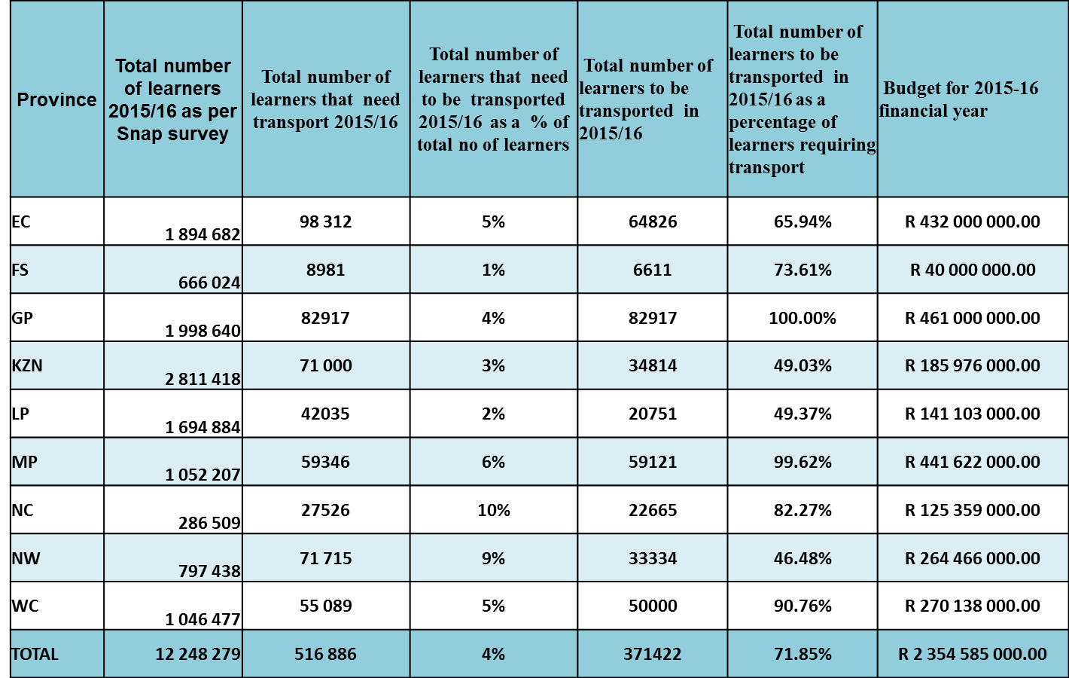
Funding for Scholar Transport
Table 6: 2015/16 Scholar Transport Budget and Expenditure Information and target Information
Source: National Learner Transport Policy Presentation, 08 September 2015

Slide 32
Scholar Transport Budget and Expenditure
Reported figures are intuitively incorrect.
National Household Survey(2013), in KZN alone, there are more than 2 million learners who walk all the way to school. Of these learners, more than 210 000 walk for more than an hour( in one direction), while a further 659 000 learners walk between 30 min to 1 hour.
Without accurate figures of the number of learners in need of scholar transport assistance, needy learners will not benefit from the National Scholar Transport Policy.

Slide 33
National Policy Funding Model
Funding model does not address the growing demand for scholar transport and the budget constraints of Provincial Departments.
Insufficient funding from Provincial Treasury.
Current Policy is silent on whether a conditional grant is being considered despite recommendations by EE to this Committee in November 2013 and April 2014.
Further EE has not been provided with reasons or explanations why this funding model has not been considered should this be the case.

Slide 34
Budget Constraints and Learner Estimates
Provinces are struggling to meet the demand for scholar transport assistance.
Based on the EC and KZN budget estimates, these provinces will continue to under budget for scholar transport over the MTEF.
Lack of accurate data on the extent of the scholar transport problem will result in costing needs for scholar transport being grossly underestimated.

Slide 35
Scholar Transport Grant Design
Conditional Grant to be used specifically for scholar transport. This funding model could protect or ‘ring fence” the scholar transport budget to be used strictly for the purposes of scholar transport.
The Grant allocation formula will take into account the rural terrain of a province, the number of children who qualify and the distances within the province that they have to travel to ensure fair and equitable distribution of resources across the provinces.
The Formula Based Transfers be based in detailed calculations(cost analysis) of the overall provincial scholar transport costs and expenditure needs covering specific considerations: modes of transport-route accessibility-quality and availability of road infrastructure.
Grant funds different interventions most appropriate to the varying scenarios across the provinces.
Grant linked to key outputs or performance indicators. Stronger lines of reporting and accountability.

Slide 36
Concluding Remarks and Recommendations
EE has raised concern regarding shrinking projections for school infrastructure funding and a low commitment for provinces to contribute towards this national priority.
EE calls for greater transparency. We call for both the costing assessments for N&S and provincial implementation plans to be made publically accessible.

Slide 37
Concluding Remarks and Recommendations
EE has raised concern over the performance based incentive approach to awarding additional EIG funds.
We call for a more nuanced approach to assessing performance.
We recommend a thorough assessment of infrastructure delivery in provinces and propose a target-based model that takes provincial capacity and capability into account.
The delivery of school infrastructure needs to be more inclusive and participatory – citizens must be allowed to comment on planning documents, and this means that citizens should be able to access infrastructure reports such as User Asset Management Plans (U-AMPs) and procurement plans.

Slide 38
Concluding Remarks and Recommendations
EE calls for a conditional grant to address scholar transport.
With a conditional grant, provinces will be able to provide a more reliable and consistent service with clarity on the availability of funds.
Conditional grants can empower national government to influence fiscal decisions at the sub national level to ensure that provincial government allocates adequate resources for the achievement of national and constitutional objectives.
Under the provincial fiscus funding model, provinces are free to allocate learner transport budgets according to their own discretion which may be based on other factors and not necessarily based on need.
Conditional grants will ensure that provinces provide necessary and adequate funds for learner transport and “ring fence” or protect these funds from being diverted towards other purposes.

Slide 39
Concluding Remarks and Recommendations
EE calls for an urgent finalization of a scholar transport policy framework and implementation timeline, and the creation of a national Scholar Transport Conditional grant.

