Slide 1
Information Brief to the Joint Standing Committee on Defence The SANDF’s involvement in current Internal and External Operations
South African National Defence Force
Joint Operations Division
11 March 2016

Slide 2
Aim
To brief the JSCD on matters pertaining to current internal and external operational deployments (joint force employment) by the SANDF

Slide 3
Scope
Current deployments:
- Internal
- External
Unique deployment conditions
Conclusion
Questions

Slide 4
Current Deployments

Slide 5
Internal Operations
Name | Type | Area | Force Levels | Duration
ARABELLA | S&R | National | Depends | Depends
CORONA | Border safeguarding | RSA borders | -4 x Bn HQ -13 x Comp Inf Coy -Plans for 2 x addl coys | Continuous Mar 16
CHARIOT | Human assist | National | -Eng ele -Stby helis - Water supply in FS - Veld fires in WC | Per request Nov 15 Jan 16
PROSPER | Sup to SAPS | National | -1 x Standby Coy per Province -Sup by SANDF eles to FOCAC - Sup to Opening of Parliament | Continuous Dec 15 Feb 16

Slide 6
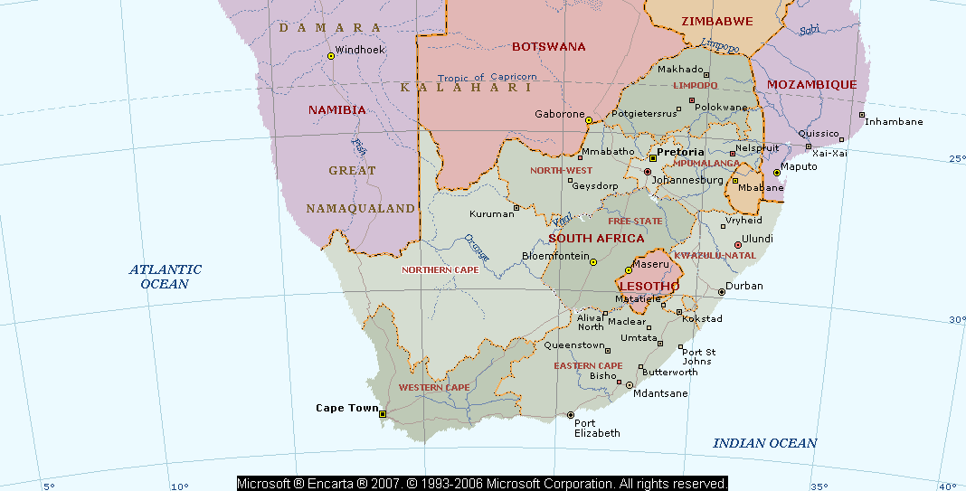
BORDER ORIENTATION
RSA/ZIM: 214 Km
RSA/BOT: 1516 Km
RSA/MOZ: 417 Km
MPU/SWAZI: 290 Km
KZN/MOZ: 76 Km
KZN/SWAZI: 137 Km
RSA/NAM: 897 Km
FREE STATE/LES: 445 Km
KZN/LES: 232 Km
EC/LES: 247 Km
TOTAL LAND BORDER: 4 471 Km
TOTAL MARITIME BORDER: 2 798Km
TOTAL AIR BORDER: 7 660Km
11/03/2016
6

Slide 7
OP CORONA DEPLOYMENTS
BN TAC HQ (MUSINA)
3 X SUBUNITS
3 X INT TEAMS
1 X COMP ENGR TP
LOG AND SIG SUP FROM POLOKWANE
1 X RES COY
1 X RES PL
PONTDRIFT
MUSINA
MADIMBO
BN TAC HQ (MACADAMIA)
3 X SUBUNITS
3 X INT TEAMS
1 X COMP TAC INT TP (OP RHINO)
1 X COMP ENGR TP
LOG AND SIG SUP FROM NELSPRUIT
1 X RES COY
SANDRIVER
MACADAMIA
1 X SUBUNIT
1 X INT TEAMS
ENGR ELEMENTS
LOG AND SIG SUP FROM POTCHEFSTROOM
1 X RES COY
ZONSTRAAL
MAHIKENG
PONGOLA
BN TAC HQ (LADYBRAND)
2 X SUBUNITS
2 X INT TEAMS
ENGR ELEMENTS
LOG AND SIG SUP FROM BLOEMFONTEIN
NDUMO
VIOOLSDRIF
FOURIESBURG
WEPENER
1 X SUBUNIT
1 X INT TEAMS
ENGR ELEMENTS
LOG AND SIG SUP FROM KIMBERLEY
1 X RES COY
BN TAC HQ (PONGOLA)
2 X SUBUNITS
2 X INT TEAMS
ENGR ELEMENTS
LOG AND SIG SUP FROM DURBAN
1 X RES COY
MALUTI
1 X SUBUNIT
1 X INT TEAMS
ENGR ELEMENTS
LOG AND SIG SUP FROM PORT ELIZABETH
1 X RES COY
13 X SUB UNITS
4 X BN TAC HQs
2 X ENGR TPs
LOG & SIG SUPP

Slide 8
External Operations
Name | Type | Area | Force Levels | Duration
COPPER | Counter piracy | Mozambique Channel | -1 x Ship -1 x Lynx (w/a) -1 x MSA -1 x C130 stby -2 x MTH stby -1 x Med Task Team | Apr 11 – indefinitely. Most recent deployment 26 Oct – 4 Dec 15. (SAN; SAAF; SAHMS; SF; DI; MP Div)
CORDITE | PSO (UNAMID) | Sudan (Darfur) | -1 x Mot Inf Bn (+) -1 x Eng Tp (+) -1 x Sig Sqn (-) -1 x Med Gp -15 x MILOBS -9 x Staff Offs -1 x Log Coy | Deployed since 2008. 12 month rotation. Plan the complete withdrawal

Slide 9
External Operations (2)
Name | Type | Area | Force Levels | Duration
MISTRAL | PSO (MONUSCO) | DRC | Framework Forces: -SANDF Spec -1 x Eng Sqn -4 x MILOBS -20 x Staff Offs | Unknown
FIB | PSO (MONUSCO) | East DRC | 1 x Mot Inf Bn (+ sup) -1 x Sig Sqn (-) -1 x Eng Tp (+) Aviation Unit: -3 x CSH -5 x MTH 1 x Med Task Gp | Mar 13 – TBD. 12 month rotation

Slide 10
EXTERNAL DEPLOYMENTS
OP CORDITE
1 X BN (4 X SUB UNITS)
1 X SUPP COY
1 X ENGR TP
SUP ELEMENT
MILOBS
RESERVE
1 X COY
SUDAN
SUDAN
MISSION THEBE
SOLDIERS DEPLOYED TO
MAINTAIN AND SECURE ASSETS (SA ARMY TRG MSN)
OP MISTRAL
1 X BN (3 X SUB UNITS)
1 X SUPP COY (-)
1 X ENGR SQN
SUPP ELEMENT
STAFF OFF
MILOBS
DRC
OP COPPER
MOZ CHANNEL
ANTI-PIRACY OPS

Slide 11
Unique Deployment Conditions
Climate
Terrain
Security
Remote areas
Urban areas

Slide 12
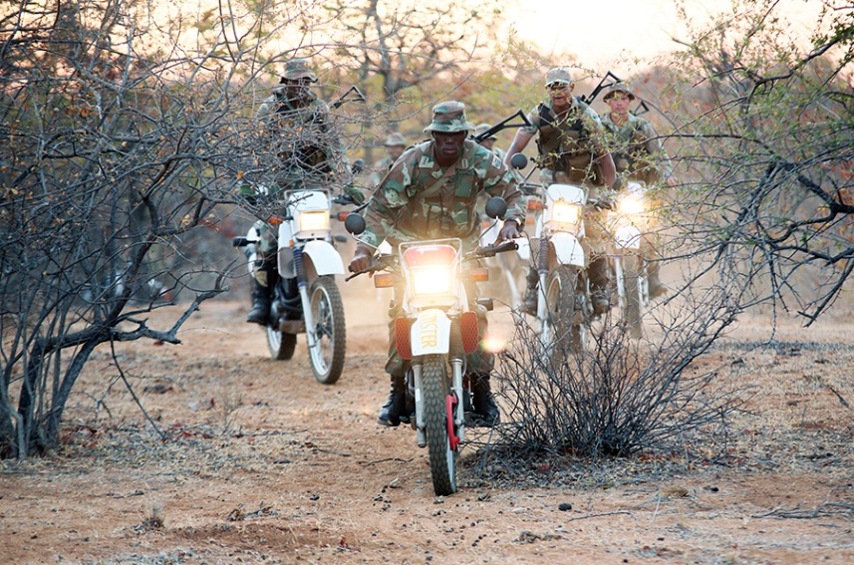
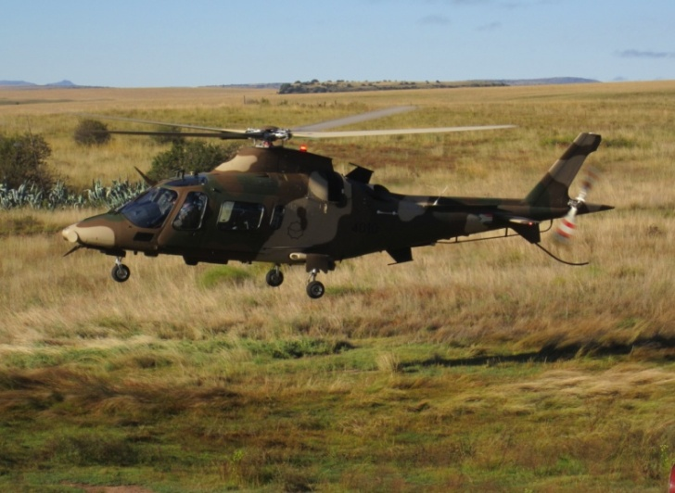
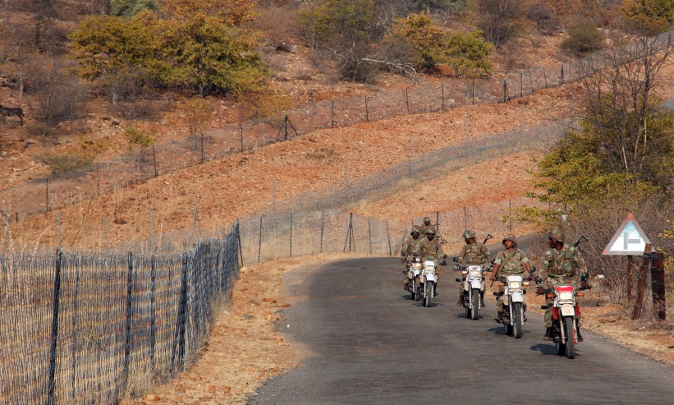
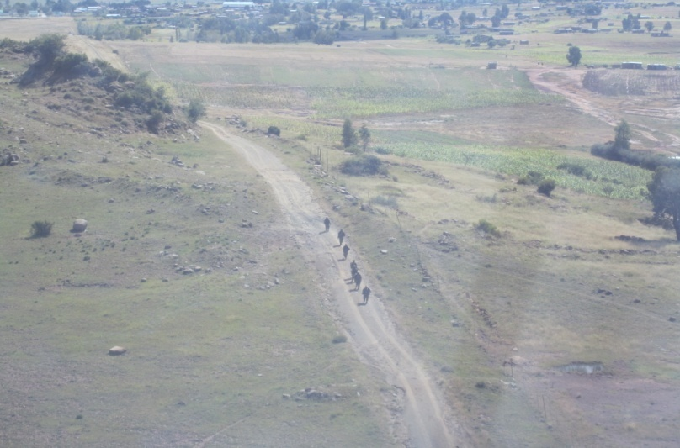
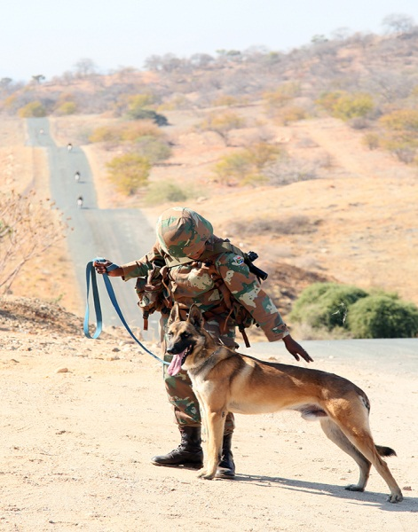
Border Areas

Slide 13
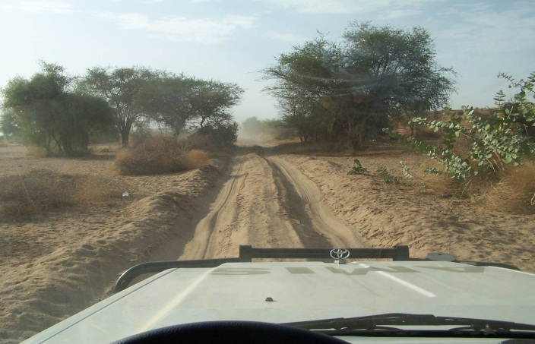
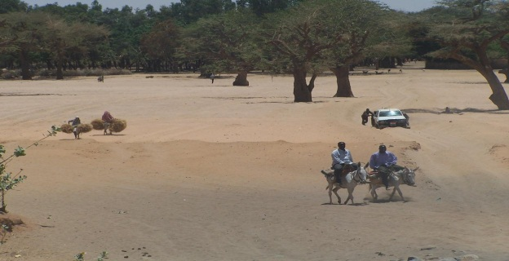
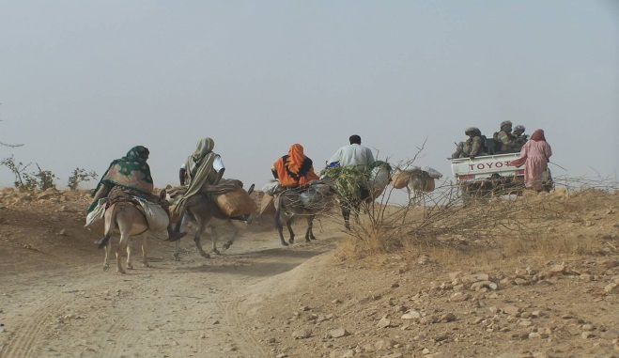
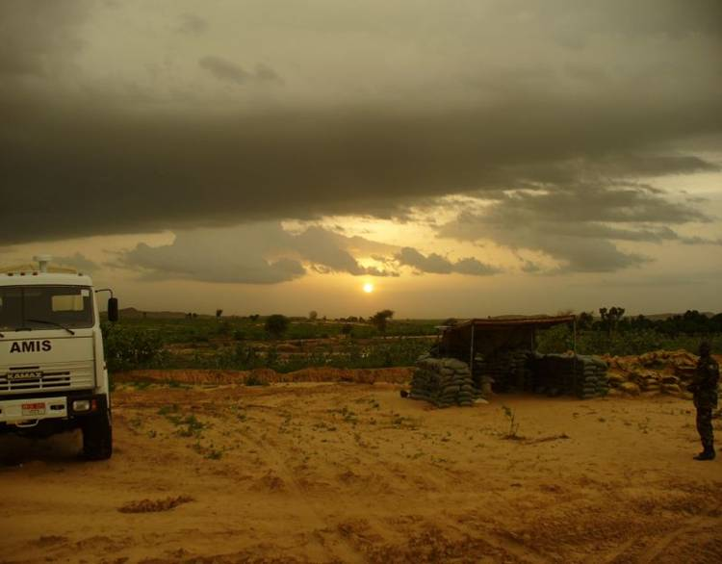
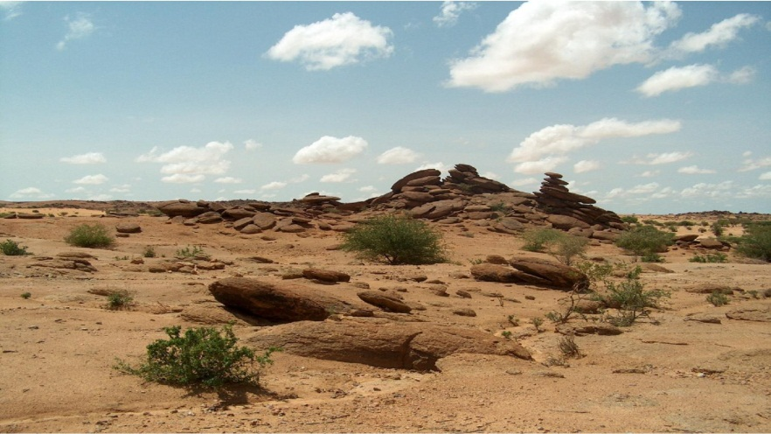
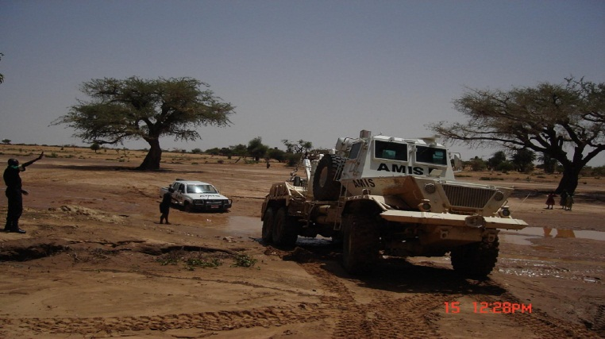
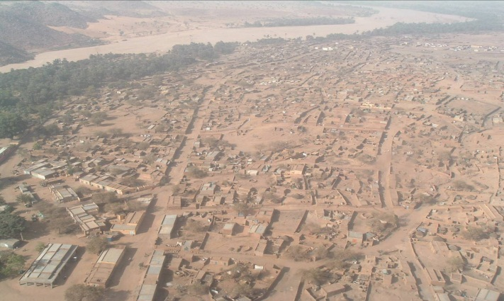
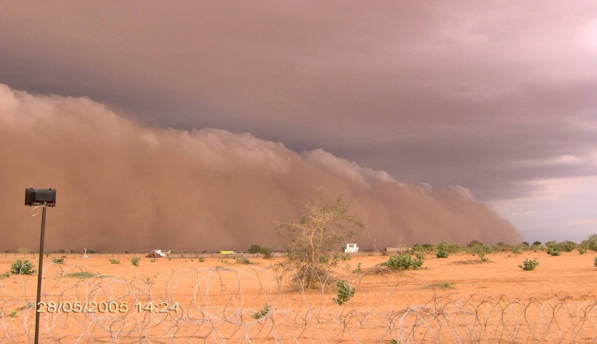
Sudan (Darfur)

Slide 14
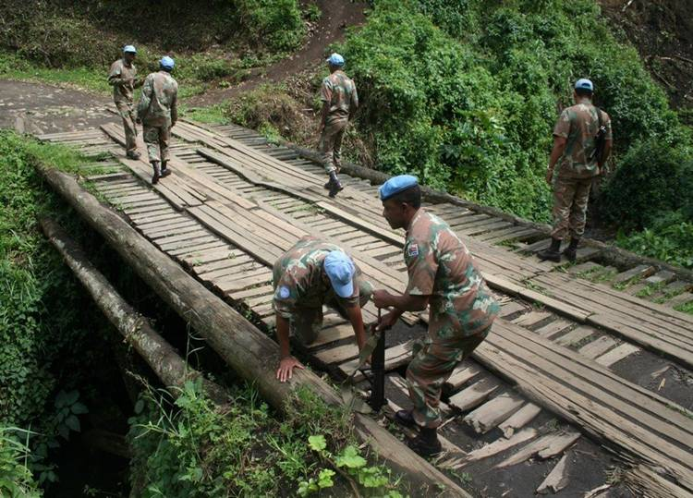
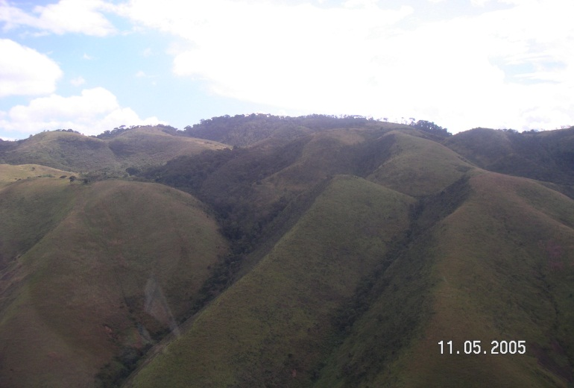
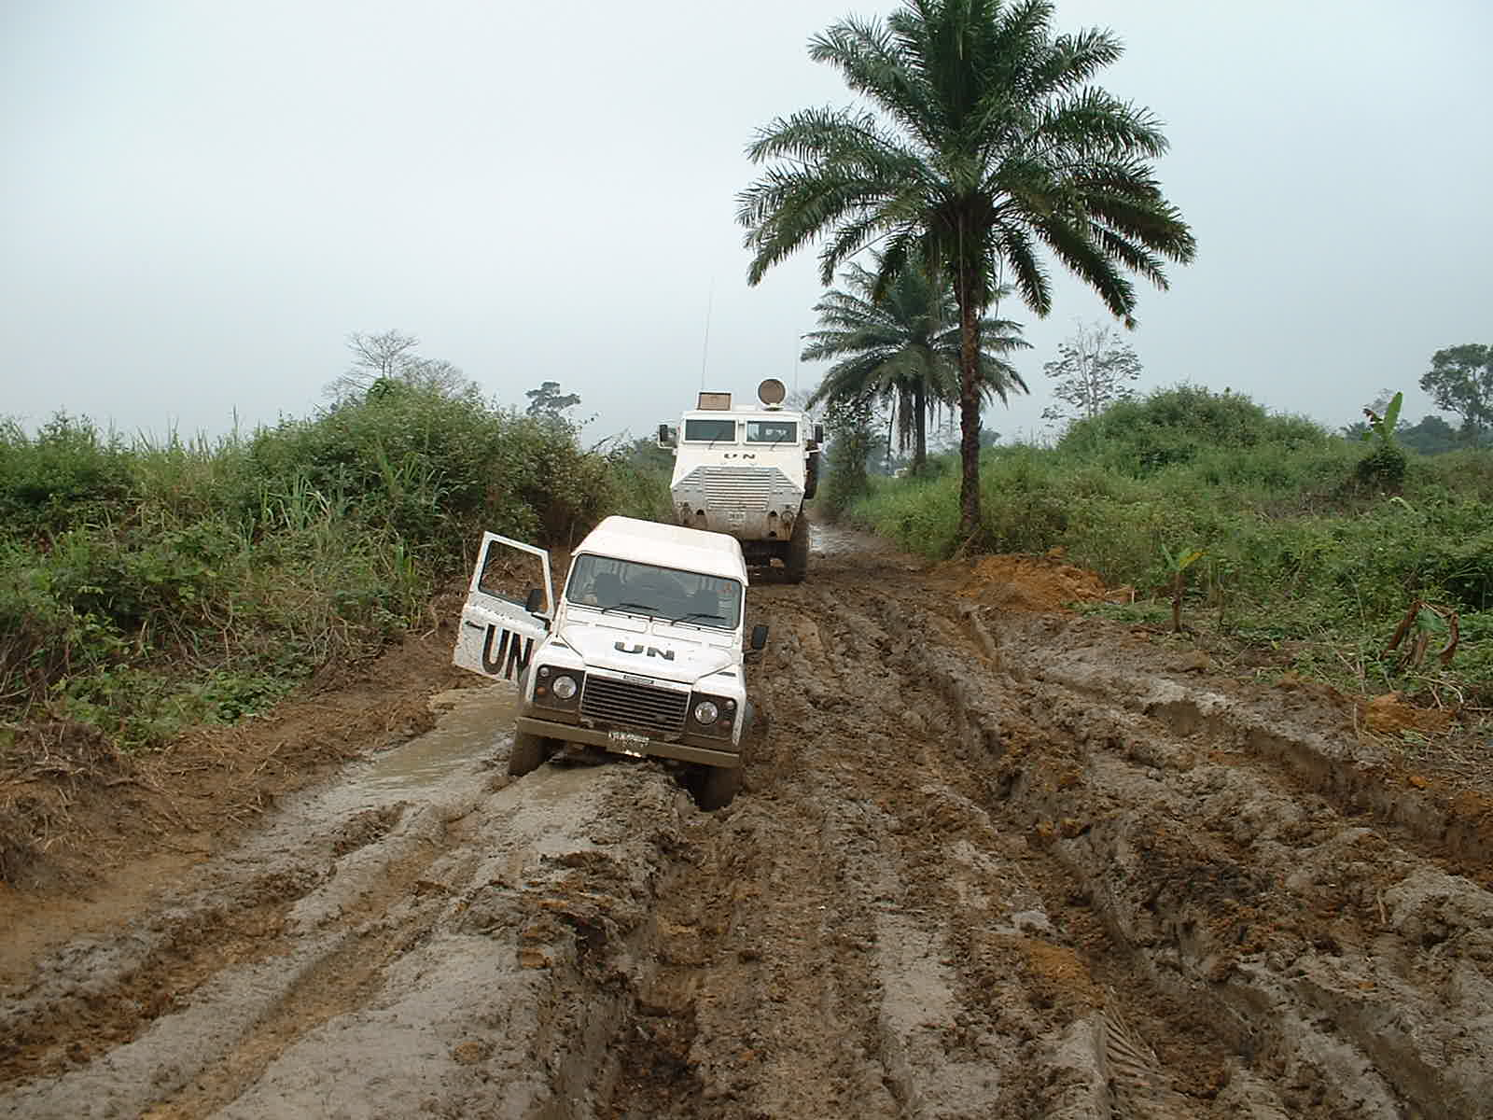
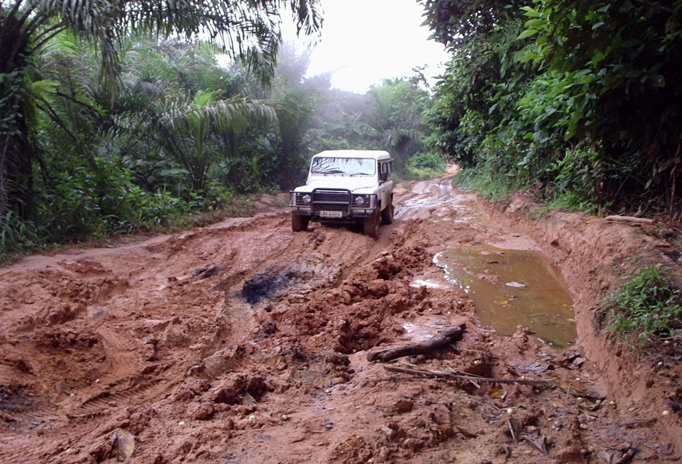
Eastern DRC

Slide 15
Conclusion
‘We do what we can with what we have, as we acknowledge the military’s role as Government’s instrument to achieve internal and external diplomatic and security objectives’

Slide 16
Questions

