Slide 1
TYPHOID CASES IN SOUTH AFRICA AND GAUTENG PROVINCE
BRIEFING TO THE PORTFOLIO COMMITTEE ON HEALTH, 9 MARCH 2016
NATIONAL DEPARTMENT OF HEALTH

Slide 2
Outline
Background
Typhoid fever outbreaks
Typhoid fever in South Africa
Recent Typhoid cases in Gauteng province
Public health implications
Actions taken

Slide 3
Background
Typhoid fever, also called enteric fever, is caused by infection with Salmonella enterica subspecies enterica serotype Typhi
Salmonella Typhi is spread via faeco-oral contamination
It may be spread from person to person by direct contact or through ingestion of contaminated food or water
Symptoms develop after incubation period of 10-14 days; and may include fever, headache, skin rash (rose coloured spots on chest, abdomen, back) and abdominal pain/cramps, nausea vomiting, constipation or diarrhoea
Diagnosis is made when Salmonella Typhi is identified in culture of blood, bone marrow, stool or other tissue

Slide 4
Typhoid fever outbreaks
Sub-Saharan Africa has experienced a number of large outbreaks of typhoid fever over the last decade, e.g.,
Outbreak of Typhoid fever in Harare beginning 2011 lead to 4000 cases. The outbreak was associated with drinking water from a well and having burst sewer pipe at home
In South Africa, extensive outbreak of typhoid fever in Delmas, Mpumalanga in 1993 and 2005 when over 500 cases were reported. Sporadic cases reports , including family clusters have been identified in subsequent years

Slide 5
Typhoid fever in South Africa
Typhoid fever is endemic in South Africa, but the number of cases and rates and deaths have declined over the last 20 years. Cases declined from about 6000 in 1985 to about 200 cases in 2002.
A low trend continue to be observed (2013 – 2015) through a national , active laboratory-based surveillance system at NICD.
Risk factors; poor food hygiene, and inadequate water and sanitation infrastructure
In more industrialised settings with lower transmission rates, travellers make up a large proportion of cases
South Africa observes mixed pattern of endemic disease and sporadic cases in more industrialised areas of the country

Slide 6
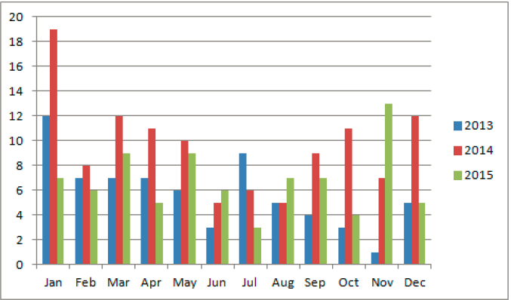
Number of Salmonella Typhi cases by month in South Africa, 2013-2015

Slide 7
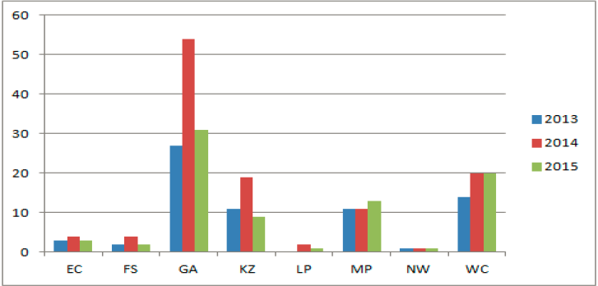
Number of Salmonella Typhi cases by province in South Africa, 2013-2015

Slide 8
Typhoid cases, January to 24 February 2016
As of 24 February, a total of 33 cases including 2 deaths have been reported in 5 provinces (Gauteng 17, Western Cape 12, KZN 2, Limpopo 1, and Mpumalanga 1)
Case patient age range; 9 months to 52 years (mean 19 years), five (15%) are children under five years-old
Among 29 case-patient on whom travel history was obtained, 15 (52%) had travelled out of their home town within a month before onset of illness, to (Limpopo 1, Eastern Cape 1, Zimbabwe 9, Malawi 1, India 2 and Bangladesh 1)
Of the 14 cases without travel history, 4 had visitors from the Eastern Cape (1), Gauteng (1), Tanzania (1) and Pakistan (1)

Slide 9
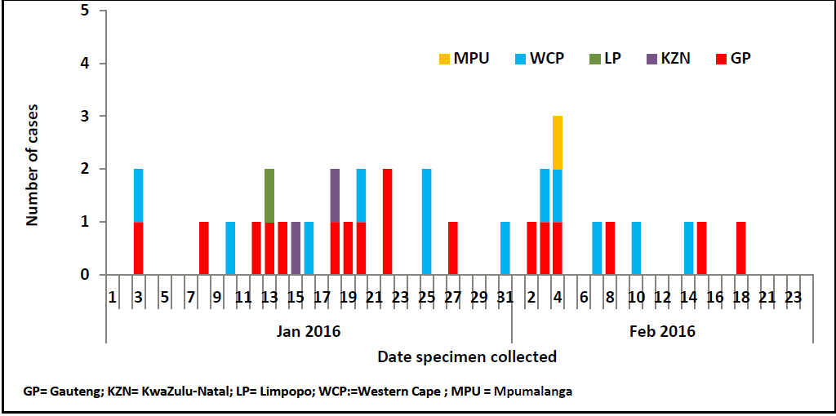
Number of laboratory confirmed typhoid cases in five South African provinces, January to 24 February 2016

Slide 10
Typhoid cases in Gauteng
As of 24 February, a total of 17 cases have been reported, from city of Johannesburg Metropolitan 10, City of Tshwane Metropolitan 5, Ekurhuleni Metropolitan 1, and Sedibeng District Municipality 1.
Among 14 with travel history obtained, 8 travelled outside hometown/city within 1 month before onset of illness; Zimbabwe 5, Malawi 1 (deceased), Bangladesh 1, and Limpopo 1.
Age range, 9 months to 49 years (mean 20 years) and 59% (10/17) are female

Slide 11
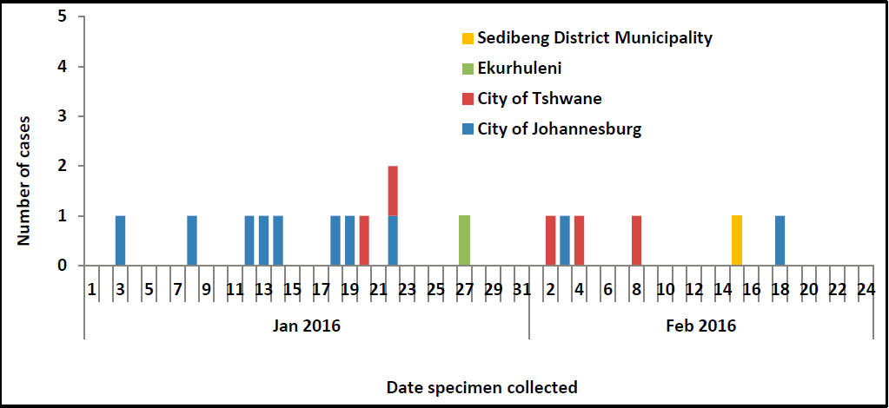
Number of laboratory confirmed typhoid cases by district, Gauteng province, January to 24 February 2016

Slide 12
Public health implications (i)
Typhoid fever is endemic in South Africa but of very low incidence rate. Sporadic cases are reported in the country and mostly with travel history to possibly endemic areas. The recently reported confirmed cases of typhoid fever are within the expected range and do not necessarily constitute an outbreak.
The need for ongoing comprehensive investigation and management of typhoid fever

Slide 13
Public health implications (ii)
Recognised risk factors for acquisition of typhoid fever relate to contaminated water supply, food bought from street vendors, consumption of raw fruit and vegetables, history of contact with other cases or chronic carriers, and community level risk factors including population density, temperature, rainfall, river level and proximity to water sources.
In light of these risk factors, the changing social and ecological environment including rapid urbanisation and recent drought, it is imperative that each typhoid case be appropriately investigated and managed

Slide 14
Actions taken
Reviewed, revised and disseminated guidelines for the diagnosis and management of typhoid fever
Provincial Outbreak response teams coordinated investigation of cases
Rapid and timely follow-up of cases, obtaining of detailed histories from patients and active contact tracing including specimen collection has ensured no further spread of typhoid fever in South Africa.
Strengthen the national , active laboratory-based surveillance system for Salmonella Typhi at NICD

Slide 15
THANK YOU

