Slide 1
Briefing by SAWS on the support that is provided to farmers in response to climate change and the current drought
Parliamentary Portfolio
Committee on Agriculture
8 March 2016
^{Dr. Linda Makuleni}
South African Weather Service
www.weathersa.co.za

Slide 2
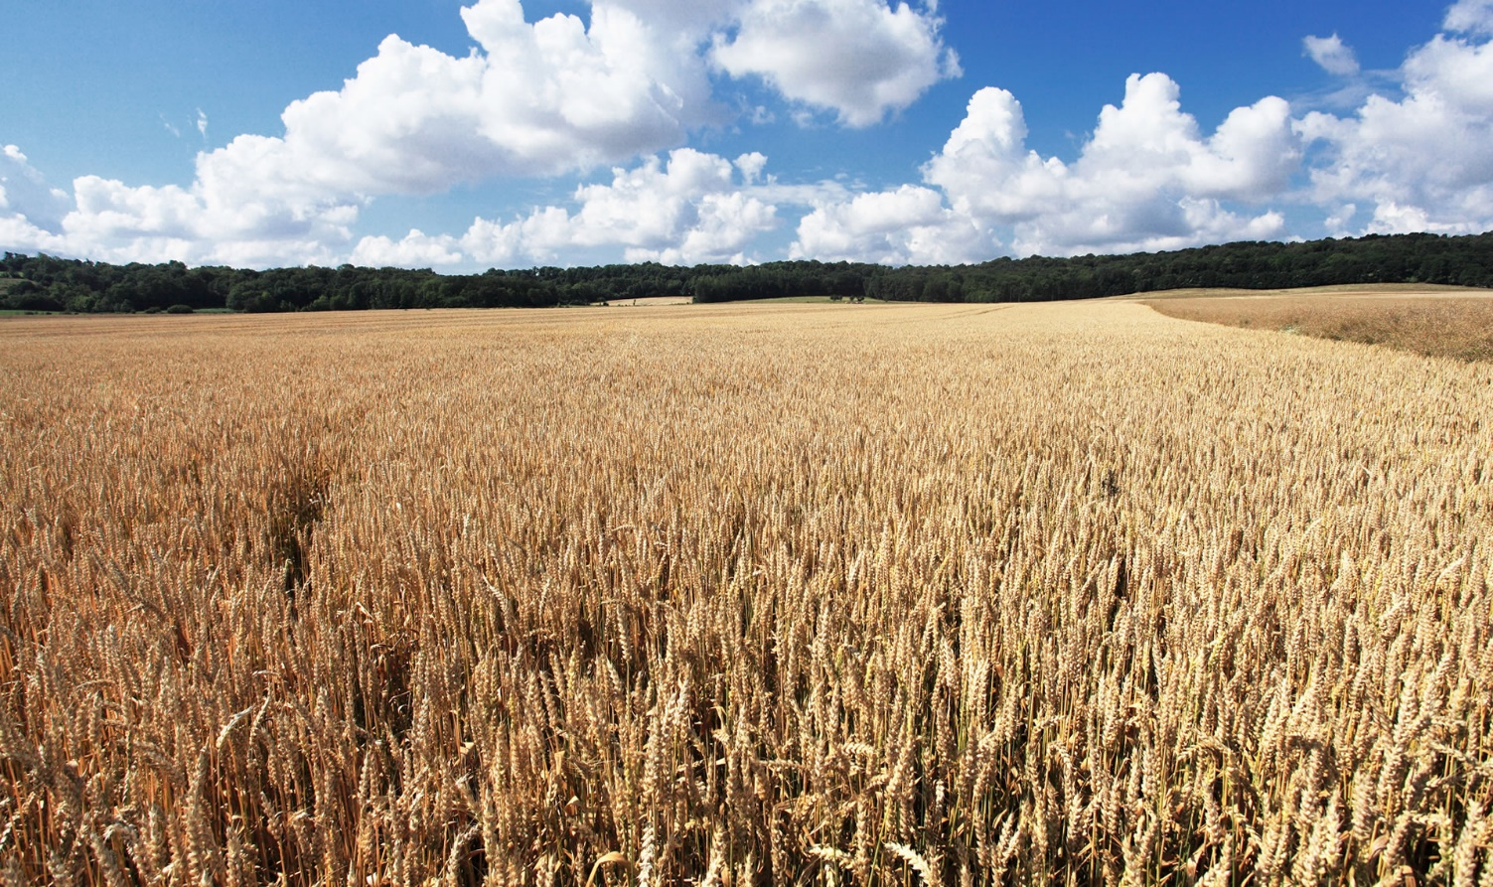
Content
Introduction
Mandate
Purpose
Key Infrastructure
Climate change challenges for the Agricultural sector
SAWS strategic context
SAWS Climate change and Drought Response initiatives
Forecasting Services
Research and Development
Products and Services for the agricultural sector
Development of Agro-meteorology Capacity and Capability
Enabling the Drought plan
Conclusion

Slide 3
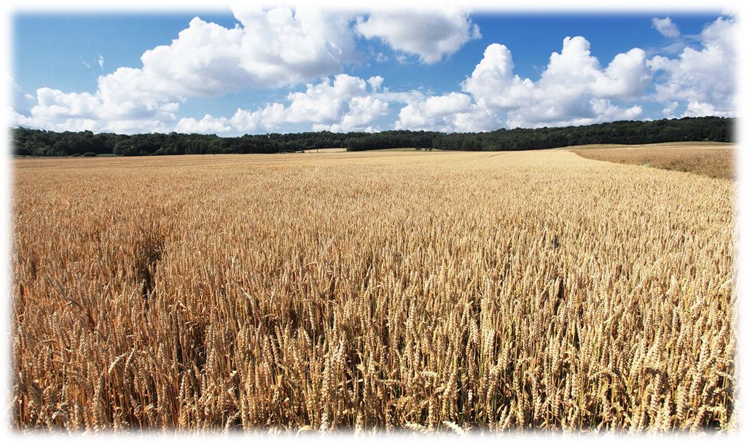
Introduction

Slide 4
Mandate
Established as a Schedule 3A public entity on 15 June 2001
Two distinct Services: Public Good & Commercial
Public Good
Funded by Government Grant
Forecasts & Warnings
Commercial Services
User-pays principle applies
Tailor made products & services

Slide 5
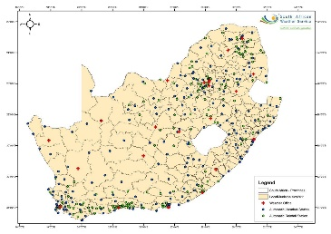
Footprint of key infrastructure per municipality - 2011
1277 Rainfall Stations
214 Automatic Weather Stations (AWS)
24 Lightning Detection Network Sensors
141 Automatic Rainfall Stations (ARS)
25 Climate Stations
14 Meteorological Radar Systems
(C-, S- and X-Band)

Slide 6
Purpose
To brief the Portfolio Committee on Agriculture, Forestry and Fisheries on the South African Weather Service (SAWS) Value Proposition for Agricultural sector:
assist the agricultural community to be well prepared for climate changes and weather issues that could affect crops, livestock and livelihood
play an advisory role that informs relevant stakeholders beforehand of weather and climate patterns/issues likely to affect the agricultural sector
Provide an overview of SAWS response to the Government Drought Plan

Slide 7
Climate change Challenges for the Agricultural Sector
Climate change affects rainfall, temperature and water availability for agriculture in vulnerable areas.
Weather and climate are critical for agriculture in risk assessment and agricultural production management systems (crop planning and irrigation scheduling, for example)
Degradation of arable soils and loss of fertility due to high exposure to climatic stress and human pressure on forests and other vegetation cower under a changing climate will lead to a 50% drop in agricultural production in Africa by 2030.
Persistent drought due to increase in temperature and unreliable rainfall patterns, is expected to affect the lifestyles of most of the migratory wild species, in particular the wildebeest and some bird species.
Increasing temperatures, in combination with changes in rainfall and humidity, may have significant impacts on wildlife, domestic animals and human diseases.
The increase in water temperature has detrimental effects on the physiology of marine organisms

Slide 8
Who is likely to suffer the most?
Drought effects are felt by:
Municipalities, Business Community, Agricultural enterprises,
Households and Individuals,
Government (at National, Regional and Local level).
Everyone……(you and me)
In South Africa, worst affected regions are:
KwaZulu-Natal, the Free State, Limpopo, North West and the Northern Cape, where farmers growing white and yellow maize, soya beans and sunflower have already incurred major losses. We have already observed impacted livestock farming.

Slide 9
SAWS Strategic context – Agricultural Sector
South African Weather Services Value Chain – Enabling the Agricultural Sector
Networks
Data Collection
Science
Processing & Data Management
Devices
Dissemination
Content
Value Add
Strategy
Develop Products and services enabling the Agricultural Sector
Develop and facilitate Implementation of National Framework for Climate Services in partnership with various stakeholders
Socio-economic benefits study
Infrastructure
Recapitalisation
Human Capital
Development
Weather – ready
Nation
Scientific
Capability
R&D and Innovation towards establishing a robust Agro-Hydrometeorology
competence
Capacity Development
Infrastructure upgrade, expansion and optimisation
Improved service delivery to the agricultural sector – adoption of new products and applications
Skills Development
National Education Plan

Slide 10
SAWS Climate Change and Drought Response Initiatives

Slide 11
Forecasting Services

Slide 12
Weather Forecasts and Warnings
Observations
Numerical Weather Prediction
Global Climate Model
Coupled: GCM+ Ocean
Satellite
Radar
SAFFG
Synops
LDN
Upper Air
Regional (SADC)
Local (SA)
Mesoscale
Ensembles
MOS
Medium range (ECMWF)
Ensembles (NCEP)
MOS
Ensembles
MOS
Multi-model Ensembles
MOS
Ocean Models -GCM Ensembles
Tools
> 2 Years
30 Days– 2 Years
Forecast
11- 30 Days
4 -10 Days
24 -72 Hours
Outlook:
Rainfall and temperature anomalies
Rainfall and Temperature Tendencies
Climate Change
Agro-meteorology advisory service
Outlook:
Rainfall & temperature anomalies
Agro-meteorology advisory service
6-24 Hours
Advisories:
Potential hazardous weather events
Rain and temperature anomalies
Products
0 – 6 Hours
Watches & Warnings:
Severe weather
Daily weather elements
Reducing the vulnerability of society, crops and livestock to climate-related hazards - air pollution, heat, floods, drought, lightning detection and diseases
Build necessary skills in the agro sector that enables better decisions – offering training to farmers and ensuring protection
of assets
Maximising the utilisation of existing weather and climate service infrastructure
Improving coordination, and strengthening and building infrastructure where needed – strategically positioning observation network
Benefits

Slide 13
Customized solutions for the Agricultural Sector
Prior to a severe weather event
Customised Forecasts
(low rainfall patterns e.g.. Kakamas)
Instrumentation
(geo-specific monitoring some AWS’s on farms)
Real-time
(During the severe weather event)
Lightning Detection
(Prevent damage to property and loss of life)
Storm notification
(e.g.. move livestock to a safer area – prevent drownings)
After a severe weather event
Climate information
(Risk planning and activities e. g. Dairy vs game farming)
Tailored products and channels
(geo-specific apps e.g.. rainmaps)

Slide 14
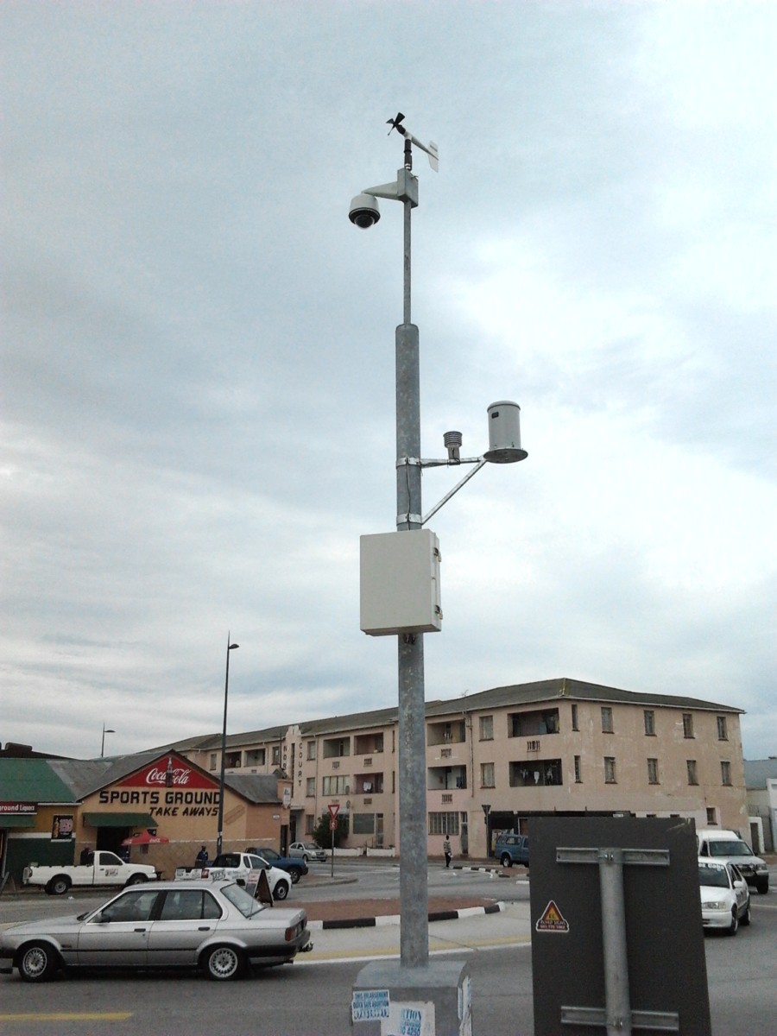
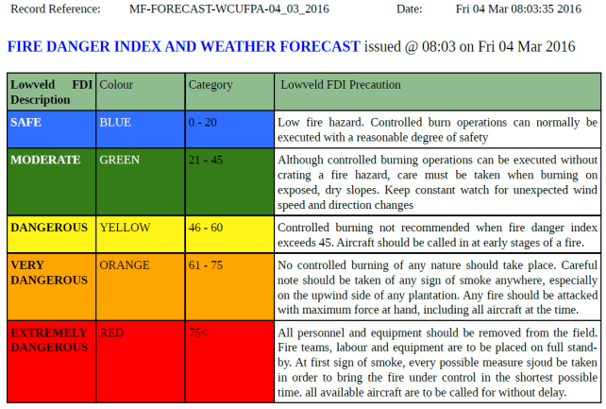
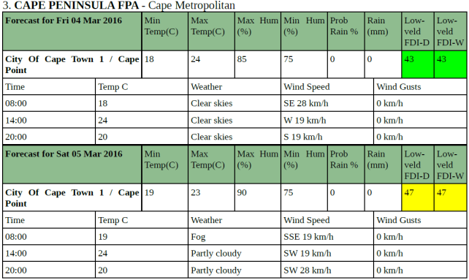
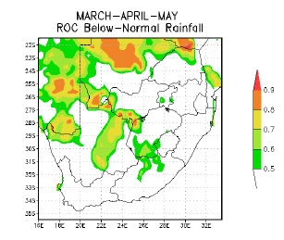
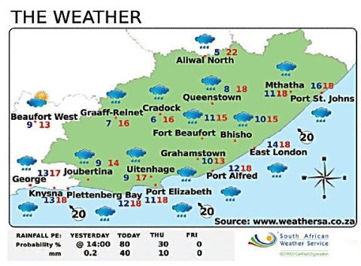
Forecasts or predictions
Target – Agricultural and other economic sectors
e.g. Forestry plantations - Mondi
HEAT AND FIRE DANGER INDEX
Benefits:
Forecasts provided ahead of time to enable careful planning of resources around severe weather events
Instrumentation with cameras enable visuals with key parameters to be viewed in key locations supporting quick decision making
This product can assist farmers to put their safety measures such as ventilation when the heat value exceed certain threshold
Seasonal Climate Watch

Slide 15
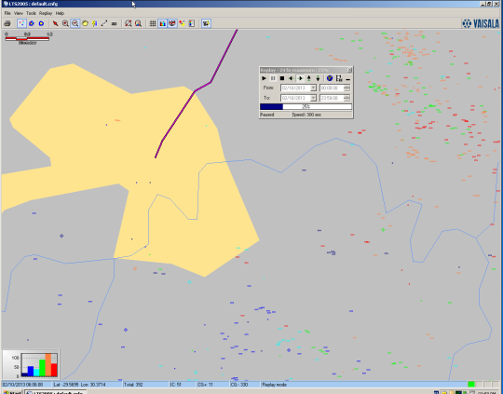
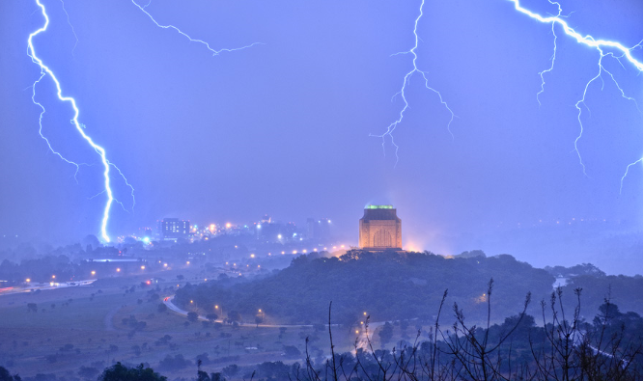
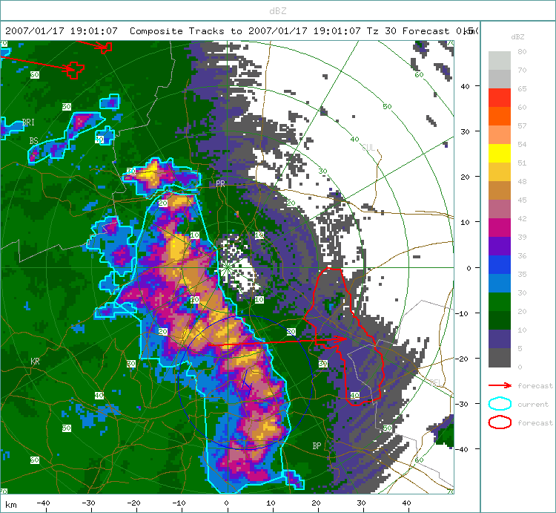
Real-time data
Lightning strokes as they occur
Instrumentation
Benefits:
Real-time data enables visual monitoring of weather conditions as it occurs
Farm safety
Tracking of lightning and storm activity increases capability to react quickly to address pertinent issues eg. fires, power outages
Storm tracking

Slide 16
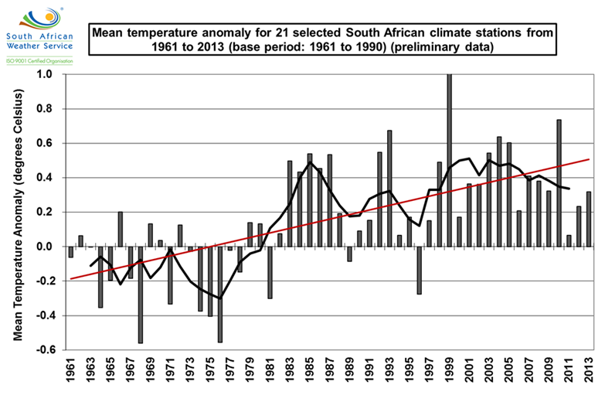
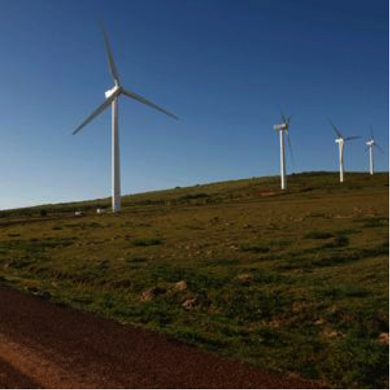
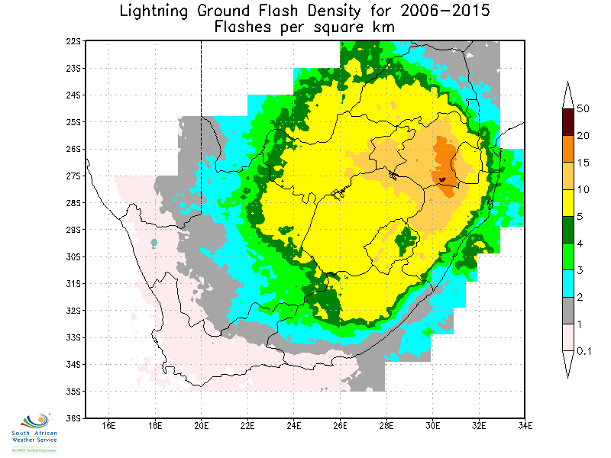
Historical data
Benefits:
More than 150 years of data for various positions across the country
All meteorological data can be processed in format to suit user requirements
Trend analysis of the data provides insights for user specific outputs
Long term climate trend analysis to determine the impacts of climate change on the severe weather phenomena
Trend analysis - historical data
Lightning Ground Flash Density

Slide 17
Research and Development

Slide 18
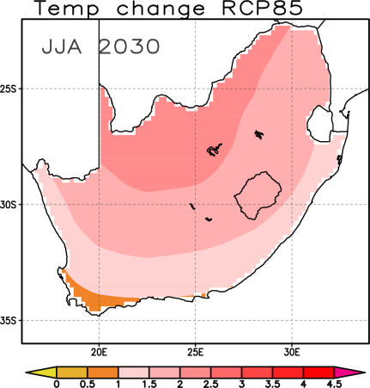
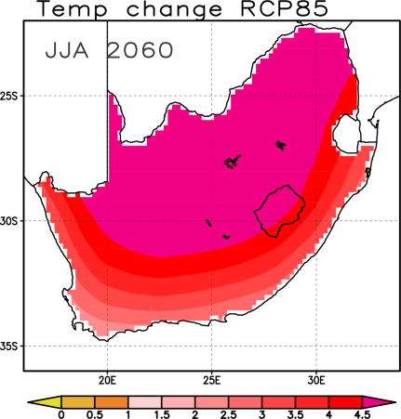
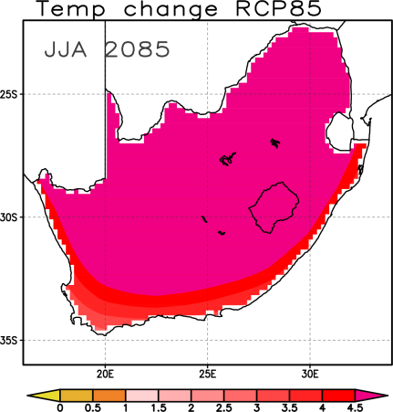
Scientific Capability/Knowledge Generation Research Projects
National Temperature Scenarios
In the business-as-usual case (i.e. no mitigation), warming continues throughout the 21st century
the inland areas are projected to warm by more than 4°C above the 1986-2005 reference period by 2071-2100 (centered on 2085, right panel)

Slide 19
Findings - Eastern Cape Province
Variable | Findings
Temperature | With aggressive mitigation, the average 21st century warming is about 0.7°C [0.4 – 1.7] in all seasons
Temperature | With Business-as-usual scenario, warming increases progressively in the 21st century from about 0.9°C [0.6 – 1.5] between 2016-2045 to 2.2°C [1.7 – 3.2] during 2046-2075 and 3.3°C [2.6 – 4.9] towards the end of the century
Precipitation | Winter precipitation is projected to decrease by up to 15% [4 – 26%] towards the end of the century (2071 – 2100) under the business-as-usual scenario
Precipitation | The range is very wide during other seasons, with some models projecting an increase in precipitation and some projecting a decrease

Slide 20
Findings - Free State Province
Variable | Findings
Temperature | With aggressive mitigation, the average 21st century temperature stabilize around 1.5°C [0.5 – 2.3] in all seasons
Temperature | With Business-as-usual scenario, warming increases progressively in the 21st century from about 1.2°C [0.7 – 1.9] between 2016-2045 to 2.7°C [1.9 – 4.1] during 2046-2075 and 4.2°C [3.2 – 6.2] towards the end of the century
Precipitation | Winter precipitation is projected to decrease by up to 20% [8 – 28%] towards the end of the century (2071–2100) under the business-as-usual scenario
Precipitation | The range is very wide during other seasons, with some models projecting an increase in precipitation and some projecting a decrease

Slide 21
Findings – Gauteng and KZN
Gauteng
In the business as usual case, warming reaches 6C towards the end of the 21st century
KZN
Under the aggressive mitigation scenario, warming in the KZN is projected to remain below 2.5°C above the 1986-2005 reference period
In the business-as-usual case warming exceed 4°C towards the end of the 21st century
Projected changes in total seasonal rainfall have large uncertainties with no clear sign, an exception being under the intermediate concentration pathway

Slide 22
Capacity Building Research Projects
Project Name | Deliverables - 2015/16 | Outcomes
Impact-based SWWS (Severe Weather Warning System) | Prototype System developed and tested in a Pilot Area | Predict the likely severity of the impact of severe weather on communities
NEPAD Project | Trained farmers and agricultural extension officers on the use and application of agro-meteorological information towards climate change adaptation | Enhanced agricultural production and thus ensuring food supply and security
Adaptive capacity for small scale farmers-FAO Project | Testing different cultivars Set up of AWS | - Optimized agricultural farming under changing climate

Slide 23
Product Development Research Projects
Project Name | Target market and product descriptor | Benefits
Temperature Humidity Index (THI) - (Development of a THI forecasting system) | Livestock farmers (Informs farmers of increases in humidity and temperature that may impact production) | Enhanced production of milk and thus ensuring dairy food supply and security Improved management of feed and ambient temperatures in intensive farming systems
Enthalpy index - Heat index: Poultry (Enthalpy is the total heat content of air and serves as a key indicator for heat stress in animals) | Livestock farmers (Informs intensive system farmers of heat stress conditions) | This product can assist farmers to put their safety measures such as ventilation when the heat value exceed certain threshold
6 – 12 hour forecast of severe weather which includes storm tracking, hazardous weather notification e.g.. hail etc. | Crop and live stock farmers | Warning to farmers prior to the event to implement loss reduction measures Management of day to day operations

Slide 24
Products and Services for the Agricultural Sector

Slide 25
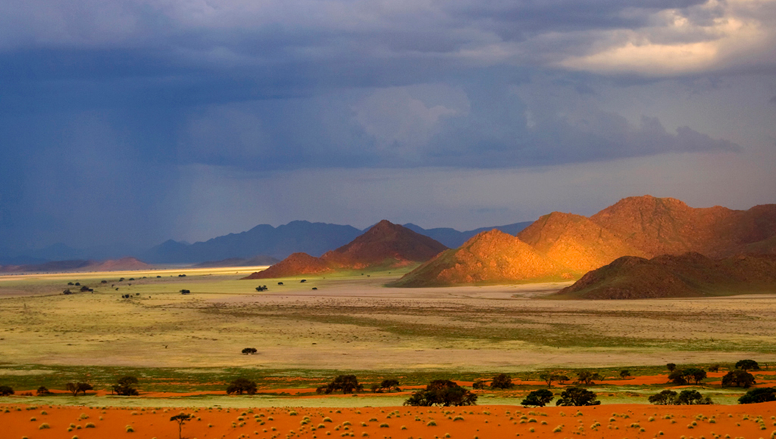
: Web Portal
Customised weather-related web portals with security access, pprovides data and applications via the Internet to support weather sensitive industries to reduce water related challenges
Three applications:
Weather Stations
At a click of a button - direct access to actual (real-time) and historical rainfall information
SAWS observation network data for planning & reporting purposes
Amount of rainfall at a specific location per hour / per day / per time series
RainMap
To optimize the proactive scheduling of weather sensitive activities to manage water resources
Reduce the need for additional rain gauges
Easily accessible information as quality checks improve the data
Personalised dashboards linked to own strategic indicators
Weather Forecast
Weather forecasts for specific locations over different time periods
Improves risk related planning
Reduces exposure to possible impacts of forecasted factors

Slide 26
Products and Services for the Agricultural Sector
Product Name | Description/application | Benefit to Agriculture
Real time satellite based rainfall estimation Rainfall Products: Convective Rain Rate(CRR) Hydro Estimator (HE) Rapidly Developing Thunderstorm(RDT) | Product is derived from the Nowcasting Satellite Application Facility (SAF). Real-time satellite based rainfall estimation adapted from the Nowcasting Satellite Application Facility (SAF) Real-time satellite and model based rainfall estimation product. RDT-monitors the phase ( growing/decaying) and moment of thunderstorms | Planting time, harvesting time farming management

Slide 27
Products and Services for the Agricultural Sector
Product Name | Description/application | Benefit to Agriculture
Severe Weather Forecasting Demonstration Products (SWFDP) | Product is derived from the Nowcasting Satellite Application Facility (SAF): Real-time satellite based rainfall estimation adapted from the Nowcasting Satellite Application Facility (SAF) Real-time satellite and model based rainfall estimation product. RDT-monitors the phase (growing/decaying) and moment of thunderstorms Various severe weather information maps and products supplied to the SWFDP-web | Planting time, harvesting time farming management
Utilizing Numerical weather prediction model to develop various application products: Products include: Frost Forecast ( Agriculture) Future scenarios under climate change impacts(under development) |  | Information utilized for long term planning of agriculture

Slide 28
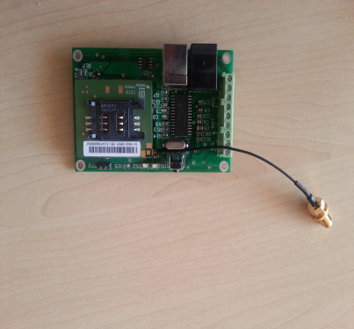
Community Rainfall Station
Designed by SAWS for communities
Built in modem for SMS dissemination
Product can be placed on farms or communal land(co-operatives)
Placement in vulnerable areas to provide geo-specific rainfall information

Slide 29
Development of Agro-meteorology Capacity and Capability

Slide 30
SAWS Agro-meteorology Human Capacity Development
Functional Agro-meteorology function – skilled experts
Developed National Education Plan – Develop National capability – Skills at national, provincial and local government levels
Regional Training Centre – WMO –accredited –Design courses focusing on agro-meteorology
User capacity development projects – NEPAD project

Slide 31
Enabling the Drought plan

Slide 32
SAWS contributions: Drought monitoring plan
SAWS provides technical advisory service to the National Joint Drought Coordinating Committee as well as the Ministerial Committee on Drought
SAWS contributed to the National Drought Monitoring Plan - SAWS Drought Monitoring plan attached
SAWS Contributes to National Disaster Management Centres/National Agricultural Centres as follows:
Weekly reports on drought regarding rainfall, temperature (tmin, tmax, heat waves & drought index)
Seasonal outlooks(1-3 months ahead)
Report on dam/water reservoir levels
Communicate confidence level of likelihood and probability of events

Slide 33
Conclusion
Continue to enable the Agricultural sector:
Provision of sector-specific products and services
Provision of advisory services to industry and key decision makers
Continued monitoring of drought, water resources and climate change impacts
Collaboration with Key sector players
Capacity building
Train users on Interpretation, usage and pro-active response to weather and climate information
Infrastructure operation and maintenance
Availability of human capital skilled in agro-meteorology
Infrastructure network expansion and optimisation
Improved prediction and accuracy
Strategic positioning of infrastructure – geo-specific information

Slide 34
Thank You! Questions?

