Slide 1

PRESENTATION THIRD QUARTER PERFORMANCE REPORT:
1 October – 31 December 2015
PORTFOLIO COMMITTEE ON TRADE & INDUSTRY
09 March 2016
Cape Town
Presenter:
Ms Caroline Kongwa-Hankanga
(Accounting Authority)

Slide 2

CONTENT
Executive summary
Gambling Sector Performance, FY16, Quarters 1 & 2
Research [Socio-economic impact of illegal gambling, with focus on online]
Performance against business plan
Progress on actions in the risk register
Report against post audit implementation plan
Financial report
PFMA and Treasury regulation compliance checklist /calendar
Conclusion

Slide 3
    EXECUTIVE SUMMARY
    There were 17 Targets that were to be reported against in the entity’s Annual Performance Plan 2015/2016 in Quarter 3 and 100% of the targets were achieved.
    The electronic Illegal Gambling Operative Register (IGOR) has been established and rolled out in Quarter 4
    The NGB in collaboration with the law enforcement agencies, have identified online gambling syndicates in Gauteng and are in the process of securing arrests. The NGB maintains its leading role in a Project with the HAWKS.
The NGB has successfully performed evaluations and compliance monitoring of nine (9) Provincial Licensing Authorities (PLAs).
The NGB gathered national gambling statistics and information about the performance of the South African legalised gambling industry from all Provincial Licensing Authorities (PLA’s).
NGB has commissioned research to determine the socio-economic impact of illegal gambling, with the focus on online gambling. The NGB is currently involved in gathering data from various stakeholders and gamblers participating in illegal gambling, especially those gambling online.

Slide 4
Q1&2 GAMBLING SECTOR PERFORMANCE
Casino’s account for the highest percentage contribution of total GGR at 69.7%, with Betting at 17.8% followed by LPM’s at 9.0%.and Bingo at 3.4%.

Slide 5
Q1&2 GAMBLING SECTOR PERFORMANCE
Gauteng is the highest contributor to GGR at 40.8%, followed by KZN at 19.0% and Western Cape at 16.5%.

Slide 6
NCEMS LPM SECTOR PERFORMANCE
As at 31 Dec 15, KZN accounts for the highest distribution at 21.8%, followed by Gauteng at 20.0% and Western Cape at 16.3%.
Northern cape has in the month of October effected its first distribution.

Slide 7
NCEMS LPM SECTOR PERFORMANCE
Limpopo has rolled out largest percentage of its provincial allocation with 71% of LPMs allocated by province for phase 1 installed.
It is followed by Eastern Cape with just over 59% LPMs installed.
Free State has installed the lowest number of about 14% of LPMs allocated for phase 1.
It is superseded by Northern Cape that has rolled out about 19% of LPMs allocated for phase 1.

Slide 8
CHALLENGES
Key challenges
Proposed action
      Capacity constraints impacts on our ability to effectively reach out as broad as possible to sections of our communities when doing public awareness and education.
      Underspending of the budget appears to be an area of concern as the entity has only spent 47% of the budget as opposed to 75% by the end of the third quarter.
    Collaborating with the dti in participating in the public outreach and initiatives organised by the dti.
    The NGB has revised its Annual Performance Plan along with the Budget for the 2015/16 financial year to ensure that priorities are realigned and what is funded is achievable. To this end, management have drafted a detailed plan for implementation to ensure that the budget is spent by the end of the current financial year.

Slide 9
PERFORMANCE AGAINST APP - Compliance
Performance Indicator | 3rd Quarter Milestone | Actual Achievement | Reason for Variance | Corrective action
Nine (9) Consolidated three tier compliance evaluation assessment reports | Conduct desktop evaluation of four (4) provinces and report findings | Achieved Conducted 5 (five) desktop and onsite evaluations between October and December 2015 and reported findings for Eastern Cape, Western Cape, Mpumalanga, Limpopo & Free State. | N/A | N/A
 | Evaluate applications, conduct onsite evaluations and report findings of all LPM applications in excess of 5 machines | Achieved Evaluated four (4) applications from Limpopo Gambling Board on LPMS in excess of five and findings have been reported. Conducted on site evaluations of five PLAs and reported findings. | N/A | N/A
Report on intervention and support provided to regulators and law enforcement agencies | Report on intervention and support provided to regulators, law enforcement agencies | Achieved Provided support to PLA’s and participated in a collaborative multidisciplinary Law Enforcement Agency through a National Project for suppressing online gambling with various regulators and law enforcement agencies as members . | N/A | N/A
Number of investigations finalised | Reporting on unlawful winnings and related matters | Achieved A report on illegal gambling activities and related matters was drafted. This report covers the strategy used to address the backlog of investigations into the unlawful winnings that the NGB has as well as the communication that currently occurs between the NGB and third parties that confiscate illegal winnings. | N/A | N/A

Slide 10
PERFORMANCE AGAINST APP
- Compliance cont…..
Performance Indicator | 3rd Quarter Milestone | Actual Achievement | Reason for Variance | Corrective action
Annual Analysis and reporting data in accordance with the prescribed requirements | Monitor significant events associated with LPMs and analysis and report data | Achieved Monitored significant events associated with LPMs and analysed and reported on 14 December 2015 and 18 December 2015 respectively. | N/A | N/A
Report on the accessibility and functionality of national registers | Report on Maintenance National functional Registers | Achieved Produced report on the maintenance of the national functional registers containing recommendations for improvement toward functionality of registers. Consulted with PLAs through LCF/CEO forums for inputs and collaborative act on automated linkages of national registers. Provided advice / inputs on amended national regulations relating to national registers of exclusions and gambling devices. NGB held meeting with the dti’s Policy and Legislation Unit to make inputs on amendment of Regulations affecting exclusion registers. | N/A | N/A
Illegal Operator register development., implementation and roll out | System development | Achieved A workshop was held with the PLAs to finalise the list of the required fields that users will populate. A user manual was produced. | N/A | N/A

Slide 11
PERFORMANCE AGAINST APP
- Stakeholder Liaison and Advisory Services
Performance Indicator | 3rd Quarter Milestone | Actual Achievement | Reason for Variance | Corrective Action
S65 Advisory reports presented to the Accounting Authority | Advisory report on feasibility of regulating forms of gambling tabled with Accounting Authority | Achieved Submitted researched advisory report on Exclusions Regulations to the AA. Participated in drafting of regulations for excluded persons. | N/A | N/A
Report on continuous legal advisory services provided to the entity | Report continuous legal advice and litigious matters | Achieved A quarterly report on continuous legal advice and litigious matters was completed. NGB succeeded in a Labour Court application on the setting aside of the appointment and employment contract. The case constituted a reportable judgment. | N/A | N/A
Conduct research on the impact of gambling and present the report to the Accounting Authority | Field work Conducted and analysis of data | Achieved Field work conducted and data analysed. Report on impact of gambling (prevalence) submitted and presented to the Accounting Authority. Presented the research report to the Portfolio Committee for Trade and Industry for information purposes on 11 November 2015. | N/A | N/A
Audited gambling sector performance report | Report on Gambling Sector Performance (2nd quarter, 2015/2016) Presentation on national gambling statistics (2nd quarter; 2015/16) | Achieved Quarter 2 Report on Gambling Sector Performance submitted. Further to the above, the Audited Annual Gambling Sector Performance Report for 2014/15 published on the NGB’s website and hardcopies distributed to the Portfolio Committee for Trade and Industry on 11 November 2015. Presentation on national gambling statistics for quarter 2 (2015/16) was prepared. | N/A | N/A

Slide 12
PERFORMANCE AGAINST APP
- Stakeholder Liaison and Advisory Services
Performance Indicator | 3rd Quarter Milestone | Actual Achievement | Reason for Variance | Corrective Action
BBBEE concept document presented and approved by the Accounting Authority | Present B-BBEE concept document at Intergovernmental forums | Not achieved BBBEE concept document presented to and approved by the Accounting Authority. The document was presented that the CEO’s Forum on 14 December 2015. In addition, a presentation for NGPC was compiled and submitted through the AA to the dti. A meeting of the NGPC of 10/12/2015 was subsequently rescheduled to the fourth quarter | N/A | N/A
100 percent implementation of communication strategy and plan | Progress report on 75% implementation against the plan | Achieved Progress report on 80% implementation of communication strategy and plan completed. In addition, the NGB conducted 2 outreach programmes: “Men’s Day Event” at the dti in November 2015 and illegal gambling through SABC media on Ikwekwezi FM in December 2015. | N/A | N/A
Stakeholder management strategy and plan (framework) presented and approved by the Accounting Authority | Progress report on 75% implementation against the framework | Achieved Progress report on 87% implementation against the plan has been completed. In addition, the NGB held stakeholder meetings through existing Forums, OCC on 18 December 2015, MC and CEO’s Forums on 14 December 2015 and ICT Forum on 10 October 2015. Meeting with SAPS and FIC was held in November 2015 and meeting with Project Airline Members on 05 November 2015. | N/A | N/A
100 percentage Implementation and assessment of the framework | Progress report on 75% implementation against the plan | Achieved Progress report reflecting 100% implementation against framework plan was achieved. | N/A | N/A

Slide 13
PERFORMANCE AGAINST APP
– Corporate Services
Performance Indicator | 3rd Quarter Milestone | Actual Achievement | Reason for Variance | Corrective action
Unqualified audit report with a reduction in the number of audit findings reported in the management report | Quarterly reports submitted reflecting the status of the audit action plan (reflecting reduction in audit findings) | Achieved Quarterly status of the Audit Action Plan was tabled at ARC on 28 October 2015. The Audit Action Plan has since been up-dated to reflect the revised status as at 31 December 2015. Refer to Annexure A below. | N/A | N/A
Report on the implementation of Human Capital Strategy and Plan | Report on progress made against the implementation of the human capital strategy and plan | Achieved 53.85% implementation of the human capital strategy and plan for the quarter was achieved. This included a report reflecting the rapid decrease in the vacancy rate from 48.1% (Quarter 1) to 25.9% in Quarter 3. . | N/A | N/A
98% uptime of NGB servers | 98% Up-time or above. | Achieved 100% uptime was achieved. | N/A | N/A

Slide 14
SUMMARY PROGRESS ON ACTIONS
IN THE RISK REGISTER
STRATEGIC RISKS
Risk name | Risk control | Residual risk | Action
Lack of cooperation by PLAs, lack of participation in the fora, lack of response when inputs are sought for consolidation purposes, lack of coherence on policy positions. | Prepare deficiency reports and set timelines for rectification and communicate at Fora and other collaborative structures in place. | 8 | Compliance monitoring, evaluation and inspection of five (5) PLAs took place during the quarter. All PLAs evaluated cooperated with the NGB Also, all PLAs participated during the consultation on national registers, research and establishment of illegal operator’s register. There is no more threat of risk in this area.
Proliferation of illegal forms of gambling and loss of revenue to the fiscus. | Fora and other collaborative structures in place. Enhanced identification, reporting and provision of support to the PLAs. | 16 | Raids conducted in Limpopo and arrests were made. The NGB was a witness in the court cases, providing evidence on what modes of gambling are legal and regulated and which ones are illegal, as well as whether or not the suspects were granted gambling licenses. Through Project Airline, which is a national projects providing a collaborative structure to curb online gambling, identification, reporting and provision of support to the PLA was achieved.
Unavailability of reliable data from external stakeholders. | Reliability on audited data from external stakeholders. | 12 | The maintenance of quality registers is improving with a plan to close gaps. The NGB reached agreement with the PLAs to interlink information for the enhancement of the registers.

Slide 15
REPORT AGAINST POST AUDIT
IMPLEMENTATION PLAN
Audit Action Plan (FY2015) reflects that of the 34 findings raised, 25 were resolved and 9 in progress.
From the 6 findings carried forward from FY2014, 4 were resolved and 2 in progress.

Slide 16
FINANCIAL STATUS AND PERFORMANCE AS AT 31 DECEMBER 2015
NGB has spent 48%of its annual budget as at the end of Q3.
Cash balance of R30.5 million is on hand. This balance includes confiscated winnings amounting to R4.8 million.

Slide 17
COMPLIANCE CALENDAR FOR THE FIRST QUARTER: 1 OCTOBER 2015 – 31 DECEMBER 2015
DATE | SECTION OF THE REGULATION/ACT | ACTION NEEDED | Done (Yes/No)
OCTOBER 2015
30 October 2015 | Shareholder’s requirement | Submit monthly expenditure and income statements with projections for the remaining months, explanations for material variances as well as possible remedies to be applied to ensure that expenditure and income are in line with the approved budget | Yes
31 October 2015 | TR 26.1.1, 26.1.2, 29.1.3, 29.3.1, 30.2.1 & 30.4.2 | Submission of the second quarterly report signed by the Accounting Authority to the Minister via Public Entity Oversight (PEO). The report should be aligned to the Annual Performance Plan (APP) and Business Plan. | Yes
31 October 2015 | TR 29.1.3 | Schedule 3B entities to submit quarterly reports on borrowing programme to National Treasury on actual borrowing for quarter and update on borrowing plan | N/A
31 October 2015 | Framework for Strategic Plans and Annual Performance Plans Shareholder’s requirement | 3A public entities submit second draft of the Annual Performance Plans to the Minister via the PEO | Yes
31 October 2015 | Shareholder’s requirement | 3B public entities submit first draft of the Corporate Plans to the Minister via the PEO | N/A
31 October 2015 | Shareholder’s requirement | Commissioners, Executive Chairperson and Chief Executive Officers reporting directly to the Executive Authority submit bi-annual performance review | Yes

Slide 18
COMPLIANCE CALENDAR FOR THE FIRST QUARTER: 1 OCTOBER 2015 – 31 DECEMBER 2015
DATE | SECTION OF THE REGULATION/ACT | ACTION NEEDED | Done (Yes/No)
NOVEMBER 2015
10 November 2015 | Shareholder’s requirement | Commissioners, Executive Chairperson and Chief Executive Officers reporting directly to the Executive Authority meet with Executive Authority to discuss bi-annual performance | Yes
To be confirmed | Shareholder’s requirement | Chief Financial Officers(CFO’s) convene with the Shareholder for a CFO’s Forum to discuss key financial issues | Yes
To be confirmed | Shareholder’s requirement | Board Secretaries convene with the Shareholder for Board Secretaries Forum to discuss key corporate governance issues | No requests for meeting was received
To be confirmed | Shareholder’s requirement | Cluster Forums convene with the shareholder to discuss matters relevant to the cluster | No
To be confirmed | Shareholder’s requirement | Submit first draft shareholder’s compact with Accounting Authorities’ comments | Yes
27 November 2015 | Shareholder’s requirement | Submit monthly expenditure and income statements with projections for the remaining months, explanations for material variances as well as possible remedies to be applied to ensure that expenditure and income are in line with the approved budget | Yes
DECEMBER 2015
18 December 2015 | Shareholder’s requirement | Submit monthly expenditure and income statements with projections for the remaining months, explanations for material variances as well as possible remedies to be applied to ensure that expenditure and income are in line with the approved budget | Yes
15 December 2015 | Shareholder’s requirement | Submit five (5) PowerPoint presentation to the Executive Authority on specified topics in preparation for the one-on-one meetings | Yes
15 December 2015 | IMU Administration Agreement. | The ECIC should submit an interest make-up (IMU) budget for the 2015/16 financial year for approval (Extension of the South African Export Credit Support Agreement:2009) | N/A

Slide 19
CONCLUSION
100% of the annual performance targets were achieved.
Balancing of the socio economic impact of gambling versus growth in the gambling industry through effective compliance monitoring of PLA’s continues to be of priority.
The NGB will continue to monitor and report on gambling sector performance.
NGB will monitor all phases of commissioned research to determine the socio-economic impact of illegal gambling in South Africa.
Multi-disciplinary law enforcement agency to combat illegal gambling has been strengthened.
NGB will continue to strengthen its efforts with regards to curbing illegal gambling. Illegal operatives register has been established.
Through strengthened stakeholder relations there has been success in areas of concurrent jurisdiction.
The financial position of the entity has been stabilised and 48% of the budget has been reported as spent with plans to spend NGB’s full allocation by year end.
NGB has reported a decrease in audit finding from 134 to 34. There has been improvement regarding management of internal controls relating to prevention of irregular expenditure.
Cost containment measures have been implemented with regards to travel.

Slide 20
PART 2: NGB STRATEGIC PLAN 2016/2021

Slide 21
OUTLINE OF PRESENTATION
Mandate
Governments’ MTSF Priorities
Strategic Mapping of SOOGS to the dti Strategic Goals
Strategic Outcome Orientated Goals
Programme structure
Strategic thrust 2016/21
Strategic Objectives 2016/21
Performance Environment
Operational Environment
Envisaged Outputs
Risks to achieving envisaged Outputs
Key Challenges
Envisaged key cost drivers
Revenue and Expenditure Projections 2016/21

Slide 22
MANDATE
Mandate from the National Gambling Act 7 of 2004
.
The work of the NGB is be driven by the following strategies:
Regulation of gambling sustains a high level of integrity; efforts are being made to provide leadership
NGB’s strategic intents are to sustain & grow its regulatory capability to position South Africa as pre-eminent jurisdiction with an exemplary & effectively regulated gambling industry
The Strategic Plan proposes the organisation to be a tactical strategy-driven and action oriented focused organisation.
Harmonisation in a dynamic legislative environment
Suppression of illegal gambling activities
Effective monitoring of Limited Payout Machines
Organizational Excellence
Establish and maintain National Functional Registers
Combatting of unlicensed gambling activities
Compliance monitoring of all provinces with Gambling Legislation

Slide 23
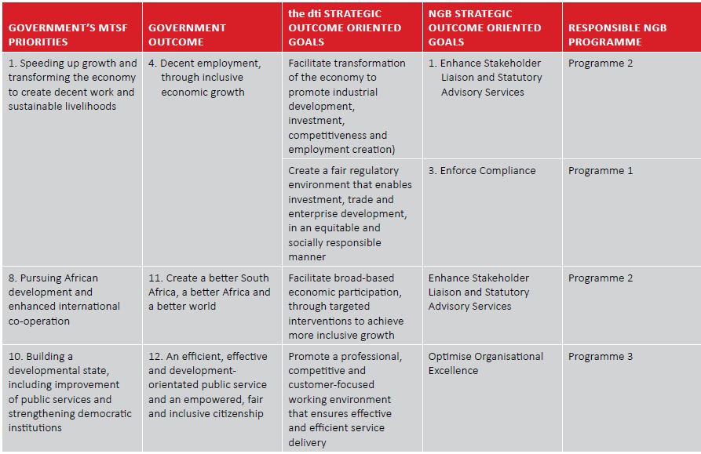
GOVERNMENT’S MTSF PRIORITIES

Slide 24
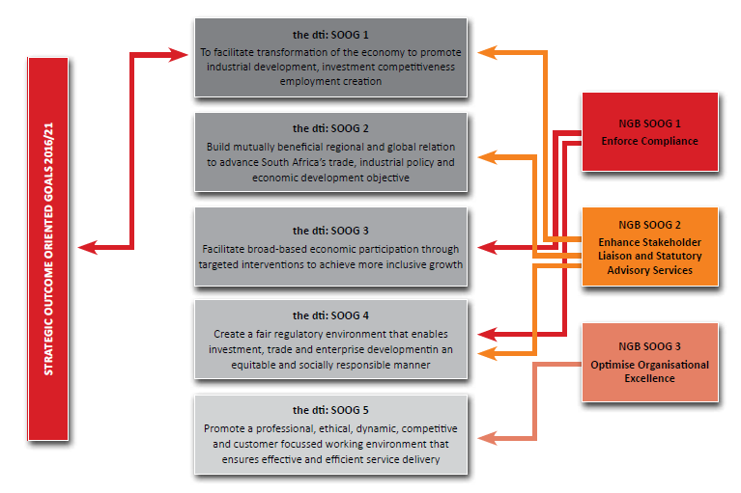
STRATEGIC MAPPING OF 2016-2021 SOOGS TO the dti STRATEGIC GOALS

Slide 25
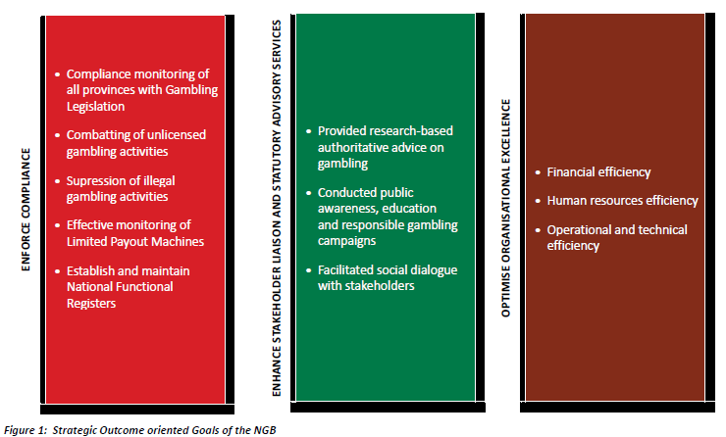
STRATEGIC OUTCOME ORIENTED GOALS (SOOGS)

Slide 26
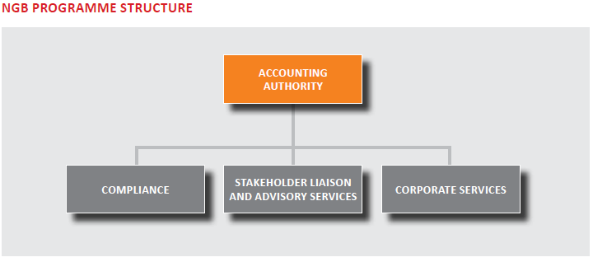
PROGRAMME STRUCTURE

Slide 27
STRATEGIC THRUST 2016/2021
The NGB has assessed its performance and operational environment in relation to targets set, the budget allocation received and the demand of the industry together with government imperatives. As a result, the priorities of the NGB have been reviewed in line with the National Development Plan.

Slide 28
STRATEGIC OBJECTIVES 2016/2021
Programme 1 | 1. Compliance
Strategic Outcome Oriented Goal: Enforce Compliance
Strategic Objectives
SO 1.1 | Compliance monitoring of all provinces with gambling legislation.
SO 1.2 | Combating of unlicensed gambling activities.
SO 1.3 | Suppression of illegal gambling activities
SO 1.4 | Effective monitoring of Limited Payout Machines.
SO 1.5 | Establish and maintain National Functional Registers.
Programme 2 | 2. Stakeholder liaison and advisory services
Strategic Outcomes-Oriented Goal: Enhance Stakeholder Liaison and Statutory Advisory Services
Strategic Objectives
SO 2.1 | Provided Researched based authoritative advice on gambling.
SO 2.2 | Conducted public awareness, education and responsible gambling campaigns.
Programme 3 | 3. Corporate Services
Strategic Outcome oriented Goal: Optimise organisational excellence
Strategic Objectives
SO 3.1 | Financial efficiency.
SO 3.2 | Human resources efficiency.
SO 3.3 | Improved operational and technical efficiency.

Slide 29
PERFORMANCE ENVIRONMENT
External factors impacting on performance outcomes:
- The Approved Gambling Policy,
- Proposed Gambling Amendment Bill
Expectations of industry: the NGB to give leadership with regard to continued legislative reform
- Taking full advantage of the Gambling Review Commission Outcomes
Strategic intent of NGB to become first port of call for all national gambling matters
- Implementing national policy perspectives in advancing NGB’s role in the industry
NGB has to lead & guide, be an arbiter in resolving disputes, contradictions between industry and the regulators

Slide 30
OPERATIONAL ENVIRONMENT
Suppression of illegal gambling – including online gambling;
Combatting unlicensed gambling activities;
Revenue generation that will be aligned to a self-funding model;
Ongoing Research on the socio economic impact of gambling;
Develop norms and standards applicable to National and Provincial Regulation;
Develop stronger regulation models;
Exercise oversight on all provincial gambling activities;
Demonstrate the benefits derived from the returns from the current regulated modes of gambling; and
Provision of reliable information through the establishment and maintenance of national systems.

Slide 31
OPERATIONAL ENVIRONMENT cont…
SECTOR PERFORMANCE, MARKET SHARE AND MARKET CONDUCT

Slide 32
OPERATIONAL ENVIRONMENT cont…
SECTOR PERFORMANCE, MARKET SHARE AND MARKET CONDUCT

Slide 33
OPERATIONAL ENVIRONMENT cont…
SECTOR PERFORMANCE, MARKET SHARE AND MARKET CONDUCT

Slide 34
ENVISAGED OUTPUTS
Amendment of Act to address changes in the governance structure
Review of National Gambling Policy: to enhance the regulation of the currently regulated gambling modes, having regards to economic and employment benefits within the gambling sector
NGB contributing to combatting of crime: working with the law enforcement bodies - established a forum (receives information on illegal practices)
Develop & provide statistics on jobs created & size of the industry: investment & impact
Repository of useful information: used by regulators & stakeholders
Suppress & eliminate illegal practices: which undermine lawfully conducted business
Education and Awareness: Educate and make the public aware of the pro’s and con’s of gambling
Capacity building programme: longer term, towards building & facilitating a range of higher level research skills on problem and responsible gambling
Sharing the ministry’s vision with industry through sectoral dialogue

Slide 35
RISKS TO ACHIEVING THE ENVISAGED OUTPUTS
Risk Management
Risk:
Lack of participation by external stakeholders which results in poor compliance with the gambling provisions.
Reluctance by some external stakeholders to contribute to the submission of the information according to the statutory prescripts.
Mitigation:
The NGB to explore options of reporting the issues at the NGPC and advise the Ministry about the challenges;
Develop Memorandum of Understanding (MOU) addressing to provide a mechanism to address matters of non-compliance or non-co-operation;
the dti has started with a comprehensive policy review of the NGA;
Intensify compliance with statutory prescripts with respect to the national functional registers.
SOOG 1 Enforce Compliance
Goal statement | Strengthened regulatory oversight on all provincial gambling activities. Continuous update and maintenance of national registers contemplated in the legislation.

Slide 36
RISKS TO ACHIEVING THE ENVISAGED OUTPUTS Cont…
SOOG 2 Enhance Stakeholder Liaison and Statutory Advisory Services
Goal statement | Comprehensive and researched advisory services provided to the Minister, the dti and NGPC to ensure inter-governmental governance information and research within the gambling sector informs policy and regulatory development inputs.
Risk Management
Risk:
Uncoordinated research with external regulatory stakeholders on matters of national importance regarding cooperative research initiatives; and
Duplication of research initiatives among the gambling regulatory jurisdictions (PLAs).
Mitigation:
Coordinate the research strategy with provinces on issues of national importance with PLAs; and
Develop a business model that provides for the coordinated and integrated research with the PLAs.

Slide 37
RISKS TO ACHIEVING THE ENVISAGED OUTPUTS Cont…
Risk Management
Risk:
Lack of organisational effectiveness and efficiency, resulting in a dysfunctional organisation.
Mitigation:
Ensure robust organisational governance systems, internal control processes and efficient resources.
SOOG 3 Optimise Organisational Excellence
Goal statement | Strategically partner to provide strategic support services to the NGB. Continually improve to ensure best practice governance and organisational excellence.

Slide 38
KEY CHALLENGES
Addressing policy and legislative reform amendments will impact on the NGB outputs
Proliferation of illegal forms of gambling and improve prosecution of illegal gambling activities
Continuously balancing the economic gains of gambling against the negative impacts thereof
Creating a balance between revenue generation and protection of the public, while taking cognisance of governmental developmental priorities.

Slide 39
ENVISAGED KEY COST DRIVERS
ICT infrastructure to automate the information portal and to monitor the LPM industry – with a secure web based for PLAs and the industry
Public Awareness and Education Campaigns of the work of the NGB and profiling of messages
Research on socio economic impact of gambling and problem gambling in the country
Combatting of illegal gambling activities, law enforcement and oversight working with cybercrime units

Slide 40
REVENUE AND EXPENDITURE PROJECTIONS 2016/21

Slide 41
Thank you
420 Witch-Hazel Avenue
Eco-Glades 2, Block C, Eco Park, Centurion
Telephone: 0100033475
Facsimile: 0866467150
info@ngb.org.za

