Slide 1
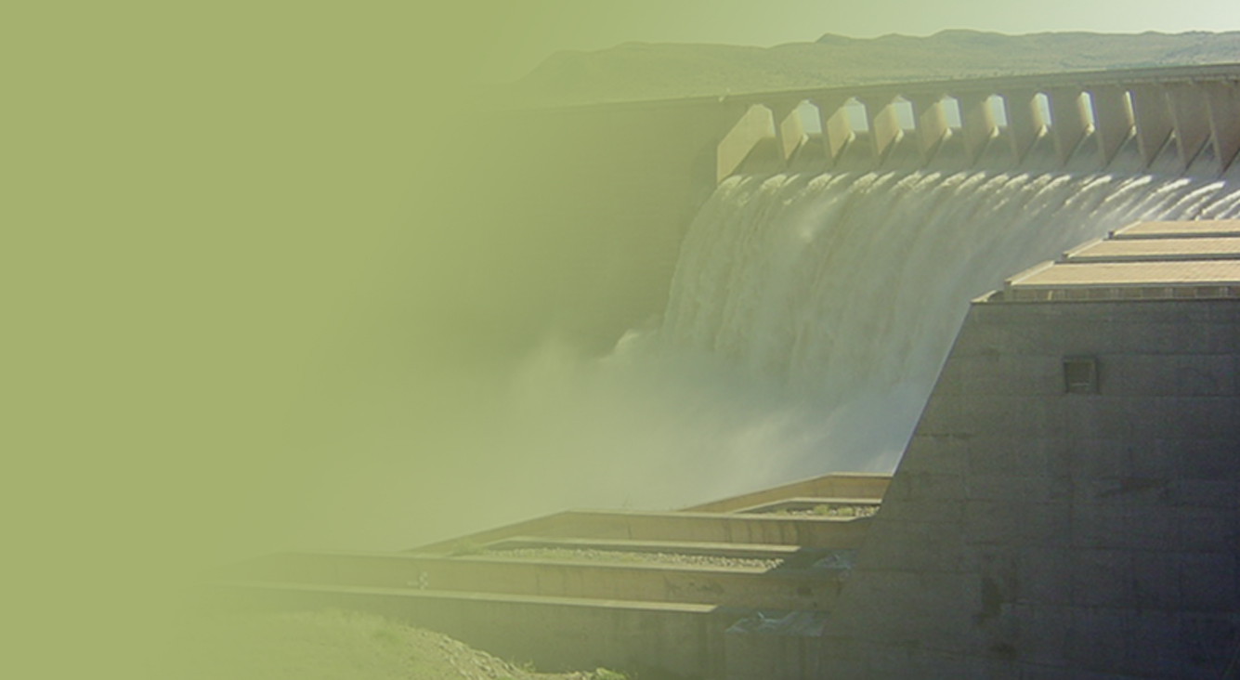
BLOEM WATER BOARD
Annual report for the 2014/15 financial year
02 March 2016
Presented by: CE Dr L Moorosi
PRESENTATION TITLE
Presented by:
Name Surname
Directorate
Date

Slide 2
Annual report for the 2014/15 financial year
CONTENTS
Part 1: Overview of financial performance
Part 2: Overview of non-financial performance

Slide 3
Part 1: overview of financial performance

Slide 4
STATEMENT OF COMPREHENSIVE INCOME FOR THE YEAR ENDED 30 JUNE 2015
 | 2015 |  | 2014
 | R’000 |  | R’000
Revenue | 462 255 |  | 418 593
Water abstraction costs | (23 323) |  | (23 337)
Gross income | 438 932 |  | 395 256
Other income | 25 453 |  | 20 178
Chemicals | (18 899) |  | (14 826)
Depreciation | (52 508) |  | (47 209)
Distribution cost | (16 592) |  | (14 630)
Energy cost | (87 645) |  | (75 443)
Repairs and maintenance | (14 523) |  | (12 437)
Employment costs | (140 790) |  | (116 553)
Impairment of trade receivables | (34 754) |  | (15 213)
Operating expenses | (66 971) |  | (56 516)
Operating profit | 31 703 |  | 62 607
Finance income | 27 772 |  | 24 036
Finance costs | (17 339) |  | (21 008)
Profit for the year | 42 136 |  | 65 635
Other comprehensive income | - |  | -
Total comprehensive income for the year | 42 136 |  | 65 635
Income aligned to volumes budgeted and tariff
Expenditure aligned to raw water transfer, treated volumes and budget
Increase in Implementing agent fees
HR expenditure accommodated pension fund valuation movements, filling of vacant positions
Improvement of provision for bad debt
Finance revenue high for interest charges on debtors.
Finance cost – payment of loans

Slide 5
STATEMENT OF FINANCIAL POSITION FOR THE YEAR ENDED 30 JUNE 2015
 | 2015 |  | 2014
 | R’000 |  | R’000
Assets
Non-current assets | 859 648 |  | 801 125
Property, plant and equipment | 833 242 |  | 780 313
Defined benefit asset | 26 406 |  | 20 812
Current assets | 504 574 |  | 443 446
Inventories | 10 581 |  | 12 117
Trade and other receivables | 103 700 |  | 71 583
Short term investments | 160 376 |  | 170 348
Cash and cash equivalents | 133 188 |  | 159 185
Infrastructure project receivable | 96 729 |  | 30 213
Total assets | 1 364 222 |  | 1 244 571
Non current assets marginally lower than budget as not all CAPEX projects were concluded
Defined Benefit asset pension fund improved
Current assets marginally higher than budget
Mangaung and Kopanong outstanding accounts
Funding committed for loans and CAPEX projects

Slide 6
STATEMENT OF FINANCIAL POSITION FOR THE YEAR ENDED 30 JUNE 2015 (Cont.)
Equity and liabilities
Capital and reserves | 855 070 |  | 812 934
Retained earnings | 643 482 |  | 602 276
Capital replacement fund | 87 350 |  | 87 350
Capital development fund | 70 217 |  | 70 217
Insurance fund | 10 442 |  | 9 512
Asset DWS reserve fund | 43 579 |  | 43 579
Non-current liabilities | 320 765 |  | 309 090
Interest bearing loans and borrowings | 233 046 |  | 221 371
Deferred income | 87 719 |  | 87 719
Current liabilities | 188 387 |  | 122 547
Current portion of interest bearing loans and borrowings | 69 362 |  | 69 586
Trade and other payables | 119 025 |  | 52 961
Total equity and liabilities | 1 364 222 |  | 1 244 571
Reserves improved from retained earnings
Transfer to insurance Fund
Non current liabilities aligned with implementation plan and budget
Accruals for Implementing Agent projects, Eskom, etc
Current liabilities aligned with revised implementation plan and budget

Slide 7
Ratios
Liquidity
The current ratio: 2.68
Cash and cash equivalents
The cash and cash equivalent at the end of the year amounted to: R293 mil. It is earmarked for capital projects – commitments of R269 mil.
Return on assets
The ratio on return on assets is 2.32%. This illustrates the entity’s effectiveness in using its investment in assets.
Debtor days
During the period under review, the debtor days’ analysis reflected a regression from 2013/14: 52.01 days to 2014/15: 76.27 days.
This is due to Late Payment of June 2015 invoices by Mangaung Metro Municipality and continues defaulting and non payment of accounts by Kopanong Local Municipality.

Slide 8
Indicators and Financial Actions
- Continued Solvency
- Ongoing Liquidity
- Remain a Going Concern
- Debtors position worsened
- Cash position stable
- Debt ratios remained high due to CAPEX requirements
- Sales volumes aligned to budget
- Streamlining of the pension fund in terms of Funding the deficit.

Slide 9
Expenditure outcome: 30 June 2015
Programme (R'000) | Budget | Expenditure | Variance | % Spent
Administration | 126784 | 102499 | 24285 | 80.8%
Water Sector Management | 375641 | 370845 | 4796 | 98.7%
Total | 502425 | 473344 | 29081 | 94.2%

Slide 10
Provide reasons for under / overspending:
Underspending due to cost containment measures implemented and to assist with capital requirements .
Raw water charges were below the targeted expense mainly due to a decrease in abstraction from Groothoek dam.
Depreciation is lower due to project values not capitalized and depreciated before operational.
Staff cost is marginally lower as recruitment is done in a phased approach.

Slide 11
Notes to the financial statements
The financial statements have been prepared in accordance with South African Statements of Generally Accepted Accounting Practice and the Public Management Act of South Africa.

Slide 12
Analysis of current payments
Compensation of employees
Goods & services
30%
70%

Slide 13
Unauthorised expenditure
DESCRIPTION | 2014/15 | 2013/14 | Variance | % Variance
 | R'000 | R'000 | R'000
Unauthorised expenditure | 0 | 0 | 0 | 0
13

Slide 14
Irregular expenditure
DESCRIPTION | 2014/15 | 2013/14 | Variance | % Variance
 | R'000 | R'000 | R'000
Irregular expenditure | 0 | 0 | 0 | 0

Slide 15
Fruitless and Wasteful Expenditure
 | 2014/15 | 2013/14
 | R'000 | R'000
Fruitless and wasteful expenditure awaiting resolution | 1700 | 2700
Measures implemented: The executive Management has suspended the implicated individuals pending the outcome of a detailed investigation into the matter.

Slide 16
Accruals
 | 2014/15 | 2013/14
 | R’000 | R’000
 | Total | Total
Goods and services | 81 525 | 36 764
Capital assets | 26 771 | 8 709
Total | 108 296 | 45 473
16

Slide 17
Contingent liabilities and assets
DESCRIPTION | 2014/15 | 2013/14 | Variance | % Variance
 | R'000 | R'000 | R'000
Contingent liabilities and assets | 0 | 0 | 0 | 0
17

Slide 18
Commitment analysis

Slide 19
Capex Projects
Performance of Capex Programme
Capex Programme 2010-2015 consists of 190 projects
140 Projects operations and Maintenance
50 Capital Projects
133 Completed :70%
Balance of 57 Active projects (30% ) to be completed in the year 2015/2016
Background
Capex 2010-2015 Programme came to end in June 2015
Programme had 190 projects in total
Programme budget : R563 million
Loan funding: R269 million
Grant Funding ( NWRI) R100 million
Total Capex Programme Budget :R633 million

Slide 20
Capex Projects- Performance Cont.
Completed Projects R233 million utilised
57 Projects to be implemented with R269 million in 2015/2016

Slide 21
Capex Projects- Performance Cont.
Region | Project | Budget (M) | Actual Expenditure | Status
Modder River Region | Replace Tanks at Rural Villages Phase 2 | R 1.7 | R 1.6 | Completed
 | Replace Tanks at Rural Villages Phase 3 | R 2.3 | R 2.3 | Completed Under Retention
 | Raw Water Pumps | R 4.2 | R 3.5 | Completed
 | Replacement of Morago Pipeline |  |  | Completed
Caledon River Region | Extension of NOVO Pumping Capacity | R38.8 | R34.7 | completed
Orange River Region | Hydro Power Generation | R2.0 | R1.6 | completed
Completed Projects
Expansion:
21 Infrastructure Expansion Projects , 6 completed ( 28.5%)
15 Projects to be completed : R240 million
Variance due to multi year projects that take long in terms of planning
Refurbishment Projects
36 Projects in total , 11 completed (30.5%) budget R 29 million

Slide 22
OVERVIEW OF audit report

Slide 23
Analysis: matters relating the audit report per year
2010/11 | 2011/12 | 2012/13 | 2013/14 | 2014/15
Unqualified | Unqualified | Unqualified | Unqualified | Unqualified
No Matter of emphasis
Opinion that financial statements fairly presents the financial position

Slide 24
Other reports
Agreed upon procedures on engagements – performance contracts
Investigations by Executive Management to probe alleged irregularities – in process

Slide 25
Part 2: overview of non-financial performance

Slide 26
Analysis: achievement of the strategic oriented goals
Achieved
(100%)
Partially achieved
(50 – 99%)
Not achieved
(<50%)

Slide 27
Concluding Remarks
Water Challenges
Debtors position and Cash flow constraints
Capacity constraints and Capex funding
Investigation and disciplinary cases

Slide 28
End

