Slide 1
BURUNDI
Briefing to the Portfolio Committee on International Relations
Cape Town
2 March 2016

Slide 2
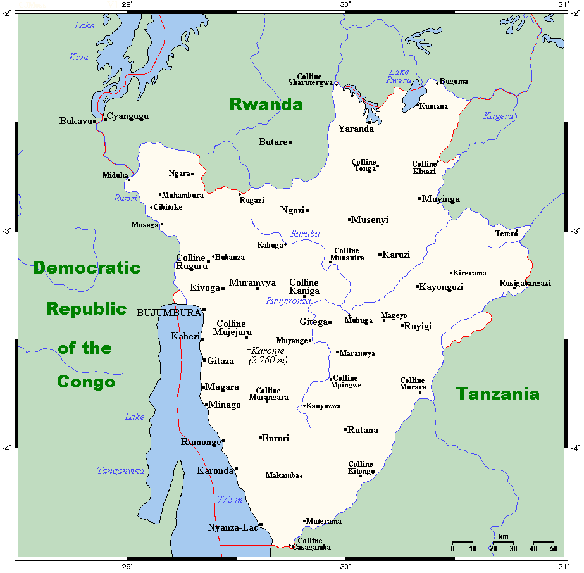

Slide 3
CONTENTS
Genesis of Problem
Security and Stability
Interventions: Regional
Interventions: African Union
AU High-Level Visit Outcomes
Expected Way Forward
Expected Way Forward: SA Role

Slide 4
Genesis of Problem
Prior to the 2015 election, Burundi was a stable country, with a fairly open media and democratic freedoms (expression and association).
President Nkurunziza announced candidature for re-election May 2015.
Opposition parties rejected his eligibility as unconstitutional and against the Arusha Accords, as he had already served “two” full five-year terms.
Constitutional Court declared his candidature legitimate.
Elections held in July 2015 and President Nkurunziza won by 69% of poll, 70% voter turnout. Most opposition parties boycotted the elections.
East African Community (EAC) and United Nations (UN) election observers declared elections peaceful, but not free and fair. AU did not send observers to elections.
“Government of National Unity” formed in August 2015, includes some members of opposition, notably Mr Agathon Rwasa, of the Abigenga Mizero Y’Abarundi Party, a former exiled rebel and fierce opponent of President Nkurunziza. He got 20% of the vote and party given 5 Cabinet posts.
Mr Rwasa was elected Deputy Speaker of the National Assembly.

Slide 5
Security and Stability
Street protests and civil unrest against “Third Term” degenerated into violence mainly in Bujumbura, met by strong response by security forces,.
Attempted coup d’etat allegedly led by former Chief of Military Intelligence, General Godefroid Niyombare on 13 May 2015, thwarted by loyalist troops.
- Niyombare has since launched an armed rebel movement in exile.
President dismissed three Ministers (Defence, Foreign Affairs; Economic Development)
Continuing protests and random attacks on security forces by unnamed groups and security force retaliations / roundups in opposition stronghold areas.
Assassinations of high-profile leaders of both Government and opposition, Hutus and Tutsis, including:
- opposition leader Zedi Feruzi on 23 May 2015;
- former Head of National Intelligence, political-military advisor to the President and co-ordinator of militant youth wing of ruling party Imbonerakure Gen Adolphe Nshiririmana on 2 August
- Come Harerimana, another leader of the CNDD -FDD youth militia on 4 August 2015;
- military strong-man Colonel Jean Bikomagu on 15 August 2015;
- attempted assassination of high-profile activist Pierre-Claver Mbonimpa, son killed;
- attempted assassination of wife of Mr Agathon Rwasa, later elected Speaker.

Slide 6
Security and Stability (contd.)
Reportedly 450 civilians and security forces killed to date.
230 000 people reportedly fled to neighbouring countries.
Arrests, detentions, alleged human rights violations, torture and disappearances, as well as deaths continue.
Claims of emerging genocide and civil war thus far found to be unsubstantiated.
Fears of regional spill-over of instability and violence
Burundian Government openly accuses Rwanda of recruiting, training and arming rebels from refugee camps in Rwanda. (e.g.. in official representations to the AU and UN).
Rwanda denies charges.
Economy in severe decline; exacerbated by withdrawal of donor funds. Tax revenues heavily reduced; Government social programmes cut back and may struggle to pay civil servants

Slide 7
Interventions : Regional
EAC convened several summits to address the crisis.
SA participated in all summits as invited guest.
EAC summit of 6 July 2015 appointed President Museveni as Mediator for all-inclusive Inter-Burundian Dialogue;
Since July, no demonstrable progress in dialogue process,
Government initially put conditions on dialogue, including refusal to talk to alleged coup plotters and certain Civil Society Organisations.
Opposition divided but all seek dialogue. Some in exile.
Agenda for dialogue will be the main hurdle – opposition parties seek President’s resignation and new elections as well as their inclusion in government, at least Interim Government to organize fresh elections
Government unlikely to agree to an Interim Government and new elections – but may be open to inclusive government that will allow President Nkurunziza to serve his term.

Slide 8
Interventions: African Union
AU has endorsed EAC mandate to President Museveni, called for dialogue to start urgently
AU initially sent around 100 military and human rights observers to Burundi - effectiveness hampered by non-finalized MOU and limited numbers to cover the country.
AU Peace and Security Council (PSC) met several times against backdrop of escalation of violence.
Based on Article 4(h) of the AU Constitutive Act, PSC decided 17 December 2015 to deploy a protection and prevention force (MAPROBU) of up to 5,000 troops to Burundi. Requested UN Security Council (UNSC) endorsement.
UNSC has not endorsed as no evidence of impending genocide and civil war
AU Summit 31 January 2016 decided not to deploy the force, but to send a High-Level Delegation to discuss with Government and all stake-holders the urgent resumption of inclusive dialogue under President Museveni.
AU Summit also mandated additional AU military observers as well as more human rights observers.

Slide 9
AU High-Level Visit Outcomes
AU Chairperson appointed 5-member High-Level Delegation representing each of Africa’s RECs (Presidents of RSA; Senegal; Gabon; Mauritania and PM of Ethiopia).
President Zuma led the delegation to Burundi, 25 – 26 February 2016.
Delegation engaged relevant stakeholders during the visit
Its communique highlighted the following:
Condemnation of all violations of human rights and violence perpetrated against civilians and security forces.
Expressed concern at the deterioration of the humanitarian situation.
Urged the government and all armed groups to end the violence.
Stressed the need to dismantle and disarm all the militias.

Slide 10
AU High-Level visit Outcomes (contd.)
Called on all armed groups to lay down their arms and fully participate in the Inter-Burundian Dialogue.
Encouraged countries and peoples of the region to refrain from actions that may destabilize Burundi.
Welcomed the commitment of all stakeholders to participate without preconditions in an inclusive dialogue.
Commended the government for:
- lifting warrants of arrest against some Burundians;
- re-opening of radio and broadcasting stations;
- the announcement of the imminent release of detainees under common law;
- allowing the AU to deploy 100 human rights observers and 100 military monitors.

Slide 11
AU High-Level Visit Outcomes (contd.)
Encouraged the government to:
- continue in the above-mentioned direction; and
- consider granting temporary amnesty to all opposition leaders against whom arrest warrants have been issued.
Called upon the international community to restore aid to Burundi in order to encourage participation by all stakeholders in the Inclusive Dialogue and to permit development to continue.

Slide 12
High Level contd
AU High-Level Delegation to provide a full report to the AU Chairperson which will include recommendations on the way forward.
Inclusive mediation / dialogue will start as soon as possible, with the convening of a meeting by President Museveni before the end of March 2016.

Slide 13
SA Role
Visit of interdepartmental Team on a fact-finding mission from 8-9 December 2015 and met wide range of stakeholders.
While not negating the seriously volatile and unstable situation, concluded that:
Violence by unidentified attackers is sporadic, mainly restricted to some parts of Bujumbura;
Reports of impending civil war and genocide exaggerated;
Economy in dire straits worsened by suspension of donor funding;
All stakeholders committed to resumption of dialogue - however, agenda and objectives differ widely;
Need to include the internal National Commission on Inter-Burundian Dialogue into EAC-led dialogue process;
Need to strengthen AU military observers; human rights observers; and include police observers.

Slide 14
Expected Way Forward: SA Role (contd.)
As one of the guarantors of the Arusha Peace Accords, South Africa remains ready to play her part to assist in the peace process in Burundi.
Already playing her part through participation in the EAC meetings, and AU level engagements through PSC and High Level Representatives
South Africa expected to participate in the AU military observer deployment.
South Africa has agreed to be part of the mediation under President Museveni (pending a formal request).

Slide 15
SA role contd
On a bilateral level, South Africa will, pursuant to the request from the Government of Burundi, resuscitate her Post Conflict Reconstruction and Development (PCRD) on Burundi which includes:
Training Burundian diplomats;
TRC support;
Institutional capacity building;
Establishment of Business Council
Structured Bilateral engagements (JCC).
Development and identification of economic and infrastructure projects

Slide 16
THANK YOU

