Slide 1
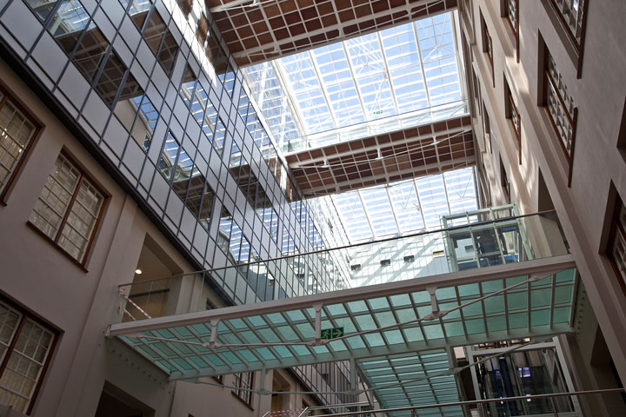
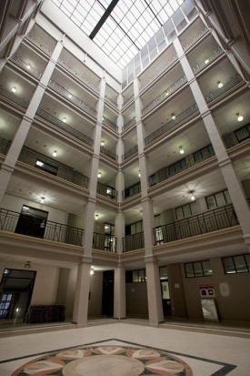
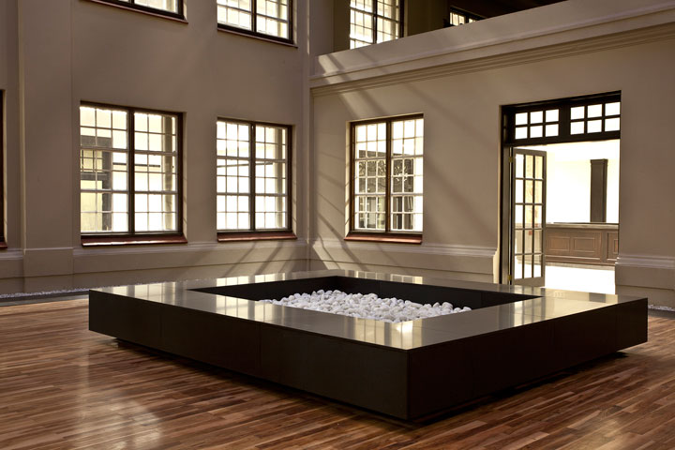
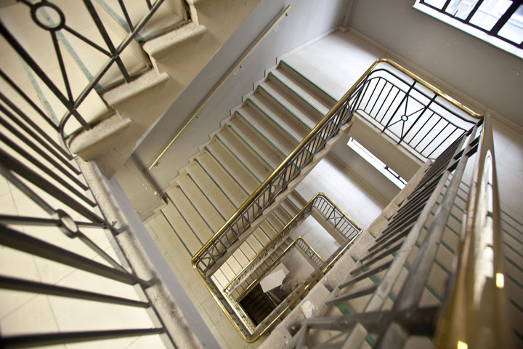
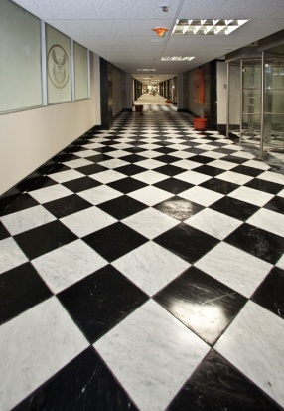
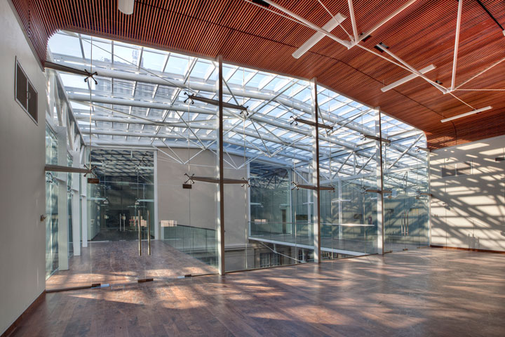
GREEN BUILDING FRAMEWORK
PROPERTY MANAGEMENT TRADING ENTITY
Presentation to the Portfolio Committee on Public Works
1 March 2016

Slide 2
Presentation Outline
Purpose of the Presentation
Background and History
Progress on the Implementation of the Green Building Framework and Policy
Fiscal Allocation and Expenditure Report
Current Projects - Sector Plan Core Focus Areas
Savings on Energy and Water
Outsourcing of Work to install smart meters
Inter-Departmental Collaboration
Conclusion

Slide 3
Purpose of the Presentation
To Update the DPW Portfolio Committee on:
The implementation of the Green Building Programme, Framework and Policy;
Implementation of Projects and Achievements
To Report on Expenditure vs. Fiscal Allocation;
To Provide Clarity on Outsourcing of Services
Collaboration with other Departments.

Slide 4
Background and History
The Hon. Minister of Public Works launched the Department’s Green Building Framework in December 2011 during COP17;
Chief aim of positioning DPW as a central authority on green building particularly on its property portfolio;
South Africa is a co-signatory to international agreements which embrace sustainable human settlements;
The framework was a product of two research papers commissioned by DPW and developed by the CSIR:
- International Review on Sustainable Building, and
- National Imperatives to be addressed through Sustainable Building.

Slide 5
Background and History
The framework shall be implemented through a Built Environment Green Economy Programme (BEGEP) encompassing:
Sustainable Building
DPW Green Building Norms & Standards
Energy Efficiency and Water Efficiency
Sustainable Waste
Social-cohesion Interventions
Building Retrofitting
Indigenous Knowledge Systems (IKS) and Critical Regionalism
Eco-Maintenance and
Eco-labeling of Building Processes and Materials.

Slide 6
PROGRESS ON THE IMPLEMENTATION OF THE FRAMEWORK AND POLICY
PROPERTY MANAGEMENT TRADING ENTITY

Slide 7
Progress on the Implementation of the Framework and Policy
In Response to the Objectives of the Green Building Framework and Policy
Green building plans and programmes
A Sector Plan has been developed by all Provinces and DPW Regions;
Development of strategies to meet national requirements
DPW participates with other Departments in the development of strategies to meet national requirements – (Dept of Energy) DoE (Post 2015 National Energy Efficiency Strategy) and (Dept of Environmental Affairs) DEA (National Appropriate Mitigation Actions and Implementation of COP 21);
Focusing on the enhancement of human settlements and social cohesion
Identified targets on Indigenous Knowledge Systems (IKS).

Slide 8
Progress on the Implementation of the Framework and Policy
In Response to the Objectives of the Green Building Framework and Policy
Integration into immovable asset formation
Working with Asset Management Unit, Construction, SCM and Precinct Unit;
Identification of opportunities and threats to green building
Participation and Involvement in the planning phases as identified above.

Slide 9
How the Framework Is Being Used
The policy has been developed to include all organs of state;
Refinement of policies, programmes and action plans done through the Sector Plan;
Development of National Green Building Indicators in the Sector Plan;
National Green Building Standards and Guidelines – development underway;
Green Building skills development and training programmes Conducted in all Regions and recently included Provinces;
Research and development of capacity Dept. of Science and Technology (IKS), DoE Energy Training, Service Providers (Water Efficiency).

Slide 10
Fiscal Allocation and Expenditure
PROPERTY MANAGEMENT TRADING ENTITY

Slide 11
Budget Allocation and Expenditure
 | Item Description | Budget Allocation (R) | Expenditure | Comments
1. | Measurement and Verification of Energy Efficiency Projects | 32 565 000 | Nil | Procurement Process Underway. Remote monitoring solution in development.
2. | Measurement and Verification of Water Efficiency Projects | 1 790 000 | Nil | Procurement Process Underway
3. | Capacity Building and Training | 5 280 000 | 5 280 000
4. | Green Building Operations (Waste management, Recycling, Alternative Sources of Water, IKS | 50 000 000 | Nil | Procurement Process Underway. Remote monitoring solution in development.

Slide 12
CURRENT PROJECTS (Sector Plan Core Focus Areas)
PROPERTY MANAGEMENT TRADING ENTITY

Slide 13
Sector Plan Core Focus Areas (1)
Energy Management
Renewable Energy
Water Management
Waste Management
IKS Management

Slide 14
Sector Plan Policy Focus Areas (2)
Green Building Prescripts
Public Sector Green Building Policy
Employment creation/ retention targets
Norms and Standards, Guidelines and Targets
Norms and Standards, Guidelines and Targets
Energy Performance Certificates (EPCs)
Water Performance Certificates (WPCs)
Green Building Rating Tool

Slide 15
Shared Energy and Water Savings Contracts at DPW
DPW Shared Energy and Water Savings Contracts in all Regions;
A number of technology retrofits have been effected through the contracts, with energy and water consumption savings achieved;
Service Level Agreement (SLA) for Energy Efficiency signed with DPW;
Service Level Agreement (SLA) for Water Efficiency under review by Legal Services;
Monitoring and Verification (M&V) of reported savings and project implementation will be undertaken .

Slide 16
Savings on Energy and Water
PROPERTY MANAGEMENT TRADING ENTITY
GREEN BUILDING PROGRAMME

Slide 17
Savings in Energy and Water (Q3)
Indicator Category | Initiative Description | Key Performance Activity/Target 2015 / 16 | ytd Actual Performance Against Planned Target / Activity
National
Energy Efficiency | Reduction in energy consumption in kilowatt hour (kWh) | 220 000 000 kWh | 107 051 723 kWh
Water Efficiency | Savings in kl achieved | 3 905 528 kl | 4 681 921 kl

Slide 18
Outsourcing Of Services to Germany Company
PROPERTY MANAGEMENT TRADING ENTITY

Slide 19
Projects and Way Forward
Smart Meter installation (101) was a pilot project;
DPW not responsible for procurement of services and equipment;
DPW has no relationship with any International Donor.
Current Financing and Procurement Plan:
Applied for a NAMA facility in collaboration with DoE and DEA to fund some of the projects;
Considering contracting model for Power Purchase Agreements (Private Investments in Photovoltaic) and PPPs;
DPW will continue to top slice the Facilities Management Budget.

Slide 20
Inter-Departmental Collaboration
PROPERTY MANAGEMENT TRADING ENTITY

Slide 21
Inter-Departmental Collaboration
Established a Green Building Technical Committee;
All 9 Provinces and 11 Regions represented;
Consult with Client Departments through KAM on the Policy;
Continue collaboration with key Stakeholders Dept. of Energy and Department of Environmental Affairs;
Sharing of information with Department of Science and Technology (IKS and Research);
Planning to work with Dept. of Communication (Campaigns);
MOU with Department of Water and Sanitation.

Slide 22
CONCLUSION
Review of the Draft Green Building Policy;
Finalisation of the Draft Sector Plan as per MinMec Directive;
Progress Reporting to MinMec on the Sector Plan Indicators for 2015/16;
Planning for Information campaigns;
Commissioning of Measurement and Verification;
Finalisation of Procurement Processes;
Delivery on APP Commitments.

Slide 23
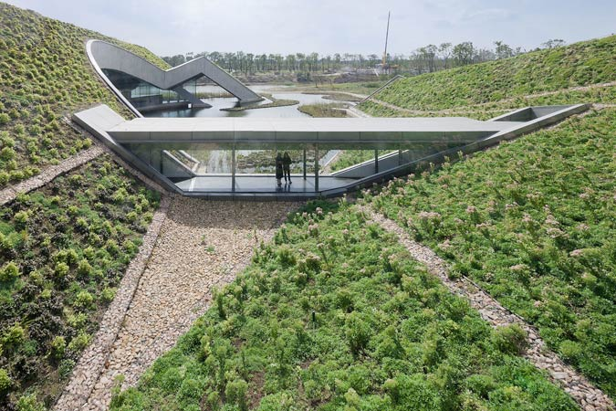
THANK YOU

