Slide 1
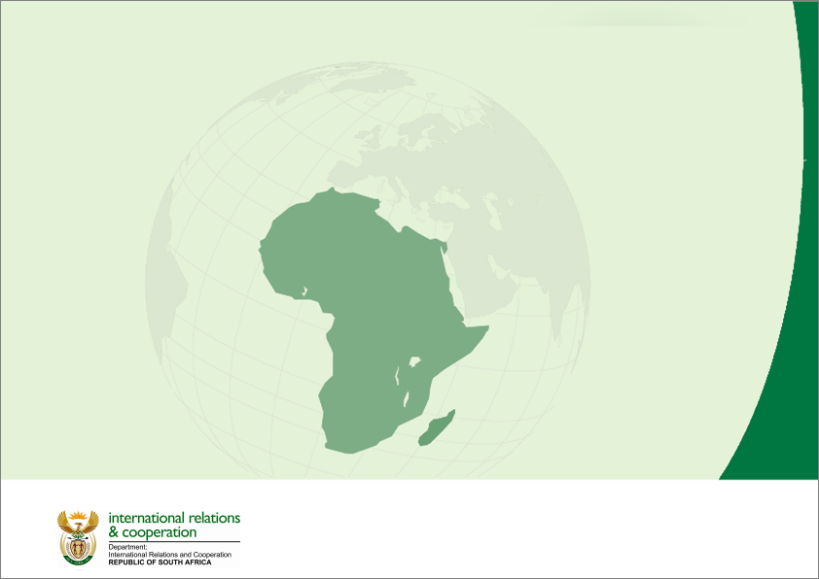
SOUTH AFRICA IN THE INDIAN OCEAN RIM ASSOCIATION (IORA)

Slide 2
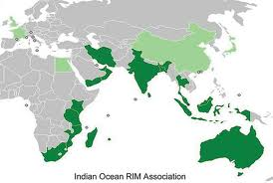
Indian Ocean Rim Association (IORA)
The Association’s membership (21 + 7):
South & East Africa: Comoros, Kenya, Madagascar, Mauritius, Mozambique, Seychelles, South Africa and Tanzania, Somalia
Gulf: Iran. Oman, Yemen & the UAE
South Asia: Bangladesh, India & Sri-Lanka
The South Eastern Indian Ocean: Australia, Indonesia, Malaysia, Singapore & Thailand
Dialogue Partners: USA, Japan, France, UK, Egypt, China, Germany
8 Least Developed Countries (LDC) – 6 Africa

Slide 3
POLICY CONTEXT FOR SOUTH AFRICA
South-South Cooperation
Economic Diplomacy
North-South Dialogue

Slide 4
BACKGROUND
The establishment of IORA in 1997 could be regarded as a South African initiative. In 1995 President Mandela visited India and stated: “the natural urge of the facts of history and geography should broaden itself to include the concept of an Indian Ocean rim for socio-economic co-operation … “
The Indian Ocean:
is the 3rd largest Ocean
carries half of the world’s container ships; one third of the bulk cargo traffic and two thirds of the world’s oil shipments
is a lifeline for international trade and economic development
has a third of the world’s population
produces goods and services worth over $1 trillion. Intra IORA trade is about $777 bn
is rich in strategic and precious minerals and metals; marine resources; agricultural wealth; significant human resources and considerable technological capabilities

Slide 5
BACKGROUND
The Blue Economy, the sustainable development of the ocean is a vast spatial concept and an equally broad-based initiative for economic development. This is the new frontier for the IORA Member States, all of which are coastal or island/ocean states.
The economic diversities of the IORA today reflect varying knowledge, resources and capacities for the multi-faceted activities required for the sustainable economic development of the Indian Ocean, which is vital for the future of the rim and its hinterland.
IORA is an ideal platform to bring Member States to cooperate and share their experience and expertise in harnessing the tremendous potential of the Blue Economy and in establishing an ocean management and governance architecture for the sustainable development of an Indian Ocean blue economy.
It is important to note that SA’s engagement with IORA is informed by the imperative that mechanisms for the protection of the ocean’s biodiversity are considered simultaneously with the processing of proposals by IORA Member States for developing the blue economy.

Slide 6
IORA
Burgeoning strategic interest in the Indian Ocean Rim & the Blue Economy
IORA has re-focused its activities in support of the Oceans and Blue Economy in key sectors:
Fisheries and Aquaculture
Renewable Ocean Energy
Seaports and Shipping
Seabed Exploration and Minerals
Marine Biotechnology, Research and Development
Tourism
Leadership of IORA driven by India, Australia, SA, & Indonesia. UAE is the Chair after SA

Slide 7
SOUTH AFRICA IN IORA
SA leadership role growing – Troika member with Vice Chair (2015-2017) being used to prepare for Chair (2017-2019) (developing strategy as Chair)
SA the 4th G20 Member State to lead IORA
Benefit from 2 Special Fund Projects totaling ZAR 120 thousand:
SA (HSRC) coordinates the Blue Economy Core Group - workshops on Blue Economy issues such as maritime safety and security, and aquaculture and food security. In the longer term, the focus could be expanded to include Shipping, and Oil and Gas Exploration.
SA (WRC) coordinates the IORA Water Science and Technology Working Group - framework for researcher exchanges in member countries in the water research and development domain, and workshops to promote cooperation activities in the water resource management domain

Slide 8
SA STRATEGIC OBJECTIVES
Oceans (Blue) Economy & sustainable economic development (alignment with SDGs & Operation Phakisa)
(Maritime) Peace and Security in the Rim, especially Africa
Capacity building/skills development incl Research, Innovation and Technology
Gender empowerment and the African Agenda (Agenda 2063 and the AIMS) cross cutting priorities
SA Candidacy for the position of Secretary General to coincide with IORA Chair

Slide 9
High Level Meetings
IORA
PRESIDENT
Inaugural IORA Summit (Indonesia) to commemorate 20th Anniversary: 2-6 March 2017
MINISTER
IORA 16th CoMM (October 2016) – Vice Chair
IORA 17th CoMM (October 2017) - Assume Chair

Slide 10
Thank You

