Slide 1
BRIEFING TO THE PORTFOLIO COMMITTEE ON
TRADE AND INDUSTRY
ON THE STATE OF THE NATION ADDRESS
WITH RESPECT TO
the dti’s MANDATE
BY THE MINISTER OF TRADE AND INDUSTRY
23 February 2016

Slide 2
Outline
Global Economic Context
Impact on SA Economy
Areas to be Built Upon
High-level Progress in implementing the 9-Point Plan
Conclusions
2

Slide 3
Global Economic Context
IMF has lowered its global growth forecast for 2016 by 0.2 percentage points from 3.6% to 3.4%.
Global demand in 2016 is expected to remain low, due to the following key transitions:
  Gradual tightening of US monetary policy,
  Lower prices for energy and other mineral commodities, and
  Slower economic growth in China, as it re-balances its economy.

Slide 4
Global Economic Context
The Global Economic Crisis has entered a 3rd wave of destruction with emerging economies likely to bear the brunt of the impact.
China embarks on structural change. Demand for commodities plummets…heralding end of commodity super-cycle.
As developed economies return to growth, the expected end of QE increases emerging markets currency volatility.
Global recession exposes EU imbalances… high fiscal deficits lead to EU debt crises in EU periphery first…later impacting on EU core members too.
US Federal Reserve ends QE and Increases interest rates for 1st time since 2006.
Collapse of Lehman Brothers triggers Global Financial Crisis.
US falls into recession…other developed countries follow.
US and later EU Central Banks flood financial sector with cheap money…much of which chases yields in emerging markets.
Emerging markets incl. China pull global economy out of recession… but global consumer demand outside of Africa stagnates…
Plunging commodity demand and prices lead to Emerging market slowdown…capital inflows are reversed and exchange rates become volatile.
1ST WAVE
2ND WAVE
3RD WAVE

Slide 5
Global Economic Context
IMF has lowered its global growth forecast.
All commodity exporters are struggling.
SA growth outlook is similar to peer countries. Drought is new but key risk.

Slide 6
Impact on SA Economy
Notwithstanding global and domestic headwinds, SA economy continues to grow. But we are well off the 5% inclusive growth needed for radical economic transformation.
Impact of low commodity prices was first felt in Mining but knock-on effects in Manufacturing and Construction, and finally Services.

Slide 7
Impact on SA Economy
Weak global demand in traditional markets constrains our ability to use weak exchange rate to export our way out of the current global slowdown.
But Oxford Business Group report highlights advantages SA has compared to other peer countries. These can be built on and extended.
Oxford Business Group identifies among others:
  The infrastructure build programme, our main counter-cyclical response developed with onset of crisis in 2009,
  The Renewable Energy Independent Power Producers Programme (REIPPP), and
  Programmes like the APDP.
Feature of the latter was policy certainty, good design & efficient implementation.
Current economic conditions underscore need for SA to accelerate its transition from an economy dominated by production and exports of basic commodities.

Slide 8
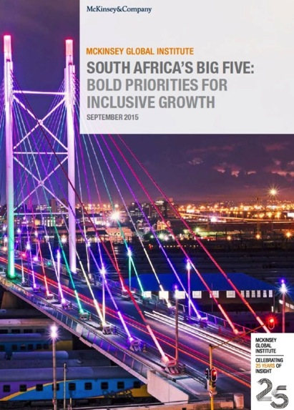
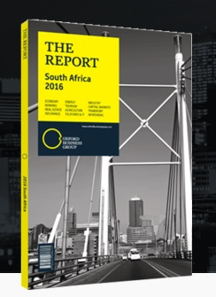
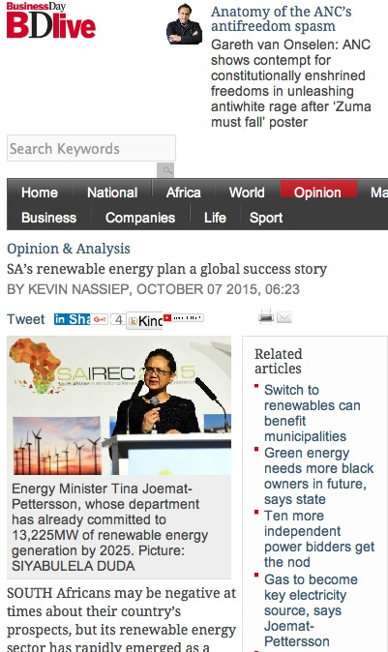
Impact on SA Economy
Examples of success stories we can build on:

Slide 9
Areas to be Built Upon
As President Zuma highlighted in the State of the Nation Address, there are already areas of significant progress within the 9-PP that was developed in response to the weakening economic outlook in early 2015.
The McKinsey Global Institute and Oxford Business Group reports support the approach taken in terms of the 9-PP, and the 9-PP is gaining traction amongst stakeholders incl. Business.
Must stay the course if we are to address the triple challenges of poverty, inequality and unemployment.
Focus now is on scaling-up and consolidating the progress achieved in the 1st year of implementation of 9-PP, prioritising scalable interventions across Government.

Slide 10
Implementation Progress - Autos
South Africa has become an international player in the autos sector with all the major OEMs producing locally.
The APDP is the critical lever that has attracted production to SA.
The review of the APDP and the policy certainty we have created has grown the auto sector. The APDP has leveraged private-sector investment of over R25,7bn over the last 5 years.
In Jan 2015 we reported on the Mercedes (R2.4bn), General Motors (R1bn), Ford (R3.6bn), and Metair Group (R400m) investments.
In February 2016 we can report on the following new investments:
  Goodyear – R670m (Sep’15),
  VW – R4.5bn (Oct’15),
  BMW – R6bn (Nov’15), and
  Beijing Auto Works – R12bn (Dec’15).

Slide 11
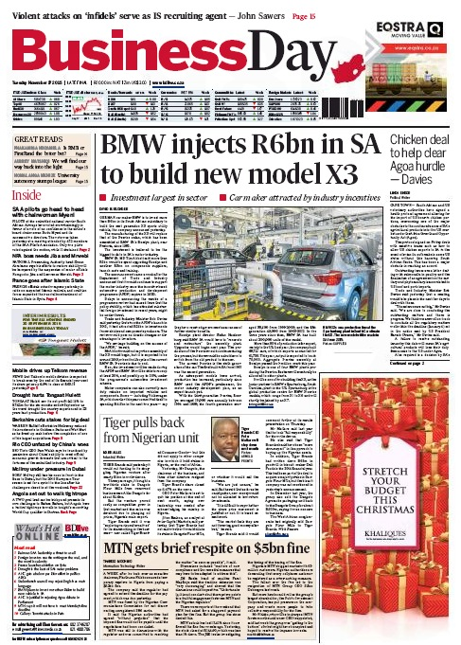
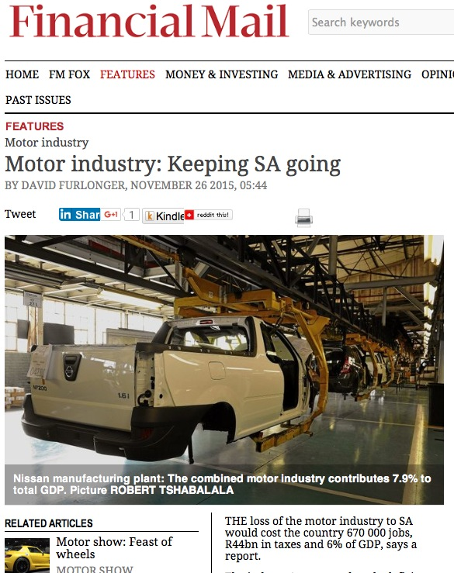
Implementation Progress - Autos

Slide 12
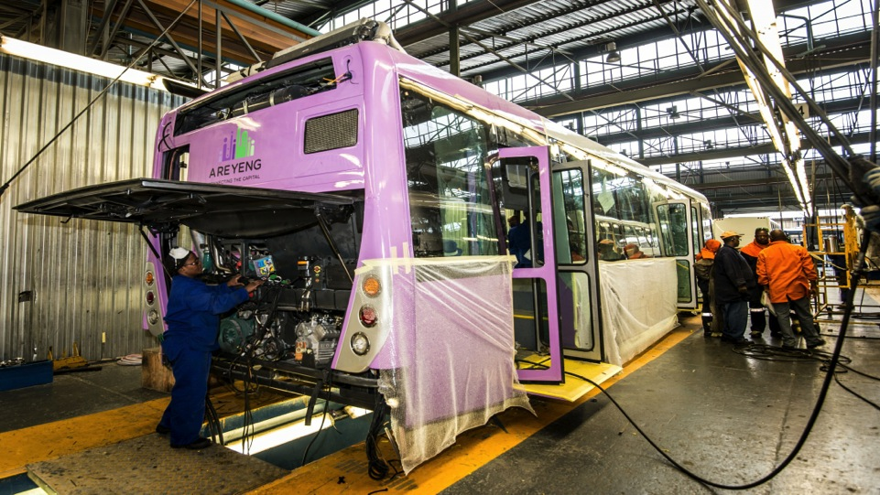
Implementation Progress - Autos
Marcopolo’s Germiston plant producing buses for Tshwane’s A Re Yeng BRT.

Slide 13
Implementation Progress – Machinery & Transport Equip.
US technology multinational GE announced a R700m commitment to support innovation, enterprise- and skills-development in SA.
  R500m will be invested in the creation of a customer innovation centre, and
  R200m in a supplier-development vehicle to provide technical, funding and business support to SMEs. The Technology Localisation Unit (TLU) of the DST/CSIR is providing support to supply companies to raise competitiveness and meet standards.
  The AU has decided that SA should become the rail production hub for Africa. The dti has provided funding of R11 million to Grindrod for its shunting and short-haul locomotive with an 80% local content level, and is exported to a number of African countries.

Slide 14
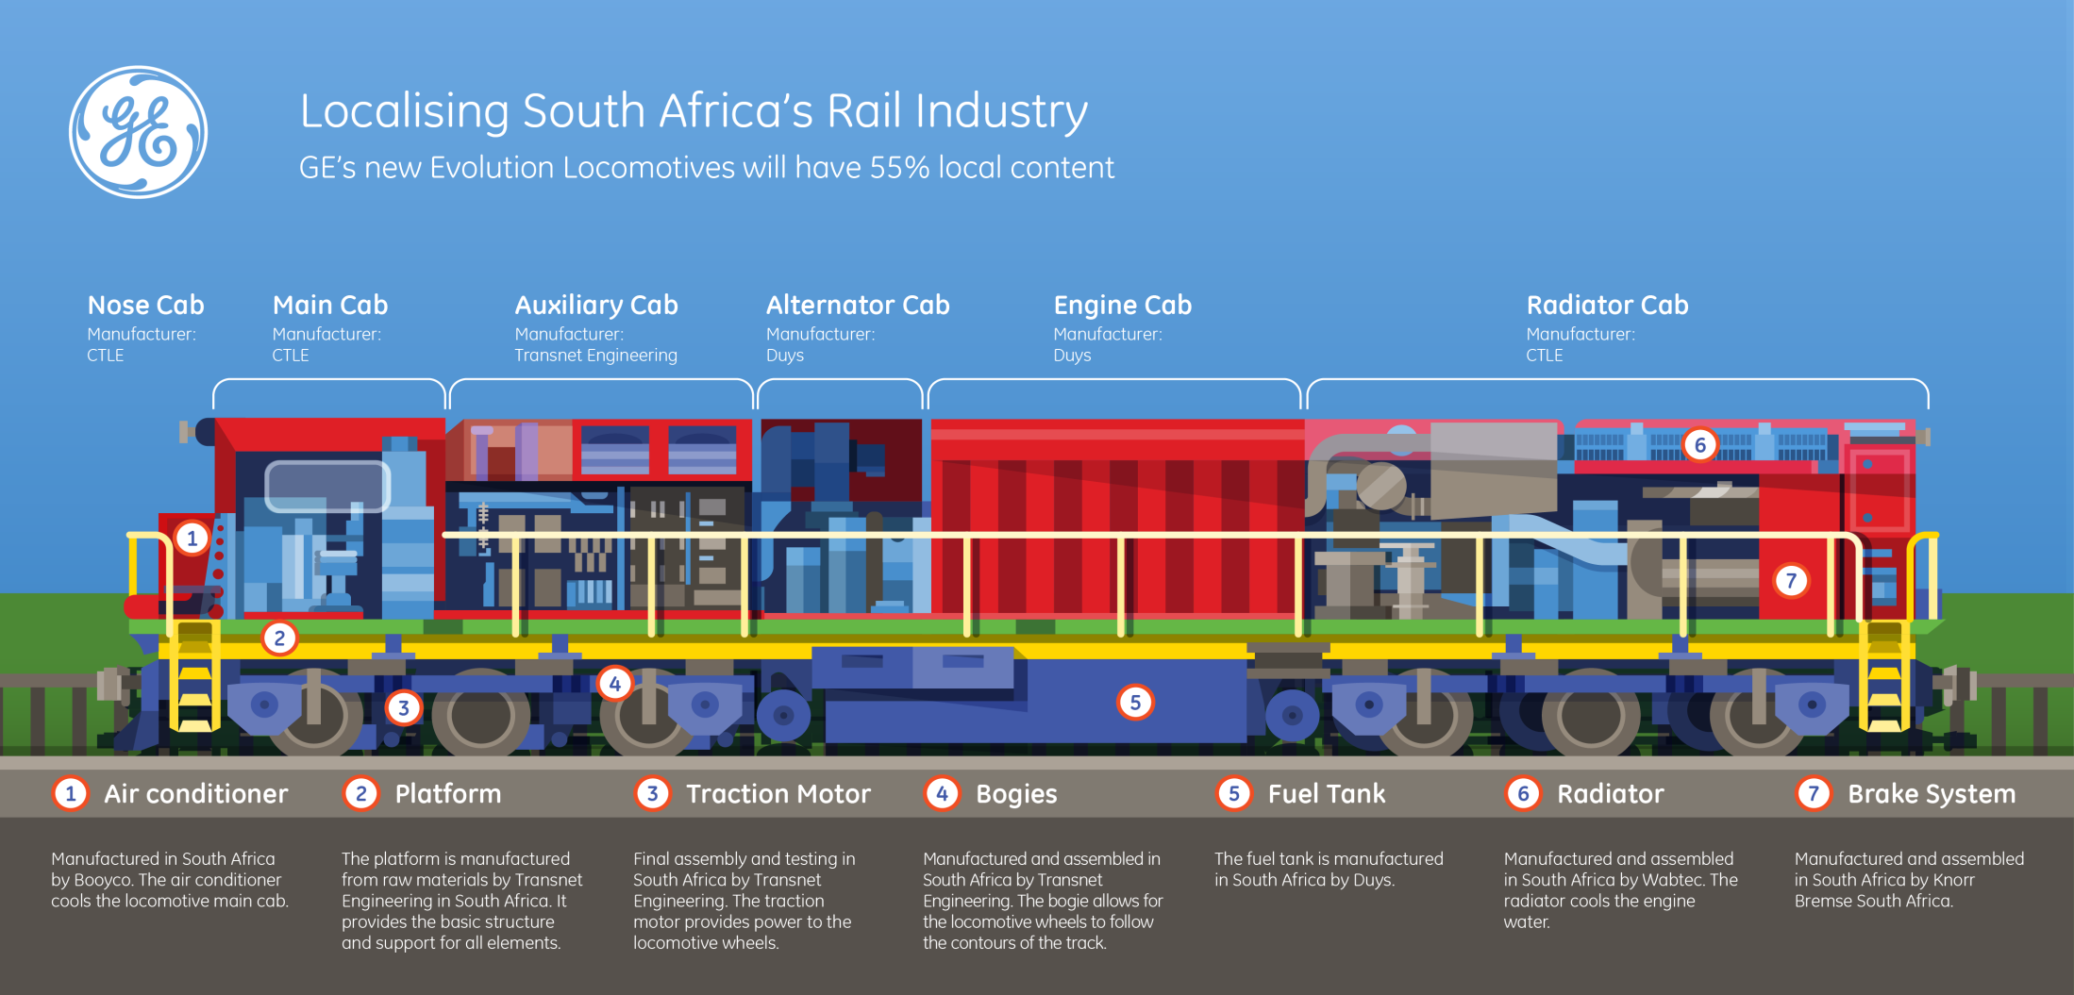
Implementation Progress – Machinery & Transport Equip.
  Significant localisation has already been achieved through the CSDP localisation programme in Transnet/PRASA procurement. Significant rail production capability has been rebuilt and a platform created for the Africa export drive.

Slide 15

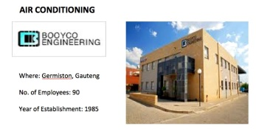
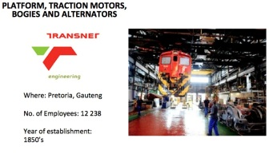
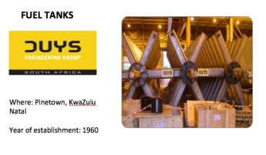
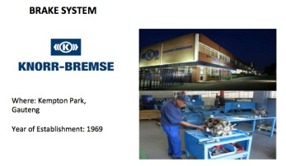
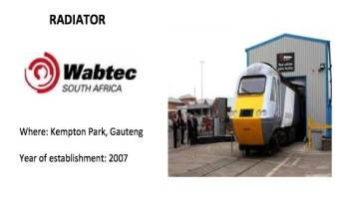
Implementation Progress – Machinery & Transport Equip.

Slide 16
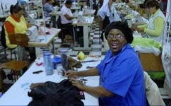
Implementation Progress – Clothing, Textiles, Footwear/Leather
Between 2000 and 2010, the clothing sector lost 45,000 jobs. Imports (in real terms) grew four fold from just R2,9bn in 2000 to over R11bn by 2010.
The sector was in crisis and SA faced the real prospect of the sector losing its critical mass of technical, design and logistical capacity.
In order to stabilise the sector, the Clothing and Textile Competitive Programme (CTCP) was introduced in 2010.

Slide 17
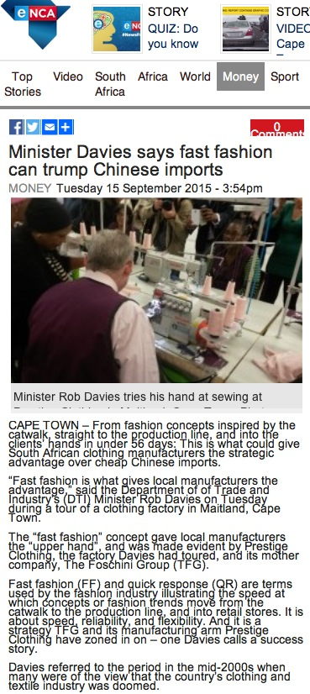
Implementation Progress – Clothing, Textiles, Footwear/Leather
Between the inception of the Clothing and Textiles Competitiveness Programme (CTCP) in 2010 and March 2015, a total of R3.7 billion was approved to support private sector investment.
As a result 68,000 jobs have been retained in the sector, 6,900 new jobs created, 22 new factories in leather and footwear sector have opened.
The sector has been successfully stabilised, is steadily regaining domestic market share and is beginning to grow exports.

Slide 18
Implementation Progress – Investment
  Since the introduction of the Self Service Terminals for company registrations, the CIPC improved turnaround times significantly from 3 - 4 weeks to an average of 2 days but in most cases registration is completed in a matter of hours.
  In 2014/15 financial year, SA attracted a total of R43bn FDI and remains the largest recipient of FDI projects in Sub Saharan Africa.
  During FOCAC, China announced investments of $50bn, of which SA will receive $10bn for infrastructure, industrialisation and skills development.
  Spain announced that it has included SA in its top 16 Priority Market list and SA was the only sub-Saharan African country included in the list.
  All these, affirm that foreign investors believe in the prospects of the South African economy.

Slide 19
Implementation Progress – IDZ’s
Between 2002 and 2014, the following 6 IDZs have been designated and have so far attracted a significant number of investors on site with an investment value of more than R10.7bn.

Slide 20
Implementation Progress – IDZ’s
Number of Operational, Secured and Pipeline Investors in 4 operational IDZs

Slide 21
Implementation Progress – Investment Awards
International Awards
During the grand opening of the UNCTAD World Investment Forum in October 2014 SA was awarded the Global Award for outstanding performance in attracting foreign direct investment projects that support sustainable development.
Business Process Services Awards
The National Outsourcing Association (UK) Offshoring Destination of the Year 2012,
European Outsourcing Association Offshoring Destination of the Year 2013, and
National Outsourcing Association (UK) Professional Awards – Skills Development Programme of the Year 2014.

Slide 22
Implementation Progress – Investment Awards
Manufacturing - Automotive Awards
BMW’s Rosslyn Plant - the recipient of the 2015 Plant Assembly Line Quality Award (based on models produced for U.S. market) and Platinum Plant Quality Award, which represents the highest performing assembly plant in the world for initial quality.
Mercedes-Benz South Africa's (MBSA) - plant in East London was awarded silver in the 2013 automotive Initial Quality Study (IQS) by American market research firm JD Power and Associates.
MBSA was the only automotive company to be nominated in six categories at the Truck X Conference and Awards in 2014 and the only one to win four awards, including the Truck of the Year award.

Slide 23
Implementation Progress – One Stop Shop Investment Centre
As announced by President Zuma - An efficient One Stop Shop to support increased domestic and foreign investment in line with the NDP’s aspirations will be developed by the dti.
It will focus on reducing regulatory inefficiencies, setting up norms and standards including turnaround times, coordinate, fast-track, unblock and reduce red tape for all investors.
It will also coordinate the One Stop Shop Investment Centres in the:
  SEZ’s,
  Provincial Investment Agencies,
  local authorities, and
  relevant government departments involved in regulatory, registration, permits and licensing matters.
The One Stop Shop will be chaired by the President.
The Initiative will be supported by the Inter-Ministerial Committee.

Slide 24
Implementation Progress – One Stop Shop Investment Centre
It will operate as the main interface (front office) between government and investors; supported by the Inter-Departmental Clearing House (ICH) at the dti, operating as the back office.
For this reason Trade and Investment South Africa (TISA) has been split into two divisions enabling the establishment of the ICH.
ICH will focus on unblocking bureaucratic obstacles, red-tape and administrative barriers, thereby improving government services and support to investors.
In January 2016, the President established the Inter-Ministerial Committee (IMC) on investment to support the One Stop Shop Investment Centre.
The One Stop Shop Investment Centre was launched in early February 2016 by the President.

Slide 25
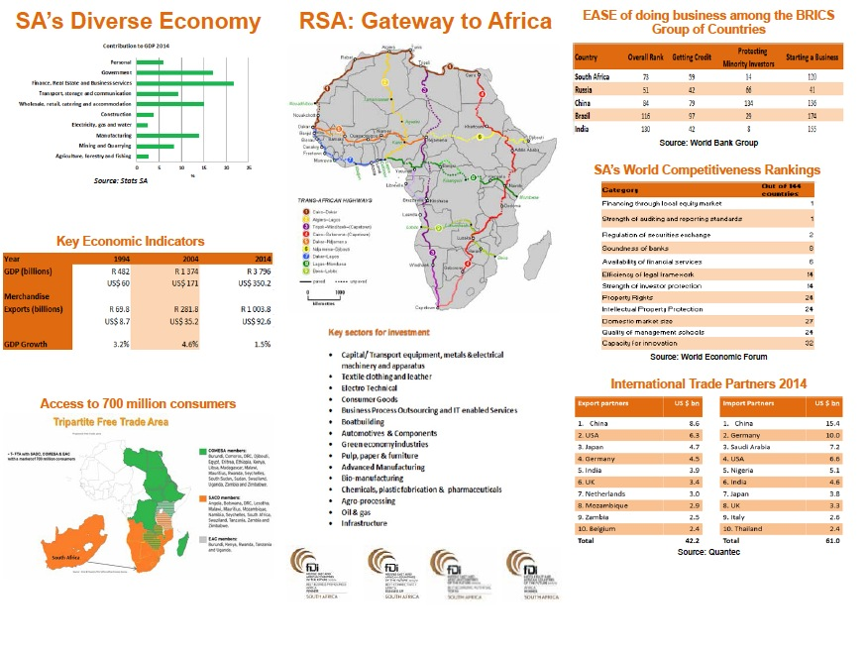
Implementation Progress – One Stop Shop Investment Centre

Slide 26
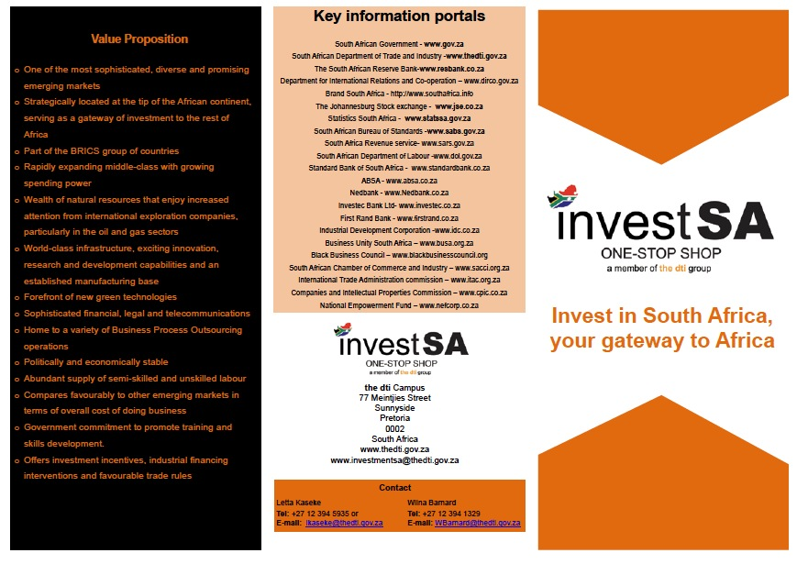
Implementation Progress – One Stop Shop Investment Centre

Slide 27
Conclusions
Our economic environment has deteriorated, partly due to developments in the global economy and partly due to domestic factors such as the drought.
Critically, there is broad agreement across all stakeholders on the need for ‘business unusual’.
Business and government have agreed that partnerships will need to be substantially deepened to assist in ensuring that SA is not downgraded and to weather the current difficult economic conditions.
As the President noted in the SONA, the 9-PP has traction, and the dti has built momentum in IPAP, Beneficiation and Private-sector Investment.
These efforts will be built-upon and reinforced through a renewed focus on supporting labour-intensive and growth-enhancing sectors such as Clothing, Textiles & Footwear, Agro-processing, BPS and Tourism.
In the current fiscal climate we will refine our existing incentives to ensure the greatest possible economic benefit to the SA economy.

