Slide 1
DST ANNUAL REPORT PRESENTATION FOR THE 2014/15 FINANCIAL YEAR
SELECT COMMITTEE OF
COMMUNICATION AND PUBLIC ENTERPRISES
Mr Imraan Patel
04 November 2015

Slide 2
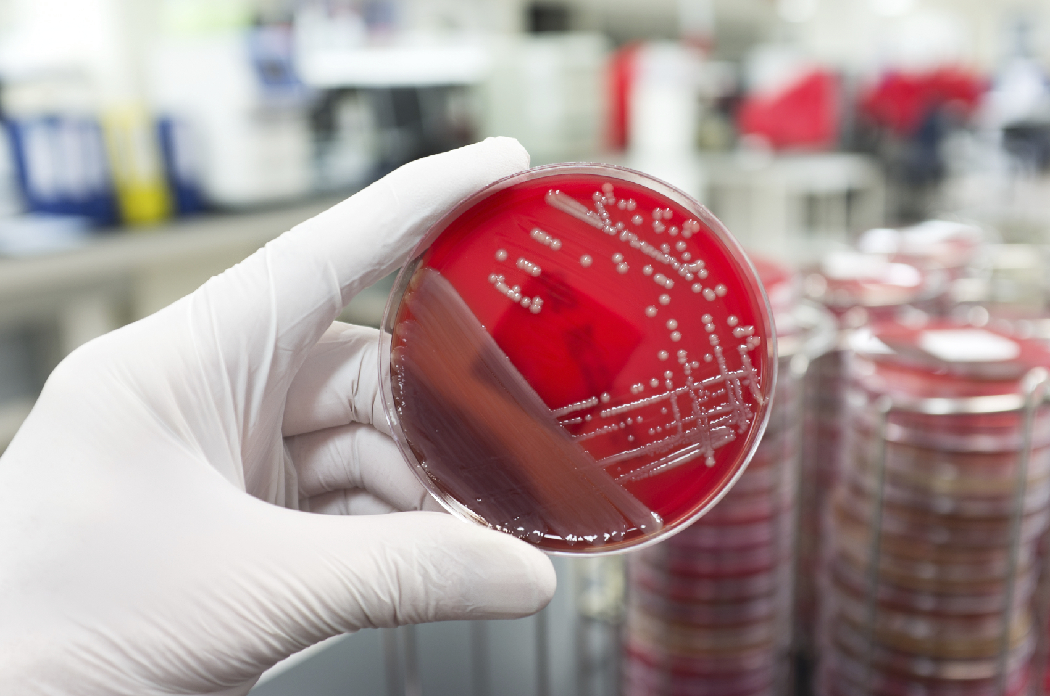
OUTLINE OF PRESENTATION
Background
Programmes
Performance Overview
Performance per Programme
DST Key Goals
Targets not achieved
Key Achievements per Programme
DST Projects across the Provinces
Financial Performance
Conclusion

Slide 3
BACKGROUND

Slide 4
DST POLICY MANDATE
The Department of Science and Technology (DST) derives its mandate from the 1996 White Paper on Science and Technology, which introduced the concept of a National System of Innovation (NSI).
The NSI remains an ideal for which South Africa continues to strive. It is an enabling framework for science, technology and innovation (STI).
The NSI can be understood as a set of functioning institutions, organisations and policies that interact constructively in the pursuit of a common set of social and economic goals and objectives, seeking to promote change through the introduction of innovations.

Slide 5
DST POLICY MANDATE
The DST, as the custodial coordinator for the development of the NSI, influences this system through key strategies such as the National Research and Development Strategy (NRDS) and the Ten-Year Innovation Plan (TYIP).
The latter, particularly, seeks to contribute to the transformation of the South African economy from a resource-based into a knowledge-based economy, in which the production and dissemination of knowledge will lead to economic benefits and enrich all fields of human endeavor.
In this regard, the measure of success will be the level to which science, technology and innovation (STI) play a driving role in enhancing productivity, economic growth and socio-economic development.

Slide 6
VISION
Vision
To create a prosperous society that derives enduring and equitable benefits from science and technology

Slide 7
.
DST MISSION STATEMENT
.
Mission
To develop, coordinate and manage a National System of Innovation that will bring about maximum human capital, sustainable economic growth and improved quality of life

Slide 8
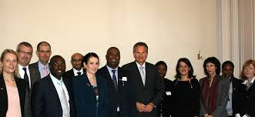
KEY GOALS OF THE DEPARTMENT
To develop the innovation capacity of the NSI.
To enhance South Africa’s knowledge capacity.
To develop appropriate STI human capital to meet the needs of society.
To build world-class STI infrastructure.
To position South Africa as a strategic international RDI partner.

Slide 9
DST CONTRIBUTION TO OUTCOMES
Outcome 2: A long and healthy life for all South Africans.
Outcome 7: Vibrant, equitable and sustainable rural communities and food security for all.
Outcome 4: Decent employment through inclusive economic growth.
Outcome 6: An efficient, competitive and responsive economic infrastructure network.
Outcome 10: Environmental assets and natural resources that are well protected and continually enhanced.
Outcome 5: A skilled and capable workforce to support an inclusive growth path.

Slide 10
PROGRAMMES

Slide 11
DST PROGRAMMES
White Paper on S&T, National Research & Development Strategy,
Ten-Year Innovation Plan
Technology Innovation
Research Development and Support
Socio-Economic Innovation Partnerships
International Cooperation and Resources
Administration

Slide 12
PURPOSE
PROGRAMME 1: Administration
To conduct the overall management and administration of the Department.

Slide 13
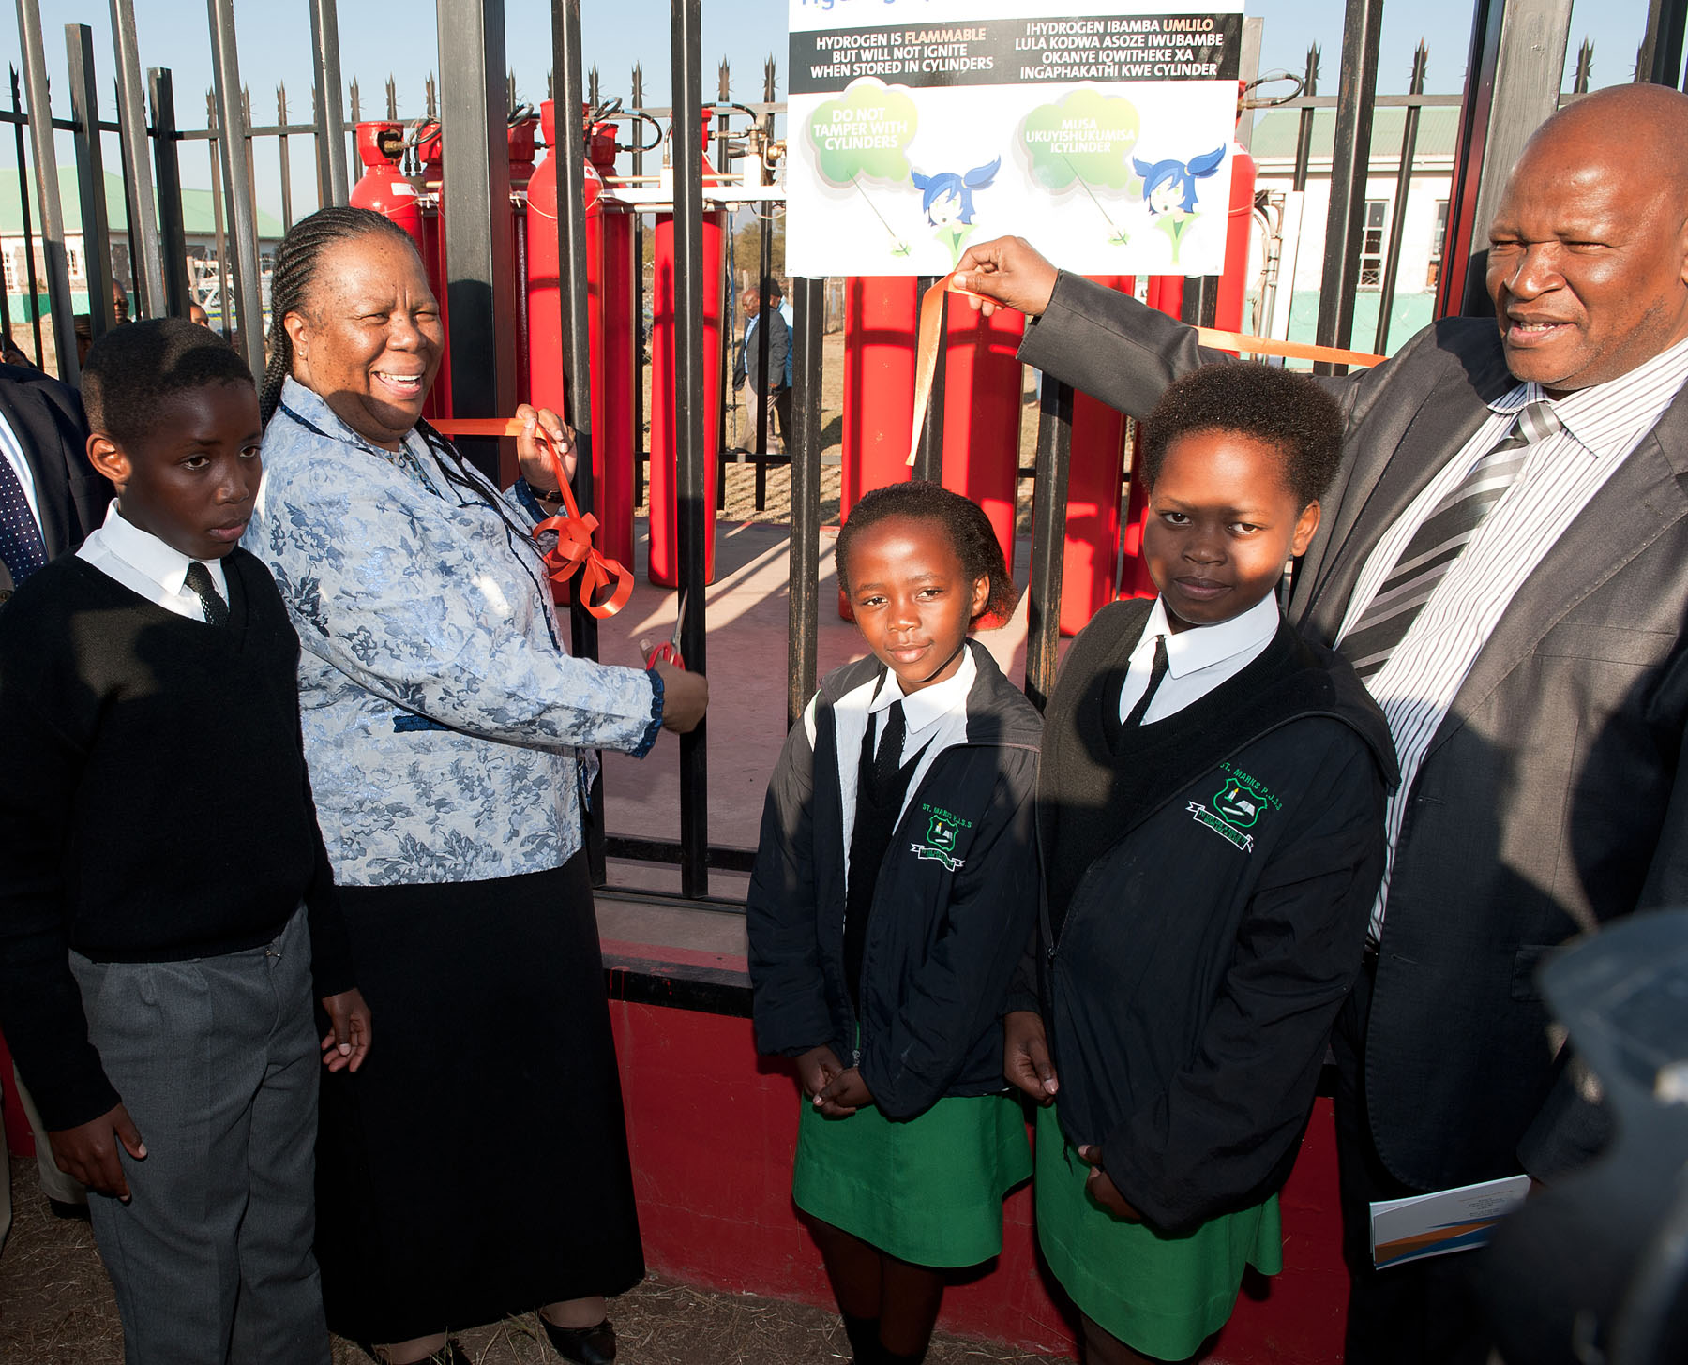
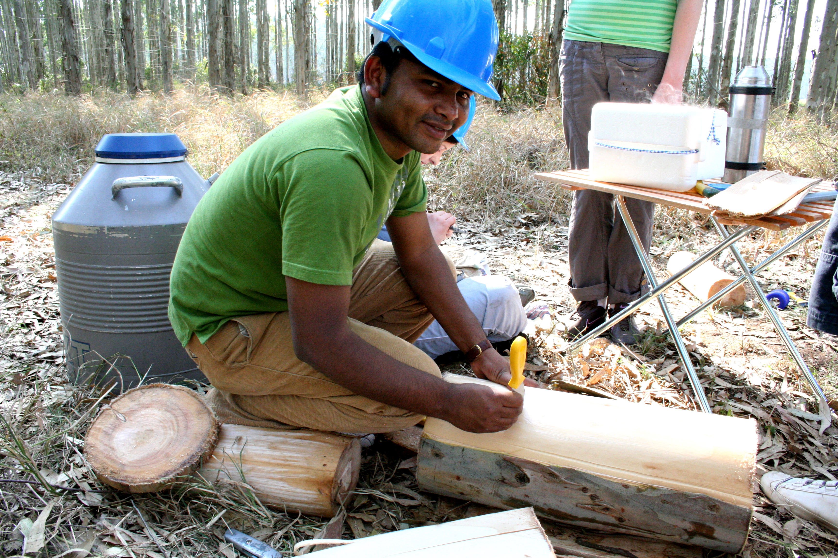
PURPOSE
PROGRAMME 2: Technology Innovation
To enable research and development in strategic and emerging focus areas that promotes the realisation of commercial products, processes and services from R&D outputs; through the implementation of enabling policy instruments.

Slide 14
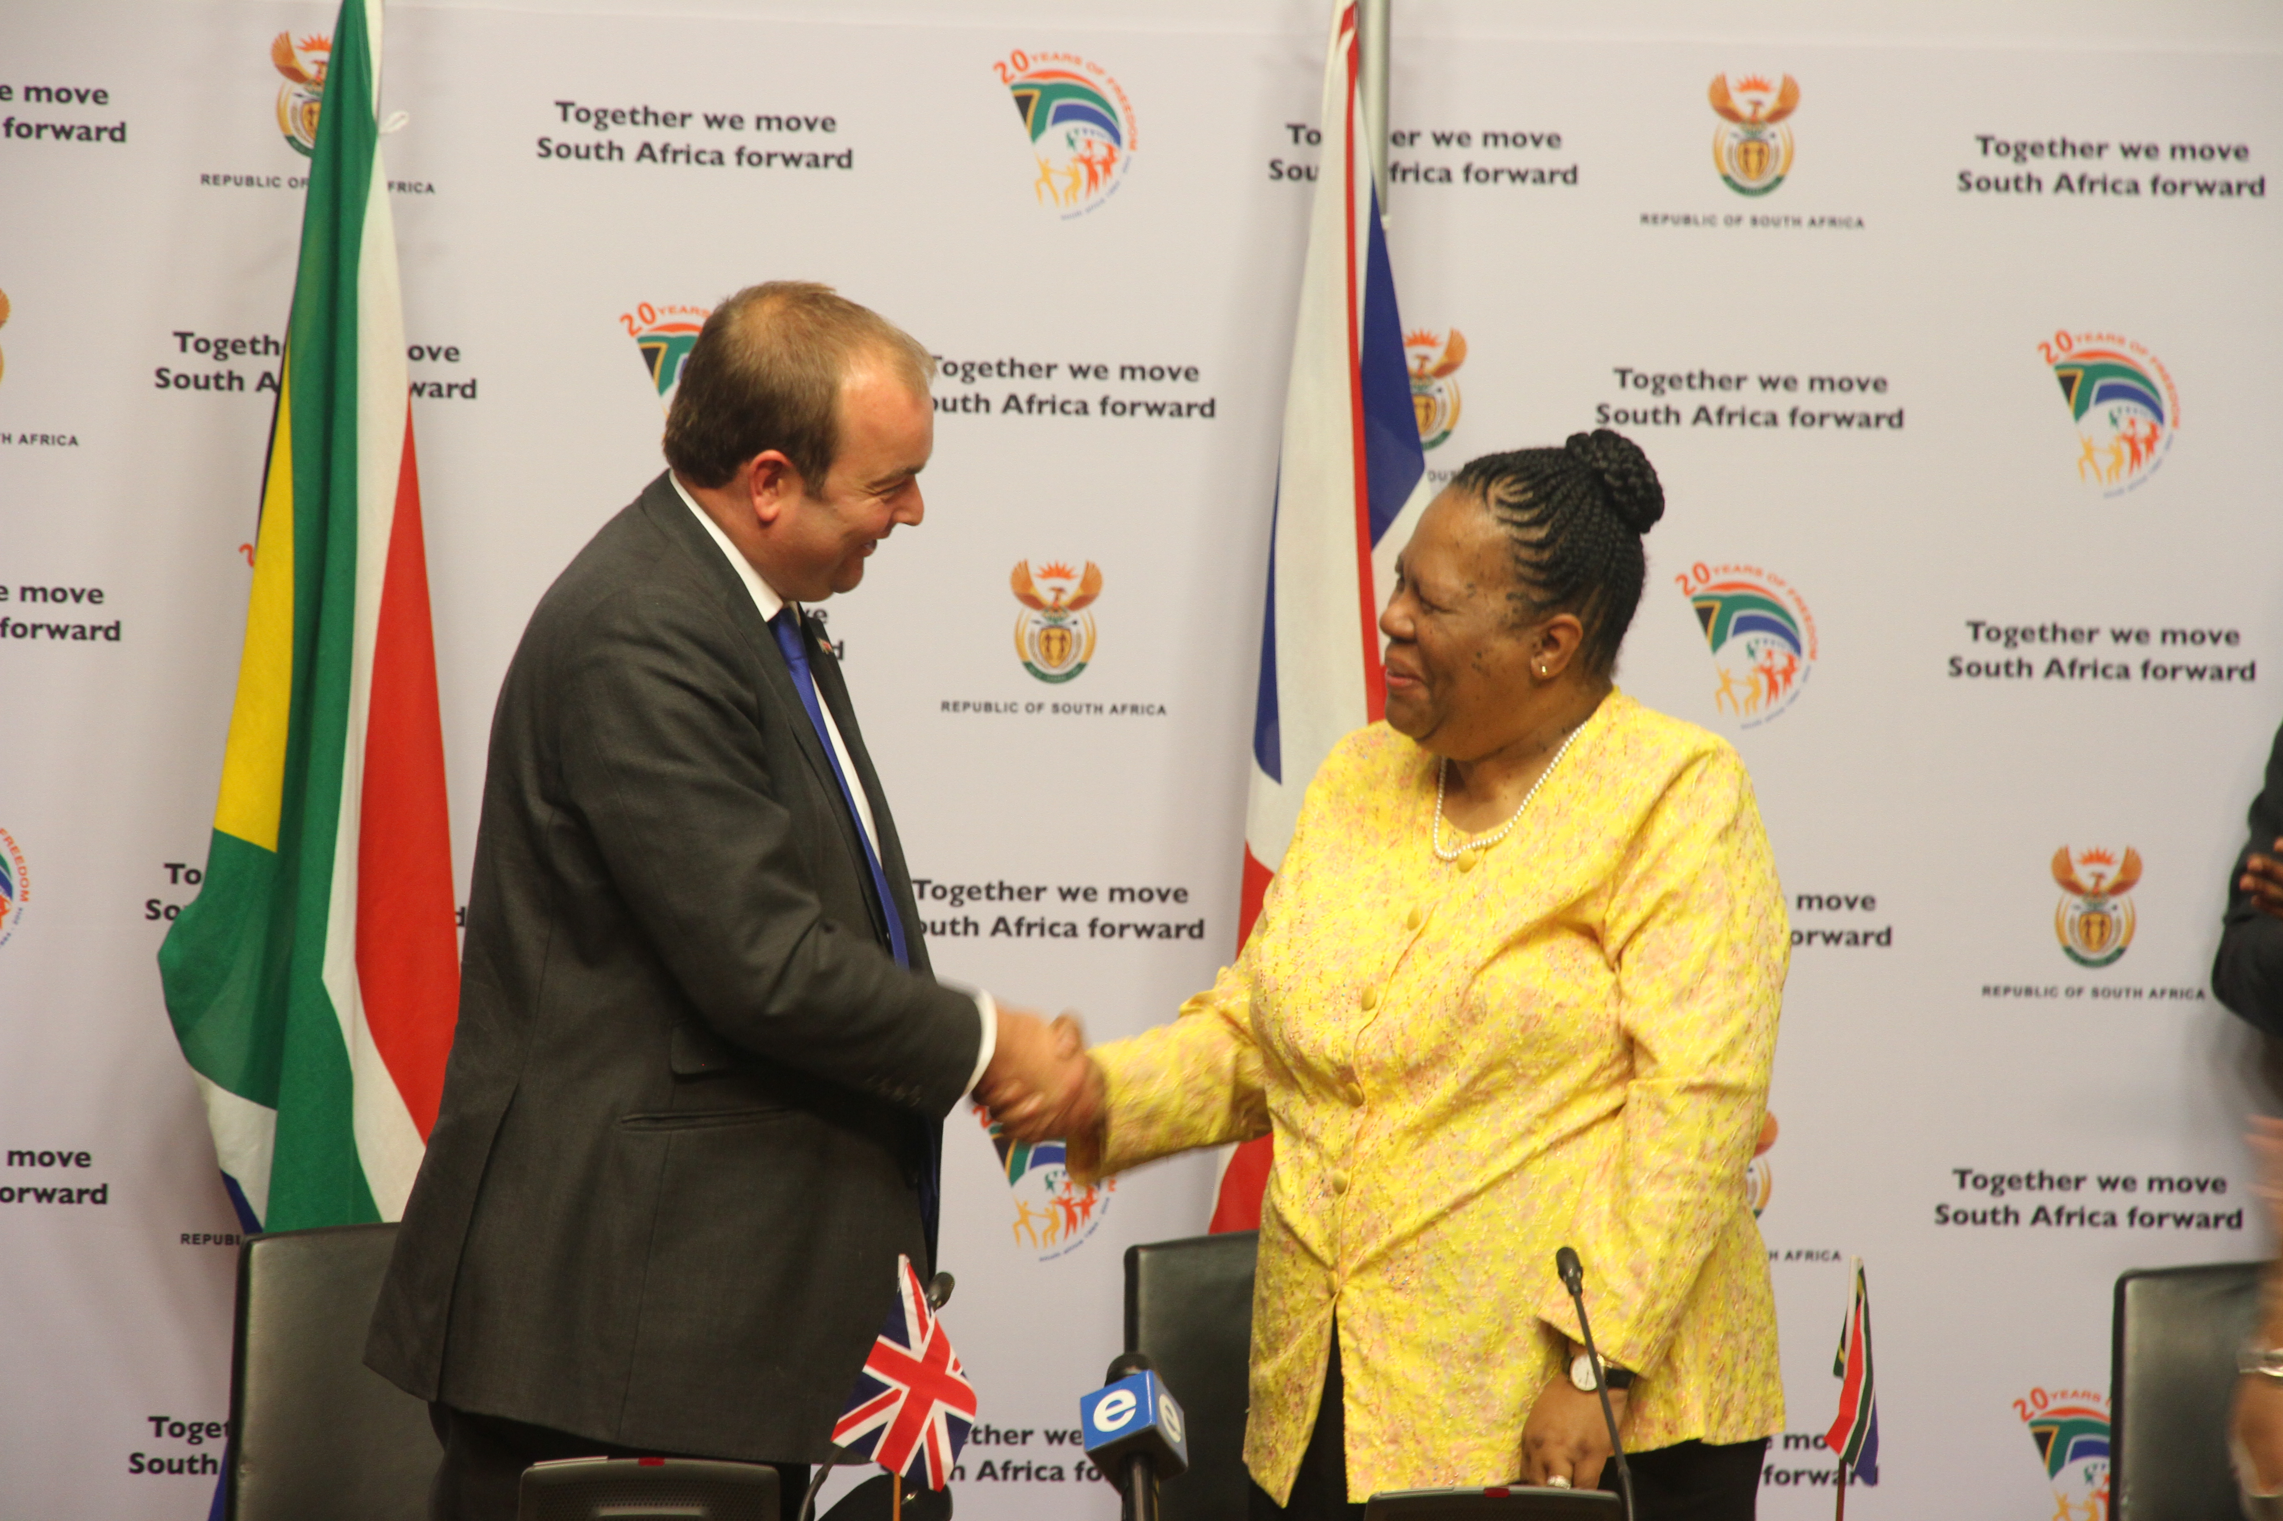
PURPOSE
PROGRAMME 3: International Cooperation and Resources
This Programme aims to strategically develop, promote and manage international relationships, opportunities and S&T agreements that strengthen the NSI and enable an exchange of knowledge, capacity and resources between South Africa and its regional and international partners.

Slide 15
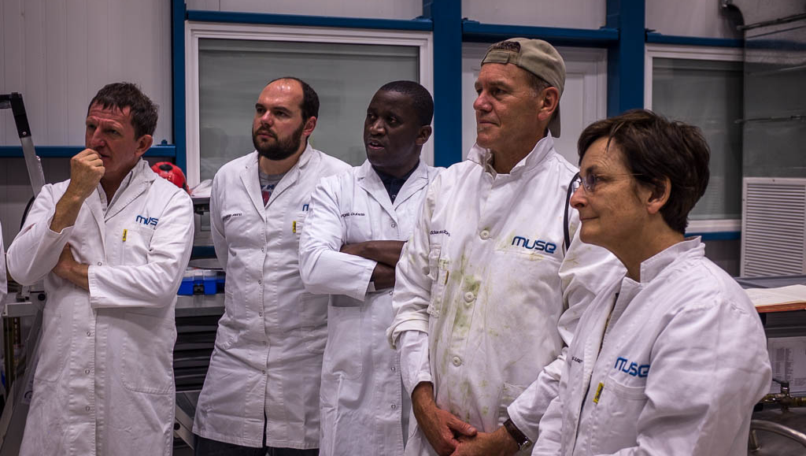
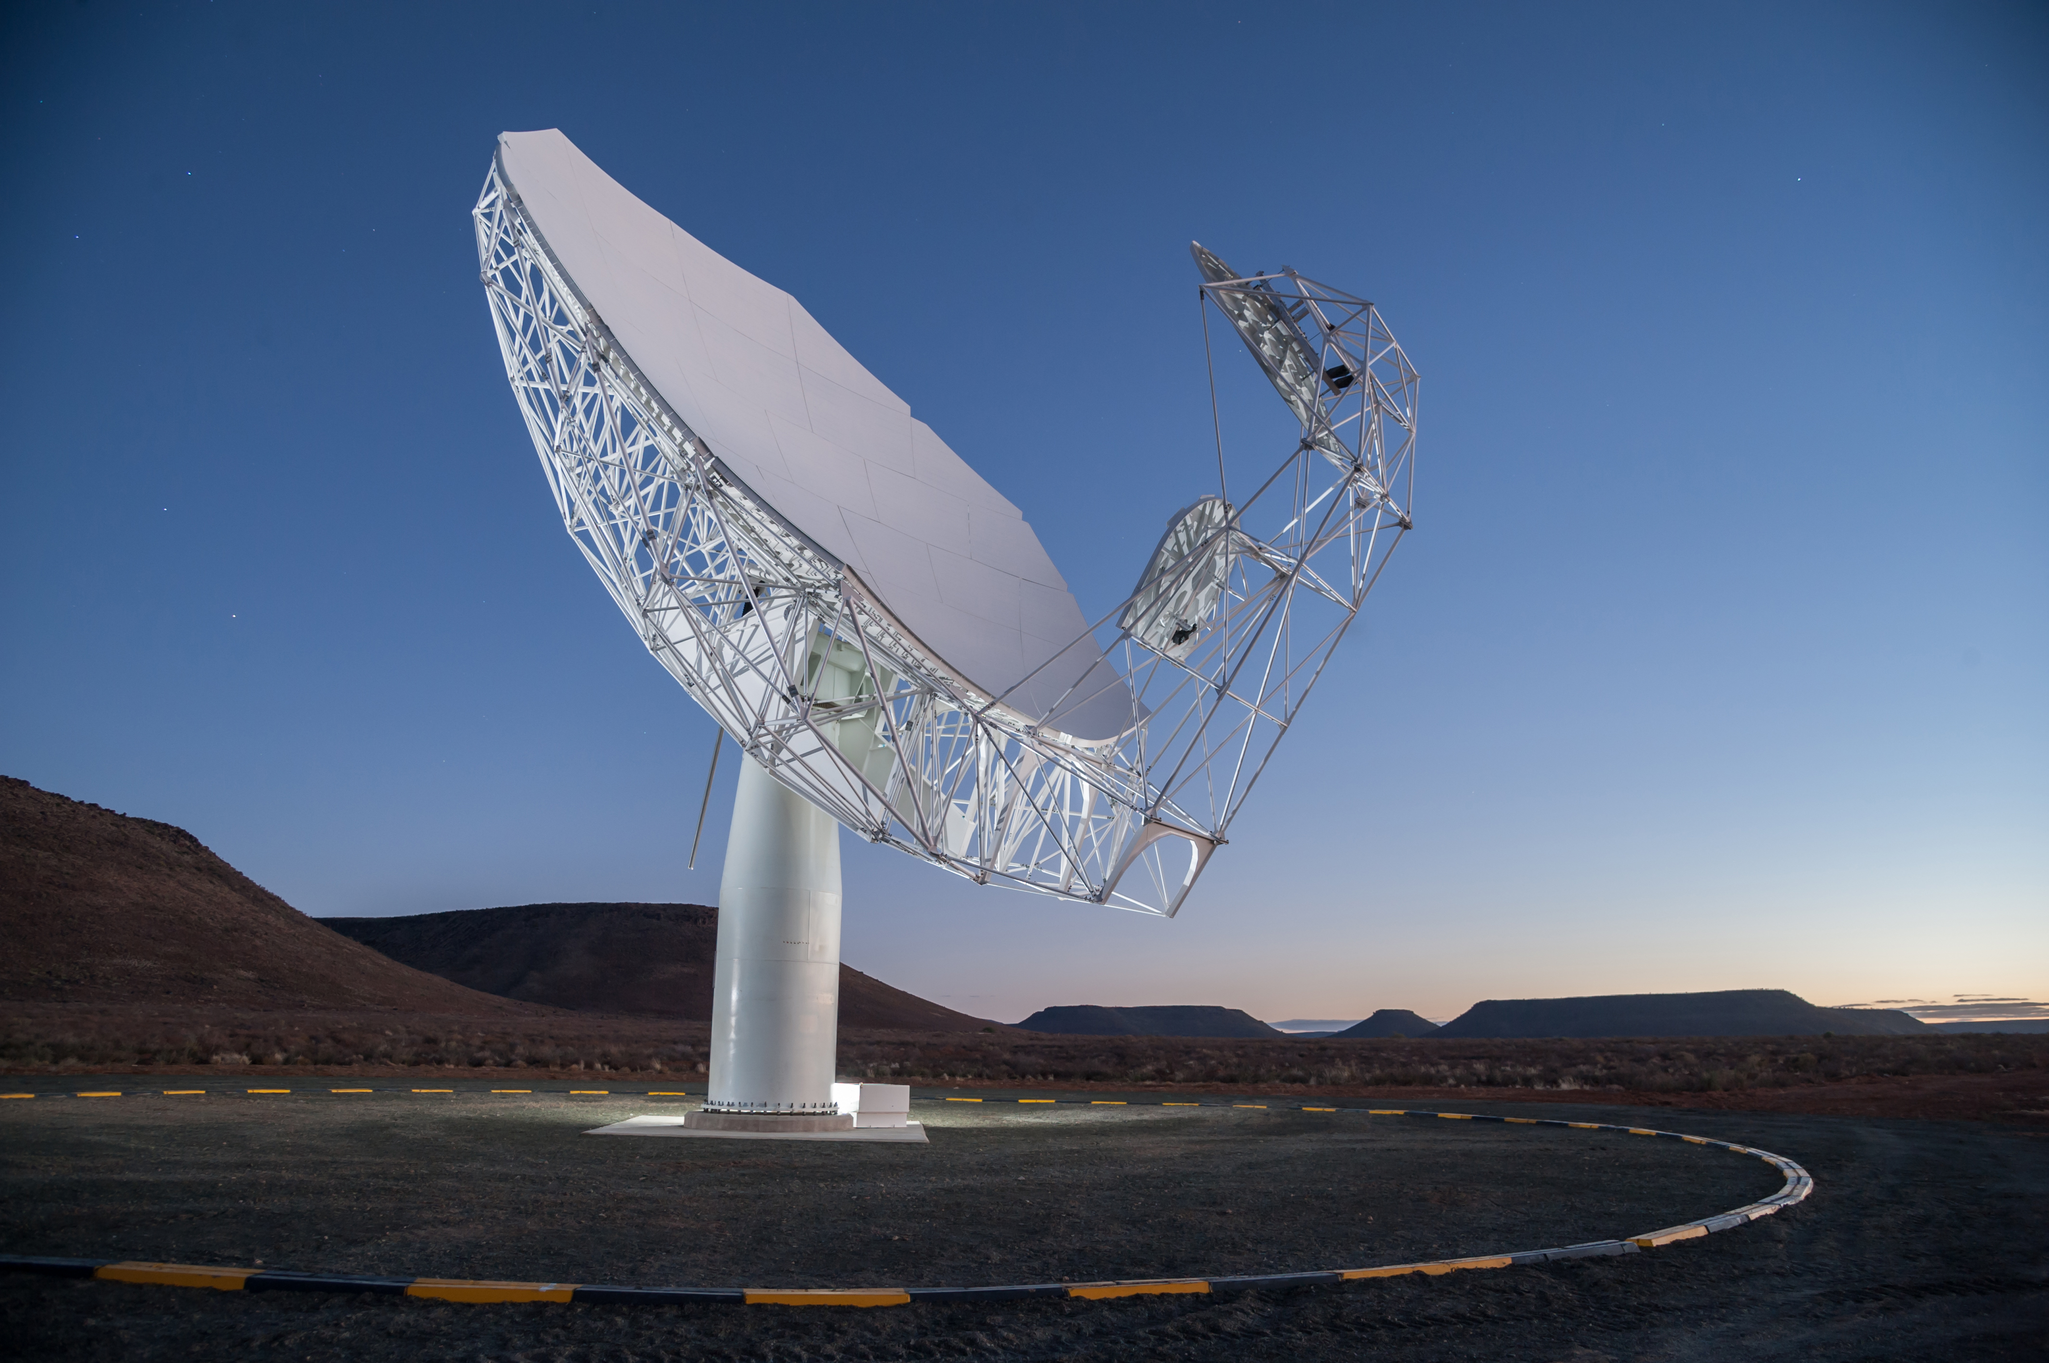
PURPOSE
PROGRAMME 4: Research Development and Support
To provide an enabling environment for research and knowledge production that promotes strategic development of basic sciences and priority science areas, through science promotion, human capital development, the provision of research infrastructure and relevant research support in pursuit of South Africa’s transition to a knowledge economy.

Slide 16
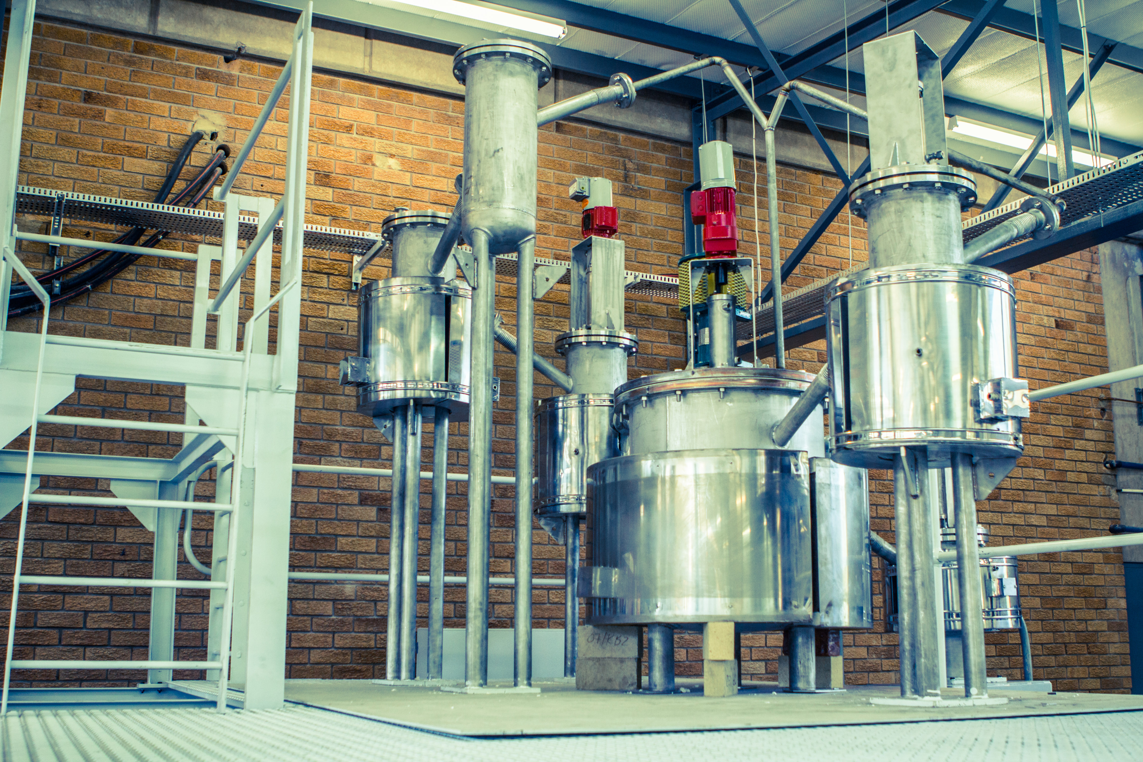
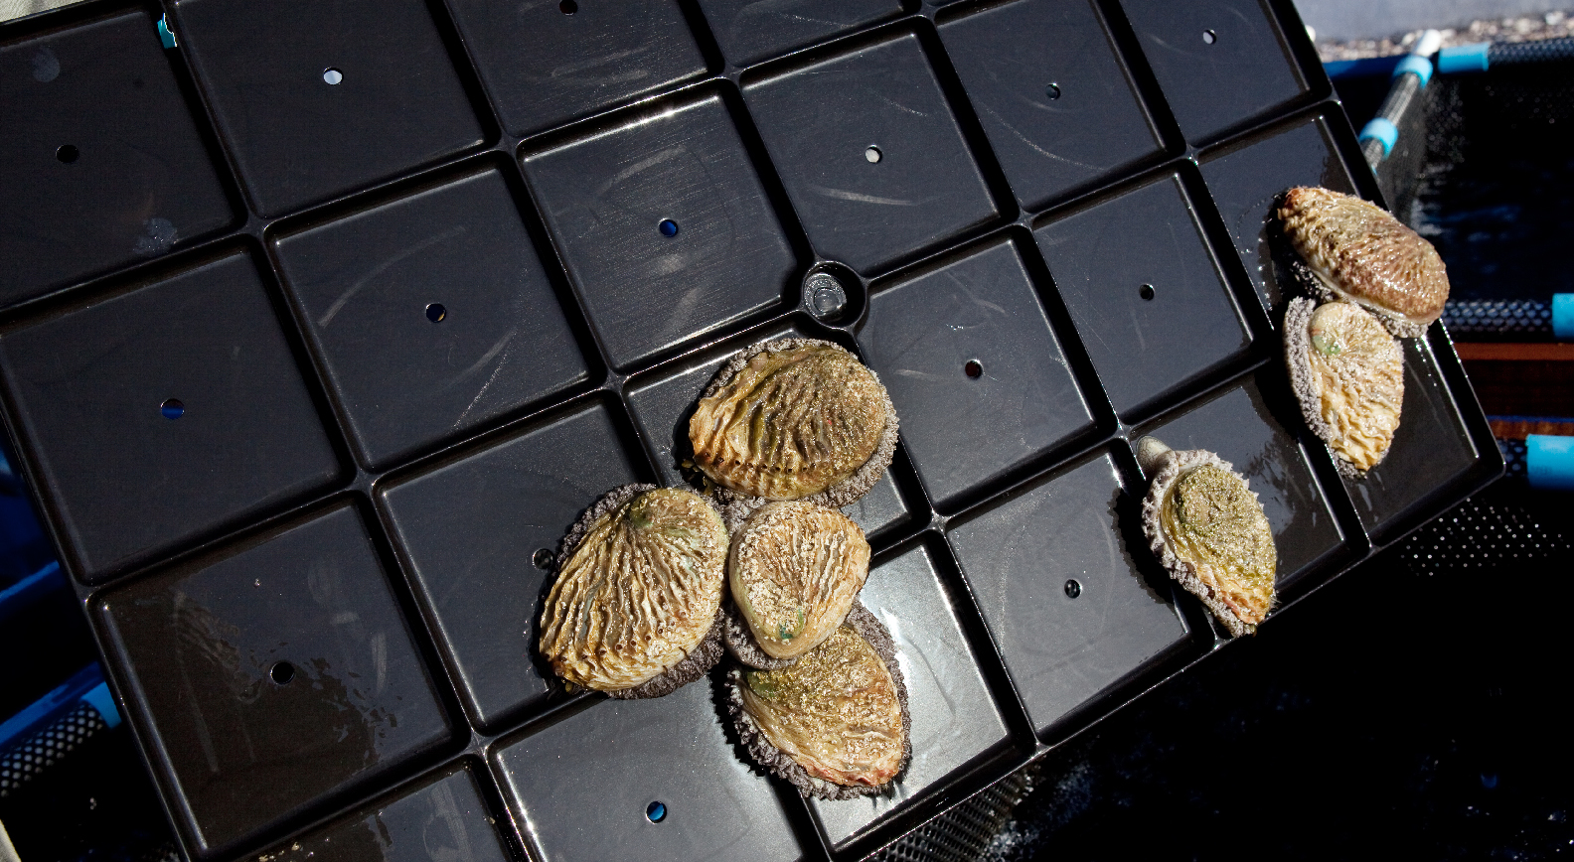
PURPOSE
PROGRAMME 5: Socio-Economic Innovation Partnerships
This Programme enhances the growth and development priorities of government through targeted S&T-based innovation interventions and the development of strategic partnerships with other government departments, industry, research institutions and communities.

Slide 17
PERFORMANCE OVERVIEW

Slide 18
DST TREND PERFORMANCE OVERVIEW (1)
Figure 1: DST four years comparative performance

Slide 19
DST FOUR YEARS PERFORMANCE TRENDS: 2011- 2014
DST TREND PERFORMANCE OVERVIEW (2)
Figure 1 shows DST performance trends in the last four years:
Performance has increased from 67% in the 2011/12 financial year, to 85% in the 2014/15 financial year.
This can be attributed to the Department’s performance information management strategic interventions such as:
The implementation of the Performance Information Management Systems (PIMS), which resulted in the improvement of performance compliance standards (validity, relevance, integrity and usefulness of performance information).

Slide 20
DST 2014/15 FINANCIAL YEAR PERFORMANCE OVERVIEW
Figure 2: DST overall performance: (total number of output targets, n=65)

Slide 21
DST 2014/15 FINANCIAL YEAR PERFORMANCE OVERVIEW
Of the 65 targets set for the 2014/15 financial year, the Department achieved a total of 55 (85%), with 9% partially achieved and only 6% not achieved (Figure 2).

Slide 22
PERFORMANCE PER PROGRAMME

Slide 23
DST’S PERFORMANCE PER PROGRAMME
Figure 3: DST programme performance

Slide 24
Figure 4 illustrates the annual performance of the Department per programme. An analysis of Figure 4 shows that:
PERFORMANCE PER PROGRAMME
Programme 1 achieved 15 (88%) of its annual targets and two (12%) targets were partially achieved;
Programme 2 achieved nine (64%) of its annual targets, two (14%) were partially achieved and three (22%) were not achieved;
Programme 3 achieved 10 (100%) of its annual targets;
Programme 4 achieved 11 (84%) of its annual targets, one (8%) was partially achieved and one (8%) was not achieved; and
Programme 5 achieved 10 (91%) of its targets and only one target (9%) was partially achieved.

Slide 25
TARGETS UNDERACHIEVED
AND NOT ACHIEVED

Slide 26
CLASSIFICATION OF REASONS FOR VARIANCES
Target formulation deficiencies – refers to indicators which were not achieved because of variables which were not foreseen during the target formulation phase.
Process delays – refers to factors which are outside the control of the DST and therefore the achievement of such targets is mainly dependent on the outside stakeholder.
Administrative delays- refers to delays due to internal process of the DST.
Effectiveness of implementers- refers to non achievements due to deficiencies during the implementation phase

Slide 27
ANNUAL TARGETS WHICH WERE NOT ACHIEVED OR UNDER ACHIEVED IN THE 2014/15 FINANCIAL YEAR
Annual Target | Actual Achievements | Reasons for non/under-achievement | Status
90% alignment between the 2015 DST ENE and the 2015/16 APP by 31 March 2015. | 71.4% alignment between APP and ENE. | The ENE and APP has a lower percentage alignment because the ENE was finalised prior to the finalisation and approval of the Strategic Plan and APP. | Partially Achieved
10 public participation programmes conducted by 31 March 2015. | Seven public participation programmes conducted by 31 March 2015. | This indicator was partially achieved due to the changes in the political leadership of the DST. | Partially Achieved
16 policy instruments developed/implemented by 31 March 2015. | A total of nine policy instruments developed by 31 March 2015. | The three Bio-economy implementation plans, the National Space Programme, the Space Human Capital Development Plan and the Upgrade of the Houwteq Plan and Plans for the two Centres of Competence in Space Science were submitted for EXCO approval. However, EXCO has recommended that changes be made to the documents before resubmitting for approval. | Partially Achieved

Slide 28
ANNUAL TARGETS WHICH WERE NOT ACHIEVED OR UNDERACHIEVED IN THE 2014/15 FINANCIAL YEAR
Annual Target | Actual Achievements | Reasons for non/under achievement | Status
18 oversight instruments developed/reviewed to strengthen S&T innovation by 31 March 2015. | 13 oversight instruments developed/reviewed. | There were delays in reviewing certain documents, which resulted in the non-achievement. | Partially Achieved
11 440 postgraduate students (3 414 BTech and honours, 4 671 master's and 2 665 PhD students) and 690 postdoctoral fellows awarded bursaries through NRF-managed programmes by 31 March 2015. | 11 335 postgraduate students and postdoctoral fellows (3 448 honours, 4 263 master's, 2 845 PhD and 779 postdoctoral fellows) awarded bursaries as reflected in the NRF reports. | The target was under-achieved by 1%. It is difficult to project the target exactly, given that postgraduate students at different study levels (honours, master's, PhD and postdoctoral) are awarded different amounts. | Partially Achieved
Four new MeerKAT antennae installed as per SKA specifications by 31 March 2015. | Three MeerKAT antennae installed as per SKA specification. | The original plan has always been to install four antennae by 2014/15. This was therefore a cumulative indicator that includes the one installed by the end of the 2013/14 financial year. | Partially Achieved

Slide 29
ANNUAL TARGETS WHICH WERE NOT ACHIEVED OR UNDERACHIEVED IN THE 2014/15 FINANCIAL YEAR
Annual Target | Actual Achievements | Reasons for non/under achievement | Status
285 innovation support interventions developed or supported in key strategic areas by 31 March 2015. | A total of 38 innovation support interventions developed or supported as planned. | The IP Creator intervention was phased in with a certificate of recognition this year due to the lack of funds to incentivise the IP creators as per the recommendation of the NIPMO Advisory Board. It is expected that if funds are made available for this incentive scheme, the incentives could be paid from next year onwards in a phased manner. | Not Achieved
One trademark, design, copyright, plant breeder rights in the key strategic areas by 31 March 2015. | No trademark, design, copyright, plant breeder right in the key strategic areas. | Given the nature of research and development, it is difficult to accurately predict the granting of trademarks. | Not Achieved

Slide 30
ANNUAL TARGETS WHICH WERE NOT ACHIEVED OR UNDERACHIEVED IN THE 2014/15 FINANCIAL YEAR
Annual Target | Actual Achievements | Reasons for non/under achievement | Status
One new technology commercialised in strategic areas by 31 March 2015. | No new technology commercialised as planned. | There were project delays in ensuring the finalisation of the ZA African Resource Management Constellation (ZA-ARMC) satellite design. Remedial measures are being taken. | Not Achieved
A Bill for the Protection, Promotion, Development and Management of IKS tabled before Parliament by 31 March 2015. | The Bill was not tabled with the Cabinet as planned. | While the Bill was not tabled before Parliament, it was tabled with the Cabinet (and approved for publication in the Gazette), as the necessary first step in tabling it before Parliament. The delay in submitting it arose out of delayed inputs from cognate departments and the introduction of new administrative steps in the submission of draft Bills. | Not Achieved

Slide 31
DST’s CONTRIBUTION TO THE NSI

Slide 32
KNOWLEDGE GENERATION
Publications
5700 research articles published
Centres of Excellence (COE)
In the reporting period five new Centres of Excellence (COE) were established.
The number of Centres of Excellence increased from eight in 2010/11 to fourteen in 2014/15.
Research Chairs
On the SARChI programme, to date 153 Research Chairs have been awarded with 150 of them filled to date.
Of the filled SARChI programme positions:
23% are women; and
30% are blacks.
During the reporting period, the Minister approved the awarding of twenty more Research Chairs, reserved for the appointment of female South African citizens and permanent residents

Slide 33
KNOWLEDGE GENERATION
Human Capital Development (HCD)
11 335 students received financial support for studying bachelor, honours, master’s, doctoral degrees and postdoctoral fellows to during the year under review.
3 876 researchers were awarded grants through the NRF.
1 190 interns placed in work opportunities.

Slide 34
KNOWLEDGE GENERATION
Infrastructure
In the 2014/15 financial year, the DST's ring-fenced infrastructure allocation of R551.9m supported DST’s initiatives such as :
the Centre for High Performance Computing (CHPC);
the South African National Research Network (SANReN);
the Data Intensive Research Initiative of South Africa (DIRISA); and
the acquisition of international broadband connectivity on the West Africa Cable System (WACS).

Slide 35
KNOWLEDGE EXPLOTATION
Economic and social development
The DST contributed to government’s initiatives to fight unemployment, inequality and poverty by providing technology-led opportunities for sustainable rural livelihoods development such as:
The DST’s Rose Geranium Essential Oils portfolio has been successfully transferred to the South African Essential Oils Business Incubator for management, to effectively contribute to Local Economic Development.

Slide 36
KNOWLEDGE EXPLOTATION
Eight instruments funded in support of increased localisation (competitiveness) and R&D led industry development by 31 March 2015.
29 knowledge and innovation products in the form of:
patents, technology demonstrators technology transfer packages and prototypes) added to the IP portfolio by 31 March 2015.

Slide 37
KNOWLEDGE EXPLOTATION
Science for policy decision making
Four decision support instruments developed and maintained:
Two new ones were in sanitation and education.
Two maintained ones were in planning (Stepsa), and DisasterManagement (Risk and Vulnerability Atlas).

Slide 38
DST PROJECTS ACROSS THE PROVINCES

Slide 39
Name of the Province | Name of the Project | Project in brief
Gauteng | Installation of a 5kW hydrogen fuel cell at Windsor East Clinic in Randburg, in collaboration with Anglo Platinum, Air Products and Gauteng Provincial Department of Health. | Fuel cell will provide back up power during power outages in order to preserve TB vaccines at the clinics.
Eastern Cape | Installation of five energy solutions at five schools (three 5kW hydrogen fuel cell units at three schools and two 3kW Solar PV systems at two schools) in Cofimvaba district through Public Private Partnerships. | Fuel cells and the Solar PV systems will provide power to the ICT infrastructure at the schools.
Gauteng, Eastern Cape and Limpopo | IKS-Based Nutraceuticals. | Indigenous vegetable-based nutraceuticals, functional food and ingredients. Nutraceutical Platform launched the Morogo Noodles with Nestle’.
Western Cape | Health-Beverages (Honeybush). | Community-Based Cooperatives with nurseries and orchards commercialising seeds and value-added products such as honey tea beverages.
Gauteng and Eastern Cape | IKS-Based Cosmeceuticals. | Feasibility study for extraction of cosmeceutical ingredients in Mamelodi is completed. Construction will commence in early 2016.
Limpopo | Moringa. | Piloting of Moringa Agro-processing plant .

Slide 40
Name of the Province | Name of the Project | Project in brief
North West | Bachelor of Indigenous Knowledge System (BIKS). | Rolling out the BIKS degree at the North West University.
Venda | Bachelor of Indigenous Knowledge System (BIKS). | Rolling out the BIKS degree at the University of Venda
Eastern Cape | Indigenous Knowledge System Bioprospecting and Product Development Platform’s (Cosmeceuticals flagship project) | A skin-tone candidate product, between a cosmeceuticals consortium and the community of Kubandakazi in the Eastern Cape.
Eastern Cape Free State KwaZulu-Natal Limpopo Northern Cape North West Western Cape. | The National Recordal System (NRS) Initiative. | The ultimate aim is to create livelihood opportunities for poor communities. The project is being implemented through the Indigenous Knowledge Documentation Centres (IKSDCs) in seven provinces. University of Fort Hare- hosts the Eastern Cape. Bakgatla-Ba-Kgafela Traditional Authority hosts the IKSDC. University of Free State- hosts the Free State IKSDC. The University of Venda- hosts the Limpopo Institution. University of Zululand and University of KwaZulu-Natal -hosts the two IKSDCs at KZN. . The South African San Institute- hosts the Northern Cape IKSDC. The Resonance Bazaar- hosts the Western Cape IKSDC.

Slide 41
Name of the Province | Name of the Project | Project in brief
Mpumalanga Limpopo Northern Cape | Broadband For All (BB4All) Initiative. | The objective of the project is to offer broadband access to rural communities in an affordable and sustainable manner. The project has two components: The wireless mesh technology, and The village operator model. The DST, with the support from CSIR, implemented large scale demonstrator pilots of wireless mesh network in : Mpumalanga and Limpopo. JT Gaetsewe District of Northern Cape. e.g. The Nkangala District component connected 200 schools and education district offices operating under Embizo (Pty) Ltd – a black owned SMME and 15 Village Operators.
Mpumalanga/Limpopo/Northern Cape. | Broadband For All (BB4All) Initiative. | The Northern Cape network has connected 55 schools and district offices. The mining companies are also supporting the operational costs of the network for the next three years. The network is operated and supported by Redline (Pty) Ltd.

Slide 42
Name of the Province | Name of the Project | Project in brief
Gauteng | mLab Southern Africa (SA) | MLab Southern Africa based in Pretoria was established as part of a collaboration between the World Bank InfoDev, The Ministry of Foreign Affairs of Finland, the Department of Science & Technology and the Innovation Hub. The mLab is one of the DST programmes at the core of the implementation of the ICT RDI Roadmap with the vision of developing a globally competitive mobile innovation ecosystem and hence achieving Digital Advantage for South Africa.
Gauteng | mLab Southern Africa (SA). | Successful startups that graduated in 2014: GoMetro (Adopted by Passenger Rail Agency of South A rica for Metrorail & Gauteng Roads & Transport), AftaRobot (Adopted by the Alexandra Midrand Sandton Taxi Association and supported by a multinational Telco), and Afroes (Rockefeller grant to develop Social Impact games in South Africa, Kenya and Nigeria), Tour2.0 (Community tourism). www.mlab.co.za
Eastern Cape | Nelson Mandela Bay Regional Innovation Forum | The Regional Innovation Forum (RIF) aims to stimulate, support and promote innovation in the Eastern Cape: in the Nelson Mandela Bay / Cacadu District Municipality; and The RIF will work with Provincial Government to drive innovation activities in line with Provincial priorities. www.innovationeasterncape.co.za

Slide 43
Name of the Province | Name of the Project | Project in brief
Western Cape | WCRIN | The aim of the Regional Innovation Network (RIN) is to strengthen collaboration and cooperation between universities, research institutions and industry, as well as government at a regional level; and set a long term agenda to design partnerships that can drive innovation in the region. http://www.wcedp.co.za/iris/regional-innovation-network-rin-part-1
Western Cape | Cape Peninsula University of Technology (CPUT) Innovation Incubator Feasibility study | Incubator feasibility study, due diligence and strategic plan for an innovation incubator at CPUT. The envisaged incubator is intended to foster team-based activities and deepen interactions among technology innovators at CPUT.
Gauteng | Southern Gauteng Regional Innovation forum (SGRIF) | The SGRIF is intended to be a catalyst for socio-economic growth/development through innovation by partnering with business, government, academia and civil society to foster collaboration around the use of natural resources, technologies, service delivery, human talent, capital and the entrepreneurial spirit.
Limpopo | Nkowankowa Demonstration Centre project | The Nkowankowa Demonstration Centre project has now registered as a PTY Ltd under the name Wolkberg Fruit Processors (WFP). This project is now advancing towards becoming a financially sustainable entity and it has increased by 300%. Therefore it has tripled the economic benefit accruing to farmers, households and employees in the Greater Tzaneen local economy
2014/15 PROVINCIAL SET PROJECTS

Slide 44
KEY ACHIEVEMENTS PER PROGRAMME

Slide 45
PROGRAMME 1 (ADMINISTRATION) 2014/15 HIGHLIGHTS
Science Communication
Science Communication developed and implemented communication, media and marketing strategies for the Budget Vote, Africa Engineering Week, National Science Week, Women in Science Awards, and Public Service Week.
Science Communication also hosted six public participation programmes.
Science Councils Oversight
The NRF Board’s term expired on 30 September 2014 and the Board was reconstituted with effect from 1 October 2014.
The Minister appointed the new SANSA Board with effect from 1 September 2014 to 31 August 2018.
The DST facilitated the appointment of the new Board of the Council for Scientific and Industrial Research (CSIR) that took office from 1 January 2015.

Slide 46
PROGRAMME 1 (ADMINISTRATION) 2014/15 ACHIEVEMENTS
Annual Target | Actual Achievements | Reasons for Deviation | Status
Approved 2015/16 DST public entities’ Strategic and Annual Performance Plans and signed shareholders’ compacts by 31 March 2015. | Strategic Plans and Annual Performance Plans for DST public entities (HSRC, SANSA, TIA, ASSAf, NRF, CSIR and NACI) were approved by the Minister by 5 March 2015 and shareholders’ compacts were signed thereafter. | No deviations. | Achieved
Four DST 2014/15 quarterly performance reports approved by Exco and signed by the DG within 60 days after each quarter. | Four DST 2014/15 quarterly performance reports approved by Exco and signed by the DG within 60 days after each quarter. | No deviations. | Achieved
One DST 2013/14 annual report approved by Exco and signed by the DG by 31 May 2014. | One DST 2013/14 annual report approved by Exco and signed by the DG by 31 May 2014. | No deviations. | Achieved

Slide 47
PROGRAMME 1 (ADMINISTRATION) KEY ACHIEVEMENTS
Annual Target | Actual Achievements | Reasons for Deviation | Status
Nine DST public entities' 2013/14 annual reports submitted to Parliament by 30 September 2014 -- Africa Institute of South Africa (AISA), Academy of Science of South Africa (ASSAf), Council for Scientific and Industrial Research (CSIR), Human Sciences Research Council (HSRC), National Advisory Council on Innovation (NACI), National Research Foundation (NRF), South African Council for Natural Scientific Professions (SACNASP), South African National Space Agency (SANSA) and the Technology Innovation Agency (TIA). | Nine DST public entities’ 2013/14 annual reports submitted to Parliament by 30 September 2014. | No deviations. | Achieved
90 days to fill vacancy after date of advertisement by 31 March 2015. | 73 days to fill a vacancy after date of advertisement by 31 March 2015. | Target achieved before 90 days due to faster than expected recruitment processes. | Achieved
Minimum 90% of DST personnel submitting performance contracts and reviews on time by 31 March 2015. | 98% of DST personnel’s performance contracts and reviews by 31 March 2015. | Reasonable level of compliance by the DST officials. | Achieved

Slide 48
PROGRAMME 1 (ADMINISTRATION) KEY ACHIEVEMENTS
Annual Target | Actual Achievements | Reasons for Deviation | Status
Two Enterprise Architecture Development lifecycle steps developed and implemented by 31 March 2015. | Two Enterprise Architecture Development lifecycle steps were developed and implemented by 31 March 2015. | No deviations. | Achieved
Suppliers paid within 30 days after date of invoice and tender process completed within a 90-day period. | Suppliers paid within 30 days after date of invoice. Tender process completed within 90-day period. | No deviations. | Achieved
Unqualified audit report of financial matters issued by the Auditor-General by 30 September 2014. | Unqualified audit report of financial matters issued by the Auditor-General. | No deviations. | Achieved

Slide 49
PROGRAMME 2 (TECHNOLOGY INNOVATION) HIGHLIGHTS
Strengthening bio-economy-related R&D in the country
The DST continued to provide support in the bio-economy arena. This has contributed to South Africa being ranked number 36 among 54 countries in the World Review of Biotechnology (2014).
The bio-economy RDI initiatives led by the DST have also resulted in the generation of four publications in journals and one copyright (Copyright on Moringa Vitamin Water). In addition, a total of 154 postgraduate students were supported in the bio-economy-related RDI initiatives.
Other achievements include the following seed-funded project initiatives:
A pre-breeding platform for wheat; and
A new tripartite bio-entrepreneur programme aligned with the industrial bio-economy plan.

Slide 50
PROGRAMME 2 (TECHNOLOGY INNOVATION) HIGHLIGHTS
Other key bio-innovation flagship projects include:
The Indigenous Knowledge Systems (IKS) Bioprospecting and Product Development Platform's cosmeceuticals project, which resulted in the signing of an access and benefit-sharing agreement for a skin-tone candidate product between a cosmeceuticals consortium and the community of Kundabakazi in the Eastern Cape in September 2014.
The DST investment led to the signing of a Memorandum of Understanding (MoU) between Pfizer Inc. and the North West University (NWU) in June 2014 towards the potential use of Pfizer’s genetically modified animal models, for evaluations in oncology, inflammation, immunology, the central nervous system and cardiovascular system disorders.

Slide 51
PROGRAMME 2 (TECHNOLOGY INNOVATION) HIGHLIGHTS
Strengthening innovation and commercialisation
The 2014/15 financial year was a watershed year for NIPMO in terms of promoting, protecting and commercialising intellectual property emanating from publicly financed research and development in higher education institutions and science councils.
NIPMO hosted the World Intellectual Property Organisation (WIPO) Summer School on Intellectual Property (IP) and Technology Transfer, and implemented the Technology and Innovation Support Centres (TISC) through the Offices of Technology Transfer (OTTs) at institutions.
The first NIPMO Incentive Scheme Guideline for Intellectual Property Creators (IP Creators) was completed during the period under review. This resulted in more than 360 IP Creators being awarded a Certificate of Recognition for their role in the creation of an invention for which a South African patent was granted.

Slide 52
PROGRAMME 2 (TECHNOLOGY INNOVATION) ACHIEVEMENTS
Annual Target | Actual Achievements | Reasons for Deviation | Status
352 postgraduate students (MSc, PhD) financially supported in key strategic areas by 31 March 2015. | A total of 406 postgraduate students (MSc, PhD) financially supported in key strategic areas by 31 March 2015. | The targets are based on the previous year’s estimates and may vary on a yearly basis, especially as some students may complete their courses faster or slower than their stipulated period of completion. | Achieved
Six postgraduate students (MSc, PhD) produced in key strategic areas by 31 March 2015. | A total of 10 postgraduate students produced. | The targets are based on the previous year’s estimates and may vary on a yearly basis, especially as some students may complete their courses faster or slower than their stipulated period of completion. | Achieved
340 trainees supported in key strategic areas by 31 March 2015. | 364 trainees supported in key strategic areas. | There was a greater interest and participation from individuals in attending workshops conducted and hosted by the Department. | Achieved
Six new technology innovation products developed/supported in key strategic areas projects by 31 March 2015. | Six new technology innovation products developed/supported in key strategic areas projects. | None | Achieved

Slide 53
PROGRAMME 2 (TECHNOLOGY INNOVATION) ACHIEVEMENTS
Annual Target | Actual Achievements | Reasons for Deviation | Status
Three new patents in key strategic areas registered/granted by 31 March 2015. | A total of three new patents in key strategic areas registered and granted. | None | Achieved
250 disclosures reported by publicly funded institutions by 31 March 2015. | 251disclosures reported by publicly funded institutions by 31 March 2015. | The targets are based on previous years’ estimates and may vary on a yearly basis. | Achieved

Slide 54
PROGRAMME 3 (INTERNATIONAL COOPERATION RESOURCES) HIGHLIGHTS
Implementation of Overseas Bilateral Cooperation initiatives
The subprogramme successfully managed a diverse portfolio of bilateral relations with countries in the Americas, Asia, Australasia and Europe, to develop and implement cooperation initiatives aimed at benefiting South African access to STI international experience and expertise.
The major highlight was Minister Pandor’s attendance of a Science and Technology Ministerial Meeting of the Brazil, Russian Federation, India, China and South Africa (BRICS) group which resulted in the signing of the first BRICS MoU on cooperation in STI initiatives.
Individual relations with BRICS partners were also strengthened, for example through the signing of a new cooperation agreement with the Russian Federation, during Minister Pandor’s visit to that country in October 2014.
In the Americas new initiatives, for example in the marine sciences, were launched with Argentina, while in the Caribbean a biotechnology cooperation with Jamaica was initiated.

Slide 55
PROGRAMME 3 (INTERNATIONAL COOPERATION RESOURCES) HIGHLIGHTS
Strengthening STI partnerships with other African countries
Heads of State of the African Union adopted, in July 2014, the comprehensive new “Strategy for Science, Technology and Innovation in Africa” or STISA, a ten-year framework for enhancing continental cooperation and integration.
The Department is at the forefront of the preparation of implementation plans for STISA, an engagement agreed to during the visit to South Africa by the African Union Commissioner for Human Resources, Science and Technology, Prof. Paul Ikounga.
As part of South Africa’s Presidency of the Science and Technology Centre of the Non-Aligned Movement (NAM), a course on minerals processing and beneficiation was presented in South Africa, which resulted in the enrolment of not only South African students, but also students from several other developing nations.

Slide 56
PROGRAMME 3 (INTERNATIONAL COOPERATION RESOURCES) HIGHLIGHTS
Strengthening STI International Resources
The DST’s strategic partnerships with the EU and philanthropic organisations such as the Bill and Melinda Gates Foundation attracted foreign investment in the country related to new joint funding programmes in the areas of water and sanitation technology, and health of women and children.
Other initiatives include the multi-billion rand European Developing Countries Clinical Trials Partnership (EDCTP) launched in December 2014 in Cape Town. The programme strives to accelerate the development of new drugs, vaccines and other interventions for the fight against infectious, especially neglected, diseases.

Slide 57
PROGRAMME 3 (INTERNATIONAL RESOURCES AND COOPERATION) ACHIEVEMENTS
Annual Target | Actual Achievement | Reasons for Deviation | Status
R354 600 000 foreign STI funds secured from international partners through agreed instruments for knowledge production, technology transfer, enhanced innovation, and STI human capital development by 31 March 2015. | R634 436 204 foreign STI funds leveraged by 31 March 2015. | The overachievement was due to an increase in funding from international partners because of the successes of NSI partners in competitive STI initiatives. | Achieved
R84 300 000 national STI funds secured for knowledge production, technology transfer, enhanced innovation, and STI human capital development by 31 March 2015. | R119 552 773 national STI funds secured for knowledge production, technology transfer, enhanced innovation, and STI human capital development by 31 March 2015. | The overachievement was due to increased participation by African partners, increased multilateral organisational participation and improvements in the quality of reporting. | Achieved
32 specialist or joint technical workshops, policy dialogues, symposia or conferences accessed, hosted, facilitated, or contributed to for participation by South African researchers and students by 31 March 2015. | A total of 56 specialist or joint technical workshops, policy dialogues, symposia or conferences accessed, hosted, facilitated, or contributed to for participation by South African researchers and students by 31 March 2015. | The overachievement was as a result of increased activities with the EU partners, as well as strengthening partner relationships on the African continent. | Achieved

Slide 58
PROGRAMME 3 (INTERNATIONAL RESOURCES AND COOPERATION) ACHIEVEMENTS
Annual Target | Actual Achievement | Reasons for Deviation | Status
19 regional continental and/or global initiatives led by South Africa by 31 March 2015. | A total of 26 regional continental and/or global initiatives led by South Africa by 31 March 2015. | An additional three multilateral engagements that were not anticipated were supported | Achieved
Six regional, continental and/or multilateral governance systems supported by means of capacity building by 31 March 2015. | Seven regional, continental and/or multilateral governance systems supported by means of capacity building by 31 March 2015. | Multilateral Cooperation and Africa participated in the Africa Higher Education Summit which was a request received from Rwanda, which was not included during the planning process. | Achieved
44 international human capital development opportunities accessed for participation by South African researchers and students by 31 March 2015. | 67 international human capital development opportunities accessed for participation by South African researchers and students by 31 March 2015. | The overachievement is due to increased participation in EU-Africa initiatives, as well as an increase in joint committees with Africa partner countries. | Achieved
1 456 South African researcher and student participants in international human capital development opportunities by 31 March 2015. | 2 143 South African researcher and student participants in international human capital development opportunities by 31 March 2015. | There were more joint projects approved with international partners, e.g. Japan, India, Argentina and Korea, than was anticipated during the planning phase. | Achieved

Slide 59
PROGRAMME 4 HIGHLIGHTS: RESEARCH DEVELOPMENT AND SUPPORT
Implementation of Science Missions: Exploitation of South Africa’s geographical advantage
A review by an international panel of the Applied Centre for Climate and Earth Systems Science (ACCESS), under the leadership of the National Research Foundation, was successfully completed by October 2014. It recommended the repositioning of ACCESS as a Centre of Excellence (CoE).
Indigenous Knowledge Systems (IKS): An evaluation of the implementation of the IKS policy was selected for inclusion in the National Evaluation Plan. This is a joint evaluation between the DST and the Department of Planning, Monitoring and Evaluation. The outcome of the evaluation will assist in charting the future course for IKS.

Slide 60
PROGRAMME 4 HIGHLIGHTS: RESEARCH DEVELOPMENT AND SUPPORT
Strengthening Human Capital Development and Science Promotion
On the human capital development front the following results can be reported:
500 students have been supported at undergraduate levels, of which 443 have graduated.
700 students and postdoctoral fellows have been supported through the SKA SA Bursary and Scholarship Programme and the National Astrophysics and Space Physics Programme.
The SKA Bursary Programme can be commended for its high graduation rate (89%), which is considerably higher than the national averages for the same levels of study, which are below 50%.

Slide 61
PROGRAMME 4 HIGHLIGHTS: RESEARCH DEVELOPMENT AND SUPPORT
Strengthening Human Capital Development and Science Promotion
The number of students funded through the NRF increased to 11 335 in the 2014/15 financial year.
This represents an increase of 1 564 from the previous financial year.
The percentages of funded black and women students were 62% and 53%, respectively.
Plans to disburse a new injection of R300m per annum towards increasing bursary values and the number of students awarded bursaries were completed during the reporting period.

Slide 62
PROGRAMME 4 HIGHLIGHTS: RESEARCH DEVELOPMENT AND SUPPORT
Stimulation of the development of astronomical sciences
The first four MeerKAT dishes with the sub-reflectors were installed at the Karoo site.
The Minister hosted a successful 2nd SKA African Partner Countries Ministerial Meeting in Pretoria on 25 March 2015, which resulted in the SKA/AVN Readiness Strategy approved for implementation of the Big Data Africa Programme, with a focus on astronomy.
The National Multi-Wavelength Astronomy Strategy, a culmination of the Astronomy Desk and the DST’s work, was approved by the DST Exco during the period under review.
In terms of strategic partnerships, astronomy-specific bilateral relations have been forged with the Netherlands, India, China, the United Kingdom and the United States of America.

Slide 63
PROGRAMME 4 (RESEARCH DEVELOPMENT AND SUPPORT) ACHIEVEMENTS
Annual Target | Actual Achievement | Reasons for Deviation | Status
1 000 graduates and students placed in DST-funded work preparation programmes in science, engineering and technology institutions. | 1 021 graduates and students placed in DST-funded work preparation programmes in science, engineering and technology institutions. | The value of the individual internships depends on the qualification levels of the individual interns, and the number of awards made at the different levels is thus dependent on the distribution of the qualification levels across the pool of interns. | Achieved
60 research infrastructure grants awarded as per award letters by 31 March 2015. | 69 grants have been awarded in the four categories of research infrastructure: Specialised facilities; Global infrastructure; Scientific equipment; and High-end and Cyber infrastructure. | Because the individual grants awarded were smaller than anticipated, the overall allocation could be spread across a larger number of proposals, hence leading to the positive deviation. | Achieved
2 800 Mbps average bandwidth capacity availability per South African National Research Network (SANReN) site by 31 March 2015. | 2 820 average bandwidth capacity availability per South African National Research Network (SANReN) site. | Broadband capacity upgrades at various existing SANReN sites increased the network’s average capacity bandwidth availability per site. | Achieved

Slide 64
PROGRAMME 4 (RESEARCH DEVELOPMENT AND SUPPORT) ACHIEVEMENTS
Annual Target | Actual Achievement | Reasons for Deviation | Status
3 876 researchers awarded research grants through NRF-managed programmes as reflected in the NRF project reports by 31 March 2015. | 4 064 researchers awarded research grants through NRF-managed programmes as reflected in the NRF reports. | Target was exceeded by 5%. It is difficult to project this target accurately given the differing research grant sizes for the researchers, thus leading to some uncertainty (i.e. variability) in the number of grants awarded. | Achieved
5 700 ISI-accredited research articles published by NRF-funded researchers by 31 March 2015. | 6 470 ISI research articles published by NRF-funded researchers as reflected in the NRF project reports. | This target is also dependent on some factors that cannot be determined by the NRF and DST. | Achieved
One implementation plan for the science, technology, engineering, mathematics and innovation promotion and engagement strategy for the NSI approved by Exco by 31 March 2015. | One implementation plan for the science, technology, engineering, mathematics and innovation promotion and engagement strategy for the NSI approved by Exco by 31 March 2015. | No deviation. | Achieved
One Marine and Antarctic Research Strategy approved by Exco by 31 March 2015. | One Marine and Antarctic Research Strategy approved. | No deviation. | Achieved

Slide 65
PROGRAMME 5 HIGHLIGHTS: SOCIO-ECONOMIC INNOVATION PARTNERSHIP
Implementation of Sector Innovation and Green Economy
During the period under review, the DST Exco approved the National Water Research, Development and Innovation (RDI) Roadmap. The roadmap has two broad focus areas:
Water supply:
Increase ability to make use of more sources of water, including alternatives;
Improve governance, planning and management of supply and delivery;
Improve adequacy and performance of supply infrastructure; and
Run water as a financially sustainable “business” by improving operational performance.

Slide 66
PROGRAMME 5 HIGHLIGHTS: SOCIO-ECONOMIC INNOVATION PARTNERSHIP
Implementation of Sector Innovation and Green Economy
During the period under review, the DST Exco approved the National Water Research, Development and Innovation (RDI) Roadmap. The roadmap has two broad focus areas:
Water demand:
Improve governance, planning, and management of demand and use;
Reduce losses and increase efficiency of productive use; and
Improve performance of pricing, monitoring, billing, metering and collection.
In February 2015, the DST, in partnership with ASSAf, launched the “State of Green Technologies in South Africa” report which aims to document green technologies currently utilised in South Africa.

Slide 67
PROGRAMME 5 HIGHLIGHTS: SOCIO-ECONOMIC INNOVATION PARTNERSHIP
Promotion of Innovation for Inclusive Development
The Nkowankowa Demonstration Centre project has now been registered as a Pty Ltd under the name Wolkberg Fruit Processors (WFP).
This project is now advancing towards becoming a financially sustainable entity and it has increased production by 300%, thus tripling the economic benefit accruing to farmers, households and employees in the Greater Tzaneen local economy.
The Rose Geranium Essential Oil portfolio has been successfully transferred to the South African Essential Oil Business Incubator for management.
The process resulted in the strengthening and consolidation of government's efforts to build an inclusive essential oils industry and increased the project's contribution to local economic development.

Slide 68
PROGRAMME 5 ACHIEVEMENTS PER PROGRAMMES
Annual Target | Actual Achievement | Reasons for Deviation | Status
One knowledge product for government planning and service delivery improvement through innovation in water published by 31 March 2015. | One knowledge product (the Policy Brief on the Point of Use Water Treatment Technologies) published on the DST website by 31 March 2015. | No deviation. | Achieved
10 master’s and doctoral students fully funded or co-funded in designated niche areas (sustainable development, and the greening of society and the economy) by 31 March 2015. | 11 master’s and doctoral students fully funded or co-funded in designated niche areas (sustainable development, and the greening of society and the economy) by 31 March 2015. | No deviation. | Achieved
255 master’s and doctoral students fully funded or co-funded in designated niche areas (advanced manufacturing, aerospace, chemicals, mining, advanced metals and ICTs) by 31 March 2015. | 353 master’s and doctoral students fully funded or co-funded in designated niche areas (advanced manufacturing, aerospace, chemicals, mining, advanced metals and ICTs) by 31 March 2015. | The demand for bursaries is high and the DST’s allocation is therefore distributed in such a way that most of the recipients are co-funded from other sources. | Achieved

Slide 69
PROGRAMME 5 ACHIEVEMENTS PER PROGRAMMES
Annual Target | Actual Achievement | Reasons for Deviation | Status
20 knowledge and innovation products added to the IP portfolio by 31 March 2015. | 29 knowledge and innovation products added to the IP portfolio by 31 March 2015. | IP portfolio additions are difficult to anticipate due to the complexity of the work being done and it is also based on market demand. | Achieved
Eight instruments funded in support of increased localisation, competitiveness and R&D-led industry development by 31 March 2015. | Eight instruments funded in support of increased localisation, competitiveness and R&D-led industry development by 31 March 2015. | No deviation. | Achieved

Slide 70
FINANCIAL PERFORMANCE AND CONCLUSION

Slide 71
BUDGET SPLIT – BY PROGRAMME

Slide 72
BUDGET SPLIT BY ECONOMIC CLASSIFICATION

Slide 73
FINANCIAL PERFORMANCE - SUMMARY

Slide 74
FINANCIAL PERFORMANCE PER PROGRAMME

Slide 75
Year-on-year comparison of budget vs expenditure

Slide 76
CONCLUSION
The NDP acknowledges the role that STI can play in addressing poverty, unemployment and inequality in the country.
In contribution to government efforts to address the above social ills, the DST has made substantial progress in enhancing knowledge production, growth and transformation of the pool of knowledge workers, and knowledge exploitation for a better life for all.
The DST will continue to work towards another clean audit in the next financial year by promoting operational efficiency in all levels of its operations.

Slide 77
THANK YOU

