Slide 1
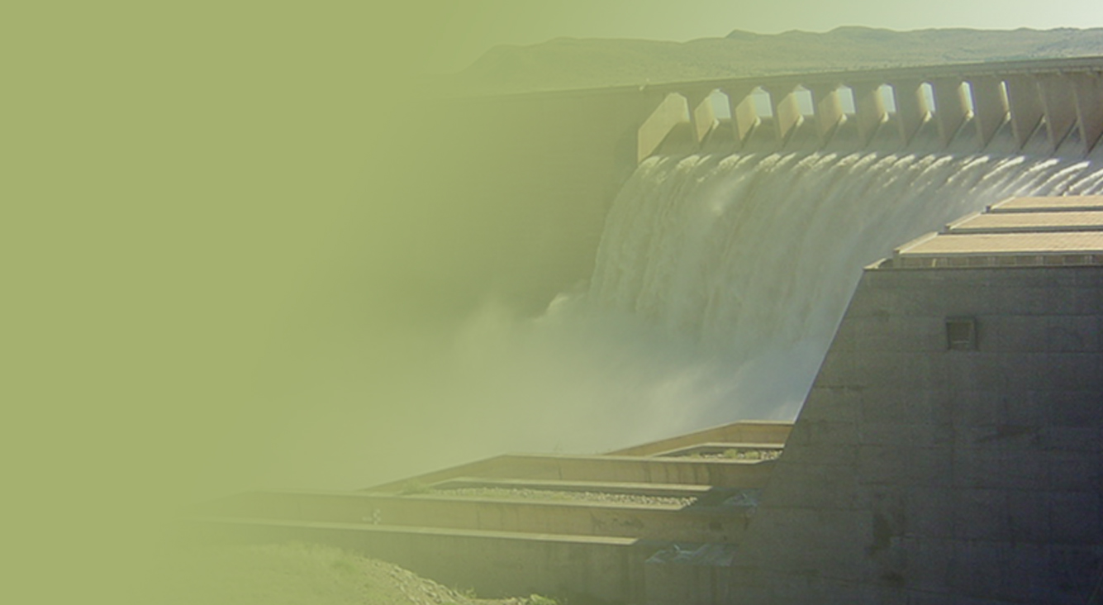
PROGRESS REPORT ON THE BUCKET ERADICATION PROGRAMME
Ms. Margaret-Ann Diedricks
Director General
28 October 2015
PRESENTATION TITLE
Presented by:
Name Surname
Directorate
Date

Slide 2
CONTENT
Defining the Bucket Backlog
Definition of a Bucket Toilet
Handover report (DHS Report 2012)
Verified Buckets by DWS
Delivery Targets by December 2015
Project Methodology
Infrastructure Concept
2015/16 Bucket Projects per Province
Delivery Progress to 20 October 2015
Planned Completion dates
Programme Challenges and Interventions
Virtual Site Visit

Slide 3
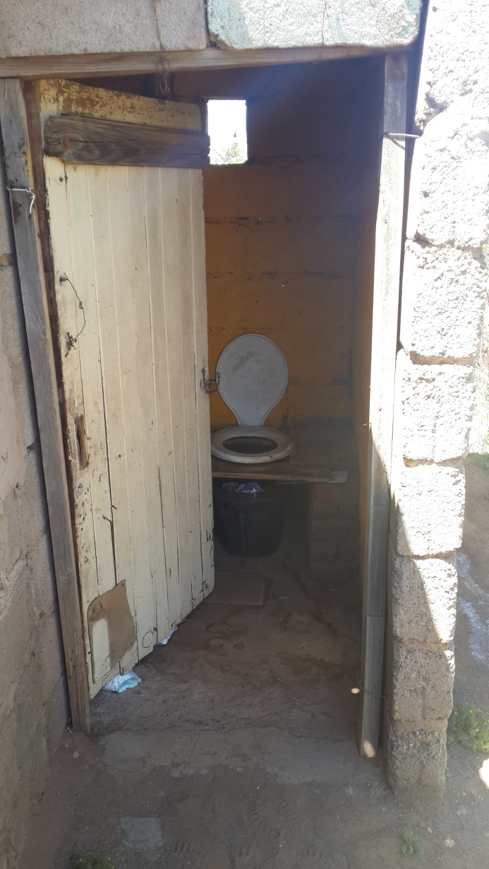
DEFINITION OF A BUCKET TOILET
For the purpose of this project, a bucket toilet refers to the use of a bucket (or similar container) located under a toilet seat which is used to retain untreated human waste and urine until the bucket is removed for disposal of its contents.
The municipal service usually replaces the full bucket with an empty one when servicing these toilets. This project focused on bucket toilets in formal areas established pre 1994.

Slide 4
BUCKET ERADICATION BACKLOG
DHS verified the “post ’94” formal buckets in 265 municipalities and in all 9 provinces and in February 2007 the combined backlog for all municipalities in SA were 272 995 bucket toilets whereas only 2,2% (12,5m h/hlds) households use the bucket system;
Stats SA - Community Survey was used as a baseline to determine the bucket toilet backlog in the country;
Respondents had 7 types of sanitation systems to choose from i.e flushing, chemical, VIP toilet etc;
The results of the verification shows that by July 2012, the backlog of bucket toilets in formal areas in South Africa is 58 010 buckets an overall reduction of 214 985 buckets;
Bulk of the buckets were in FS (55,2%), NC (25,5%), NW (6%), EC (12,4%),GP (0,09%), WC (0,64%) ;

Slide 5
QUALIFYING THE BACKLOG
The large backlog is largely as a result of the 2007 Survey that was not aimed at capturing bucket backlogs ONLY in formal areas but to record the existence of a bucket toilet in sampled households – irrespective of location;
The backlog of 88 127 backlog dropped substantially (from a previous report for the period April to June 2012) to a backlog of 58 010 buckets;
The reduction of 30 117 buckets are as a result of the following clarifications
In the Nelson Mandela Bay Metro – a backlog a total of 19 444 buckets are found to be located in informal settlements
With regards to Free State – an over estimation of some 42 715 to 32 042 actual buckets were confirmed. This suggests a reduction of 10 673 buckets;

Slide 6
QUANTIFICATION OF THE BACKLOG
DHS Bucket Toilet Backlog Report | 88 127
LESS – NMBM (Informal Settlements) | 19 444
LESS – Free State (Over estimation) | 10 673
TOTAL | 58 010

Slide 7
DISTRIBUTION OF BUCKETS PER PROVINCE as at February 2007 and July 2012
PROVINCE | NO OF BUCKETS FEB 2007 | % | NO OF BUCKETS JULY 2012 | % REDUCTION
Eastern Cape | 43 550 | 16% | 7 237 | 83,4%
Free State | 101 810 | 37,3% | 32 042 | 68,5%
Gauteng | 30 031 | 11% | 58 | 99,8%
Kwa Zulu Natal | 10 956 | 4% | 0 | 100%
Limpopo | 562 | 0,2% | 0 | 100%
Mpumalanga | 4 205 | 1,5% | 0 | 100%
North West | 38 041 | 13,9% | 3 503 | 90,8%
Northern Cape | 11 764 | 4,3% | 14 797 | +25,8%
Western Cape | 32 076 | 11,7% | 373 | 98,8%
TOTAL | 272 995 | 100% | 58 010 | 78,8%

Slide 8
DWS VERIFICATION OF BUCKETS
The DWS inherited during the period of the function transfer a target (of buckets in formal areas) of 88 127;
With the 3 clarifications provided by DHS, the formal buckets stands at 58 010;
However, DWS undertook a second round of verification and confirmed some 57 329 bucket toilets (see slide below);

Slide 9
VERIFIED BUCKET TOILETS
PROVINCE | DHS 2012 | DWS VERIFIED BUCKETS | VARIANCE
Eastern Cape | 7 237 | 6 353 | 884
Free State | 32 042 | 37 152 | ₊ 5 110
Northern Cape | 14 797 | 13 228 | 1 569
North West | 3 503 | 596 | 2 907
Mpumalanga | 0 | 0 | 0
Limpopo | 0 | 0 | 0
Kwa Zulu Natal | 0 | 0 | 0
Gauteng | 58 | 0 | 0
Western Cape | 373 | 0 | 373
TOTAL | 58 010 | 57 329 | 623

Slide 10
BUCKET ERADICATION PROGRAMME SUMMARY AS AT 20 OCTOBER 2015
Verified Bucket Eradication Target | 57 329
LESS – Completed Work | 15 544
Outstanding Work to be completed | 41 785
To be completed by Dec 2015 | Implementing Agents – 13 420
 | DWS – 28 365

Slide 11
PROJECT METHODOLOGY
1. DWS appointed 3 Turnkey Contractors as follows;
Free State
Northern Cape and North West
Eastern Cape
2. Construction approach :
Toilet Structures and Reticulation network (water and sewer) to be constructed at the same time using multiple teams on site;
Use of sub-contractors to accelerate delivery but also 25% use of local SMME’s (SBD stipulations);
Completion and handover of the buckets as and when the reticulation networks is completed;

Slide 12
PROJECT METHODOLOGY
3. Project Management
Established Project Steering Committee’s in all provinces to oversee the implementation of the programme;
Appointment of Project Managers to support and assist the Department in implementation of the Projects;
Standardised rates on various aspects of the project including the cost of a toilets structure (R15 000/structure), reticulation per metre, Project Management (8%) and Professional Fees (5%)

Slide 13
INFRASTRUCTURE CONCEPT
Where infrastructure is available – proceed with construction with the use of conventional supporting infrastructure i.e Water reservoirs and Waste Water Treatment Works;
Where bulk infrastructure is not available the Department will provide alternative or temporary sanitation solutions;
Alternatives include;
The use of grey water systems (package plants) in BEP projects for flushing as a water saving strategy;
Provision of Low / pour flush toilets and or dry, on-site sanitation where infrastructure is not available and or settlements are remote;
Reduced the Toilet cistern capacity from 9 litres to 6 litres for flushing;

Slide 14
BUCKET ERADICATION
PROGRESS REPORT

Slide 15
PROGRESS REPORT AS AT 20 OCTOBER 2015 BY IMPLEMENTING AGENTS (IA’s) AND THE DEPARTMENT
PROVINCE | NO OF PROJECTS AS PER TOWN | PROJECT STATUS
 |  | Planned No of Units to be eradicated | Completed to date | Outstanding | Progress to date (Completed Structures) | Water and Sewer Reticulation completed
NC | 30 | 13 228 | 2615 | 10 613 | 1 968 | WIP
EC | 9 | 6353 | 2758 | 3 595 | 60 | WIP
NW | 3 | 596 | 398 | 198 | 0 | WIP
FS | 38 | 37 152 | 9773 | 27 379 | 30 | WIP
TOTAL | 80 | 57 329 | 15 544 | 41 785 | 2058 | WIP

Slide 16
PROPOSED COMPLETION DATE
Completion Date | Planned No of Units Completed and Flushing | Planned No of Units Completed but not Flushing
December 2015 | 4275 | 5246
March 2016 | 37 510 | -
TOTAL | 41 785

Slide 17
PROGRAMME / PROJECT CHALLENGES
The Department suggested an initial eradication date of December 2015 however, due to the unforeseen challenges time was or will be lost and include;
CHALLENGES | INTERVENTIONS
Reaching agreements with Local sub-contractors on the quantum of work allocated Community dictating daily labour rates / construction rates | Department negotiated quantum and price with subcontractors and reached agreement Quantum is also informed by the capacity of the sub-contractor to perform work Introduction of standardised project rates on various aspects of the project at the inception of the programme;
Contractors are experiencing hard rock conditions in the NC which is delaying the pace of excavating the services trenches | Heavier, specialised equipment deployed to the province;
Choice on the type of sanitation solution (Pre-cast vs Brick structure) as well as the location of the structure in the property by the community prohibit the commencement of construction – | Erect samples of two toilet structures for community engagement / decision making

Slide 18
PROGRAMME / PROJECT CHALLENGES
CHALLENGES | INTERVENTIONS
Absence of bulk infrastructure to support Bucket Eradication projects in the Free State | DWS Prioritised the provision of some outstanding bulk-link infrastructure (i.e Outfall sewers) in projects in the Free State to ensure toilets are flushing
Possible theft / vandalism of elements of the toilet structure over festive season if structures are completed by December 2015 | Handover of structure to communities to lock toilet ensuring Household takes care of the structure over the festive period

Slide 19
NORTHERN CAPE PROVINCE
Site Camp / Establishment
PROJECT : ROSEDALE (2374 UNITS)
Programme : Bucket Eradication Programme

Slide 20
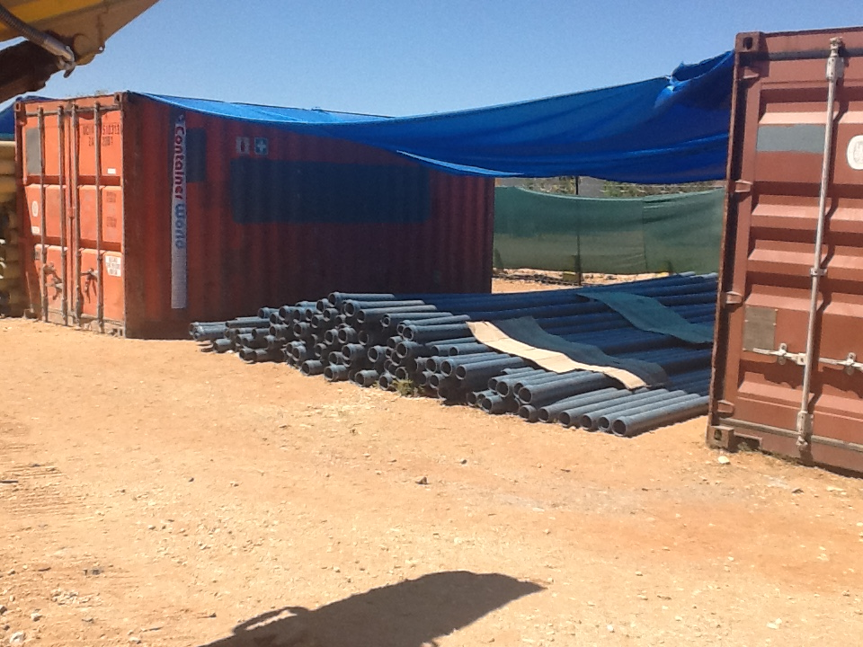

Slide 21
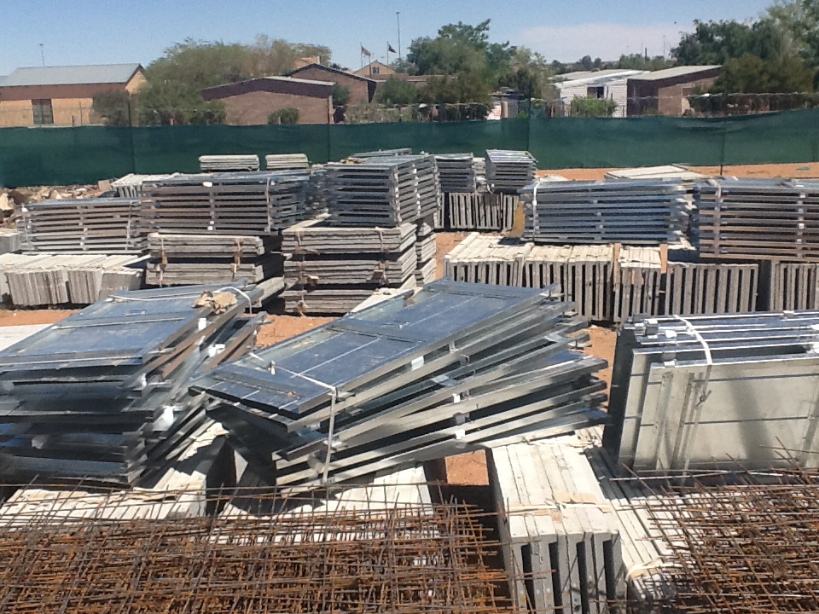

Slide 22
NORTHERN CAPE PROVINCE
Town: Britstown - Work In Progress
PROJECT : Mziwabantu (404 UNITS)
Programme : Bucket Eradication Programme

Slide 23
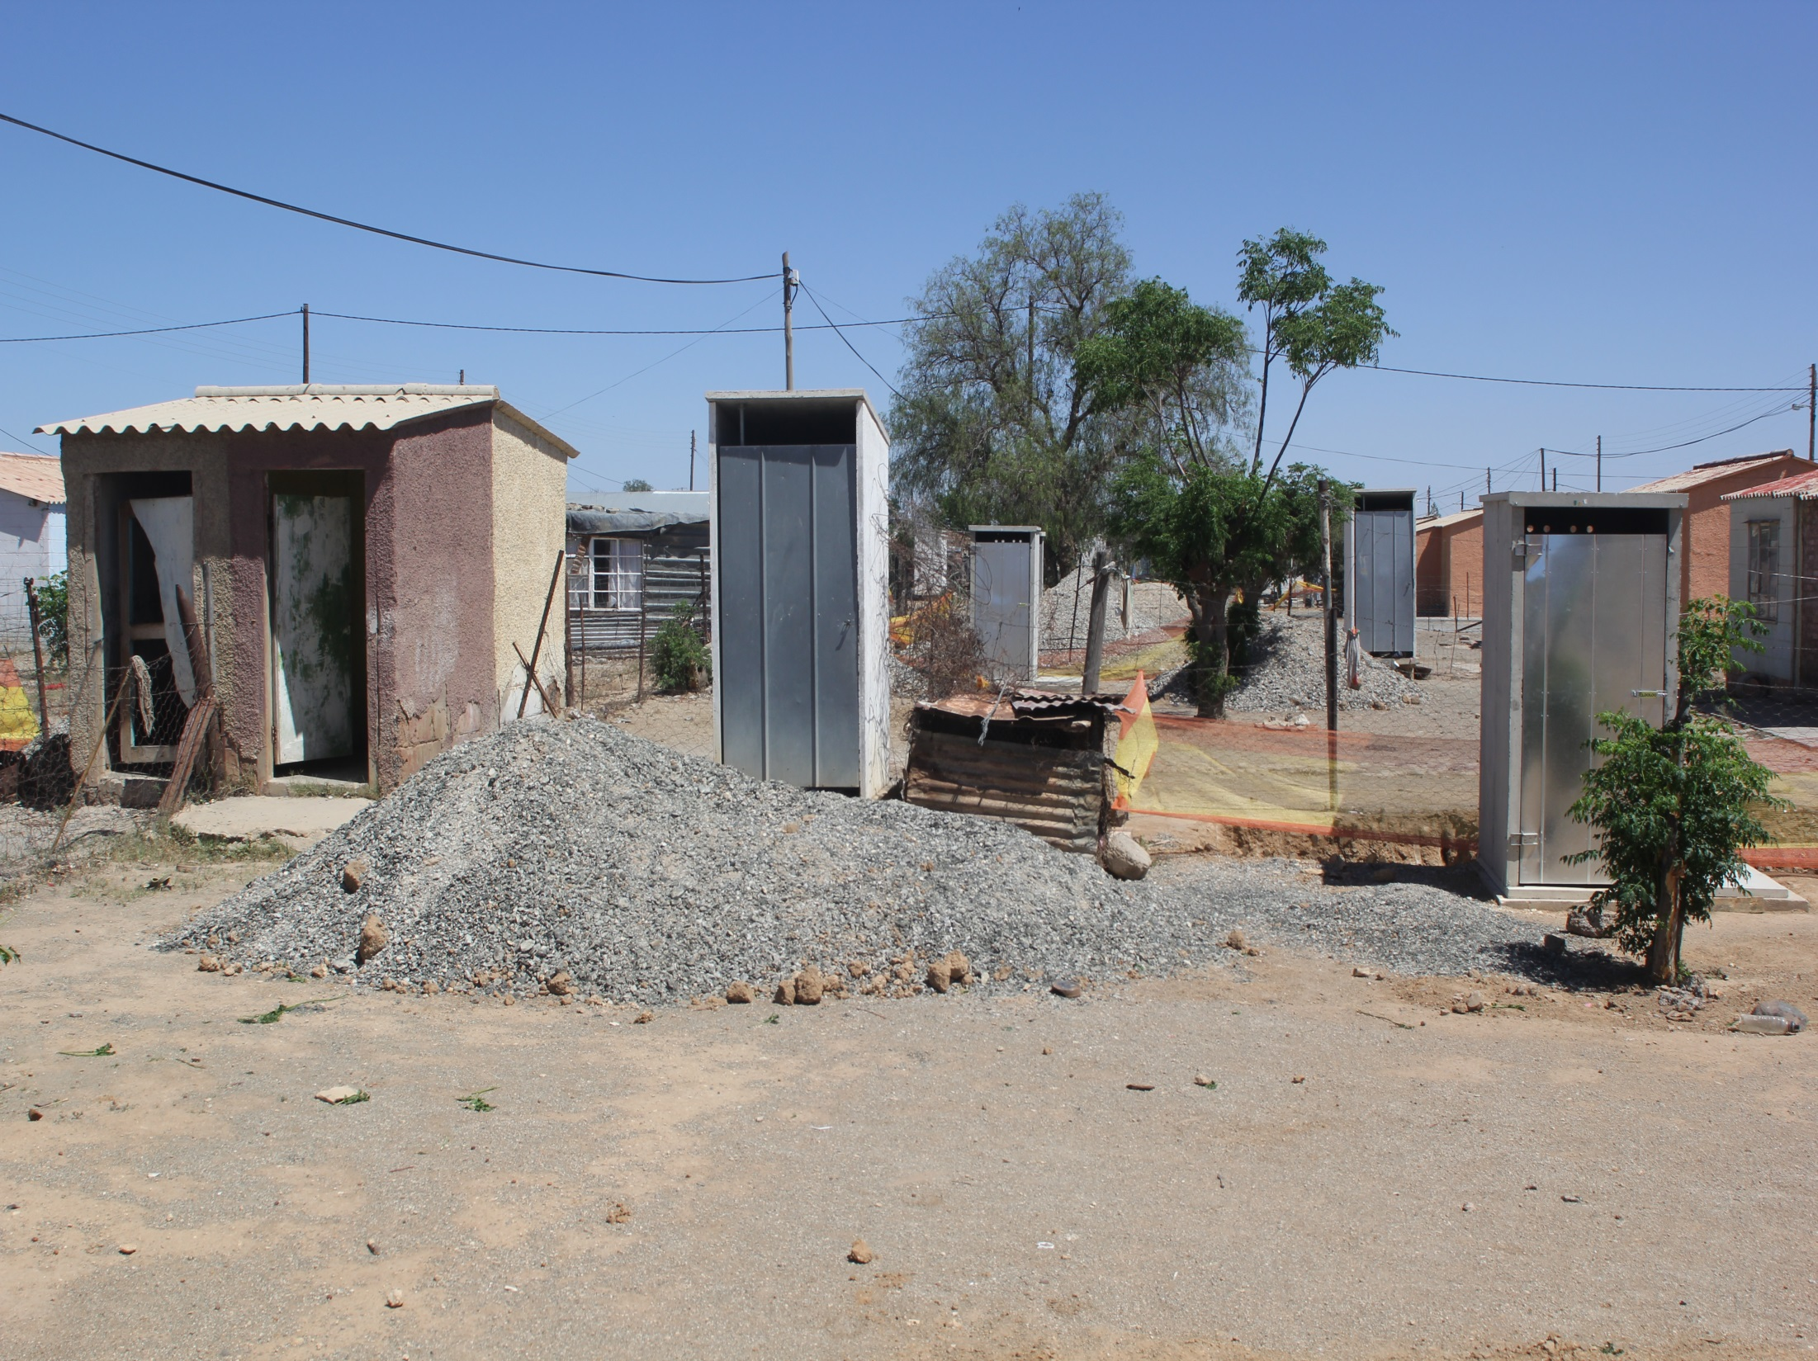

Slide 24
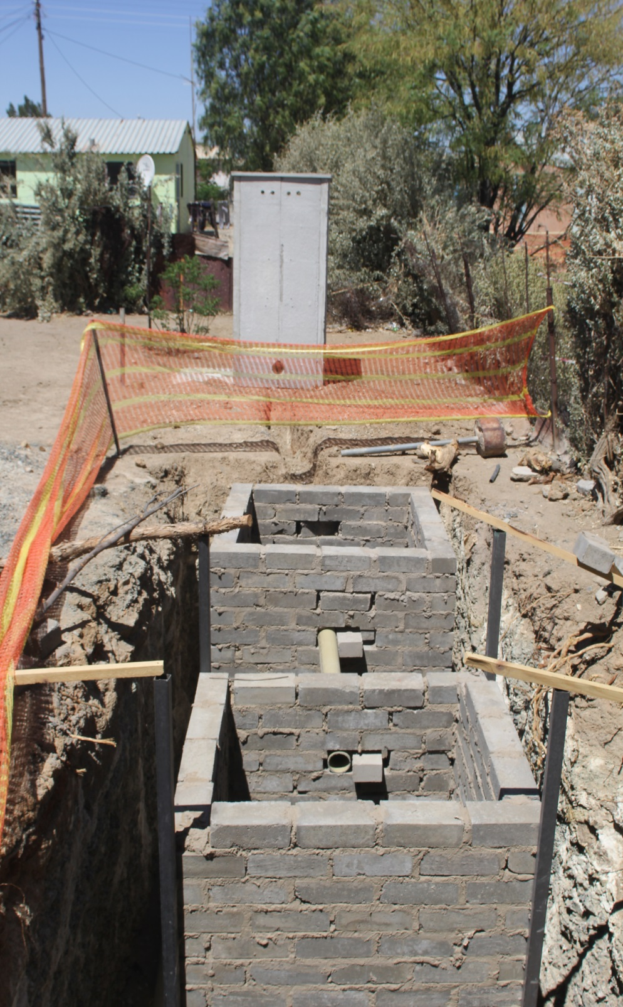
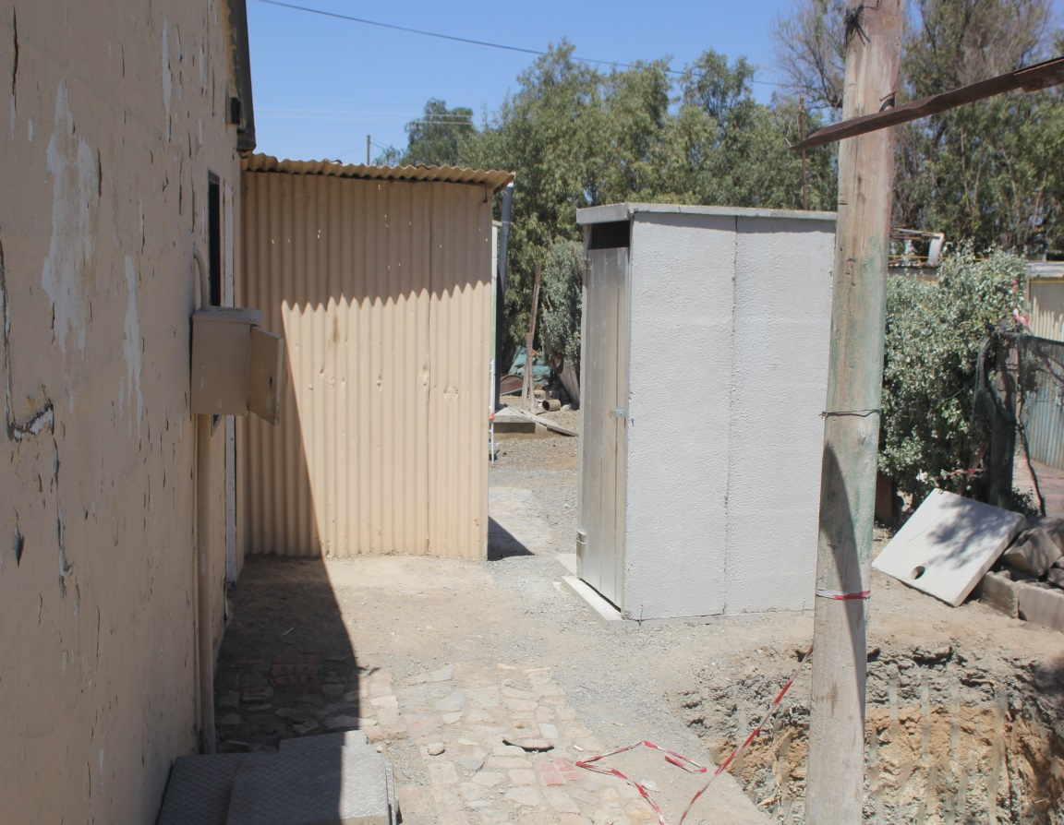
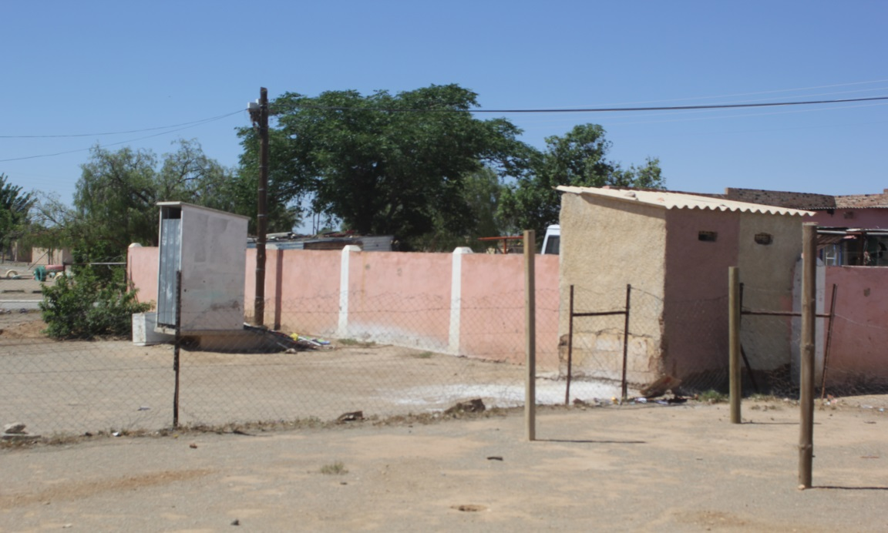

Slide 25
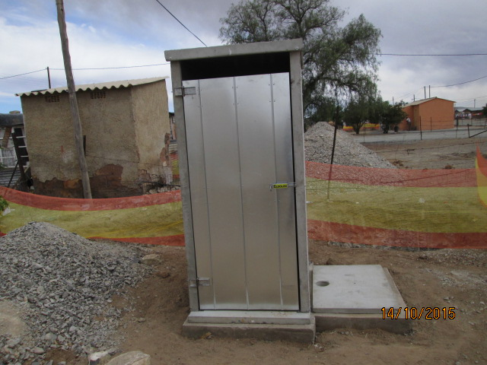
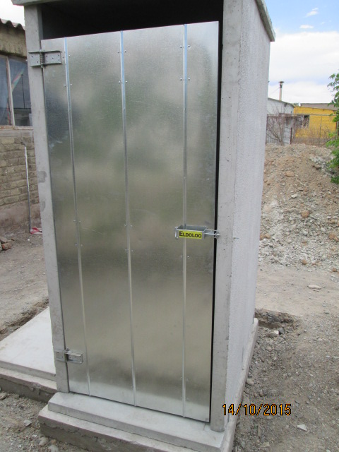

Slide 26
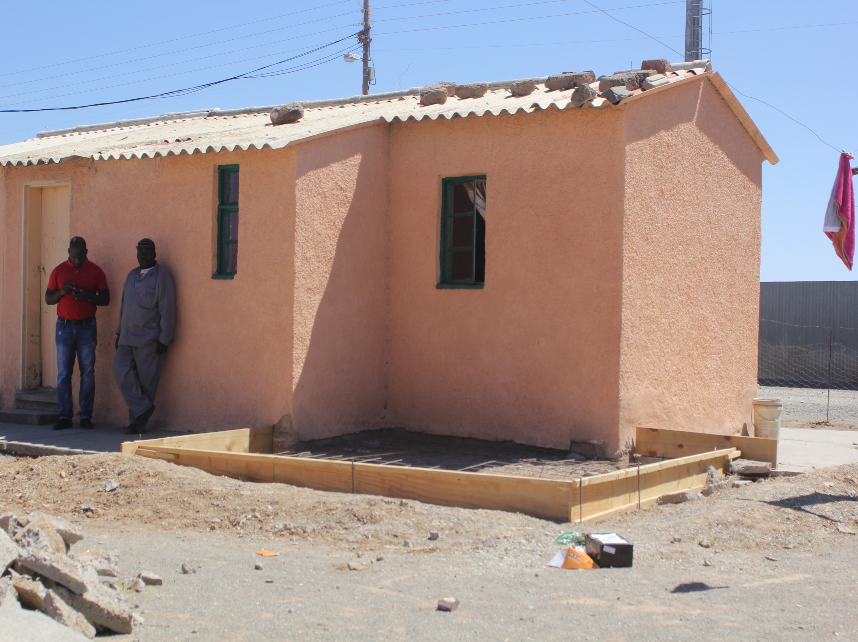

Slide 27
NORTHERN CAPE PROVINCE
Town : Douglas - Work In Progress
PROJECT : BONGANI (555 UNITS)
Programme : Bucket Eradication Programme

Slide 28
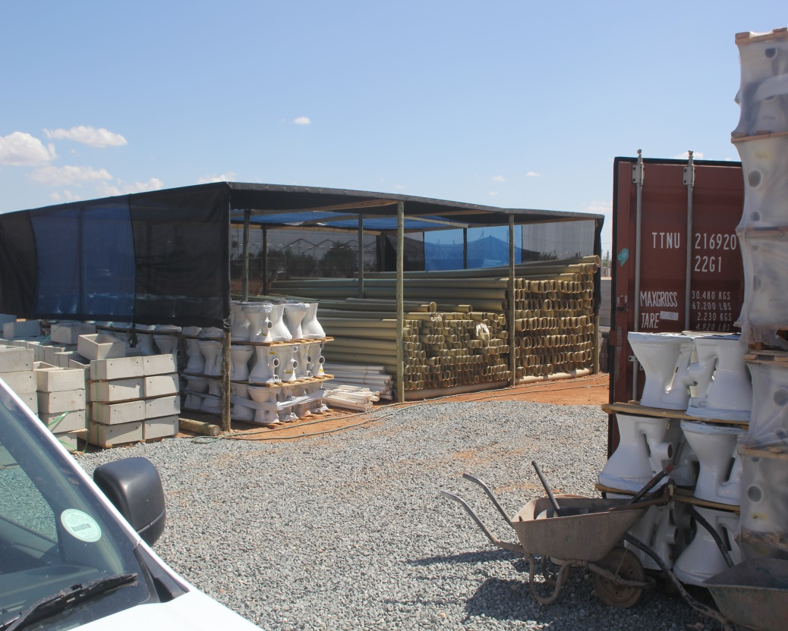
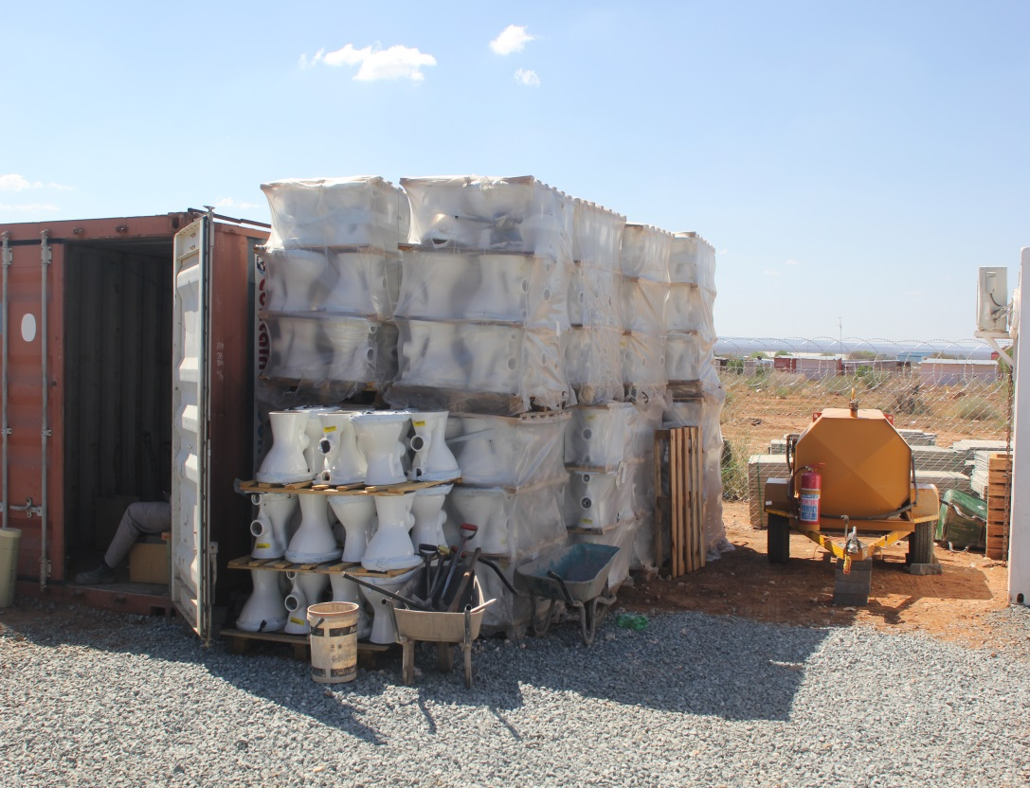
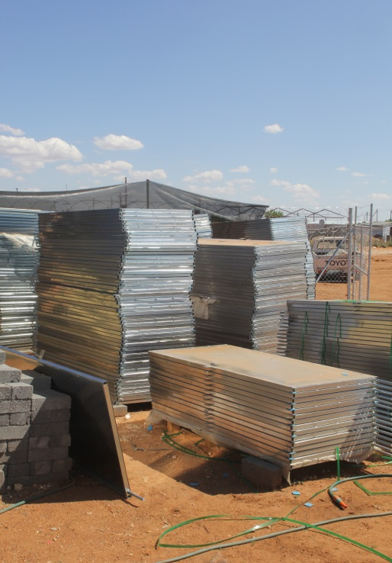
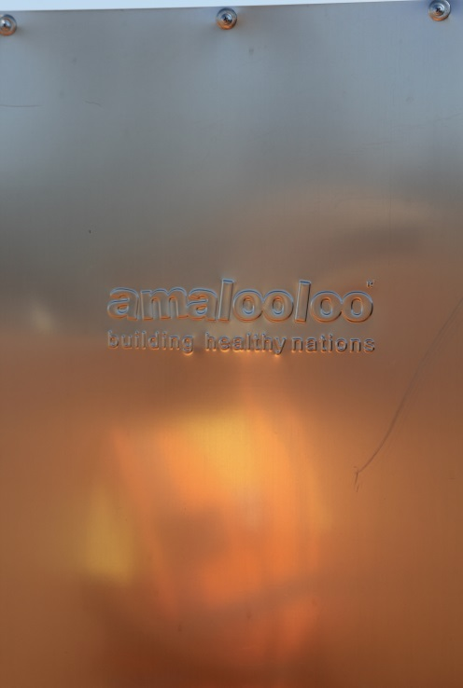
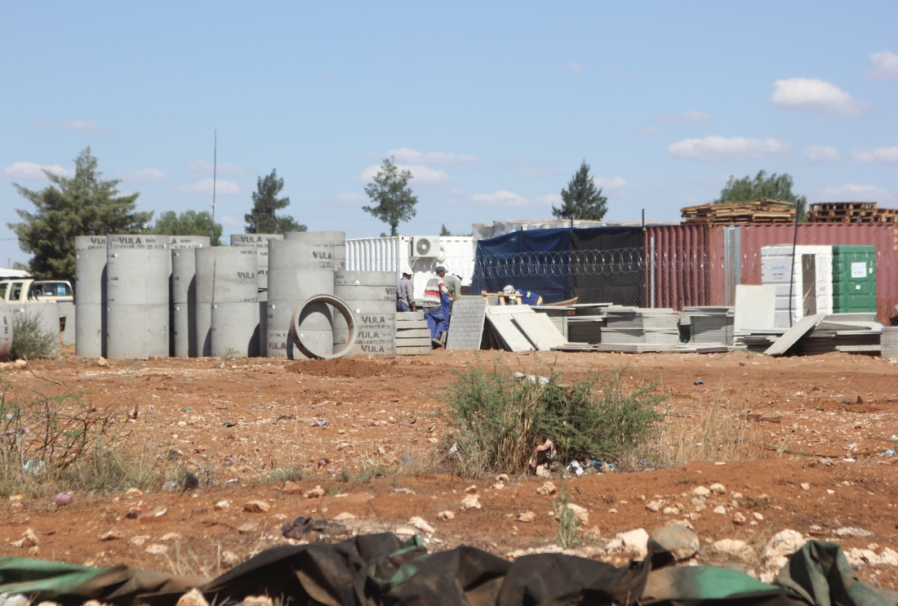

Slide 29
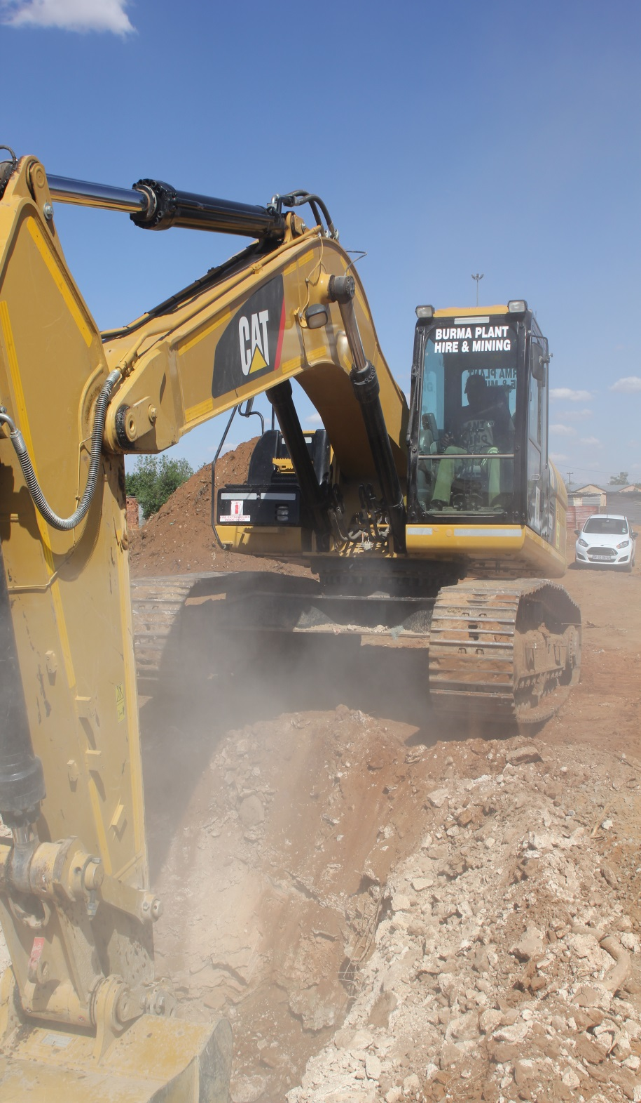
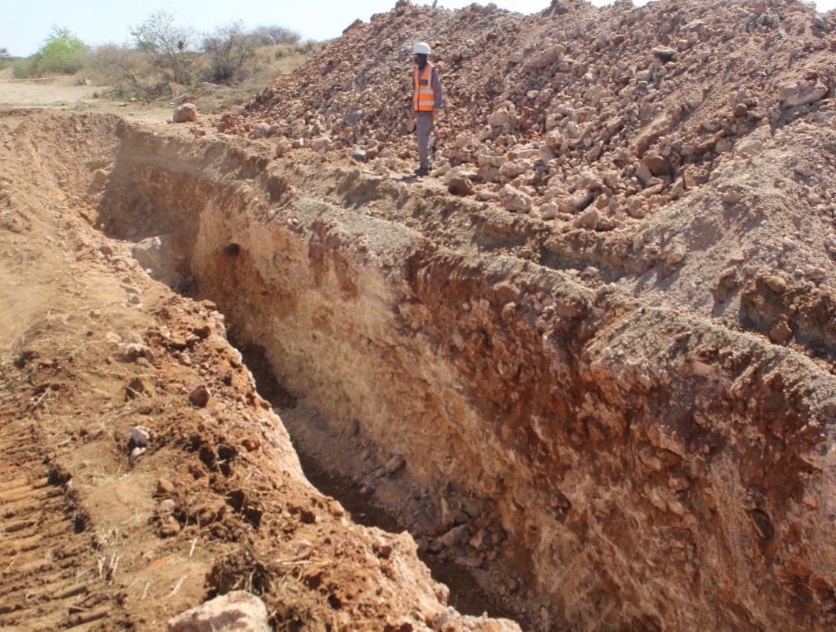
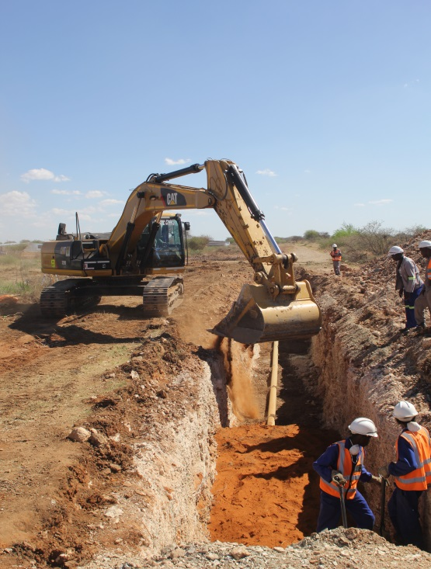

Slide 30
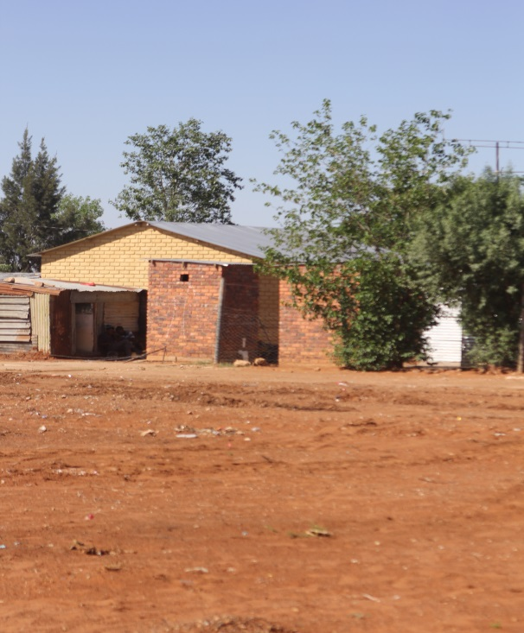
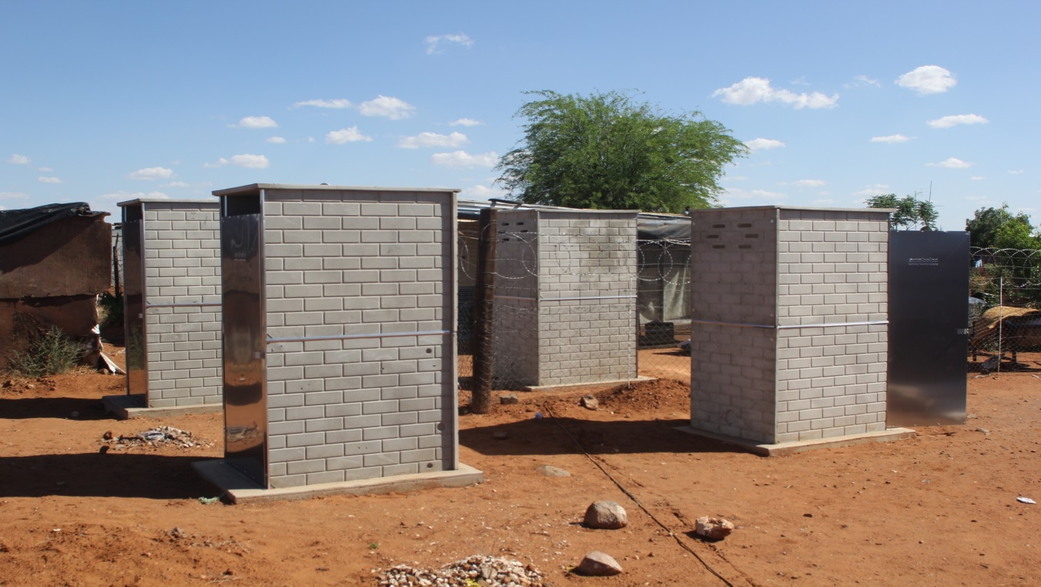
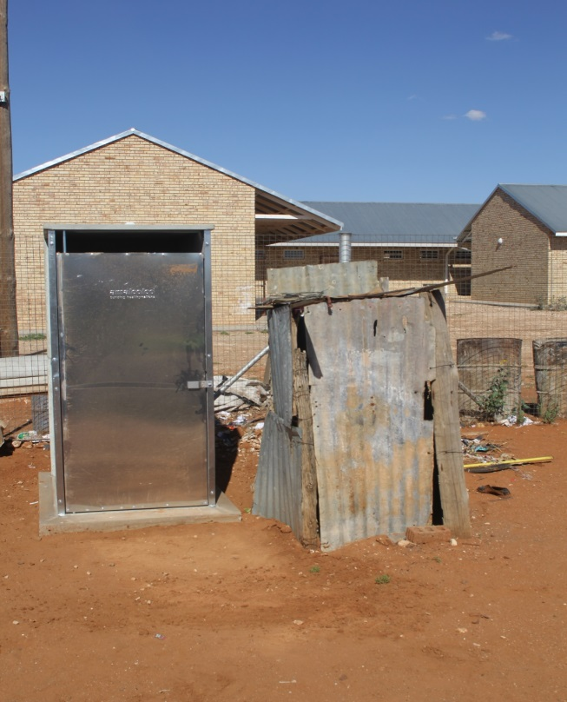
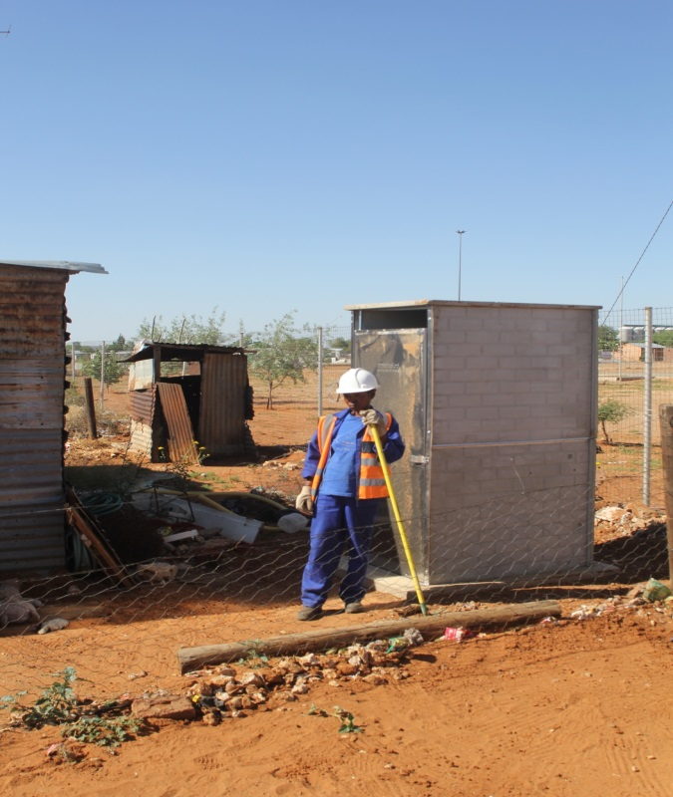

Slide 31
NORTHERN CAPE PROVINCE
Town : Victoria West - Work In Progress
PROJECT : VICTORIA WEST (890 UNITS)
Programme : Bucket Eradication Programme

Slide 32
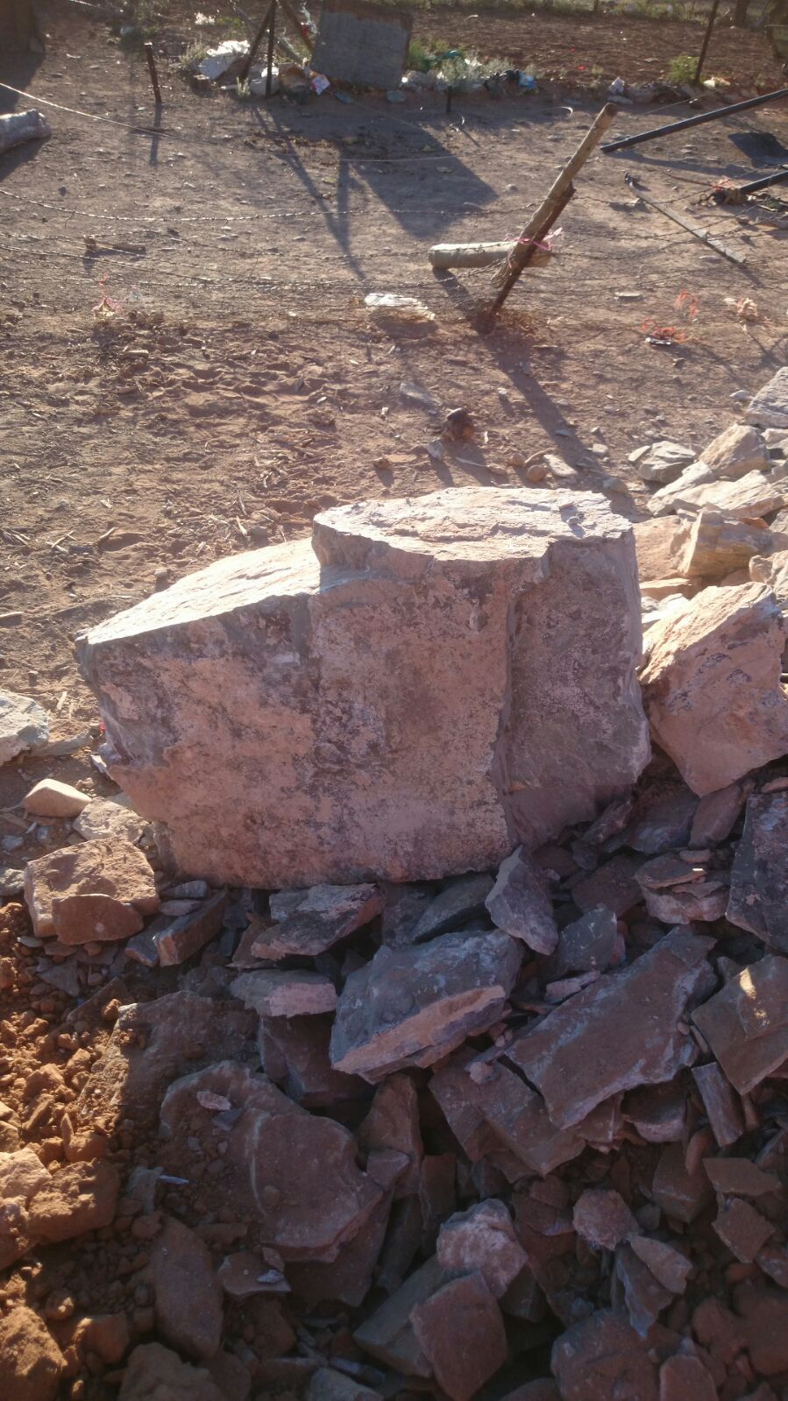
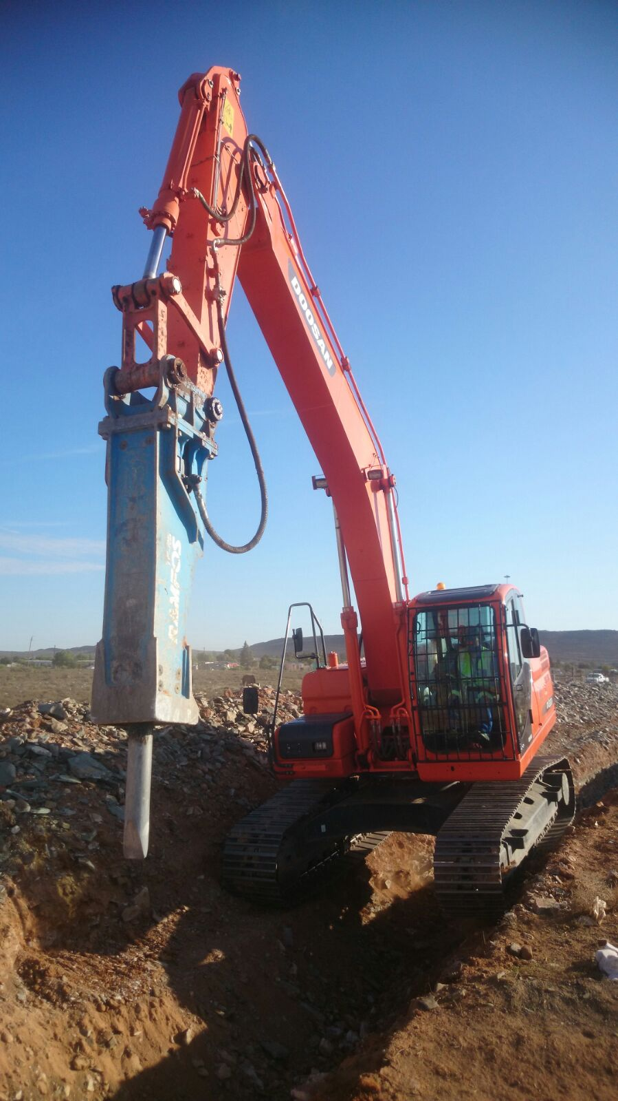

Slide 33
The End – Thank You WATER IS LIFE – SANITATION IS DIGNITY

Slide 34
PROGRESS REPORT AS AT 20 OCTOBER 2015 BY DWS
PROVINCE | NO OF PROJECTS | PROJECT STATUS
 |  | Planned No of Buckets to be eradicated | Progress to date (Completed Structures) | Site Established (Projects with Designs) | Pending Designs
NC | 19 | 9 513 | 854 | 11 | 8
FS | 13 | 15 145 | 30 | 5 | 8
NW | 2 | 198 | 0 | 0 | 2
EC | 3 | 3 523 | 60 | 3 | 0
TOTAL | 37 | 28 379 | 944 | 19 | 18

Slide 35
DELIVERY TARGETS BY DECEMBER 2015 41 785 Bucket Toilets
Projects to be implemented by IA’s and completed by December 2015 |  | Projects to be implemented by Contractors and completed by December 2015
72 | EC | 3523
1 114 | NC | 9499
12 234 | FS | 15 145
0 | NW | 198
13 420 | TOTAL | 28 365
The reduction of the target was achieved after the verification of the scope of work with the applicable municipalities.

Slide 36
BUCKET ERADICATION PROGRAMME (DELIVERY PROGRAMME – WITH DESIGNS)
Province | Municipality | Project Name | No of Buckets | August 2015 | Sept 2015 | Oct 2015 | Nov 2015 | Dec 2015 | Jan 2016 | Feb 2016
FS | Tokologo LM | Boshoff | 300 | Site Handover | 0 | 75 | 125 | 100
 | Tokologo LM | Malebogo/ Hertzogville | 1020 | Site Handover | 0 | 325 | 400 | 285
 | Setsoto LM | Ficksburg | 1469 |  |  | Site Handover | 530 | 469 | 40 | 470
 | Nketoana LM | Lindley | 900 |  |  | Site handover | 200 | 200 | 100 | 400
 | Nketoana LM | Petrus Steyn | 960 |  |  | Site Handover | 200 | 200 | 100 | 460
EC | Sunday River Valley LM | Patterson | 1245 |  | Site Handover | 0 | 75 | 280 | 390 | 500
 | Makana LM | Hlaleni / Makana | 888 |  | Site Handover | 0 | 50 | 100 | 350 | 388
 | Ndlambe LM | Nemato | 1390 | Site Handover | 60 | 200 | 410 | 180 | 140 | 580

Slide 37
Province | Municipality | Project Name | No of Buckets | August | Sept 2015 | Oct 2015 | Nov 2015 | Dec 2015 | Jan 2016 | Feb 2016
NC | Emthanjeni LM | Britstown | 404 | Site Handover | 0 | 200 | 204
 | Tsantsabane LM | Maranteng | 463 | Site Handover | 0 | 79 | 290 | 100
 | Tsantsabane LM | Postdene | 505 | Site Handover | 0 | 100 | 200 | 150 | 55
 | Khara Hais LM | Louisvale | 800 | Site Handover | 0 | 0 | 200 | 200 | 200 | 200
 | Khara Hais LM | Rosedale | 2374 | Site Handover | 0 | 500 | 700 | 500 | 200 | 474
 | Khara Hais LM | Pabalello | 533 | Site Handover | 0 | 60 | 240 | 233
 | Siyacuma LM | Breipal | 264 | Site Handover | 0 | 116 | 116 | 32
 | Siyacuma LM | Bongani | 555 | Site Handover | 0 | 100 | 244 | 211
 | Siyacuma LM | Griekwastad | 480 | Site Handover | 0 | 120 | 240 | 120
 | Siyathemba LM | Marydale | 237 |  | 0 |  | Site Handover | 42 | 100 | 95
 | Nama-Khoi LM | Various Sites | 192 | Site Handover | 0 | 42 | 84 | 66
 | Sol Plaatjie LM | Kimberley | 527 |  | 0 | 0 | 0 | 64
 | Ubuntu LM | Victoria West | 890 | Site Handover | 0 | 0 | 324 | 242 | 162 | 162
TOTAL |  |  | 14556 |  | 957 | 4587 | 4838 | 3840 | 334

