Slide 1
Update on south africa’s fiscal cliff presentation to parliamentary standing and select committees on the mtbps: October 2015
Jannie Rossouw
Head: School of Economic and Business Sciences
University of the Witwatersrand
Fanie Joubert
Senior Lecturer: Department of Economics
University of South Africa
Adèle Breytenbach
Senior Lecturer: Department of Economics
University of South Africa

Slide 2
Summary
This presentation elaborates on earlier research showing that South Africa faces the danger of a looming fiscal cliff:
The point where social grant expenditure and civil service remunaration will absorb all government revenue.
The fiscal cliff is calculated on the basis of a continuation of expenditure trends since 2008.
This presentation focuses on developments since the publication of the earlier research and uses an econometric model to project future trends.
South Africa can move from a fiscal cliff to a fiscal plato if populist choices can be avoided.

Slide 3
Social Spending
The South African government budgted to spend R130,1 billion on social grants in the 2015/16 fiscal year.
This is about 12,0 per cent of total government spending.
It is an average annual increase of 9,9 per cent since the 2007/08 fiscal year, when expenditure on social grants amounted to R62,5 billion.
The National Treasury predicts that the number of beneficiaries from social grants will amount to about 18,5 million people in 2028.

Slide 4
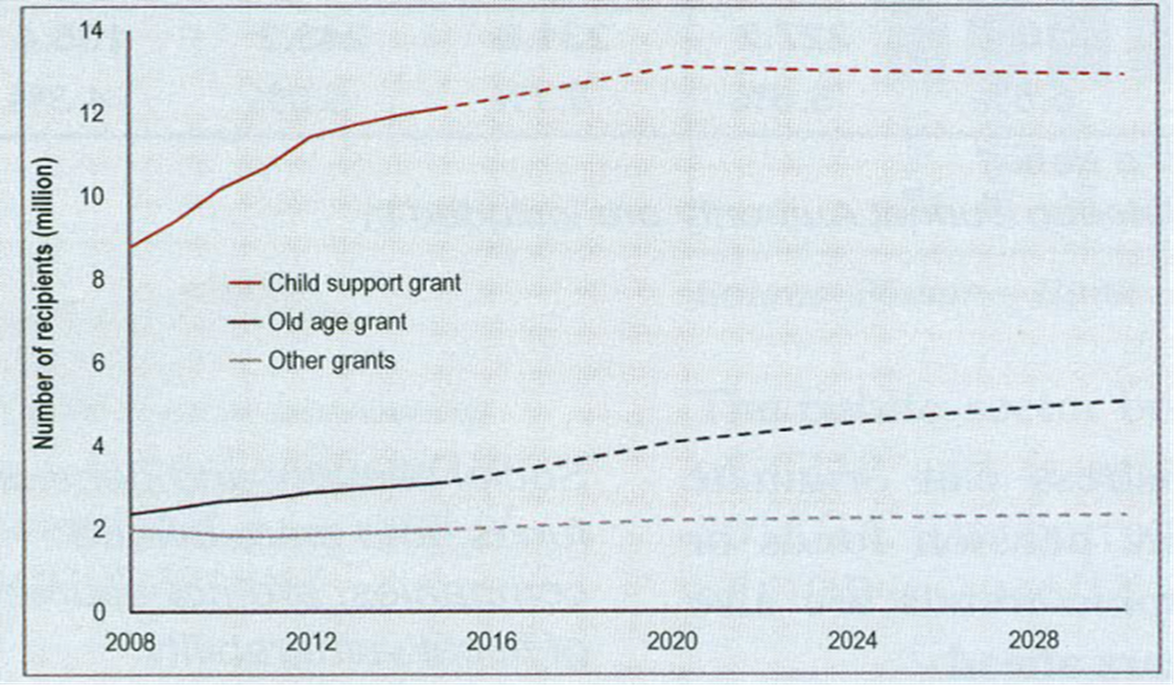
Social Grant Expenditure
Source: 2014 Budget Review: 44

Slide 5
Social Grants
Disconcerting announcements:
Minister of Finance on 27 February 2013: All people over 60 will qualify for old age pensions from 2016. The implementation of this proposal was psotponed in the MTBPS of 2014
Minister of Social Development in 2015: Child grants to the age of 21 for qualifying children in continuous study – our assessment is that is will be impossible to apply such a limitation
Our calculations show that the acceptance of these proposals (including grants for all children to age 21 will place an additional burden of R31 billion on the fiscus:
R8 billion (after full phasing-in) for child grants; and
R25 billion for old age pensions
Extention of grants as alluded to by these ministers are not compatable with the projections of the National Treasury, highlighted above

Slide 6
Civil Service Remuneration
Breytenbach & Rossouw (2013) showed that civil serivce remuneration increased on average by 13,1 per cent per annum since 2008, comprising increases of:
5,9%: General annual increase in remuneration;
1%: 1 percentage point general annual increase above the inflation rate;
2,6%: Structural adjustments in remuneration in favour of more senior staff members in the civil service;
1%: Annual notch adjustments; and
2,6%: Growth in employment (more staff members).

Slide 7
Civil Service Remuneration, 2007/08 To 2018/19
 | Actual/budget, R billion | Percentage change (% y:y)
2007/08 | 195.0
2008/09 | 232.5 | 19.2%
2009/10 | 273.1 | 17.5%
2010/11 | 309.9 | 13.5%
2011/12 | 346.0 | 11.6%
2012/13 | 375.0 | 8.4%
2013/14 | 411.3 MTBPS | 9.7% MTBPS
2014/15 | 445.3 (441.1) | 8.3% (7.2%)
2015/16 | 479.5 (486.2) | 7.7% (10.2%)
2016/17* | 509.6 (524.0) | 6.3% (7.8%)
2017/18* | 539.6 (569.4) | 5.9% (8.7%)
2018/19* | n/a (615.6) | n/a (8.1%)
Sources: 2014 MTBPS, Republic of South Africa 2011:170, Republic of South Africa 2014a:147-148, Republic of South Africa 2015a: 59, 2015 MTBPS and own calculations
*Medium-term estimates

Slide 8
Civil Service Employment 31 March 2008 to 31 June 2015
 | Central government | Provincial governments | Total | % y:y
31/03/2005 | 369 500 | 823 677 | 1 193 117
31/03/2006 | 385 441 | 860 580 | 1 246 021 | 4.4%
31/03/2007 | 407 489 | 889 652 | 1 297 141 | 4.1%
31/03/2008 | 405 805 | 938 173 | 1 343 978 | 3.6%
31/03/2009 | 418 879 | 967 740 | 1 386 619 | 3.2%
31/03/2010 | 410 051 | 1 006 793 | 1 416 844 | 2.2%
31/03/2011 | 427 281 | 1 047 990 | 1 475 271 | 4.1%
31/03/2012 | 443 199 | 1 075 515 | 1 518 714 | 2.9%
31/03/2013 | 454 757 | 1 084 197 | 1 538 954 | 1.3%
31/03/2014 | 454 000 | 1 116 404 | 1 570 404 | 2.0%
31/03/2015 | 448 209 | 1 104 058 | 1 552 267 | -1.2%
31/06/2015 | 473 197 | 1 085 872 | 1 559 069 | 0,44%*
Figures exclude local authorities and public entities
*Quarterly and annualised figure for 31/06/2015
Sources: SA Reserve Bank, own calculations

Slide 10
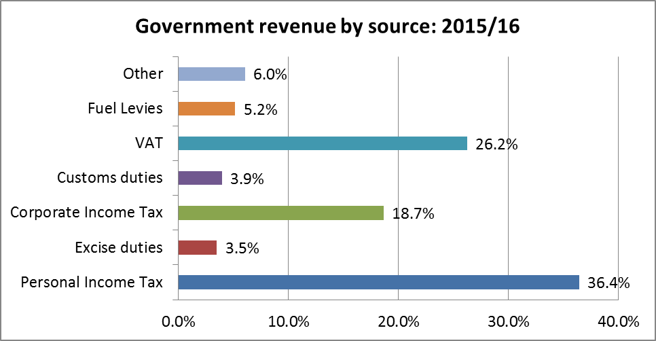
Government Revenue
Source: Budget Review 2015

Slide 11
Model for Government Revenue
Variable (name in model) | Assumption
Money supply (RM3) | Result obtained from econometric model
Disposable income (RYD) | Expected nominal GDP (Potential GDP + 5,9% inflation)
Prime interst rate (RPRIME) | Inflation plus 4.0 percentage points
Inflation (INFL) | Actual average annual South African inflation rate for the period 2002 to 2014 was 5,9%. An inflation rate of 4,3% (2015 National Budget) is used for 2015 and for the period 2016 to 2060 a rate of 5,9% per annum is used
*GDP assumed for 2015 at 2,0% and 2,5% per annum from 2016. The modelling is based on full-employment real GDP growth of 2,5% per annum, as calculated by Anvari et al. (2014) of the SA Reserve Bank. The OECD (OECD, 2012) estimates South Africa's full-employment real GDP growth at 3 per cent per annum, but Anvari et al (2014) reports more recent research findings.

Slide 12
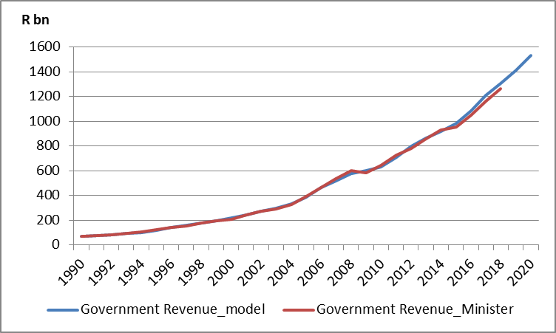
Model Results

Slide 13
Scenario 1: Assumptions (more of the same)
No real tax increases
Social grants:
Child grants increase from the 2016/17 fiscal years owing to the phasing-in of these allowances for children up to the age of 21, by R2,67 billion in 2016/17 (⅓ of R8 billion) and by similar amounts in in 2017/18 and 2018/19 (these grants are NOT limited to qualifying children in full-time studies).
Growth at inflation (5,9 per cent per annum) plus 1 percentage point.
Old age pensions
Old age pensions increase one-off by R25 billion in the 2018/19 fiscal year to provide for the abolition of the means test.
Growth at inflation (5,9 per cent per annum) plus 1 percentage point.
Civil service remuneration increases at 13,1% per annum owing to general adjustments and employment growth (as since 2008)

Slide 14
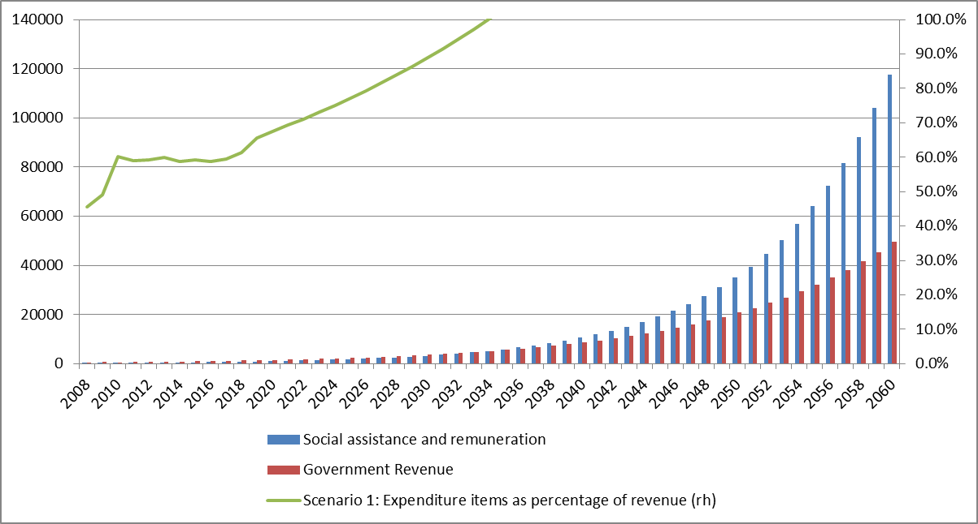
Scenario 1: Result

Slide 15
Scenario 2: Assumptions (New Beginnings)
No real tax increases
Social grants:
No extension in grants to additional recipients over the age of 18 or over 60;
Real and budgeted payments used to 2017/18; and
After that an increase at a rate of inflation (5,9 per cent per annum) plus 1 percentage point
Civil service remuneration:
Real and budgeted figures used to 2017/18;
Thereafter growth at 10,5 per cent per annum:
General annual adjustment at inflation rate (5,9 per cent) plus 1 percentage point; and
3,6 per cent per annum for notch increases, promotions and structural chnages, but no further employment growth

Slide 16
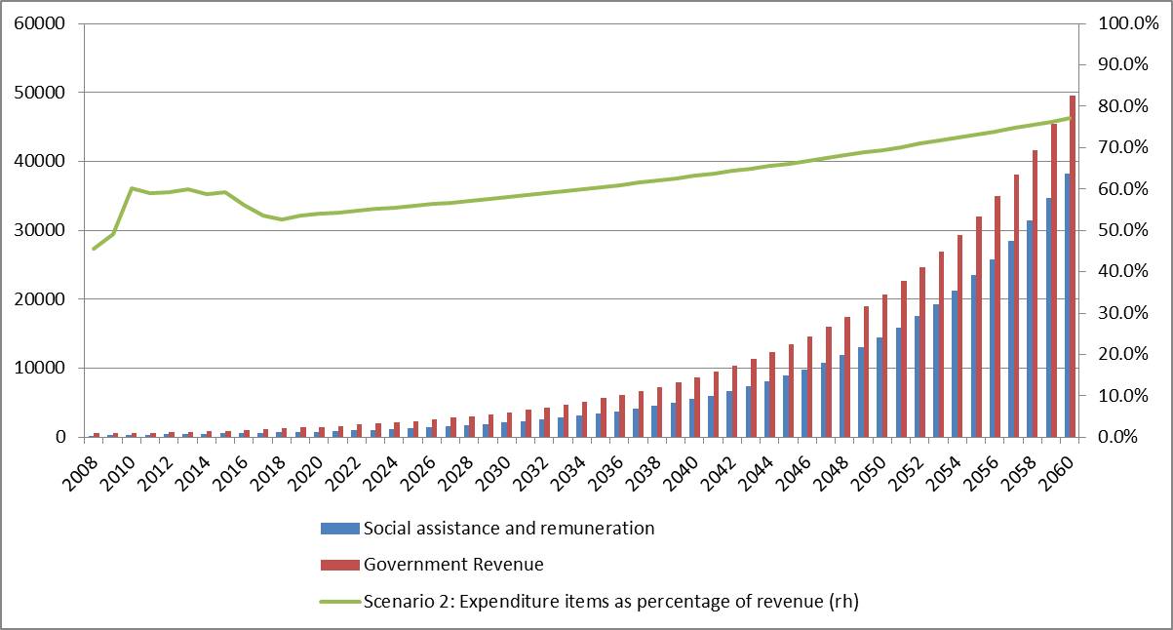
Scenario 2: Result

Slide 17
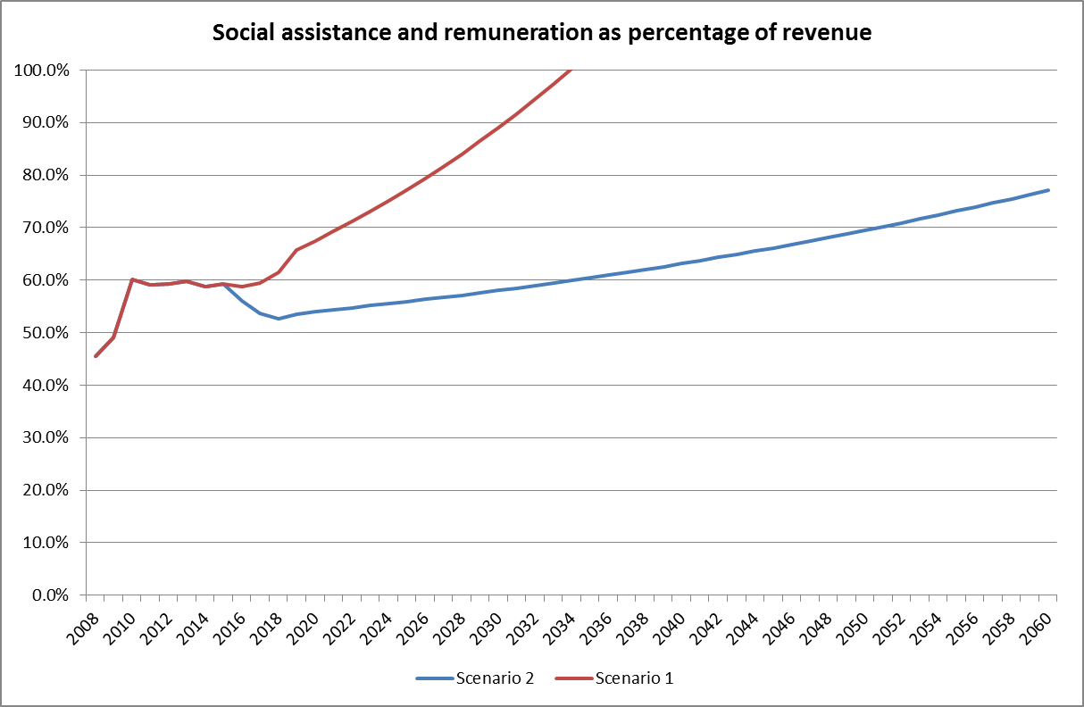
Summary: Scenario 1 and 2

Slide 18
The Way Forward
It is no longer what we want; but what we can
Hard choices: It is OR, not AND
Critical rethinking of spending priorities is necessary
Free education at tertiary level:
Approximately 535 000 students at 22 residential universities (excluding UNISA students)
Unisa: Some 400 000 students
Affordability: Free for all or only South African students?
Estimate of fees paid by all students:
935 000 x R35 000 p.a. = R33 billion per annum
Government vehicle pool
Tax increases

Slide 19
South African Passenger Cars, Pick-up Trucks and SUVs
Government and politicians should use exclusively vehicles manufactured in South Africa:
3 series BMW
Ford Ranger pick-up truck
Chev Corsa pick-up truck
Isuzu KB pick-up truck
C class Mercedes-Benz
Nissan NP 300 (hardbody) pick-up truck
Nissan Livina
Nissan NP 200
Renault Sandero
Toyota Corolla
Toyota Corolla Quest
Toyota Hilux
Toyota Fortuner
Toyota Quantum
Volkswagen Polo Vivo

Slide 20
Tax Increases
Increased taxation on income above R1 million per annum, rather than a wealth tax.
However, higher income tax is preferable to a wealth tax (Piketty):
Affordability (e.g. low income but a very valuable property)
Asset classes:
Property
Liquid assets

Slide 21
Tax Revenue
Currently the maximum marginal tax rate (41%) is payable on taxable income exceeding R701 301
An increase of tax rates above this income level will increase revenue for the government

Slide 22
Tax Revenue
Estimated that South Africa has:
120 000 tax payers earning between R1 million and R2 million per annum
34 000 tax payers earning over R2 million per annum
Increase marginal tax rate for income between R1 million and R2 million to 45% (4 percentage points increase)
Increase marginal tax rate for income above R2 million to 50% (9 percentage point increase)
Assume no elasticity (e.g. people will not work less owing to increased taxation)

Slide 23
Tax Revenue
45% tax (rather than 41%) on 120 000 tax payers earning between R1 million and R2 million = 4% x R500 000 (assumption of average income) x 120 000 = R2,4 billion.
45% tax on 34 000 tax payers earning above R2 million i.r.o earnings between R1 million and R2 million = 4% x R1 million x 34 000 = R1,36 billion.
50% tax on 34 000 tax payers above R2 million (assume average of R3 million per annum) = 9% x R1 million x 34 000 = R3,06 billion.
Extra tax from 2 additional brackets: R6,82 billion.

Slide 24
Conclusions
Scenario 1 (more of the same) shows that South Africa cannot afford a continuation of trends since 2008 (more of the same)
Scenario 2 (we are serious) shows that South Africa can reach a fiscal plato, but that:
This plato is a too high a level; and
Changed behaviour is necessary
Multi-year civil service remuneration adjustments agreed to in 2015 are unaffordable
Extentions of social grants cannot be afforded
There is evidence that the Government paid attention to the warnings of Rossouw, Joubert & Breytenbach (2014) about South Africa’s looming fiscal cliff and commenced with stepts to avert this cliff, which is commendable
Civil service trade unions should refrain from asking for large and unaffordable remuneration increases

Slide 25
Conclusions
Politici should refrain from making populist statements with serious finanical implications (e.g. extention of grants)
Free education at tertiary level = Some R33 billion extra per annum
Extra tax revenue:
Income tax increases are preferable to wealth taxes
R6,82 billon from extra tax brackets
Government and politicians should only use vehicles manufactured in South Africa:
The President, the Deputy President, cabinet ministers, deputy ministers and MECs can be very comfortable in the back seat of a 3 series BMW, a C-Class Mercedes or a Toyota Fortuner
These vehicles can still be painted black to intimidate other road users, as is currently the case

Slide 26
Questions/Discussion
Selected bibliography:
2015 National Budget Review. 2015. National Treasury: Pretoria
Breytenbach, A. & Rossouw, J. 2013. ’n Ontleding van vergoedingsneigings in die Suid-Afrikaanse staatsdiens, 2005 tot 2012. Tydskrif vir Geesteswetenskappe. Jaargang 53:4. Desember.
Business Day. 2014. “Gauteng education MEC moots exemption of teachers from income tax”. Available on: http://www.salabournews.co.za/index.php/component/content/article/70-labour-news/18780-gauteng-education-mec-moots-exemption-of-teachers-from-income-tax.html. [Downloaded on: 14 July 2014]
IMF. 2014. South Africa: Staff report for the 2014 Article IV consultation. 17 November
Joubert, S. J. & Rossouw, J. 2013. Lewensstandaard: ’n Ekonomiese perspektief op lewensgehalte in Suid-Afrika. Tydskrif vir Geesteswetenskappe. Jaargang 53:1. Maart
Rapport. 2014. 11 Mei
Republic of South Africa. 2015. Budget Review 2015. National Treasury: Pretoria
Republic of South Africa. 2014. Budget Review 2014. National Treasury: Pretoria
Republic of South Africa. 2014. Estimates of National Expenditure 2014. 26 February. Republic of South Africa. National Treasury: Pretoria
Republic of South Africa. 2013. 2013 Budget Speech. Minister of Finance (Mr Pravin Gordhan). 27 February 2013
Rossouw, J., Joubert, S. J. & Breytenbach, A. 2014. Suid-Afrika se fiskale afgrond: ’n Blik op die aanwending van owerheidshulpbronne. Tydskrif vir Geesteswetenskappe, Jaargang 54 No. 1: Maart.
Rossouw, J. & Breytenbach A. 2015. Fiscal constraints determine South Africa’s social agenda. Unpublished Working Paper.
SA urged to avoid ‘fragile five’ downgrade – Raymond Parsons (http://www.bdlive.co.za/economy/2015/09/13/sa-urged-to-avoid-fragile-five-downgrade)
SA Reserve Bank: Various sources

