Slide 1
PORTFOLIO COMMITTEE ENVIRONMENTAL AFFAIRS Progress on Secondary Asbestos Remediation
27 October 2015

Slide 3
Map of the affected areas

Slide 4
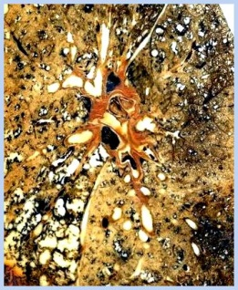
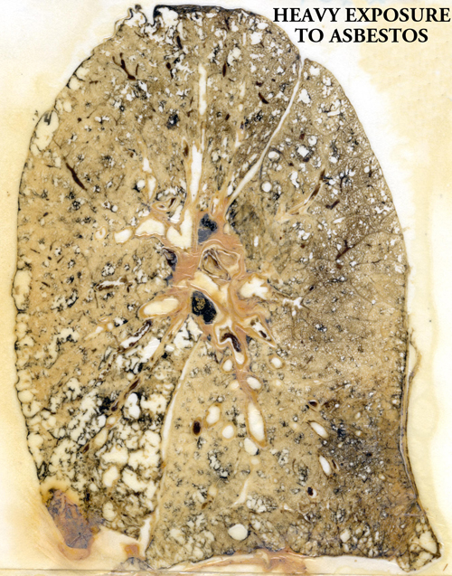
PHOTOGRAPHIC INSIGHT Lungs exposed to asbestos

Slide 5
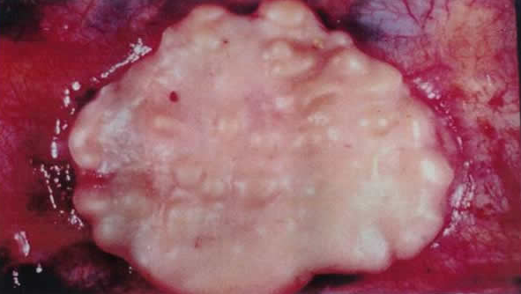
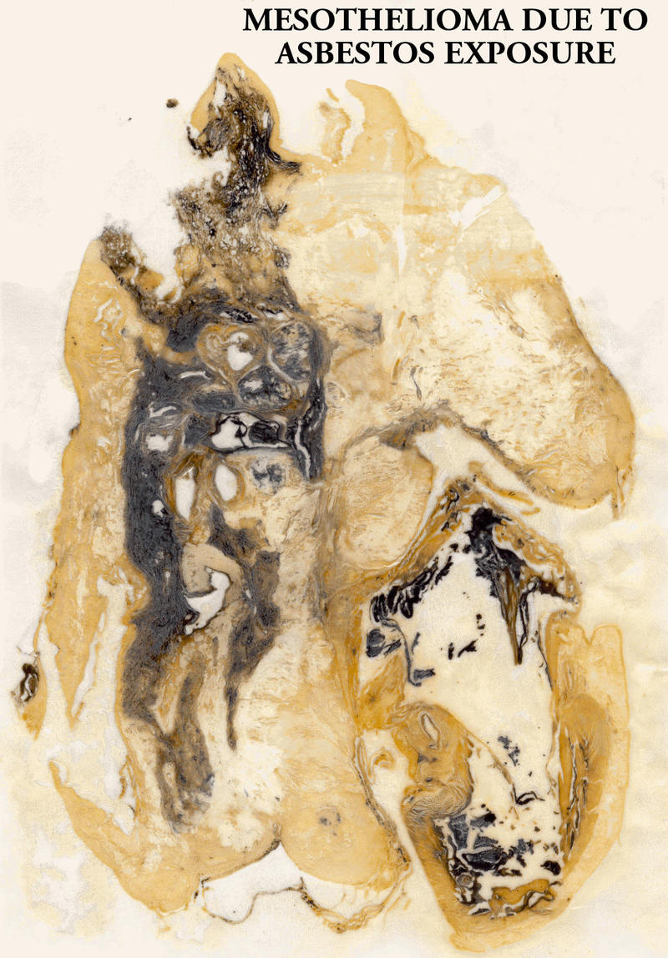
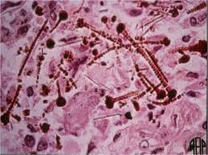
PHOTOGRAPHIC INSIGHT Lungs exposed to asbestos
Malignant pleural mesothelioma
(Asbestos caused disease)
Asbestos Fibres in Lungs

Slide 6
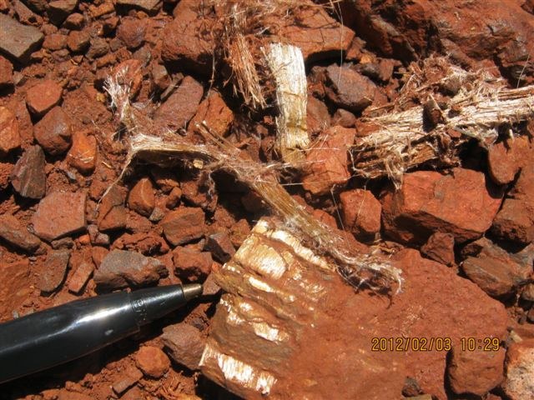
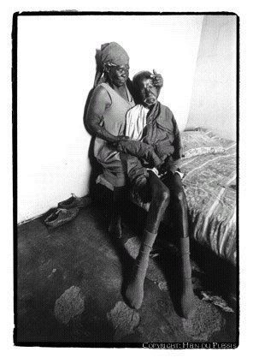
PHOTOGRAPHIC INSIGHT
Asbestos Fibres in Lungs

Slide 7
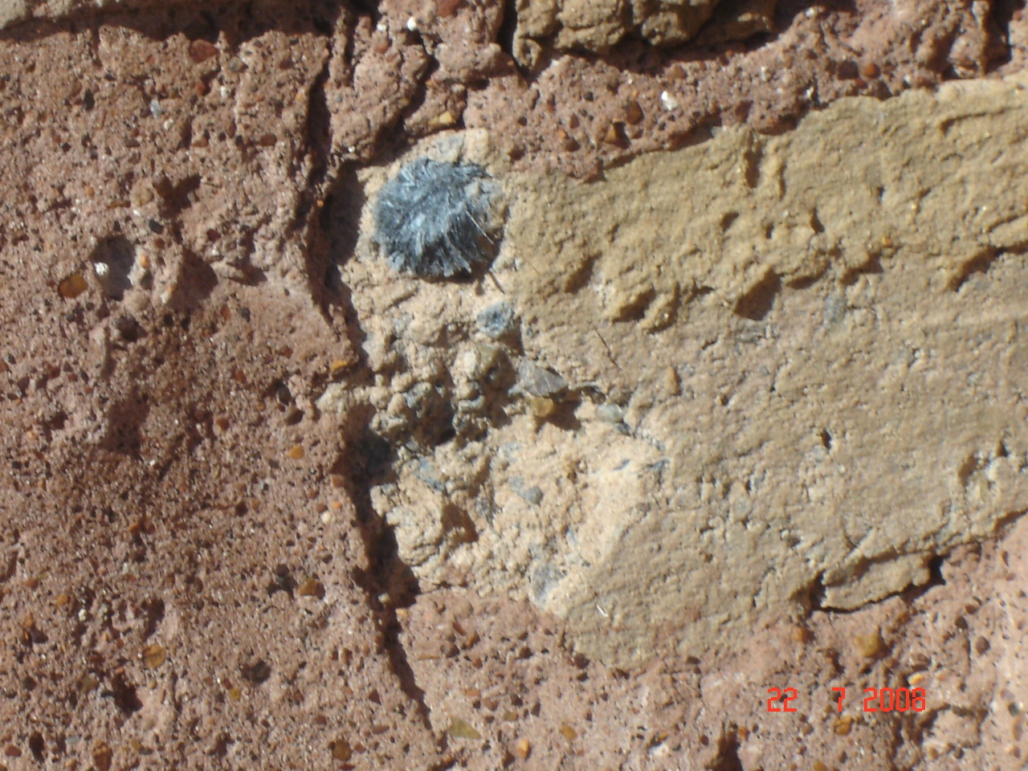
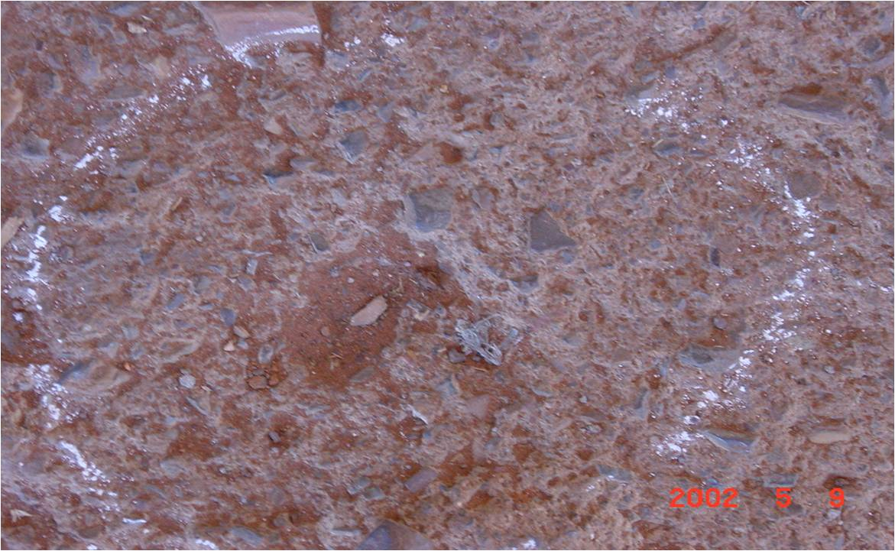
PHOTOGRAPHIC INSIGHT – Houses Built of asbestos contaminated soil

Slide 8
BACKGROUND
DEA was tasked by the Cabinet in 2004 to undertake a study in order to assess the extent of secondary asbestos contamination in SA The study was completed in 2006 and showed that there are different levels of contamination in four provinces (NC, L, MP & NW). Following the 2006 study, the DEA took the study further by developing (in 2008) a remediation plan & costing model for contaminated areas. The 2008 study included the social impact assessment (SIA) to assess how exposure to asbestos has affected the socio-economic aspects of relevant communities. The study further investigated remediation options as well as financial implication The number of people affected by Secondary Asbestos contamination is in Millions

Slide 9
SARP`s Summary of all affected Provinces

Slide 10
BACKGROUND (CONT) REMEDIATION OPTIONS
No Action Alternative: In this regard all the contaminated areas will be left the way they are (non-remediated) Permanent Relocation: In this regard minimal or no remediation will be applicable, but will be case specific. This can be regarded as the most reliable and permanent solution to the problem. However, this is dependent on whether the communities are willing to relocate and the extent of contamination Temporal relocation (In-situ Remediation): In this regard there will be a need for temporary relocation of the community while remediation is being carried out (estimated 10 yrs.) NB: selection of the remediation option is based on cognizance of asbestos hazards to people, hence appropriate measures will be taken during remediation.

Slide 11
BACKGROUND (CONT…)
It should be noted that there is neither a cure nor medication to elongate the lives of ARD sufferers with exception of prevention through remediation and/or relocation. According to the study, the latency of Mesothelioma is about 30 – 40 years and it takes about one year from the time the symptoms of Mesothelioma starts to show for a person to die. Unlike most terminal diseases which can be avoided, communities exposed to asbestos are very poor with little choices in terms of relocation hence require Government intervention. The findings of the Secondary Asbestos Remediation Plan and Funding Model study was approved at the full Cabinet meeting of 12 June 2013.

Slide 12
Background Cont: Estimated Cost (2012) for In-Situ Remediation
Year | Low range | High range
1st Year | R 164 700000 | R 274 500 000
2nd Year | R 174 582 000 | R 290 970 000
3rd Year | R 185 056 920 | R 308 428 200
4th Year | R 196 160 335 | R 326 933 892
5th Year | R 207 929 955 | R 346 549 926
6th Year | R 220 405 753 | R 367 342 921
7th Year | R 233 630 098 | R 389 383 496
8th Year | R 262 506 778 | R 437 551 296
9th Year | R 278 257 185 | R 463 761 974
10th Year | R 294 952 616 | R 491 587 693
TOTAL | R 2 218 181 640 (To remediate 40 identified areas ) | R 3 697 009 398

Slide 13
Progress on Asbestos Remediation
Priorities for the coming Three years
Limpopo
1. 88 km gravel road to be tarred - R 176m (Estimated at 2m per km)
2. 2 Schools to be demolished and rebuild - R 20m
3. Demolish, rebuild Traditional Council offices & pave the yard - R 5m
4. Build Traditional Council offices & pave the yard - R 3m
Northern Cape
1. 802km gravel road to be tarred - R 1604m (estimated at 2m per km)
2. Demolish & rebuild 3 schools - R 15m
TOTAL = R 1 823m
WE HAVE APPLIED TO THE NATIONAL TREASURY FOR FUNDING IN THE ABOVE REGARD

Slide 14
PROGRESS ON SECONDARY ASBESTOS REMEDIATION
Limpopo Construction of Mafefe Traditional (Tribal) Councils Offices is underway Northern Cape Khiba school has been closed and the children have been moved to Gamopedi school. Paving at Gamopedi school has been done and mobile classrooms have been constructed for the additional children. An asbestos free clinic has been constructed at Gamopedi Consultation with the community is underway to determine a new site on which Asbestos free Khiba school will be constructed during 2015/16. Required documents have been prepared and submitted to Treasury to secure funding for the implementation of the Secondary Asbestos Remediation Plan.

Slide 15
RECOMMENDATIONS
To note progress on the Implementation of the Asbestos Remediation Plan To request Portfolio Committee to visit all affected areas (Mafefe, Penge, Taung, Gamopedi amongst others) to intensify the implementation of the SARP

