Slide 1
THE SUSTAINABILITY AND ECONOMIC IMPACT OF AGRICULTURAL COOPERATIVES IN SOUTH AFRICA
BRIEFING TO THE SELECT COMMITTEE ON LAND AND MINERAL RESOURCES BY DAFF
20 October 2015

Slide 2
OUTLINE
Introduction and Background
Factors affecting the sustainability of agricultural cooperatives
Compliance
Impact of agricultural cooperatives in South Africa
Agricultural cooperatives and job creation
Agricultural cooperatives and their contribution to the economy
Smallholder farmers benefiting from services of agricultural cooperatives
Conclusions

Slide 3
INTRODUCTION AND BACKGROUND
The International Fund for Agricultural Development of the United Nations (IFAD), estimates that there are about 500 million smallholder farmers in the world feeding more than 2 billion people. These farmers account to production of 80% of the food consumed in Asia and sub-Saharan Africa
The Food and Agriculture Organisations of the United Nations (FAO) reports that smallholder farmers will provide food for the estimated 9 billion people by 2050
However smallholder farmers continue to face challenges of enhancing productivity and accessing markets for their products.
Enhancing productivity and commercialization among smallholder farmers is widely perceived as a key strategy for rural development, poverty reduction, and food security in Sub-Saharan Africa.

Slide 4
INTRODUCTION AND BACKGROUND ctn..
For productivity gains to be achieved, smallholder farmers need to have better access to technology; easy access to extension services in order to optimize on-farm technical efficiency and productivity, given the limited resources available.
Agricultural cooperatives are an option for providing services to smallholder farmers. They serve the dual purpose of aggregating smallholder farmers and linking them to input and output markets. They are regarded as preferential institutions for moving smallholder farmers out of subsistence agriculture and linking them to emerging input and output markets.
To ensure sustainability of agricultural cooperatives, they need to be supported to improve their technical efficiency. This will enable their members to get better access to productive inputs and services that enhances their productive efficiency.
The presentation is confined to an analysis of 1788 cooperatives captured on the cooperative data analysis system (CODAS) of the Department of which female dominated cooperatives accounts for 55% (983).

Slide 5
FACTORS AFFECTING THE SUSTAINABILITY OF AGRICULTURAL COOPERATIVES
Sustainability of cooperatives
Access to land
Access to Finance
Markets & participation
Training & Capacity Development
Effective cooperative Management
Value adding & Processing
Compliance with regulations

Slide 6
ACCESS TO LAND
As a result of the legacy of inequitable land distribution in South Africa, during the first decade of democracy and ongoing, there has been a strong focus on land reform delivered through restitution, tenure and redistribution.
The most common form of collective ownership of land acquired through land reform is the Communal Property Associations (CPAs), most of them became dysfunctional with the passing of time owing to various reasons, mostly conflict among the members.
cooperatives have been used to manage and utilise land acquired through land reform initiatives. As a result of the promulgation of the Cooperatives Act ( Act No. 14 of 2005) it became easier for African people to register cooperatives. This saw a large number of smallholder farmers grouping themselves through collective organisations such as cooperatives for the purposes of acquiring land for farming purposes through land reform initiatives.
Collectively, the 1788 cooperatives on the cooperative data base have access to 645 583 ha of land.

Slide 7
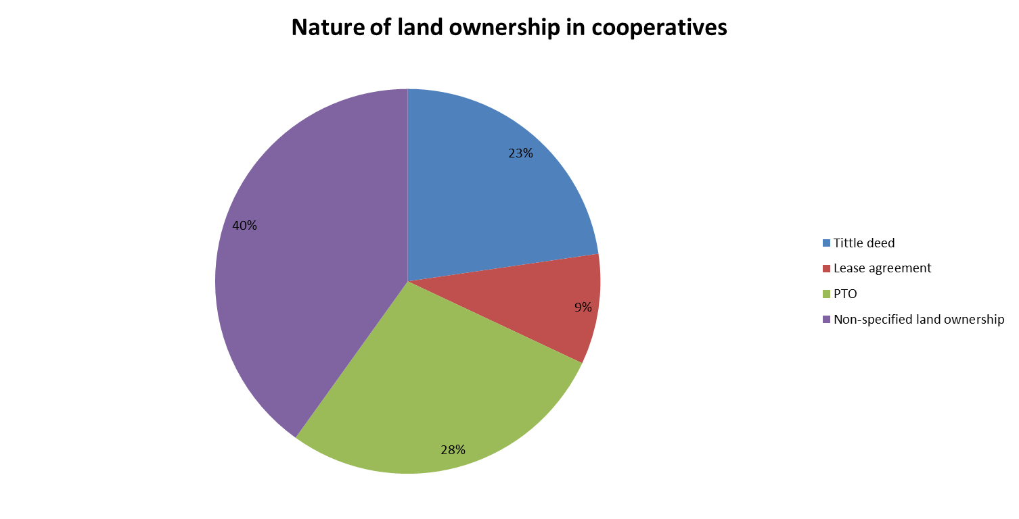
ACCESS TO LAND ctn..

Slide 8
ACCESS TO FINANCE
Like any other investor owned enterprise, cooperatives are required to raise capital to finance and sustain their operations.
However, it is often difficult for small farmers to secure funding in the financial markets due to lack of collateral among others.
Most farmers depend on government grants and loans to propel their farming enterprises.
The principle of “Member economic participation” in cooperatives means that members of cooperatives contribute equitably towards the capital of their cooperatives. This results in improved gearing ratio and sustainability of cooperatives
However, cooperatives are also permitted to raise funds from the mainstream financial institutions in a form of loans or grants/donations from external organisations.
The next slides illustrate the amount of revenue raised by cooperatives both internally (equity) and externally (loans and grants)

Slide 9
ACCESS TO FINANCE ctn..

Slide 10
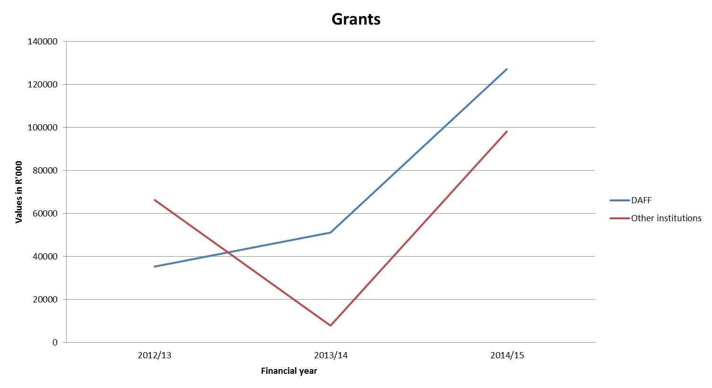
ACCESS TO FINANCE ctn..

Slide 11
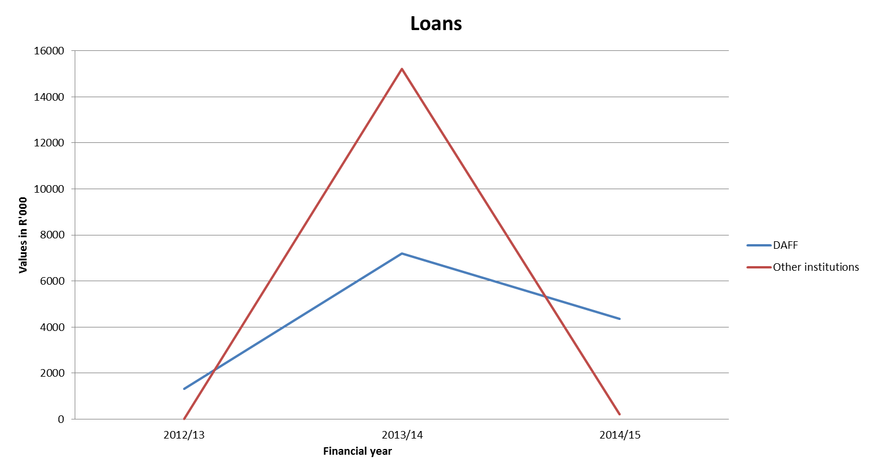
ACCESS TO FINANCE ctn..

Slide 12
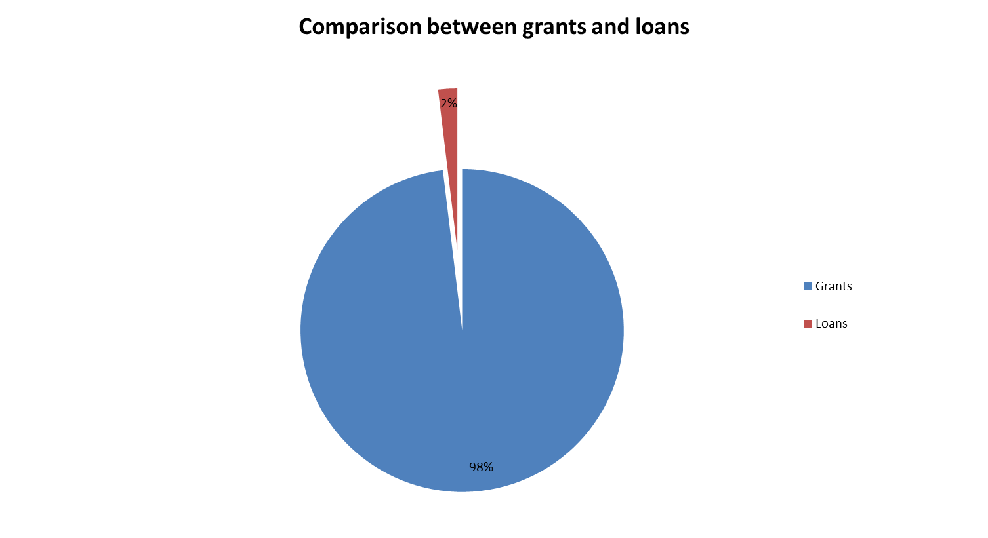
ACCESS TO FINANCE ctn..

Slide 13
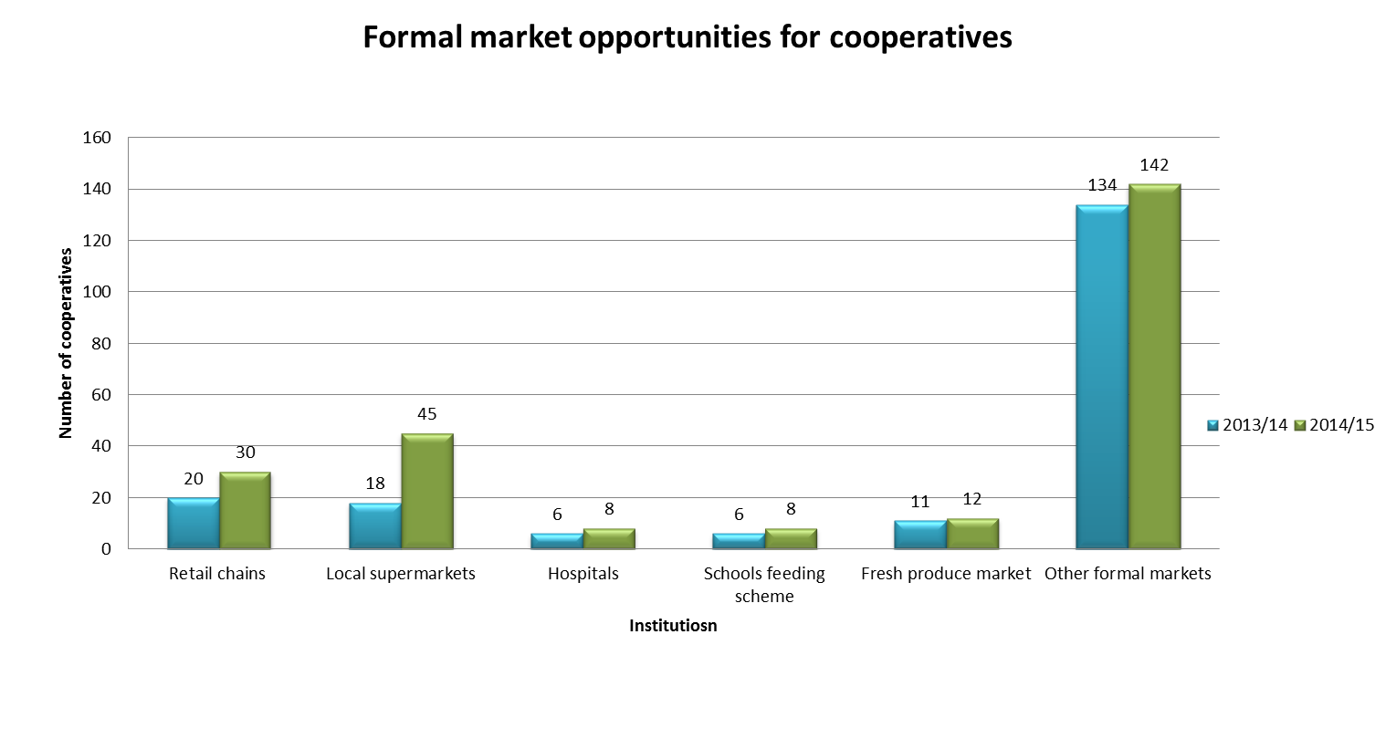
ACCESS TO MARKETS

Slide 14
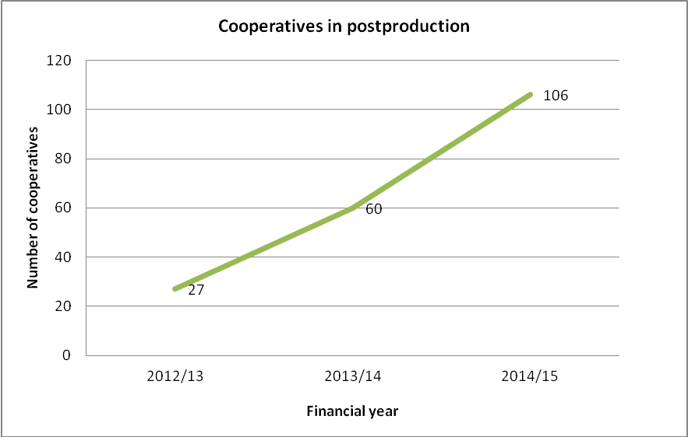
VALUE ADDING AND PROCESSING

Slide 15
TRAINING AND CAPACITY DEVELOPMENT
The increasingly competitive environment requires cooperative enterprises to develop their capacity to continually re-invent themselves and offer new goods and better services to maintain and increase their market share.
The core tools cooperatives need in order to flourish are advice on capacity building, entrepreneurship development, leadership training, market research, financial management, inter cooperative networking and federation building.
The sustainability of a cooperative enterprise, as well as its failure, is very much connected with the understanding and sense of ownership members have in respect of their enterprises.
In order to appraise capacity in sector cooperatives, key competency areas were identified as crucial for a cooperative to be able to manage its affairs effectively.

Slide 16
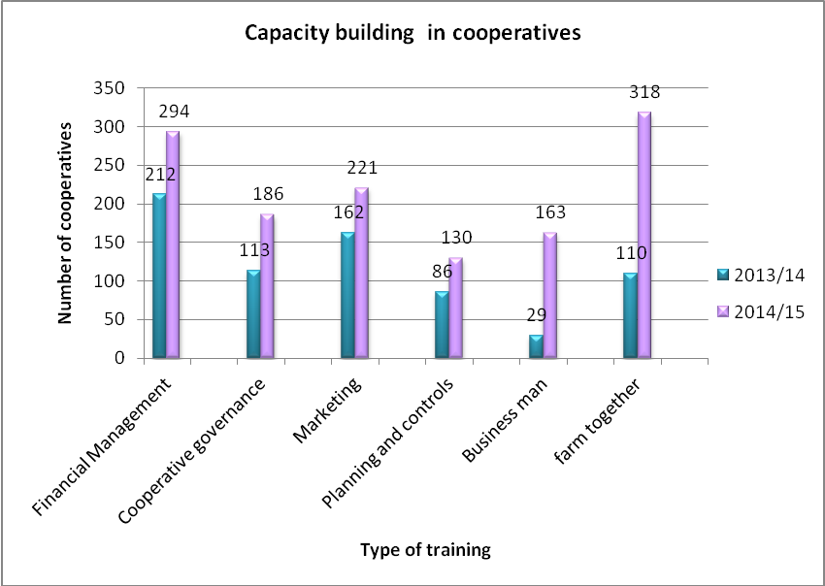
TRAINING AND CAPACITY DEVELOPMENT ctn..

Slide 17
EFFECTIVE MANAGEMENT
Province | No of coops | Coops with managers | Males | Females | Youth | People living with disabilities
EC | 212 | 124 | 93 | 31 | 2 | 1
FS | 89 | 48 | 30 | 18 | 0 | 0
GP | 106 | 73 | 48 | 25 | 0 | 0
KZN | 383 | 147 | 52 | 95 | 2 | 0
LP | 384 | 93 | 92 | 1 | 1 | 1
MP | 224 | 117 | 50 | 67 | 5 | 0
NC | 107 | 12 | 7 | 5 | 0 | 0
NW | 222 | 74 | 52 | 22 | 3 | 0
WC | 61 | 28 | 24 | 4 | 0 | 0
TOTAL | 1788 | 716 | 448 | 268 | 13 | 2

Slide 18
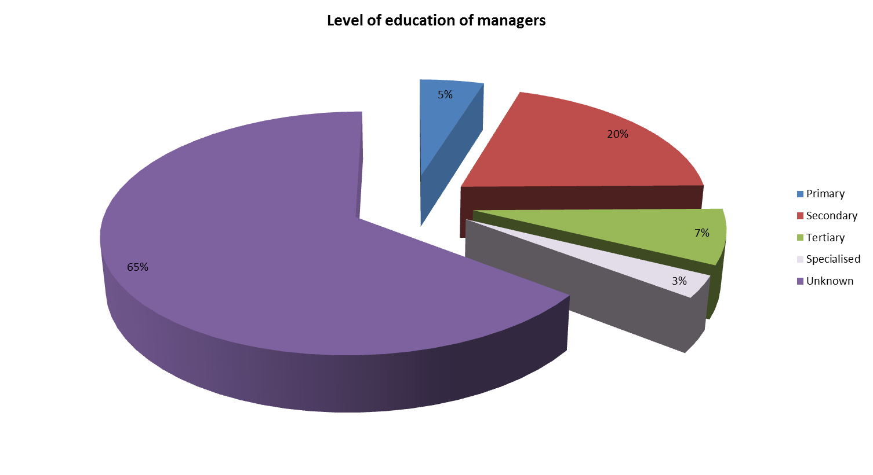
EFFECTIVE MANAGEMENT ctn..

Slide 19
COMPLIANCE
Like any other business enterprise, cooperatives are expected to comply with certain legislative and regulatory frameworks such as the annual tax returns.
Five key compliance areas have been identified and used as a norm to measure the level of compliance by cooperatives in the sector.
Through raising awareness and education on compliance issues the number of cooperatives complying with regulations is increasing.

Slide 20
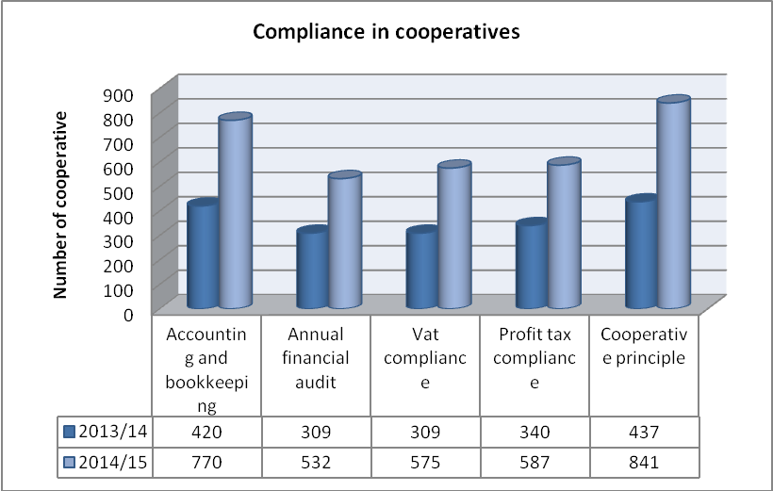
COMPLIANCE ctn..

Slide 21
IMPACT OF AGRICULTURAL COOPERATIVES
The World Cooperative Monitor reveals that together cooperatives around the world generate US$2,96 trillion in national revenue and employ around 12 million persons.
There has been a steady increase in annual revenue generated by agricultural cooperatives in South Africa from R63 million in 2012 to R 157 million in 2014.
Employment opportunities created have also seen a steady increase from 4989 in 2012 to around 9715 in 2014.
In terms of membership, around 41 000 smallholder farmers are benefiting from services of cooperatives.

Slide 22
IMPACT OF AGRICULTURAL COOPERATIVES ctn..

Slide 23
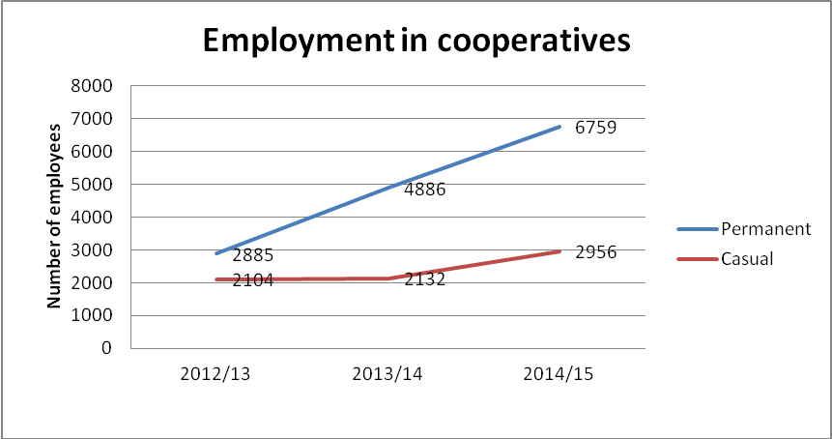
AGRICULTURAL COOPERATIVES AND JOB CREATION

Slide 24
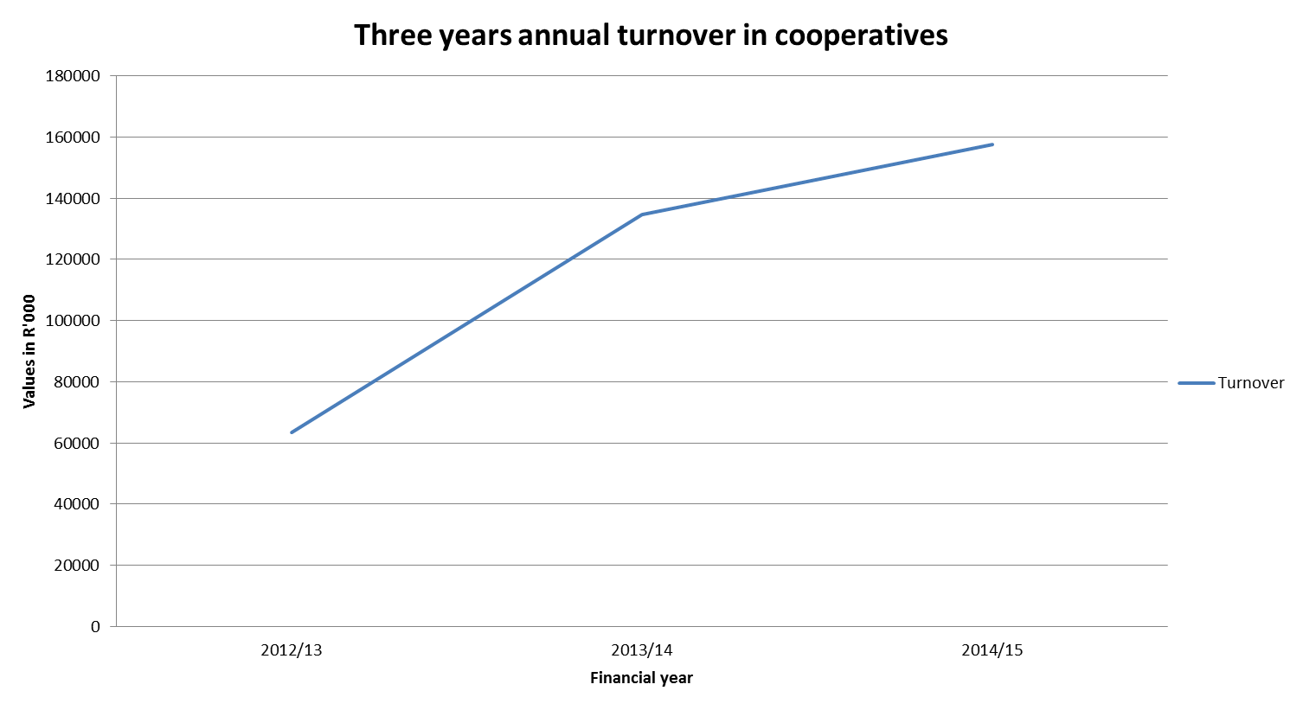
AGRICULTURAL COOPERATIVES AND CONTRIBUTION TO THE ECONOMY

Slide 25
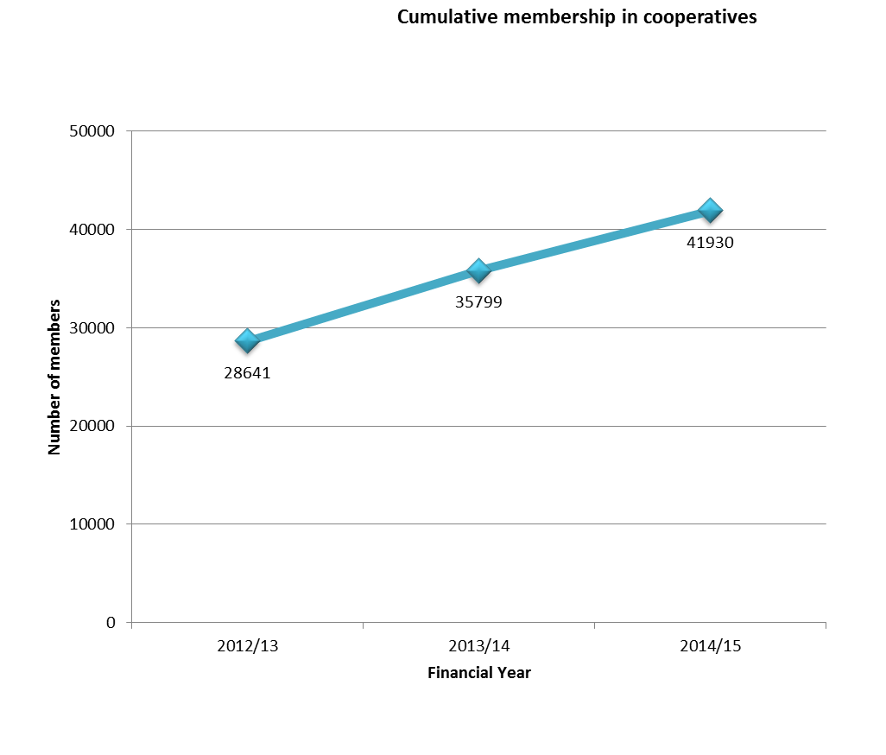
SMALLHOLDER FARMERS BENEFITING FROM COOPERATIVE SERVICES

Slide 26
CONCLUSIONS
The role of agricultural cooperatives in providing collecting marketing of smallholder products and bulk buying of inputs cannot be overemphasized
Only a few agricultural cooperatives in the Country are able to access formal markets such as the retail chain supermarkets.
Of the 1788 cooperatives, only 5% are involved in post-production related activities. This means that the majority of smallholder farmers are unable to optimize profitability since they sell their products raw.
Majority of cooperatives (98%) rely of government grants as a source of funding, this puts a question mark on their levels of sustainability. In relation to increased financial support from the Department, the number of jobs created by cooperatives increased over a three year period
However, there is a worrying inverse relationship between investment and revenue generated by the cooperatives on the data base.

Slide 27
PULA!!!!

