Slide 1
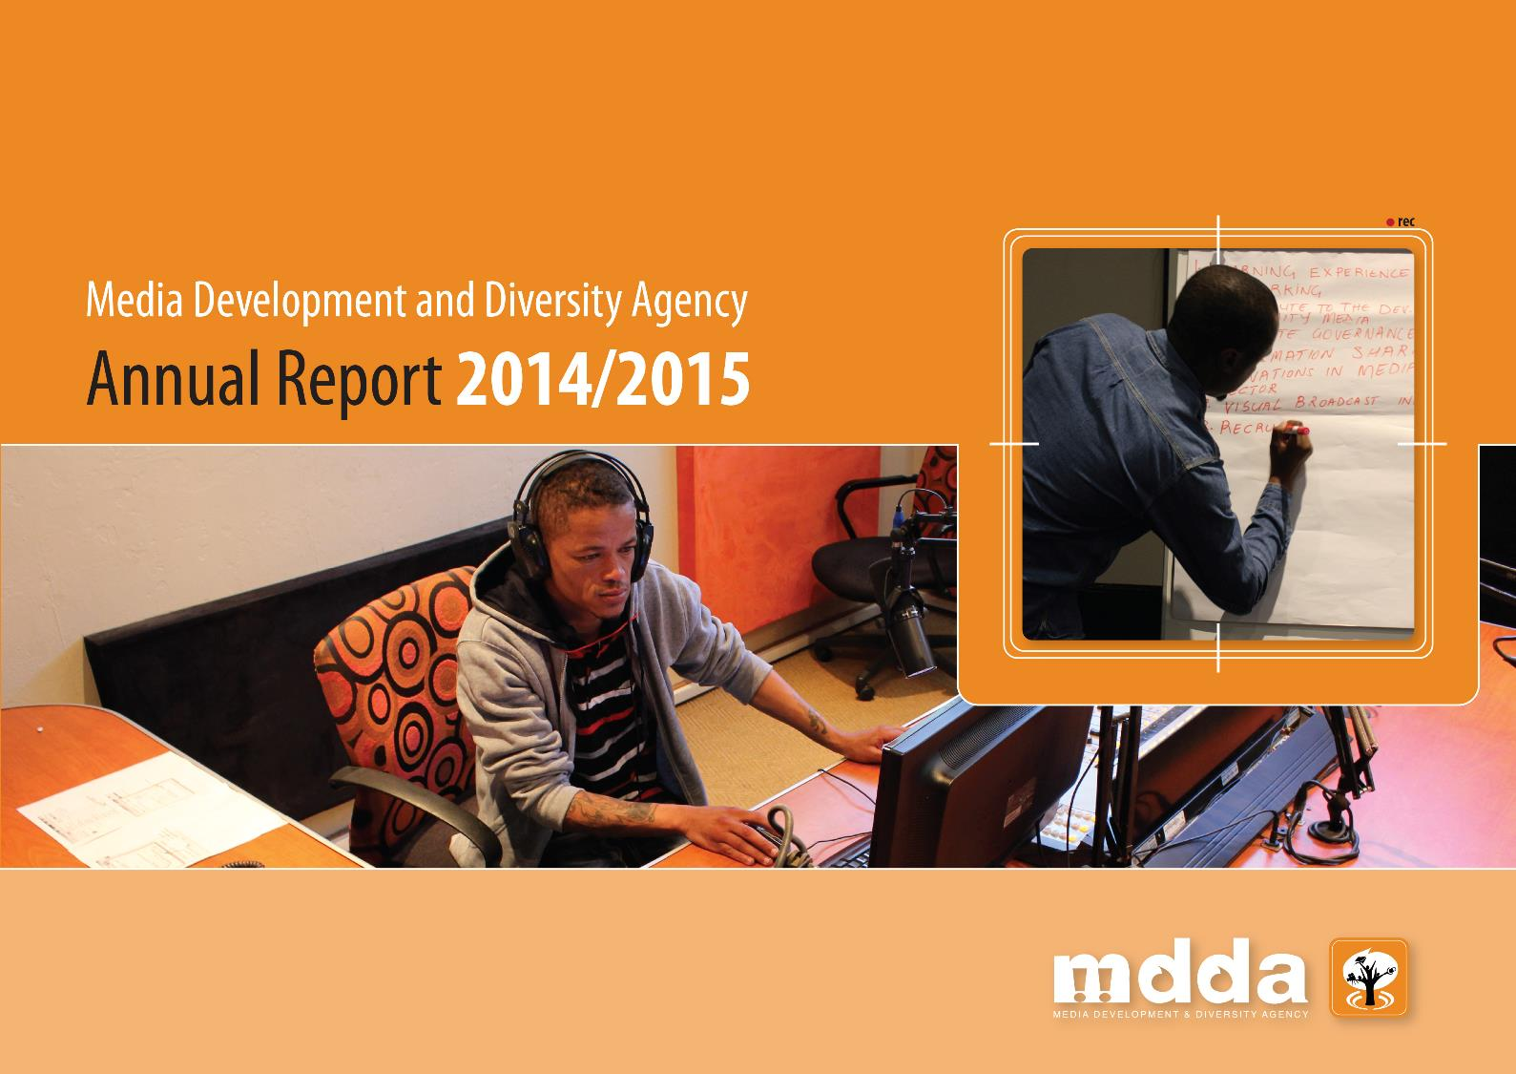
Presentation to the Portfolio Committee on Communications

Slide 2
Table of Contents
Overview
Mandate Vision Mission and Values Legislative and Regulatory Framework Highlights from 11 Years of the MDDA
2014/2015 Annual Report
Programme Performance
Human Resources
Governance, Audit and Financial Analysis

Slide 3
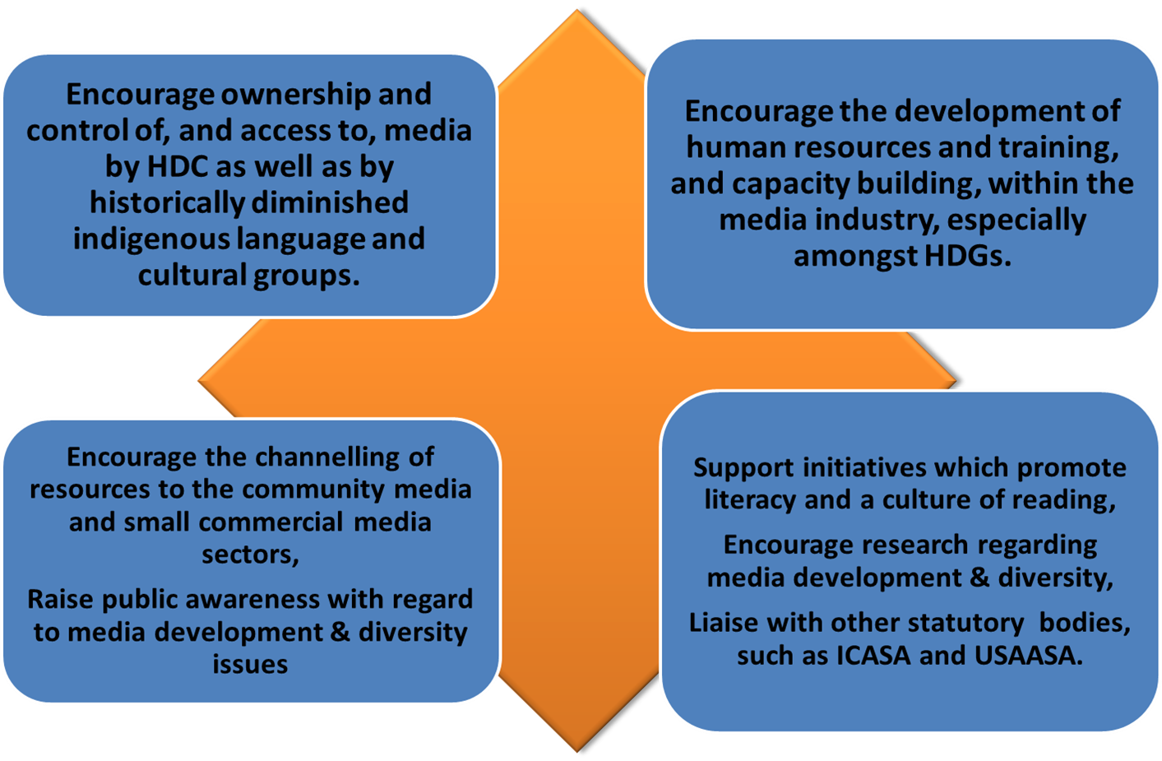
Mandate

Slide 4
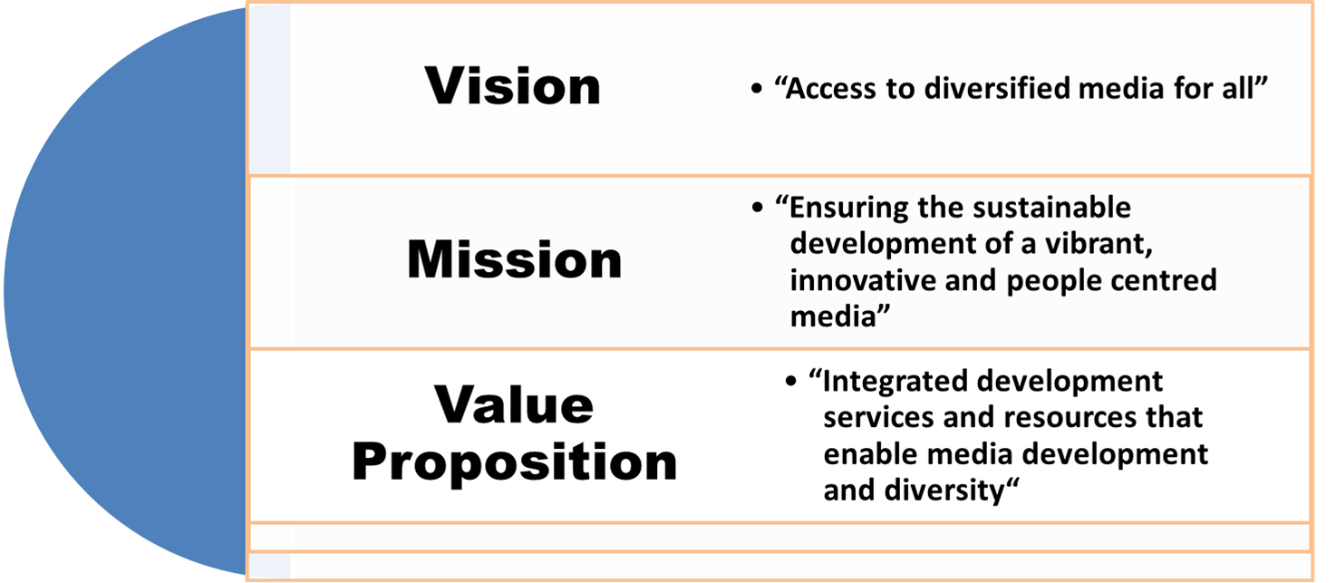
Vision, Mission and Values

Slide 5
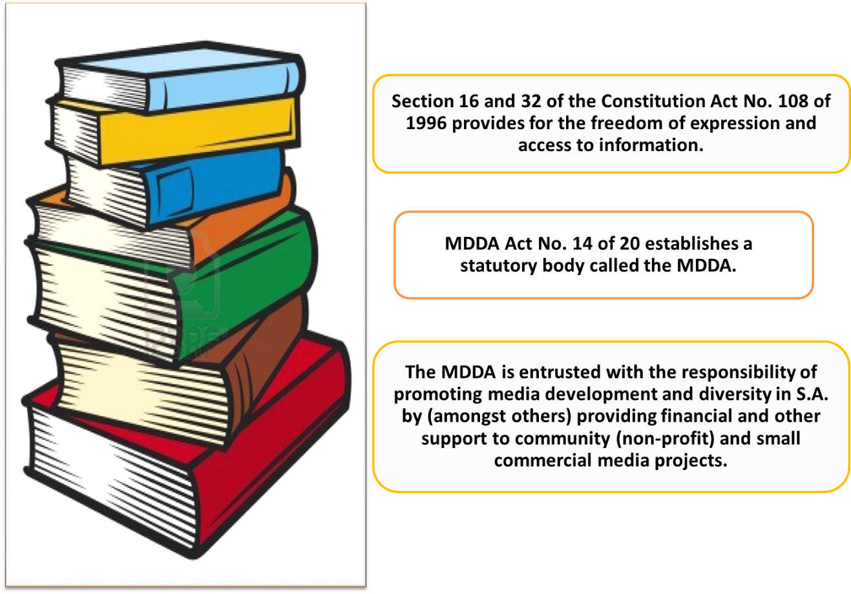
Regulatory & Legislative Framework

Slide 6
Highlights from 11 years of MDDA
The MDDA is the largest contributor to enabling access to, control of and management of the sector by historically disadvantaged individuals. Since its inception:
Some 135 community radio stations funded by the MDDA.
Some 53 community print projects and 93 small commercial print projects funded by the MDDA.
Investment in purchase of world class radio equipment, enabling quality productions.
Four TV stations supported by the MDDA.
Signal distribution costs for community broadcasting discounted or reduced.
More than 2 500 individuals in community media trained and skilled.
More than 230 bursaries awarded for media studies.
Eight research projects aimed at providing insight into media in South Africa,
Discounts from printers negotiated for Community and Small Commercial newspapers and magazines.
Easy to use toolkits published in specific skills areas, such as Marketing and Advertising and Corporate Governance.

Slide 7
2014/2015 Annual Report

Slide 8
Year Overview
2014/2015 financial year was a period of significant transition for the MDDA:
Changes in leadership across Executive Authority and Executive Management levels
A number of Board members came to the end of their terms
The Agency adapted and aligned its key priorities to the mandate of the new Department of Communications
The Agency achieved 56% of its performance indicators; that is 84 of 147 performance indicators achieved, a significant outcome given the challenging environment of 2014/2015
The launch of the DoC’s digital migration provided an opportunity for MDDA to start positioning itself as a key player in this field.

Slide 9
Year Overview
MDDA received unqualified audit report, an unbroken record since its inception.
Spending for year under review was well within the regulated percentage of allocations. Underspending mainly attributable to:
Few projects that were approved by the Board due to the Board not having a full quorum of members in last two meetings.
High staff-turnover.
MDDA received funding from the Government through the DoC, as well as from broadcast service licensees. MDDA received no funding from the print sector. As this sector is an important partner towards achieving media development and diversity in South Africa, the Agency will continue to engage it.

Slide 10
2014/15 Project Achievements
Community Media
3 community radio stations supported for digital broadcast equipment through grant funding.
2 community print projects supported.
1 community radio station with on-line presence (audio streaming) and 2 newspapers with on-line presence (electronic community newspapers).
Small Commercial Media
3 newspapers funded.
Research, Training and Development
Some 400 Beneficiaries trained on Content Development, Financial Management and Governance.
Nine content development seminars held covering all provinces on implications of Digital Terrestrial television (DTT) on Local Content and to develop a strategy for broadcast media. Print media also included in the consultation process.
Maintained a database of Trainers / Mentors for the Projects.
Media Literacy & Culture of Reading Summit in partnership with Department of Basic Education.
Monitoring and Evaluation (M&E)
Revised M&E Framework and M&E template.
Conducted monitoring over 93 projects (60 site visits and 33 desktop).

Slide 11
2014/2015 Challenges
Board unable to form a quorum in last two meetings of the year, halting onboarding of new projects.
High staff turnover.
Executive leadership positions appointed in acting capacity.
Inadequate budget allocation due to cessation of print media funding.

Slide 12
2014/2015 Programme
 |  | PROGRAMME PURPOSE | STRATEGIC OBJECTIVE | APPROPRIATION 2014/2015 R’000
PROGRAMME A GRANT FUNDING AND SUPPORT |  |  |  | 40 965
Sub Programme A1 | Community Media | To provide technical, non-financial and financial support to diverse media platforms owned and controlled by communities | Ownership, control and access to information and content production by communities | 29 995
Sub Programme A2 | Small Commercial Media | To provide technical, non-financial and financial support to diverse media platforms owned and controlled by independent publishers | Enhancement of ownership and control by independent media entrepreneurs | 1 917
Sub Programme A3 | Research, Training and Development | To create and enhance a body of knowledge regarding the media landscape and build capacity for a diverse media industry | A vibrant, innovative and people centred media | 1 924
Sub Programme A4 | Monitoring and Evaluation | To assess grant agreement compliance and impact of MDDA funded projects | The strengthening and promotion of a vibrant, innovative and people centred and diversified media | 310

Slide 13
2015/2015 Programme cont.
 | PROGRAMME PURPOSE | STRATEGIC OBJECTIVE | APPROPRIATION 2014/2015 R’000
PROGRAMME B LEGAL AND CONTRACTS MANAGEMENT | To provide legal support and advice, and contract management service to the Agency | Legally sound contract management and litigation free Agency | `61
PROGRAMME C HR AND CORPORATE AFFAIRS | To develop MDDA human capital so as to deliver products and services that delight stakeholders | Creation of an environment and capabilities that deliver MDDA value products and services | 1 799
PROGRAMME D RISK MANAGEMENT AND AUDIT | To limit the negative impact of organizational and environmental risks | Enhanced governance and accountability standards of the MDDA | 1 205

Slide 14
2014/2015 Programme cont.
 |  | PROGRAMME PURPOSE | STRATEGIC OBJECTIVE | APPROPRIATION 2014/2015 R’000
PROGRAMME E FINANCIAL MANAGEMENT AND AUXILIARY SERVICES |  |  |  | 7 111
Sub Programme E1 | Finance and Supply Chain Management | To provide the Agency with overall financial and supply chain management, and guide management in complying with legislative requirements, budget planning, financial management and administration | To strengthen, grow and protect the MDDA funding base | 7 111
Sub Programme E2 | Information Technology | To strengthen the Media Development and Diversity Agency’s Information Management System | To standardise the basic IT infrastructure and to ensure that it complies with industry standards | 527
PROGRAMME F COMMUNICATIONS CEO’S OFFICE: COMMUNICATIONS AND STAKEHOLDER MANAGEMENT |  | To enhance the MDDA brand as a leader in media development and diversity | A well known, valued and reputable brand | 620

Slide 15
Programme Performance

Slide 16
Summary of Projects
Supported for 2014/2015
Sector | No. of Projects | Total Rand Value Approved R’000s | % Approved Regulations
Community Media | 5 | 6 076 000.00 | 60%
Community Radio | 3 | 5 098 488.68
Community Television | 0 | 0
Community Print | 2 | 977 511.32
Provincial Hubs | 0 | 0
Small Commercial Media - Print | 3 | 1 050 000.00 | 25%
Research, Training and Development | 5 | 1 850 000.00 | 15%
Sub-Total |  | 8 975 625.26 | 100%
DoC – Programme Productions | 0 | 0 | DoC
Total |  | 8 975 625.26 | 100%

Slide 17
Overview of Projects Approved – 2014/15
Community radio:
Name of Organisation | Type of support | Province | District | Broadcast languages | Target Audience | Ownership
Kumani FM | Digital Broadcast infrastructure (on-air & production studio) equipment, contribution towards salaries, transmission costs , audio steaming and operational costs. | EC | Buffalo City Metro | 60% isiXhosa 30% English 10% Afrikaans | Youth | 100% owned by the community through 5 member Board of Governance
ICORA FM |  | KZN | uThungulu District | 100% isiZulu | Family | 100% owned by the community through a 5 member Board of Governance
Sekhukhune FM |  | Limpopo | Sekhukhune District | 92% Sepedi 3% isiNdebele 5% English | Family | 100% owned by the community through a 9 member Board of Governance
Notes:
Kumkani CR – Buffalo City Metropolitan Municipality – Eastern Cape – 60% isiXhosa, 30% English and 10% Afrikaans, the licensed broadcast coverage area is Buffalo City Metropolitan area in the Eastern Cape, target audience is youth – listenership
uThungulu District Municipality, KwaZulu-Natal, 100% isiZulu, target audience is family and broadcast coverage area is Babanango, Queen, Esikhawini & Richards Bay in KZN, the listenership is
Sekhukhune CR,

Slide 18
Overview of Projects Approved – 2014/15 – cont.
Community print:
Name of Organisation | Type of support | Province | District | Language of publication | Target Audience | Ownership
Mamre News | Personnel costs, capital expenses, printing & distribution costs, newspaper development (electronic newspaper) & training. | Western Cape | City of Cape Town | Setswana isiZulu English | Family | 100% owned by the community through a 5 member Board of Governance.
Ledig Sun | Printing & distribution costs, electronic newspaper development, office equipment and salaries. | North West | Bojanala Platinum | IsiXhosa Afrikaans English | Family | 100% owned by the community through a 5 member Board of Governance .

Slide 19
Overview of Projects Approved – 2014/15 – cont.
Small commercial media:
Name of Organisation | Type of support | Province | District | Language of publication | Target Audience | Ownership
North Western Times (Kuruman Chronicle) | Printing, distribution, operational costs & stipends | Northern Cape | John Taole Gaetsewe | Setswana English | Entire community | Close Corporation
Langa Media (Bushbuck- ridge News) |  | Mpumalanga | Ehlanzeni District | Tshitsonga Sepulane English | Entire community | Close Corporation
Close to Home (Phetoho News) |  | Free State | Thabo Mofutsanyane District | Sesotho English | Entire community | Close Corporation

Slide 20
Training 2014/2015
 | Type | No. of delegates
World Press Freedom Day Dialogue 2014 | Seminar | 37
Learning Forum 2014 | Training | 99
Content Development Seminars · KwaZulu-Natal Province · Mpumalanga Province · Eastern Cape Province · North West Province · Gauteng Province · Northern Cape Province · Free State Province · Limpopo Province · Western Cape Province | Consultative Seminar / Focus Group | 34 22 40 29 28 13 25 29 37
Media Kidiocracy | Exchange Programme | 99
Media Freedom Day 2014 Roundtable | Roundtables | 45
Grantee Compliance Orientation Workshop | Training Programme | 47

Slide 21
Projects Monitored Nationally 2014/2015

Slide 23
Human Resources

Slide 24
Vacancy Rate at 31 March 2015
Programme | Number of posts | Number of posts filled | Vacancy rate | Number of posts filled additional to the Agency
Lower skilled (level 5) | 4 | 3 | 1 | 0
Skilled (levels 9 – 13) | - | - | - | -
Highly skilled production (levels 14 – 15) | 13 | 8 | 5 | 0
Highly skilled supervision (levels 16 – 17) | 11 | 6 | 5 | 0
Senior management (levels 19 – 21) | 4 | 0 | 4 | 0
Total | 32 | 17 | 15 | 0

Slide 25
Vacant positions at 31 March 2015
Chief Executive Officer
Chief Financial Officer
Chief Operations Officer
Programme Director
Human Resource Manager
Communications Manager
Supply Chain Management Specialist
Legal & Contracts Manager
Executive Secretary to the CEO
Secretary to the COO
Company Secretary
Project Officer (Research Training & Development)
Project Officer – Community Media
Financial Disbursement Officer
Risk Management Officer

Slide 26
Employment Equity at 31 March 2015
Levels | Males |  |  |  | Females |  |  |  | Total
 | A | C | I | W | A | C | I | W
Executive/Senior Manager | 0 | 0 | 0 | 0 | 0 | 0 | 0 | 0 | 0
Manager | 3 | 0 | 0 | 0 | 3 | 0 | 0 | 0 | 6
Professional/Specialist | 2 | 0 | 0 | 0 | 6 | 0 | 0 | 0 | 8
Administrative/Support | 0 | 0 | 0 | 0 | 5 | 0 | 0 | 0 | 5
Total | 5 |  |  |  | 14 |  |  |  | 19

Slide 27
Governance, Audit and Financial Analysis

Slide 28
Governance
In carrying out its mandate, the MDDA has remained committed to good governance. The Agency has over the past 11 years of its existence attained an unqualified audit opinion from the Auditor General – South Africa. The 2014/15 financial year marks another year of an unqualified audit.
The Board consists of nine members; six members are appointed on the recommendation of Parliament and three members are appointed by the President, taking into consideration the funding of the Agency, of whom one is from the commercial print media and another one from the commercial broadcast media.
The Board held 5 meetings during the financial year, but did not comprise a quorum in the last two Board meetings due to Board members terms expiring.
In accordance with the Audit and Risk Committee Charter, the audit committee held four meetings during 2014/2015.

Slide 29
Audit Outcomes 2014/15

Slide 30
Audit Movement
Details | 2014/15 | 2013/14 | Movement
Audit opinion (Financial) | Unqualified | Unqualified | Regressed
Findings on predetermined objectives (PDOs) | Unqualified | Unqualified | Unchanged
Findings on compliance with laws and regulations | Yes | No | Regressed

Slide 31
Audit Report Highlights 2014/15
Findings | Remedial Action/Status
1. Restatement of corresponding figures – Employee Cost & Grant Cost Employee costs incorrectly classified as grant costs Corresponding figures for employee cost (of the team responsible for community and small commercial media projects) for 31 March 2014 have been restated as a result of an error discovered during 31 March 2015. | The employee cost has been adjusted to reflect all the cost, particularly those of the team responsible for the projects. This adjustment will be carried forward into the ensuing financial years.
2. Property, Plant and Equipment Zero value assets still in use – Reassessment of useful lives The zero value assets that are in use must be replaced. | The zero valued assets will accordingly be disposed off and replaced. To ensure that this finding does not recur the MDDA has reassessed the useful life for computer equipment and furniture and fittings upwards. Computer Equipment – 6 years (from 3 years) Furniture and Fittings – 8 years (from 5 years)

Slide 32
Audit Report Highlights 2014/15
Findings | Remedial Action/Status
1. Non-compliance with laws and regulations Annual Financial Statements to be prepared in terms of the PFMA Quarterly reports were not submitted to the Department of Communication timeously as required by Treasury Regulation 30.2.1. | The AFS were adjusted accordingly in order to meet the requirement of the PFMA and GRAP. Reports are submitted to the Department of Communication and discussed during the Minister’s Bilateral Meetings with the Board and the executive management.

Slide 33

Key Root Cause 2014/15
Transversal root causes
No | Root cause | Yes/No | Movement | Comment on the status of the root cause | Action Plan/Status
01 | Instability or vacancies in key positions | Yes |  | There was a 54% vacancy rate at MDDA during the year under audit and all the key positions were vacant impacting on the running of the organisation. The CEO and CFO positions were vacant during the year under review. | The MDDA vacancies have been filled. This will enable the Agency to fill all staff vacancies

Slide 34
Commitments by Management
Vacancies in key management personnel will be filled before the end of quarter three for the financial year.
Compliance report will be reviewed by the audit committee on a quarterly basis .
Interim financial statements prepared by management will be reviewed by internal audit to ensure compliance with GRAP.
Key strategic positions will be filled on or before the end of the third quarter.

Slide 35
Financial Statements
31 March 2015

Slide 36
Annual Budget vs Revenue
2014/15
DETAILS | PY: 201 3/14 | 2014/15 |  | VARIANCE | REASON
 | Audited R’000 | Budget R’000 | Audited R’000
REVENUE
Transfer from DOC | 20 790 | 21 815 | 21 815 | -
Print and Broadcast Income | 35 804 | 29 353 | 32 213 | 2 860 | Increased broadcast funding contributions
Interest | 4 103 | 6 527 | 4 624 | (1 903) | The interest income is lower due to economic conditions and varying period of investing
TOTAL REVENUE | 60 697 | 57 695 | 58 652 | (957)
Notes:
Insert the issue of the investment policy to be approved so that we are able to demonstrate a plan to reinvest in viable schemes

Slide 37
Revenue Analysis
R21.8m was received as a grant for year ended 31 March 2015 as compared to R20.7m received in previous financial year. This transfer was used to fund projects and administration of the Agency.
R32m was received from broadcast contributions compared to R35.8 m in previous financial year. Decrease is due to non-renewal of print funding agreement by PDMSA.
Interest income increased slightly to R4.6m from R4.1m in prior year.
Overall income received for year ended 31 March 2015 decreased by 3% compared to prior year (R58.6m as compared to R60.6m received in previous financial year). Broadcast funding continued being largest contributor by 55%.

Slide 38
Annual Budget vs Expenditure
2014/15
DETAILS | PY: 201 3/14 | 2014/15 |  | VARIANCE | REASON
 | Audited R’000 | Budget R’000 | Audited R’000
EXPENDITURE
Grant Costs (Community Media, Small Commercial Media, Monitoring and Evaluation, Research, Training and Development) | 36 909 | 34 781 | 36 416 | (1 635) | Slight increase in the number of grantees complying with funding agreement
Administrative Cost | 8 474 | 7 601 | 7 769 | (168) | Underspending is attributable to high staff turnover
Employee Cost | 12 029 | 15 128 | 11 523 | 3 605
Depreciation and Amortisation | 211 | 185 | 329 | (144) | Useful life assessed
Finance Cost | 0 | 0 | 34 | (34)
TOTAL EXPENSES | 57 623 | 57 695 | 56 071 | 1 624

Slide 39
Expenditure Analysis
For year ended 31 March 2015, the Agency disbursed R36m to grantees who complied with the funding aid agreement.
Spending on administration and employee cost decreased to R19.6m compared to R20.7m in previous financial year. The 5% decrease is mainly attributable to high staff turnover.
Overall expenditure for year ended 31 March 2015 decreased to R56m as compared to R57.6m in previous financial year.

Slide 40
Statement of Financial Position
Cash and Cash Equivalents:
The cash on hand reflects huge amounts of committed funds, as the Agency releases the funds in tranches. The cash and cash equivalent increased by 2.4 per cent compared to the prior year.
These reserves will be used to service commitments to the value of R43 million and liabilities amounting to R8 million. The MDDA will focus on implementation of the revised grant funding strategy
Commitments
Commitments represent the project funds approved for specific projects for which contracts have been entered into which await the disbursement. Unutilised project funds are held on a call and other short term investments accounts.
Item | Actual – Financial Year March 2015 R’000 | Actual – Prior Year March 2014 R’000
Cash and Cash Equivalents | 78 340 | 76 498
Item | Commitments March 2015 R’000 | Commitments PY March 2014 R’000
Closing Balance of Commitments | 43 734 | 70 321

Slide 41
Use of Consultants
Project | Section | Amount
Internal Audit Co-sourcing Services | Internal Audit | 602 762.48
Recruitment Services | Human Resource Management | 442 499.00
Human Resource Services | Human Resource Management | 257 540.60
Legal Services | Legal | 362 379.93
Research Services | Research | 209 370.00
Grand Total |  | 1 874 552.01

Slide 42
Irregular, Fruitless and Wasteful Expenditure
Irregular Expenditure
For the year under review the MDDA did not incur irregular expenditure.
The internal controls in supply chain management were enhanced and compliance was monitored regularly.
Fruitless and Wasteful Expenditure
The Agency incurred R21 000 on interest on CCMA award in favour of an employee in terms of Labour Relations Act.
The full amount was considered irrecoverable and therefore written off.

Slide 43
Contingent Liabilities and Litigations
Contingent Liabilities
There was no contingent liability at the end of the financial year.
Litigations
At the end of the financial year there was no ligation against the MDDA.

Slide 44
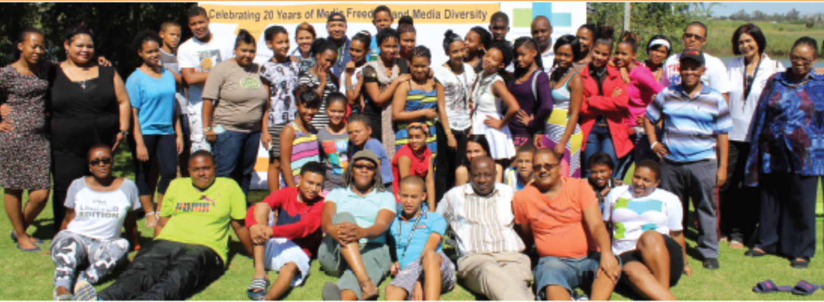
Thank You

